Slide 1
Populations
Chapter 1 Section 2

Slide 2
Goals : What we will learn
Identify methods for estimating population sizes
Explain how competition limits population growth
List factors that influence changes in population size

Slide 3
Requirements of Life
What do all living things need?

Slide 4
Requirements of Life
What do all living things need?
Food
Shelter
Water
Oxygen
Living space (area)

Slide 5
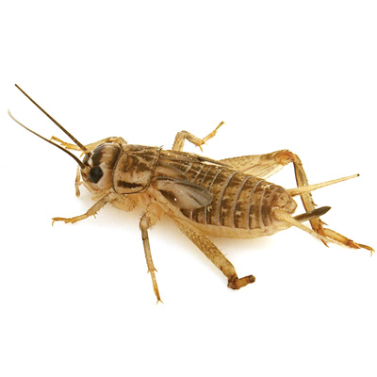
Competition
Wild crickets feed on plant s at night and hide under leaves or in dark damp places during the day
Some crickets are raised in pet shops
inside cages to be used as food for reptiles
As the population of caged crickets
grows, extra food and more hiding places
are needed.
What could a pet shop owner do as the population increases?

Slide 6
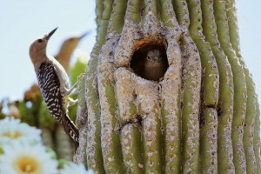
Competition for Food and Space
Competition occurs when two or more organisms seek the same resource at the same time
Gila Woodpecker
Makes nesting holes in the
saguaro cactus.

Slide 7
Competition and Growth Limits
Competition limits population size
What would happen if nesting spaces were limited?
What would happen to the woodpeckers if food was scarce?

Slide 8
Competition and Population Size
Competition for food, living space, and other resources can limit population growth
The most intense competition is between the same species… why ?
Competition also takes place among different species….. Why?

Slide 9
Populations
Chapter 2 (Part 2)

Slide 10
Measuring Populations
Why do scientists measure populations?

Slide 11
Measuring Populations
Scientists measure populations because the information can indicate whether or not a population is healthy and growing
Population counts also help identify if a population could be in danger of disappearing

Slide 12
Measuring Populations
How do scientists measure populations?

Slide 13
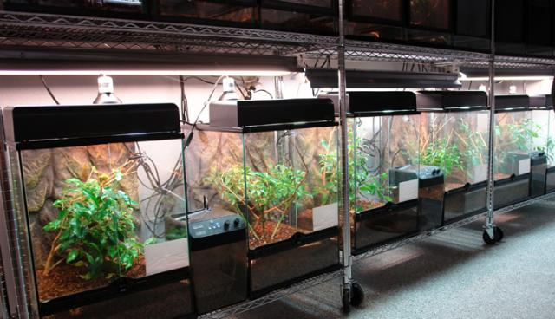
Measuring Populations
One way is calculating population density.

Slide 14
Population Density
Population density is the number of individual species per specific area
You could count all of the crickets in each tank or you could calculate the number of crickets per a specific area and then compare that to other containers (tanks)

Slide 15
Measuring Crickets
Crickets are tricky. They are small and move around a lot.
Counting them is difficult.
What if you wanted to measure the number of crickets in a field?

Slide 16
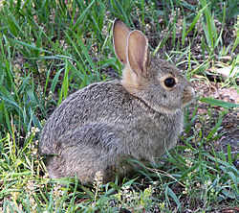
Measuring Populations
Scientists have problems measuring wildlife populations as well
One of the methods they use is called
trap and release

Slide 17
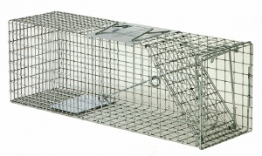
Trap and Release for Estimating Population Size
Ecologists set traps
Captured rabbits are marked and released
Later, another sample of rabbits is captured
Some will have marks, some will not
By comparing the number of
marked and unmarked rabbits
in the second sample,
ecologists can estimate population size

Slide 18
Sample Counts for Estimating Population Size
Wildebeests

Slide 19
Sample Counts
To estimate the number of wildebeests in 100 acres you could count the number of wildebeests in 1 acre and multiple by 100.
This method is called sample counting

Slide 20
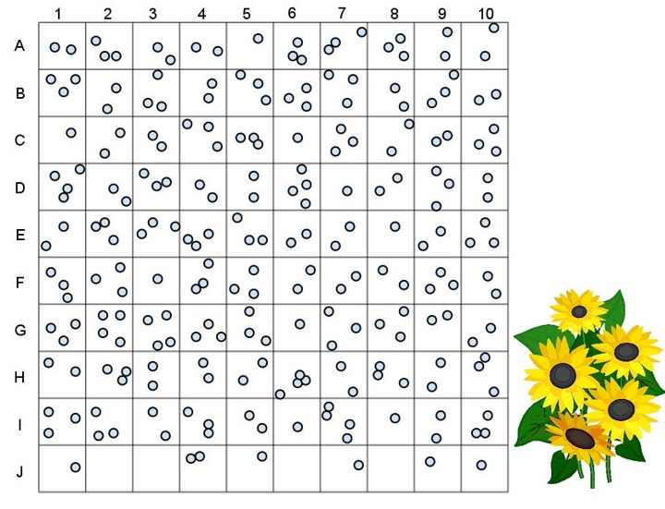
Sample Counts

Slide 21
Review
What is population density?
What are 3 ways that ecologists can measure a population?

