Slide 1


Scan now to
complete the pretest
Multiple Myeloma:
Enhancing Treatment Tolerability, Adherence, and Patient-Centered Care
Scan the QR here or on the front of your i3 Health folder to complete the pretest OR use the paper assessment included in your i3 Health folder
To scan the QR code:
FOR IPHONE:
Open the camera & focus it to QR code
Your internet browser should pop up with a link
Click the link and complete
FOR ANDROID:
Open the camera & focus it to QR code
Hold ‘Home’ button
The pretest comes visible to complete

Slide 2
Multiple Myeloma: Enhancing Treatment Tolerability, Adherence, and Patient-Centered Care
Tiffany Richards, PhD, ANP-BC
Advanced Practice Nurse
University of Texas MD Anderson Cancer Center

Slide 3
Jointly provided by USF Health and i3 Health
ACCREDITATION
i3 Health is accredited with distinction as a provider of nursing continuing professional development by the American Nurses Credentialing Center’s Commission on Accreditation.
A maximum of 1.0 contact hour may be earned by learners who successfully complete this nursing continuing professional development activity.
INSTRUCTIONS TO RECEIVE CREDIT
An activity evaluation form has been distributed. To claim credit, you must turn in a completed and signed evaluation form at the conclusion of the program. Your certificate of attendance will be mailed or emailed to you in approximately 2 weeks.
UNAPPROVED USE DISCLOSURE
This educational activity may contain discussion of published and/or investigational uses of agents that are not indicated by the FDA. The planners of this activity do not recommend the use of any agent outside of the labeled indications.
The opinions expressed in the educational activity are those of the faculty and do not necessarily represent the views of the planners. Please refer to the official prescribing information for each product for discussion of approved indications, contraindications, and warnings.
DISCLAIMER
The information provided at this NCPD activity is for continuing education purposes only and is not meant to substitute for the independent medical/clinical judgment of a healthcare provider relative to diagnostic and treatment options of a specific patient’s medical condition.
COMMERCIAL SUPPORT
This activity is supported by independent educational grants from Celgene Corporation, Sanofi Genzyme, and Karyopharm Therapeutics. Supported by an educational grant from Janssen Biotech, Inc., administered by Janssen Scientific Affairs, LLC.

Slide 4
Disclosures
Dr. Richards discloses the following commercial relationships:
  Advisory board or panel: Celgene, Takeda, GSK
  i3 Health has mitigated all relevant financial relationships.

Slide 5
Learning Objectives
Identify predictive and prognostic markers that can tailor treatment selection and goals to individual patients with MM
Evaluate the efficacy and safety profiles of novel therapeutic strategies for newly diagnosed and relapsed/refractory MM
Assess strategies to manage treatment-related adverse events, promote adherence to therapy, and ensure patient-centered MM care
MM = multiple myeloma.

Slide 6
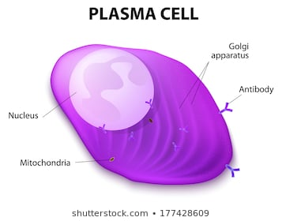
MM: Scope of the Problem
Cancer of the bone marrow plasma cells
IgG, IgA, IgM, IgD, IgE
Kappa/lambda
Overproduction of monoclonal immunoglobulins can lead to MM
Ig = immunoglobulin.
Kyle et al, 2003.
Notes:
Multiple myeloma (MM) involves plasma cells (PCs)
Malignant PCs produce monoclonal protein: high immunoglobulin G (IgG), IgA (quantitative immunoglobulins lab), or for light chain subtype: high kappa or high lambda light chain level that can be monitored by serum free light chain (FLC) labs

Slide 7




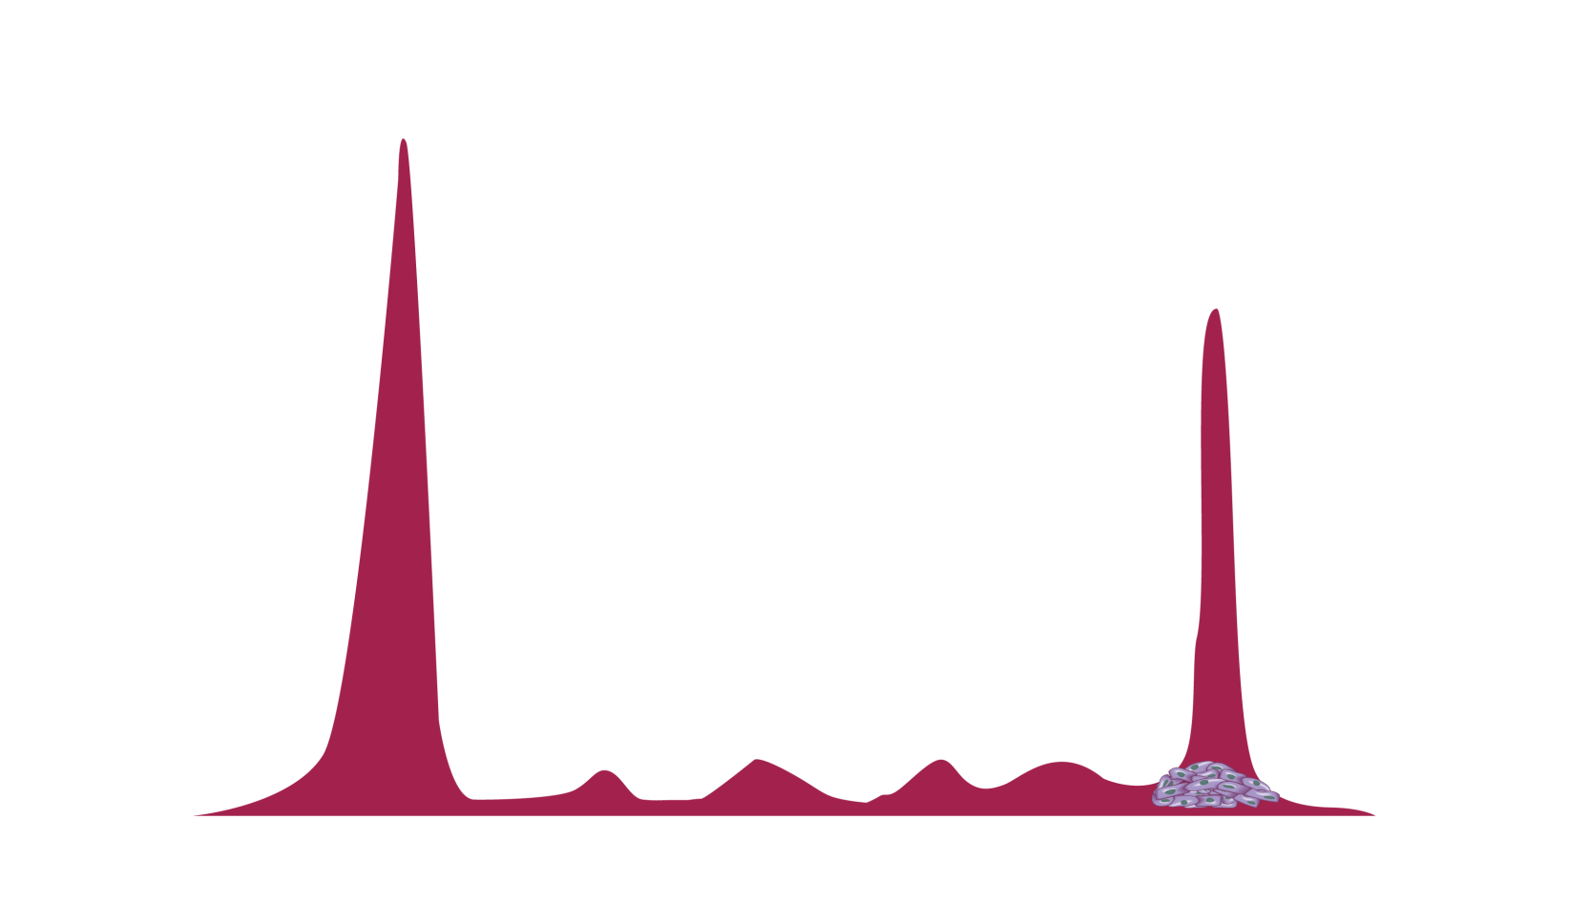


MM: Scope of the Problem (cont.)
Myeloma
Albumin
Myeloma cells produce abnormal immunoglobulins continually
(nonsecretory disease is rare)
Gamma
Alpha-1
Alpha-2
Beta
Light chain
Kappa
Lambda
Heavy chain
IgG
IgA
IgM
International Myeloma Foundation, 2018.

Slide 8
Clinical Workup
Lab tests
  Serum protein electrophoresis (SPEP)
  Urine protein electrophoresis (UPEP)
  CBC + differential + chemistry, including albumin, β2 macroglobulin, and LDH
  FLC ratio of free kappa/lambda light chains (plasma)
  Monoclonal protein analysis (MPA)
Bone marrow biopsy
  FISH, cytogenetics
Imaging
  Whole body low-dose CT, skeletal survey, MRI
CBC = complete blood count; LDH = lactate dehydrogenase; FLC = free light chain;
FISH = fluorescent in situ hybridization; CT = computed tomography; MRI = magnetic resonance imaging.
Ghobrial & Landgren, 2014; Rajkumar et al, 2014; Faiman, 2014; NCCN, 2020.

Slide 9





Updated IMWG Criteria for MM Diagnosis
MGUS
Smoldering Myeloma
Multiple Myeloma
M protein <3 g/dL
Clonal plasma cells in BM <10%
No end organ damage or amyloidosis attributed to underlying lymphoproliferative disorder
M protein ≥3 g/dL (serum) or ≥500 mg/24 hours (urine) and/or clonal plasma cells in BM ≥10%-60%
No myeloma-defining events or amyloidosis
Clonal plasma cells in BM ≥10% or biopsy-proven bony or extramedullary plasmacytoma
≥1 myeloma-defining events:
  End organ damage attributed to underlying lymphoproliferative disorder (evidenced by a CRAB featureª)
  Malignancy biomarker: clonal plasma cells in BM ≥60%, serum FLC ratio ≥100, or >1 MRI focal lesion
Higher-risk SMM?
M spike ≥2 g/dl
FLC Ratio ≥20%
Bone marrow ≥20% PC
SLiM CRAB criteria
S: BM ≥60% PC
Li: FLC ratio ≥100
M: MRI ≥2 lesions
ªC: Calcium elevation (>11 mg/dL or >1 mg/dL higher than ULN)
R: Renal insufficiency (CrCl <40 mL/min or serum creatinine >2 mg/dL)
A: Anemia (Hb <10 g/dL or >2 g/dL below LLN)
B: Bone disease (≥1 lytic lesions on skeletal radiography, CT, or PET/CT)
IMWG = International Myeloma Working Group; MGUS = monoclonal gammopathy of undetermined significance; M = myeloma; BM = bone marrow;
SMM = smoldering multiple myeloma; PC = plasma cells; ULN = upper limit of normal; CrCl = creatinine clearance; min = minutes; Hb = hemoglobin;
LLN = lower limit of normal; PET = positron emission tomography.
Lakshman et al, 2018; Rajkumar et al, 2014; Kyle et al, 2010; NCCN, 2020.
Notes:
New smoldering multiple myeloma (SMM) definition:
“In 2014, the International Myeloma Working Group reclassified patients with smoldering multiple myeloma (SMM) and bone marrow-plasma cell percentage (BMPC%) ≥ 60%, or serum free light chain ratio (FLCr) ≥100 or >1 focal lesion on magnetic resonance imaging as multiple myeloma (MM). Predictors of progression in patients currently classified as SMM are not known. We identified 421 patients with SMM, diagnosed between 2003 and 2015. The median time to progression (TTP) was 57 months (CI [confidence interval], 45-72). BMPC% >20% [hazard ratio (HR): 2.28 (CI 1.63-3.20); P<0.0001]; M protein >2 g/dL [HR: 1.56 (CI, 1.11-2.20); P=0.01], and FLCr > 20 [HR: 2.13 (CI, 1.55-2.93); P< 0.0001] independently predicted shorter TTP in multivariate analysis. Age and immunoparesis were not significant. We stratified patients into three groups: low risk (none of the three risk factors; n=143); intermediate risk (one of the three risk factors; n=121); and high risk (≥2 of the three risk factors; n=153). The median TTP for low-, intermediate-, and high-risk groups were 110, 68, and 29 months, respectively (P<0.0001). BMPC% > 20%, M-protein >2 g/dL, and FLCr >20 at diagnosis can be used to risk stratify patients with SMM. Patients with high-risk SMM need close follow-up and are candidates for clinical trials aiming to prevent progression” (Lakshman et al, 2018).

Slide 10
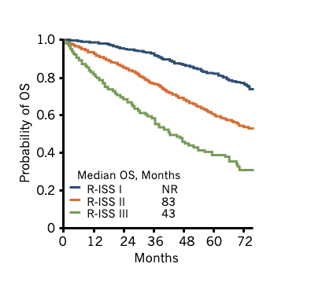
Revised ISS Staging
 | ISS Definition
I | Serum albumin ≥3.5 g/dL and β₂-M <3.5 mg/L
II | Not stage I or III
III | β₂-M ≥5.5 mg/L
 | R-ISS Definition
I | ISS stage I and Normal LDH No t(4;14), t(14;16), or del(17p)
II | Not stage I or III
III | ISS stage III and Serum LDH >ULN or With t(4;14), t(14;16), or del(17p)
ISS = International Staging System; β2-M = beta2-microglobulin; R-ISS = Revised ISS; t = translocation; del = deletion; OS = overall survival;
NR = not reached.
Palumbo et al, 2015.

Slide 11
Case Study 1
52-year-old teacher presents with acute low back pain and L5 vertebral compression fracture
Newly diagnosed R-ISS Stage 2 IgG kappa MM
  PS 0
  FISH – 1q+, t(4;14), 17p del
  BUN 12, Cr 1.0, Hb 9.5, Ca 9.9
What would be the best initial therapy?
  Lenalidomide/dexamethasone (Rd)
  Daratumumab/lenalidomide/dexamethasone (DRd)
  Lenalidomide/bortezomib/dexamethasone (RVd)
  Carfilzomib/lenalidomide/dexamethasone (KRd)
PS = performance status; BUN = blood urea nitrogen; Cr = creatinine; Ca = calcium.

Slide 12
Case Study 1 (cont.)
Best answer: D (could also be C)
This patient has high-risk MM (17p is especially high risk, but 1q+ and t(4;14) are at least intermediate in risk)
At least triplet therapy is preferred for all newly diagnosed MM. In the transplant-eligible population, the options are RVd or KRd
  Ongoing trials, including daratumumab (dara)/RVd or dara/KRd, may change this landscape
Given the high-risk features, many would recommend KRd, with the data demonstrating deeper remissions in the newly diagnosed high-risk setting
  Again, patient-centered discussions and goals of care are integral to the decision-making process
NCCN, 2020; Rajkumar, 2020; Landgren et al, 2019.

Slide 13
Essentials of Risk-Adapted Therapy Selection
Primary goals: diagnostic certainty, treat disease
  IMWG Criteria
Risk Stratification
  R-ISS Staging
  FISH
  Performance status, fit/frail
Consider also…
  Patient’s desire for treatment, aggressiveness
  Shared decision making
Data and experience
Patient preference
Disease characteristics & prior therapy
Administration, chair time
Efficacy of regimen
Finances/
insurance
Comorbid conditions
Social status/
caregiver support
NCCN, 2020.

Slide 14
Common Treatments for Multiple Myeloma
Various Treatments Produce Different Depth, Duration of Response
Frontline (Induction)
Maintenance
Relapse
Gentler
Rd: lenalidomide/dex
Vd: bortezomib/dex
RVd lite: lenalidomide/bortezomib/
dex lite
RVd: lenalidomide/bortezomib/dex
DVMP: daratumumab/bortezomib/
melflufen/prednisone
KRd: carfilzomib/lenalidomide/dex
DVTd: daratumumab/bortezomib/
thalidomide/dex
ASCT: autologous stem cell transplant
Bortezomib
Lenalidomide
Carfilzomib
Ixazomib
Pomalidomide
Daratumumab
Elotuzumab
Panobinostat
Cyclophosphamide
Doxorubicin
Bendamustine
Isatuximab
Selinexor
Belantamab mafadotin
Melflufen
Ide-cel (CAR T)
Lenalidomide ±
proteasome inhibitor
Ixazomib
Non–transplant-eligible
Often in combination regimens
Plus new agents in clinical trials
Transplant-eligible
More
Aggressive
dex = dexamethasone; ide-cel = idecabtagene vicleucel; CAR = chimeric antigen receptor; melflufen = melphalan flufenamide.
Faiman et al, 2016; NCCN, 2020; Rajkumar et al, 2014.
Notes:
Many treatment options at diagnosis, relapse
Proteasome inhibitors (PIs) and immunomodulatory drugs are first-line therapies in the setting of newly diagnosed disease and are increasingly used for maintenance in the initial treatment setting
Lenalidomide along with a PI forms the backbone of initial treatment in older, frailer patients and is used for maintenance after autologous stem cell transplant (ASCT) in transplant-eligible patients

Slide 15
Common Treatments for MM (cont.)
Transplant eligible:
Induction
Consolidation
Maintenance
Relapse/Rescue
1-4 drug regimen
Observation or
IMiD, PI
Numerous options!
Melphalan flufenamide (melflufen)
200 mg/m²
ASCT
IMiD = immunomodulatory drug; PI = proteasome inhibitor.
Faiman et al, 2016; NCCN, 2020; Rajkumar et al, 2014.

Slide 16
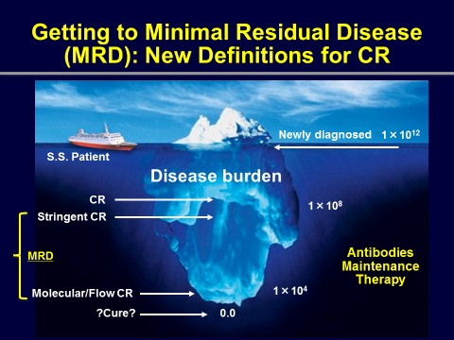
Minimal Residual Disease (MRD)
A New Goal of Care, Surrogate for Survival
Key concepts:
Deeper response = improved PFS
Set the expectation for continuous therapy upfront, management of side effects
Increasing depth of response
CR = complete response; PFS = progression-free survival.
Lonial, 2015; Kumar et al, 2016.
Notes:
clonoSEQ®: Medicare-reimbursed minimal residual disease (MRD) test from bone marrow with the ability to detect 1; 1million plasma cells
MRD is often achieved through the administration of combination therapies from various drug classes, ongoing treatment

Slide 17
Role of MRD Assessment
clonoSEQ©: FDA approved in fall 2018
  IMWG response criteria incorporating MRD testing (based on NGS), lower limit of disease detection
  Affords potential to better define response, guide therapy
Relapse still occurs even in MRD (-) patients
Questions remain:
  When and how should MRD testing be done?
  When is the achievement of MRD (-) a realistic goal?
  Can/should therapeutic decisions be made based on MRD testing? If so, how?
NGS = next-generation sequencing.
Avet-Loiseau et al, 2017; Kumar et al, 2016.

Slide 18
Update on Emerging Combination and Sequential Treatment Strategies for Newly Diagnosed and Relapsed/Refractory Disease

Slide 19
Approved Classes of Drugs to Treat MM
IMiD | PI | Anthracycline Chemotherapy | Alkylating Agents
Thalidomide (PO) | Bortezomib (IV/SC) | Doxorubicin (IV) | Cyclophosphamide (IV, PO)
Lenalidomide (PO) | Carfilzomib (IV) | Liposomal doxorubicin (IV) | Bendamustine (IV)
Pomalidomide (PO) | Ixazomib (PO) |  | Melflufen (PO)
Supportive care throughout
Aspirin/DVT prevention
Bone-modifying agents
Infection prevention and kidney protection
Adherence strategies
PO = oral administration; IV = intravenous; SC = subcutaneous; DVT = deep vein thrombosis.
NCCN, 2020.

Slide 20
Approved Classes of Drugs to Treat MM (cont.)
Steroids | HDAC inhibitor | Monoclonal antibodies | Peptide conjugate | XPO1 inhibitor | CAR T
Dexamethasone (IV, PO) | Panobinostat (PO) | Elotuzumab (IV) | Melflufen | Selinexor (PO) | Ide-cel
Prednisone (PO) |  | Daratumumab (IV, SC)
 |  | Isatuximab (IV)
 |  | Belantamab mafadotin (IV)
Supportive care throughout
Aspirin/DVT prevention
Bone-modifying agents
Infection prevention and kidney protection
Adherence strategies
HDAC = histone deacetylase; XPO1 = Exportin 1.
NCCN, 2020; Mateos, Bladé et al, 2020.

Slide 21
High-Risk Features
Advanced ISS stage
Cytogenetic, FISH abnormalities
  del(13), hypodiploidy
  t(4;14), t(14;16), or del(17p) by FISH
  1q+
Poor performance status
Circulating myeloma cells
High serum LDH
  Note the FISH abnormalities of our case study
Kumar et al, 2012; NCCN, 2020.

Slide 22
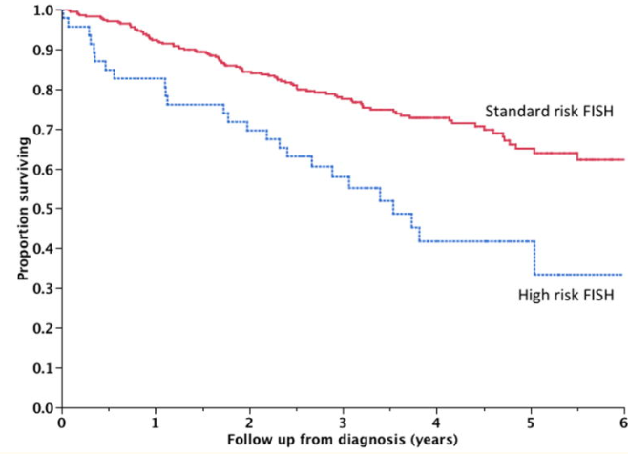
Survival Based on Risk
High-risk status warrants a more aggressive approach to therapy, regardless of age (at least discuss)
Minimize toxicity with dose adjustments, side effect management
Kumar et al, 2014.
Notes:
High-risk myeloma: survival remains lower even in the era of novel therapy.

Slide 23
DETERMINATION Trial (IFM 2009)
Newly Diagnosed MM
700 NDMM patients randomized to RVd or high-dose melflufen plus stem cell transplantation followed by RVd
Arm A: additional 5 RVd cycles
1-year maintenance
Median PFS: 36 mo
4-year OS: 82%
RVd
(3 cycles)
Arm B: melflufen
200 mg/m² then
2 RVd cycles
1-year maintenance
Median PFS: 50 mo
4-year OS: 81%
NDMM = newly diagnosed MM; IFM = Intergroupe Francophone du Myélome; mo = months.
Attal et al, 2017.

Slide 24
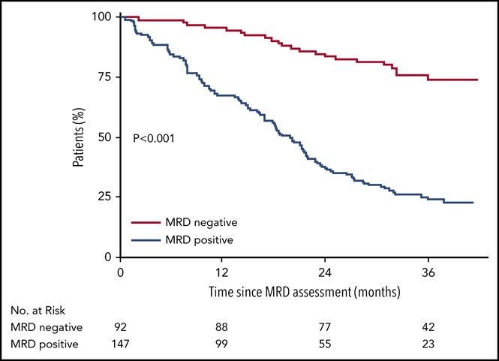
IFM 2009 Follow-up Study
Focus on MRD
Median PFS at median follow-up of 55 months:
not reached
(MRD negative)
vs 29 months
(MRD positive)
MRD - 10⁻⁶
MRD (-) 10⁻⁶
MRD (+)
MRD negativity obtained in 30% (73/245) with RVd + transplant and 20% (54/264) with RVd alone
No = number.
Perrot et al, 2018.

Slide 25
CASSIOPEIA Trial
VTd +/- daratumumab in NDMM, transplant-eligible patients: FDA approved
Daratumumab improved both the depth of response (including MRD negativity) and duration of response (PFS)
Rate of MRD negativity (10⁻⁵) ≥ CR was 33.7% for dara/VTd (DVTd) vs 19.9% for VTd alone
Post-Consolidation (d 100 Post-ASCT) Response and MRD-Negative Rates: ITT
 | DVTd, % | VTd, % | OR (95% CI) | P
sCR | 28.9 | 20.3 | 1.60 (1.21-2.12) | 0.0010
≥ CR | 38.9 | 26.0 | 1.82 (1.40-2.36) | <0.0001
≥ VGPR | 83.4 | 78.0 | 1.41 (1.04-1.92) | 0.0239
MRD negative (10⁻⁵) | 63.7 | 43.5 | 2.27 (1.78-2.90) | <0.0001
≥ CR + MRD negative (10⁻⁵) | 33.7 | 19.9 | 2.06 (1.56-2.72) | <0.0001
Dara = daratumumab; d = day; ITT = intention to treat; OR = overall response; CI = confidence interval; sCR = stringent complete response;
VGPR = very good partial response.
Moreau et al, 2019.

Slide 26
FORTE Trial: KRd vs KRd + ASCT in NDMM
12 cycles of KRd versus KRd + ASCT: both were equally effective in producing deep responses
In R-ISS stage I disease, impressive MRD negativity rates of 69% and 62%
 | KRd-ASCT-KRd (n=158) | KRd₁₂ (n=157) | R-ISS 1 |  | R-ISS 2/3
 |  |  | KRd-ASCT-KRd (n=48) | KRd₁₂ (n=39) | KRd-ASCT-KRd (n=92)
sCR | 44% | 43% | 46% | 49% | 39%
≥ CR | 60% | 61% | 66% | 64% | 56%
≥ VGPR | 89% | 87% | 92% | 79% | 86%
MRD negative | 58% | 54% | 69% | 62% | 51%
Gay et al, 2019.

Slide 27
Maintenance Therapy
Meta-Analysis: Post-ASCT Lenalidomide Maintenance
Improved PFS, OS versus placebo/observation
1.0
 | No. of events/ no. of patients | Median PFS (95% CI) | HR (95% CI)
Lenalidomide maintenance | 316/605 | 52.8 months (45.1-62.6) | 0.48 (0.41-0.55)
Placebo/ observation | 411/603 | 23.5 months (21.0-26.2)
0.8
0.6
PFS (probability)
Lenalidomide maintenance
0.4
0.2
0
Placebo/observation
0
10
20
30
40
50
60
70
80
90
100
110
120
Time (months)
HR = hazard ratio.
McCarthy et al, 2017.
Notes:
Key point with lenalidomide (len): stay on len after transplant. Progression-free survival (PFS) and overall survival (OS) benefit observed across subgroups:
Older or younger than 60
Male or female
International Staging System (ISS) stage I/II, III
Response after autologous stem cell transplant (ASCT) (prior to maintenance)
Different induction regimens

Slide 28
Maintenance Therapy (cont.)
Ixazomib Post-ASCT Data
1.0
0.8
0.6
Probability of
Progression-free Survival
Ixazomib
0.4
0.2
Placebo
HR, 0.72
(95% CI, 0.58-0.89; P=0.0023)
0
0
15
24
33
3
6
12
18
30
36
45
39
9
21
27
42
Months from Randomization
Dimopoulos et al, 2019; Dimopoulos et al, 2018.
Notes:
Ixazomib abstract: good if people don’t tolerate len (clot, rash); also only 3 pills a month.

Slide 29
Daratumumab/Lenalidomide/Dexamethasone
ASCT-Ineligible Newly Diagnosed Myeloma (MAIA)
Daratumumab 16 mg/kg IVª +
lenalidomide 25 mg/d PO, d 1-21 +
dexamethasone 40 mg/w PO or IV
(n=368)
Transplant-ineligible NDMM
ECOG PS 0-2
CrCl ≥30 mL/min
(N=737)
28-day
cycles until
PD
1:1
Lenalidomide 25 mg/d PO, d 1-21 +
dexamethasone 40 mg/w PO or IV
(n=369)
Stratification:
ISS (I, II, III)
Region (North America vs other)
Age (<75 y vs ≥75 y)
Primary end point: PFS
Secondary end points: CR, VGPR, MRD negativity, ORR, OS, safety
Median age: 73 years (45-90)
99% of patients age ≥65 years
ªQW cycles 1-2, Q2W cycles 3-6, Q4W cycles ≥7.
ECOG = Eastern Cooperative Oncology Group; w = week; PD = progressive disease; y = years; ORR = overall response rate; QW = once a week;
Q2W = once every 2 weeks; Q4W = once every 4 weeks.
Facon et al, 2019.

Slide 30
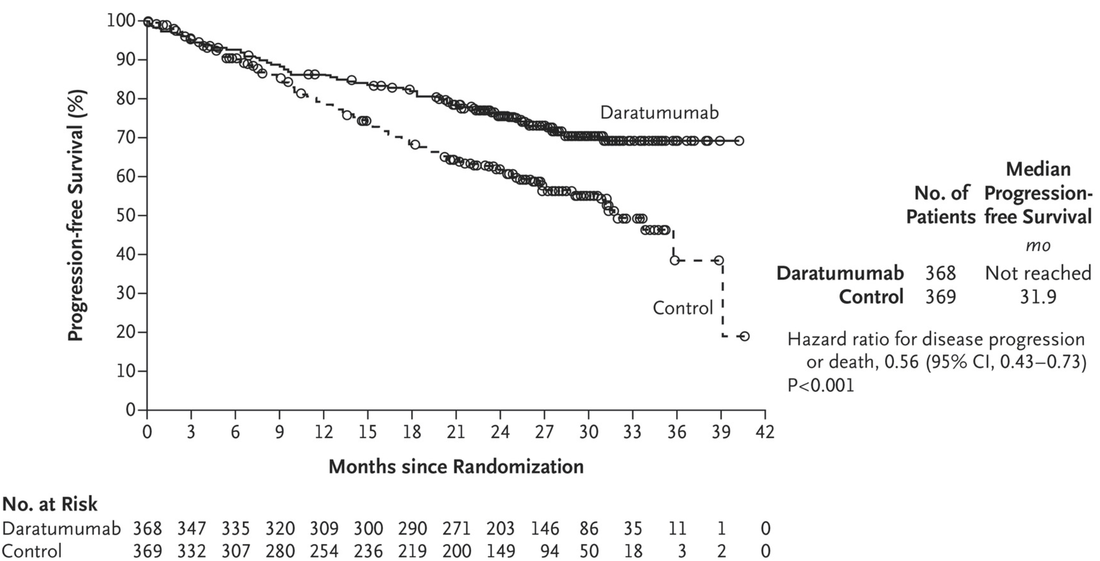
MAIA: Efficacy
Response | Dara | Control
ORR | 92.9% | 81.3%
≥CR | 47.6% | 24.9%
MRD negativity | 24.2% | 7.3%
Facon et al, 2019.
Notes:
24.9%

Slide 31
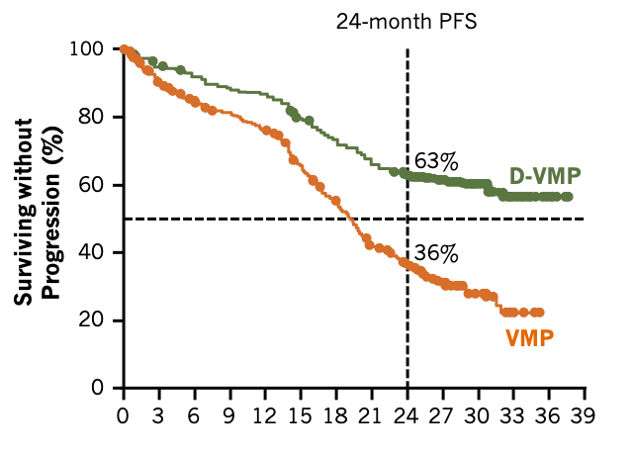
ALCYONE Study
DVMP for Untreated MM, Transplant Ineligible
706 transplant-ineligible NDMM patients randomized to VMP or DVMP
Median PFS:
DVMP: NR
VMP: 19.1 mo
24-mo PFS
DVMP: 63%
VMP: 36%
HR, 0.43
(95% CI, 0.35-0.54; P<0.0001)
Median FU: 27.8 mo
Median FU: 40.1 mo
Months
DVMP = daratumumab/VMP; FU = follow-up.
Mateos et al, 2018; Mateos, Cavo et al, 2020.

Slide 32
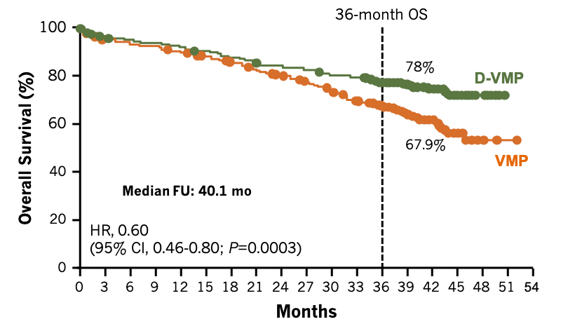
ALCYONE Study (cont.)
DVMP for Untreated MM, Transplant Ineligible
40% reduction in death
Mateos et al, 2018; Mateos, Cavo et al, 2020.

Slide 33
ASCT-Ineligible Patients
Modified RVd: “RVd Lite”
RVd lite results: 90% ORR (≥ PR), 60% ≥ VGPR
5 patients discontinued after <4 cycles:
  Worsening adrenal insufficiency (n=1)
  Lenalidomide-based rash (n=1)
  Investigator discretion (n=1)
  Travel distance (n=2)
AEs manageable and well tolerated in an older population
  Grade ≥3 AEs: hypophosphatemia (34%), rash (10%)
Median follow-up: 30 months
PR = partial response; AEs = adverse events.
O’Donnell et al, 2018.

Slide 34
Subcutaneous Daratumumab
(Daratumumab and Hyaluronidase-fihj)
FDA Approved May 2020
Approvals in newly diagnosed, transplant-ineligible patients:
  In combination with VMP (ORR in PLEIADES: 88.1%)
  In combination with Rd (ORR in PLEIADES: 90.8%)
Adverse events:
  Upper respiratory tract infection
  In combination with VMP: constipation, nausea, fatigue, pyrexia, peripheral sensory neuropathy, diarrhea, cough, insomnia, vomiting, back pain
  In combination with Rd: fatigue, diarrhea, upper respiratory tract infection, muscle spasms, constipation, pyrexia, pneumonia, dyspnea
VMP = bortezomib/melphalan flufenamide/prednisone.
Chari, Goldschmidt et al, 2019; Darzalex FasproTM prescribing information, 2020.

Slide 35
Managing Adverse Events and Promoting Adherence to Therapy

Slide 36
Optimal Monitoring of Adverse Events and QOL
Requires a team approach
Challenges: variable side effect/toxicity profile of different agents, ranging from mild to severe
  Challenges of oral therapies
    Steroids: hyperglycemia
    Lenalidomide: related diarrhea
    Selinexor: moderate to severe GI disturbances in some cases
  Adherence: IV/oral or monitoring
QOL = quality of life; GI = gastrointestinal.
Xpovio® prescribing information, 2019; Revlimid® prescribing information, 2019; NCCN, 2020.

Slide 37
Optimal Monitoring of Adverse Events and QOL (cont.)
Common patient/caregiver questions:
  How long will I take this therapy?
  What side effects should I expect?
  How can I keep myself healthy?
    Diet, exercise, health maintenance
  What other treatments would I need to take?
    DVT prophylaxis, infection prevention/immunizations, bone health

Slide 38
Bone-Modifying Agents
Recommended for all MM patients
Pamidronate: 90 mg over 2+ hours every 3-4 weeks
  In patients with severe renal impairment (CrCl <30 mL/min): 90 mg over 4-6 hours
  Consider dose adjustment for mild/moderate renal impairment
Zoledronic acid: 4 mg over 15+ min every 3-4 weeks
  Adjust dose for mild/moderate renal impairment (CrCl
  30-60 mL/min) per prescriber information
  Not recommended in patients with severe renal impairment
Denosumab: demonstrated noninferiority to zoledronic acid in SRE
  Fewer renal AEs; may be preferred in pts with kidney disease
  Hypocalcemia can be an issue (calcium supplements)
SRE = skeletal-related events; pts = patients.
Anderson et al, 2018; Chantzichristos et al, 2008.
Notes:
Both the International Myeloma Working Group (IMWG) and the National Comprehensive Cancer Network (NCCN) recommend patients on antimyeloma therapy receive a bone-modifying agent.
Nursing implications for bisphosphonates:
Acute phase reaction: 11% fever, chills
Dental health (dental exams every 6 months)
Renal (24-hour urine)
Patient advocacy: speak up if patient on antimyeloma therapy isn’t prescribed bisphosphonates or a dose adjust if they have renal compromise

Slide 39
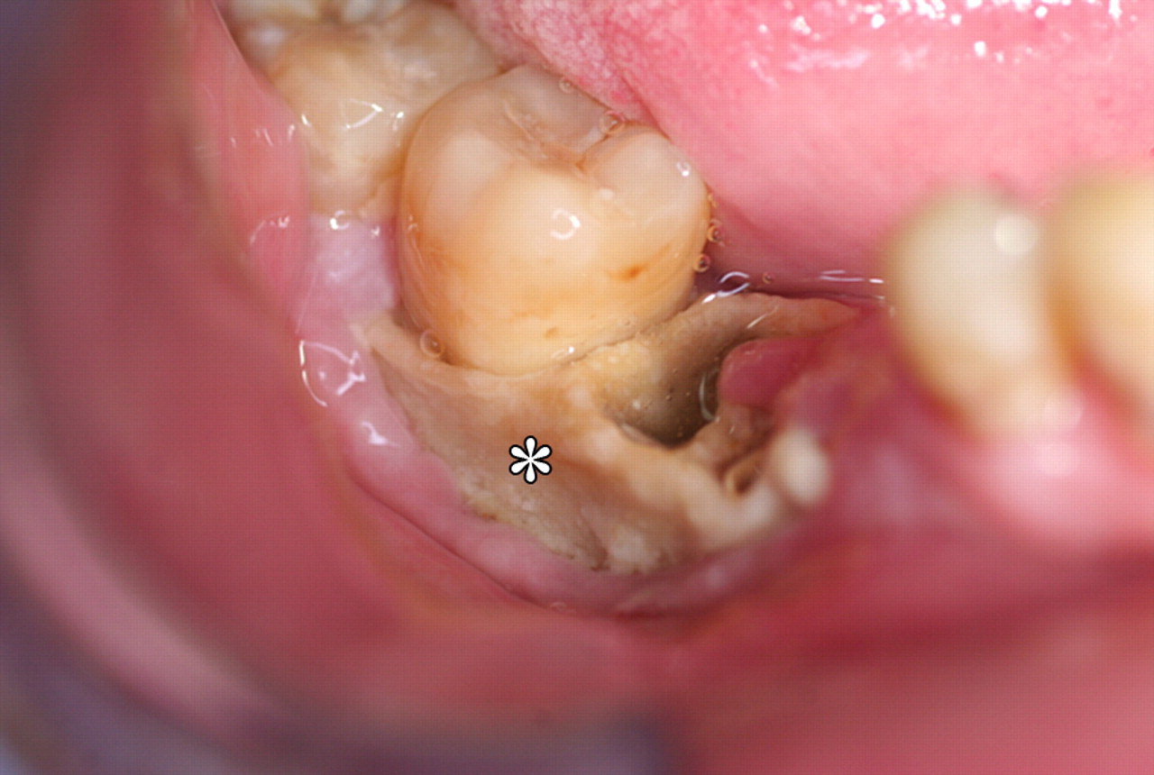
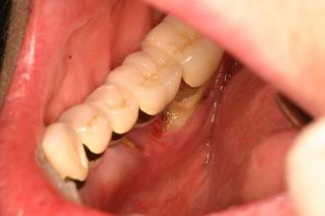
Bone-Modifying Agents (cont.)
Continuous bone-modifying agent treatment by provider discretion
Retreatment with bone-modifying agent recommended at relapse
Osteonecrosis of the jaw
Anderson et al, 2018; Morag et al, 2009..
Notes:
Both the International Myeloma Working Group (IMWG) and the National Comprehensive Cancer Network (NCCN) recommend patients on antimyeloma therapy receive a bone-modifying agent.
Nursing implications for bisphosphonates:
Acute phase reaction: 11% fever, chills
Dental health (dental exams every 6 months)
Renal (24-hour urine)
Patient advocacy: speak up if patient on antimyeloma therapy isn’t prescribed bisphosphonates or a dose adjust if they have renal compromise

Slide 40
Risk of VTE, Infection
Types of VTE
  DVT: proximal DVT (knee or higher) is a prognostic marker for recurrence and mortality
  PE: severity depends on size and cardiopulmonary reserve
All patients with MM should be screened for DVT risk factors: surgery, immobilization, hospitalization, renal disease, rx combination, obesity
Consider prophylactic AC, ASA
VTE = venous thromboembolic event; PE = pulmonary embolism; rx = drug; AC = anticoagulation;
ASA = acetylsalicylic acid.
NCCN, 2020.

Slide 41

Risk of VTE, Infection (cont.)
Infection risk
  VZV if MAb, PI
  Hand washing, avoid others with known illness
  Immunizations (influenza, pneumococcal, shingles)
  Education re: triggers to call, prompt treatment of sxs
  Levofloxacin
  IVIg for hypogammaglobulinemia
VZV = varicella zoster virus; MAb = monoclonal antibody; sxs = symptoms; IVIg = intravenous immunoglobulin.
NCCN, 2020.

Slide 42
Monitor Response, Relapse
Definition of Relapse
Meets IMWG criteria for PD
RRMM:
  Progression on therapy in patients who obtain ≥ minor response or progress within 60 days of most recent therapy
Relapsed MM:
  Meets IMWG criteria for PD but does not fit definition of RR or primary refractory MM
RR = relapsed/refractory.
NCCN, 2020.

Slide 43
Monitor Response, Relapse (cont.)
Definition of Progressive Disease
IMWG Criteria for PD
≥25% increase from nadir in:
Serum or urine M protein (absolute increase ≥0.5 g/dLª and ≥200 mg/24 hrs, respectively), or
Difference between involved and uninvolved FLC levels^{b} (absolute increase >100 mg/L), or
Bone marrow plasma cells^{c} (absolute increase ≥10%), or
New lesions (≥50% increase in SPD of >1 lesion or longest diameter of previous lesion >1 cm in short axis), or
Circulating plasma cells (≥50% increase [minimum 200 cells/μl] if only measure of disease)
ªIf lowest M component ≥5 g/dL, increase must be ≥1 g/dL.
^{b}In patients without measurable serum/urine M protein.
^{c}In patients without measurable serum/urine M protein or involved FLC.
SPD = sum of the products of the maximal perpendicular diameters of measured lesions.
NCCN, 2020.

Slide 44
Case Icebreaker:
Optimizing Treatment Experiences and Ensuring Patient-Centered Care

Slide 45
Case Study 2: Relapsed MM
78-year-old widow diagnosed with R-ISS Stage 2 MM in 2011 (at age 69)
  Standard-risk cytogenetics, FISH
  Several lytic lesions in spine, humerus
  M spike: IgG kappa 5.2 g/dL
  Received RVd lite with supportive care:
    Acyclovir for shingles prevention
    Metformin for steroid-induced hyperglycemia
    Dex eliminated after 8 cycles and unconfirmed CR
    Reinforce ongoing disease education (risk of relapse, monthly labs, living well strategies)
Best response: unconfirmed CR (negative immunofixation of serum, urine, normal FLC ratio)
    Continued maintenance lenalidomide 15 mg PO d 1-21 Q4W
    Not a candidate for ASCT due to COPD and lack of caregiver
COPD = chronic obstructive pulmonary disease.

Slide 46
Case Study 2: Relapsed MM (continued)
Develops diarrhea 20 months after starting lenalidomide
  Managed with hydration, diet diary, loperamide, cholestyramine
Discusses symptoms regularly with nurse practitioner
Labs show progressive, slow increase in serum M protein over a period of 10 months, suggestive of biochemical disease progression
Wonders what treatment options are

Slide 47
Practical Approach to Treatment of Relapsed Myeloma
Disease-related factors
  Duration of response to initial therapy
  High-risk versus low-risk status
  Molecular relapse versus symptomatic relapse
  Other comorbid conditions, patient frailty
Treatment-related factors
  Previous/current therapy exposure (relapsed or refractory)
  Toxicity/tolerability of previous regimen (combination versus single agent)
  Mode of administration (ie, PO or IV)
  Cost and convenience (out-of-pocket copays for IV vs PO)
Patient preference
Data and experience
Patient preference
Disease characteristics & prior therapy
Administration, chair time
Efficacy of regimen
Finances/
insurance
Comorbid conditions
Social status/
support
Faiman et al, 2016.

Slide 48
Monoclonal Antibody–Based Therapy
Daratumumab (dara, D),
Isatuximab (isa)
Elotuzumab (elo)
Human CD38-directed
Antibody targeting SLAMF-7
Risk of infusion reaction
For each MAb, premedicate with corticosteroids, H1 blocker, acetaminophen
  Both given weekly for 8 doses, then biweekly or monthly based on combination
  Prescribed with IMiDs, corticosteroids
DVT prophylaxis
Steroid side effects and schedule (am vs pm)
Steroid-induced hyperglycemia
Monitor
  Blood counts (hold/adjust dose if needed)
  Response assessment (monthly), interference
  Glucose monitoring (dex can affect)
  Renal, hepatic functions
Empliciti® prescribing information, 2019; Gleason et al, 2016; Darzalex® prescribing information, 2019.
Notes:
Daratumumab approvals:
In combination with VMP (bortezomib/melflufen/prednisone) in patients with newly diagnosed MM who are ineligible for transplant
In combination with Rd (lenalidomide/dexamethasone) or Vd (bortezomib/dexamethasone) in patients with MM with ≥1 prior therapy
In combination with Kd (carfilzomib/dexamethasone) following 1-3 lines of prior therapy
In combination with pomalidomide and dexamethasone in patients with ≥2 prior therapies, including lenalidomide and a proteasome inhibitor (PI)
As a monotherapy in patients with MM who have received ≥3 prior lines of therapy including a PI and an immunomodulatory drug (IMiD), or who are double-refractory to a PI and an IMiD
Subcutaneous daratumumab (daratumumab and hyaluronidase-fihj):
In combination with VMP or with Rd for newly diagnosed, transplant-ineligible patients
In combination with Vd following ≥1 prior line of therapy
As monotherapy following ≥3 prior lines of therapy or in patients double refractory to a PI and an IMiD
Elotuzumab: with pomalidomide, lenalidomide. No single-agent activity.
me

Slide 49
ICARIA-MM
Isatuximab/Pomalidomide/Dexamethasone for RRMM
Anti-CD38 monoclonal antibody
307 RRMM patients with ≥2 prior lines, refractory to lenalidomide and proteasome inhibitors
Median prior lines of therapy: 3
Estimated GFR: <60ml/min in 33.9% patients; 92.5% refractory to len; 75.9% refractory to PI
19.5% pts had high-risk cytogenetics
PFS: 11.5 months for IsaPd vs 6.5 months for Pd (HR 0.596, P=0.001)
Benefit seen across all major subgroups
ORR (≥PR) was 60.4% for IsaPd vs 35.3% for Pd (P<0.0001)
Common AEs: infusion reactions (38.2%), infections (42.8% vs 30.2%), neutropenia (84.9% vs 70.1%)
FDA approved March 2020
GFR = glomerular filtration rate; len = lenalidomide; isa = isatuximab; Pd = pomalidomide/dexamethasone.
Attal et al, 2019.

Slide 50
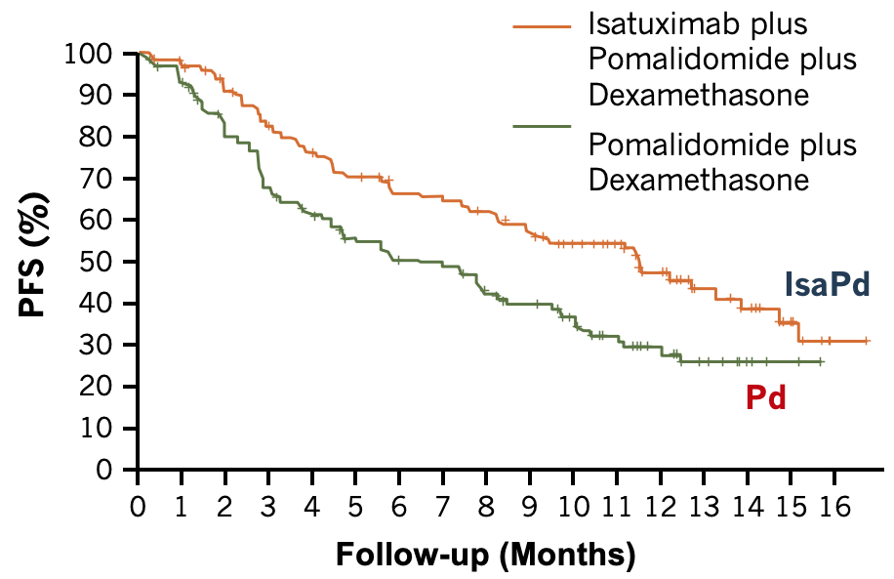
ICARIA-MM (cont.)
Isatuximab/Pomalidomide/Dexamethasone for RRMM
40% improvement in PFS
P=0.001
11.53 months
6.47 months
Attal et al, 2019.

Slide 51
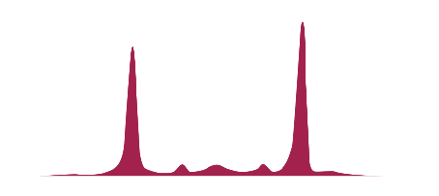
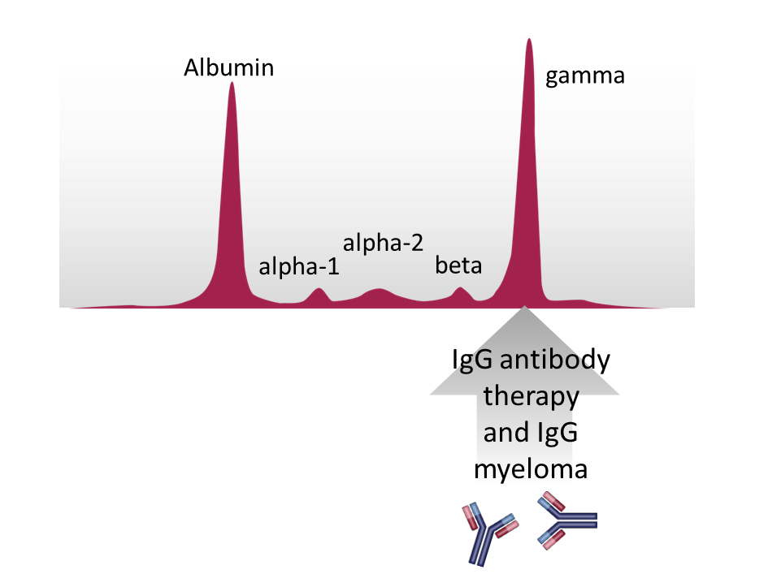




Special Considerations With Antibody Therapy
Albumin
Gamma
Potential interference with laboratory test
  Comigration of therapeutic antibody with M protein
    Overestimation of M protein and reduced CR rates
Solutions
  Laboratory assays to minimize effects (eg, high-resolution mass spectrometry)
  Awareness
Elotuzumab, daratumumab, isatuximab are IgG antibodies
Alpha-2
Alpha-1
Beta
2
3
1
dara
M protein
m/z
Mills & Murray, 2017.

Slide 52
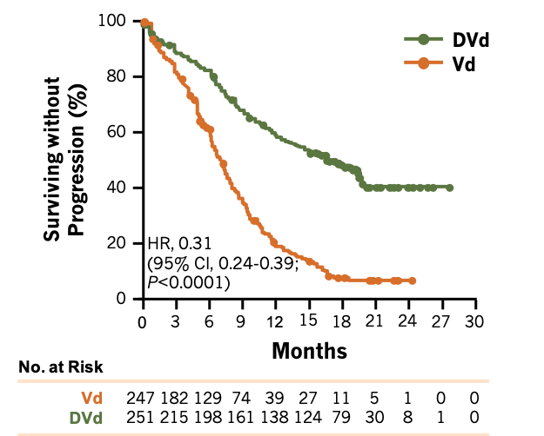
DVd Regimen for Relapsed Myeloma
CASTOR: MM Patients With 1 Prior Therapy
PFS
DVd
Median PFS:
16.7 mo
Vd
Median PFS:
7.1 mo
DVd = daratumumab/bortezomib/dexamethasone.
Spencer et al, 2017.

Slide 53
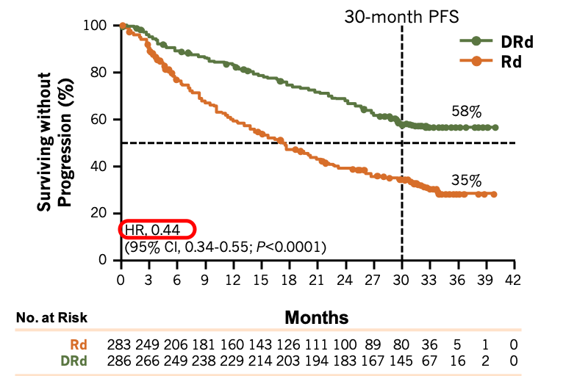
DRd Regimen for Relapsed Myeloma
POLLUX: MM Patients With 1 Prior Therapy
DRd
Median:
not reached
Rd
Median:
17.5 mo
DRd = daratumumab/lenalidomide/dexamethasone.
Dimopoulos et al, 2017.

Slide 54
Subcutaneous Daratumumab
(Daratumumab and Hyaluronidase-fihj): FDA Approved May 2020
Approved in combination with Vd following ≥1 prior line of therapy
Approved as monotherapy following ≥3 prior lines of therapy or in patients double refractory to both a PI and an IMiD
  COLUMBA trial: 522 patients, ECOG PS ≤2
  Randomized 1:1 to SQ or IV daratumumab
  Median follow-up of 7.5 months: SQ daratumumab noninferior to IV
    ORR: 41% vs 37%
  Most frequent grade ≥3 AEs: anemia (13% SQ vs 14% IV), neutropenia (13% vs 8%), thrombocytopenia (14% vs 14%)
  Additional serious AEs
    Pneumonia (3% SQ vs 4% IV)
    Treatment-related deaths: 1 SQ (febrile neutropenia) vs 4 IV (sepsis [n=2], hepatitis B reactivation [n=1], PJP [n=1])
SQ = subcutaneous; PJP = Pneumocystis jirovecii pneumonia.
Darzalex FasproTM prescribing information, 2020; Mateos, Nahi et al, 2020.

Slide 55
Pomalidomide: Clinical Pearls
Oral immunomodulatory agent active in R-refractory patients
Monitor:
  Blood counts (neutropenia most frequent grade 3/4 AE)
  Liver function
  Response
Proactive AE management
Patient education
  Adherence and REMS
  Infection prevention
  Refrain from smoking (reduces pomalidomide exposure)
Protect renal health (renal excretion of pomalidomide)
  Hydration
  Avoid NSAIDS, IV contrast, other drugs with renal interactions
R = lenalidomide; REMS = Risk Evaluation and Mitigation Strategies; NSAID = nonsteroidal anti-inflammatory drug.
Pomalyst® prescribing information, 2019; Faiman et al, 2016; NCCN, 2020.
Notes:
“Nearly all patients treated with [pomalidomide] + low-dose dex experienced at least 1 adverse reaction (99%). In trial 2, the most common adverse reactions included neutropenia (51.3%), fatigue and asthenia (46.7%), upper respiratory tract infection (31%), thrombocytopenia (29.7%), pyrexia (26.7%), dyspnea (25.3%), diarrhea (22%), constipation (21.7%), back pain (19.7%), cough (20%), pneumonia (19.3%), edema peripheral (17.3%), peripheral neuropathy (17.3%), bone pain (18%), nausea (15%), and muscle spasms (15.3%). Grade 3 or 4 adverse reactions included neutropenia (48.3%), thrombocytopenia (22%), and pneumonia (15.7%)” (Celgene, 2019).

Slide 56
Ixazomib
Oral proteasome inhibitor
  Indication: patients with MM who have received ≥1 prior therapy
  In combination with Rd
Administration
  Oral capsule once per week; do not crush, chew, or open
  Empty stomach: 1 hour before or 2 hours after food
Clinical pearls
  Adherence, schedule, viral prophylaxis
  Rapid response (1.1 months)
  Fast absorption (if vomit, do NOT repeat dose)
  Cyclic thrombocytopenia
  Peripheral neuropathy, peripheral edema
Ixazomib/Rd
FDA approved
November 2015
Ninlaro® prescribing information, 2015; Faiman et al, 2016; Moreau et al, 2015.
Notes:
Ixazomib is an oral PI approved in combination with lenalidomide/dexamethasone for patients who have had ≥1 prior therapy
It is given weekly on Days 1, 8, 15 of a 28-day cycle and taken on an empty stomach
During treatment, monitor complete blood count (CBC) and platelets, especially during the first 3 cycles, as patient will nadir between days 14-21
Monitor for symptoms of peripheral neuropathy and peripheral edema

Slide 57
Ixazomib: Oral Proteasome Inhibitor (cont.)
100
Median follow-up ≈15 months
Median PFS:
IRd: 20.6
Placebo/Rd: 14.7 months
80
60
Probability of PFS (%)
35% improvement
in PFS for
IRd vs Rd
40
20
Log-rank P=0.012
HR (95% CI): 0.742 (0.587-0.939)
0
0
2
4
6
8
10
12
14
16
18
20
22
24
Time from randomization (mos)
Number of events: IRd 129; placebo/Rd 157
IRd = Ixazomib/Rd.
Ninlaro® prescribing information, 2019; Faiman et al, 2016; Moreau et al, 2015.
Notes:
Ixazomib is an oral PI approved in combination with lenalidomide/dexamethasone for patients who have had ≥1 prior therapy
It is given weekly on Days 1, 8, 15 of a 28-day cycle and taken on an empty stomach
During treatment, monitor complete blood count (CBC) and platelets, especially during the first 3 cycles, as patient will nadir between days 14-21
Monitor for symptoms of peripheral neuropathy and peripheral edema

Slide 58
Carfilzomib: Proteasome Inhibitor
Escalate dose
Dose-dependent 10- or 30-minute infusions
Hydration but not overhydration
Premedication (dex)
Aspirin prophylaxis
Monitor blood counts, response
Monitor for infection
Herpes virus prophylaxis
Know cardiac and pulmonary status; optimize heart failure and blood pressure management
Diuretic (furosemide or torsemide) or inhalers if needed
Stewart et al, 2015.
Notes:
ASPIRE trial: set up as Rd (lenalidomide/dexamethasone) vs carfilzomib/Rd (KRd)
Improved PFS, OS, response rate, depth of response

Slide 59
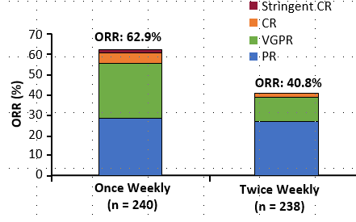
Carfilzomib: Proteasome Inhibitor (cont.)
Overall response rate:
once weekly
car/dex 20/27 mg/m² vs
car/dex 20/70 mg/m² RRMM
car = carfilzomib.
Moreau et al, 2018.
Notes:
ASPIRE trial: set up as Rd (lenalidomide/dexamethasone) vs carfilzomib/Rd (KRd)
Improved PFS, OS, response rate, depth of response

Slide 60
Daratumumab/Carfilzomib/Dexamethasone
FDA Approved August 2020
Following 1-3 lines of prior therapy
CANDOR Trial
 | DaraKd | Kd
PFS (mo) | NR | 15.8
Treatment duration (wk) | 70.1 | 40.3
Grade ≥3 AEs | 82% | 74%
Discontinuation due to AEs | 22% | 25%
Median follow-up: 17 months
Kd = carfilzomib/dexamethasone; wk = weeks.
Dimopoulos et al, 2020.

Slide 61
Daratumumab/Carfilzomib/Dexamethasone
Adverse Events
Grade ≥3 AEs (≥5% of patients)
  Respiratory tract infections (29%)
  Thrombocytopenia (24%)
  Hypertension (18%)
  Anemia (17%)
  Pneumonia (13%)
  Neutropenia (9%)
  Fatigue (8%)
  Lymphopenia (7%)
  Viral infection (6%)
Additional grade ≥3 AEs of note
  Cardiac failure (4%), acute renal failure (3%), ischemic heart disease (3%)
Fatal AEs (4%)
  Pneumonia (1%), respiratory tract infections (2%), cardiac failure (1%)
Dimopoulos et al, 2020.

Slide 62
Daratumumab/Carfilzomib/Dexamethasone
Adverse Events (cont.)
Any-grade AEs affecting ≥20% of patients
  Respiratory tract infections (73%)
  Thrombocytopenia (37%)
  Anemia (33%)
  Diarrhea (31%)
  Hypertension (31%)
  Upper respiratory tract infection (29%)
  Fatigue (24%)
  Dyspnea (20%)
  Viral infection (20%)
Additional any-grade AEs of note
  Daratumumab-related infusion reaction (18%)
  Peripheral neuropathy (17%)
  Cardiac failure (7%)
  Acute renal failure (6%)
  Ischemic heart disease (4%)
Dimopoulos et al, 2020.

Slide 63
Belantamab Mafodotin
Fourth-Line Treatment: FDA Approved August 2020
Immunoconjugate targeting B-cell maturation antigen (BCMA)
DREAMM-2
  N=293, relapsed/refractory multiple myeloma
  ORR: 31%
  DOR ≥6 months: 71%
Dosage: 2.5 mg/kg IV over 30 minutes Q3W
Q3W = every 3 weeks; DOR = duration of response.
Lonial et al, 2020; Blenrep® prescribing information, 2020.

Slide 64
Belantamab Mafodotin
Adverse Events
40% of patients reported serious adverse events
  Most frequent grade 3/4 AEs: keratopathy (27%), thrombocytopenia (20%), anemia (20%)
Any-grade AEs (≥20% of patients)
  Keratopathy, decreased visual acuity, nausea, blurred vision, pyrexia, infusion-related reactions, fatigue
Boxed warning for changes in the corneal epithelium: alterations in vision (can cause severe vision loss and corneal ulcer), blurred vision, dry eyes
  Opthalmic exams at baseline, prior to each dose, and immediately for worsening symptoms
  Patients still responded in DREAMM-2 study when drug was held (3.6 mean dose delays)
Lonial et al, 2020; Blenrep® prescribing information, 2020; Lonial et al, 2021.

Slide 65
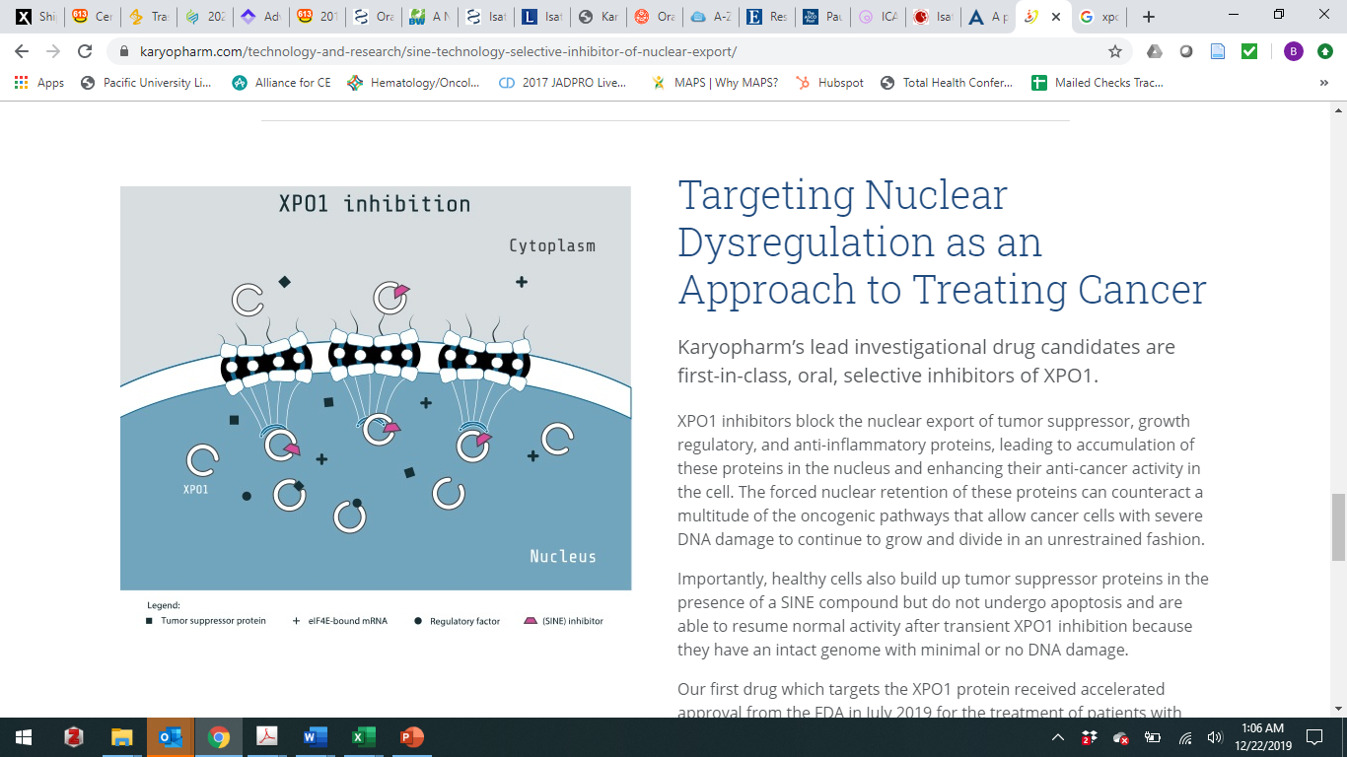
Selinexor
Oral Selective Inhibitor of Nuclear Export (SINE) Compound
STORM study enrolled MM patients with a median of 7 prior regimens
ORR of 26.2%, including 2 stringent CRs
Median OS: 8.6 months
Better tolerated once weekly (BOSTON and STOMP studies)
Cytoplasm
elF4E-bound mRNA
TSP
XPO1
SINE
Regulatory
factor
Nucleus
Selinexor inhibits XPO1. By blocking tumor suppressor proteins (TSPs) from being exported from the nucleus, selinexor forces nuclear restoration and reactivation of TSPs, leading to selective induction of apoptosis of cancer cells
Mikhael et al, 2020; Chari et al, 2018; Chari, Vogl et al, 2019; Grosicki et al, 2020; Chen et al, 2020.

Slide 66
Selinexor: Supportive Care
Monitor Closely During First 2 Months of Treatment
Strategies for supportive care
Thrombocytopenia | 25,000-<75,000/mcL: reduce sel by 1 dose level 25,000-<75,000/mcL with bleeding: interrupt; restart sel at 1 dose lower after resolution of bleeding <25,000/mcL: interrupt, monitor until plt ≥50,000/mcL, then restart sel at 1 dose lower | Prophylaxis at start of rx: romiplostim or eltrombopag used in STORM study
Nausea/vomiting | Grade 1/2 (≤5 episodes/d): maintain sel dose; start additional anti-nausea medications Grade ≥3: interrupt sel, monitor until n/v ≤ grade 2 or baseline, then restart sel at 1 dose level lower | Prophylaxis with 5-HT3 antagonists at start of Rx
sel = selinexor; plt = platelet count; n/v = nausea/vomiting.
Mikhael et al, 2020; Chari et al, 2018; Chari, Vogl et al, 2019; Xpovio® prescribing information, 2019.

Slide 67
Selinexor: Supportive Care (cont.)
Monitor Closely During First 2 Months of Treatment
Strategies for supportive care
Anorexia/ weight loss | Grade 2 wt loss 10%-<20% or significant wt loss or malnutrition: interrupt, monitor until wt ≥90% of baseline, then restart sel at 1 dose level lower | Prophylaxis at start of rx; consult dietitian
Hyponatremia | Na+ ≤130 mmol/L: interrupt; provide appropriate supportive care, monitor until Na+ ≥130 mmol/L, then restart sel at 1 dose level lower | Prophylaxis at start of rx
Fatigue | Grade 1 or 2 (≤7 days): maintain dose Grade 2 (>7 days) or Grade 3: interrupt, monitor until reduced to Grade 1, then restart sel at 1 dose lever lower | Prophylaxis at start of rx
Anemia, neutropenia | Monitor closely; consider blood transfusions, G-CSF, or growth factors | Prophylaxis at start of rx
wt = weight; Na+ = sodium ion; G-CSF = granulocyte-colony stimulating factor.
Mikhael et al, 2020; Chari et al, 2018; Chari, Vogl et al, 2019; Xpovio® prescribing information, 2019.

Slide 68
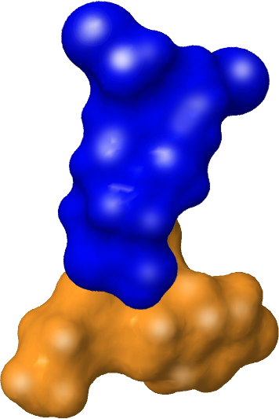

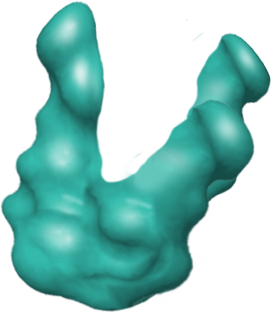
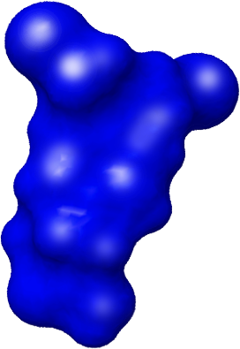
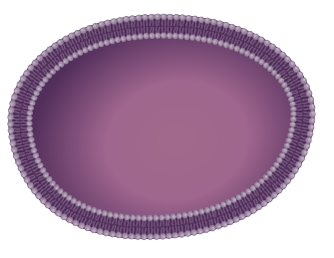
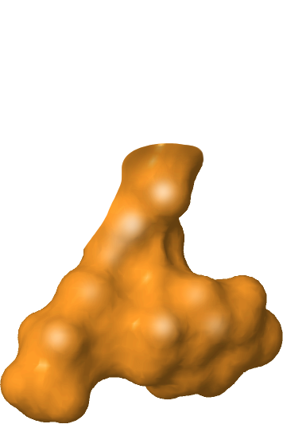


Melphalan Flufenamide (Melflufen)
Mechanism of Action
Peptidases are expressed in several cancers, including multiple myeloma
1
Melflufen rapidly induces irreversible DNA damage, leading to apoptosis of the myeloma cell
5
Melflufen is rapidly taken up by myeloma cells due to its high lipophilicity
2
Once inside the myeloma cell, melflufen is immediately cleaved by peptidases
Melflufen
3
pFPhe (carrier)
4
Peptidase
The hydrophilic alkylator payloads are entrapped
(cannot leave the myeloma cell)
Alkylator payload
pFPhe = p-L fluorophenylalanine ethyl ester.
Mateos et al, 2019; Oncopeptides, 2021; Mateos, Bladé et al, 2020.

Slide 69
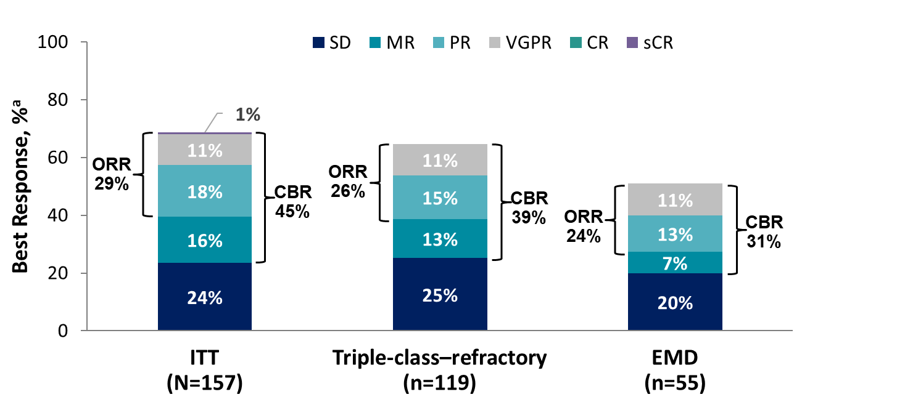

Melflufen: Peptide-Drug Conjugate
Peptide-alkylating drug conjugate
Key points:
  Dosing: 30-minute infusion Q4W
  No premeds
  Monitor for hematological AEs
    May need to hold or reduce dose
Withhold dose, monitor counts weekly
Resume melflufen
At same dose if hold ≤2 weeks
At lower dose if hold >2 weeks
Recommended dosage | Dosage
Starting dose | 40 mg
First dose reduction | 30 mg
Second dose reduction | 20 mg
Subsequent | Discontinue
    If platelets <50$×$10⁹/L on dosing day
    OR
    If ANC <1$×$10⁹/L on dosing day
    If Grade 4 hematological AE in 2 consecutive cycles, reduce dose
  Other AEs mostly mild (grade 1 or 2): nausea, fatigue, asthenia, diarrhea, pyrexia, cough, URTI, constipation
  Efficacy in patients with high-risk cytogenetics and/or extramedullary disease
Q4W = every 4 weeks; premed = premedication; AE = adverse event; ANC = absolute neutrophil count; URTI = upper respiratory tract infection.
Pepaxto® prescribing information, 2021; Richardson et al, 2021; Richardson et al, 2020; Mateos et al, 2019; Mateos, Bladé et al, 2020.
Notes:
Faculty to look over pearls

Slide 70
Melflufen: FDA Alert
OCEAN trial
  Melflufen/dex vs pom/dex following 2-4 lines of prior therapy
  Increased risk of death with melflufen/dex vs pom/dex
Melflufen/dex still approved (accelerated approval) and used in clinic
FDA actions
  Manufacturer required to suspend enrollment in OCEAN and other ongoing melflufen trials
  HCPs encouraged to review patients’ progress on melflufen and discuss risks of continued treatment with patients
pom = pomalidomide; HCP = health care professional.
US FDA, 2021.

Slide 71
KarMMa: Idecabtagene Vicleucel
R/R MM
Phase 2 trial design
  Idecabtagene vicleucel (ide-cel; bb2121): CAR T therapy targeting BCMA
  128 patients with R/R MM treated in dose escalation study
    ≥3 prior therapies, including PI, IMiD, and anti-CD38; refractory to last regimen
    Median of 6 prior therapies
Results for 450×10⁶ CAR T-cell dose
  82% ORR (35% CR/sCR)
  Median DOR: 11.3 months
  96% CRS, with 6% grade ≥3
CAR T: patient’s own T cells engineered, which takes between 7 days and several weeks
  Must have sufficient blood counts/organ function to be eligible
  Must be able to wait/have bridging therapy while CAR T therapy is produced
  Tip: refer patients early to begin evaluation for CAR T therapy
Different CAR T products have different transduction methods and targets
  CRS experienced by nearly all patients; mild to severe
CRS = cytokine release syndrome.
Munshi et al, 2020; Munshi et al, 2021; Dana-Farber, 2021; LLS, 2021; NCI, 2019.

Slide 72
Cytokine Release Syndrome Ranges in Severity
Mild to Life-Threatening: Needs Early Recognition and Treatment
Hepatic
Transaminitis
↑ ALT
Hyperbilirubinemia
Monitoring for CRS
Vital signs (temperature,
O₂ saturation, etc)
Review of systems and physical exam
  Focus on cardiovascular, pulmonary, and neurologic systems
  Survey for occult infection
Laboratory monitoring
  CRP
  Cytokines
  Ferritin
  LDH
Renal
↑ serum creatinine
Renal insufficiency
TLS
Gastrointestinal
Nausea
Vomiting
Diarrhea
Respiratory
Hypoxia
Dyspnea
Capillary leak syndrome
Hematologic
Anemia
Thrombocytopenia
Neutropenia
Cardiovascular
Tachycardia
Hypotension
Arrhythmias
Musculoskeletal
↑ CPK
Myalgia
Weakness
CRS
Constitutional
Fever
Fatigue, malaise
Headache
Neurologic
Delirium
Somnolence
Dysphagia
ALT = alanine aminotransferase; CPK = creatine phosphokinase; CRP = C-reactive protein; O₂ = oxygen; TLS = tumor lysis syndrome.
Oluwole & Davila, 2016; June et al, 2018; Brudno & Kochenderfer, 2016; Shimabukuro-Vornhagen, et al, 2018; Lee et al, 2019.

Slide 73
Emerging Options
Bispecific T-cell engagers (BiTE)
CAR T-cell therapy; other products
Venetoclax: t(11;14)
Many, many more drugs and combinations in development!!
Raje et al, 2018; Zhao et al, 2018; Mailankody et al, 2018; Trudel et al, 2018; Topp et al, 2018; Matulis et al, 2019.
Notes:
“The idea of [bispecific T-cell engager (BiTE)] in combating cancer is to specifically direct T cells to destroy cancer cells. BiTE is composed of 2 single-chain antibodies, with 1 antibody specific for B-cell maturation antigen (BCMA), a tumor antigen, and the other specific for CD3, a protein found on the surface of T cells. By binding to both BCMA and CD3, BiTE technology forms a structure similar to a bridge between the T cell and tumor cell, allowing the T cell to target the tumor cell, resulting in tumor cell lysis, reduced tumor burden, and halting the progression of the cancer” (Bai, 2018).

Slide 74
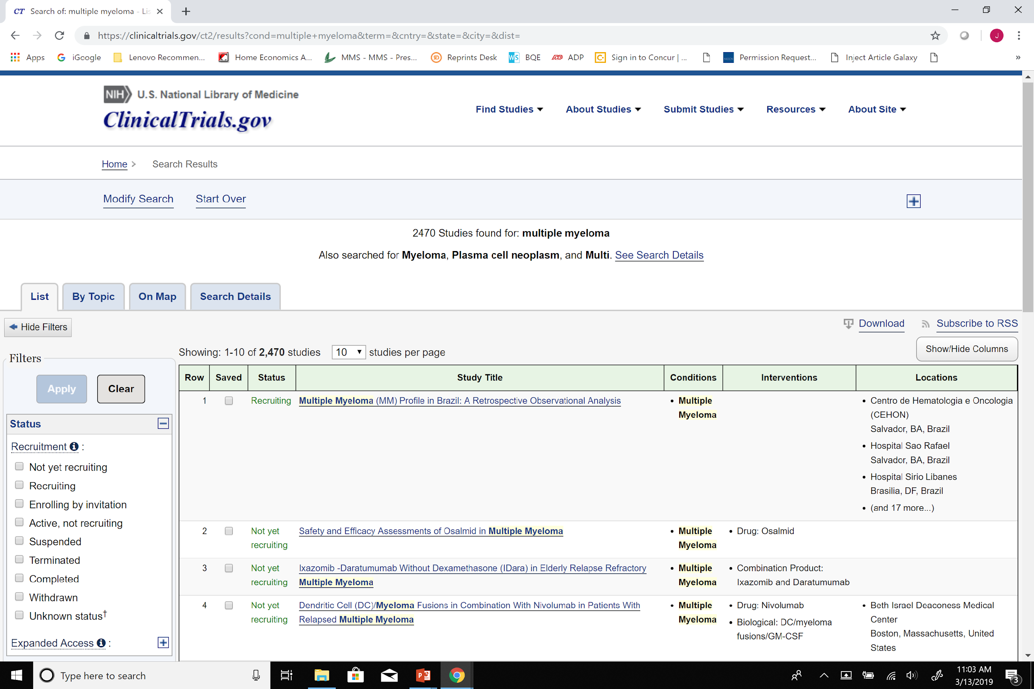
Finding Clinical Trials
https://clinicaltrials.gov/

Slide 75
Resources to Share With Patients With MM
General Myeloma/Cancer Resources
American Cancer Society
CANCERcare
International Myeloma Foundation
Multiple Myeloma Research Foundation
Leukemia and Lymphoma Society
LIVESTRONG
MedLine Plus

Slide 76
Resources to Share With Patients With MM (cont.)
Psychological/Social
Association of Oncology Social Work
Cancer Hope Network
Cancer.net
Cancer Support Community

Slide 77
Resources to Share With Patients With MM (cont.)
Financial Assistance
CancerCare Co-Payment Assistance Foundation
Cancer Financial Assistance Coalition
Center for Medicare and Medicaid Services
HealthWell Foundation
Pharmaceutical manufacturer websites
Rx Assist
GoodRx
Patient Assistance Foundation
Good Days

Slide 78
Key Takeaways
Although multiple myeloma remains incurable, treatment options have improved dramatically, as has survival
PI/IMiD triplet therapy is the standard for NDMM (outside of clinical trials)
Maintenance therapy has significant benefits to overall survival, MRD status
High-risk disease remains high risk
Therapies with novel mechanisms of action are emerging
Nurses are uniquely positioned to manage side effects and provide disease education

Slide 79
Scan now to complete the
posttest and evaluation
Thank you joining us!
Scan the QR here or on the front of your i3 Health folder to complete the posttest and evaluation OR use the paper assessment and paper evaluation included in your i3 Health folder
To scan the QR code:
FOR IPHONE:
Open the camera & focus it to QR code
Your internet browser should pop up with a link
Click the link and complete
FOR ANDROID:
Open the camera & focus it to QR code
Hold ‘Home’ button
The pretest comes visible to complete

Slide 80
References
Anderson K, Ismaila N, Flynn PJ, et al (2018). Role of bone-modifying agents in multiple myeloma: American Society of Clinical Oncology clinical practice guideline update. J Clin Oncol, 36(8):812-818. DOI:10.1200/JCO.2017.76.6402
Attal M, Lauwers-Cances V, Hulin C, et al (2017). Lenalidomide, bortezomib, and dexamethasone with transplantation for myeloma. N Engl J Med, 376:1311-1320. DOI:10.1056/NEJMoa1611750
Attal M, Richardson PG, Rajkumar SV, et al (2019). Isatuximab plus pomalidomide and low-dose dexamethasone versus pomalidomide and low-dose dexamethasone in patients with relapsed and refractory multiple myeloma (ICARIA-MM): a randomised, multicenter, open-label, phase 3 study. Lancet, 394(10214):2096-2107. DOI:10.1016/S0140-6736(19)32556-5
Avet-Loiseau H, Lauwers-Cances V, Corre J, et al (2017). Minimal residual disease in multiple myeloma: final analysis of the IFM2009 trial. Blood, 130(suppl_1):435. DOI:10.1182/blood.V130.Suppl_1.435.435
Bai D (2018). Amgen's AMG 420 finds early success in patients with relapsing/refractory multiple myeloma. Available at: https://www.ajmc.com/newsroom/amgens-amg-420-finds-early-success-in-patients-with-relapsingrefractory-multiple-myeloma
Blenrep® prescribing information (2020). GlaxoSmithKline. Available at: https://gsksource.com/pharma/content/dam/GlaxoSmithKline/US/en/Prescribing_Information/Blenrep/pdf/BLENREP-PI-MG.PDF
Brudno JN & Kochenderfer JN (2016). Toxicities of chimeric antigen receptor T cells: recognition and management. Blood, 127(26):3321-3230. DOI:10.1182/blood-2016/04-703751
Celgene (2019). Celgene corporation announces POMALYST® granted breakthrough therapy designation from FDA for HIV-positive and negative Kaposi sarcoma. Available at: https://ir.celgene.com/press-releases-archive/press-release-details/2019/Celgene-Corporation-Announces-POMALYST-Granted-Breakthrough-Therapy-Designation-from-FDA-for-HIV-Positive-and-Negative-Kaposi-Sarcoma/default.aspx
Chantzichristos D, Andréasson B & Johansson P (2008). Safe and tolerable one-hour pamidronate infusion for multiple myeloma patients. Ther Clin Risk Manag, 4(6):1371-1374. DOI:10.2147.tcrm.s4004
Chari A, Goldschmidt H, San-Miguel J, et al (2019). Subcutaneous (SC) daratumumab (DARA) in combination with standard multiple myeloma (MM) treatment regimens: an open-label, multicenter phase 2 study (PLEIADES). Clin Lmphoma Myeloma Leuk (17th International Myeloma Workshop Abstracts), 19(suppl_10):E16-E17. Abstract OAB-22. DOI:10.1016/j.clml.2019.09.023
Chari A, Vogl DT, Dimopoulos MA, et al (2018). Results of the pivotal STORM study (part 2) in penta-refractory multiple myeloma (MM): deep and durable responses with oral selinexor plus low dose dexamethasone in patients with penta-refractory MM. Blood (ASH Annual Meeting Abstracts), 132(suppl_1). Abstract 598. DOI:10.1182/blood-2018-99-116663
Chari A, Vogl DT, Gavriatopoulou M, et al (2019). Oral selinexor-dexamethasone for triple-class refractory multiple myeloma. N Engl J Med, 381(8):727-738. DOI:10.1056/NEJMoa1903455

Slide 81
References (cont.)
Chen CI, Bahlis N, Gasparetto C, et al (2020). Selinexor in combination with pomalidomide and dexamethasone (SPd) for treatment of patients with relapsed refractory multiple myeloma (RRMM). Blood (ASH Annual Meeting Abstracts), 136(suppl_1):18-19. Abstract 726. DOI:10.1182/blood-2020-139858
Dana-Farber Cancer Institute (2021). What is CAR T-cell therapy and how does it work? Available at: https://blog.dana-farber.org/insight/2017/06/car-t-cell-therapy/
Darzalex® (daratumumab) prescribing information (2019). Janssen Biotech, Inc. Available at: http://www.janssenlabels.com/package-insert/product-monograph/prescribing-information/DARZALEX-pi.pdf
Darzalex FasproTM (daratumumab and hyaluronidase-fihj) prescribing information (2020). Janssen. Available at: http://www.janssenlabels.com/package-insert/product-monograph/prescribing-information/DARZALEX+Faspro-pi.pdf
Dimopoulos MA, Gay F, Schjesvold F, et al (2019). Oral ixazomib maintenance following autologous stem cell transplantation (TOURMALINE-MM3): a double-blind, randomised, placebo-controlled phase 3 trial. Lancet, 393(10168):253-264. DOI:10.1016/S0140-6736(18)33003-4
Dimopoulos MA, Gay F, Schjesvold FH, et al (2018). Maintenance therapy with the oral proteasome inhibitor ixazomib significantly prolongs progression-free survival following autologous stem cell transplantation in patients with newly diagnosed multiple myeloma: phase 3 TOURMALINE-MM3 trial. Blood (ASH Annual Meeting Abstracts), 132(suppl_1). Abstract 301. DOI:10.1182/blood-2018-99-112079
Dimopoulos M, Quach H, Mateos MV, et al (2020). Carfilzomib, dexamethasone, and daratumumab versus carfilzomib and dexamethasone for patients with relapsed or refractory multiple myeloma (CANDOR): results from a randomised, multicentre, open-label, phase 3 study. Lancet, 396(10245):186-197. DOI:10.1016/S0140-6736(20)30734-0
Dimopoulous MA, White D, Benboubker L, et al (2017). Daratumumab, lenalidomide, and dexamethasone (DRd) versus lenalidomide and dexamethasone (Rd) in relapsed or refractory multiple myeloma (RRMM): updated efficacy and safety analysis of POLLUX. Blood, 130:379.
Empliciti® (elotuzumab) prescribing information (2019). Bristol-Myers Squibb. Available at: https://packageinserts.bms.com/pi/pi_empliciti.pdf
Facon T, Kumar S, Plesner T, et al (2019). Daratumumab plus lenalidomide and dexamethasone for untreated myeloma. N Engl J Med, 380:2104-2115. DOI:10.1056/NEJMoa1817249
Faiman B (2014). Myeloma genetics and genomics: practice implications and future directions. Clin Lymphoma Myeloma Leuk, 14(6):436-440. DOI:10.1016/j.clml.2014.07.008
Faiman B, McBride A, Devine H, et al (2016). New agents in the treatment of multiple myeloma. J Adv Pract Oncol, 7:45-52. DOI:10.6004/jadpro.2016.7.2.13
Gay F, Cerrato C, Petrucci MT, et al (2019). Efficacy of carfilzomib lenalidomide dexamethasone (KRd) with or without transplantation in newly diagnosed myeloma according to risk status: results from the FORTE trial. J Clin Oncol (ASCO Annual Meeting Abstracts), 37(15_suppl). Abstract 8002. DOI:10.1200/JCO.2019.37.15_suppl.8002
Gleason C, Devine H, Faiman B, et al (2016). Monoclonal antibodies in the treatment of multiple myeloma. J Adv Pract Oncol, 7(suppl_1):53-57. DOI:10.6004.jadpro.2016.7.2.14
Ghobrial IM & Landgren O (2014). How I treat smoldering multiple myeloma. Blood, 124(23):3380-3388. DOI:10.1182/blood-2014-08-551549
Grosicki S, Simonova M, Spicka I, et al (2020). Once-per-week selinexor, bortezomib, and dexamethasone versus twice-per-week bortezomib and dexamethasone in patients with multiple myeloma (BOSTON): a randomised, open-label, phase 3 trial. Lancet, 396(10262):1563-1573. DOI:10.1016/S0140-6736(20)32292-3

Slide 82
References (cont.)
International Myeloma Foundation (2018). Understanding your test results. Available at: https://www.myeloma.org/sites/default/files/resource/u-testresults.pdf
June CH, O’Connor RS, Kawalekar OU, et al (2018). CAR T cell immunotherapy for human cancer. Science, 359(6382):1361-1365. DOI:10.1126/science.aar6711
Kumar S, Paiva B, Anderson KC, et al (2016). International Myeloma Working Group consensus criteria for response and minimal residual disease assessment in multiple myeloma. Lancet Oncol, 17(8):e328-e346. DOI:10.1016/S1470-2045(16)30206-6
Kumar SK, Dispenzieri A, Lacy MQ, et al (2014). Continued improvement in survival in multiple myeloma: changes in early mortality and outcomes in older patients. Leukemia, 28(5):1122-1128. DOI:10.1038/leu.2013.313
Kumar SK, Lee JH, Morgan G, et al (2012). Risk of progression and survival in multiple myeloma relapsing after therapy with IMiDs and bortezomib: a multicenter international myeloma working group study. Leukemia, 26(1)149-57. DOI:10.1038/leu.2011.196
Kyle RA, Durie BGM, Rajkumar SV, et al (2010). Monoclonal gammopathy of undetermined significance (MGUS) and smoldering (asymptomatic) multiple myeloma: IWWG consensus perspectives risk factors for progression and guidelines for monitoring and management. Leukemia, 24(6):1121-1127. DOI:10.1038/leu.2010.60
Kyle RA, Gertz MA, Witzig TE, et al (2003). Review of 1027 patients with newly diagnosed multiple myeloma. Mayo Clin Proc, 78(1):21-33. DOI:10.4065/78.1.21
Lakshman A, Rajkumar SV, Buadi FK, et al (2018). Risk stratification of smoldering multiple myeloma incorporating revised IWWG diagnostic criteria. Blood Cancer J, 8(6):59. DOI:10.1038/s41408-018-0077-4
Landgren O, Sonneveld P, Jakubowiak A, et al (2019). Carfilzomib with immunomodulatory drugs for the treatment of newly diagnosed multiple myeloma. Leukemia, 33:2127-2143. DOI:10.1038/s41375-019-0517-6
Lee DW, Santomasso BD, Locke FL, et al (2019). ASTCT consensus grading for cytokine release syndrome and neurologic toxicity associated with immune effector cells. Biol Blood Marrow Transplant, 25(4):625-638. DOI:10.1016/j.bbmt.2018.12.758
Leukemia & Lymphoma Society (2021). Chimeric antigen receptor (CAR) T-cell therapy. Available at: https://www.lls.org/treatment/types-treatment/immunotherapy/chimeric-antigen-receptor-car-t-cell-therapy
Lonial S (2015). Living with myeloma: managing side effects and quality of life. Leukemia & Lymphoma Society of Canada. Available at: https://www.llscanada.org/sites/default/files/National/USA/Pdf/Slides_Transcipts/Myeloma%20Slides_4.8.15_Lonial.pdf
Lonial S, Lee HC, Badros A, et al (2020). Belantamab mafodotin for relapsed or refractory multiple myeloma (DREAMM-2): a two-arm, randomised, open-label, phase 2 study. Lancet Oncol, 21(2):207-221. DOI:10.1016/s1470-2045(19)30788-0
Lonial S, Nooka A, Thulasi P, et al (2021). Characterization of ocular adverse events in patients receiving belantamab mafodotin for ≥12 months: post-hoc analysis of DREAMM-2 study in relapsed/refractory multiple myeloma. European Hematology Association Virtual Congress Abstracts. Abstract EP1026.
Mailankody S, Ghosh A, Staehr M, et al (2018). Clinical responses and pharmacokinetics of MCARH171, a human-derived BCMA targeted CAR T cell therapy in relapsed/refractory multiple myeloma: final results of a phase I clinical trial. Blood (ASH Annual Meeting Abstracts), 132(suppl_1). Abstract 959. DOI:10.1182/blood-2018-99-119717
Mateos MV, Bladé J, Bringhen S, et al (2020). Melflufen: a peptide-drug conjugate for the treatment of multiple myeloma. J Clin Med, 9(10):3120. DOI:10.3390/jcm9103120

Slide 83
References (cont.)
Mateos MV, Cavo M, Blade J, et al (2020). Overall survival with daratumumab, bortezomib, melphalan, and prednisone in newly diagnosed multiple myeloma (ALCYONE): a randomised, open-label, phase 3 trial. Lancet, 395(10218):132-141. DOI:10.1016/S0140-6736(19)32956-3
Mateos MV, Dimopoulos MA, Cavo M, et al (2018). Daratumumab plus bortezomib, melphalan, and prednisone for untreated myeloma. N Engl J Med, 378:518-528. DOI:10.1056/NEJMoa1714678
Mateos MV, Nahi H, Legiec W, et al (2020). Subcutaneous versus intravenous daratumumab in patients with relapsed or refractory multiple myeloma (COLUMBA): a multicentre, open-label, non-inferiority, randomised, phase 3 trial. Lancet Haematol, 7(5):E370-E380. DOI:10.1016/S2352-3026(20)30070-3
Mateos MV, Oriol A, Larocca, et al (2020). HORIZON (OP-106): melflufen plus dexamethasone in patients with relapsed/refractory multiple myeloma with high-risk cytogenetics—subgroup analysis. Blood (ASH Annual Meeting Abstracts). Abstract 3237.
Mateos MV, Oriol A, Larocca A, et al (2019). Clinical activity of melflufen in patients with triple-class refractory multiple myeloma and poor-risk features in an updated analysis of HORIZON (OP-106), a phase 2 study in patients with relapsed/refractory multiple myeloma refractory to pomalidomide and/or daratumumab. Blood (ASH Annual Meeting Abstracts), 134(suppl_1). Abstract 1883. DOI:10.1182/blood-2019-124825
Matulis SM, Gupta VA, Neri P, et al (2019). Functional profiling of venetoclax sensitivity can predict clinical response in multiple myeloma. Leukemia, 33(5):1291-1296. DOI:10.1038/s41375-018-0374-8
McCarthy PL, Holstein SA, Petrucci MT, et al (2017). Lenalidomide maintenance after autologous stem-cell transplantation in newly diagnosed multiple myeloma: a meta-analysis. J Clin Oncol, 35(29):3279-3289. DOI:10.1200/JCO.2017.72.6679
Mikhael J (2020). Treatment options for triple-class refractory multiple myeloma. Clin Lymphoma Myeloma Leuk, 20(1)1-7. DOI:10.1016/j.clml.2019.09.621
Mills JR & Murray DL. Identification of friend or foe: the laboratory challenge of differentiating M-proteins from monoclonal antibody therapies (2020). J Appl Lab Med, 1:421-431. DOI:10.1373/jalm.2016.020784
Morag Y, Morag-Hezroni M, Jamadar DA, et al (2009). Bisphosphonate-related osteonecrosis of the jaw: a pictorial review. Radiographics, 29(7):1971-1984. DOI:10.1148/rg.297095050
Moreau P, Attal M, Hulin C, et al (2019). Phase 3 randomized study of daratumumab (DARA) + bortezomib/thalidomide/dexamethasone(D-VTd) vs VTd in transplant-eligible (TE) newly diagnosed multiple myeloma (NDMM): CASSIOPEIA Part 1 results. J Clin Oncol (ASCO Annual Meeting Abstracts), 37(15_suppl). Abstract 8003. DOI:10.1200/JCO.2019.37.15_suppl.8003
Moreau P, Masszi T, Grzasko N, et al (2015). Ixazomib, an investigational oral proteasome inhibitor (PI), in combination with lenalidomide and dexamethasone (IRd), significantly extends progression-free survival (PFS) for patients (pts) with relapsed and/or refractory multiple myeloma (RRMM): the phase 3 Tourmaline-MM1 study (NCT01564537). Blood (ASH Annual Meeting Abstracts), 126(23). Abstract 727. DOI:10.1182/blood.V126.23.727.727
Moreau P, Mateos M, Berenson JR, et al (2018). Once weekly versus twice weekly carfilzomib dosing in patients with relapsed and refractory multiple myeloma (A.R.R.O.W.): interim analysis results of a randomised, phase 3 study. Lancet Oncol, 19(7):953-964. DOI:10.1016/S1470-2045(18)30354-1

Slide 84
References (cont.)
Munshi NC, Anderson LD Jr, Shah N, et al (2021). Idecabtagene vicleucel in relapsed and refractory multiple myeloma. N Engl J Med, 384(8):705-716. DOI:10.1056/NEJMoa2024850
Munshi NC, Anderson LD Jr, Shah N, et al (2020). Idecabtagene vicleucel (ide-cel; bb2121), a BCMA-targeted CAR T-cell therapy, in patients with relapsed and refractory multiple myeloma (RRMM): initial KarMMa results. J Clin Oncol (ASCO Annual Meeting Abstracts, 38(suppl_15). Abstract 8503. DOI:10.1200/JCO.2020.38.15_suppl.8503
National Cancer Institute (2019). CAR T cells: engineering patients’ immune cells to treat their cancers. Available at: https://www.cancer.gov/about-cancer/treatment/research/car-t-cells#new-target
National Comprehensive Cancer Network (2020). Clinical Practice Guidelines in Oncology: multiple myeloma. Version 3.2020. Available at: http://www.nccn.org
Ninlaro® (ixazomib) prescribing information (2015). Takeda. Available at: https://www.accessdata.fda.gov/drugsatfda_docs/label/2015/208462lbl.pdf
O’Donnell EK, Laubach JP, Yee AJ, et al (2018). A phase 2 study of modified lenalidomide, bortezomib and dexamethasone in transplant-ineligible multiple myeloma. Br J Haematol, 182(2):222-230. DOI:10.1111/bjh.15261
Oluwole OO & Davila ML (2016). At the bedside: clinical review of chimeric antigen receptor (CAR) T cell therapy for B cell malignancies. J Leukoc Biol, 100(6):1265-1272. DOI:10.1189/jlb.5BT1115-524R
Oncopeptides (2021). Mechanism of action. Available at: https://www.oncopeptides.com/en/innovation/investigational-drug/mechanism-of-action
Palumbo A, Avet-Loiseau H, Oliva S, et al (2015). Revised International Staging System for Multiple Myeloma: a report from International Myeloma Working Group. J Clin Oncol, 33(26):2863-2869. DOI:10.1200/JCO.2015.61.2267
Pepaxto® (melphalan flufenamide) prescribing information (2021). Oncopeptides. Available at: https://www.accessdata.fda.gov/drugsatfda_docs/label/2021/214383s000lbl.pdf
Perrot A, Lauwers-Cances V, Corre J, et al (2018). Minimal residual disease negativity using deep sequencing is a major prognostic factor in multiple myeloma. Blood, 132(23):2456-2464. DOI:10.1182/blood-2018-06-858613
Pomalyst® (pomalidomide) prescribing information (2019). Celgene. Available at: https://media2.celgene.com/content/uploads/pomalyst-pi.pdf
Raje NS, Berdeja JS, Lin Y, et al (2018). bb21 anti-BCMA CAR T-cell therapy in patients with relapsed/refractory multiple myeloma: updated results from a multicenter phase I study. J Clin Oncol (ASCO Annual Meeting Abstracts), 36(15_suppl). Abstract 8007. DOI:10.1200/JCO.2018.36.15_suppl.8007
Rajkumar SV (2020). Multiple myeloma: selection of initial chemotherapy for symptomatic disease. UpToDate. Available at: https://www.uptodate.com/contents/multiple-myeloma-selection-of-initial-chemotherapy-for-symptomatic-disease
Rajkumar SV, Dimopoulos MA, Palumbo A, et al (2014). International Myeloma Working Group updated criteria for the diagnosis of multiple myeloma. Lancet Oncol, 15(12):e538-e548. DOI:10.1016/S1470-2045(14)70442-5
Richardson PG, Oriol A, Larocca A, et al (2021). Melflufen and dexamethasone in heavily pretreated relapsed and refractory multiple myeloma. J Clin Oncol, 39(7):757-767. DOI:10.1200/JCO.20.02259

Slide 85
References (cont.)
Richardson PG, Bringhen S, Voorhees P, et al (2020). Melflufen plus dexamethasone in relapsed and refractory multiple myeloma (O-12-M1): a multicentre, international, open-label, phase 1-2 study. Lancet Haematol. [Epub ahead of print] PII:S2352-3026(20)30044-2. DOI:10.1016/S2353-3026(20)30044-2
Richardson PG, Oriol A, Larocca A, et al (2020). HORIZON (OP-106): Melflufen plus dexamethasone (dex) in 55 patients (pts) with relapsed/refractory multiple myeloma (RRMM) with extramedullary disease (EMD)—subgroup analysis. Blood (ASH Annual Meeting Abstracts). Abstract 3214.
Shimabukuro-Vornhagen A, Gödel P, Subklewe M, et al (2018). Cytokine release syndrome. J Immunother Cancer, 6(1):56. DOI:10.1186/s40425-018-0343-9
Spencer A, Hungria VTM, Mateos MV, et al (2017). Daratumumab, bortezomib, and dexamethasone (DVd) versus bortezomib and dexamethasone (Vd) in relapsed or refractory multiple myeloma (RRMM): updated efficacy and safety analysis of CASTOR. Blood (ASH Annual Meeting Abstracts), 130(suppl_1). Abstract 3145. DOI:10.1182/blood.V130.Suppl_1.3145.3145
Stewart AK, Rajkumar SV, Dimopoulos MA, et al (2015). Carfilzomib, lenalidomide, and dexamethasone for relapsed multiple myeloma. N Engl J Med, 372:142-152. DOI:10.1056/NEJMoa1411321
Topp MS, Duell J, Zugmaier G, et al (2018). Treatment with AMG 420, an anti-B-cell maturation antigen (BCMA) bispecific T-cell engager (BiTE) antibody construct, induces minimal residual disease (MRD) negative complete responses in relapsed and/or refractory (R/R) multiple myeloma (MM) patients: results of a first-in-human (FIH) phase I dose escalation study. Blood (ASH Annual Meeting Abstracts), 132(suppl_1). Abstract 653. DOI:10.1182/blood-2018-99-109769
Trudel S, Lendvai N, Popat R, et al (2018). Targeting B-cell maturation antigen with GSK2857916 antibody-drug conjugate in relapsed or refractory multiple myeloma (BMA117159): a dose escalation and expansion phase 1 trial. Lancet Oncol, 19(12):1641-1653. DOI:10.1016/S1470-2045(18)30576-X
US Food & Drug Administration (2021). FDA alerts patients and health care professionals about clinical trial results showing an increased risk of death associated with Pepaxto (melphalan flufenamide). Available at: https://www.fda.gov/drugs/drug-safety-and-availability/fda-alerts-patients-and-health-care-professionals-about-clinical-trial-results-showing-increased
Xpovio™ (selinexor) prescribing information (2019). Karyopharm Therapeutics Inc. Available at: www.xpovio.com
Zhao WH, Liu J, Wang BY, et al (2018). A phase 1, open-label study of LCAR-B38M, a chimeric antigen receptor T cell therapy directed against B cell maturation antigen, in patients with relapsed or refractory multiple myeloma. J Hematol Oncol, 11:141. DOI:10.1186/s13045-018-0681-6

