Slide 1
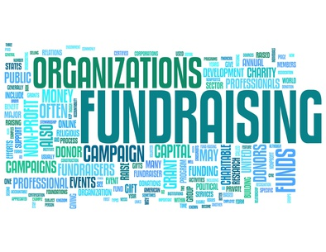
Capital Campaign Training
Using InterChange as a tool for Capital Campaign success

Slide 2
Presenters
Dean Feener:
Debbie Diaz:

Slide 3
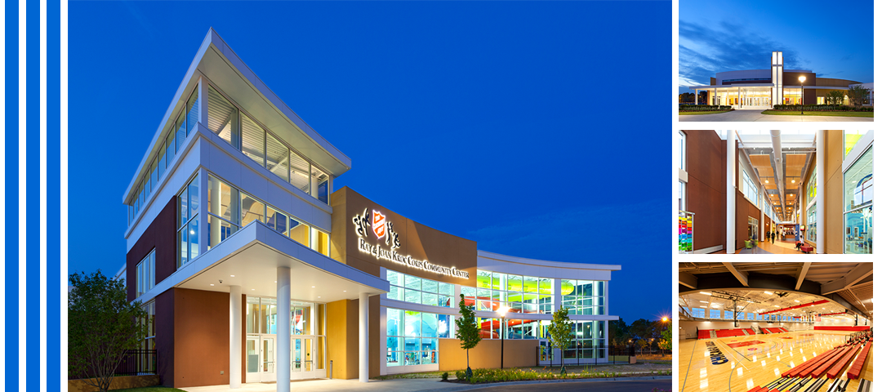
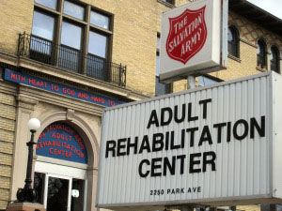
What is a Capital Campaign?
A set of fundraising and outreach activities focused on raising money for a specific defined need.

Slide 4
Capital Campaign Characteristics
Narrowly defined need or focus
Specific financial goal
Timeframe for meeting goal
Identified group of volunteers (Board)
Major gift fundraising is a priority
Recognition plan for major gift donors
Capital Campaigns are focused, major fundraising initiatives because of these characteristics.

Slide 5
Stages of a Capital Campaign
Use InterChange to help your organize and track progress in 4 of these stages.
Readiness
Planning Study
Quiet Phase
Public Phase
Celebration Phase
Look at current prospects/prospect plans and opportunities.
Set Goals. Secure gifts from major prospects. Run reports to gauge progress.
Cultivate other prospects. Host fundraising events.
Thank and honor donors. Host a celebration event.
There are 5 distinct phases or stages of a Capital Campaign

Slide 6
Some Important Terms
There’s a lot of Capital Campaign and Fundraising terms we’ll be using during this training

Slide 7
Designation: Where donated funds should be applied
If your Capital Campaign is raising money for a new Kroc Center building, one of the designations could be for the library.

Slide 8
Purpose: The reason for a specific fundraising Goal
The purpose of Designation LB101 is for the new library in our Kroc Center.

Slide 9
Hierarchy: Organizes your Campaigns in one place. Allows you to track Overall fundraising progress.
If your Capital Campaign is raising money for a new Kroc Center building, your can place all of the different rooms inside the building in a hierarchy.

Slide 10
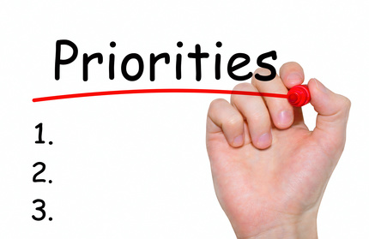
Priorities: Helps you organize fundraising Goals that have subgoals
If your Capital Campaign is raising money for a new library, you may have subgoals for the library goal, such as fundraising goals for books and computers.

Slide 11
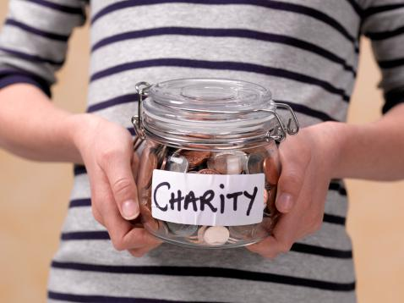
Fundraisers: individual People or Teams that are given the ‘Fundraising’ role in IC because they cultivate prospects
Jane, a fundraiser, cultivates prospects by researching them, forming long-term relationships with them, and creating and following a prospect plan.

Slide 12
Teams: A group of fundraisers that is tasked with raising money for a Capital campaign
Not every fundraiser in Kentucky will be working on the KTN Kroc Center Campaign, therefore a Kroc Center Campaign team will be created in IC

Slide 13
Major Giving: Opportunities and Planned Gifts
Opportunities: A gift a prospect promises to give while they are alive.
Planned Gift: A gift a prospect promises to give when they pass.

Slide 14
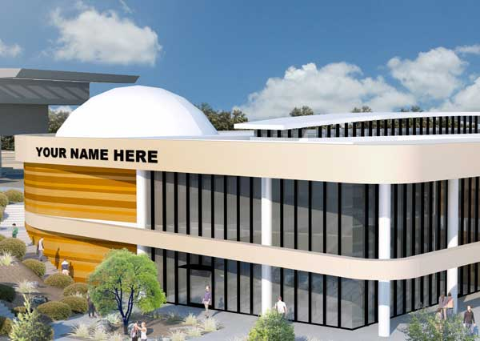
Naming Opportunities: Incentives for donors to give in order to receive public recognition
If you donate $500,000, we will name the library after you.

Slide 15
Snapshots: Static reports that you can access from your Capital Campaign Page
If you run a report on how well you’re progressing towards your fundraising goal for the library, you can take a snapshot of it so that the team who accesses the Campaign can view it as well.

Slide 16
Preparing for a Capital Campaign Video

Slide 17
Questions?

Slide 18
4 Mistakes people make with Capital Campaigns

Slide 19
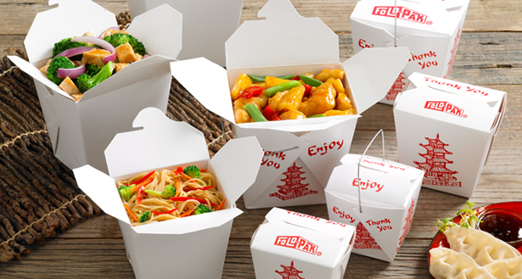
Training Take-Aways
What will you take away from this training to help you manage a successful Capital Campaign?

