Slide 1


Emerging Issues in the Western Delta, a Delta Conservancy Perspective
campbell.ingram@deltaconservancy.ca.gov

Slide 2
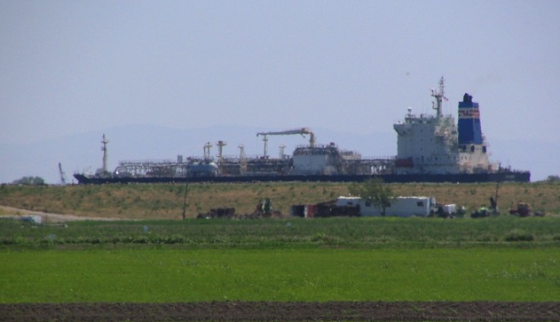
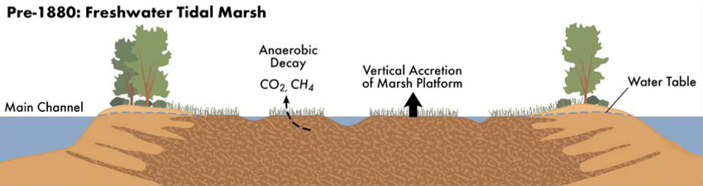
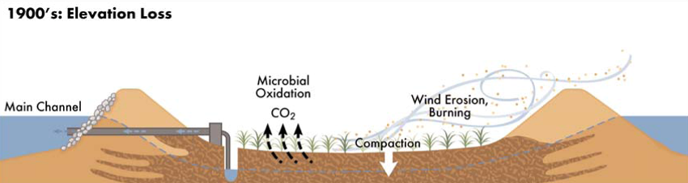
Subsidence Process

Slide 3
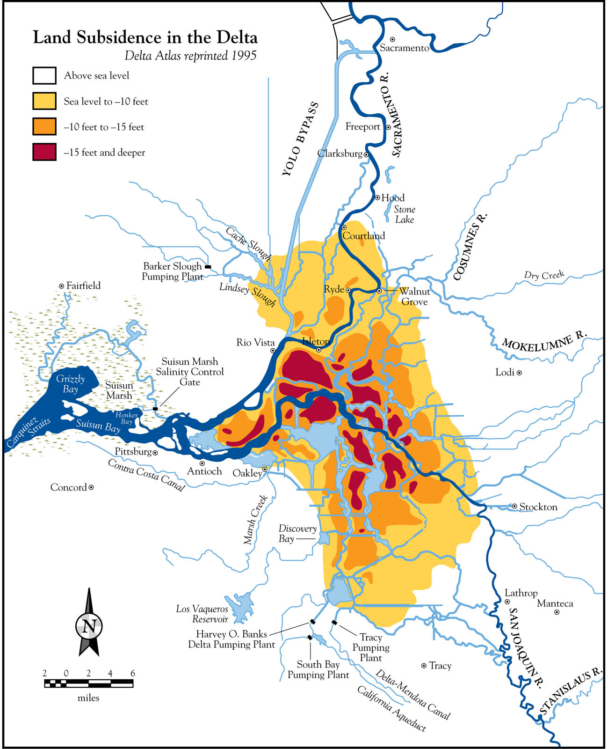
Subsidence and Risks
Subsidence continues at rates ranging from about 0.5 to 1.5 inches per year
Sea levels are rising at a rate of about 0.3 inch per year

Slide 4
Carbon Emissions Quantified
Average of 15 metric tons of CO2 per acre per year
~2,000,000 metric tons of CO2 per year, Delta total
~500,000 vehicle equivalent
Just over 1/4 of CA’s total plant based agriculture carbon emissions

Slide 5
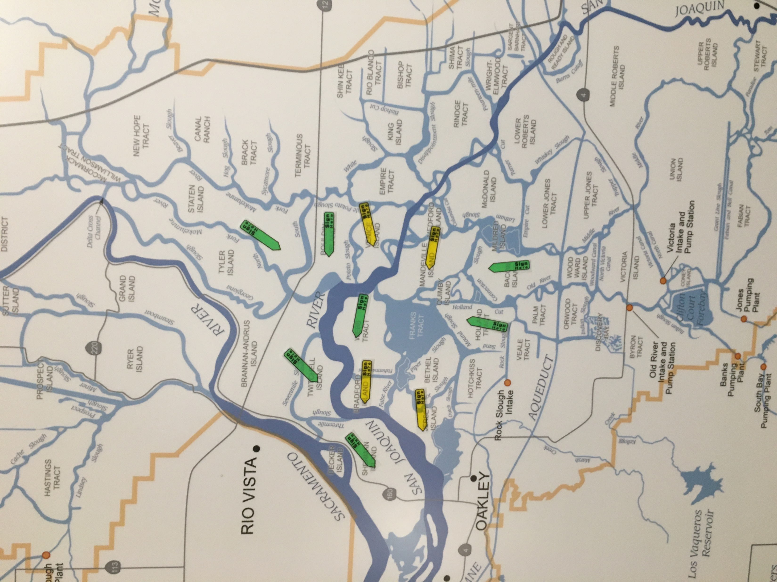
Delta Realities
Possibly the last land owners

Slide 6
Delta Public Lands
Strategy
Planning Process and participation
Key strategies and outcomes
What we learned

Slide 7
Subsidence and Emissions Reductions
ACR Methodology approved in April 2017 – Re-saturate the land through rice cultivation or managed wetlands
Working with public and private land owners to develop pilot projects
Working with carbon financiers and investors to market resulting carbon credits
Seeking funds to support project construction
Ongoing discussions with ARB for eventual inclusion in the compliance program

Slide 8
Market Potential
Estimated Annual Income per Acre | Voluntary | Compliance Base Case | Compliance High Case
Offsets generated Held in buffer account Offsets for sale | 15 (4) 11 | 15 (4) 11 | 15 (4) 11
Sale price ($/offset) | $7.00 | $19.00 | $30.00
Gross revenue per acre Verification & registration costs Net revenue per acre | $77 -$18 $59 | $209 -$26 $183 | $330 -$26 $304

Slide 9
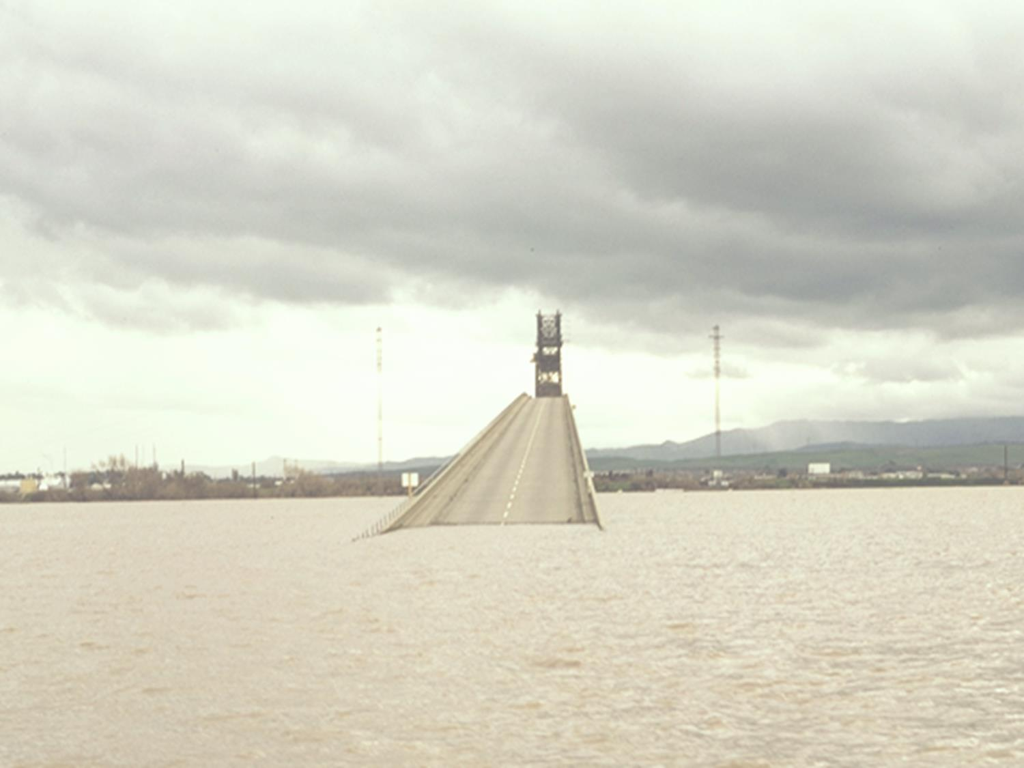
Questions?

