Slide 1
PowerVille™
Real-Time Communications Application Suite
Elhum Vahdat
Notes:
My name is Elhum Vahdat and I am the Vice President of Applications Marketing at Dialogic.

Slide 2
PowerArchitecture - PowerVille
PowerArchitecture
3 ways to application deployment
Application deployment options
Customer develops app using Dialogic® Enabling Elements
Dialogic® Application Practice creates the application for the customer
White Labeled App Library available from Dialogic®
Real-Time Communications SIP / RTP / HTTP Load Balancer (if required)
Media Server
Dialogic® PowerNova™ SCE
3rd party app servers
Signaling
Dialogic® PowerVille™ Applications
Dialogic® PowerNova™ AS
Boards
3rd Party Management and Orchestration (MANO)
Virtualization Layer
Hardware Resources
Optional NFV
Notes:
There are three ways to application deployment. I will be discussing five best practices for the third way, which is white-label applications or service-ready applications. These applications are typically 80 to 90% complete, with the remaining 10 to 20% being customization, integration, and tuning, which could include customer-specific database integration, prompt recordings, private-labeling, and call flow customizations. Lets jump right into the best practices, starting with number 5.

Slide 3
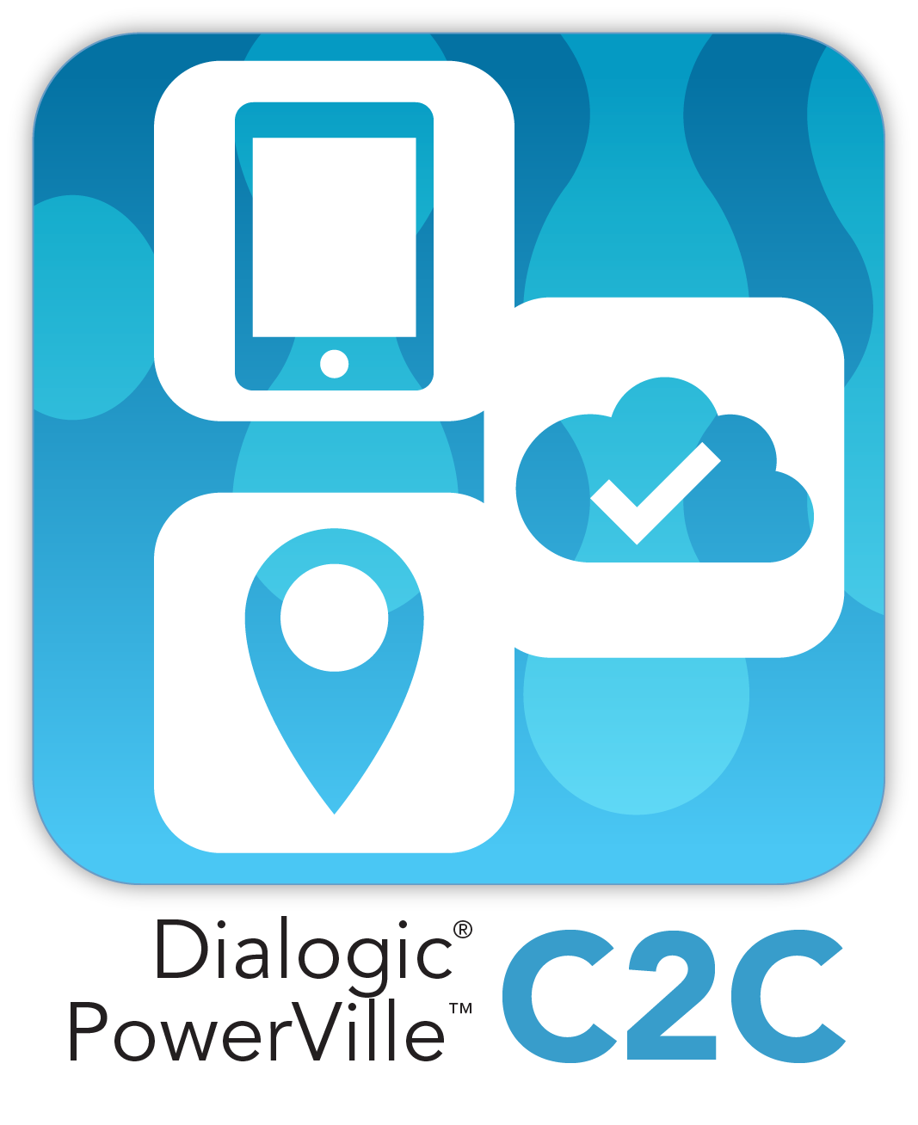
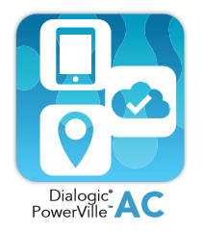
PowerVille Applications
Ready for Revenue
Notes:
To Focus:
Web Collaboration Apps
Similar to Skype, Viber, Lync, etc.
Many SPs want their “own” OTT App
Likely Based on WebRTC
Valued-Added Services (VAS): Conversion of a Current App to a Modern App
Voice Messaging / Voice Mail to Voice/Video Messaging / Mail
Voice Conference to Voice/Video Conference
Cloud Enabling of Current Deployed Apps
New Greenfield Opportunities
IoT
Mobile Self-Care
C5 for use with our Switch
NOT To Focus:
Contact Center
We have many good customers here
This is very specialized
Fax
We have many good customers here
This is very specialized
Today, Dialogic has a community of PowerVille ready-to-deploy software applications covering a spectrum of solutions for both enterprise and service provider deployments. Based on proven platforms, these service-ready applications can minimize time-to-market, cut time-consuming development, reduce maintenance expenses, and improve time-to-revenue. Create a unique offering by applying your own branding and customization, the applications include Enterprises Services Suite, Cloud Centrex, Auto Attendant, audio conferencing, video conferencing, visual IVR, WebRTC Click-to-Call, and Call Interceptor. These white-label applications are ready to private label, have been widely deployed, are field proven, and are built on dependable Dialogic enabling technologies which reduce vendor management.
With that, I will pass it back to Alan.

Slide 4
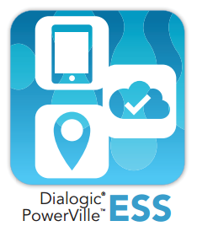
PowerVille ESS – Enterprise Services Suite
Suite of cloud-based services targeting the relatively untapped, micro, small, and medium enterprise markets, including nearly 100 million such enterprises in emerging markets. PowerVille ESS offers MNOs monetization opportunities by capturing new and emerging enterprise business.
Features
Multi-Tenant Solution
Diameter Charging
Tenant Reporting/Usage Stats
Stand-Alone or Bundled
Self-Service Web Portal
MNO Reports and CDRs
Notes:
A suite of cloud-based services targeting the lucrative, yet relatively untapped, micro, small, and medium enterprise markets, including nearly 100 million such enterprises in emerging markets. PowerVille ESS offers Mobile Network Operators (MNOs) around the world monetization opportunities, as it enables them to capture new and emerging enterprise business. Features and benefits of PowerVille ESS include:
Multi-tenant solution which maximizes revenue by hosting multiple services on a single platform with high-availability options for maximizing up-time.
Diameter charging interface – enables centralized access control and billing options.
Tenant reporting & usage statistics - facilitates billing and performance monitoring.
Stand-alone or bundled solution suites - allows customized bundles of services to meet customer needs and future up-sell options.
Self-service web portals - reduces management costs and empowers user.
MNO reports & CDRs - facilitates integration into existing billing systems.

Slide 5
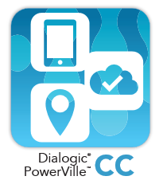
PowerVille CC – Cloud Centrex
A carrier-class solution hosted in a cloud environment, enabling network operators to offer hosted PBX and SIP trunking services to their business customers while also offering basic and advanced Class 5 services to their residential customers.
Features
Self-Care Web Mgmt. Portal
SIP Application Server
Highly Scalable Design
Support for ATAs and ONTs
Telecom Application Server
Enterprise/Residential
SIP Trunking & Hosted PBX
Notes:
A carrier-class solution hosted in a cloud environment, enabling network operators to offer hosted PBX and SIP trunking services to their business customers while also offering basic and advanced Class 5 services to their residential customers. Features and benefits include:
With the self-care web management portal, subscribers are empowered to configure their own services on their own times, further lowering overall costs.
The flexible SIP application server is designed for mobile, fixed, IPTV, and broadband network operators.
Cloud Centrex’s highly scalable design supports 100 to 100,000+ concurrent calls and up to five million subscribers.
Full support of ATAs & ONTs facilitates CPE for legacy equipment or use cases.
The carrier-class Telecom Application Server (TAS) enables centralized configuration, remote access, monitoring, reporting, SCE, and more.
Offering services to both enterprise and residential customers broadens reach and shortens return-on-investment (ROI).
Compatible with a wide range of carrier services such as SIP trunking and hosted PBX.

Slide 6
PowerVille HP – Hosted PBX – NOT IN PAGE 3
Carrier-class hosted PBX platform for enterprise and residential services that enhances the traditional telecom architecture by enabling a self-service component. User configuration and control via a web-based portal that enhances basic phone functionality.
Features
Multi-Tenant Solution
Self-Service Web Portal
Converged Services
Dialogic®
PowerVille™
HP
Highly Scalable
Centralized Configuration
Diameter Charging
Notes:
A carrier-class hosted PBX platform for both enterprise and residential services that enhances the traditional telecom architecture by enabling a self-service component. User configuration and control via a web-based portal that enhances basic phone functionality to make standard services like multi-device ringing, conference calling, call move, and call forwarding easier to manage and new services simpler to deploy. Features and benefits include:
Multi-tenant solution to improve revenue by hosting multiple services on a single platform with high-availability options for maximizing up-time.
Self-service web portals which reduce management costs by enabling subscribers to configure their own services.
Converged services environment for provisioning various services including Unified Messaging, Auto Attendant, ACS, and Audio/Video Conferencing.
Highly scalable design supports 100 to 100,000+ concurrent calls and up to five million subscribers.
Centralized configuration through the application server enables remote access, monitoring, reporting, SCE, and more.
Diameter charging interface for centralized access control and charging capabilities,

Slide 7
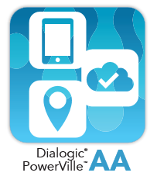
PowerVille AA – Network Auto Attendant
Simple to use and cost-effective to deploy, PowerVille AA has a carrier-class architecture and design, includes a user-friendly web portal, and supports IMS with integration to major Telecommunications Equipment Manufacturers (TEMs).
Features
Multi-Tenant Solution
Browser-Based Web Portal
IVR Script Mgmt. (per tenant)
Detailed Report & Usage Stats
Integration w/ other PV Apps
W
Notes:
Provides a network-based automated attendant that is of high-value, yet simple to use and cost-effective to deploy. With its carrier-class architecture and design, user-friendly web portal, and IMS support with integration to major telecommunications Equipment Manufacturers (TEMs), the Auto Attendant can host an almost unlimited number of tenants, to maximize return-on-investment (ROI). Its…
Multi-tenant solution allows multiple businesses to be served by a single instance of software.
Browser-based web portal is easy to manage both locally and remotely.
IVR script management (per tenant) allows basic IVR interactions for incoming callers, handling call routing based on caller responses.
Detailed Reports and Usage Statistics provides data on actual call traffic and usage, allowing streamlining of frequent interactions.
Integration with other Dialogic® PowerVille™ Applications simplifies integrating of complex application deployments with a common software base.

Slide 8
PowerVille AC – Audio Conferencing
Complete conferencing platform that seamlessly integrates with existing IP, TDM, Mobile, and converged networks. Robust enough to offer carrier-class conferencing services, yet simple enough to implement revenue–generating conferencing services quickly.
Features
Scalable
E-Mail and SMS Notification
In/Outbound Conferencing
Customizable CDRs
Diameter Interface - Charging
Web Provisioning & Mgmt.
W
Notes:
A complete conferencing platform that seamlessly integrates with existing IP, TDM, Mobile, and converged networks, delivering superior quality and eliminating the need for costly operator administration. Robust enough to offer carrier-class conferencing services, yet simple enough to implement revenue–generating conferencing services quickly. PowerVille AC is:
Scalable, supporting up to 800 participants per conference for large group conference calls.
Reminders and notifications through e-mail and SMS notifications improve attendance,
Inbound and Outbound Conferencing allows conference managers to reach out and pull in subject matter experts and remote participants.
Customizable Call Detail Records (CDRs) enables integration into existing billing systems.
Improve security and access control with Diameter interface and offer Charging Capabilities
Simplify management and control with web-based provisioning and management.

Slide 9
PowerVille VC – Video Conferencing
Complete HD audio/video conferencing platform, supporting VGA and 720p with H264, VP8 and VP9. Seamlessly integrates with mobile/3G/4G (LTE) and IP/IMS converged networks and supports WebRTC making video conferencing available to virtually anyone.
Features
Browser-Based
3G/4G (LTE) & SIP Networks
Voice Activated Switching
Continuous Presence
Lecture Mode
Scheduled/Permanent/Instant
Web Provisioning & Mgmt.
WebRTC Support
Notes:
PowerVille Video Conferencing is a complete wideband/HD audio and HD video conferencing platform that seamlessly integrates with existing mobile/3G/4G (LTE) and IP/IMS converged networks, and is device-agnostic for maximizing market penetration. Supporting VGA, and 720p with H.264, VP8 and VP9 incorporating the power of WebRTC, making video conferencing available to virtually anyone using a website, addressing the "any device" challenge. Features and benefits include
Eliminate the need for telephone dial-in numbers, expensive phone lines and hard-to-remember DTMF conference commands with browser-based conferencing.
Offer broad network compatibility by supporting 3G/4G (LTE) and SIP networks.
With voice activated switching and continuous presence, common conferencing annoyances are eliminated, allowing the active speaker to be heard and avoiding clipped sentences.
Improve the one-to-many experience with lecture mode, well suited to educational presentations.
Flexible scheduling tools, such as scheduled, permanent, and instant Conferences, allow pre-planned and ad-hoc conferences.
Accelerate installation and management from either local or remote locations with web-based provisioning and management
The the support for WebRTC facilitates conferencing from a wide range of devices and locations.

Slide 10
PowerVille VIVR – Visual IVR
Extends the capabilities of voice-only IVRs by transforming them into collaborative web-based voice and visuals mobile applications for smartphones. Sharing visual content during a voice call offers a mobile experience that conveniently and effortlessly engages the caller both visually and audibly.
Features
Information Rich Input
Secure Communications
Seamless Upgrade
Web-Based Visual Content
Omni-Channel Experience
Menu-Driven Interface

Slide 11
PowerVille C2C – Click-to-Call (WebRTC)
Enable immediate connection via voice, video, chat, or social media to an agent or automated system in real time. Increase conversion rates, average orders, and sales by enhancing the user experience through reduced on-hold times and intelligent routing of calls based on contextual awareness.
Features
Contextual Awareness
Flexibility
Continuous Communications
Dialogic®
PowerVille™
C2C
Omni-Channel
Reduce Toll-Free Costs
Notes:
Simple and effective, WebRTC Click-to-Call is a communication tool that enables an immediate connection via voice, video, chat, or social media to a live agent or automated system in real time. Click-to-Call increases conversion rates, average orders, and sales by enhancing the user experience through reduced on-hold times and intelligently routing calls based on contextual awareness. WebRTC Click-to-Call has many features and benefits, including:
The live agent knows exactly what page the customer clicked-to-call from to more efficiently handle the call through contextual awareness.
The flexibility to include a click-to-call button in e-mails, blogs, signature blocks, and other internet-based objects
Enabling continuous communications by keeping the caller on the web page and at the same time starting a conversation with them
Offering an omni-channel experience with the option to call from their desktop, laptop, tablet and smartphone
Reducing toll-free costs as calls are free (no extra cost) since click-to-call uses existing internet connections.
Of course, let’s not forget all the benefits that WebRTC brings, such as no more downloading of applications and plug-ins, and no more registering.

Slide 12
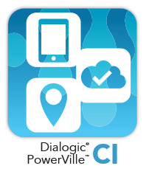
PowerVille CI – Call Interceptor
An intelligent solution for Network Operators to reach their intended subscribers with urgent messages in real-time. Used for a variety of applications, including collections, promotions, up-selling, and SIP voice mail notifications and announcements.
Features
Message Delivery
Real-Time Delivery
Advanced Business Rules
Personalized Messages
Message Delivery Repetition
After Delivery Options
Notes:
An intelligent solution that enables Network Operators to reach their intended subscribers with urgent messages in real-time. Used for a variety of applications (including collections, promotions, up-selling, and SIP voice mail notifications and announcements), when the subscriber makes an outbound call, the call is routed to PowerVille CI, which will play a message for the type of subscriber selected based on business rules. Features and benefits include:
Message Delivery - Messages heard by 100% of intended subscribers.
Real-time delivery - Urgent messages are heard when you want them to be heard, in real-time.
Advanced business rules - Set business rules based on subscriber’s available data which you already have.
Personalized messages - Assign the messages to be played based on pre-defined business rules.
Message delivery repetition - Control how often to play a message once a call has been intercepted.
After delivery options - Decide call completion options: continue call, transfer to IVR, transfer to live agent

Slide 13
PowerVille OT – Outbound Telemarketing – NOT IN PAGE 3
Facilitates proactive outbound notification and IVR, supporting multiple delivery methods (voice, text/SMS, e-mail, video), to multiple devices, with interactive communications enabling recipients to respond right away over the same device.
Features
Black & White Lists
Seamless Transfer to Agent
Sub-Campaigns
Dialogic®
PowerVille™
OT
Answer Device Detection
Customizable Reports/CDRs
Diameter Integration
Notes:
Facilitates automatic outbound notification and IVR, supporting multiple delivery methods, including voice, text/SMS, e-mail and video, to multiple devices, for immediate receipt of messages. The PowerVille OT offers interactive communications enabling message recipients to respond right away over the same device if needed, enabling customers to take instantaneous action. Key features and benefits include:
Black lists and white lists to aid in Aids in managing recipient lists and facilitating “do not call” compliance.
Seamless transfer to live agents to improve customer satisfaction with single-call resolution.
Sub-campaigns within primary campaigns enable complex multi-tier campaigns for surveys and other structured interactions.
Answer device detection configuration allows custom messages to be left on voicemail or answering machines.
Customizable reports and call detail records facilitate performance analysis and integration into billing systems.
Diameter integration improves security and access control and off charging capabilities.

Slide 14
Thank You

