Slide 1
LOTO and Truck Dock Energy Control Options

Slide 2
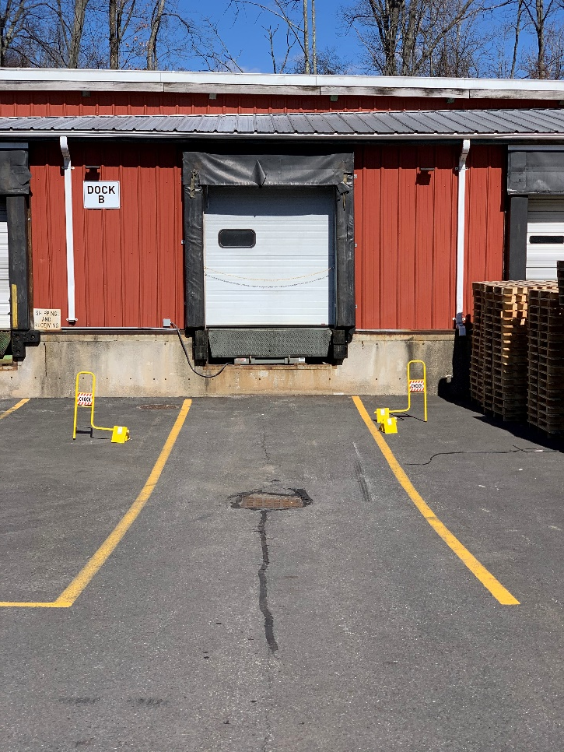
What is the purpose of this training?
To ensure the safety of employees by preventing injury as the result of unexpected movement by trucks and trailers.
As a reminder, all trucks must be turned off to prevent diesel fumes from entering buildings.
There are 2 acceptable methods of controlling movement by trucks and trailers.

Slide 3
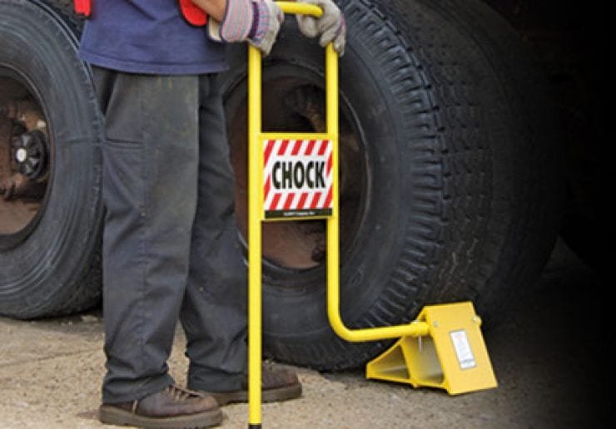
Wheel Chocks
All vehicles prior to using any control method must have their rear wheels chocked.
At least 1 wheel chock must be placed firmly and squarely against the center of a trailer’s tire.
*Pictured is the chock required by all sites to conform with our Truck Dock Safety Standard

Slide 4
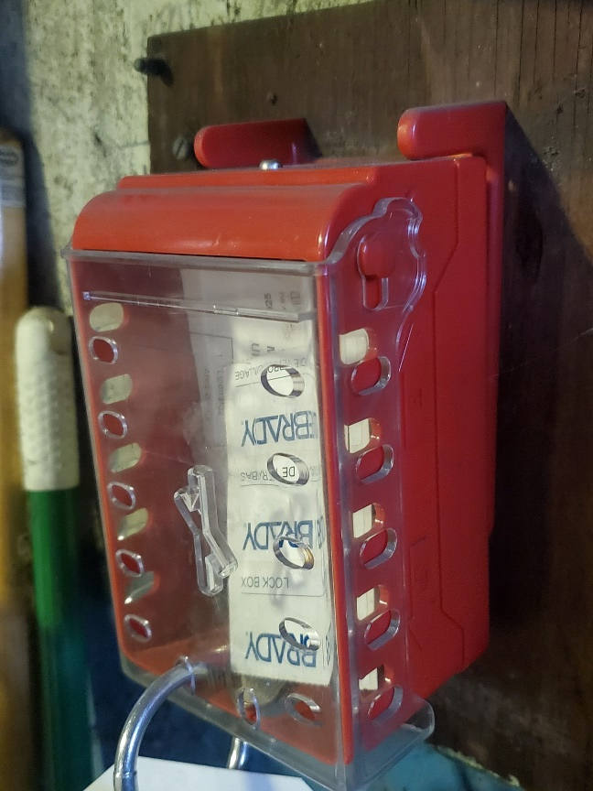
LOTO & Truck Dock Safety
After the truck is backed into the dock, the driver will place the ignition keys into the lock box.
Any employee who must enter the truck, flatbed, or trailer by any means (fork truck or foot) will place their personal lock and ID tag on the lock box.
Upon completion of the loading or unloading process, the employee(s) will remove their lock and return the keys to the truck driver.

Slide 5
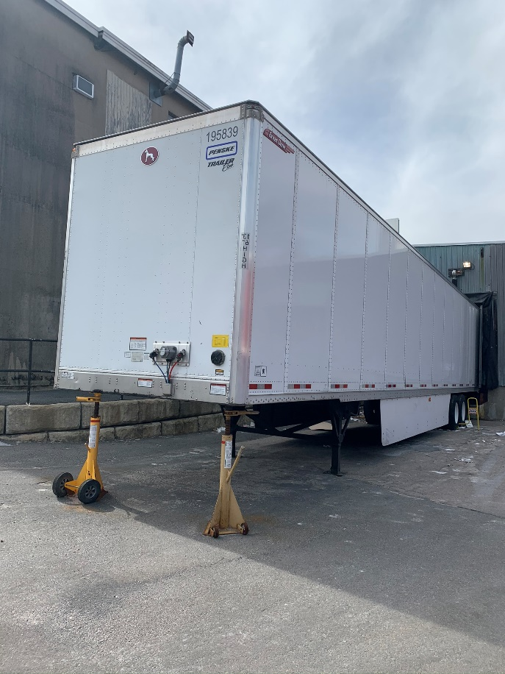
Alternative to Ignition Keys Secured in Lock Box
If a driver is unwilling or unable to relinquish ignition keys, disconnecting tractor from trailer is an acceptable alternative.
After the truck is backed into the dock and wheel chocks are in place, the driver will disconnect the truck from the trailer.
The driver will move the truck at least 25 feet away, and turn off the ignition.
After the employee has placed a jack stand under the trailer, loading can commence.
When the employee has completed loading/unloading the jack stands will be removed. The employee will then verbally communicate to the driver that it is safe to reconnect the trailer.

Slide 6
Dropped Storage Trailers
Dropped storage will all be chocked with jack stands placed below the nose of the trailer.
If the dock is equipped with a red light/green light interlock safety chain system:
When loading/unloading a trailer, the safety chain interlock will be disconnected which will be indicated by a red light at the dock.
After the trailer is loaded/unloaded, the safety chain interlock will be reconnected. This will change the light to green indicating that it is safe to move the trailer.
If there is no red light/green light interlock safety chain system the driver should verify with employees inside the facility prior to removing trailer.

