Slide 1
Heavy and Tractor-Trailer Truck Driver
Career Cluster:
Transportation

Slide 2
What a truck driver does.
They drive long distances.They follow all traffic laws and keep their trucks clean.

Slide 3
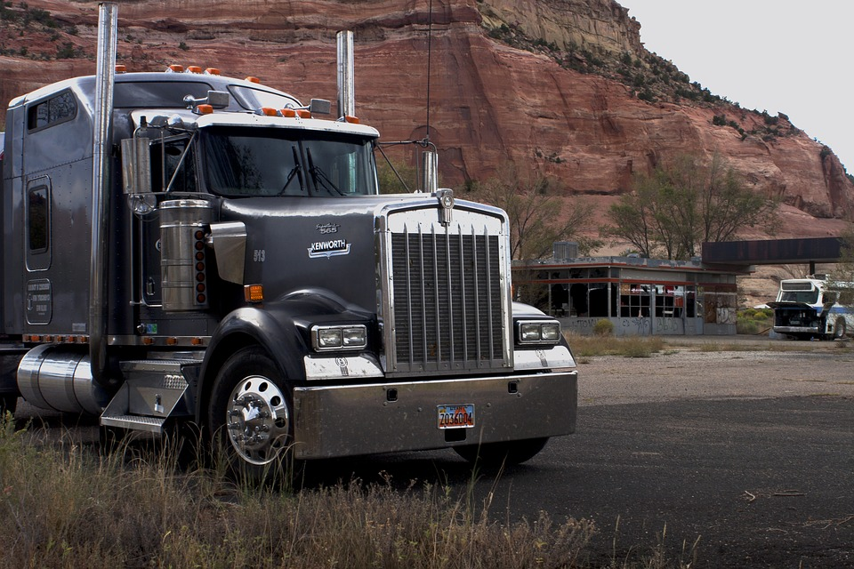
What training does a truck driver need.
They need a high school diploma
They need to attend a professional truck driving school.

Slide 4
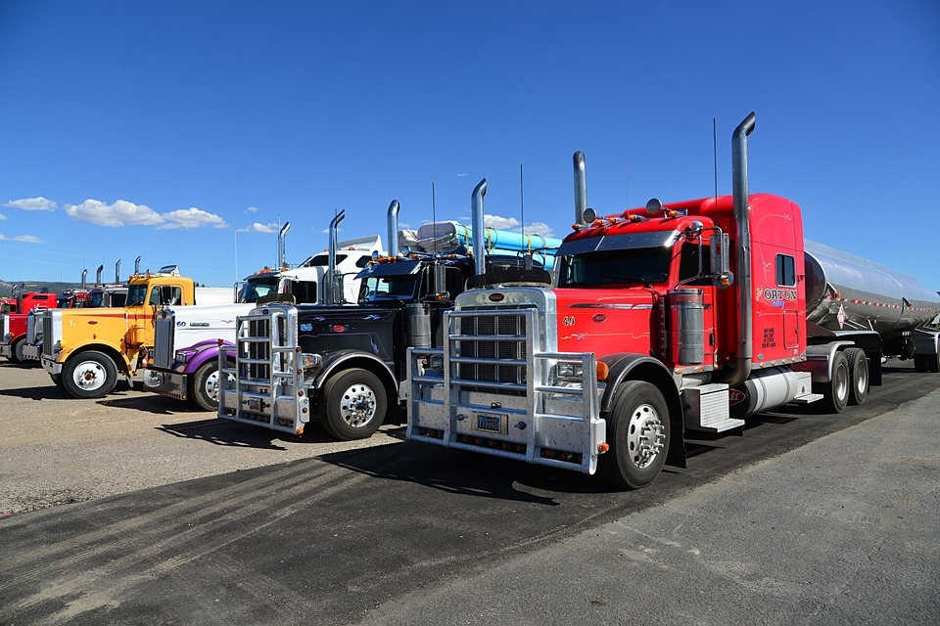
How much can a truck driver make?
They can make $19.87 per hour. The average per year is $41,340.

Slide 5
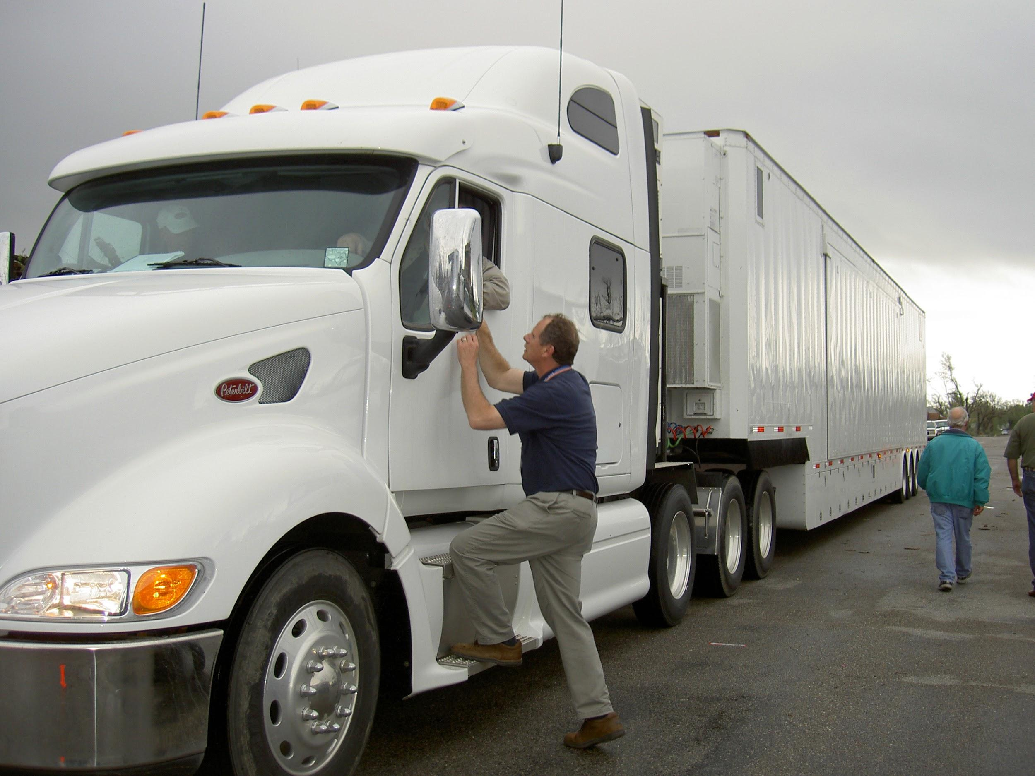
The outlook
In ten years the number of truck drivers needed will rise by 6%.
In the next ten years 113,800 more will be needed.

