Slide 1
Resilience Among Older Adults
Kristin Margaret Whitehill, MSW
Dallas Area Gerentological Society 2012

Slide 2
My Experience
Discovered I wanted to help people.
Master’s
Pofessional Experience
  Case management
  Community work/ Community Education
  Hospice
PhD

Slide 3
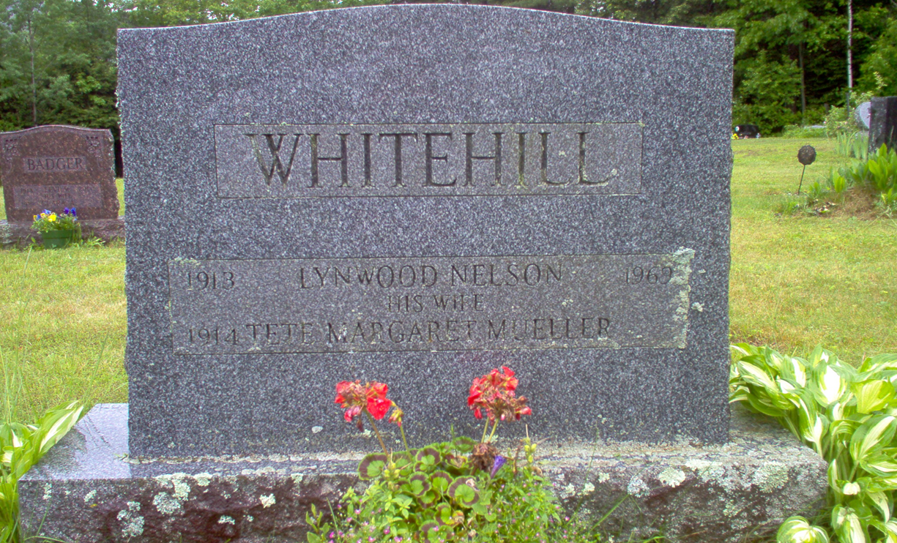
My Motivation

Slide 4
What is Resilience??
Resilience refers to positive outcomes in the face of adversity.
It is a dynamic multilevel process
Three Central Constructs
Risk Factors | Vulnerability Factors | Protective Factors
Events of adversity or conditions of vulnerability. Ex. Poverty, parents with psychiatric disorders, chronic exposure to community violence | Characteristics (both environmental and psychological) that result in greater maladjustment among individuals when faced with adversity. Ex. Mental disorders, lack of positive relationship with adult | Characteristics (both environmental and psychological) possessed by individuals that aide in preventing maladjustment when faced with adversity. Ex. Self- efficacy, self- esteem, social support

Slide 5
My Research
Contribute to the knowledge base in terms of resilience and older adults.
  Determine protective factors
  Develop assessment tool
  Use established measures
  Biological factors
  Develop and test interventions
  Develop multidimensional model

Slide 6
Qualitative Meta-Synthesis
Methodological process used to aggregate and synthesize qualitative studies.
Useful in increasing understanding and furthering theory development.
QMS is the foundation for my dissertation research.
Findings generated nine factors that connote resilience among older adults.

Slide 7
QMS Factors
1. External connections
2. Grit
3. Independence
4. Altruism
5. Self-Care
6. Self-Acceptance
7. Meaningfulness
8. Positive Perspective on
Life
9. Previous Experience
  with Hardship

Slide 8
Next Step
Develop questions to assess each one of the factors derived from the QMS.
Test reliability and validity of scale.
Find a large sample to complete validation.
Identify and utilize additional clinical assessment tools to administer with RS.
Include biological factors

Slide 9
Biological Factors
Cortisol levels and resilience
  Measured through saliva
  Response to stress
Determine if polymorphism in genes serve as a protective function
  Gene encoding enzyme monoamine oxidase A (MAOA)
    Polymorphism in the MAOA gene has been linked to antisocial behavior.
  Serotonin transporter gene (5-HTTLPR)
    Modulated interaction between life and depression
    Allele length

Slide 10
Why
Uncharted territory for social work.
Link between biological and psychological factors.
Assessment tool for older adults
Interventions

Slide 11
Questions??

