Slide 1
Important Considerations for Mathematics Intervention
Sarah R. Powell, Ph.D.
Lincoln, Nebraska
May 12, 2018

Slide 2
Contact Information
Sarah R. Powell
Assistant Professor
The University of Texas at Austin
srpowell@austin.utexas.edu
@sarahpowellphd
Copyright 2018 Sarah R. Powell, Ph.D.

Slide 3
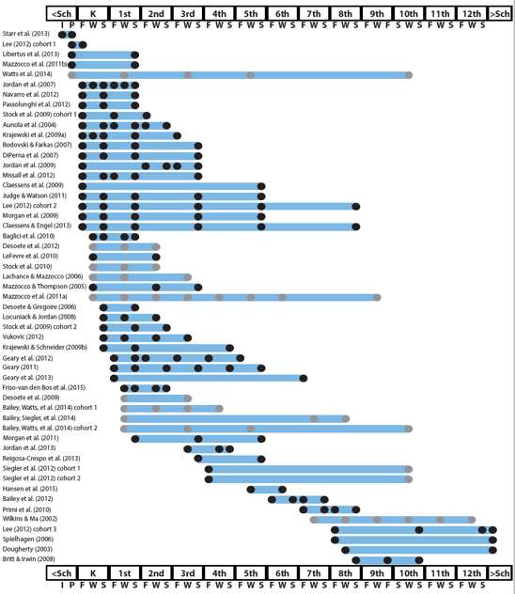
http://www.greatertexasfoundation.org/trajectories-of-mathematics-performance/

Slide 4
Broad math in preK predicted K broad math
Mathematics in preschool predicts later mathematics
http://www.greatertexasfoundation.org/trajectories-of-mathematics-performance/
Broad math in preK predicted grade 10 broad math

Slide 5
Counting in K predicted grade 1 broad math
Mathematics in kindergarten predicts later mathematics
http://www.greatertexasfoundation.org/trajectories-of-mathematics-performance/
Broad math in K predicted grade 8 broad math
K math accurately predicted math performance below 10th percentile in grades 2 and 3 with 84% correct classification

Slide 6
Mathematics in elementary school
predicts later mathematics
Addition influenced arithmetic with increasing importance from grades 1 to 5
http://www.greatertexasfoundation.org/trajectories-of-mathematics-performance/
Grade 1 arithmetic predicted arithmetic at grades 2, 3, and 4
Grade 1 broad math predicted broad math at grades 3, 5, and 10

Slide 7
Mathematics in middle school
predicts later mathematics
Counting and comparison in grades 2 or 4 predicted broad math 1 year later
http://www.greatertexasfoundation.org/trajectories-of-mathematics-performance/
Fractions at 10-12 years old predicted broad math 5 years later
Broad math in grade 7 predicted broad math in grade 8

Slide 8
Broad math in grade 8 predicted completion of 4-year college degree
Mathematics in
high school
predicts later outcomes
http://www.greatertexasfoundation.org/trajectories-of-mathematics-performance/
Students who took algebra in grades 8 took more advanced math courses and enrolled in 4-year colleges more often than students who took algebra in grade 9
Numeracy measured in adolescence impacted hourly earnings 7 to 15 years later

Slide 9
Mathematics in preschool predicts later mathematics
Mathematics in kindergarten predicts later mathematics
http://www.greatertexasfoundation.org/trajectories-of-mathematics-performance/
Mathematics in elementary school
predicts later mathematics
Mathematics in middle school
predicts later mathematics
Mathematics in
high school
predicts later outcomes

Slide 10
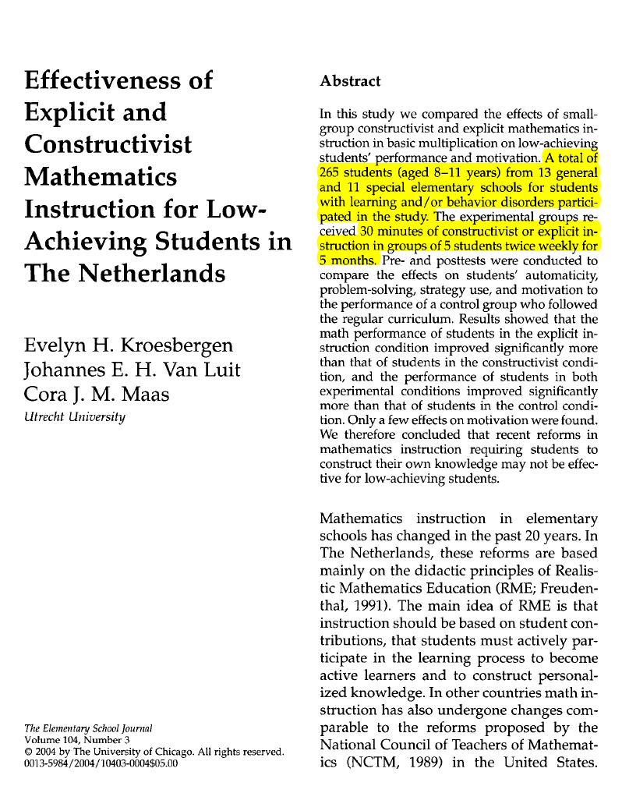
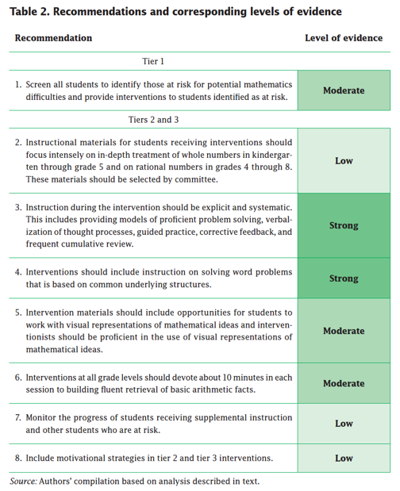
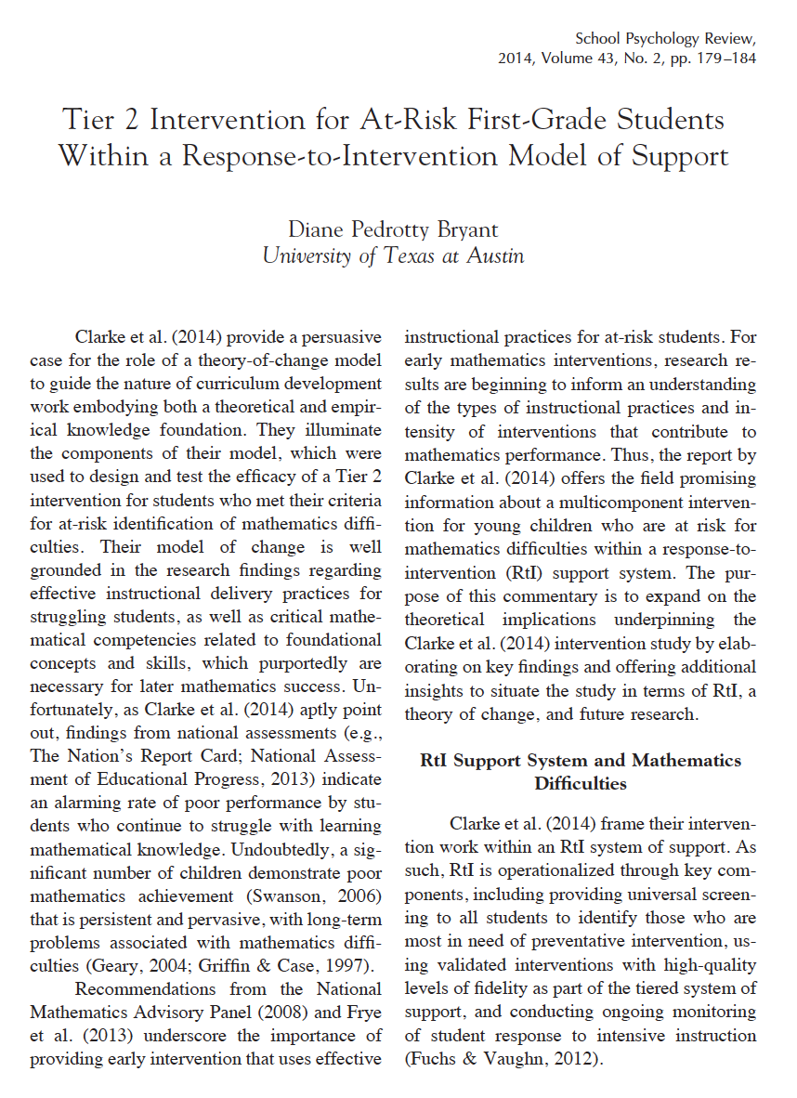
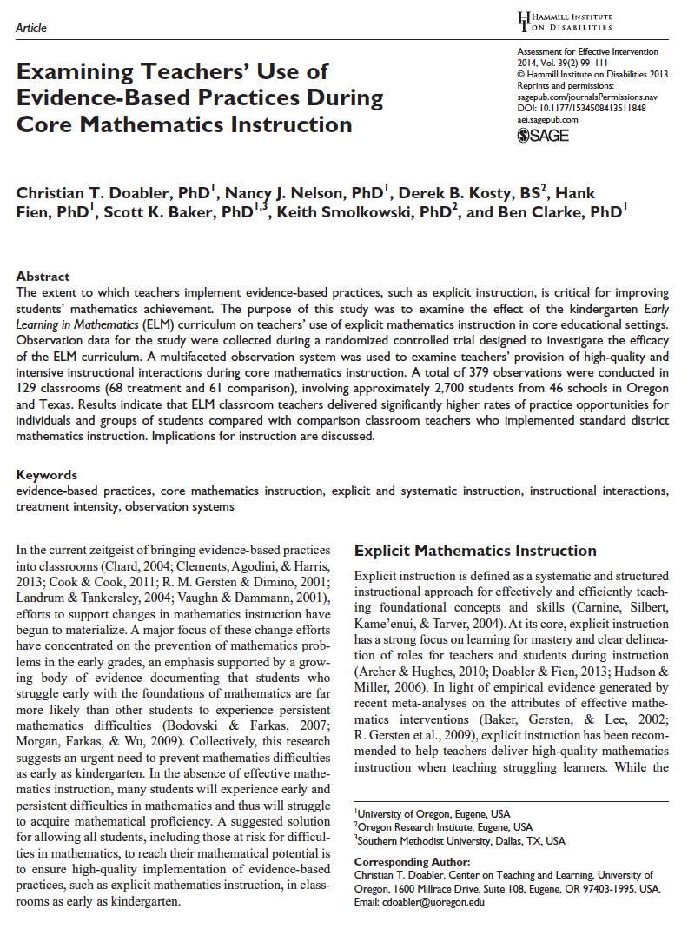
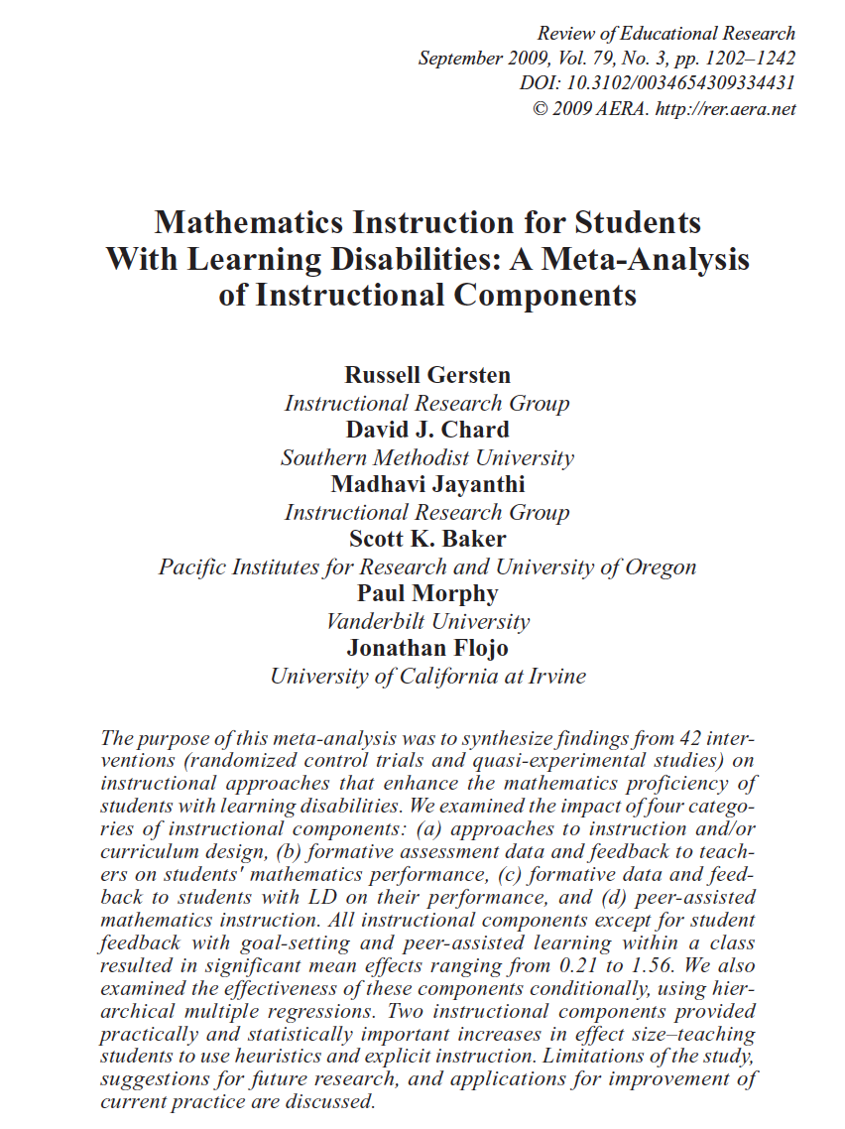
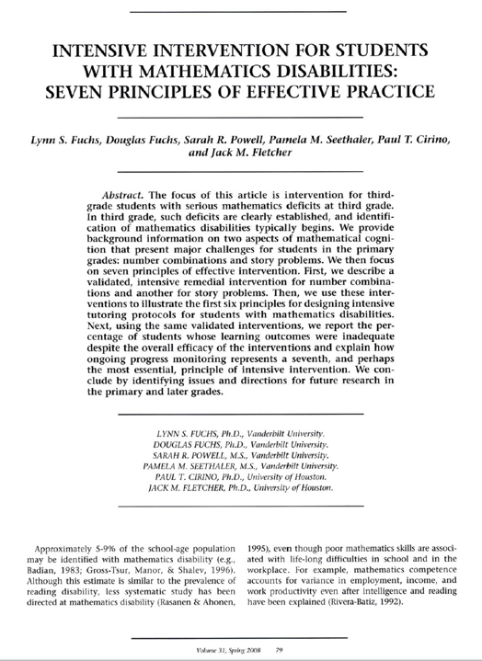
Explicit instruction
Multiple representations
Concise language
Fluency building
Problem solving instruction
Motivation component
Gersten et al. (2009)

Slide 11
Explicit instruction

Slide 12
Explicit Instruction
Modeling
Practice
Clear Explanation
Guided
Practice
Planned
Examples
Independent Practice
Supporting Practices
Asking the right questions
Eliciting frequent responses
Providing immediate specific feedback
Maintaining a brisk pace

Slide 13
Goal and importance
“Today, we are learning about division. This is important because sometimes you have to share objects or things with your friends.”
Modeling
Practice
Clear Explanation
Guided
Practice
We Do
Planned
Examples
Independent Practice
“Let’s continue working with our three-dimensional shapes and volume. Understanding volume and calculating volume helps with measuring capacity.”
You Do
Supporting Practices
Asking the right questions
Eliciting frequent responses
Providing immediate specific feedback
Maintaining a brisk pace

Slide 14
Goal and importance
Model steps
Modeling
Practice
Clear Explanation
Guided
Practice
“To solve 26 plus 79, I first decide about the operation. Do I add, subtract, multiply, or divide?”
We Do
Planned
Examples
Independent Practice
“The plus sign tells me to add. So, I’ll add 26 plus 79. I’ll use the partial sums strategy. First, I add 20 plus 70. What’s 20 plus 70?”
You Do
Supporting Practices
“The sum of 20 plus 70 is 90. I write 90 right here.”
Asking the right questions
Eliciting frequent responses
Providing immediate specific feedback
Maintaining a brisk pace
“Then I add 6 plus 7. What’s 6 plus 7?”
“The sum of 6 plus 7 is 13. So, I write 13 here.”
“Finally, we add the partial sums: 90 and 13. 90 plus 13 is 103. So, 26 plus 79 equals 103.”

Slide 15
Goal and importance
Model steps
Modeling
Practice
Clear Explanation
Concise language
Guided
Practice
We Do
Planned
Examples
Independent Practice
“To solve 26 plus 79, I first decide about the operation. Do I add, subtract, multiply, or divide?”
You Do
“The plus sign tells me to add. So, I’ll add 26 plus 79. I’ll use the partial sums strategy. First, I add 20 plus 70. What’s 20 plus 70?”
Supporting Practices
Asking the right questions
Eliciting frequent responses
Providing immediate specific feedback
Maintaining a brisk pace
“The sum of 20 plus 70 is 90. I write 90 right here.”
“Then I add 6 plus 7. What’s 6 plus 7?”
“The sum of 6 plus 7 is 13. So, I write 13 here.”
“Finally, we add the partial sums: 90 and 13. 90 plus 13 is 103. So, 26 plus 79 equals 103.”

Slide 16
Examples
“Today, we are learning about division. This is important because sometimes you have to share objects or things with your friends.”
Modeling
Practice
Clear Explanation
Guided
Practice
24 / 6
We Do
35 $)$ 5
28 $÷$ 7
Planned
Examples
Independent Practice
You Do
Supporting Practices
Asking the right questions
Eliciting frequent responses
Providing immediate specific feedback
Maintaining a brisk pace

Slide 17
Examples
“Today, we are learning about division. This is important because sometimes you have to share objects or things with your friends.”
Modeling
Practice
Clear Explanation
Guided
Practice
24 / 6
We Do
35 $)$ 5
28 $÷$ 7
Planned
Examples
Independent Practice
You Do
Non-examples
Supporting Practices
Asking the right questions
Eliciting frequent responses
Providing immediate specific feedback
Maintaining a brisk pace
32 $÷$ 8
42 $÷$ 7
25 $−$ 5

Slide 18
Explicit Instruction
Modeling
Practice
Clear Explanation
Guided
Practice
Planned
Examples
Independent Practice
Supporting Practices
Asking the right questions
Eliciting frequent responses
Providing immediate specific feedback
Maintaining a brisk pace

Slide 19
I Do
Modeling
Practice
Clear Explanation
Guided
Practice
Planned
Examples
Independent Practice
Supporting Practices
Asking the right questions
Eliciting frequent responses
Providing immediate specific feedback
Maintaining a brisk pace

Slide 20
Teacher and student practice together
I Do
Modeling
Practice
Clear Explanation
Guided
Practice
Planned
Examples
Independent Practice
Supporting Practices
Asking the right questions
Eliciting frequent responses
Providing immediate specific feedback
Maintaining a brisk pace

Slide 21
Teacher and student practice together
I Do
Student practices with teacher support
Modeling
Practice
Clear Explanation
Guided
Practice
Planned
Examples
Independent Practice
Supporting Practices
Asking the right questions
Eliciting frequent responses
Providing immediate specific feedback
Maintaining a brisk pace

Slide 22
Explicit Instruction
Modeling
Practice
Clear Explanation
Guided
Practice
Planned
Examples
Independent Practice
Supporting Practices
Asking the right questions
Eliciting frequent responses
Providing immediate specific feedback
Maintaining a brisk pace

Slide 23
I Do
Modeling
Practice
Clear Explanation
Guided
Practice
We Do
Planned
Examples
Independent Practice
You Do
Supporting Practices
Asking the right questions
Eliciting frequent responses
Providing immediate specific feedback
Maintaining a brisk pace

Slide 24
I Do
Modeling
Practice
Clear Explanation
Guided
Practice
Low-level and high-level
We Do
Planned
Examples
Independent Practice
You Do
“What is 7 times 9?”
“Which shape has 6 sides?”
Supporting Practices
“What do you do when you see a word problem?”
Asking the right questions
Eliciting frequent responses
Providing immediate specific feedback
Maintaining a brisk pace
“Why do you have to regroup?”
“How would you solve this problem?”
“Why do you have to use zero pairs?”

Slide 25
I Do
Modeling
Practice
Clear Explanation
Guided
Practice
Low-level and high-level
We Do
Planned
Examples
Independent Practice
You Do
Classwide, individual, partner, write on paper, write on whiteboard, thumbs up, etc.
Supporting Practices
Asking the right questions
Eliciting frequent responses
Providing immediate specific feedback
Maintaining a brisk pace
“Turn and discuss the formula for perimeter with your partner.”
“Write the multiplication problem on your whiteboard.”
“In your math journal, draw a picture to help you remember to term parallelogram.”

Slide 26
I Do
Modeling
Practice
Clear Explanation
Guided
Practice
Low-level and high-level
We Do
Planned
Examples
Independent Practice
You Do
Classwide, individual, partner, write on paper, write on whiteboard, thumbs up, etc.
Supporting Practices
Asking the right questions
Eliciting frequent responses
Providing immediate specific feedback
Maintaining a brisk pace
Affirmative and corrective
“Good work using your word-problem attack strategy.”
“Let’s look at that again. Tell me how you added in the hundreds column.”

Slide 27
I Do
Modeling
Practice
Clear Explanation
Guided
Practice
Low-level and high-level
We Do
Planned
Examples
Independent Practice
You Do
Classwide, individual, partner, write on paper, write on whiteboard, thumbs up, etc.
Supporting Practices
Asking the right questions
Eliciting frequent responses
Providing immediate specific feedback
Maintaining a brisk pace
Affirmative and corrective
Planned and organized

Slide 28
Modeling
Practice
Supporting Practices
Introduction of material
Review of material
Modeling
Practice
Modeling
Practice
Supporting Practices
Supporting Practices

Slide 29
2
3
Explicit instruction
“Today, let’s think about fractions. Say the word fraction with me.”
”Look at this fraction. This fraction is two-thirds. What fraction?”
“A fraction like two-thirds is one number, just like 4 is one number and 13 is one number. What are other numbers that you know?”
“Two-thirds is one number because it has a specific value. The value of two-thirds is always the same, just like the value of 4 is always the same. Show me where 4 goes on a number line.”
“In the same way that 4 goes here (point) on a number line. Two-thirds goes here (point)…”

Slide 30
Multiple representations

Slide 31
Multiple Representations
Abstract
Representational
Concrete

Slide 32
Abstract
Representational
Concrete
Three-dimensional objects

Slide 33
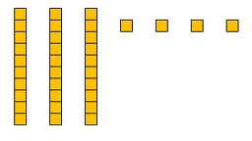
Abstract
Representational
Concrete
Two-dimensional images

Slide 34
Abstract
Representational
Concrete
Numerals and symbols
2 + 8 = 10
34 = 3 tens and 4 ones
x – 6 = 8
4,179
+ 569

Slide 35
2
3
Multiple representations

Slide 36
Concise language

Slide 37
Confusion with Mathematical Language
Homonyms
Homophones
left
square
mean
base
round
ate
eight
some
sum
pie
pi
rows
rose

Slide 38
Language of Mathematics
Technical terms
Subtechnical terms
Symbolic terms
General terms
trapezoid
rhombus
numerator
addend
subtract
base
degrees
cube
plane
arc
plus
zero
twelve
dollars
and
above
measure
answer
longest
outside

Slide 39
Instead of…
Say…
“And the last one is 10.”
“8, 9, 10. We’ll stop counting there but we could count more.”
“What number is in the tens place?”
“What digit is in the tens place?”
“Six hundred and forty-eight”
“Six hundred forty-eight”
“Bigger number and smaller number”
“Number that is greater and the number that is less”
Hughes et al. (2016)

Slide 40
Instead of…
Say…
“Numbers in the fraction”
“This fraction is one number.”
“Top number and bottom number”
“Numerator and denominator”
“Reduce”
“Find an equivalent fraction or simplify”
“One point two nine”
“One and twenty-nine hundredths”
Hughes et al. (2016)

Slide 41
Instead of…
Say…
“Corner”
“Angle”
“Flips, slides, and turns”
“Reflections, translations, and rotations”
“Box or ball
“Cube or sphere”
“Long hand and short hand”
“Minute hand and hour hand”
Hughes et al. (2016)

Slide 42
precise
“The denominator is the number of equal parts that make the whole.”
“A difference problem is two amounts compared for the difference.”
“To show the fraction, look at the denominator. A denominator of 5 means I need to break the whole into 5 equal parts.”
concise
“To use partial sums, add the hundreds, then add the tens, then add the ones. Finally, add all the partial sums.”

Slide 43
2
3
“The fraction two-thirds is comprised of a numerator and denominator. Let’s say numerator.”
”Let’s say denominator.”
“When working with a fraction, like the fraction two-thirds, always focus on the denominator first (point). What should you first focus on?”
“The denominator tells you about the whole. The whole is divided into equal parts. The denominator tells you the number of equal parts within the whole. What does the denominator tell you about the fraction?”
“With two-thirds, the denominator is 3. That means the whole is divided into how many equal parts?”
Concise language

Slide 44
Fluency building

Slide 45
Facts
There are 390 facts.
Addition
Subtraction
Multiplication
Division

Slide 46
Addition
100 addition basic facts
Single-digit addends sum to a single- or double-digit number
5 (addend)
+ 4 (addend)
9 (sum)

Slide 47
Subtraction
100 subtraction basic facts
Subtrahend and difference are single-digit numbers and minuend is single- or double-digit number
16 (minuend)
– 8 (subtrahend)
8 (difference)

Slide 48
Multiplication
100 multiplication basic facts
Multiplication of single-digit factors results in a single- or double-digit product
2 (factor)
× 3 (factor)
6 (product)

Slide 49
Division
90 division basic facts
Divisor and quotient are single-digit numbers and dividend is single- or double-digit number
8 ÷ 4 = 2
(dividend) (divisor) (quotient)

Slide 50
Instruction on the Facts
Students must understand the concepts of addition and subtraction
Students should learn and use strategies to solve the facts
Students should develop fluency with facts

Slide 51
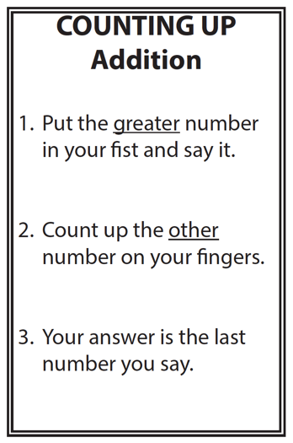
Students should learn and use strategies to solve the facts
4 + 3 = __
9 + 2 = __
6 + 8 = __

Slide 52
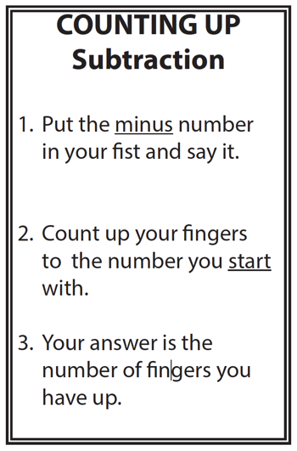
Students should learn and use strategies to solve the facts
5 – 3 = __
11 – 7 = __
15 – 9 = __

Slide 53
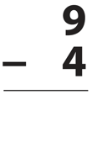
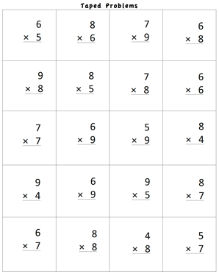
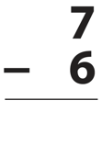
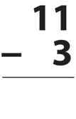
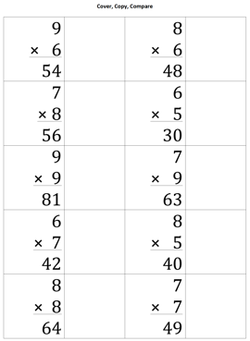
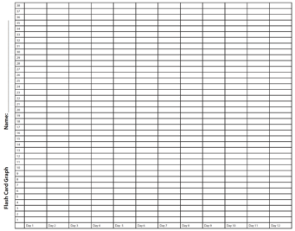
3. Students should develop fluency with facts
BRIEF
DAILY

Slide 54
3. Students should develop fluency with facts
BRIEF
DAILY

Slide 55
3. Students should develop fluency with facts
BRIEF
DAILY

Slide 56
2
3
1
5
+
3: 3, 6, 9, 12, 15
5: 5, 10, 15, 20, 25
Fluency building

Slide 57
Problem solving instruction

Slide 58
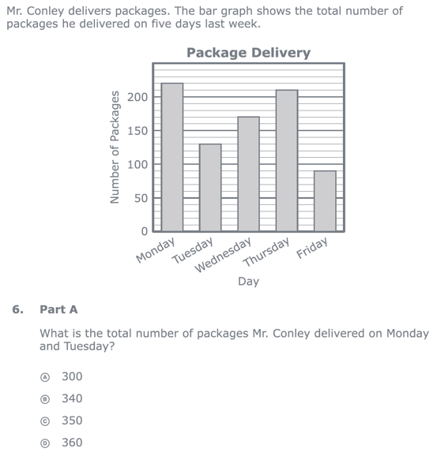
Reading the problem
Understanding vocabulary
Identifying relevant information
Ignoring irrelevant information
Interpreting charts and graphs
Identifying appropriate operation
PARCC third-grade release item (2015)
Performing computations

Slide 59
How Should We Teach Problem Solving?
Don’t use key words tied to operations
Do teach students an attack strategy
Do teach students schemas

Slide 60
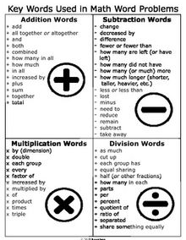
Don’t use key words tied to operations

Slide 61
1. Don’t use key words tied to operations
Kasey made $42, and Mandy made $37. How much money did they make altogether?
Kasey and Mandy made $79 altogether. If Kasey made $42, how much money did Mandy make?
Becky has $70 more than Perla. If Becky has $120, how much money does Perla have?
Becky has $70 more than Perla. If Perla has $50, how much money does Becky have?

Slide 62
1. Don’t use key words tied to operations
Matt baked 18 cookies. His brother baked twice as many. How many cookies did his brother bake?
Matt’s brother baked twice as many cookies as Matt. If Matt’s brother baked 36 cookies, how many did Matt bake?
Rachel wants to share 36 brownies with 6 friends. How many cookies will each friend receive?
Rachel shared brownies with 6 friends. Each friend ate 6 brownies. How many brownies did Rachel have to start with?

Slide 63
Note:
Students need to understand key words. But, key words should not be directly tied to operations.

Slide 64
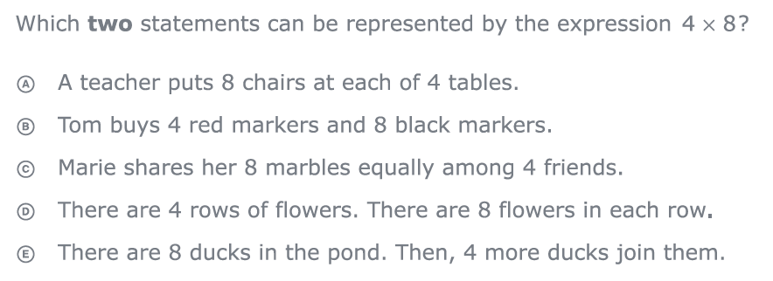
2. Do teach students an attack strategy
Regardless of the word problem (i.e., routine word problems, instructional word problems), students need an attack strategy for working through the problem.
PARCC third-grade release items (2015)

Slide 65
2. Do teach students an attack strategy
UPSCheck
Understand
Plan
Solve
Check
R-CUBES
Read the problem.
Circle key numbers.
Underline the question.
Box action words.
Evaluate steps.
Solve and check.

Slide 66
3. Do teach students schemas
When teaching about word problems, students should learn the schema of the word problem.
Structure
Problem type
Jitendra & Star (2011); Riley & Greeno (1988); Van de Walle, Karp, & Bay-Williams (2010)
Additive
Multiplicative
Total
Equal Groups
Difference
Comparison
Change
Ratios/
Proportions

Slide 67
2
3
1
5
+
“Look at this problem. Sasha bought a bunch of flowers. If 2/3 of the flowers were yellow and 1/5 of the flowers were red, what amount of her flowers were yellow or red?
Problem solving instruction

Slide 68
Motivation component

Slide 69
Motivation Component
on task
keep attention
regulate behavior

Slide 70
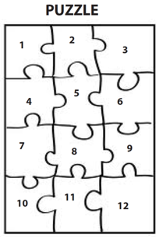
Motivation Component

Slide 71
Motivation component

Slide 72
Contact Information
Explicit instruction
Sarah R. Powell
Assistant Professor
The University of Texas at Austin
srpowell@austin.utexas.edu
@sarahpowellphd
Multiple representations
Concise language
Fluency building
Problem solving instruction
Motivation component

