Slide 1
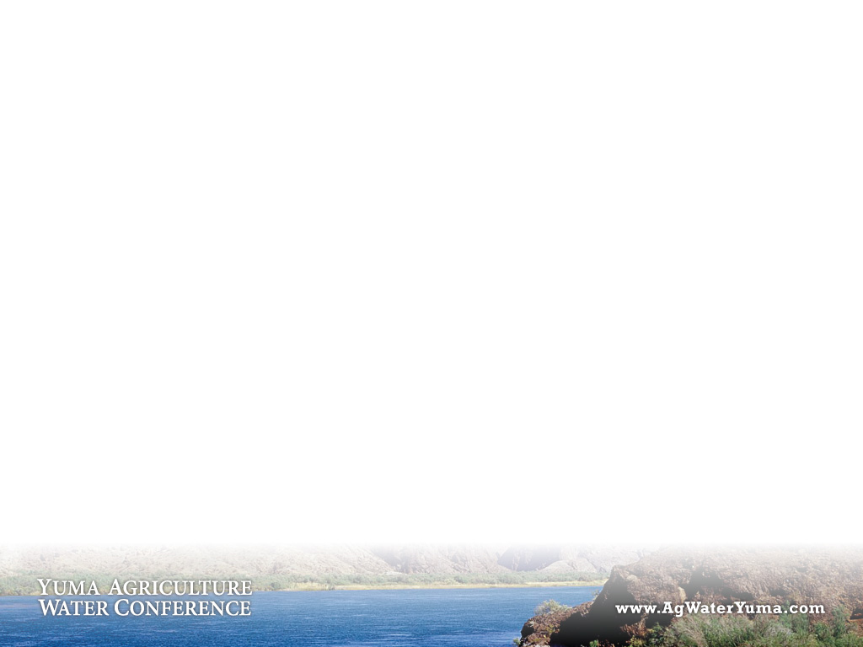


Presented by
Yuma County Water Agriculture Water Coalition
Agribusiness & Water Council of Arizona

Slide 2
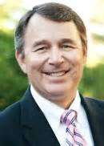
Mark W. Killian, Director
Arizona Department of Agriculture
Mkillian@azda.gov
“Arizona’s perspective on Yuma Agriculture Water”

Slide 3
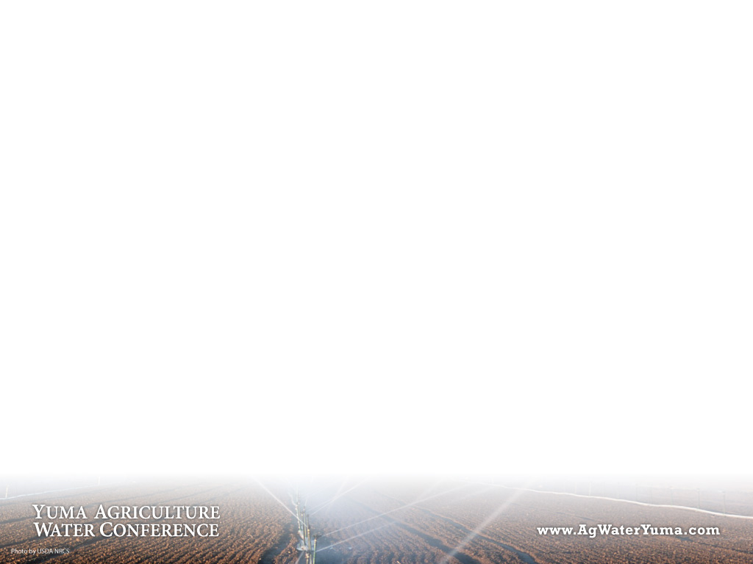
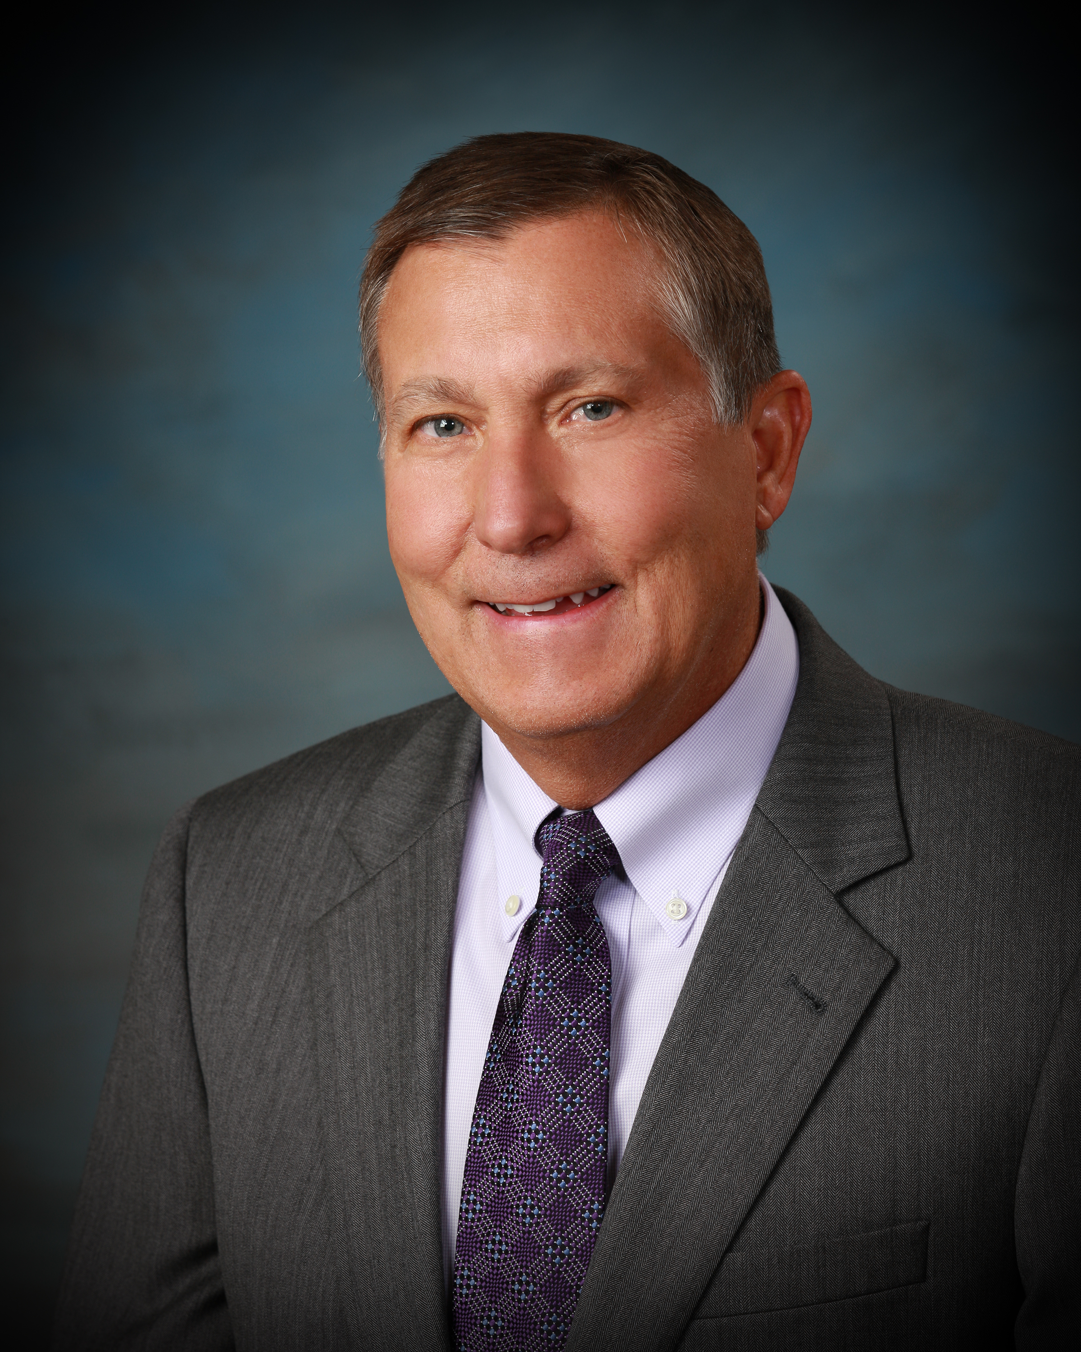
Thomas Buschatzke, Director
Arizona Department of Water Resources
Tbuschatzke@azwater.gov
“Yuma Agriculture Water- Rights and Supply”

Slide 4
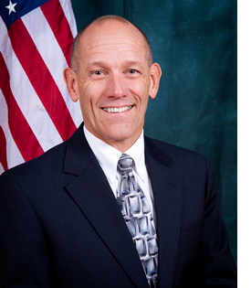
Terry Fulp, Director
Bureau of Reclamation, Lower Colorado Region
Tfulp@usbr.gov
“Yuma Agriculture Water- Rights and Supply”

Slide 5

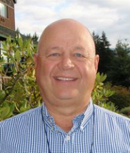
Tom Davis, General Manager
Yuma County Water Users’ Association
TDavis@ycwua.org
“Getting Agriculture Water to the Crops”

Slide 6
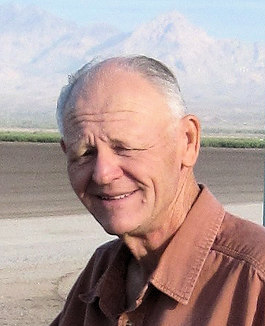
Elston Grubaugh, General Manager
Wellton-Mohawk Irrigation and Drainage District
Egrubaugh@wmidd.org
“Getting Agriculture Water to the Crops”

Slide 7
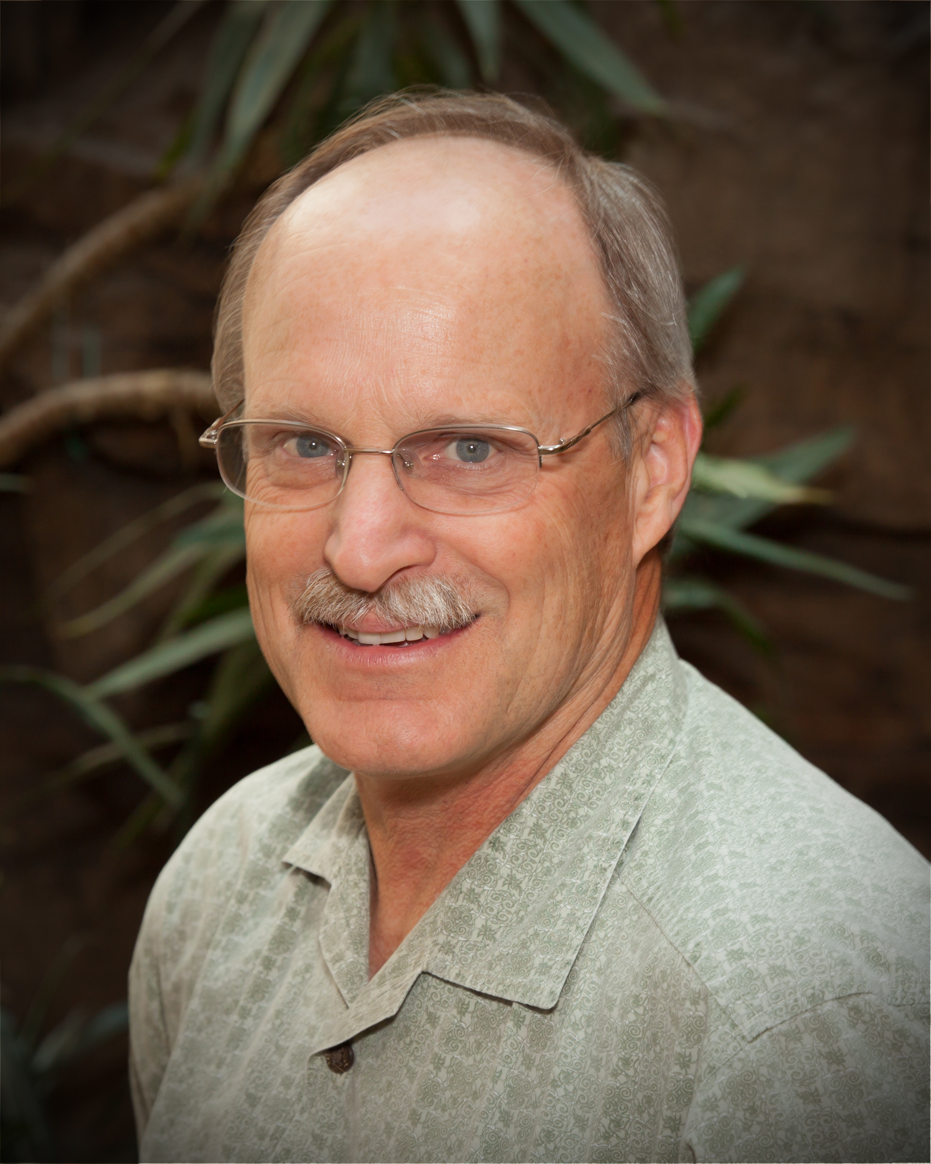
Paul Brown
University of Arizona College of Agriculture and Life Sciences
Pbrown@ag.Arizona.edu
“Agriculture Water and the Agriculture Industry”

Slide 8
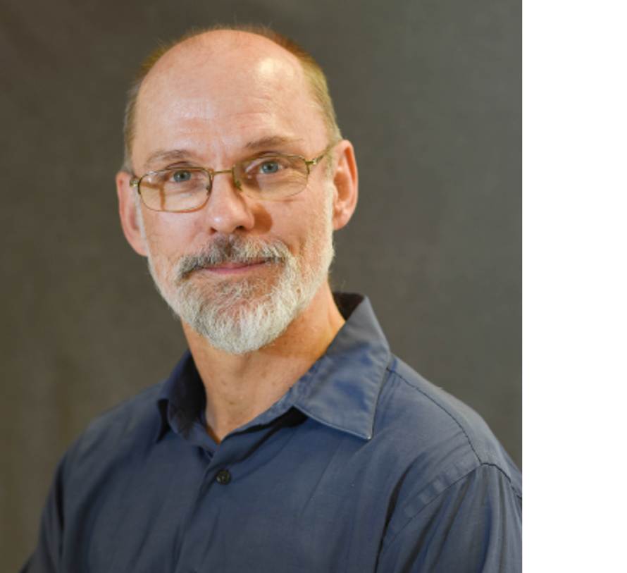
Dr. George Frisvold
University of Arizona College of Agriculture and Life Sciences
GFRisvold@ag.Arizona.edu
“Agriculture Water and the Agriculture Industry”

Slide 9
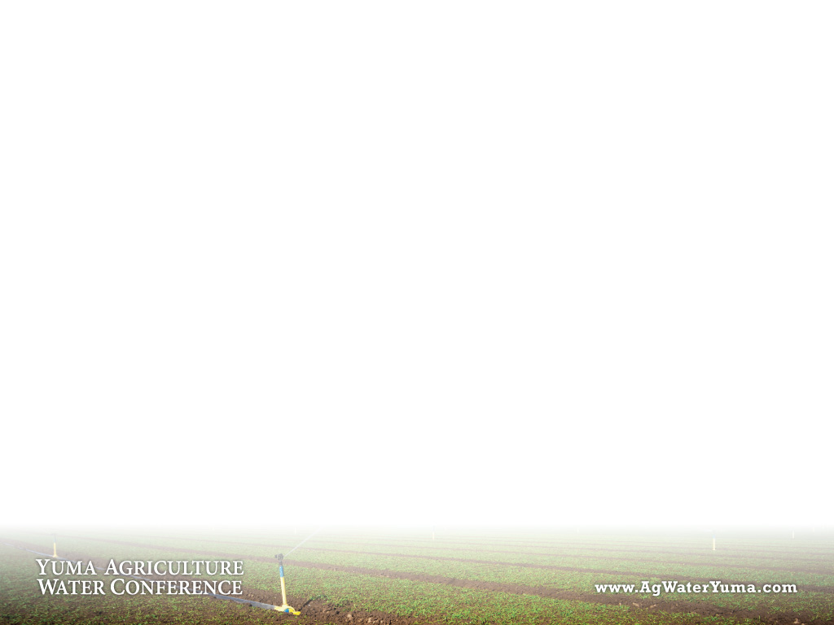
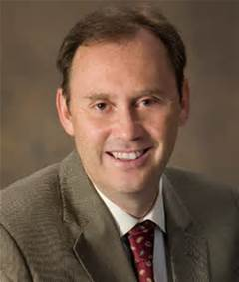
Yuma Agriculture water conference website
www.agwateryuma.com
Dr. Shane Burgess, Dean
University of Arizona College of Agriculture and Life Sciences
SBurgess@cals.Arizona.edu
“Agriculture Water and the Agriculture Industry”

Slide 10
Larry Suciu, General Counsel
Yuma County Water Users’ Association
Lsuciu@lwslaw.net
“Why can’t I move Agriculture Water out of the District?”

Slide 11
Wade Noble, General Counsel
WMIDD/YID/NGVIDD/Unit B
Wade@noblelaw.com
“Why can’t I move Agriculture Water out of the District?”

