Slide 1
Global brand value chain
Organizational structure
Global Brand
Enabling Structures and Processes
Global brand management
Shareholder value
Corporate social responsibility
Dimensions of value creation
Customer proposition
Marketing mix program
Digital strategy
Global Brand Building
Global brand equity
Performance

Slide 2
How ignoring the local context in your marketing strategy can destroy firm value – The four Fs
Failure to conduct even rudimentary market research

Slide 3
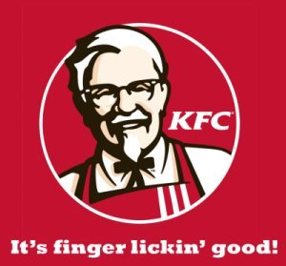
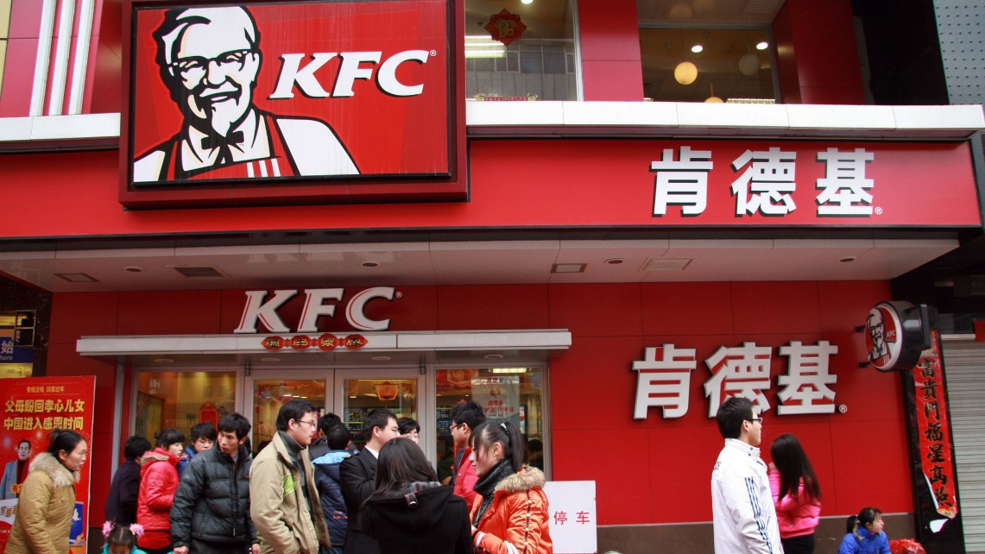
KFC in China

Slide 4
HSBC Private Banking slogan – Assume Nothing

Slide 5
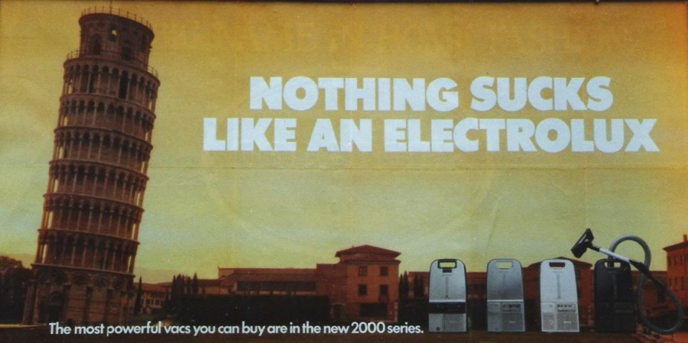

Slide 6
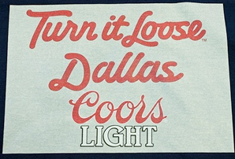
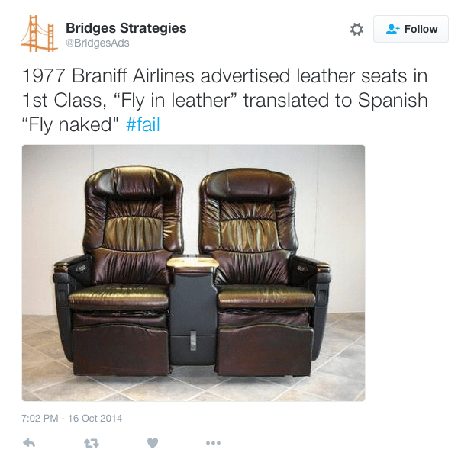

Slide 7
How ignoring the local context in your marketing strategy can destroy firm value – The four Fs
Failure to conduct even rudimentary market research
Failure to recognize unique, culturally-grounded needs

Slide 8
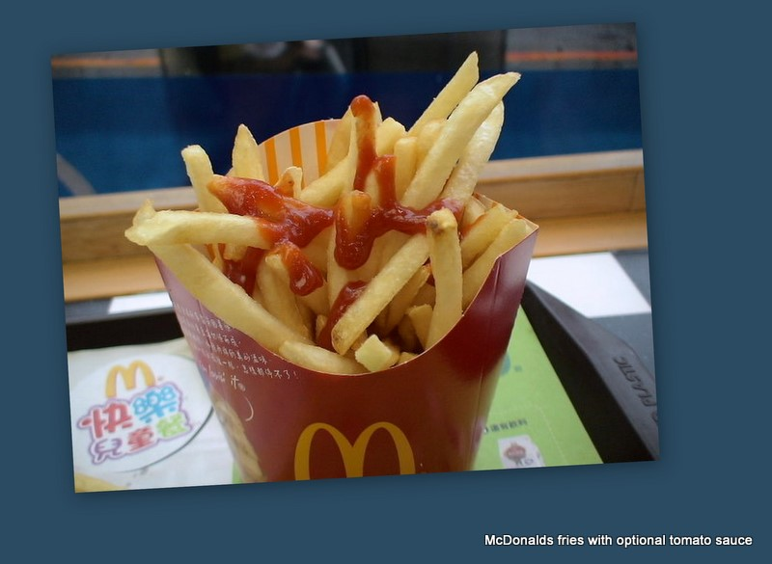
McDonald’s in the Netherlands?

Slide 9
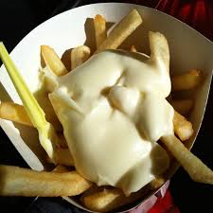
The solution:

Slide 10
Doing it right: Henkel in the Middle East

Slide 11
How ignoring the local context in your marketing strategy can destroy firm value – The four Fs
Failure to conduct even rudimentary market research
Failure to recognize unique, culturally-grounded needs
Failure to empower local management

Slide 12
Gillette in India – The context
Huge market – 400+ million men of shaving age
In 2008, Gillette’s share 20% (Mach3) - 80% used traditional (inferior) double-edge razor
People unaware of the Gillette promise of a clean, smooth shave, or didn’t care
Designer-stubble look was spreading
Mach3 up to 50 times the price of the double-edge blade
Central management

Slide 13
Gillette in India – The response
Empower local manager – Sharat Verma
Cut manufacturing costs of Mach3 by paring down the components except the all-important razor blades to allow a retail price of three times traditional double-edge razor
Develop separate razor – Gillette Guard – for the mass of consumers on low incomes. Razor system sold for 0.33 cents (US$) and replacement cartridges for 8 cents – same as double-edge razor

Slide 14
Gillette in India – The response (cont’d)
Innovative campaign, “Shave India Movement” featuring infomercials, social media and stunts such as a world record for shaving. https://www.youtube.com/watch?v=PG2ex0_cFjg
By 2013 the Gillette Guard accounted for two out of three razors sold in India.

Slide 15
How ignoring the local context in your marketing strategy can destroy firm value – The four Fs
Failure to conduct even rudimentary market research
Failure to identify and tackle strategic hubris
Failure to recognize unique, culturally-grounded needs
Failure to empower local management

Slide 16
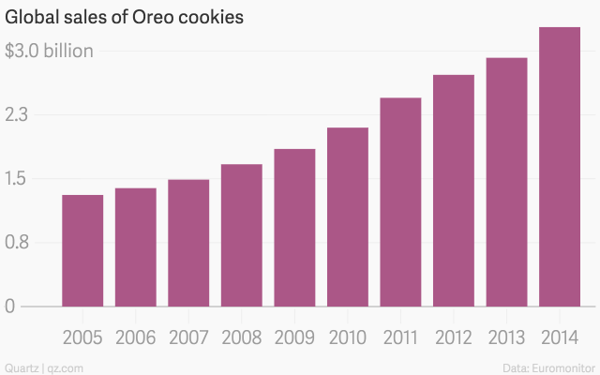
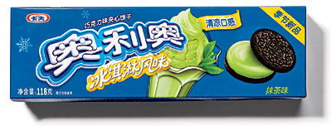
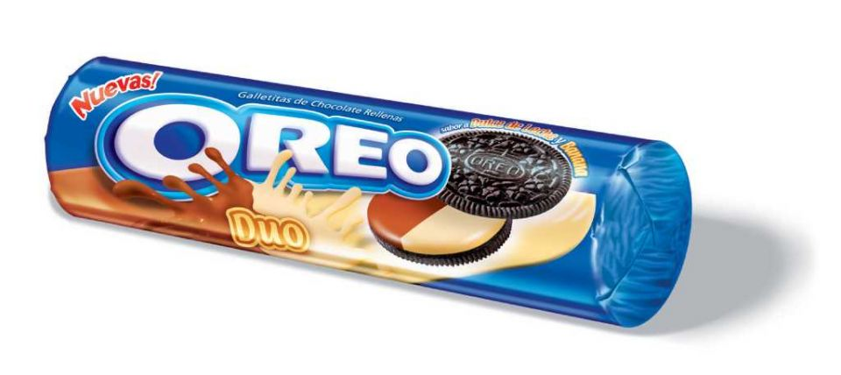
Overcoming strategic hubris: Oreos

Slide 17
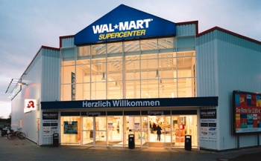
Example: Walmart in Germany
1997: Walmart entered Germany by acquiring two local chains. Results were disappointing
What happened?
Lack of market research
Failure to connect with local customers and employees
Failure to empower local management
Strategic hubris
In 2006, it withdrew, having incurred losses of over one billion dollars

Slide 18
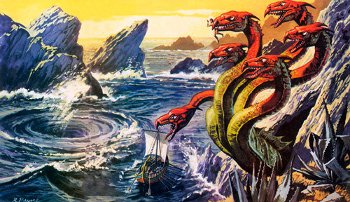
The global brand manager as a 21st century Odyssey: Sailing between Scylla and Charybdis
Lack of local brand resonance
Inability to create global brand efficiency and punch power
Global brand
Global brand
manager

Slide 19
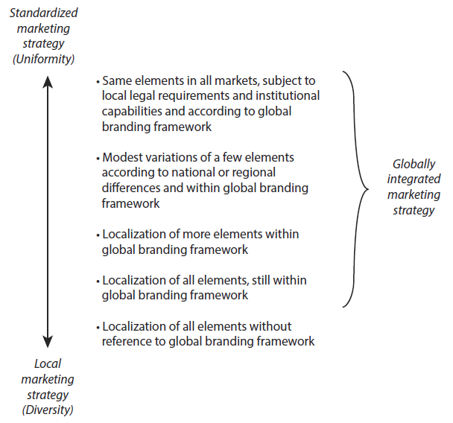
Global marketing mix strategy options

Slide 20
Brand names - options
Standardized global brand
name
Using the same brand name around the world
Dual branding
Retaining the sound of the global brand name (transliteration)
Retaining the meaning or core values of the global brand (translation)
Creating a new brand name both in meaning and pronunciation
Global brand, if accompanied by same logo, stylistic elements
Local
brand
name

Slide 21
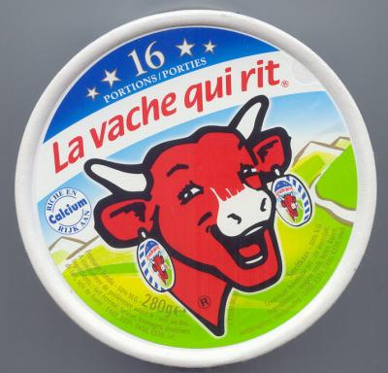
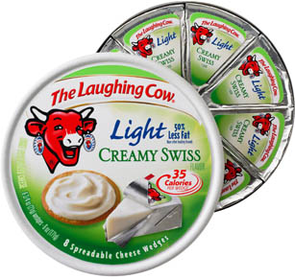
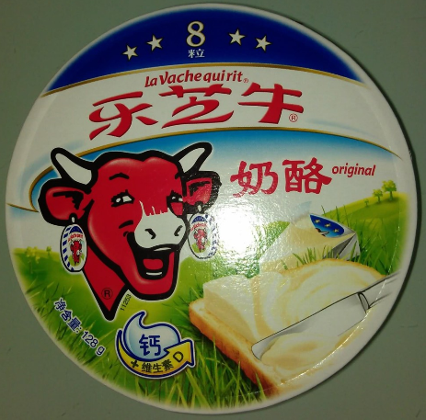
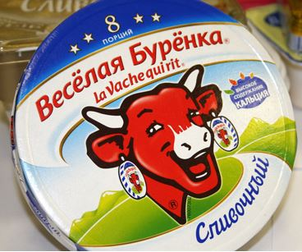
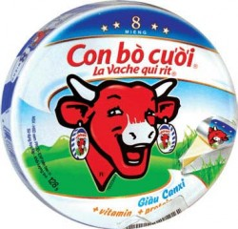
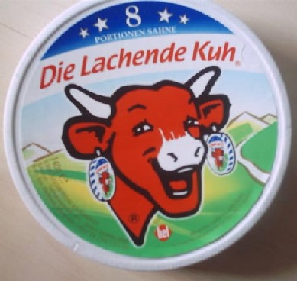
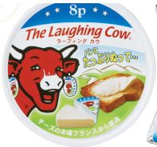
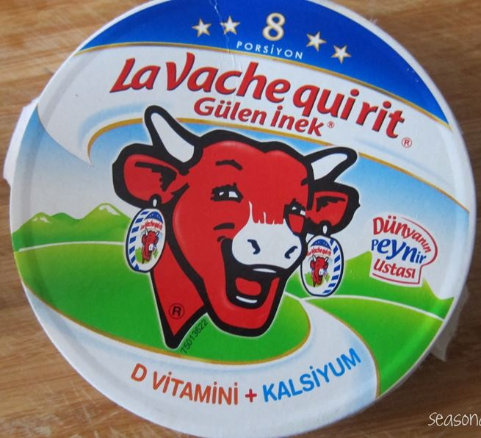
Translation/Dual branding – La Vache Qui Rit
China
Russia
France, Belgium, NL, Switzerland
US, UK,…
Japan
Turkey
Vietnam
Germany

Slide 22
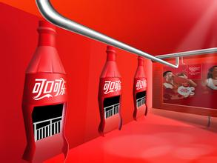
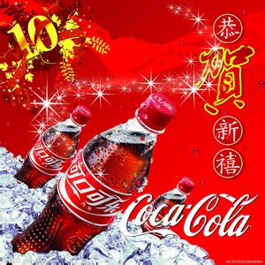
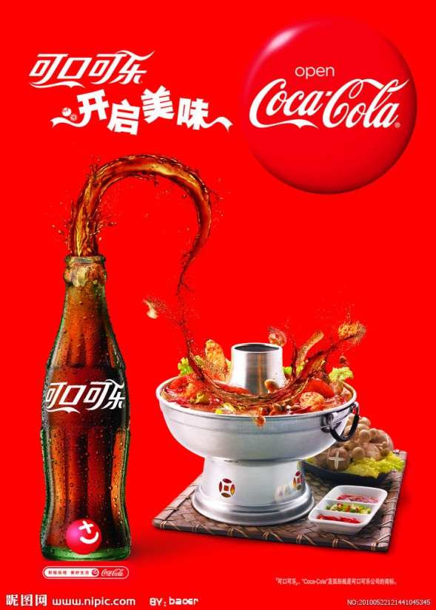
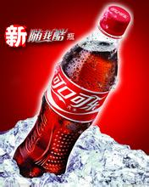
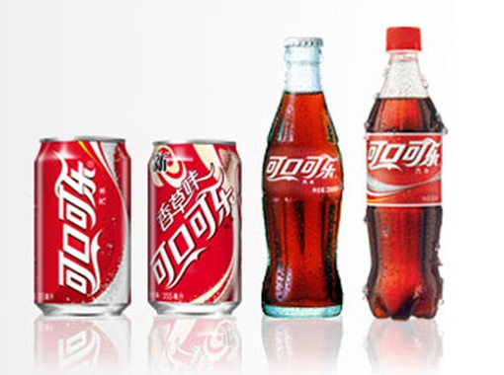
Translation/transliteration in China - Coca Cola (可口可乐)

Slide 23
Branding strategies in mergers & acquisitions
Merge one brand (usually the acquired brand) into the other (55%)
Retain – keep both brands (24%)
Fusion – create a composite brand in its name or logo (19%)
Create a new brand name (1%)
Note: Percentages are indicative only – based on 215 large mergers and acquisitions during 1997–2006; Dinner et al. (2016)

Slide 24
Merge
Strategic Rationale | Global brand equity | Signal | Immediate rebranding cost | On-going brand cost
Desire to create one global brand Acquirer has the stronger brand Agreement mandates a discontinuation of the acquired brand. | Fully discarded for one brand | Clear statement of dominance of one entity over the other | Medium | Medium
+
+
+
+
+

Slide 25
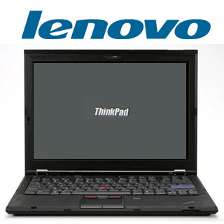
Lenovo’s brand migration strategy
2005
2006
2007
Maintain
Link
Build
Leverage IBM brand to maintain sales momentum
Emphasize ThinkPad brand and initiate link to Lenovo
Build Lenovo and ThinkPad brands and move away from IBM

Slide 26
If you merge the brands, you must
Decide which brand to delete
Manage the brand migration process without losing the deleted brand’s existing customers
Implement a three-part process, “maintain, link, build,” which requires an acknowledgement of existing consumer connections, a transference of those emotional ties, and the introduction of new attributes or value and not simply an announcement of a new brand name or design

Slide 27
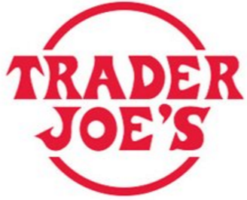
Retain both brands
Strategic Rationale | Global brand equity | Signal | Immediate rebranding cost | On-going brand cost
Diversification, expanding product and customer portfolio Brands are strong in different regions and channels Brands are reaching different customer segments Brands have unique brand image and distinctive heritage Brands are substantially different in perceived positioning and pricing | Fully preserved for both brands | Independence | Zero | High
+
+
+
+
+
+

Slide 28
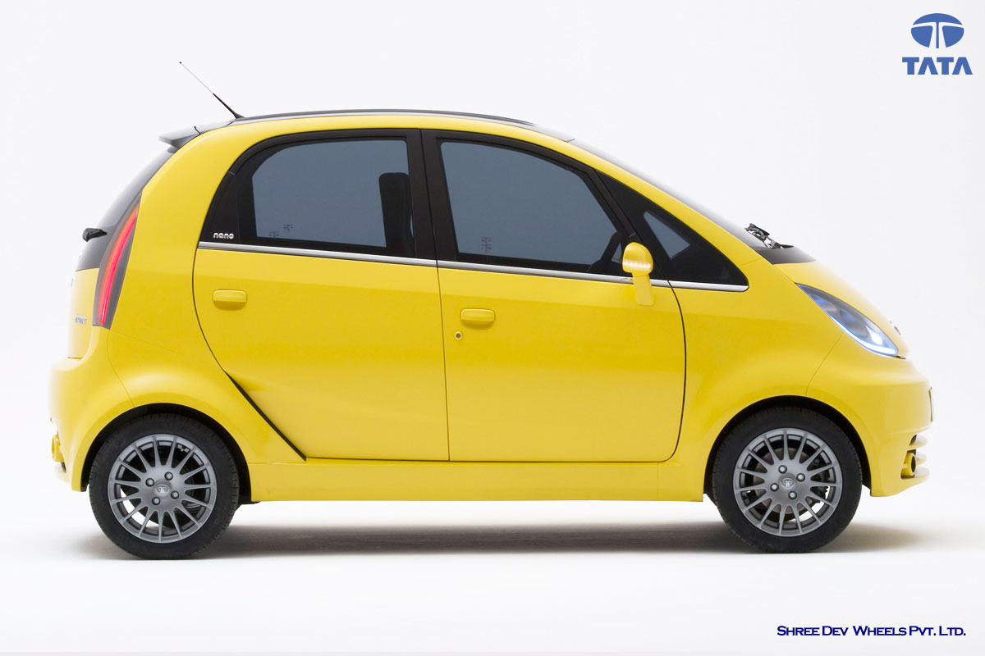
Tata car

Slide 29
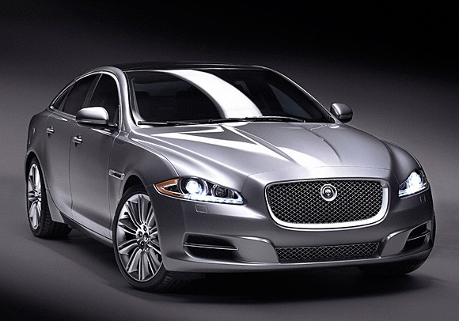
Jaguar XJ

Slide 30
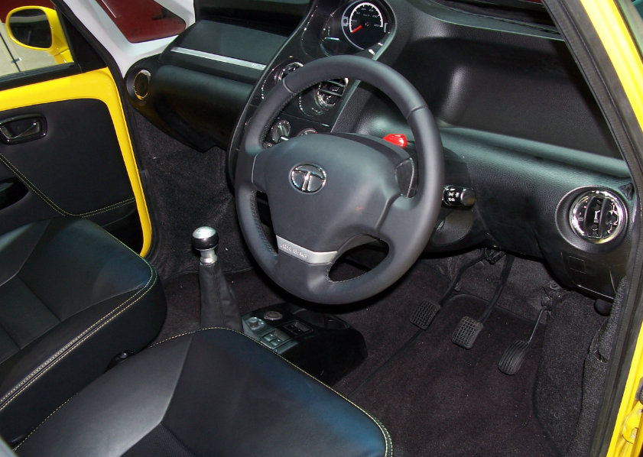
Interior of Tata car

Slide 31
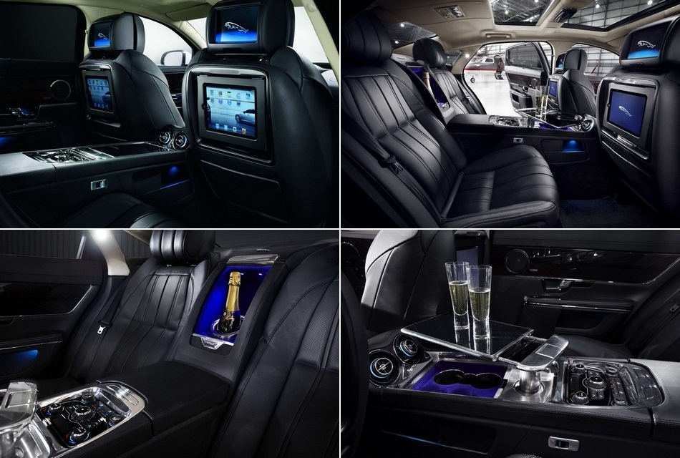
Interior of Jaguar XJ

Slide 32
If you retain both brands, must
Develop a sound strategy to grow the acquired brand and to coordinate its operations with the acquirer’s brand(s) without blurring their distinctive positions
Establish guidelines for keeping the two brands in distinct positions so that they reach different segments rather than cannibalize each other
Identify and drive operational synergies, so as not duplicate costs across the value network

Slide 33
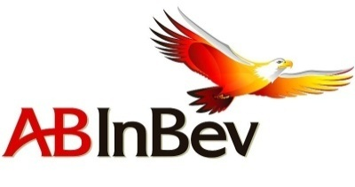
Fuse the brands
Strategic Rationale | Global brand equity | Signal | Immediate rebranding cost | On-going brand cost
Combination of the capabilities and cultures of the two companies Reap the benefits of a single global brand | Modified to enhance | Unity, collaboration and respect for both entities | High | Medium
+
+
+

Slide 34
A five-step procedure to establish a global/regional brand pricing structure
Identify your largest country-markets and base your global pricing strategy only on these markets.
2. Determine the optimal (profit-maximizing) price in each of these large countries separately.
Assess whether the country-specific optimal price structure generates significant problems.
If such disturbances are expected, set a global (or regional) price corridor to trade-off profits versus problems and adjust prices according to this corridor.
Prices in all other countries should be within this price corridor.

Slide 35
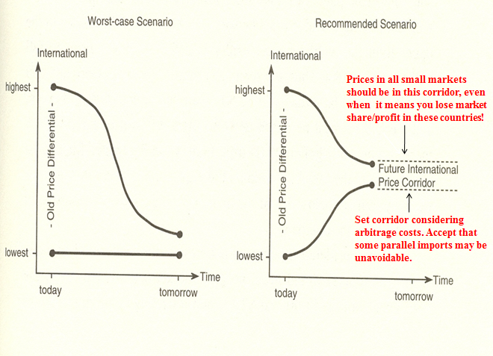
Toward a global price corridor

Slide 36
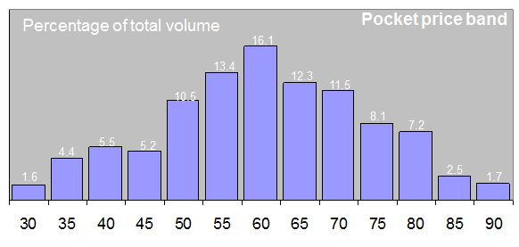
Caveat: Global list price ≠ global transaction (“pocket”) price – Global B2B lighting supplier
Pocket price as percentage of list price
Source: McKinsey

Slide 37
Chapter 5 – Global Brand Building in the Digital Age Managerial Takeaways:
Established brands can reach remote markets; niche brands can aggregate demand across geographies
The distinction between global and local brands disappears; any local brand can become global with digital
Digital has accelerated competitive responses; new competitors come from everywhere and from anywhere
Information flow, connectivity, and market transparency are more rapid and more important for success
Marketplace power has shifted to the consumer from the manufacturer
eWOM dominates
Digital channels are the future, and the now
The sharing economy has transformed many industries; which industries are next?...
IoT is the next frontier; what are the implications for your market opportunities and requirements?
You share control of your brand with your customers. Period.

Slide 38
Porter’s Competitive Analysis and Strategy
Porter’s model of industry analysis organized by his five forces influencing competition:
1. Threat of new entrants, or potential barriers to entry
2. Threat of substitute products or services
3. Power of manufacturers and trade
4. Bargaining power of suppliers further up the supply chain
5. Rivalry among competitors

Slide 39
Three winning strategies: Overall cost leadership Meaningful differentiation thru service, quality, style, or technology leadership Product-market niche focus and ownership One losing strategy: Being “middle-of-the-road” – not particularly excellent at anything
(Michael Porter and others)

Slide 40
Market-Oriented Strategic Planning – High Performance Businesses in the Global Economy
Lessons and general findings:
Market and financial success are possible even in a hostile domestic and global environment
Market-oriented strategies leading to success evidence common characteristics:
Achieve low delivered cost position, or
Achieve “meaningful” product differentiation, or
Achieve both low cost and product differentiation
Successful strategies come from purposeful, intentional moves toward leadership
Problems come from failing to capture or defend market leadership
Diversification is a risky growth strategy

Slide 41
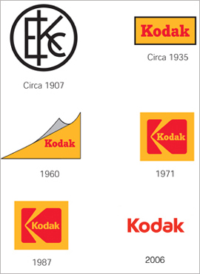
http://www.kodak.com

