Slide 1
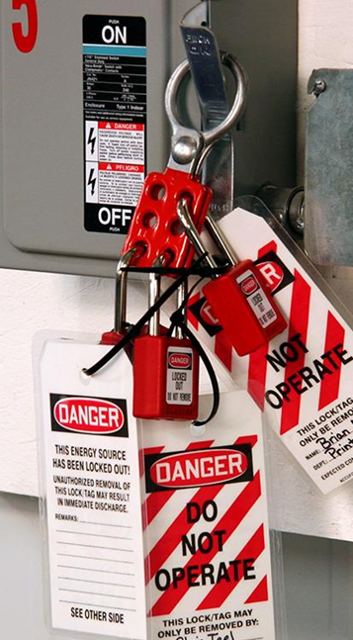
Lockout Tagout Periodic Inspection
Introduction and Overview

Slide 2
The periodic inspection
The periodic inspections must contain at least two components:
an inspection of each energy control procedure
a review of each employee's responsibilities under the energy control procedure being inspected.
How does OSHA define periodic?
Lockout/Tagout (LOTO) standard 1910.147(c)(6)(i), requires employers to “conduct a periodic inspection of the energy control procedure at least annually to ensure that the procedure and the requirements of this standard are being followed”.

Slide 3
The Inspector
The periodic inspection must be performed by an Authorized Employee or person other than the one(s) utilizing the hazardous energy control procedures being inspected. This individual will be referred to as the "inspector." The inspector must be able to determine: Whether the steps in the energy control procedure are being followed.
The inspector needs to observe a representative sample of authorized employees performing the servicing and maintenance using the lockout/tagout procedure. The inspector must also review each authorized employee’s responsibilities and talk with all other authorized employees even though they may not be using the energy control procedure.
When the periodic inspection involves a tagout procedure, the inspector’s review must extend to affected employees as well, because of their role in avoiding accidental or inadvertent activation of the equipment or machinery.
The periodic inspection need not be conducted in one-on-one meetings; the inspector can meet with a group of authorized employees. Group meetings could be even more effective in communicating the need to follow the procedure carefully.

Slide 4
Use instruction
Use a form to conduct inspections of energy control procedures to ensure that equipment adequately satisfies lockout/tagout procedures. Inspections should be carried out by a designated inspector. During the inspection, the inspector should review the authorized employees’ responsibilities under the procedures being inspected.
Periodic inspections should:
identify the machine or equipment where the energy control procedures apply
give inspection date
list the employees included in the inspection
state the name of the inspector
Carry out periodic inspections of the energy control procedures at least annually. Keep documentation of inspections for at least a year.

Slide 5
Procedure inspection/review
Each energy control procedure must be separately inspected at least annually to ensure that the energy control program is being properly utilized. At a minimum, these inspections must provide for the demonstration of the procedures and must be performed while authorized employees perform servicing and/or maintenance activities on machines or equipment. Specifically, the inspector must be able to determine whether: 1) the inspected procedures are adequate; 2) they are understood; and 3) being followed by employees. Following the inspection, there must be a review of each employee's responsibilities under the energy control procedure that was inspected.
The periodic inspection must be conducted by an authorized employee other than the one who implements the procedure. This authorized employee is designated by the employer as an inspector. He or she must observe the procedure being implemented by a representative number of authorized employees and must talk with all other authorized employees, even though they may not be implementing the energy control procedure.

Slide 6
More information
osha.gov
osha.gov has a series of eTools for LOTO that you can explore, some are even interactive to help you test your knowledge
eTool : Lockout-Tagout Interactive Training Program | Occupational Safety and Health Administration (osha.gov)

