Slide 1
Global brand value chain
Organizational structure
Global Brand
Enabling Structures and Processes
Global brand management
Shareholder value
Corporate social responsibility
Dimensions of value creation
Customer proposition
Marketing mix program
Digital strategy
Global Brand Building
Global brand equity
Performance

Slide 2
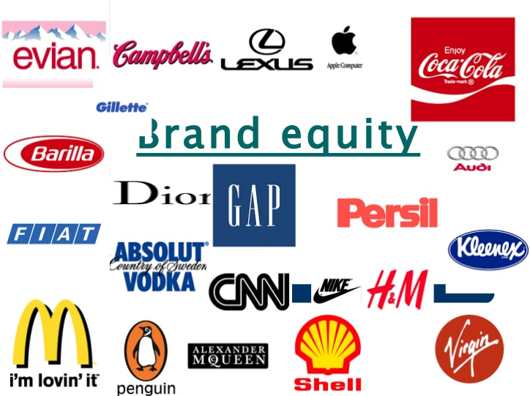
Global brand equity –
= is the goodwill ($) adhering to the brand—the outcomes that a company realizes from a product or service once it bears the brand name.

Slide 3
Global brand equity triangle
Customer-based brand equity
Awareness
Attitudes
Actions
Global brand equity ($)
Sales-based brand equity
Price premium
Volume premium
Profit-based brand equity
Profit contribution
Profit growth
Return on capital

Slide 4
Triple-A customer-based brand equity framework
(Tool 9.1)
Customer-based Brand Equity
Recognition
Recall
Attitudes
Actions
Differentiation
Relevance
Energy
Esteem
Knowledge
Purchase
Loyalty
Willingness-to-pay
Word-of-mouth
Awareness
The differential effect that brand knowledge has on customer response to the marketing of that brand

Slide 5

Key profit levers by type of global brand
Global brand type | Revenues |  | Costs
 | Sales volume | Price | COGS | R&D | Marketing | G&A
Value brand | high | very low | very low | very low | low | very low
Mass brand | very high | (slightly) above average | average | high | very high | high
Premium brand | below average | very high | high | very high | high | above average
Prestige brand | very low | extremely high | very high | average | high | average
Fun brand | high | low | low | very low | average/ high | low

Slide 6



Global brand equity –
The $ value of the brand
Conduct a financial analysis to determine the amount of corporate earnings attributed to a particular brand. To avoid a possibly atypical year, you could consider using the average earnings over the last three years.
Assess the brand’s strength. The brand strength score derives from customer equity, and is routinely calculated by various brand valuation consultancies.

Slide 7

Global brand equity – the $ value of the brand
Estimate the brand multiple, M, which is an indicator of confidence about the brand’s future earnings prospect:
  External approach: Look at the multiples in your industry used in acquisitions in recent years, and adjust the multiple for your brand strength versus that of the acquired brands.
  Internal approach: Determine the brand multiple on internal financial estimates:
    Determine the discount rate i for your brand, which is the sum of the cost of capital and a risk premium applied because the future is uncertain. Adjust the risk premium based on the brand strength score. Stronger brands carry a smaller risk premium because future earnings are more stable.
    Next, estimate the long-term (“perpetuity”) growth rate of the brand’s earnings, g.
    The brand multiple M = 1/[i-g].
Calculate brand value by multiplying current earnings by the brand multiple.

Slide 8
Calculate the brand value of Gillette at the time of the acquisition of Gillette by P&G
Data (as assessed by Merrill Lynch):
Average operating income (EBIT) per year over the years 2002-2004: $1,200 million.
Discount factor: 7.5%
Perpetuity growth rate: 2.8%.
Calculation:
Brand multiple is 1/[0.075 – 0.028] = 21.3
Brand value = $1,200 million * 21.3 = $25.5 billion

Slide 9
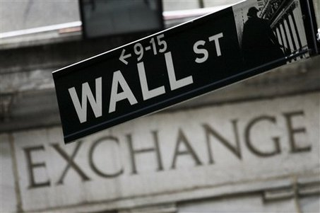
From global brand equity to shareholder value
Global Brand Equity
Shareholder Value
Market Capitalization
Shareholder Return
Shareholder
Risk
Price Premium
in M&A

