Slide 1

Emergency Response Team Training
Rule 59 - Emergency Response to Life-Threatening Asthma and Severe Allergic Reaction (Anaphylaxis)
July 2017

Slide 2

At the conclusion of this training
ERT members will be able to:
Define life-threatening asthma and anaphylaxis
Describe the signs/symptoms of life-threatening asthma and anaphylaxis
List the steps to be taken in an emergency, as outlined in the protocol
Identify the Nebraska medication administration competencies
Demonstrate how to use an EpiPen®
Demonstrate how to administer a nebulized albuterol treatment
Document pertinent information on the Emergency SHORT Report and Emergency Report Form
Complete the written test and receive a Documentation of Competencies form
Notes:
The school should be filing the documentation of competencies so that they have a record of training.
If you need EpiPen trainers – please note that every 2-pack contains a trainer.
This is a good time to check the nebulizer compressor to make sure that it is in working order and change the filter.

Slide 3
Emergency Response to
Life-Threatening Asthma or Systemic
Allergic Reactions (Anaphylaxis)
(Rule 59 protocol)
This is why you are here:
In Nebraska it is mandated that schools be prepared to treat a life-threatening asthma or severe allergy attack (NDE - Title 92 NAC Chapter 59)
  Education & training
  Medications & equipment
Purpose – to save the lives of those suffering from asthma and LTA (life-threatening allergy) who are undiagnosed and do NOT have a plan and medications at school
Omaha, NE – late 1990’s – asthma deaths at school
This protocol does not replace a diagnosed child’s asthma/allergy action plan or medications
Notes:
The Rule 59 protocol is administered an average of 60 times each school year.
In 1998 two students died in NE from an asthma attack – it was from those tragedies that the idea of an emergency breathing protocol arose. In May 2003, the NE State Board of Education mandated that every school in the state of NE be prepared to deal with a life-threatening breathing emergency due to asthma or severe allergic reaction (anaphylaxis).
Keep in mind that diagnosed student’s/staff should have an action plan and medications at school and that the protocol is intended for the undiagnosed or first-time reaction at school. However, the protocol may also be a back-up plan should a student’s/staff member’s plan not provide the relief intended – for example, a diagnosed asthmatic, action plan and meds at school, but waited too long and unable to inhale a therapeutic dose of albuterol – the protocol would be there to back-up, if need be and the student/staff was in a life-threatening situation.

Slide 4
Emergency Response Team (ERT)Training
Every Nebraska school is mandated to adopt the Rule 59 Protocol and to be prepared to respond to a life-threatening breathing emergency due to asthma or anaphylaxis
AIRE Nebraska, the organization supporting this mandate, recommends that there be, at least, 3 CPR certified staff in each building where students are present to carry out the Emergency Response to Life-Threatening Asthma or Systemic Allergic Reaction (Anaphylaxis) protocol
Civil liability immunity is provided by Neb.Rev.Stat. 25-21, 280 which states that staff members responding to a breathing emergency will be immune from civil liability ONLY when following the steps of the protocol
Notes:
All Accredited Schools, Approved Schools, and Approved Early Childhood Education Programs shall adopt and implement the Emergency Response to Life-Threatening Asthma or Systemic Allergic Reactions (Anaphylaxis) Protocol.

Slide 5
Emergency Response to
Life-Threatening Asthma or Systemic
Allergic Reactions (Anaphylaxis)
(Rule 59 protocol)
AIRE Nebraska recommendations:
All staff receive annual general asthma/severe allergy education, including unlicensed school personnel
At least, 3 persons per building (emergency response team) – trained annually (also CPR certified)
  General asthma + severe allergy education
  Emergency Response Team training by someone with a scope of practice (RN, MD, EMT, RT, etc)
Medications
  Elementary – at least, 1 dose EpiPen® & EpiPen Jr® + 3 vials of albuterol
  Middle & High School – at least, 1 dose EpiPen® + 3 vials of albuterol
Equipment – nebulizer compressor + tubing & nebulizer cup kit
Practice Drill - annually
Notes:
The Rule 59 protocol is used an average of 60 times each school year.

Slide 6
2016-17 Review
0 deaths!
66 voluntarily reported incidents
56% (37) were asthmatic in nature
  only 39% of these students had a plan/medications at school
  19% returned with plan/medications!
40% (26) had a history of severe allergy
  only 19% of these students had a plan/medications at school
  58% returned with plan/medications!
21% (14) had no history of asthma/severe allergy
  57% returned with plan/medications!
Notes:
The Rule 59 Protocol is (voluntarily) reported anywhere from 50-75 times each school year. While the protocol was developed out of a need to protect kids who have NOT been diagnosed with asthma or severe allergy, thus having no medications or plans, you can see that it is the asthmatic population which is most at risk for a life-threatening episode.
It is very important to identify kids who are diagnosed with asthma or severe allergy and to get their medication and plan at school. Schools do not have to let a student back to school without a doctor’s note after such an emergency and there are schools which do this – helps to improve that return rate with proper meds and plans.

Slide 7


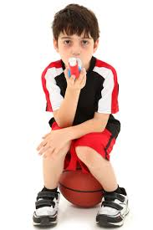
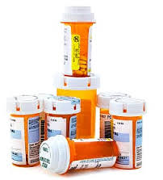

We know…
that the greatest number of incidents occur
in conjunction with activity:
target PE teachers, coaches, recess staff identify & share appropriately
that the greatest number of incidents occur
in students with a history of asthma:
identify students, share
appropriately & require action plans / meds
that the number of emergency events at school in
which are ALLERGIC in nature are increasing
27% in 2011-2012 / 40% in 2016-2017:
identify, share appropriately
& train EVERYONE!
Notes:
Here are some other important facts that we have been able to pull from the data we track. The arrows = “therefore”.

Slide 8
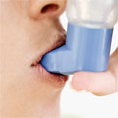
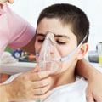
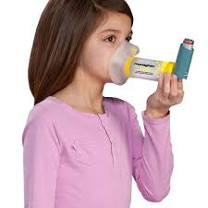

What Is Asthma?
Asthma is a lung disease caused by increased reaction of airways to stimuli, and can be life threatening
Asthma is a chronic (life-long) disease, with symptoms that may come and go and is often related to allergies
Asthma is the most common chronic childhood disease and accounts for the largest number of missed school days
In Nebraska, the greatest number of asthma-related episodes occur in students with a history of asthma
Notes:
Children do not “outgrow” asthma. They may be symptom free for long periods of time, but the tendency for an asthma attack is always there.

Slide 9
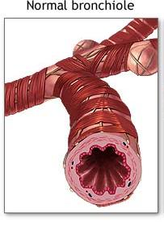
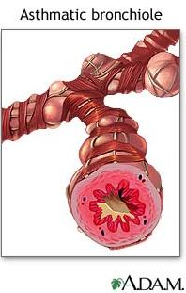
What is happening during an asthma attack?
Airway inflammation – the airway lining becomes red, swollen and narrow
Bronchoconstriction – the muscles that encircle the airway tighten/spasm
Airway obstruction – as the airway tightens and narrows, it can be very difficult to get air in and out of the lungs
Airway hyperresponsiveness – the muscles that encircle the airway respond more vigorously and quickly to smaller amounts of allergens and irritants
Secretions (mucus production) within the airway lining increases
http://bcove.me/earhv5jv
Mayo clinic animation
Notes:
In asthma, the airways of the lung become narrow and obstructed.
Swelling and increased mucus in the airway lining causes the airway to become rigid and interferes with airflow
As the airways become obstructed, it becomes harder to breathe out and the lungs get filled up with air. This causes chest tightness and shortness of breath
There is a link for a quick video from Mayo Clinic.

Slide 10
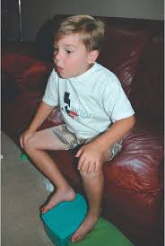

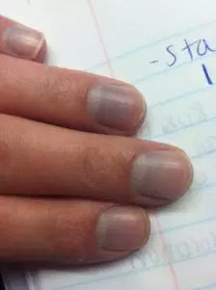

Signs and Symptoms of an Asthma Attack
Coughing
Wheezing
Difficulty breathing or shortness of breath
Chest pain, heaviness or feeling of tightness
Inability to speak
Retractions
Rapid breathing
Anxious/restless
Feeling of impending doom
Tired, no energy, “hitting the wall
Tripod positioning
Blue or grayish tinge to lips or nailbeds
Gallagher 2002
Notes:
Not every person will display every symptom, for instance some asthmatics cough constantly during an attack but never wheeze. Some wheeze but never cough.

Slide 11
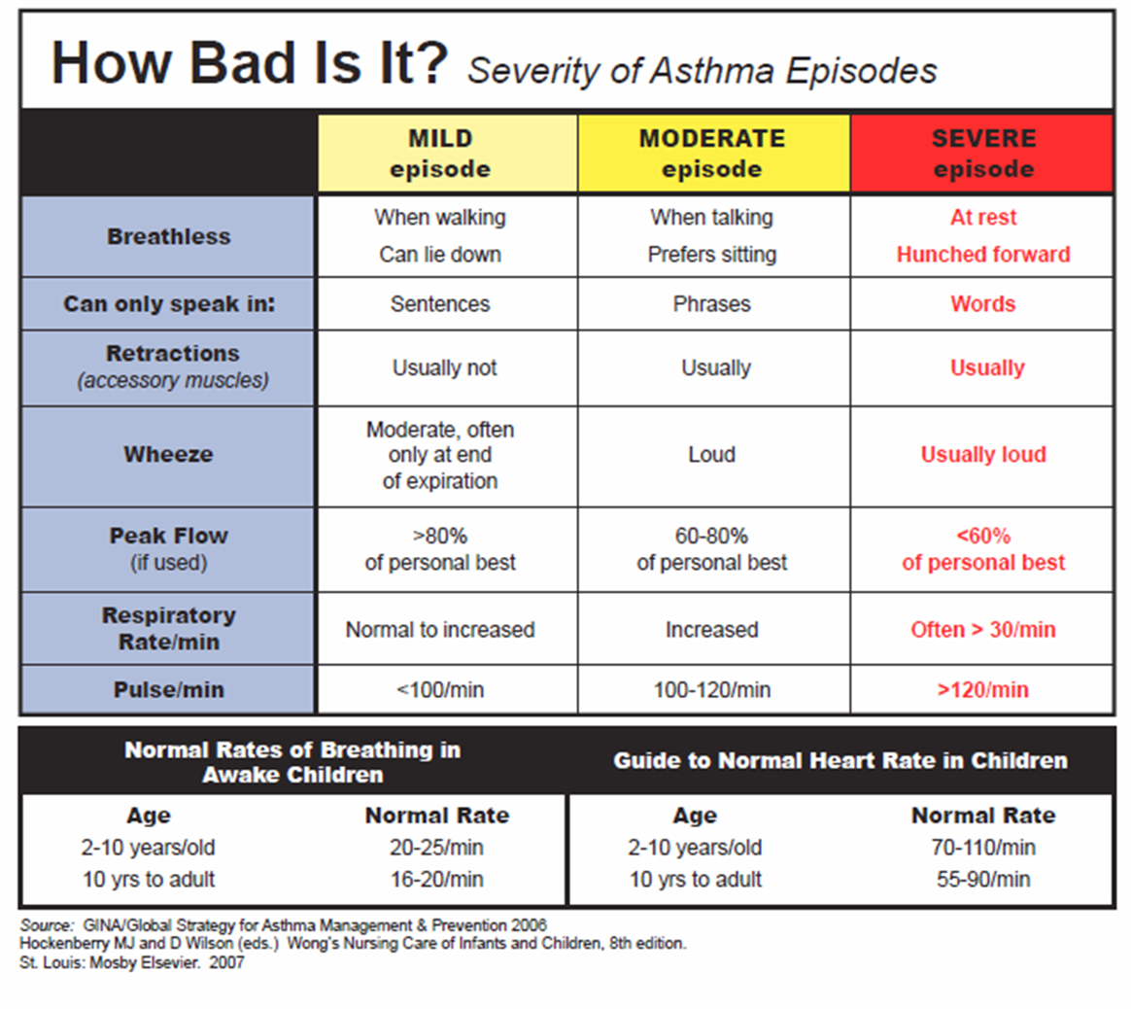
Notes:
This handy chart is a nice guideline and is found on the back side of the Skills Card. If you do not have a laminated copy of the Skills Card, please go to the AIRE Nebraska website – SCHOOLS tab and download this resource. It is recommended that you keep a Skills Card in your emergency container and post in the health room.

Slide 12
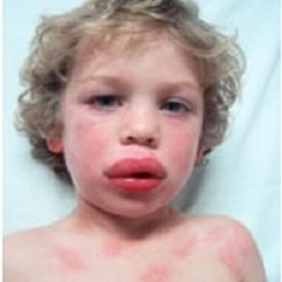
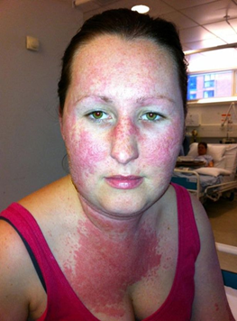
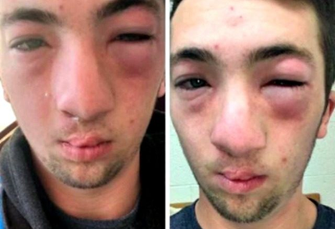
Severe Allergic Reaction (Anaphylaxis)
An allergy occurs when the immune system mistakenly attacks a food protein or normally harmless substance – it perceives the food or substance as a harmful or foreign one
Anaphylaxis is a medical emergency caused by an acute systemic (whole body) allergic reaction characterized by bronchial inflammation and constriction, and vascular collapse
Symptoms occur within minutes or up to 2 hours post-exposure; rarely—up to 4 hours later
Can occur with no previous allergic reaction
Individuals with asthma, hay fever, or eczema are at a greater risk
In Nebraska, the number of emergency events at school which are severe allergic reaction are increasing every year
Notes:
This person may DIE without treatment
Symptoms occur within minutes or up to 2 hours post-exposure, rarely – up to 4 hours later
Can occur with no previous allergic reaction
Greater risk for individuals with asthma, hay fever, or eczema

Slide 13
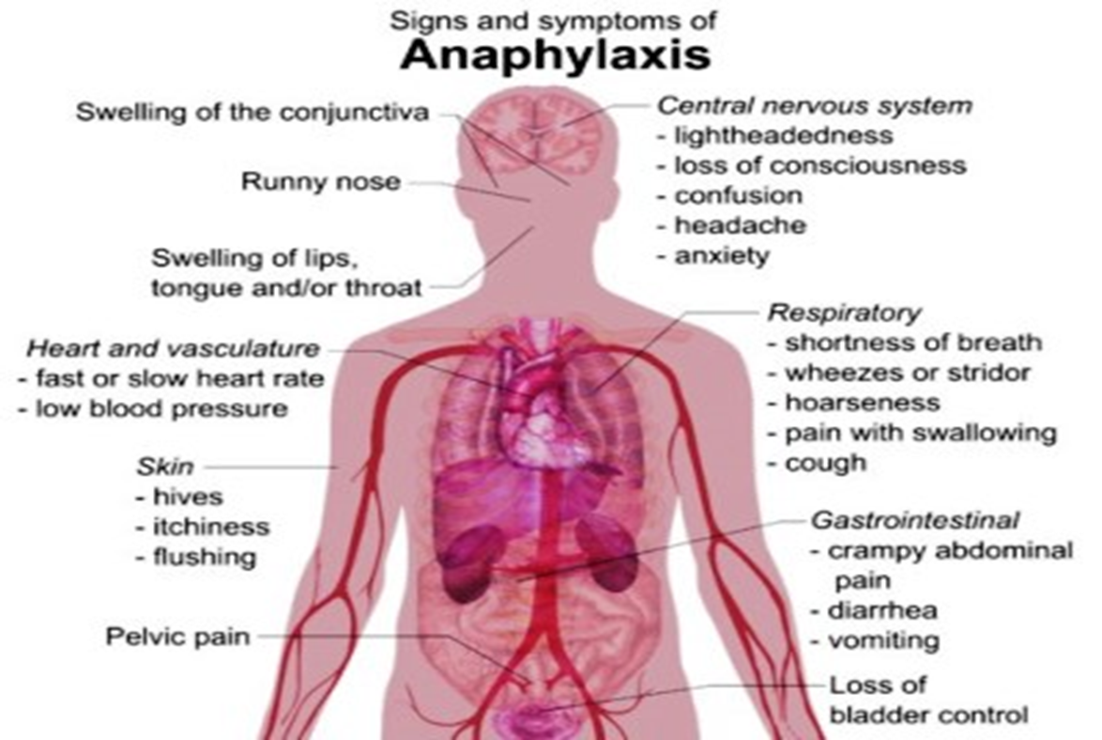
Signs & Symptoms of Anaphylaxis
*Many, patients report a sense of impending doom - anxiety
Notes:
Left unattended, these symptoms can lead to death.
You may see hives, but not always. Patients can have some of these symptoms, but do not need to have all to be a severe allergic reaction.

Slide 14

Tatelli Video (6:45)
https://www.youtube.com/watch?v=nU7pWhzdKlI&feature=youtu.be
https://youtu.be/nU7pWhzdKlI
Notes:
To watch the video – right click in the black box and click Preview. If it does not work – use the links above.
This video shows a 12 yr old girl having an allergic reaction and self-administering an EpiPen.

Slide 15

The Five Rights
Medication Administration Competency
The ERT is responsible:
to give the Right drug
to the Right patient
in the Right dose
by the Right route
at the Right time.
Notes:
Medications are given correctly when they are given according to the five rights.
An acronym that may be helpful for remembering the five rights:
MR. STD = Medication, Route, Student, Time, & Dose
OR
MRS TD (touchdown) = Medications, Route, Student, Time & Dose
EpiPen FIRST, followed by albuterol.

Slide 16


Medication Error
What is a medication error?
  A medication error refers to an error (of commission or omission) at any step along the pathway that begins when a clinician prescribes a medication and ends when the patient actually receives the medication. Agency for Healthcare Research & Quality
Usually involves an error in one of the 5 rights: right patient, right drug, right dosage, right time, and right route – some articles add right reason
Notes:
This is being reviewed due to the number of medications errors which happen with the medications which are prescribed to schools.

Slide 17

Common Medication Errors using
Rule 59 Protocol
24% (15) emergencies reported in 2016-2017 included a medication error
Administered school’s albuterol only & not calling 911
Administered school’s EpiPen® and did not administer nebulized albuterol due to perception student was “fine”
Administered the student’s auto-injectable epinephrine according to student’s action plan, followed by administering school’s albuterol
Administered school’s albuterol followed by school’s EpiPen®
Administered wrong dosage of EpiPen®
Notes:
Here are a list of common medication errors.

Slide 18
Why?
Using albuterol before the EpiPen®– why doesn’t the protocol allow for this?
  State-wide protocol
  School nurses and lay personnel administering
  Diagnosing
  Margin for error – delaying epinephrine administration contributes to death
  Don’t forget – civil liability immunity is only valid when the protocol is administered CORRECTLY
Notes:
In taking the protocol statewide and considering that both licensed school nurses and lay personnel would be administering the protocol, extreme caution and consideration went into protecting those administering the protocol and also those having the protocol administered to them.
By choosing to only administer albuterol or administering albuterol prior to epinephrine, this person can be seen as diagnosing and neither school nurses nor lay personnel can do this legally.
And, of course, there is also the concern that a life-threatening allergic event could be mistakenly perceived as an asthmatic event and a delay of epinephrine may contribute to death.

Slide 19
In an EMERGENCY!
Follow the steps of the protocol as a TEAM – someone calling, someone administering medications, someone documenting emergency on emergency SHORT report or emergency report form
Call 911
Summon school nurse if available. If not, summon designated ERT to implement emergency protocol
Check airway patency, breathing, respiratory rate, and pulse
Administer medications (EpiPen® and albuterol) per standing order
Determine cause as quickly as possible
Monitor vital signs (pulse, respiration, etc)
Contact parents immediately and physician as soon as possible
Any individual treated for symptoms with epinephrine at school will be transferred to medical facility
Notes:
Empower your team to respond and act if they believe that they believe that this is a life-threatening breathing emergency.
If there are questions on “airway patency”, please refer to the ABC’s or CPR, i.e. airway, breathing, circulation.
Signs of circulation include pulse, movement and conscious behavior.

Slide 20
Step 1 of Protocol: Call 911
Advise 911 that you are administering epinephrine and albuterol and that you believe this is a life-threatening breathing emergency
Write the time the EpiPen® is administered (writing it on the EpiPen is handy since you will give the administered EpiPen® to EMS)

Slide 21
Step 2 of Protocol:
Summon School Nurse and/or ERT
Each building needs to have a plan in place for alerting the nurse or ERT
Each staff member in the building needs to know how to alert the nurse or ERT
Each member of the ERT needs to know their role in responding (Who is going to get the bag? Who is going to manage the phone? Who is going to document?)
WHAT IS THE PLAN FOR YOUR BUILDING?
HOW WILL YOU SHARE THIS WITH YOUR STAFF?
WHEN WILL YOU HAVE A DRILL?
Notes:
WALK THE TALK - Just as we all have periodic fire drills and discuss the proper action to take in the unlikely event that a fire occurs, periodic drills for the Emergency Response Team are essential to work out the team member’s responsibilities and make sure that a timely response is possible and then discussing any changes that might need to be made.
COMMUNICATE the plan and the members of the ERT to all staff!!

Slide 22

Step 3 of Protocol: Check ABC’s
Airway – Is airway open or obstructed?
Breathing – Check for breathing by scanning the body for normal breathing for 5-10 seconds
Circulation – Look for signs of circulation - such as pulse, movement and conscious behavior. Check lips and nail beds for bluish tinge (cyanosis).

Slide 23
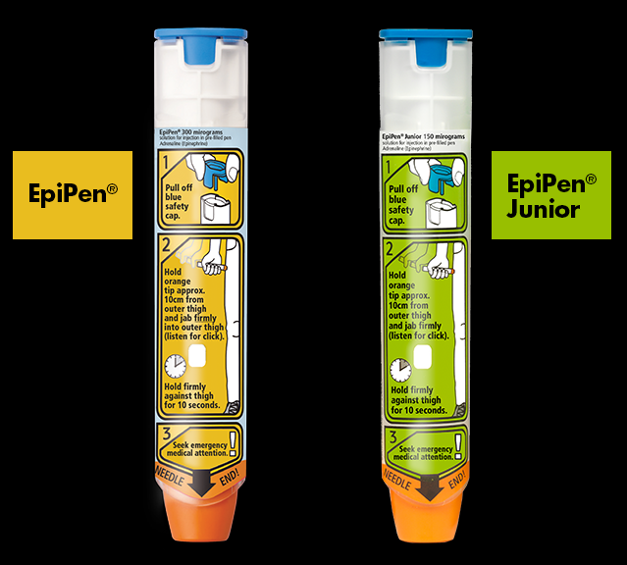
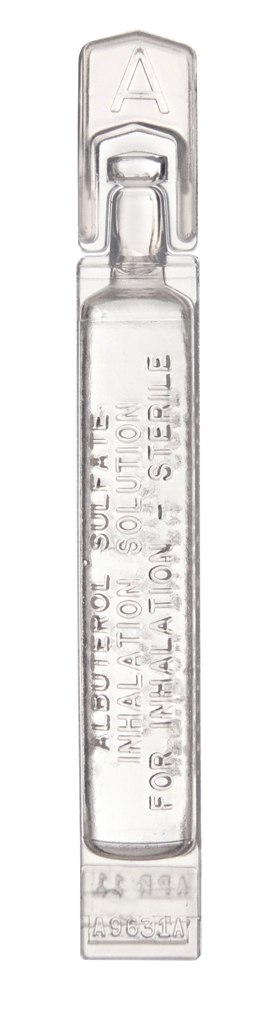
Step 4 of Protocol:
Administer EpiPen® & Albuterol
Administer an EpiPen® Jr. for a child less than 50 pounds or an adult EpiPen® for any individual over 50 pounds
Follow with nebulized albuterol (premixed) while awaiting EMS. If not better, may repeat times two, back-to-back
Be prepared to administer CPR, if indicated
Notes:
IM stands for intramuscular, so administered in a muscle (outer thigh).
Administering the EpiPen is more of a “place and push” vs. “swinging and jabbing”.
Keep in mind, that if a student or staff member has an epinephrine auto-injector other than the EpiPen, the staff should all be trained on that specific device as well.

Slide 24
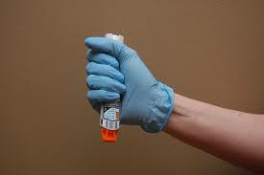
Administer EpiPen®
Epinephrine is the medication of choice for treatment of anaphylaxis and life-threatening asthma
An EpiPen® is a disposable, pre-filled automatic injection device designed to deliver a single dose of epinephrine
For a severe asthma episode, epinephrine acts as a bronchodilator and rapidly opens the airways
For a severe allergic reaction, epinephrine raises blood pressure and relieves airway constriction.
Quick treatment with epinephrine is the safest approach, even if it may have been unnecessary
An unnecessary dose of epinephrine should have no prolonged or significant ill effects on an adult or child

Slide 25
Who is in charge?
The Emergency Response
Team following the protocol is in charge!
Bystanders, to include administrators, parents or other staff, may not direct the Emergency Response Team to administer the EpiPen® and/or nebulized albuterol in any order other than the protocol
To do so puts the patient at risk for death and puts the team and the school district at risk for civil liability

Slide 26
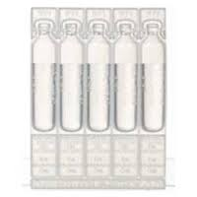
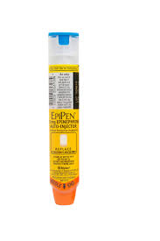
Visualize with me ~ Epi 1st
Notes:
This is a great visualization exercise – think of a vending machine – first the EpiPen drops and after you administer that, the albuterol drops. So, you cannot access the albuterol – it is behind (or secondary) to the EpiPen.

Slide 27
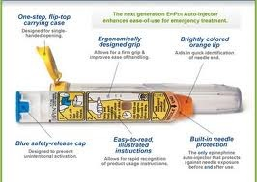
Directions for EpiPen® Administration
Never put thumb, fingers or hand over the orange tip
Grasp unit, with the orange tip pointing downward
Form a fist around the auto-injector (orange tip down)
With your other hand, pull off the blue safety release
Hold orange tip near outer thigh
Hold the leg firmly in place while administering the injection
Swing and firmly push into outer thigh so that auto-injector is at a right angle to the thigh
Hold firmly in thigh for approximately 3 seconds
Remove auto-injector from thigh (the orange needle cover will extend to cover needle) and massage injection area for 10 seconds
Note the time the dose is injected and give used auto-injector to EMS.
Continue steps of protocol by following epinephrine injection with albuterol treatment.
Notes:
Use the EpiPen® trainer(s).
NEW from the FDA in June 2016 – text in red.

Slide 28
Things To Know about the EpiPen®
  The EpiPen® is designed to be administered through clothing (including jeans)
  Administer into outer thigh, regardless of what body part is affected
  In the unlikely event of a “needle-stick” to the individual administering an EpiPen® (this is a medication error), consult and follow the school’s exposure control plan and please document and report incident to AIRE Nebraska

Slide 29
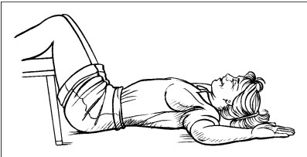
After Epinephrine…..
“Children with symptoms of anaphylaxis should be placed in a recumbent position with their legs elevated. Because cases of sudden death have been reported in children who stood up during a severe reaction, the recumbent position should be maintained. If symptoms persist or progress, epinephrine can be repeated after 5-15 minutes. In up to 20% of the cases of anaphylaxis, biphasic reactions occur. Therefore children who under-go food-induced anaphylaxis and receive epinephrine should be transported by ambulance to an emergency facility.”
Lancet, July 2013
Notes:
Patient should be allowed to relax in position comfortable for them to breathe the best in. The patient may need to be propped up for albuterol treatment. If the patient is vomiting this position may not be tolerated.
Please request that EMS put them on a gurney and not have them walk to the squad.

Slide 30
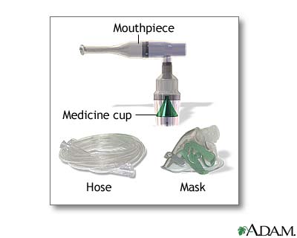
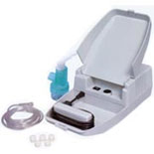
Administration of Nebulized Albuterol
Albuterol relaxes the bronchi, helps open the airway, and moves the mucus out of the lungs.
A nebulizer is a machine (compressor) that mixes the medication with air to provide a fine mist (aerosol) for breathing in through a mask or mouthpiece. This is the most efficient way to get the medication into the lungs during an emergency (better than a metered-dose inhaler).
Notes:
Albuterol relaxes the bronchi, helps open the airway, and moves the mucus out of the lungs.

Slide 31
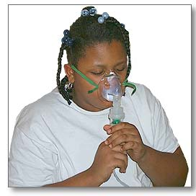
Directions for Administration of Nebulized Albuterol
Set up nebulizer as demonstrated by your instructor
Instruct/assist student to assume seated position
Place mask over mouth and nose. As aerosol begins to flow, instruct to inhale deeply and slowly through mouth, then exhale slowly
If coughing occurs during treatment, remove mask. Allow individual to clear secretions completely; resume treatment
Monitor individual for changes in respiratory rate, effort, and vocal ability
If individual continues to have difficulty breathing, administer two more treatments
Notes:
The mask is the most effective and therefore, the preferred method to deliver nebulized albuterol in an emergency.
The emergency container should include both pediatric and adult-sized masks to ensure that a proper fit and seal can be attained.
If the student is distressed by the mask, a mouthpiece can be used.

Slide 32
Step 5 of the Protocol:
Determine cause as quickly as possible
You may not know the exact cause of a sudden allergic reaction or asthma attack, but this should not keep you from providing care
Ask questions - information should be passed on to EMS
Always be aware the patient’s condition can worsen rapidly – do not leave patient alone or unobserved at any time!
Two eyes on the patient at all times!
Notes:
You do not need to know the cause of the life-threatening breathing emergency to give life-saving care.
Clues at the scene and witnesses may provide valuable evidence to the cause of the emergency.

Slide 33
Step 6 of the Protocol:
Monitor Vital Signs
Continue to monitor breathing – is patient still breathing? Look, listen and feel. How fast are they breathing?
Continue to monitor for signs of circulation-such as pulse, movement and conscious behavior
Administer CPR, if indicated – If the person is not breathing or only occasional, ineffective gasping, start CPR
Notes:
If the patient is breathing half as fast or twice as fast as you are, there is a problem.

Slide 34
Step 7 of the Protocol:
Contact parent immediately
ERT member responsible for communications should:
  call 911- give age, gender of victim, location, nature of emergency, medications administered, is victim conscious, etc.
  call the parent/guardian
Notes:
If staffing is available, one person should be sent to meet the Emergency Medical Services (EMS) to assist them with locating the student.
Another person should remain on the phone with 911 until instructed by emergency services to hang up.

Slide 35
Step 8 of the Protocol:
Any individual treated for symptoms with epinephrine at school will be transferred to medical facility
Effects of epinephrine will last only 15-20 minutes
To avoid relapse without additional epinephrine available, person should seek medical care immediately
To return to school environment, person should have medical clearance, current signed asthma/allergy action plan and medication
Notes:
In the majority of cases, one dose of epinephrine is enough, however there can be a biphasic reaction where another dose could be necessary.
Thus, the importance of seeking immediate emergency care and EMS transport!
Consider your school’s policy for return to school after a life-threatening breathing emergency -

Slide 36
Situation: A student with no known allergy is clutching their throat after eating in the cafeteria and says their throat is itchy and reports that it is hard to swallow
If the student/staff/visitor has no action plan/medications and displays signs and symptoms of a life-threatening breathing emergency:
Administer the Emergency Response to Life-Threatening Asthma or Severe Allergic Reactions (Anaphylaxis) protocol
Notes:
When a diagnosed student with a plan and medications is having breathing difficulty – follow the student’s plan and use their personal medications first.
If the student’s plan and medications do not relieve student’s difficulty, then the Rule 59 protocol comes in as the back-up.
It is appropriate to begin the emergency protocol with the epinephrine even if the student’s personal dose has already been given.
If an undiagnosed student/staff member has a first-time reaction, thus with NO plan or medications at school, you proceed directly to the Rule 59 protocol.

Slide 37
Situation: A student, diagnosed with asthma, is having difficulty breathing after running the mile for PE
Does this student have an asthma/allergy action plan?
Does this student have medication at school as part of their asthma/allergy action plan?
Are the symptoms relieved by following the action plan?
If the student has no action plan OR using their personally prescribed medications according to their action plan does not relieve symptoms
OR the symptoms return
OR gets worse
AND you believe this is a life-threatening situation
Administer the Emergency Response to Life-Threatening Asthma or Severe Allergic Reactions (Anaphylaxis) protocol
Notes:
When a diagnosed student with a plan and medications is having breathing difficulty – follow the student’s plan and use their personal medications first.
If the student’s plan and medications do not relieve student’s difficulty breathing, then the Rule 59 protocol comes in as the back-up.
It is appropriate to begin the emergency protocol with the epinephrine even if the student’s personal dose has already been given.
If an undiagnosed student/staff member has a first-time reaction, thus with NO plan or medications at school, you proceed directly to the Rule 59 protocol.

Slide 38
What if…
What if I accidentally inject myself with the EpiPen®?
What if the EpiPen® is expired?
What if a student with a known life-threatening allergy is exposed to that allergen, but hasn’t started showing symptoms?
Notes:
It does happen – people are in an emergency situation, their own adrenaline is rushing and maybe it’s been a while since they trained – they grab the EpiPen, take off the safety, re-grasp the device with a thumb over one end and administer the device into their own thumb. While it’s important to get the epinephrine on board quickly, you do have time to do it right and avoid an ER trip yourself. In one situation where this happened, they injected themselves with the adult dose and then administered the Jr dose to the patient. Another dose had to be administered to the patient either on the way or in the ER.
Expired medication - Of course, this should not happen, but if it does andthis is all you have and the person is in a life-threatening way, this is what you use. Keep in mind that depending on the medication’s circumstances – the drug may not be as effective or last as long therapeutically.
Review Natalie’s story below – the Asthma/Allergy Action Plan has been updated to include a box for the physician to check indicating that epinephrine should be administered if the person suspects exposure to known allergen.
http://blog.onespotallergy.com/2014/06/tragic-loss-of-sacramento-teen-reveals-flaws-in-anaphylaxis-guidelines/

Slide 39
Supplies
The following medical supplies are required for each building:
  Container for emergency supplies
  EpiPen® and/or EpiPen® Jr. per weight
  Nebulizer compressor with masks and tubing
  Albuterol(premixed) - three vials per building
Notes:
AIRE Nebraska recommends that elementary schools have both doses of EpiPens, whereas middle and high schools only need the adult dose of EpiPen.
A box of albuterol can be separated, but the vials should be protected with foil to reduce light exposure.

Slide 40
Supplies
The following supplies are recommended to be included in the emergency bag:
  Pen and paper
  Emergency SHORT Report or Emergency Report Form
  Protocol skills card and CPR skills card
  Gloves
  CPR face shield
  4 x 4 Gauze squares
  Student health alert information
  Monthly medication monitor sheet

Slide 41
Care, Storage & Disposal of Medication
Medication must be monitored, kept current and disposed of appropriately
Medication should be stored in a safe, unlocked area AND be accessible to ERT
EpiPen® and albuterol must be kept at a controlled room temperature (59-86°F), protected from light, freezing or extreme heat. Do not refrigerate
Check for color of drug:
EpiPen® – replace if solution is brown, pink or contains particles in solution
Albuterol – do not use solution if it is brown, pinkish, darker than slightly yellow or contains particles in solution
Monitor medication monthly for expiration date and appearance
Never place EpiPen® in the regular trash. All expired EpiPen® should be disposed of in sharps container. If none available, take to medical facility for proper disposal
Notes:
Life-saving medications should NEVER be under lock and key!
Expired EpiPens and albuterol can be used for training and return skills demonstration. AIRE Nebraska also accepts donations of expired medications for training.
EpiPens are available at no cost to schools – see AIRE Nebraska website SCHOOLS page for link to site – EpiPen4Schools.com

Slide 42
Documentation
Designate ERT member to complete documentation
NEW Emergency SHORT Report! Keep copies in emergency bag. Fill out at time of emergency, copy, keep one copy and hand one to EMS. Use the SHORT Report copy to complete Emergency Report Form with more details
Emergency Report Form to be completed whenever the medications prescribed to the school are administered
Send completed copies to the supervisor of the school’s health services program, student’s school health record and AIRE Nebraska (to protect confidentiality, the copy sent to AIRE should not contain the student’s name)
Notes:
Documentation is very much appreciated and is how AIRE Nebraska develops additional resources for education and training.
There are forms available for download on the AIRE Nebraska website.
The Emergency SHORT Report is designed to be filled out at the time of emergency, make a copy - keep one copy and give one copy to EMS so that they know what the signs and symptoms were at the time and what the school has administered and when. Keep a copy and complete the full Emergency Report form and send to AIRE Nebraska by mail or email. AIRE Nebraska does follow up on most reported incidents, so you may receive a call.

Slide 43
When it’s NOT a life-threatening emergency
NOT every asthma episode is a life-threatening breathing emergency – if you do not believe the person is going to die, do what you would normally do – call the parent/guardian, inform them, monitor the person and do not leave them alone
DO NOT administer nebulized albuterol before administering the EpiPen®! Doing this can be dangerous for the patient and puts you at risk for a lawsuit

Slide 44
Homework
What is the plan for your building?
  How will your staff notify the ERT that they need assistance?
  Who will grab the bag with medications/equipment?
  Who will document the incident?
  Who will direct the EMS response to the patient?
  Run a drill – what can you improve upon?
  Remember to notify ALL school staff of who is on the ERT and what the plan is for your building!
Notes:
This is a step which most often gets missed. Spend a few minutes in discussion with them to encourage this “planning stage”.
There is a new form on the website which can be a vehicle for building communication and/or parent communication. It is called Building ERT List and is found under Training Resources on the SCHOOLS page.

Slide 45


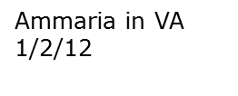

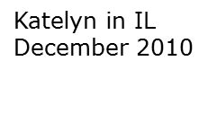


VISION
No one should die
from an asthma attack
or severe allergic reaction
(anaphylaxis)
Notes:
AIRE Nebraska is a non-profit organization receiving no state or federal funding. This organization exists solely with individual and corporate donations.
AIRE Nebraska partners with the NE Dept of Education and the State School Nurse Consultant and is committed to increasing public awareness of asthma and allergies in meeting its mission to ensure that all NE schools have the education, training and medications to respond to life-threatening breathing emergencies at school.
These students died at school due to asthma and severe allergic reaction. Students have died in Nebraska (not at school since 2003) – please help us with our vision!
Dynasty Reese - Omaha, NE
10 yrs old – passed away 5/13/12

Slide 46

Carol Tucker RN, BSN
  State School Nurse Consultant
  Child & School Health Program Manager
  Phone: (402) 471-1373, Toll Free: (800) 801-1122
  carol.tucker@nebraska.gov
Andrea Holka
  Executive Director, AIRE Nebraska
  Phone: (402)616-9600
  andrea@airenebraska.org
If there are any questions, please feel free to consult with Carol Tucker or Andrea Holka.

