Slide 1
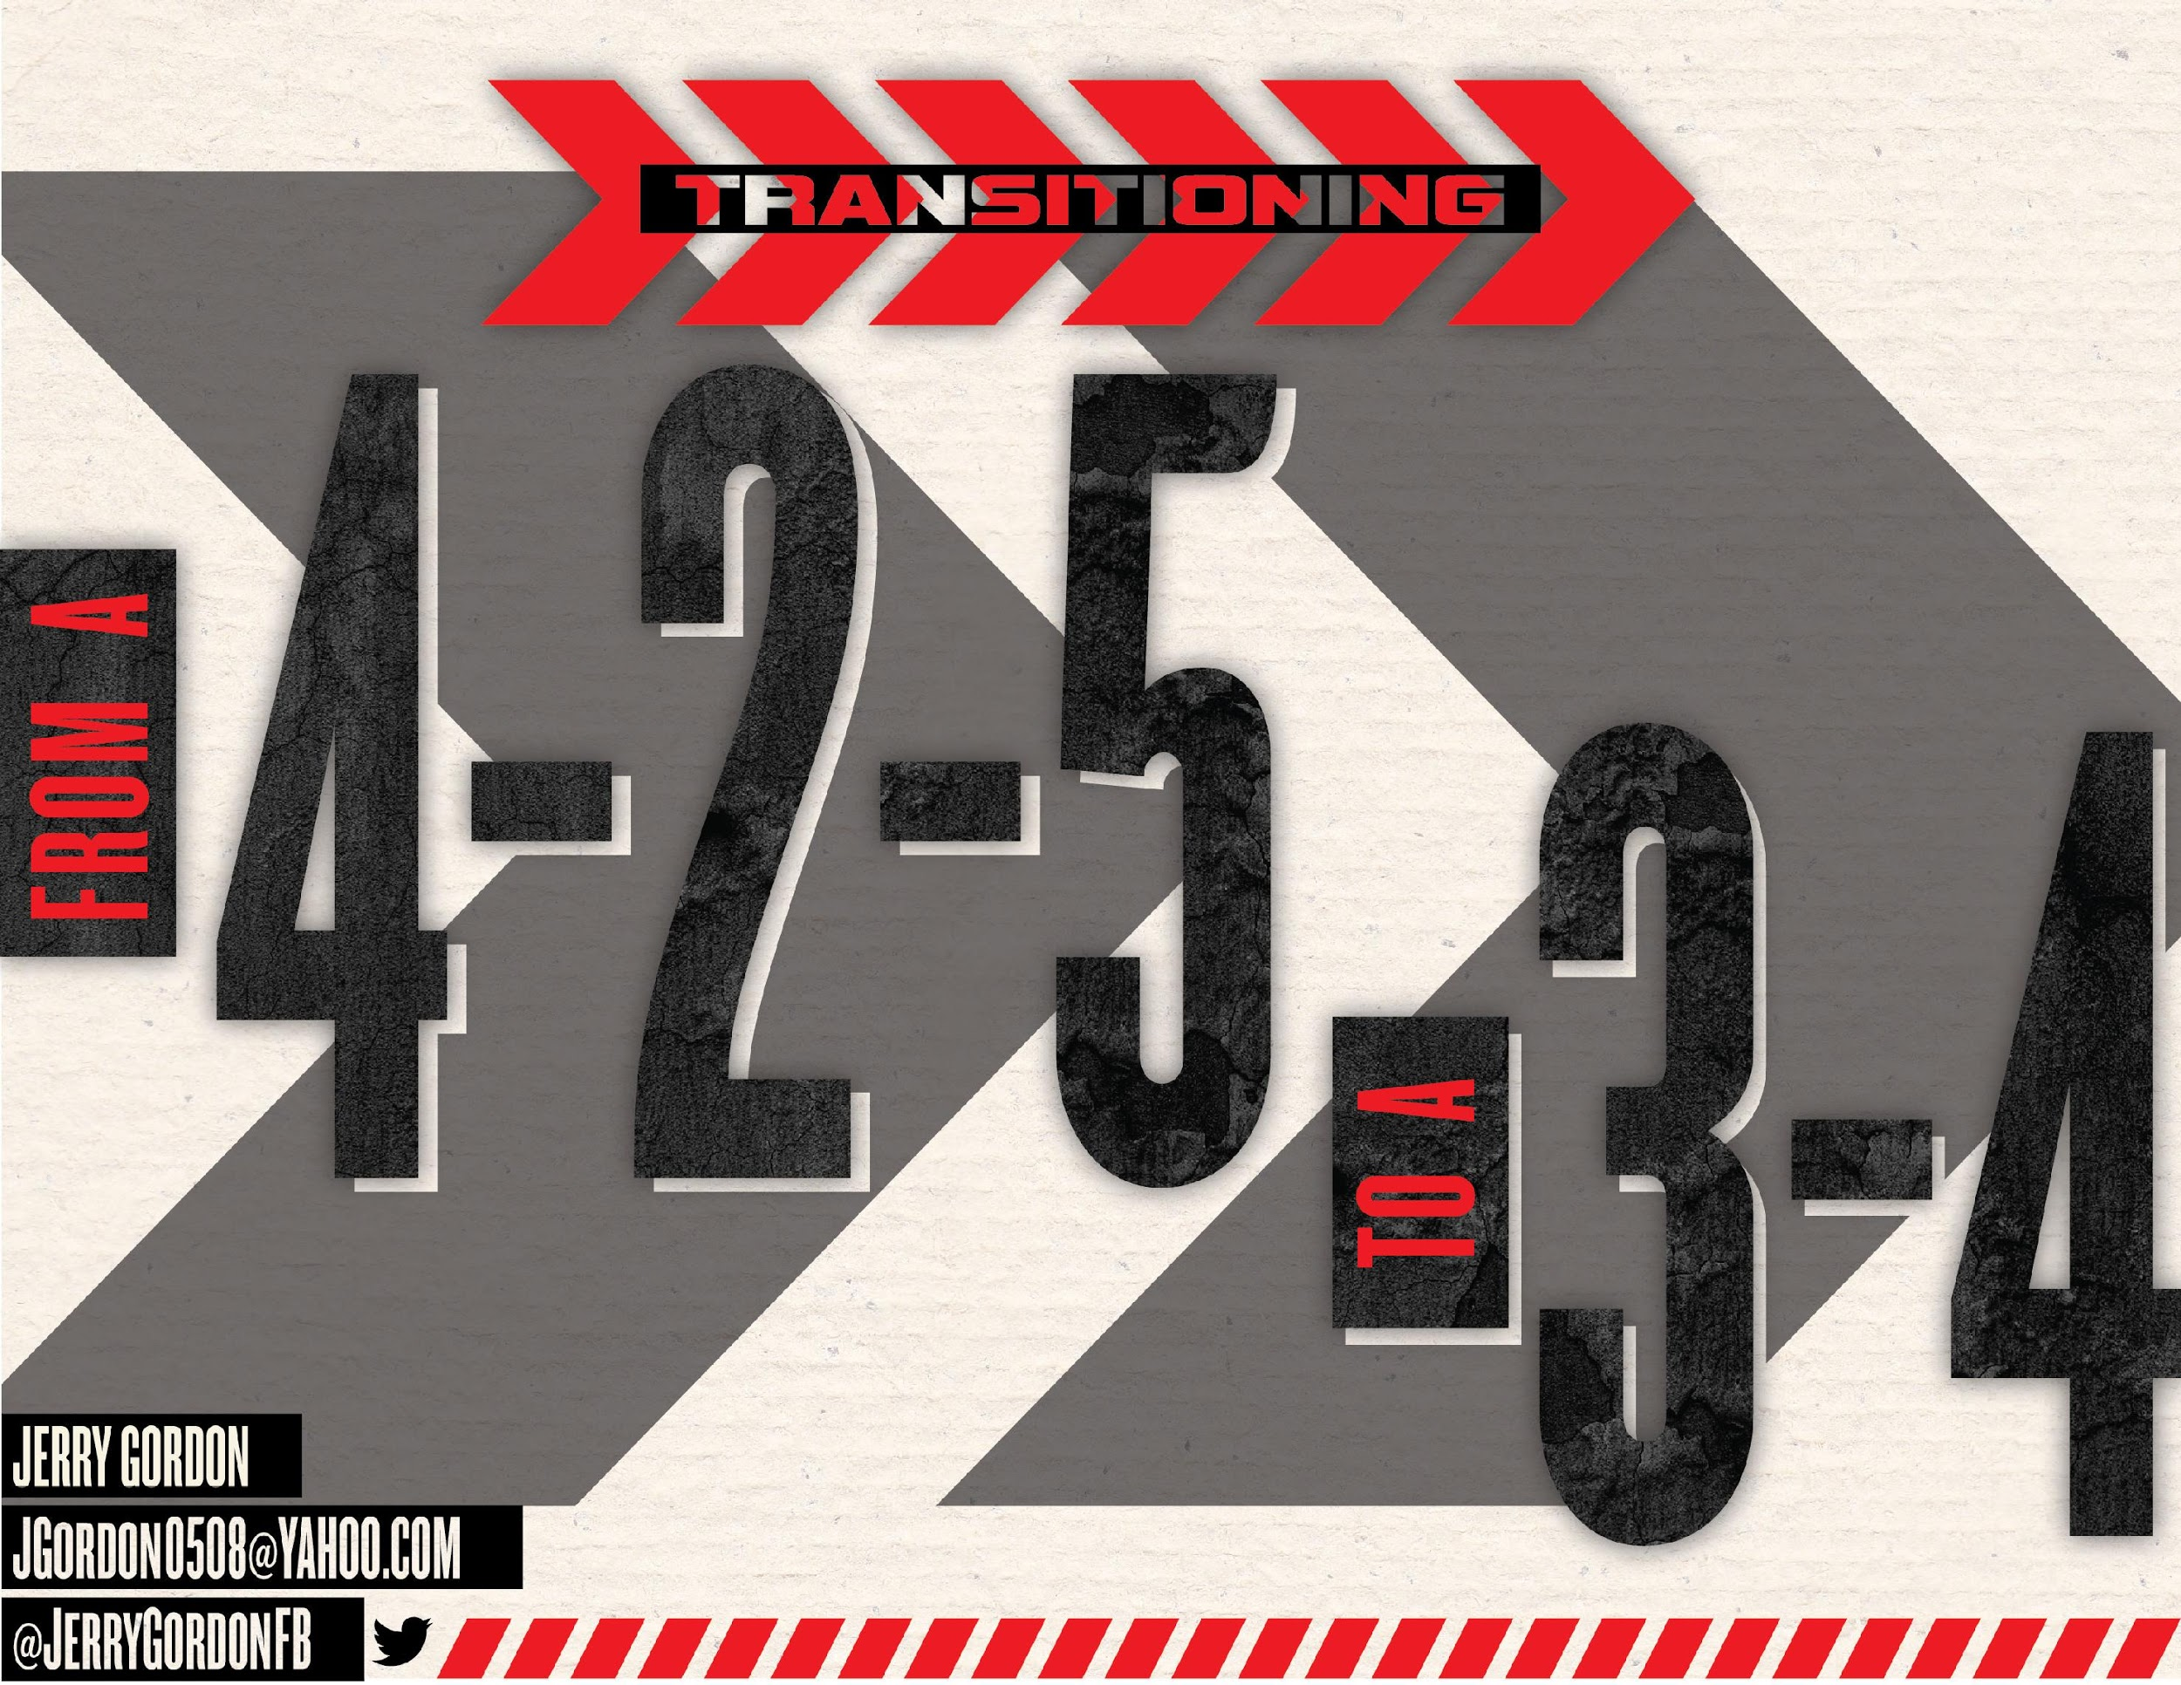

Slide 2
Today’s Agenda
Pros and Cons of playing 4 down and 3 down
Personnel Decisions
How We Line Up
Common Teaching Techniques DL, LB, DB Major points of emphasis

Slide 3
Today’s Agenda
Different Teaching Techniques
Stopping Common Run Plays With Both Defenses FILM!
Pass Coverages: Session 2
How we practice: Session 3

Slide 4
We will NOT talk about
Statistics
My Defensive Philosophy
Stuff that Bama Does
This is the…..

Slide 5
Play Defense…..
…..Not Defenses
Shed….. Pursuit… Tackle
Good Run Game
Solid Special Teams

Slide 6
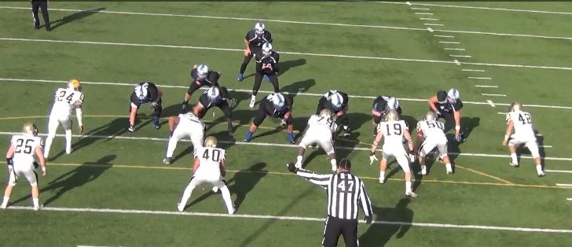
Under Front

Slide 7
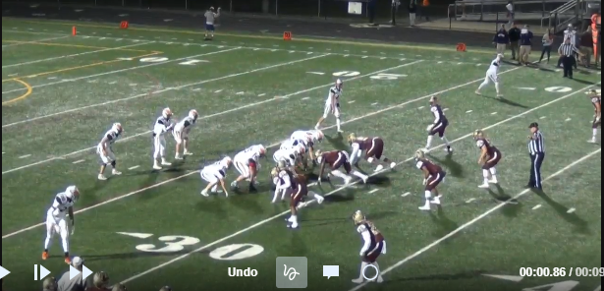
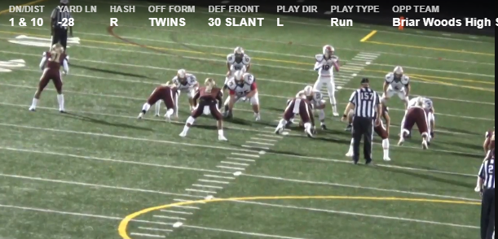
3-4 Wide

Slide 8
3-4 EZ

Slide 9
Pros
Offenses are too good now. Can’t just play one thing
Multiple- Many teams especially Wing-T and Option teams have different calls for each defense
Disguise- Easily move from one to the other before ball is snapped
Carry over between fronts.
Run the same blitzes but from different angles

Slide 10
Cons
Need that Hybrid guy
More teaching
What do you give up??

Slide 11
Personnel
We don’t get to pick our kids
Who are the flowers we see as weeds.
Our kids all have an offensive position and a defensive position
We never mess with OL. They get get first pick of starters. I coach OL too
We try to get as many kids to play as possible.
Everyone is fair game except Center unless he has a very good backup does not play defense

Slide 12
Personnel: Defensive Line
DE/DT/Nose Shade, 3, 5 Some 2i
we love wrestlers.
Relentless Unselfish Tough SOB we used kids from 180#

Slide 13
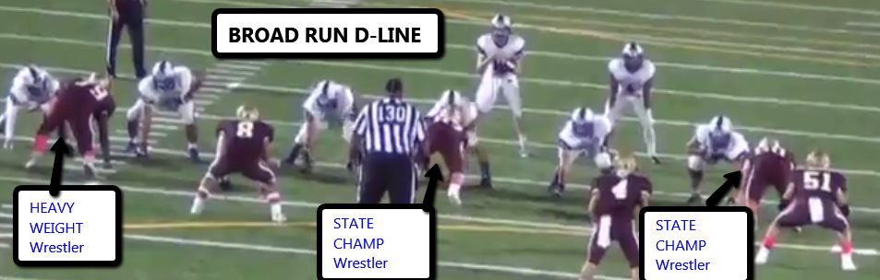

Slide 14
Personnel: Buck
Buck: Techniques (5, Heavy 7, 9)
2 point or 3 point stance Hybrid Dline or LB
Usually more experienced Good understanding of the game. Never going to play him on the hash Never in Man on a #2 See Katy HS (TX)

Slide 15
Personnel: LB’s
$trike- Usually a taller lankier guy. Baseball player. Never on a hash. Good Blitzer Some man Curl to swing of 3 Play pass with body and run with eyes
Mac- Typical LB. Playmaker We like larger running backs Fill the hole signal caller
Will- Usually a little lighter less experienced LB. We cover him up with a 3 tech (Under)

Slide 16
Personnel DB’s
Free- Plays on hash and has fill responsibilities. Mostly to the field. Calls coverage to his side
Rover- he is our most versatile player. Plays on hash and outside the box. Mostly to the boundary Calls coverage to his side of the field
Corners- must be able to play man as necessary. Usually put our best to the boundary. We had our QB the last 2 years play there

Slide 17
How We Line Up 4-2-5
We are an Under/Over team.
We flip/flop personnel
I control the front
Sara, Sally, Split, and Star are our Under front calls
Field is our 4-2-5 front and guarantees the $trike will not be a 9 tech

Slide 18
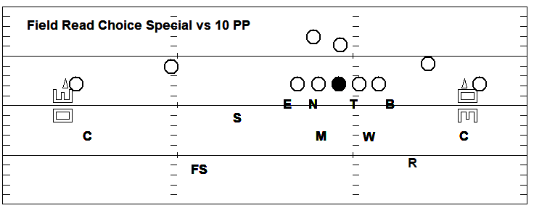
How We Line Up 4-2-5
Make Some alignment slides here

Slide 19
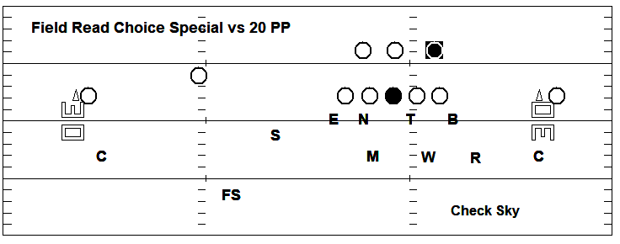
How We Line Up 4-2-5
Make Some alignment slides here

Slide 20
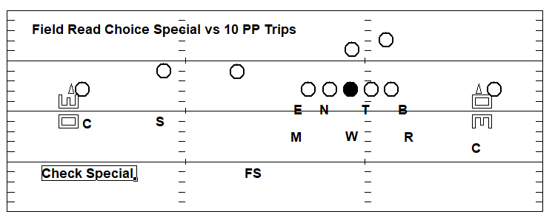
How We Line Up 4-2-5
Make Some alignment slides here

Slide 21
How We Line Up 3-4
30 50 70 90
30 $trike Rush
50 Buck Rush
70 $trike and Buck both Rush
90 $trike and Buck both Drop
Also have used code words: Lambo/Beamer/ Turbo Base

Slide 22
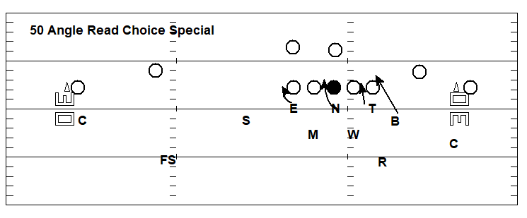
How We Line Up 3-4
Some Basic alignment slides here

Slide 23
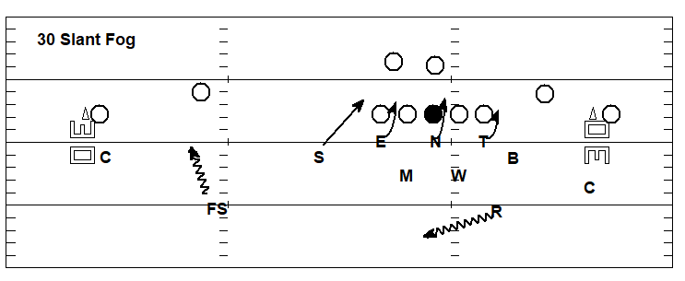
How We Line Up 3-4
Some Basic alignment slides here

Slide 24
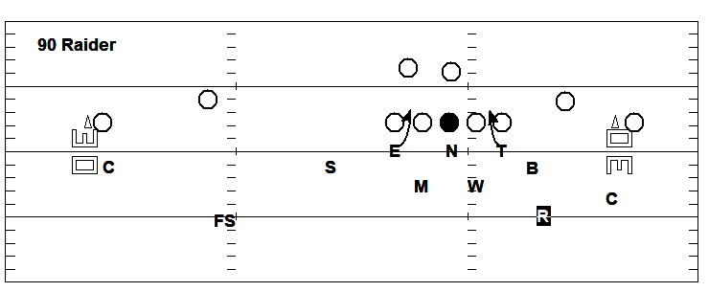
How We Line Up 3-4
Some Basic alignment slides here

Slide 25
Common Teaching Techniques: DL
DL Technique does not change.
Block Down Step Down rule.
Spill Rule Tag Rules
All allow us to play fast
Don’t play much Tite or Mint (4i-0-4i)

Slide 26
Block Down, Step Down Rule
If the offensive lineman blocks down or inside releases,the defensive lineman must step down. This is called the block down, step down rule. As the offensive lineman inside releases, the defensive lineman now must adjust his first step inside with the offensive lineman. The goal of the defensive lineman is to get his hands on the offensive lineman and drive him down towards the ball and to come off the offensive lineman’s butt with his eyes up and his shoulders perpendicular to the line of scrimmage. The defensive lineman drives the offensive player down to keep him off of the linebackers so they are free to make plays

Slide 27
Spill
If the defensive lineman is being kicked out, he must spill this blocker.
• To spill means that the defensive lineman should hit the offensive player trying to kick him out with his outside shoulder and get as far inside as he can and then drive his inside hand up field getting his shoulder square again with the line of scrimmage.
• The defensive lineman wants to contact the offensive player low and on the inside third of his body.

Slide 28
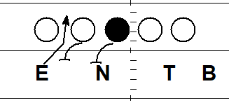
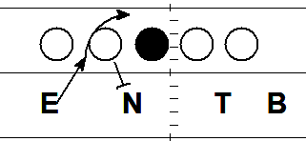
Tag Technique
Move or a slant into an adjacent gap

Slide 29
Common Teaching Techniques: LB
Read Guard to Backs---Downhill assassins
Cloudy and Clear gap
Over the Load and Under the Load concept

Slide 30
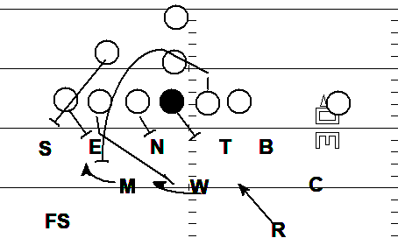
Under the Load, Over the Load

Slide 31
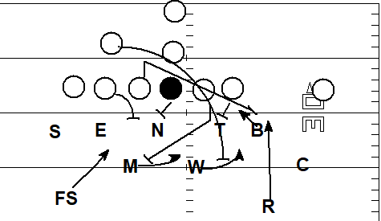
Under the Load, Over the Load

Slide 32
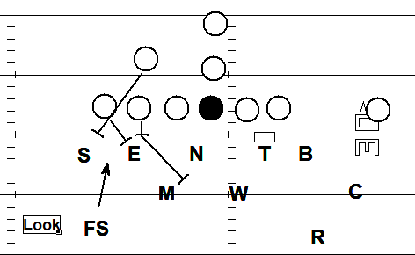
Common Teaching Techniques DB

Slide 33
Different Teaching Techniques: Buck
Need to learn Fold technique
Blitz from stand up
Seam curl flat (Just seam curl for Trap)
Curl to swing of 3 if you want to add read coverage
Always a Box UNLESS 50 angle
We will sometimes sub a Safety at Buck if we have one

Slide 34
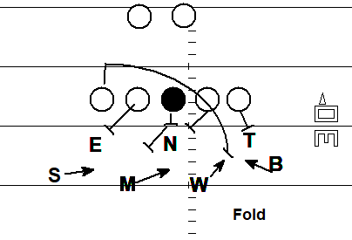
Fold Technique

Slide 35
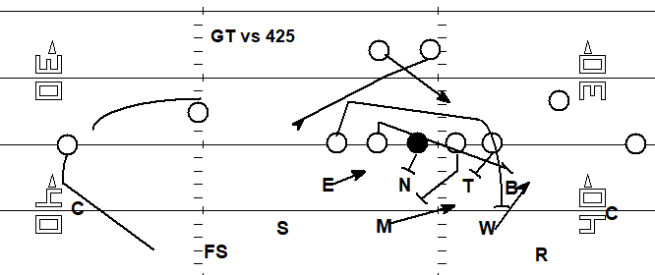
GT vs 425
Clips here

Slide 36
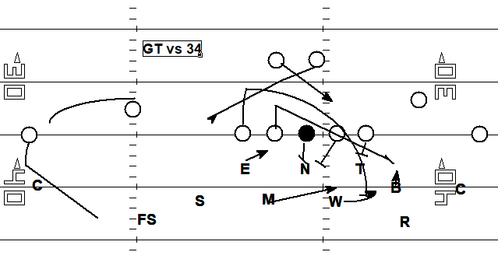
GT vs 3-4
Clips here

Slide 37
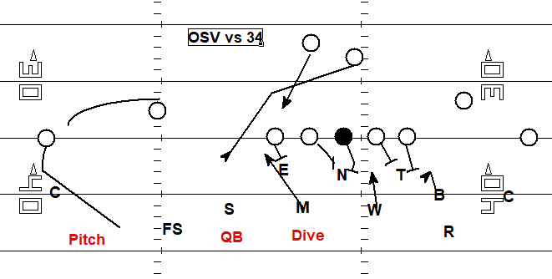
OSV vs 3-4
Clips here

Slide 38
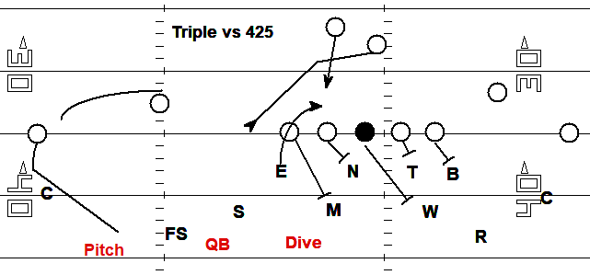
Triple vs 425
Clips here

Slide 39
Favorite Resources
Complete Linebacking - Lou Tepper
Football’s Eagle and Stack Defense Vanderlinden
CoachHuey.com
Quarters Coverage Made Simple - Shap Boyd
Twitter: @JerryGordonFB
Email: jgordon0508@yahoo.com

