Slide 1
Lesson 11: Family
Robert Wonser
Introduction to Sociology

Slide 2
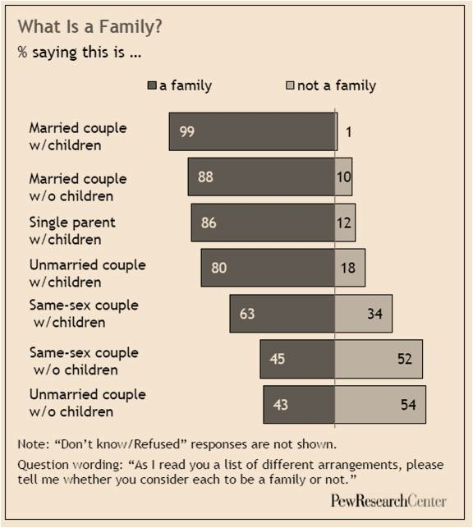
What is a Family?

Slide 3
What is a Family?
The U.S. Census Bureau defines family as two or more individuals related by blood, marriage, or adoption living in the same household.
According to sociologists, family is defined as a social group whose members are bound by legal, biological, or emotional ties, or a combination of all three.
Notes:
People in sociologists’ definition of family may or may not share a household, but its members are interdependent and have a sense of mutual responsibility for one another’s care. This more open-ended definition takes into account the diversity among today’s families.
3

Slide 4
What is the Family?
An extended family is a large group of relatives, usually including at least three generations living either in one household or in close proximity.
Kin is defined as relatives or relations, usually those related by common descent.
Notes:
Extended family most commonly includes a family with children and one or more sets of grandparents, although that is not the only arrangement. When you think of kin, you might think of family that you would run into at a reunion. You may know some of the people that you see, but there are also probably people you don’t know, or at least that you don’t know well. However, some common ancestry ties you together and makes you kin or “kinfolk.”
4

Slide 5
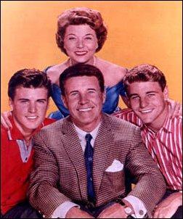
What is the Family?
A nuclear family is a familial form consisting of a father, mother and their biological children.
How common is this family type now?
Notes:
When we think of nuclear families, we tend to think of “traditional” families, however, it is important to note that nuclear families don’t necessarily include a married couple. There are many different ways that nuclear families can be formed, but you can kind of think of this as a heterosexual, two parent household with children.
5

Slide 6
Diversity in Families
Endogamy refers to marriage to someone within one’s social group (race, ethnicity, class, education, religion, region, or nationality).
Exogamy refers to marriage to someone from a different social group.
Which type is more common? Why?
Notes:
Endogamy tends to be more common for a variety of reasons. We still tend to have de facto segregation in our society (segregation as a result of housing patterns, economic patterns, etc.), so we tend to meet people of similar backgrounds. There are also social pressures to marry people of similar backgrounds. Exogamy is becoming more commonly acceptable, but is still less common than endogamy.
6

Slide 7
Diversity in Families
From the time of slavery through the 1960s, many states had antimiscegenation laws (the prohibition of interracial marriage, cohabitation, or sexual interaction).
Notes:
Anti-miscegenation laws were effectively ended by the Supreme Court case Loving vs. Virginia. Loving v. Virginia, 388 U.S 1 (1967), was a landmark civil rights case in which the United States Supreme Court, by a 9-0 vote, declared Virginia’s antimiscegenation statute, the “Racial Integrity Act of 1924", unconstitutional, thereby ending all race-based legal restrictions on marriage in the United States.
7

Slide 8
Diversity in Families
Monogamy, the practice of marrying (or being in a relationship with) one person at a time, is still considered the only legal form of marriage in modern western culture.
Polygamy, a system of marriage that allows people to have more than one spouse at a time, is practiced among some subcultures around the world, but is not widely acknowledged as a legitimate form of marriage.
Notes:
You may hear of polygamous relationships, even in the United States. Individuals may claim to be married to multiple people, but those ties would not have legal meaning and would not hold up in a court.
8

Slide 9
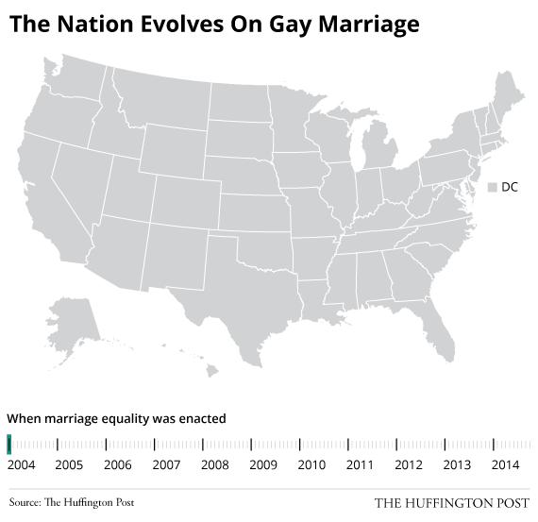
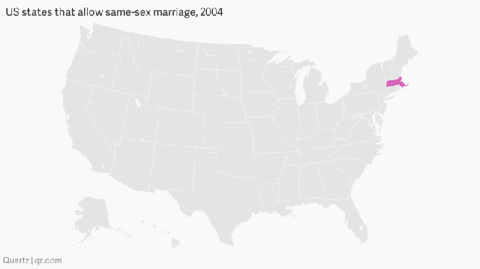
Gay Marriage
The
Notes:
Source: http://www.huffingtonpost.com/2014/10/07/marriage-equality-us_n_5946348.html
9

Slide 10
Sociological Perspectives on the Family
Structural Functionalism views the family as one of the basic institutions that keeps society running smoothly by providing functions such as producing and socializing children, economic production, instrumental and emotional support, and sexual control.
Notes:
10

Slide 11
Sociological Perspectives on the Family
Conflict theorists believe that society revolves around conflict over scarce resources, and that conflict within the family is also about the competition for resources: time, energy, and the leisure to pursue recreational activities.
Inequality begins at home
Notes:
11

Slide 12
Sociological Perspectives on the Family
Symbolic Interactionists examine the types of social dynamics and interactions that create and sustain families, emphasizing the ways that our experiences of family bonds are socially created rather than naturally existing.
Notes:
12

Slide 13
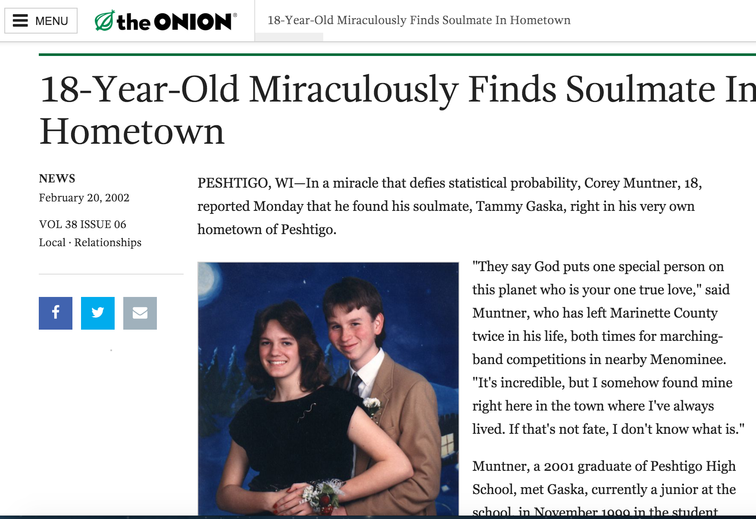
Notes:
http://www.theonion.com/article/18-year-old-miraculously-finds-soulmate-in-hometow-375

Slide 14
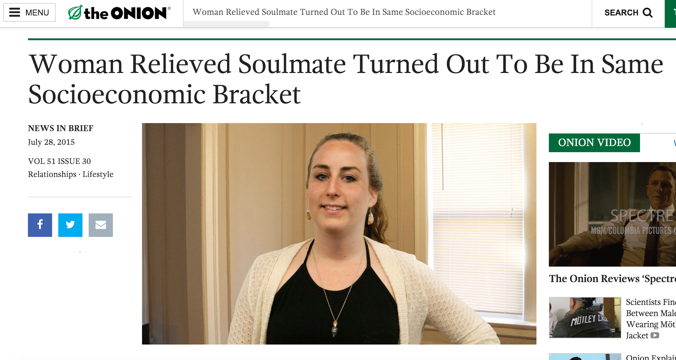
Notes:
http://www.theonion.com/article/woman-relieved-soulmate-turned-out-be-same-socioec-50946

Slide 15
Forming Relationships, Selecting Mates
The process of selecting mates is largely determined by society
Two concepts (homogamy and propinquity) tell us a lot about how this process works.
Notes:
15

Slide 16

Forming Relationships, Selecting Mates - Homogamy
Homogamy means “like marries like,” and is demonstrated by the fact that we tend to choose mates who are similar to us in:
  class, race, ethnicity, age, religion, education, and even levels of attractiveness.
Propinquity is the tendency to marry or have relationships with people in close geographic proximity.
Notes:
Propinquity is logical; we are likely to find possible mates among the people in our neighborhood, at work, or at school. The internet makes courtship and romance possible across much greater geographical areas, as we can now meet and converse with people in all parts of the world, so our pool of potential mates moves beyond local bounds. But even this technology may intensify homogamy by bringing together people with very specific interests and identities.
https://www.youtube.com/watch?v=NVDT1ARABvE
Since we know a little about how families are put together, let’s talk a bit about how they work.
16

Slide 17
Dating is Changing
1932: one third of couples who got married had lived within a five-block radius of each other before they got married.
“people will go as far as they have to find a mate, but no farther.”
Between 2005-2012, more than one-third of couples who got married in the US met through an online dating site.
  Single biggest way people meet their spouses now!
Notes:
17

Slide 18
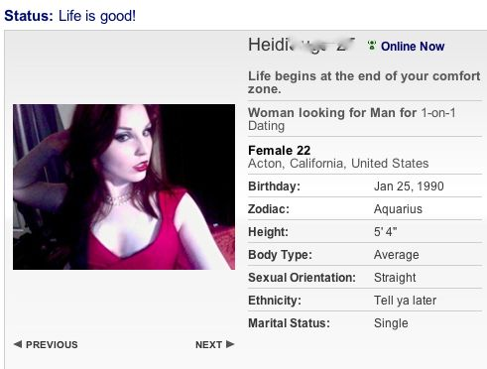

Profile Pictures: Online Dating
90% of your fate depends on it!
For women: “Flirting to the camera” proved most effective, especially when paired with straightforward “selfie” shot down from a high angle with a slightly coy look, preferably with cleavage
For men: not smiling and looking away from the camera. Also, with animals, followed by showing off muscles (six-pack) and then photos showing them doing something interesting.
In other words: do gender!
Notes:
Christian Rudder, Dataclysm, 2014
18

Slide 19
Emerging Adulthood
We get married later now than we used to.
what is happening now is analogous to what happened a century ago, when social and economic changes helped create adolescence — a stage we take for granted but one that had to be recognized by psychologists, accepted by society and accommodated by institutions that served the young.
Similar changes at the turn of the 21st century have laid the groundwork for another new stage, Arnett says, between the age of 18 and the late 20s.
Notes:
http://www.nytimes.com/2010/08/22/magazine/22Adulthood-t.html?pagewanted=all
19

Slide 20
Young people now need for more education to survive in an information-based economy:
fewer entry-level jobs even after all that schooling;
young people feeling less rush to marry because of the general acceptance of premarital sex, cohabitation and birth control;
and young women feeling less rush to have babies given their wide range of career options and their access to assisted reproductive technology if they delay pregnancy beyond their most fertile years.
Most importantly, women can partake, they used to need marriage to become adults
Notes:
27 for women and 29 for men (30 for men and women in big cities like New York and Philadelphia).

Slide 21
From Companionate to Soul Mate Marriage
Companionate marriage = until the 1960s, ‘good enough marriage’ with clearly defined roles that marked adulthood (fit with functionalist’s ideas). You married not for love, but to make a family together. There was no time to wait for ‘the right one.’
“Marriage was too vital an economic and political institution to be entered into solely on the basis of something as irrational as love.” – Stephanie Coontz
Marriage followed 6 months of dating – love was filtered through gender roles, not the partner as an individual.
Notes:
http://www.nytimes.com/2010/08/22/magazine/22Adulthood-t.html?pagewanted=all
21

Slide 22
Soul Mate Marriage
Desire for passion. When it inevitably dissipates we think love has too.
Greatest potential for fulfillment but highest potential for disappointment.
We now expect the one partner to fulfill all the needs an entire community used to give us: belonging, identity, continuity, transcendence and mystery all in one person!
People who marry after 25 are far less likely to divorce than those who got married young.
Notes:
http://www.nytimes.com/2010/08/22/magazine/22Adulthood-t.html?pagewanted=all
22

Slide 23
Doing the Work of Family
Instrumental tasks refer to the practical physical tasks necessary to maintain family life (washing dishes and cutting grass).
Expressive tasks refer to the emotional work necessary to support family members (remembering a relative’s birthday or playing with the kids).
Notes:
Can you guess which category is usually considered appropriate for men and which is considered appropriate for women?
23

Slide 24
Doing the Work of Family
Men and women have always performed different roles to ensure the survival of their families, but these roles were not considered unequal until after the Industrial Revolution.
Work started taking place outside of the home, for a paid wage.
As a result, the kind of work that became valuable was the kind that happened outside of the home.
This is when “housework” became unvalued, because it was not associated with a wage.
Notes:
With the Industrial Revolution, work started taking place outside of the home, for a paid wage. As a result, the kind of work that became valuable was the kind that happened outside of the home. This is when “housework” became unvalued, because it was not associated with a wage.
24

Slide 25
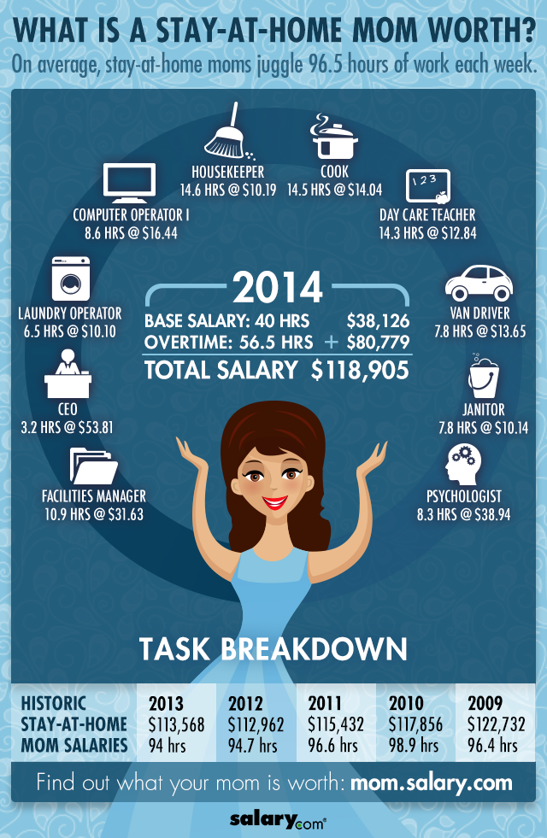
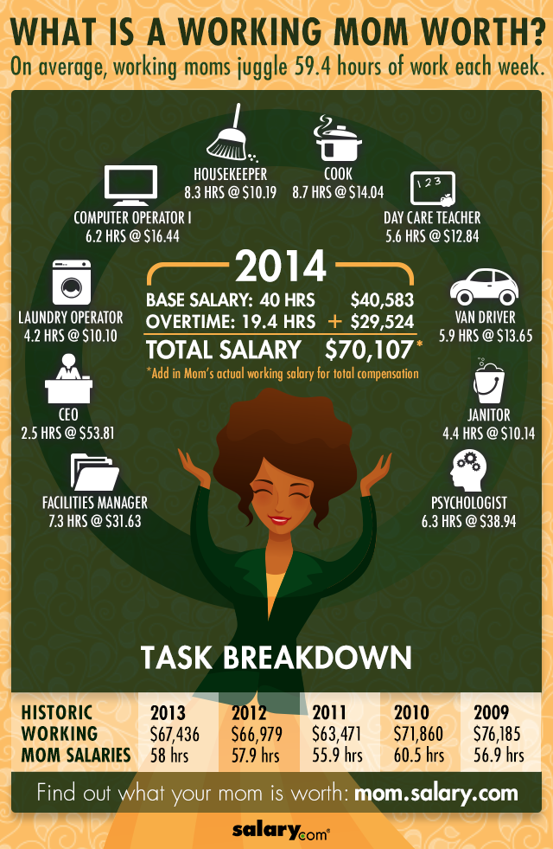
Notes:
Source: http://www.salary.com/2014-mothers-day-infographics/
Criticisms:
Hello, median earnings for women with a college degree in 2007 employed full-time were about $48,500. How could stay-at-home moms this year be doing work with a market replacement value more than twice that?
Two factors help explain this high estimate.
First, respondents to the Salary.com survey reported longer hours of household work than stay-at-home moms in the latest American Time Use Survey (ATUS), collected from a nationally representative sample of the United States population. My estimates based on the 2007 ATUS data show that mothers living in a household with at least one child under 18 who were not in paid employment reported an average of 42.5 hours — not 96.4 hours — of household work a week.
Second, the Salary.com estimates assume that all household work over 40 hours a week (in this case, 56.4 hours!) represents “overtime” that should be valued at 1.5 times normal market wage rates. This is not an unreasonable proposition, but not one that academic researchers like myself normally make.
Source: http://economix.blogs.nytimes.com/2009/05/11/mothers-pay/?_php=true&_type=blogs&_r=0

Slide 26

How does the US fare treating new moms?
Notes:
Ideally, men or women could perform either or both tasks as they see fit and feel comfortable, but we tend to see gender roles and expectations placing men into one category and women into the other.
26

Slide 27

Doing the Work of Family
Women nowadays have two jobs: paid labor outside the home and unpaid labor inside the home.
Second shift (unpaid labor inside the home that is often expected of women after they get home from working at paid labor outside the home).
Many women juggle full-time jobs with caring for their children and running their home with little help from their spouses. According to Arlie Hochschild, what are the consequences of the supermom strategy?
Notes:
Arlie Hochschild’s 1989 study of working couples and parents found that women were indeed working two jobs: paid labor outside the home and unpaid labor inside the home.
27

Slide 28
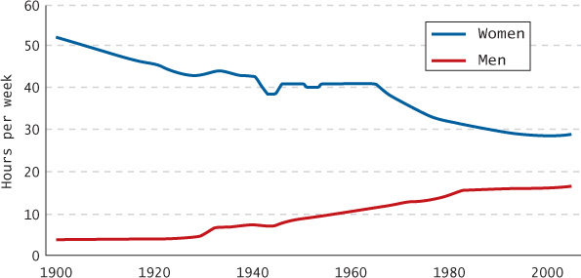
Trends in Housework since 1900

Slide 29
Family and the Life Course
Life expectancy is increasing. What is happening to the elderly population?
  About 10% of the elderly live below the poverty line.
  Care of the elderly is no longer a primary function of family: over 40% of senior citizens will spend time in a nursing home.
Notes:
The American population is aging because of the baby boom generation (the large number of Americans born in the post World War II era). Current life expectancy in the United States is seventy-seven years (with women living an average of five years longer than men).
Currently about 10 percent of the elderly live below the poverty line. Also, the care of the elderly is no longer a primary function of family: over 40 percent of senior citizens will spend time in a nursing home. Finally, coping with the transitions of retirement, widowhood, declining health, and death are central tasks for seniors.
29

Slide 30
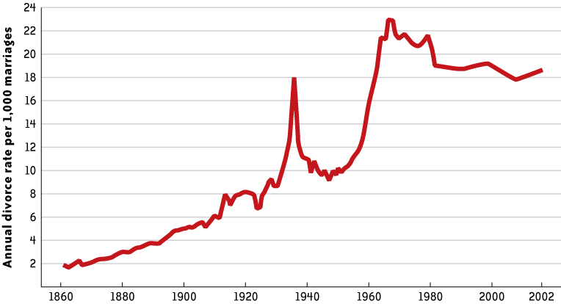
U.S. Divorce Rate Over the Past Century

Slide 31
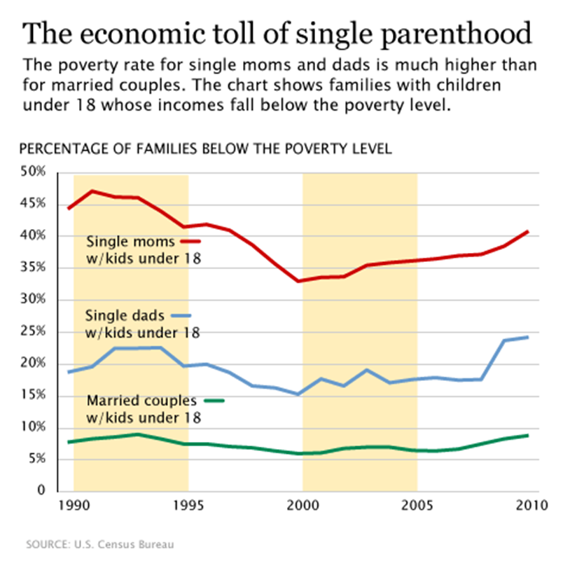
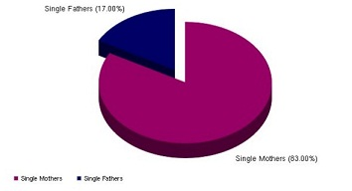
Single Parenthood

Slide 32
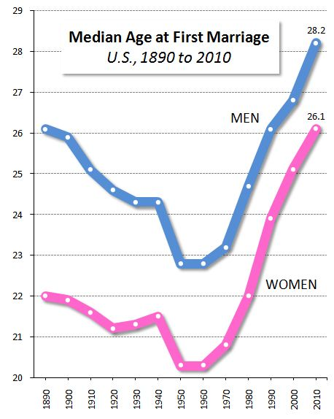
% of 25 to 35 year olds are married:
1960: 80%
2000: 55%
2010: 45%
Why:
  Education
  Cohabitation
  All Things Considered

Slide 33
Trends in American Families
About 8% of all households are occupied by couples who are cohabiting (living together as a romantically involved, unmarried couple).
Cohabitation of unmarried couples totals about 8.1 million couples who live together in the United States as of 2011.
Notes:
More than 11 million people are living with an unmarried partner, including both same-sex and different-sex couples
33

Slide 34
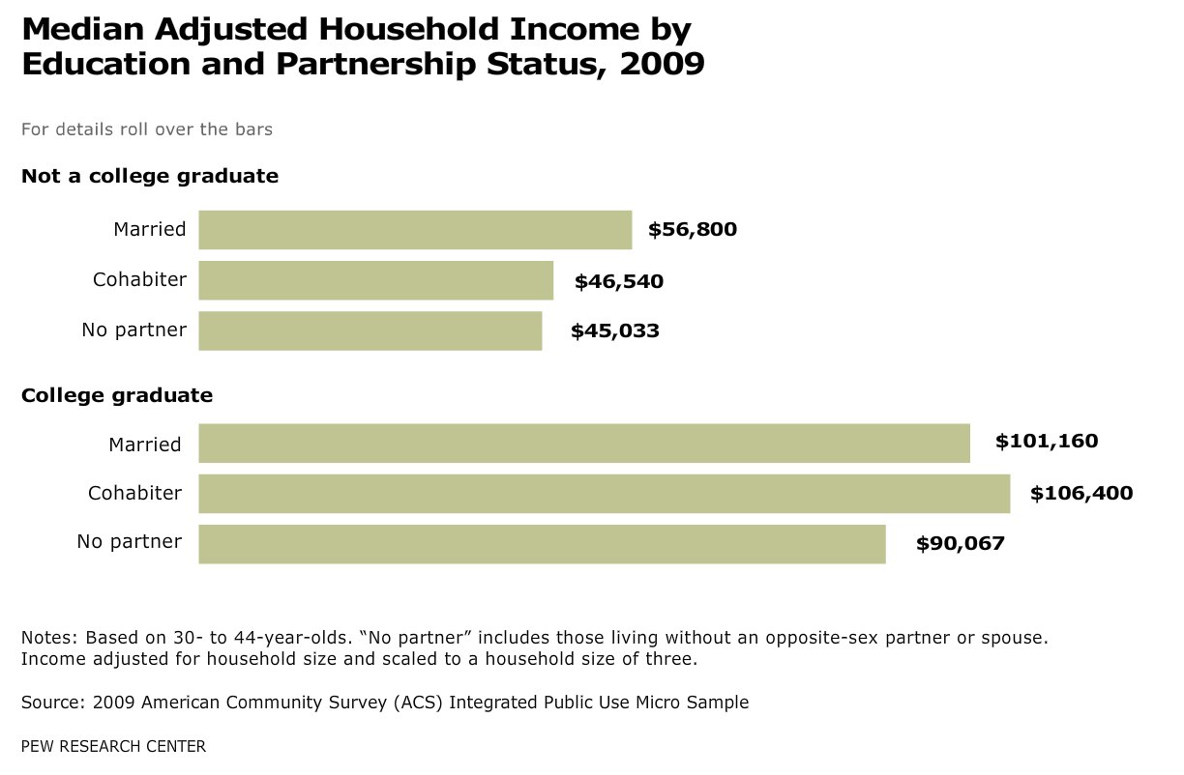

Slide 35
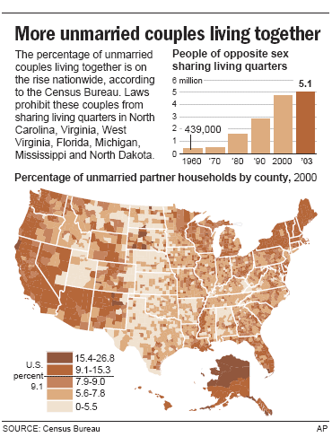
Cohabitation in the United States
The share of 30- to 44-year-olds living as unmarried couples has more than doubled since the mid-1990s. Adults with lower levels of education—without college degrees—are twice as likely to cohabit as those with college degrees.

Slide 36
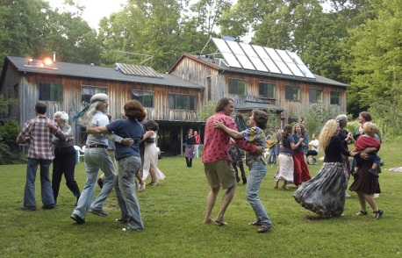
Trends in American Families
Increases in the numbers of:
  Single people.
  People who are cohabitating
  Single parents
  People who are living in intentional communities (any of a variety of groups who form communal living arrangements outside marriage).
Notes:
Married couples were the dominant household model through the 1950s, but their numbers have slipped from nearly 80 percent to just above 50 percent now. Currently, 30 percent of all households are made up of people who live alone.
Currently, more than 11 million people are living with an unmarried partner.
Currently, one-third of all first births are to unmarried partners.
Intentional communities are any of a variety of groups who form communal living arrangements outside marriage.
36

Slide 37
The Postmodern Family
Families adapting to the challenges of a postmodern society may create family structures that look very different from the “traditional” family and can include ex-spouses, new partners and children, other kin, and even non-kin such as friends and coworkers.
Notes:
37

Slide 38
Lesson Quiz
1. How do contemporary sociologists define family?
    a. Relatives or relations, usually those related by common descent
    b. A social group whose members are bound by legal, biological, or emotional ties, or a combination of all three
    c. Two or more individuals related by blood, marriage, or adoption living in the same household
    d. A two-parent household with children
Notes:
38
ANS: B

Slide 39
Lesson Quiz
2. The fact that people tend to marry someone from a similar social class background demonstrates:
      a. endogamy
      b. polygyny
      c. polyandry
      d. exogamy
Notes:
39
ANS: A

Slide 40
Lesson Quiz
3. The prohibition of interracial marriage, cohabitation, or sexual interaction is called:
      a. antimiscegenation
      b. antifulcrumation
      c. antiinternization
      d. antipolygamation
40
Notes:
40
ANS: A

Slide 41
Lesson Quiz
4. Which of the following is NOT a current trend in the population of American families?
      a. There are more single people.
      b. There are more married couples.
      c. More people are cohabitating.
      d. Modern families include a greater variety of structures, like new partners, ex-spouses, and step-children.
41
Notes:
41
ANS: B

Slide 42
Lesson Quiz
5. The unpaid labor inside the home that is often expected of women after they get home from working at paid labor outside the home is called:
      a. gendered work
      b. instrumental work
      c. a resistance strategy
      d. the second shift
42
Notes:
42
ANS: D

Slide 43
Some Reflections
The family too is socially constructed.
Its form and structure reflects the society and culture it emerges out of.
Who we marry is largely structured by society.
The Family as an institution is undergoing fundamental change.

