Slide 1
Joint Water Project Update
East Range Water Board, City of Aurora, & Town of White Special Meeting | July 27, 2022

Slide 2
Presenters
Kevin Young, PE
Asst. Project Manager
Mike Larson
Funding Specialist
Shannon Sweeney
David Drown Associates

Slide 3
Overview
Project History
Project Highlights
Project Status
Water Treatment Plant & Raw Water Intake
Engineering Task Update
Construction Cost Estimate
Pending Leases, Titles, Easements
Financing & Funding Initiatives

Slide 4
Project History
Tasks 1-1A – Shared Infrastructure Analysis & Preliminary Design (2019-2020)
Reviewed several raw water intake types and locations for the WTP
St. James Pit Feasibility Study (2020-2021)
Evaluated feasibility of continuing to use St. James Pit as water source
Tasks 2 & 3 – Final Design & Permitting (2021-2022)
Design of WTP, raw water intake, water mains
Environmental Review, Appropriations Permitting, Wetland Delineation

Slide 5
Project Highlights

Slide 6
Project Highlights
Design process
Technical Committee Meetings to review “nuts and bolts”
Water Committee Meetings to provide progress updates and solicit high level input
ERWB hired building official consultant to review drawings and specifications for conformance with building codes
Toured area WTPs to determine which features staff liked…or didn’t like

Slide 7
Water Treatment Plant
Designed to be constructed primarily of concrete to last decades
Accounts for future expansion
Utilizes modern treatment equipment to minimize footprint require to satisfy current design standards
Treatment process is familiar to existing operators and is similar to other surface water facilities in the area

Slide 8
WTP Exterior Perspective – Viewing from SE

Slide 9
WTP Exterior Perspective – Viewing from NW

Slide 10
Raw Water Intake & Pump Station
Vertical Caisson style pump station
Intake pipe will extend from wet well on shore to a screen 50’ below water surface
Below future low water level in Embarrass Pit
Pump station structure is sized to include up to four (4) pumps, with only two (2) being installed as part of this project.

Slide 11
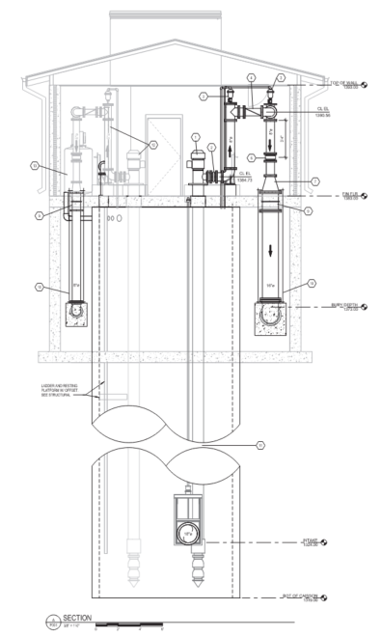
Raw Water Intake & Pump Station

Slide 12
Project Status
Task | Description | Status
1 | Preliminary Design | Complete
2 | Final Design | Complete
3 | Permitting & Regulatory Approvals | Awaiting completion of Archaeological Assessment Phase 1 Investigation MDH has approved Drawings & Specifications Awaiting response from DNR on water appropriations permit
4 | Bidding Services | Awaiting completion of Archaeological Assessment Phase 1 Investigation and SHPO approval, anticipated to begin September 2022 Awaiting final funding package
5 | Construction Phase Services | Construction anticipated to begin spring/summer 2023 with completion in November 2024

Slide 13
Estimated Project Cost
Project Component | Estimated Cost
Water Treatment Plant | $11,362,914
Water Main – Scenic Acres | $985,220
Water Main – Pineville | $505,730
Raw Water Intake Facility | $5,688,931
Raw Water Transmission Main | $1,852,720
Construction Subtotal | $20,395,515
Contingencies & Market Conditions | $2,039,552
Geotechnical Borings & Testing | $163,895
Legal | $101,978
Fiscal | $101,978
Administrative | $101,978
Engineering | $1,278,680-$1,394,950
Estimated Total Project Cost | $24,183,574-$24,299,844

Slide 14
Pending Leases, Titles, Easements
St. Louis County – final lease documents provided to ERWB for approval (raw water intake site)
DNR Lease – DNR finalizing internally as of 7/11/22 (raw water intake site)
Rosa Easement – Mr. Rosa provided counter proposal to initial offer on 7/25/22
MnDOT Permit – MnDOT provided comments on pipe alignment with respect to R/W. SEH updated design and will formally submit for permit in August.

Slide 15
Funding Initiatives
Funding Opportunity | Status | Amount
State Bonding Bill | Secured | $7,500,000
Directed Community Spending (Earmarks) | Secured | $2,500,000
Public Facilities Authority (WIF) | Committed | $8,000,000
IRRRB | Committed | $2,000,000
Army Corps 569 | Applied | $1,000,000
Directed Community Spending (Earmarks) | Applied | $4,000,000
Total |  | $25,000,000

Slide 16
Financing – PFA Loan of $2.5 million

Slide 17
Financing – PFA Loan of $5 million

Slide 18
Questions?

