Slide 1
Potomac Watershed Roundtable
Environmental considerations with respect to
industrial utility scale solar development in Virginia
Scott Cameron, Vice Chairman and Legislative Committee Chairman, Northern Virginia Soil and Water Conservation District
January 12, 2024

Slide 2
It seemed like a good idea at the time……….
Virginia Clean Economy Act was passed in 2020
Idea was to reduce greenhouse gas emissions to address climate change
Directs Virginia’s electric utilities to be carbon-free in electric generation by 2050
Mandates closure of coal, oil, natural gas power plants
Mandates 16,000 Megawatts of utility scale solar energy generation capacity

Slide 3
Issues
Solar developers are cutting forests and converting prime farmland that provide water quality benefits, fish and wildlife habitat
Acreage permitted for utility scale industrial solar in Virginia is growing at an average rate of 77% per year based on linear regression model
It takes 5-12 acres of land to create 1 MW of solar generating capacity
Based on VCEA, 317,000 acres may be converted to solar by 2045 - DEQ, March 2023
However, worst case, data center demand for renewable energy drives loss of about 1,500,000 acres by 2050, assuming no nuclear or natural gas to keep data centers running after dark – Piedmont Environmental Council, 2023
About 61% of the roughly 30,000 acres of ag land used so far for solar projects is high-suitability cropland – VCU, May 2021
69% of existing solar facilities had regulatory “issues” with stormwater/erosion – DEQ, April 2023
As of 2023, more than 10,000 acres of forest have already been lost to industrial solar “farms”, but Virginia owes the region 48,000 acres of new forest by 2025 under the latest Chesapeake Bay agreement, but had only planted 6,600 acres
Solar stormwater pollution undercuts urban investment in stormwater management (e.g.: $135M by NOVA last year, $1B by Richmond by 2028)
Data centers already 21% of Dominion’s baseload, and that’s growing at 27% annually

Slide 4
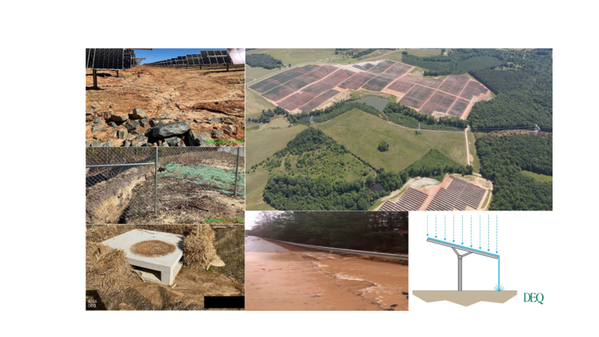

Slide 5
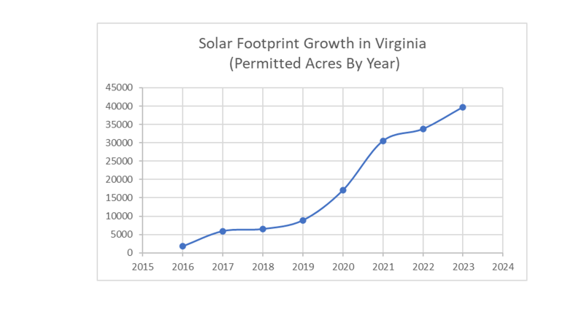

Slide 6
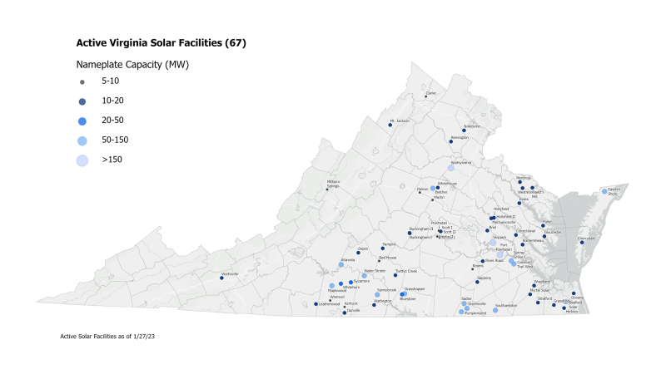

Slide 7
So what to do?
Change the incentives in Virginia state law
Incentivize solar siting in brownfields, residential and commercial structures, parking lots -- Delegate Paul Krizek’s bills HB 197, HB 198, and HB 199
Disincentivize siting utility scale industrial solar in forests and prime farmland
Promote compatible agrovoltaics (e.g.: sheep grazing, pollinator habitat, crops)
Comment on DEQ’s upcoming HB 206 regulations to mitigate the environmental impact of solar
DEQ’s stormwater Guidance Memo 22-2012 issued on 11/30/22, and effective 12/31/2024, requires more stringent stormwater controls for utility scale solar not yet connected to the grid by the effective date.

Slide 8
Ask Solar Developers Probing Questions
1. Have you built a solar facility in Virginia before? If so, where, and would DEQ confirm that your other project(s) are fully compliant with state water quality regulations? If you have not built a project in Virginia before, where have you done solar projects in the past, and what is your environmental compliance track record in those other states?
2. What will be done with the topsoil in the construction area? Will the area soils be compacted during construction, making it hard to return the land to agriculture when the project is decommissioned?
3. Will you install screening with vegetation and setbacks from property lines?
4. Will you install riparian buffers along all hydrological features (like springs, ponds, and streams) within the project area?
5. Are you providing enough space between the rows of panels to support plant growth and allow water infiltration?
6. Will you ensure proper erosion, sediment and stormwater runoff controls. (Solar panels themselves, after all, are impervious surfaces.)
7. Will you guarantee that the land be returned to its original use if solar panels are removed before the end of the lease term?
8. Will your project disturb prime farmland, forests, or cultural resources?

Slide 9
Ask More Probing Questions
9. Are you open to livestock grazing as a vegetation management tool under the panels, making the area pollinator habitat, or perhaps allowing some type of conventional agriculture under the panels (e.g.: vegetables).
10. Are you posting a bond for decommissioning the project at the end of its useful life? If so, are you reducing the amount of the bond by some estimate of the recycled value of the panels and support structure? If so, what makes you think those will have any value at all 30 years from now?
11. What financial incentives are you offering the County?
12. Do you have a customer for the solar power lined up, or are you building this project speculating that you will eventually have a customer?
13. Will new transmission lines have to be built to accommodate this project, and if so, where will the lines run?
14. Will you commit to holding title to the project all the way through construction to the point where it starts generating power, or are you planning on selling it to some other party along the way? If you plan on selling before power is generated, will the County have the ability to approve or veto anyone to whom you might sell the project? Can you guarantee that whatever conditions the County imposes on your project will be adhered to by any subsequent project owner?
15. Will you commit to adhering to DEQ’s stormwater Guidance Memo 22-2012, even if your project is connected to the grid before the Guidance Memo’s 12/31/2024 effective date?

Slide 10
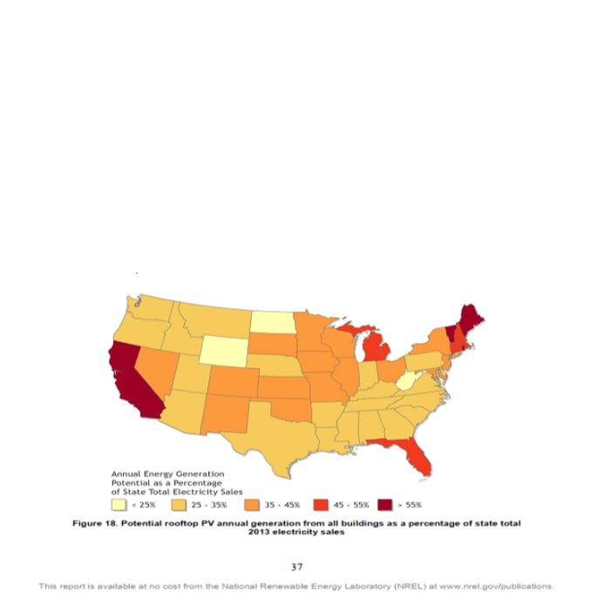
Rooftop solar could provide about 30% of Virginia’s 2016 electricity demand says DOE’s National Renewable Energy Laboratory, January 2016

Slide 11
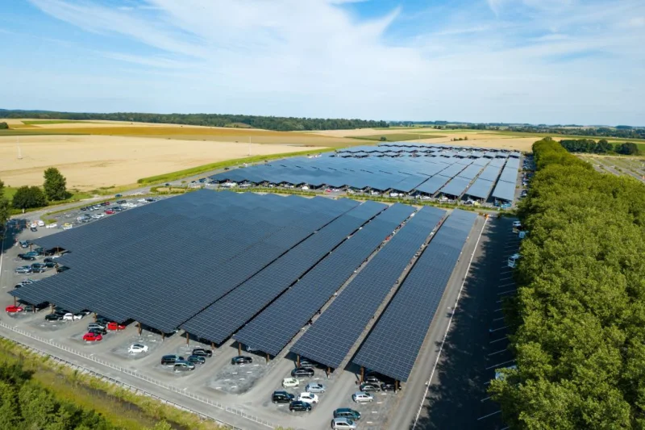
Parking lots could provide as much as 33% of US electricity demand according to Time magazine, 12/8/22. Photo below is a Belgian parking lot

