Slide 1

New Data
Boot Camp
Presented by:
April Hale, DeKalb Co.

Slide 2
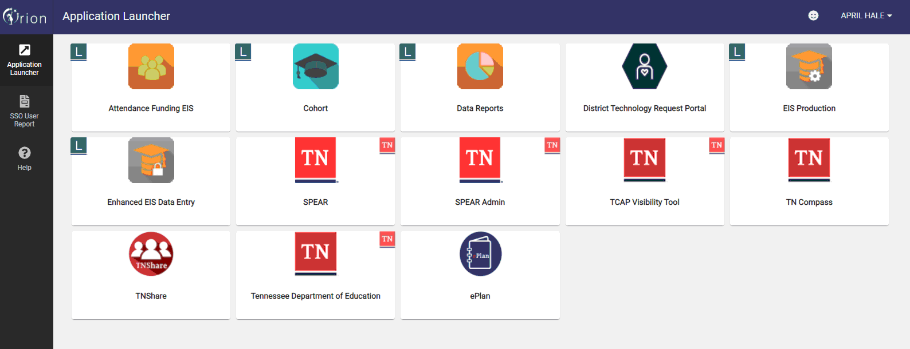
Single Sign-On Dashboard*

Slide 3
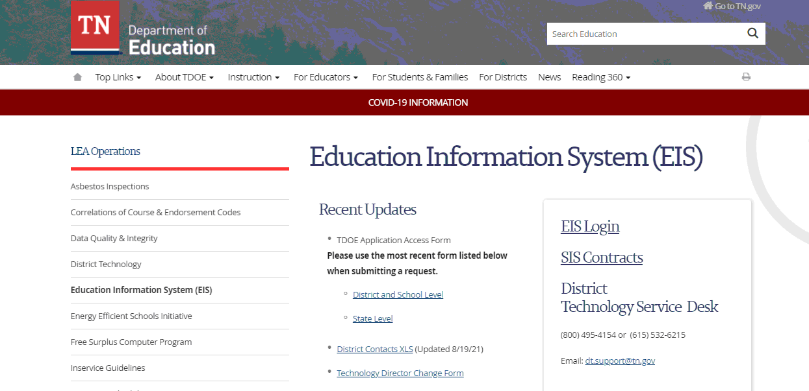
District Contact Information
Application Access Form Version 7.2
Review and update EIS contact Information when a staff change is made.
Application Access is used to add new access, modify access and remove access for employees.

Slide 4
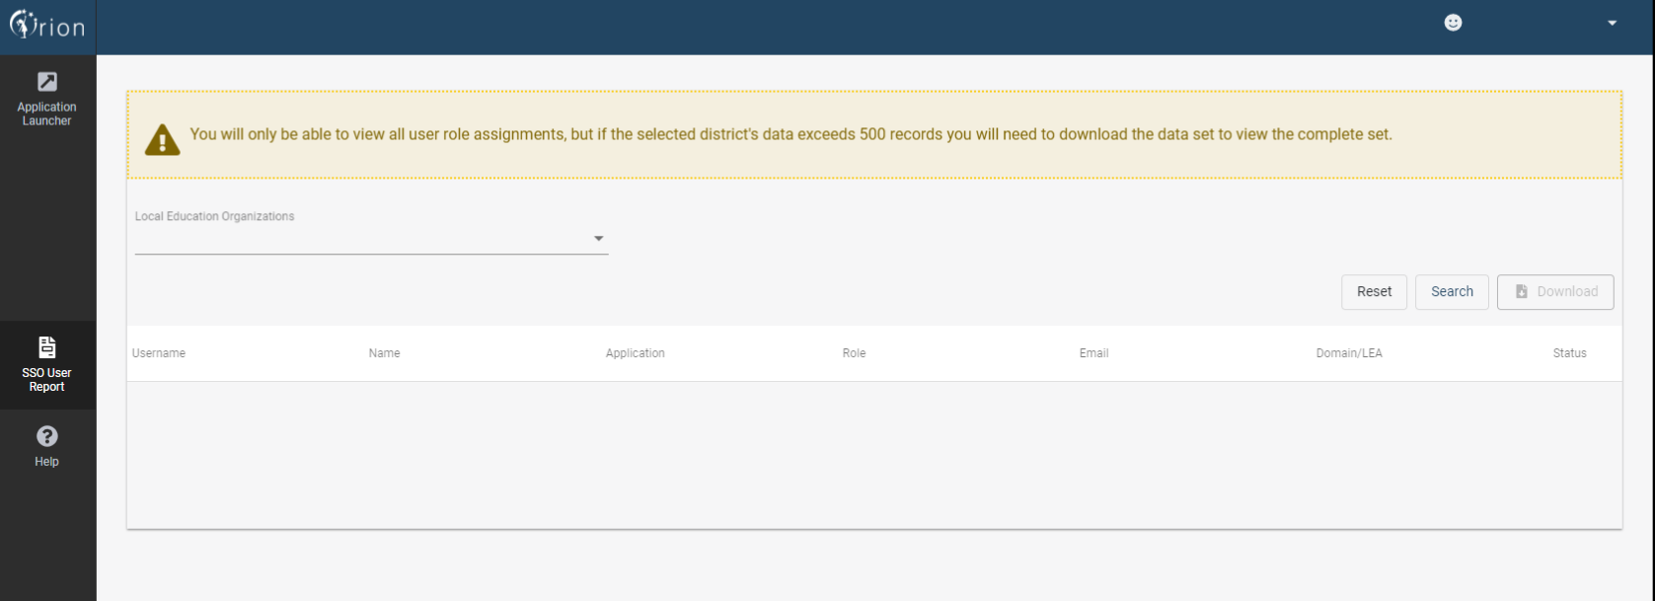
Single Sign-On User Report
The SSO User Report will be assigned for users that have an EIS Production security role of DST_AA (District EIS Approval ADM).

Slide 5
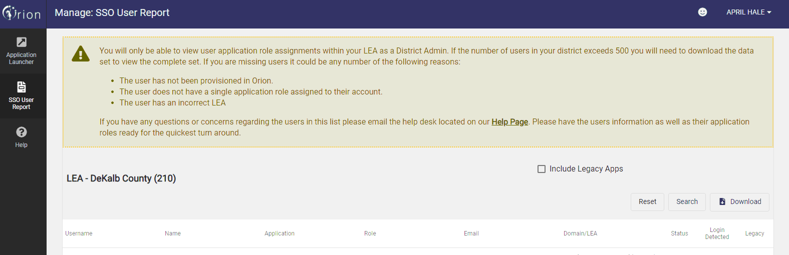
Search for Users
Download the list with or without the legacy accounts.
The Status and Login Detected column will be beneficial to District Data personnel as they work locally to confirm that staff members log-in at least one time to their SSO account.

Slide 6
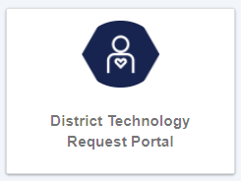
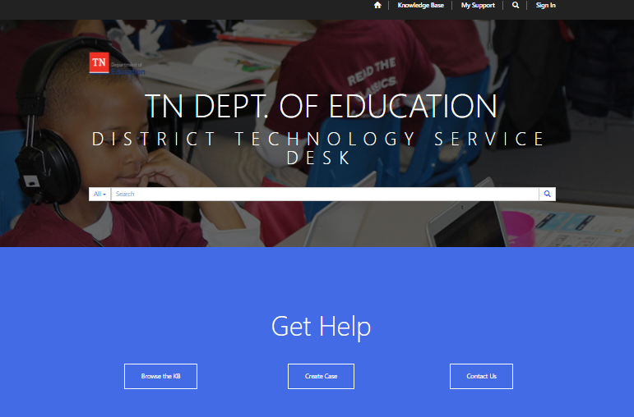
District Technology Request Portal

Slide 7
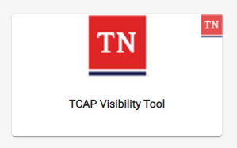
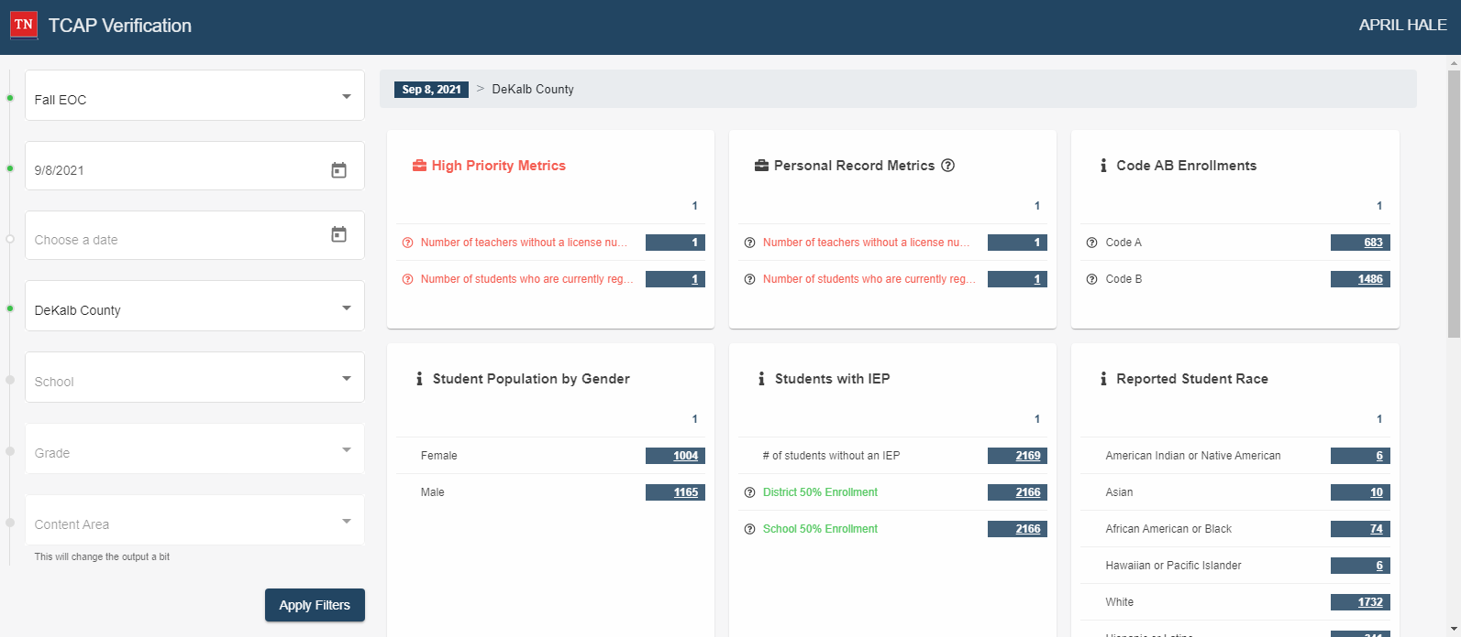
TCAP Visibility Tool

Slide 8
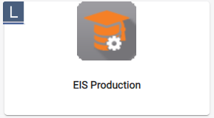
EIS Production
Education Information System. Contains selected state wide student, staff, class and calendar information by school year. What can this database do for your district?
Gives districts the ability to track students from school to school across TN
Allows districts to look up staff licensure information
Enables districts to correct school levels errors that prevent funding
Supplies districts with a means of contacting other districts
Bridges the gap between districts and allows for communication

Slide 9
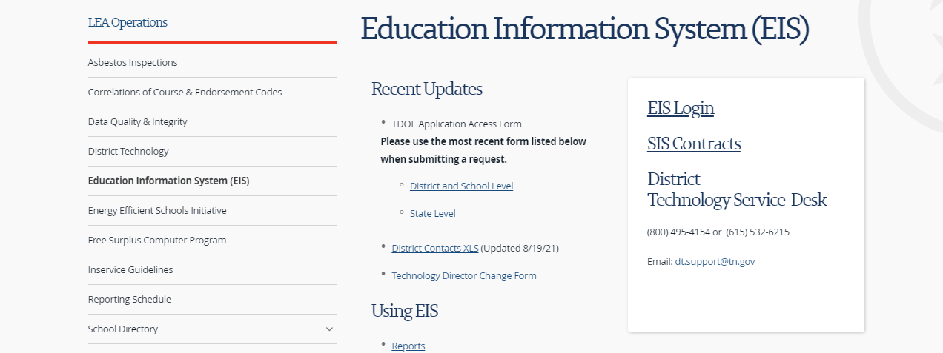
EIS Website
Department of Education- EIS homepage

Slide 10
What Info do I need for upload to EIS?
Reminder- EIS is updated nightly with data transmitted from your SIS package
EIS Appendices
EIS Data Dictionary
EIS Extracts Layout
CPM DATA MANUAL

Slide 11
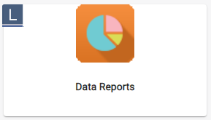
DATA REPORTS
RESEARCH QUERIES
ADM Audit Report
Federally Funded Classes
Student Disciplinary Actions
Homeless
Truant Student List
Student Membership List
And many more
STANDARDS REPORTS
Cohort
Membership Summary
Promotions and Retentions
Special Ed Option Reports
Statewide Student Key
Suspension and Expulsion Reports
And many more

Slide 12
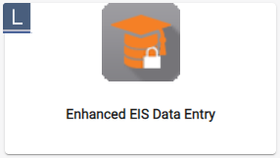
Enhanced EIS Data Entry
You must agree to the EIS Entry Disclaimer screen. This application should only be used as a last resort by districts for data that cannot be uploaded from their SIS package.
District Calendar, District events, Instructional program, Class, Student and Staff are the search options.
Each category will have options as well
Corrected data will need to be saved in order to update in EIS
Corrected data usually takes 24 hours to show up on EIS

Slide 13
Other Dashboard Tiles
Attendance Funding EIS
Cohort
Spear
Spear Admin
TN Compass
TNShare
EPlan

Slide 14
Key Items to Remember:
Funding is based on data uploaded to EIS
There are nine reporting periods in a school year. Four of the nine reporting periods are used in the BEP calculation (2- 12.5%, 3- 17.5%, 6- 35%, 7- 35%)
Students with blocked approval errors do not count in ADM/ADA
Students with Fatal Errors do not count in ADM/ADA
Expelled students do not receive an ADM or ADA
Suspended students do not receive ADA
Service Only students do not count in ADM/ADA
Students missing a schedule in EIS do not count in ADM/ADA

Slide 15
Live Data
Links in EIS to use daily:
Dynamic Errors
Block Approval Errors
Student Standard ADM Search on EIS homescreen

