Slide 1
Sundar Shadi Contest Winners
El Cerrito Garden Club
2020

Slide 2
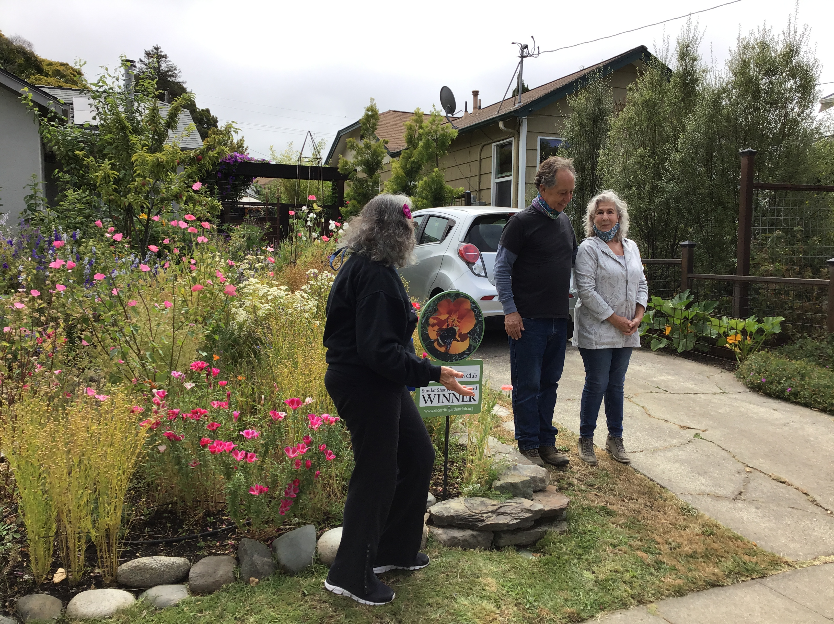
Rick & Monica
122 Julian

Slide 3
LIST OF ATTENDEES
for
EL CERRITO GARDEN CLUB
SUNDAR SHADI WINNERS PRESENTATION
June 20, 2020
Monica and Rick Padmos
122 Pomona Street
El Cerrito, CA 94530
Louise Moises, Sundar Shadi Committee Chair
Marth Jackson, President
Landry Wildwind, 1st Vice President
Phuong Le, 2nd Vice President
Eileen Libby, Nominator
Tracy Giles
Bonnie McKenzie
Kate Steinel
Le Merle Milsom
Marianne Aubert
Video: Bonnie E. Smith, Board Secretary

Slide 4
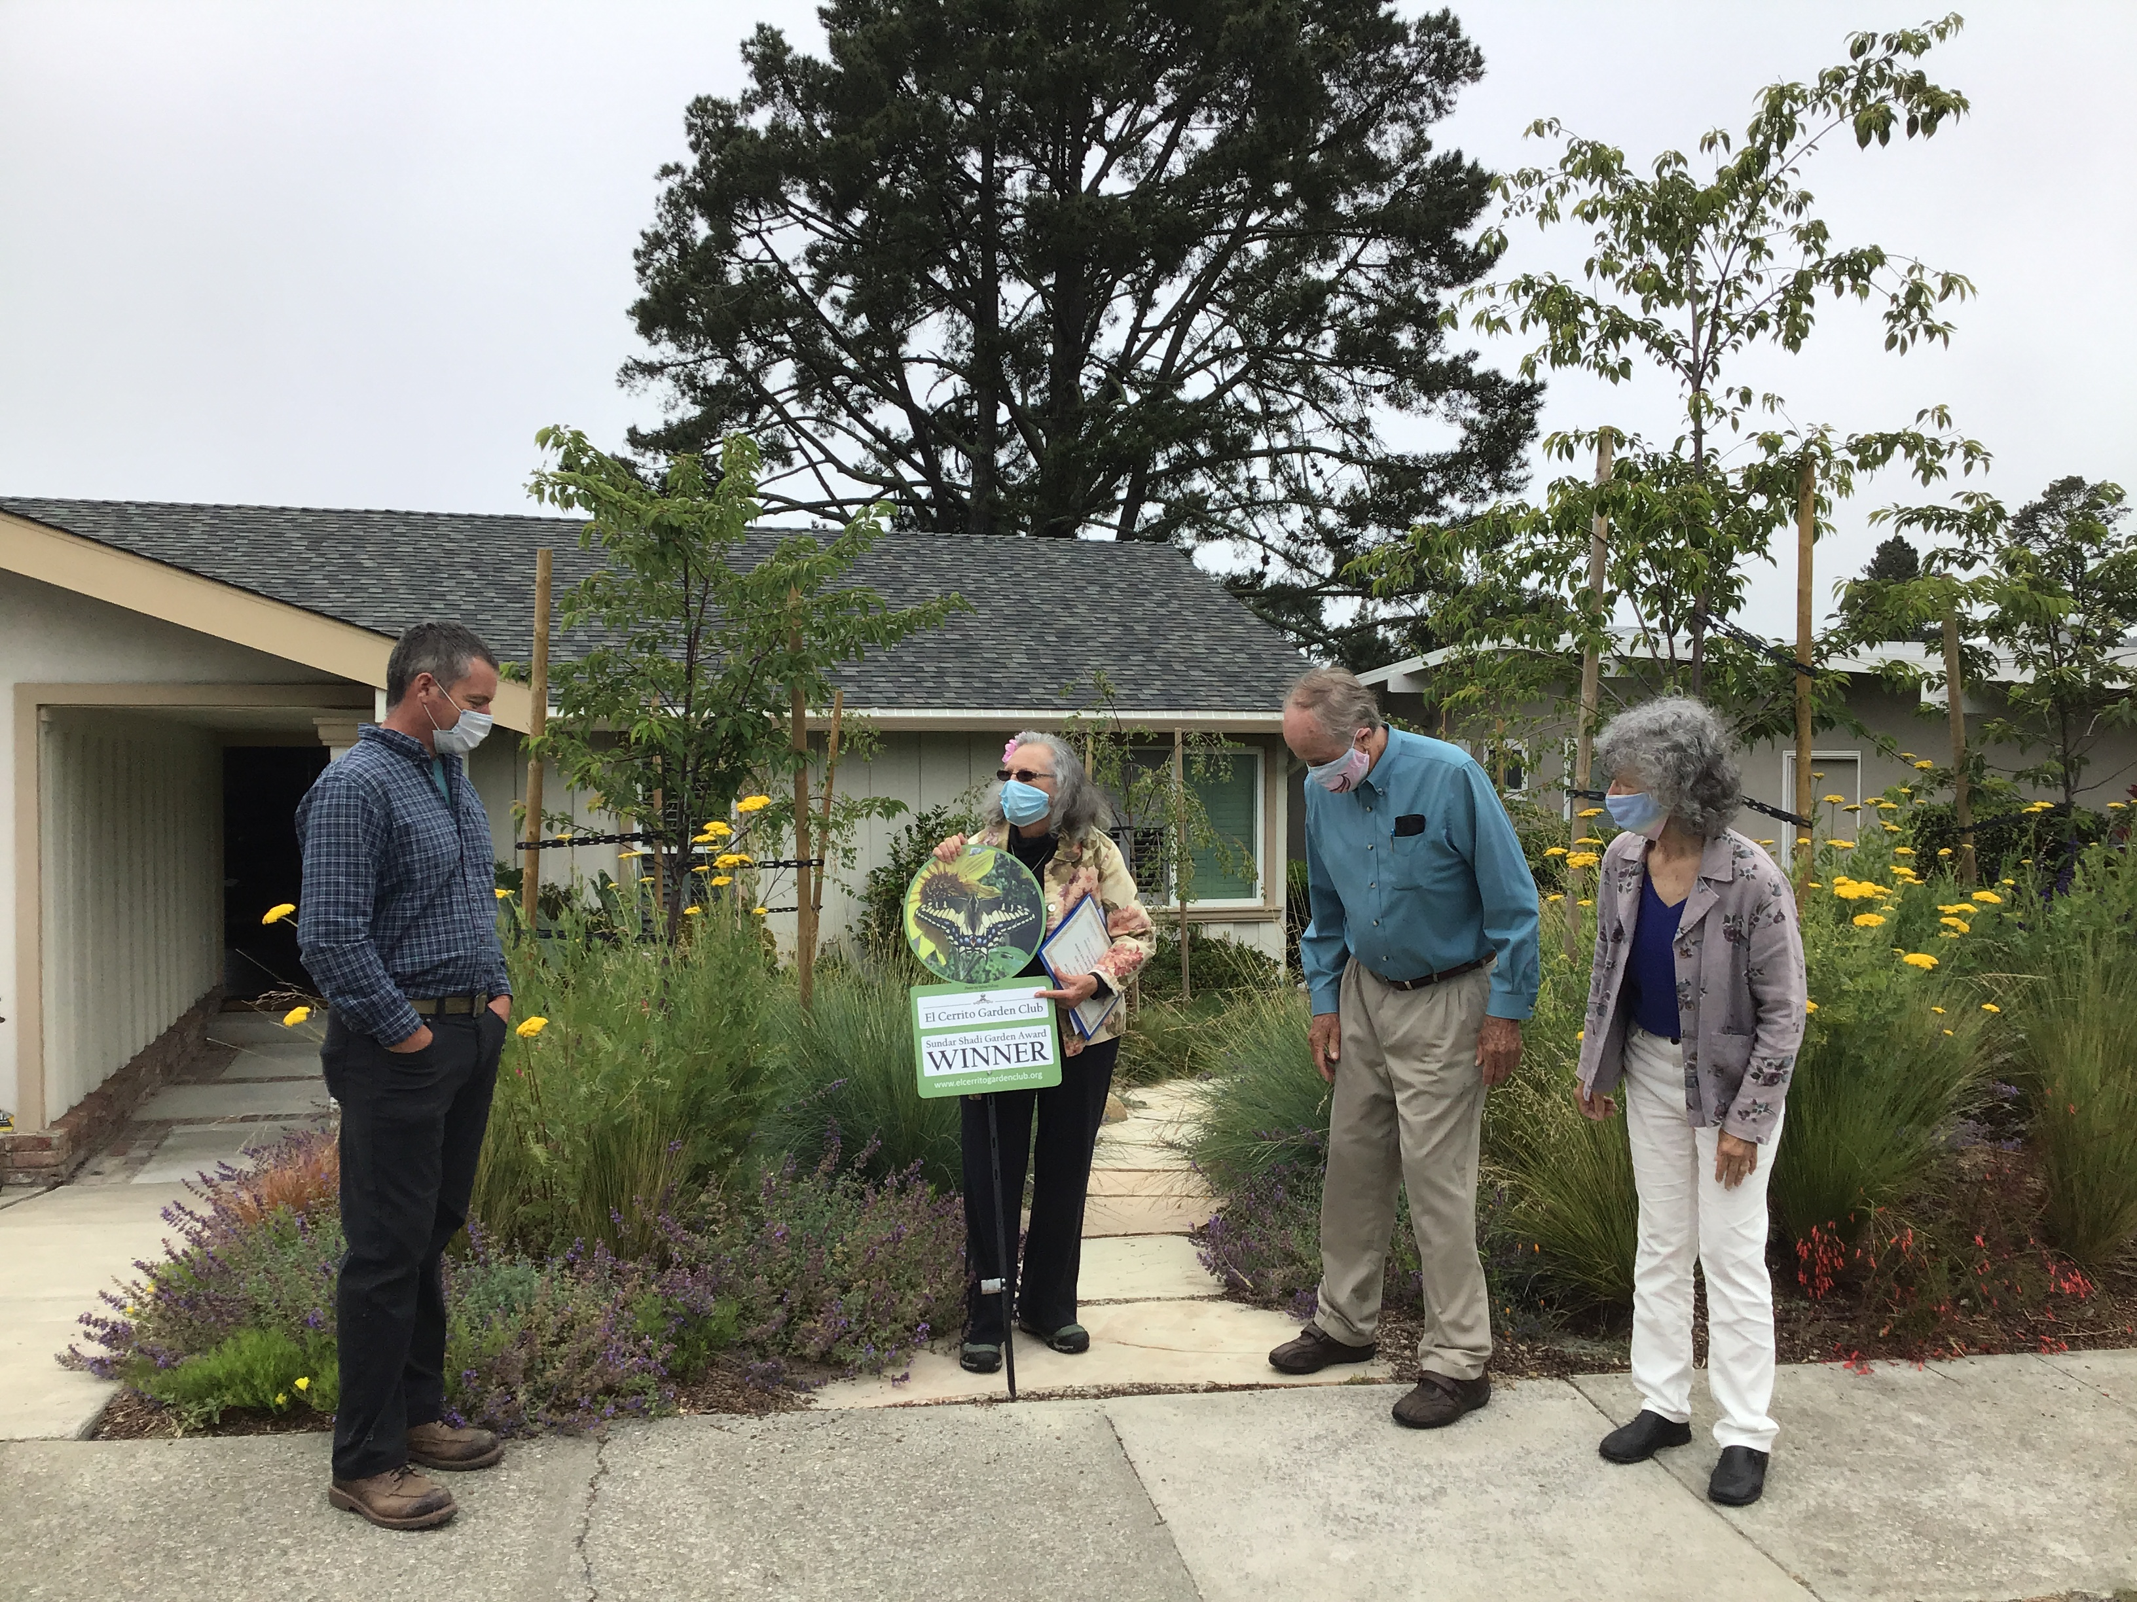
Thomas & Beebo
1704 Julian Street

Slide 5
LIST OF ATTENDEES
for
EL CERRITO GARDEN CLUB
SUNDAR SHADI WINNERS PRESENTATION
June 24, 2020
Beebo & Thomas Turman
1704 Julian
El Cerrito, CA 94530
Louise Moises, Sundar Shadi Committee Chair
Marth Jackson, President
Landry Wildwind, 1st Vice President
Phuong Le, 2nd Vice President
Eileen Libby, Nominator
Anna Frankfurt
Tracy Giles
Bonnie McKenzie
Kate Steinel
Le Merle & Clark Milsom
Marianne Aubert
Video: Bonnie E. Smith, Board Secretary

Slide 6
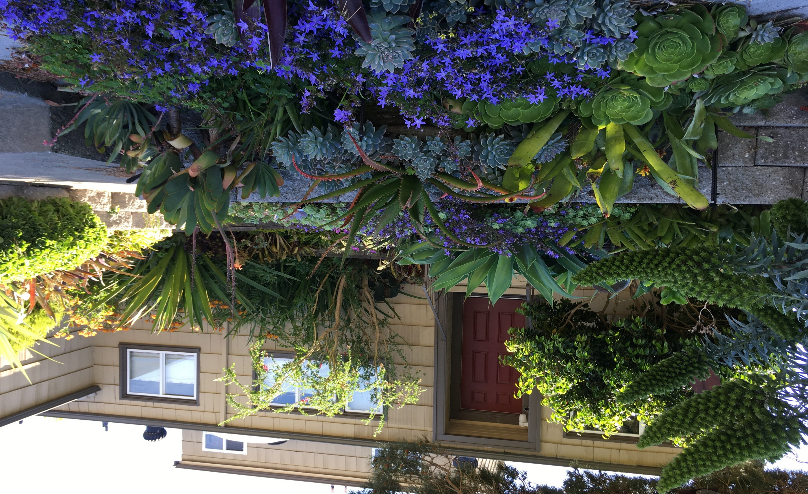

Slide 7
LIST OF ATTENDEES
for
EL CERRITO GARDEN CLUB
SUNDAR SHADI WINNERS PRESENTATION
June 27, 2020
Morrison Brown & Mark Barrett
2007 Carquinez
El Cerrito, CA 94530
Louise Moises, Sundar Shadi Committee Chair
Marth Jackson, President
Landry Wildwind, 1st Vice President
Phuong Le, 2nd Vice President
Eileen Libby, Nominator
Tracy Giles
Bonnie McKenzie
Kate Steinel
Le Merle Milsom
Marianne Aubert
Video: Bonnie E. Smith, Board Secretary

Slide 8
Thank You!

