Slide 1
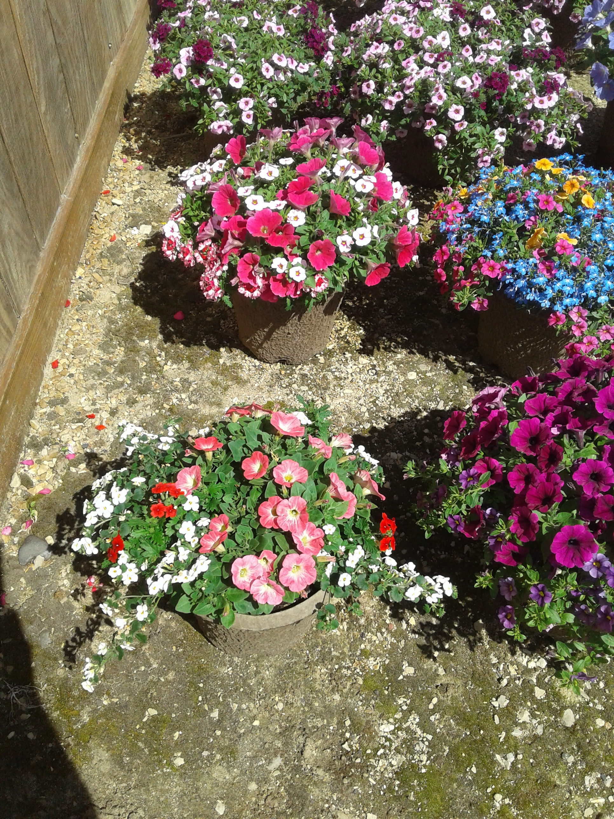
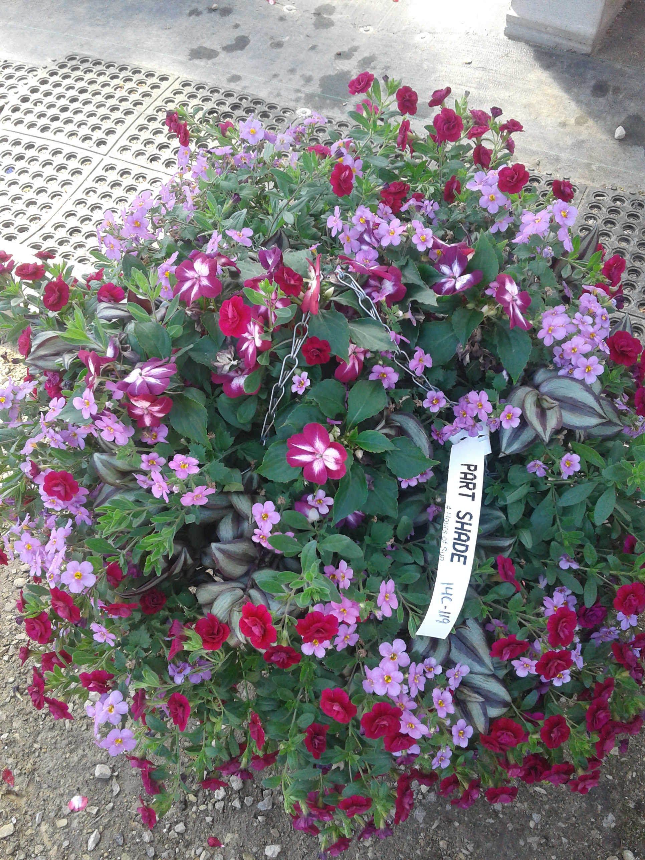
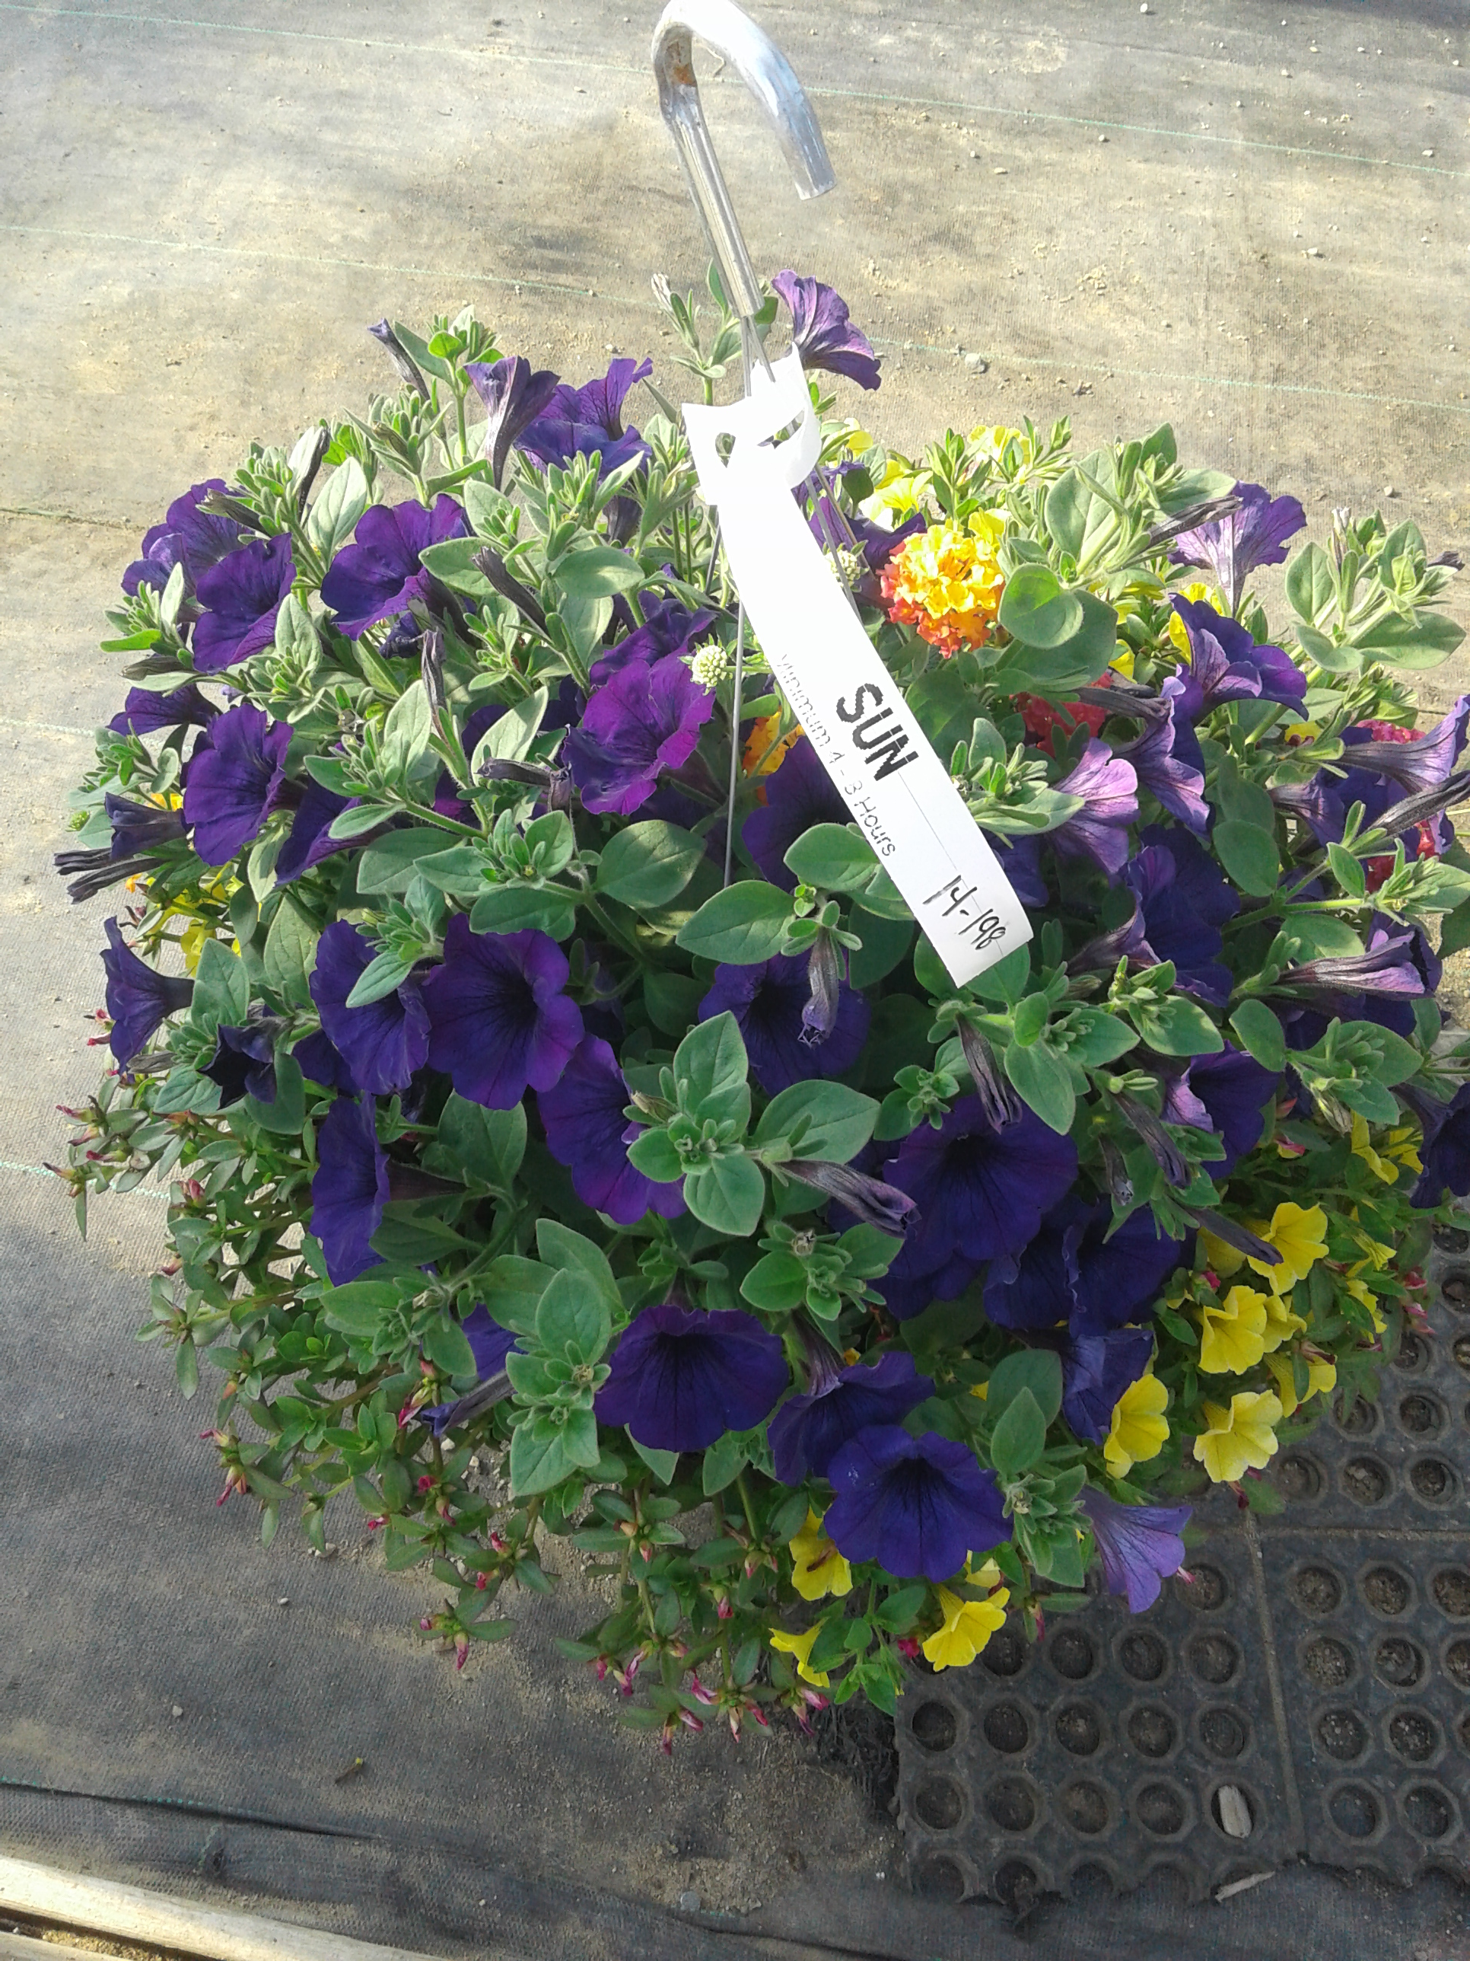
Harrington’s Greenhouse 2025 New Annuals

Slide 2
Calibrachoa Caliloco Frankenberry collection of varieties with wildflower colors and patterns, but with early flowering, tidy habits, and garden performance growers expect from modern breeding.

Slide 3
Calibrachoa Cielo Firecracker Consumers will love its large, vibrant multi-colored flowers. Growers will appreciate its excellent heat and pH tolerance.

Slide 4
Coleus Stained Glass™ Raspberry Tart annual is grown for its stunning foliage colors- beautiful reddish bronze with chartreuse edges. Remove flower spikes to allow for more foliage. Plant in full sun to light shade.

Slide 5
Coleus scutellarioides 'Skeletal’ great choice if you are in need of a shade border or looking to add texture to your shade gardens and planters. A good companion plant to go with begonias, new guineas, Bounce Impatiens or most other shade loving choices.

Slide 6
Coleus Trail Blazer Road Trip small-leaf variety with broad teardrop-shaped foliage that combines colors of deep burgundy-purple detailed with magenta pink central blazes, lime green outlining along the finely scalloped edges, and flecks of white, generally at the base. The foliage creates a colorful, full-season tapestry as it cascades from pots, window boxes, and hanging baskets.

Slide 7
Joybera Orange Gerbera Long lasting large flowers. Can plant in full or part Sun

Slide 8
Glory Days Pink Bicolor Bicolor blooms with the attractiveness of a single flower with the appearance of an ivy, but with growing characteristics of a zonal geranium

