Slide 1
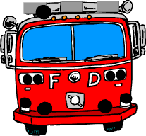
KIDS Fire Safety
Presented By The Rosenberg Texas Fire Department
Notes:
For Middle School Aged Classrooms. Accompanied by Fire Department or Fire Prevention Personnel with Fire Props. Press the horn once to get students attention.

Slide 2
Do you know what to do in case of a fire?
Notes:
Play the Video. It may take a second or two to load. This was chosen for kids and covers relevant material and the short n sweet. Video: https://youtu.be/3yJtSSovwJM

Slide 3
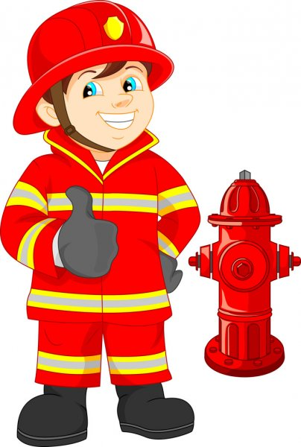
Ask a Firefighter
Got Questions?
Notes:
Give Students an opportunity to ask Fire Personnel or Fire Prevention Personnel Questions

Slide 4
Reminders
Plan an escape Route and meeting place
If you smell smoke or see Fire Get out Fast. Do not Hide or go back inside
Stay Low and GO to your meeting place
Call 911 For Help
Notes:
Reminders or takeaways that you want students to remember from today

Slide 5
Homework: Make a Fire Plan
Student Name: ____________________________________________ My FIRE Plan Draw a map of the rooms in your house and include your bedroom. Draw arrows to your nearest exits outside. Include Doors and Windows. Have at least two ways to get out. Where is your meeting place?_____________________________________ Call 911 if you smell smoke or see flames | Check Smoke Detectors and batteries once a month | Take home and place on refrigerator or on the back of front door!
Hand drawn map (expandable)
Notes:
Students would receive a hand out to either work on now or take home and do with their parents/families. This would be a full page handout.
PS If given more time I would have gotten necessary permissions for using clipart and video that is used in the PP.

