Slide 1
An Introduction to the Core Topics in the Spiritual Teaching

Slide 2
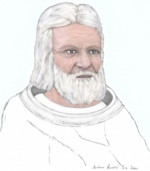
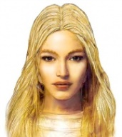
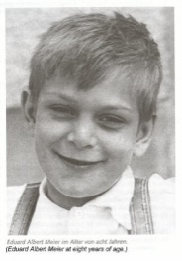
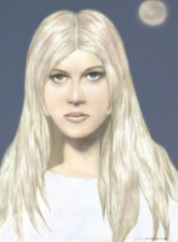
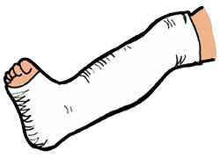
Overview
1942
Billy has first contact with extraterrestrial who called himself ‘Sfath’
1975
Billy has contact with third extraterrestrial who calls herself ‘Semjase’
1975 - 1978
Billy establishes the FIGU organisation for the preservation and dissemination of the Spiritual Teaching
1937
“Billy” Eduard Albert Meier was born
1953
Billy has contact with second extraterrestrial who called herself ‘Asket’
1975 – 1978
Billy starts publishing photographs and providing evidence of his contact with Extraterrestrials
1978 – 2018 (present)
Continued preservation and dissemination of the Spiritual Teaching, which has resulted in many opponents, critics, etc. Including 23 assassination attempts
Notes:
Before the actual presentation, for those who may not be familiar with the Billy Meier case, here is an overview of some of the highlights in the Billy Meier case, from 1937 to the present time.
When there is talk of extraterrestrials visiting the Earth:
One wouldn’t expect them to look like the way we do, but in fact in this case, the alleged extraterrestrials are humanoids like us
One would expect them to either be hostile or coming to show off their technology as is often the case portrayed in movies, but instead these alleged extraterrestrials are here to warn us about of current situation in which the continued survival of the planet is at stake
One would want or expect direct help or intervention if they really had vastly superior technology, however the main source of help is through information and a teaching called the ‘Spiritual Teaching’ so that we can help ourselves
This makes this case a very unique one and different from all the other contact cases. And so here we are today, trying to provide information with regards to the ‘Spiritual Teaching’ so that the impending catastrophes such as Overpopulation, World wars, Climate Change, Nuclear disasters can be avoided.

Slide 3
Topics covered today
Equality
Self-Responsibility
Creational Laws and Recommendations
Human Body, Psyche and Spirit Form
Self-Control
Greatest Problems prevailing on Earth
Notes:
Today, I will be introducing some of the main concepts in the Spiritual Teaching. The intention is to give an introduction into each of these topics so that you can get an idea of what each topic is about because each of these topics is actually very extensive and cannot be explained fully just by a small presentation like this. To fully understand each of these topics, it would actually require a lot of reading and studying of the material available.
So I can really only give a overview of each topic. Of course as a person who has encountered this type of information for the first time, it may be hard to grasp at first. For myself, it took at least 6-7 years until I really got a good handle of these topics, which of course is always still in need of improvement and further understanding.
The benefits which one can obtain from applying and integrating these values into their daily lives are very great, but hard work, practise and perseverance are needed in order to fully learn and apply these values. The benefits include self-control, might over oneself, confidence, self-assertion, joy, happiness, freedom, harmony, ability to see things through, increase in energy, ability to achieve any goal, and so on and so forth.

Slide 4
Equality
Equality
Notes:
So the first concept is very simple, it is about equality. Although it is well-known, it is actually very hard in practise. There will always be situations where equality is challenged and hard to obtain, e.g. in work conditions, group work, living together, etc.
All human beings are equal in value. They may have different levels of knowledge, wisdom, love, harmony and freedom but they all have the same potential to one day reach their fulfilment. Although all people are equal in value, each one has unique abilities and different talents, so one may be more suited for a certain role in society while the other may be suited for another. Contrary to the type of leadership of today where it is largely based on deceit, exploitation, might for greed, profit, etc., the true leadership as explained in the Spiritual Teaching is for the strong to protect the weak and for leaders to look after the people for their well-being in a self-less manner.
To recognise oneself as being equal in value to the fellow human beings is the only right view to ensure cooperation, peace, harmony, etc.

Slide 5
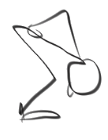
Equality
Setting oneself above another
Setting oneself below another
FIGU
Non-FIGU
Male / Female
Different Skin Colour
Level of knowledge
Different Religion
Notes:
It is not right to set oneself above the other, it leads to haughtiness, imperiousness, lust for might, etc.
It is also not right to set oneself below the other, it leads to submissiveness, exploitation, servitude, lack of independence, etc.
Equality applies to all people, regardless of race, level of development, FIGU member, non-FIGU member, religion, etc.

Slide 6
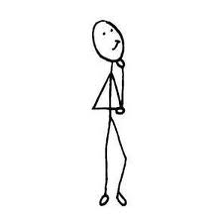
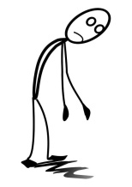
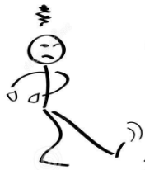
Inequality and Equality
Hierarchical
Non-Hierarchical
Notes:
Without equality, it leads to hierarchy and servitude which is against the main principles of life, which eventually leads to destruction and unpeace.
There is indeed a need for a leading role, however, the leading role should only be advice giving and the one accepting the advice is free to accept the advice or reject it. Leading is generally done by example so that the ones following may learn from examples rather than a hierarchy resulting.

Slide 7
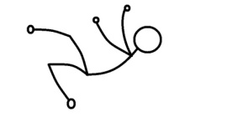
Self-Responsibility
Feeling
Acting
Effect
Destiny
Thinking
(Cause)
Notes:
The next topic is about self-responsibility, which says that through the thinking, the feelings result which lead to actions and deeds that then forms one’s destiny.
Through one’s thinking, the feeling is automatically created, and which then also automatically create the actions and deeds, which lead to outcomes and destinies.
This is interesting because if you think about it, one never actually learns this type of stuff in schools, but it is actually so important since our destines is shaped by the way we think. By habit, thinking is taken for granted and almost happens automatically, without even considering the consequences. Thus, if one was able to fully control the way of thinking for oneself, then one would have full control over their destinies.
In this sense, one is completely responsible for the outcome and the destiny which result from the thinking. This may sound harsh, for example, if one had a bad childhood and was maltreated and as a result, adopted a bad way of thinking which haunted them for the rest of their lives. But actually, the good thing about taking self-responsibility is that one automatically realises that one has the power to change their destinies. For example, if one always attributed their bad fate to be caused by a god, external power, other fellow human beings, then they are actually never in a position to be able to change their destiny. But if one realised that their way of thinking really caused the fate they have experienced, then they automatically have control of themselves and their destiny.

Slide 8
Self-Responsibility
Happiness, Peace, Love, Freedom,
Harmony, Feeling for Others, Fairness,
Prosperousness, etc.
Rich, poor, famous, unknown, capabilities, career, job, house, family, external living conditions, etc.
Inner misery, Inner pain, Inner affliction,
Suffering, Psychic illness, Unfairness, etc.
Thinking
(Cause)
Notes:
So what are the results of our thinking and what is good and what is bad?
This slide shows the good (blue) and the bad (red) and the in-between (green), which is neither good or bad.
Essentially, as shown from the previous slide, the result of our thinking and feelings create these different conditions shown here. The blue part signifies the result of good and neutral-positive thinking and the red shows the result of bad and non-neutral thinking. The ideal values such as Happiness, Peace, Love, Freedom and Harmony are actually unique to each individual, and each individual can have a different kind of happiness or peace, etc.
The result of bad thinking usually leads to these negative values which lead to inner distress or psychic illness.
The middle part is neither good or bad, which means these are indeed created by the thoughts and feelings of the individual, but in-terms of the correct sense of life according to truth and reality, these values are seen as neither good nor bad; contrary to what mainstream promotes these days or what the majority of people think in our times. So essentially, one can be rich and have inner affliction or psychic illness, or one can be poor and have happiness, peace, love and freedom.
A person can actually have values from all of these categories since no one is actually perfect and are all in need of evolution by making mistakes. So a typical person can experience happiness over the duration of his or her life, but at the same time suffer from inner misery or psychic illness at other times. But the overall goal, is to keep one’s life within the good values as much as possible, and whether one is rich or poor, famous or unknown, these values do not play a role in the overall sense of life according to the truth and reality.
If a person finds themselves mostly in the bottom category, and experiences inner misery, inner pain, unfairness, etc. then the worst thing this person can do is actually ignore the causes or even attribute the responsibility or blame somewhere else or to someone else. And the best thing a person like this can do is to recognise, analyse and accept the responsibility for the causes which lead to the effects at the bottom category so that the negative thoughts and feelings can be changed to neutral-positive and good modes of thinking.

Slide 9
Self-control
Thinking
(Cause)
Feeling
Acting
Effect
Destiny
Notes:
The next concept is about self-control.
Now that had been explained that the thinking is the most important factor which determines the destiny of our lives, one would surely strive to control their thinking so that it leads to the most favourable outcome.

Slide 10
Self-control
Factors that influence self-control and thinking
for the good or for the bad
Fluidal influences from personal objects
Effect
Destiny
Past self & unresolved issues
Thinking
(Cause)
Family, Acquaintances,
Friends, Co-workers
And more…
Notes:
But it is not so simple just to simply change one’s thinking on the spot, because there are in fact so many influences that obstruct the way to changing the way of thinking. The thinking is constantly influenced and shaped by many factors as shown here.
The idea is if one identifies and recognises the sources of what is influencing their thinking in a bad way, then it is much easier for them to change their thinking for the better. <give examples of each category>
One of the methods is to be consciously aware of factors that could influence one’s mood and thinking, so that it is possible to systematically find a preferable way of thinking. The examples shown here are only a few of the factors which influences one’s thinking, there are many more.
For example, if I thought back and recognised certain events in my childhood that really affected me while I was growing up, then I could refer to those events which lead to my current way of thinking and adjust it accordingly. The best way to change one’s thinking is to simply register or become aware of the factors that affect one’s thinking, having this first step done, the rest becomes easy to change.
Or for example, if I know that every time I am steered towards a certain negative way of thinking because I am around someplace or someone, it is then much easier to then dig down deeper and find a resolution for the issue. Otherwise, one could be attributing the causes for one’s thinking to the wrong things. E.g. If someone just had a glass of alcohol and then got into a fight with someone they usually wouldn’t have, they would more likely resolve their issue if they had attributed the cause to the alcohol they drank. The same logic applies to all these possible influences on our self-control and thinking.

Slide 11
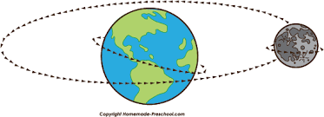
Understanding the Creational Laws and Recommendations
Overall consciousness-block
Spirit form
Birth
Life
Death
New Personality
Thought
boomerang effect
Physical laws
Respect, Equality, Love,
Peace, Harmony, Freedom
Notes:
Creational laws are what makes reality, reality, it governs all areas of the human existence, e.g. human consciousness processes, human spirit processes, physical processes (physics), etc.
Example: process of living, dying, other-side, rebirth of the Spirit form and new consciousness-block with new personality, etc.
Gravity, thought-boomerang effect, one reaps what one sows, oneness principle, universal love, etc.

Slide 12
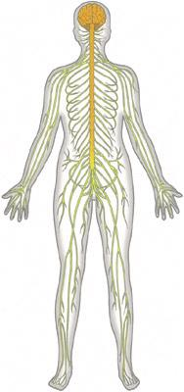
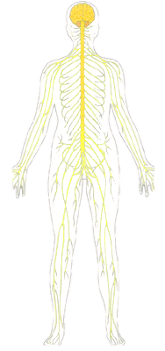
Human body – psyche - spirit
Material Body
Psyche
(medium between material and spiritual)
Human Spirit Form
Notes:
(above depictions are just for illustration purposes, the psyche and spirit form are invisible to the human eye but emanate different types of energies in the fine-fluidal and finest-fluidal/spirit frequency/realms)
Material Body – susceptible to bodily harm such as physical damage, heat or cold damage, etc.
Psyche – susceptible to fluidal harm from fine material influences such as electromagnetic waves to finer fluidal influences such as thoughts, etc.
- runs along the nervous system of the human body
- all psyche ‘feelers’ concentrate at the solar plexus of the human body, also called “Feeling Center” in the Spiritual Teaching
- regulates the human’s mood with regards to the thoughts and feelings, e.g. a unbalanced mood produced by a negative or positive wise of thinking or balanced mood produced by a equally negative and positive wise of thinking
Spirit – not susceptible to any harm
- human spirit form spreads itself throughout the whole human body like a ‘filigree web’, throughout all nerves and all cells, etc.
- spirit form resides in the human brain, exactly in the 'Superior Colliculus' of the big brain or Cerebrum
In our current times, our sciences have not yet discovered the Psyche and the Human Spirit Form, and as a result these two essential components that make up a human being are ignored and neglected. In addition, many people who have been indoctrinated by religions or materialism have largely also either misunderstood or ignored these components subconsciously as a result. But the consequences are very severe since just as the human body needs to be taken care of in order to survive and not be in anguish or pain, the psyche also needs to be taken care of so that one is not psychically disturbed or psychically damaged and in anguish as a result. Without a healthy psyche, the communication or functions between the human body and the human spirit form are impaired and as a result, many of the functions with regards to spiritual evolution are hampered.
So this leads to another topic which is the Hygiene of the Psyche which is actually very extensive as well. The Hygiene of the Psyche is maintained by several factors such as taking care of the material body, and in addition, nurturing a inner thought-world that is balanced and in accordance with the creational laws and recommendations.

Slide 13
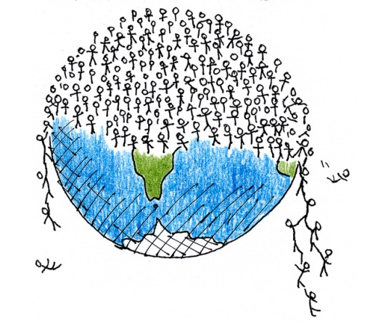
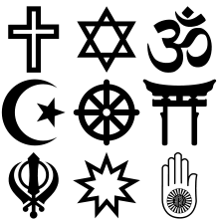
Understanding the biggest problems facing humanity
Overpopulation
Irrational Teachings
(religions, cults, sects, etc.)
Materialism
Notes:
One note about materialism: Material values are actually necessary for the human being and its evolution, so it is actually correct to have a healthy amount of ‘material’ values in our daily life so that our body can be maintained properly. Whether that be through a daily job to procure the necessities of life or contributing to society in some fashion. However, it is contrary to natural laws and destructive if material values are given too much weight and spiritual values are ignored. That is the ‘Materialism’ which is destructive and currently a very large problem for humanity’s continued survival.

Slide 14
Feeling for/with Others and Love
“Love is absolute certainty of oneself living together and breathing together (coexisting) with everything in everything, thus, in all reality (all that exists): in the world of the animals and other creatures (fauna) and in the world of plants (flora), in people of your kind (fellow human beings), in every solid (material) and all-eternal (spiritual) kind of life (life form) irrespective of its kind, and in the existence of the entire firmament (universe) and much more (laws and recommendations).”
Oneness
Notes:
One of the most valueful values to cultivate is the feeling for others and true universal love.
Feelings for others is an ability in which a person is able to perceive, interpret and understand the feelings of others so that a helpfulness for their fellow human being arises. For this an unselfishness is required so that not only one’s well being is taken in consideration, but the well being of others is also put into the foreground. With self-less thinking and a self-less wise of acting, automatically a feeling for others arise.
Egoism and selfishness, where things are only done for one’s own benefit are the factors which works against the development of a feeling for others.
A prerequisite for developing feeling for others is a healthy psyche and balanced thinking so that the feelings of others can be interpreted correctly.
Feeling for others is a value that needs to be developed from a young age, especially from the parents who motivates their child to develop this ability by the parent’s themselves showing this feeling for others with their child. Through this, the child is motivated from a young age.
Feeling for others is based upon the reality that all fellow human being’s existence are inseparably connected and are co-lived with each other, and thus it is based upon love. The knowledge that everything is actually a oneness as we are all living in this universal consciousness together. Depending on the level of love developed and understanding of oneness within a person, the feeling for others is accordingly developed in them. So the higher the level of love, the higher level of unselfishness and feeling for others is present.
One could ask, why would I do such a thing which has no benefit for me, e.g. to co-live the feelings of others and to also love others and view their existence as my own? However, only a egotistical wise of thinking can lead to such a question since this question could only arise if one only thought of oneself. In truth, with the development of love and feeling for others, things are set in motion in which the bearer of these qualities will profit from according to the laws and recommendations of the Creation, i.e. “what you sent out is what you will get back in return” or “what you sow is what you will reap”. Thus, by recognising that the existence of others is just as much included in the existence of oneself and by acting accordingly, one will equally be appreciated by the fellow human beings. As quoted from the Spiritual Teaching: “The most urgent demand of the hour is to express universal love and use it as the motivation for every word, deed, action, etc”
Of course, one cannot neglect oneself altogether since one actually must love oneself equally as one loves the fellow human beings. Since one’s own existence is just as much as the existence of all fellow human beings, according to the principle oneness. Thus is actually wrong to neglect the feeling for oneself and only express feeling for others, since one will be put into an unfavourable position.
Feeling for others is a very important value in the continued existence of a society, since without this value only egoism and selfishness would be present and thus lead to unpeace, unlove, unfreedom and disharmony, wars, materialism, etc.

