Slide 1
Testing: Data Requirements and Other Information
TN Data & Attendance Supervisors Conference – September 2018

Slide 2
Agenda
Assessment Overview
Processing Changes
Assessment Process Details
SIS
Data Review
Test Provisioning
Troubleshooting Data
Course Codes
Closing

Slide 3
Introductions
Denette Kolbe
Executive Director - Assessment Logistics
Amanda Hassman
Business Analyst - Assessment Logistics
Mark Jackson
Assistant Director - Assessment Logistics

Slide 4
TCAP Overview

Slide 5
TN Comprehensive Assessment Program
TCAP
TNReady
Students in grade 3-8: ELA, Math, Science, SS
High School EOC: ELA, Math, Science, SS
Other TN Assessments
Alternate assessments for students in grades 3-11 with the most significant cognitive disabilities (ELA, Math, Science, SS)
Grade 2 optional assessment suite
ELL Assessments

Slide 6
Changes for 2018-19
Eliminated the TNReady chemistry end-of-course exam
TDOE will provide a chemistry test form as an option for local administration
Eliminated the TNReady English III end-of-course exam
TDOE will prioritize adding a statewide dual credit English composition option available beginning in 2019-20
Eliminated the stand-alone field test window for at least the next two years (2018-19 & 2019-20)
Reduced time on the TNReady English language arts exam in grades 3 & 4 to make it a combined 78 minutes shorter
will not impact the ability to generate TVAAS
will still generate scores across all four performance levels

Slide 7
Testing for 2018-19
Online testing
All EOC
Grades 5-8 Science (Field Test)
Paper-based testing
Grades 3-8 Math and ELA
Grades 6-8 Social Studies
Grades 3-4 Science (Field Test)
Paused
Grades 3-5 Social Studies
7
Notes:
Cliff

Slide 8
Ready for TNReady
The Ready for TNReady check for online readiness includes three categories of readiness: device readiness, infrastructure readiness, and operational readiness.
The Ready for TNReady overview can be found here.
You must complete this check for readiness each year and submit it to TDOE.
If you already completed Ready for TNReady, you should have a certificate.
If unsure of your status, please email district.technology@tn.gov for assistance.
8
Notes:
Cliff

Slide 9
Assessment Processing Changes

Slide 10
Last Fall (September 2017)

Slide 11
Changes to Pre-ID and SDDV Process
Assessment is now driven by data in EIS.
Enrollment, scheduling, demographic, and class roster must entered in district SIS and transferred to EIS.
Pre-ID labels and rostering in Nextera come from EIS.
EdTools is no longer used to clean-up demographic information or complete assessment ordering.
The only key function in EdTools for assessment for 2018-19 is Teacher Student Connection (TSC).
Teachers & Leaders is taking point on TSC.
SDDV (the post-testing data clean-up) has been replaced by work in the data prior to testing.
Notes:
Cliff

Slide 12
Changes to Pre-ID and SDDV Process
District Technology team created the Visibility Tool to give a clearer picture of which students were being pulled for assessments.
We’ll talk about the improvements to the tool in a few minutes!
The quality of the data we have from districts was markedly improved - thanks to your hard work during this transition in 2017-18.
We appreciate all of the work you did in cooperation with the EIS Help Desk team to clean up student, teacher & class data.
Notes:
Cliff

Slide 13
First things first: SIS Enrollment

Slide 14
It All Goes Back to the SIS…
Visibility Tool
Data Review
Nextera
Test Provisioning
EdTools
Teacher Student Connection (TSC)
Test Administration
Reports of Irregularity (RIs)
Demographic Statistics
SIS
EIS

Slide 15
Key to Success – SIS Vigilance
Districts must ensure that complete and accurate student enrollment data is entered into their district SIS in a timely manner.
Doing this will make assessment administration easier both for the district and for the schools.

Slide 16
Platform Functions
Function | SIS | Visibility Tool | Nextera | EdTools
Enrolling and Scheduling Students | X
Updating Student Demographics | X
Updating Schedules/Class Rosters | X
Reviewing Demographic Information |  | X
Reports of Irregularity (RIs) |  |  | X
Recording Accommodations |  |  | X
Administering TCAP Assessments |  |  | X
Teacher Student Connection (TSC) |  |  |  | X

Slide 17
EIS Transfers to Nextera
Assessment data transfers from SIS to EIS occur every day.
Assessment data transfers from EIS to Questar (Nextera) occur each Monday evening.
Beginning September 24th
Information updated in a district SIS by 4 pm CST each Monday will show up in the Visibility Tool the next day.
Information updated in a district SIS by 4 pm CST will show up in Nextera Admin by 6 am EST Wednesday.
All assessment data transfers occur when the district produces an extract and submits it to EIS.

Slide 18
Final EIS Transfer for Demographic Data
The final EIS assessment transfer to generate demographic data for the Comprehensive Data File (CDF) and assessment reporting will be the last day of the testing window.
For Fall 2018 end of course testing: Friday, December 18, 2018.
Districts must be sure all demographic changes are corrected by the last day of the testing window. No changes will be accepted after the window closes.

Slide 19
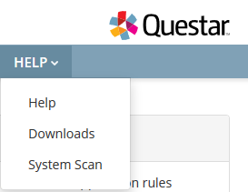
Assessment Course Codes Document
The 2018-19 assessment course codes document is posted on LiveBinders.
It is also posted under the Help tab on the Nextera Admin portal.

Slide 20
Demographic Data Review

Slide 21
Data Review
SIS
EIS
Visibility Tool
District Review

Slide 22
Demographic Data
Districts are able to view student demographic data in the Visibility Tool which is read only.
Any and all changes to demographic data must be made through the district SIS.

Slide 23
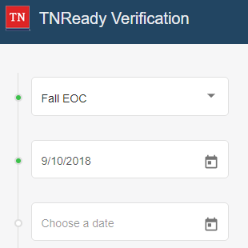
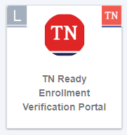
Visibility Tool
The Visibility Tool developed by the TDOE technology team gives districts a clear and timely picture of information uploaded from their SIS to EIS.

Slide 24
Downloading Data to a .CSV file
Users can now download student-level data in a .CSV file for saving or printing

Slide 25
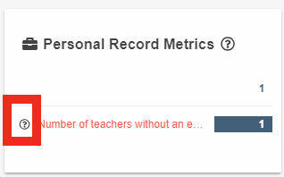
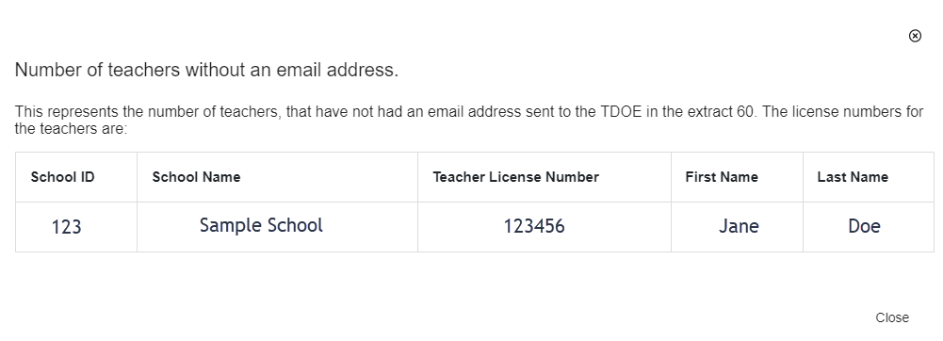
User-Friendly Error Messages
When clicking the question mark next to an error, users can see the list of accounts applicable to the error.

Slide 26
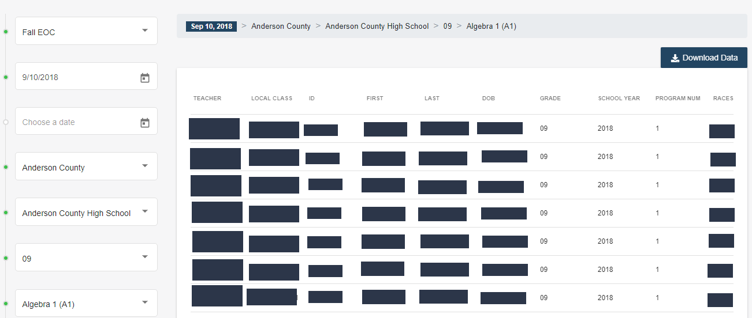
Downloading Data from Drilled Down Search
When drilled down by grade and content area, users can download a .CSV of the student data

Slide 27
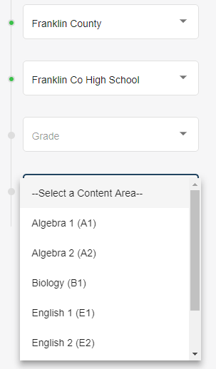
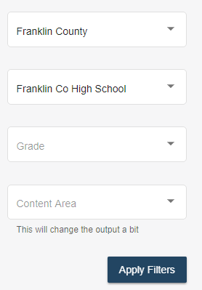
Bypassing Grade Level Selection
Users can now search by content area without pulling by grade level first

Slide 28
Additional Enhancements
Race/Ethnicity Hierarchy
The metrics by how race and ethnicity are calculated have been updated.
Will reflect what is in EIS
Weekly Error Reports
Emailed to DTC’s and EIS Supervisors
Default Date
The default date to select will be based on the date with the most updated information, not necessarily the previous day.
In the event that EIS is running longer than expected, users will, by default, see the most current date
50% Enrollment
A new metric is displayed on the dashboard showing the number of students who have been enrolled in the school/district at least 50% of the school year

Slide 29
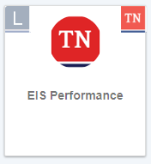
Visibility Tool – Related Updates
Feedback mechanism in the EIS Performance Tool
This will give districts the ability to see how the upload to EIS is progressing so user know if data is not showing up due to an error or because it’s still processing into EIS

Slide 30
Visibility Tool Help
LiveBinders site (Here)
Email
TNED.Assessment@tn.gov

Slide 31
Visibility Tool
The technology team is here at the conference to answer questions about EIS and the Visibility Tool.

Slide 32
Test Provisioning

Slide 33
Test Provisioning
Districts must formally enroll students in order to generate a test registration.
Formal enrollment is defined as; “A state Student ID has been issued to the district SIS by the EIS data system,” and, therefore, a record of that student exists in both the district SIS and in EIS.
Students must meet the business rules for the assessment pull in order to appear in Nextera and EdTools.

Slide 34
Business Rules for the EIS Enrollment
For a student record to result in a test registration, the student must have:
Enrollment in a school
Instructional Grade record for that enrollment
Student Class Assignment (course code) for that enrollment
Class Section (local class number) for the Student Class Assignment
Teacher identified as the teacher of record for the class section (Master Teacher record)
Valid Teacher License number for the teacher of record

Slide 35
New Students
New students enrolling in the district from out of state (home school, private school, another state) must be entered into the SIS as soon as possible in order to properly register them for the appropriate assessments.

Slide 36
Last Pull for Fall 2018
The last EIS assessment pull to provision Nextera with currently enrolled students and class rosters will be two weeks before the testing window opens.
For Fall EOC, this will be Monday, November 12, 2018.

Slide 37
In a Nutshell…
Student scheduling data must be correct in the SIS in order to generate orders and test registration for assessments.
Correct scheduling must reflect the correct course code to trigger the assessment process.

Slide 38
Troubleshooting Data

Slide 39
Common Data Quality Issues: Teachers
The teacher needs
A first & last name
A valid email address
From the appropriate district/organization
A valid Teacher license number (TLN)
Notes:
Mark

Slide 40
Common Data Quality Issues: Teachers
Teacher class assignments are complete
no missing or empty from and to date values
There are no inappropriate date overlaps between multiple teachers, leaving only one teacher as the Teacher of Record (TOR) for any given class.
In order to mark a teacher as an inactive TOR, the staff assignment end date for the class must be on or before another teacher’s start date as TOR.
Notes:
Mark

Slide 41
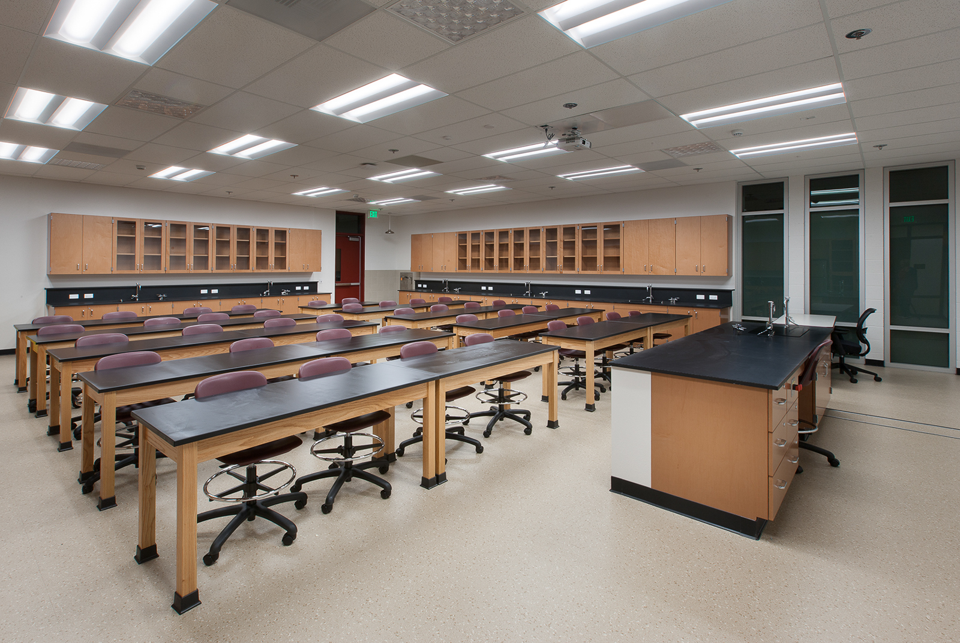
Common Data Quality Issues: Classes
Only valid and approved course codes for assessment will be used to provision students for testing.
If you are unsure of the list of valid approved course codes for assessment, please see the Course Codes document.
Notes:
Mark

Slide 42
Common Data Quality Issues: Classes
In order to be a valid class for testing, the class must have a Teacher of Record assigned. This teacher must have a valid teacher license number, and a valid work email address.
There can be only one active teacher of record assigned to a class.
Notes:
Mark

Slide 43
Common Data Quality Issues: Students
All student first name, last name, date of birth, district, school, and grade values are entered.
Student from and to dates are complete with no missing/empty date values.
Student enrollments are in no way duplicated.
Notes:
Mark

Slide 44
Common Data Quality Issues: Students
Student class assignments are complete (no active students without class assignments) and appropriate (e.g., no duplicate class assignments for the same course code and/or content area) for all active students.
Class assignment from and to dates are complete with no missing or empty date values
Date values are entered according to an appropriate and consistent date format.
Notes:
Mark

Slide 45
Alternative Schools
Students enrolled in Alternative Schools during the 2018-19 TCAP Assessments can be assessed at their alternative school or their school of remand (primary school).
For the 2018-19 school year, a student that has been remanded from their primary school to an alternative school with a school number does not need their enrollment to be moved back to their school of remand for assessment or accountability purposes.

Slide 46
Course Codes for Assessment

Slide 47
Course Codes – EOC Math
ACTIVE CODES - EOC | Regular | SPED | The “A” course codes are for the first section of yearlong courses and will not be pulled.
Algebra I | 0842 (7th & 8th)
 | 3102
 | 31024 (pt 2 - spring course) |  | 31023 (pt 1 - test as pt 2 in spring)
 |  | 31026 (B) | 31025 (A - test as B in spring)
Geometry | 0843 (7th & 8th)
 | 3108
 | 31084 (pt 2 spring course) |  | 31083 (pt 1 - test as pt 2 in spring)
 |  | 31086 (B) | 31085 (A - test as B in spring)
Algebra II | 3103
 |  | 31034 (B) | 31033 (A - test as B in spring)
Integrated Math I | 0832 (7th & 8th)
 | 3117
 | 31324 (pt 2 spring course) |  | 31323 (pt 1 - test as pt 2 in spring)
 |  | 31326 (B) | 31325 (A - test as B in spring)
Integrated Math II | 0833 (7th & 8th)
 | 3118
 | 31334 (pt 2 spring course) |  | 31333 (pt 1 - test as pt 2 in spring)
 |  | 31336 (B) | 31335 (A - test as B in spring)
Integrated Math III | 3119
 |  | 31344 (B) | 31343 (A - test as B in spring)

Slide 48
Course Codes – EOC (other content areas)
ACTIVE CODES - EOC | Regular | SPED | The “A” course codes are for the first section of yearlong courses and will not be pulled.
English I | 3001
English II | 3002
English III | 3003 |  | not an assessed EOC in 2018-19
USHistory | 3416 |  | (AP US History - 3440 - not tested)
Biology I | 3210
 | 32104 (pt 2 - spring course) |  | 32103 (pt 1 - test as pt 2 in spring)
 |  | 32106 (B ) | 32105 (A - test as B in spring)
Chemistry I | 3221 |  | not an assessed EOC in 2018-19
 | 32214 (pt 2 - spring course) |  | 32213 (pt 1 - test as pt 2 in spring)
Districts cannot use the same assessment course code twice for different classes. For example, students cannot be scheduled for Biology (3210) and for a Biology lab (3210). This duplication will cause issues with the Visibility Tool and with uploading students into the testing platform.

Slide 49
Course Codes – EOC (Cambridge)
Cambridge IGSCE
Course Name | Course Code | Required EOC
IGCSE Mathematics I | 4135 | Integrated Math I
IGCSE Mathematics II | 4136 | Integrated Math II
IGCSE Additional Mathematics III | 4137 | Integrated Math III
IGCSE English Language | 4222 | English I
IGCSE English Literature | 4226 | English II
IGCSE Biology | 4145 | Biology
IGCSE Chemistry | 4146 | Chemistry – not an assessed EOC in 2018-19

Slide 50
Course Codes – Grades 3-8
ACTIVE CODES - GRADES 3-8 | English Language Arts | Math | Science | Social Studies
Grade 3 - Reg (content specific) | 0301 | 0306 | 0307 | 0319
Grade 4 - Reg (content specific) | 0401 | 0406 | 0407 | 0419
Grade 5 - Reg (content specific) | 0501 | 0506 | 0507 | 0519
Grade 6 - Reg (content specific) | 0601 | 0606 | 0607 | 0619
Grade 7 - Reg (content specific) | 0701 | 0706 | 0707 | 0712
Grade 8 - Reg (content specific) | 0801 | 0806 | 0807 | 0814

Slide 51
Course Codes – Grades 3-8 Notes
Districts cannot use the same assessment course code twice for different classes.
For example: students cannot be scheduled in 0401 for Lang Arts and 0401 for Reading.
Reminder: Reading course codes are retired and not valid.
EL students
For grades 3-8 EL students there is an English Language Development course for each grade that covers a student of a WIDA proficiency of 1 or 2 and specifies that, in addition to their ESL course, they must also be enrolled in an ELA course.
For grades 3-8 EL students there is a course (6315) that is intended for students of a WIDA proficiency of 3 or higher. These students must also be enrolled in an ELA course.

Slide 52
Course Codes – Grades 3-8 Comprehensive
ACTIVE CODES - GRADES 3-8 | Language Arts | Math | Science | Social Studies
Grade 2 - Reg (content specific) | 0220 | 0221 | 0222 | 0223
Grade 3 - Reg (content specific) | 0320 | 0321 | 0322 | 0323
Grade 4 - Reg (content specific) | 0420 | 0421 | 0422 | 0423
Grade 5 - Reg (content specific) | 0520 | 0521 | 0522 | 0523
Grade 6 - Reg (content specific) | 0620 | 0621 | 0622 | 0623
Grade 7 - Reg (content specific) | 0720 | 0721 | 0722 | 0723
Grade 8 - Reg (content specific) | 0820 | 0821 | 0822 | 0823
COMPREHENSIVE CODES are to be used when scheduling students with more severe disabilities who require a replacement of core content instruction. The student must take the general education end-of-year assessment. These courses should be aligned to grade level/content area standards. Students who will participate in the alternative assessment must be scheduled using the alternate assessment course codes.

Slide 53
Course Codes – Grade 2
For grade 2 EL students there is an English Language Development course (6313) that covers a student of a WIDA proficiency of 1 or 2 and specifies that, in addition to their ESL course, they must also be enrolled in an ELA course (0201).
For grade 2 EL students there is a course (6315) that is intended for students of a WIDA proficiency of 3 or higher. These students must also be enrolled in an ELA course (0201).
ACTIVE CODES - GRADE 2 | Lang Arts | Math
2nd grade | 0201 | 0206
2nd grade ALT | 50201 | 50206

Slide 54
Course Codes – Grades 3-8 MSAA and TCAP Alt
ACTIVE CODES - GRADES 3-8 | Lang Arts | Math | Science | Social Studies
Grade 3 - Alternate Assessment | 50301 | 50306 | 50307 | 50319
Grade 4 - Alternate Assessment | 50401 | 50406 | 50407 | 50419
Grade 5 - Alternate Assessment | 50501 | 50506 | 50507 | 50519
Grade 6 - Alternate Assessment | 50601 | 50606 | 50607 | 50619
Grade 7 - Alternate Assessment | 50701 | 50706 | 50707 | 50712
Grade 8 - Alternate Assessment | 50801 | 50806 | 50807 | 50814
 | MSAA | MSAA | TCAP-Alt | TCAP-Alt
Only students with IEPs who are identified as taking the alternate assessment will be scheduled using these course codes.

Slide 55
Course Codes – EOC MSAA and TCAP Alt
ACTIVE CODES - HIGH SCHOOL | Lang Arts | Math | Science
Alternate Academic Diploma - English I | 53001
Alternate Assessment - English II | 53002
Alternate Academic Diploma - English III | 53003
Alternate Academic Diploma - English IV | 53004
Alternate Assessment - Algebra I |  | 53102
Alternate Academic Diploma - Algebra II |  | 53013
Alternate Academic Diploma - Geometry |  | 53108
Alternate Academic Diploma - Applied Math |  | 53183
Alternate Academic Diploma - Physical Science |  |  | 53202
Alternate Academic Diploma - Earth/Space |  |  | 53204
Alternate Assessment - Biology |  |  | 53210
 | MSAA | MSAA | TCAP-Alt
For High School students, all students in the appropriate grade (10th for Science, 11th for ELA & Math) will be scheduled using any of the listed course codes.
The sort for the pull will be:
appropriate grade (10th for Sci, 11th for ELA & Math)
followed by appropriate course codes as outlined
the pull will encompass both fall & spring classes

Slide 56
Retired Codes
The 2018-19 assessment course codes document also contains lists of retired codes for Grade 2, Grades 3-8 and End of Course.

Slide 57
Important Safety Tips
Districts cannot use the same assessment course code twice for different classes.
Service enrollments do not pull for assessment.
If you need a student to test a particular content area, they need to be given a primary enrollment with an assessed course code.

Slide 58
Questions

Slide 59
Questions?

