Slide 1
Strengths Based Nursing and Nursing Clinical Preparation Courses
ICCH: International conference on communication in healthcare Better communication, better relationships , better care
October 27—30, 2019
San Diego, California, USA
Rosetta Antonacci RN, BScN, MScAdm
Amanda Cervantes RN, MSc(A), CNCCP(C)
Lia Sanzone, N., M.Sc.(A.), M.Sc. (Management) GradCert.

Slide 2
Acknowledgements and Disclosure
We have no disclosures to make at this time.
Special Thanks to:
Strengths Based Nursing in Healthcare group, *Dr. Laurie Gottlieb
The McGill Nursing Collaborative
Ingram School of Nursing

Slide 3
Learning Objectives
Introduce the Strengths Based Nursing (SBN) Approach to care and its impact on Nursing practice
Examine the relevance of SBN in entry to practice nursing education
Examine how participants can incorporate a SBN approach into their clinical preparation courses.

Slide 4
Agenda
Participant Introduction
Introduction to SBN
Group discussion regarding current entry to practice clinical preparation courses
Large group discussion guided by our experiences at the Ingram School of nursing at McGill University.

Slide 5
I. Introductions

Slide 6
Grounding Exercise
Take 2 minutes to write about a
a clinical situation you are proud of

Slide 7
II. What is SBN?
An alternative worldview to the deficit model but complemental to the medical model
A philosophy as well as a value driven approach that guide clinicians, leaders, educators, researchers
SBN is about uncovering and developing strengths through the SBN Value wheel and Spiraling Process to motivate, maximize functioning, promote health, facilitate healing
Leverage strengths to minimize, contain, or compensate that which is not functioning as well as it could/should

Slide 8
SBN: A Mindset An Embodied Practice
Mindset: A set of beliefs that permeates every part of one’s life that affects the way one sees and responds (Dweck, 2016).
Mindset is about choice– how one chooses to be.
Embodied practice:
to personify, exemplify an idea, a way of experiencing
to represent a way of being and acting
Notes:
SBN is a way of being in the world
SBN becomes a professional identity

Slide 9
SBN IS
Not a model
Not just a list of a person’s/family’s strengths
Not just about being positive
Not prescriptive
Does not ignore, negate, or discount problems, weaknesses, concerns

Slide 10
Education
Practice
Leadership
Synergy
Values Align

Slide 11
Four Pillars
Innate Capacities
Person-Family Driven
Empowerment
Relational

Slide 12
Eight Core Values
Person
Family
Team Learner
(Gottlieb, L. 2014)

Slide 13
Health and Healing
Person
Family
Team
Learner
Person
Family
Team
Learner
Health supports the patient’s ability to adapt with flexibility to life’s challenges, rally from insults, and live with purpose and meaning.
Health coexists with illness and creates wholeness.
Healing restores wholeness and involves the rediscovery and reestablishment of equilibrium.
In the process of healing, people develop new skills that can sustain and increase their health.

Slide 14
Uniqueness
People experience and respond to their environments in unique ways.
The uniqueness of individuals is defined by both their strengths and deficits—by how these affect their physical, behavioral, and interpersonal responses and form each person’s identity.
Recognizing an individual’s uniqueness, therefore, requires an understanding of both strengths and weaknesses.

Slide 15
Holism and Embodiment
Person
Family
Team
Learner
Holism recognizes the interconnectedness of the parts as they affect each other and the functioning of the whole person.
Enabling the innate healing mechanism to restore a sense of wholeness often requires both symptom treatment and containment or elimination of that which causes the dysfunction.

Slide 16
Subjective Reality and Created Meaning
Person
Family
Team
Learner
Experiences, perceptions, representations, emotions, and meanings guide people’s understanding of events (their “reality”) and affect their responses.
Searching for meaning involves creating narratives that are woven together from facts, past and current experiences, perceptions, and beliefs.
The construction of the narrative is an important integrative process that creates health and facilitates healing.

Slide 17
Person and Environment are Integral
Person
Family
Team
Learner
Person and family are affected by environment, both physical and social.
People grow and thrive when there is a “goodness of fit” with their environments.
Such environments enable people to draw on their strengths and provide themselves with opportunities for development, healing, and thriving.

Slide 18
Self-Determination
Person
Family
Team
Learner
SBN values choice and self-determination.
SBN sees the nurse’s role not as deciding for others but rather as listening attentively and deeply in order to clarify, elaborate, explain, provide information, make suggestions, connect people with resources, and advocate for patients and their families so they may hear their own voices and make their voices heard.

Slide 19
Learning, Timing, and Readiness
Person
Family
Team
Learner
Learning involves biological, psychological, and social processes.
Timing, in the context of health care, requires synchronizing the desired outcome with the body’s capabilities and the mind’s willingness.
Readiness to engage in a new activity as a prelude to change is a prerequisite for learning.
It requires the nurse to be attuned to the patient and to know the point at which intervention will be most successful.

Slide 20
Collaborative Partnership
Person
Family
Team
Learner
The nature of the nurse–patient relationship is collaborative.
A collaborative partnership requires the nurse to be open, nonjudgmental, and willing to share power.
Collaborative partnerships require the partners to find common ground, set goals jointly, and determine a course of action that’s right for the patient.

Slide 21
Nursing’s Professional Gaze
Being mindful
Attending to
Attuning to
Adopting a reflective approach to practice
Asking for and learning from feedback from others

Slide 22
Major “A”s
Attunement and Awareness
Authentic Presence
Attentive Listening

Slide 23
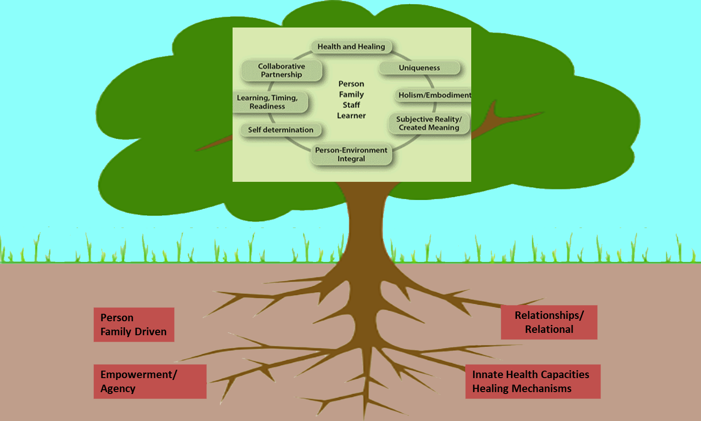
Laurie N. Gottlieb, ISoN, McGill University

Slide 24
III. Group discussion regarding current entry to practice clinical preparation courses

Slide 25
Examples from the Ingram School of Nursing
2014: SBN was adopted at the Ingram School of Nursing as our primary approach to care
2017: Health and Physical Assessment is redesigned to include SBN intentionally

Slide 26
Health & Physical Assessment Course
Course revision guided by the values of SBN
Language refined to include elements SBN
Assignments and evaluation refined to align with SBN
Simulation with standardized patients refined to include expectations that student engage with individuals using SBN i.e.: therapeutic relationships
Aligned HPA with other courses in the curriculum.

Slide 27
Incorporation of the Clinical Reasoning Cycle in Clinical Courses using SBN

Slide 28
IV. Reflection
Look back at your proud moment and think about it with the SBN lens .
What stands out for you?
What pillars or values do you recognize in your proud moment ?
What resonates with you and your practice?

Slide 29
Questions/Comments

Slide 30
Thank You
Merci

