Slide 1
Principles of Marketing (DIDOW)
BUSI 406 003
Spring Semester 2020
Review for Midterm Exam
Midterm Exam in class on Wednesday, February 12 (closed book, closed notes)

Slide 2
Today’s Agenda
Let’s review TLG & Ch. 7
Midterm Exam Information
Review Session for Midterm Exam
  Midterm Exam Wednesday, February 12
  In class
  Closed book, closed notes, open mind…

Slide 3
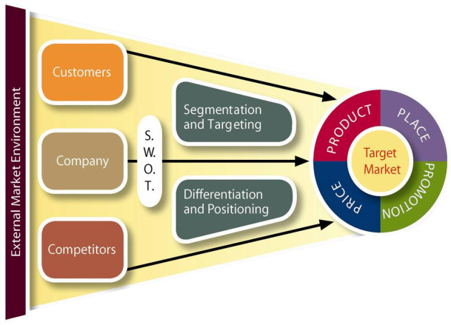
Let’s Review Ch. 7
Information
for marketing
decisions
Data guides marketing strategy
Information sources
  External/Internal data
  Primary/Secondary data
  Qualitative/Quantitative
  Observing/Questioning
Marketing analysis
  Decision support systems
  Marketing models
  Predictive analytics
Marketing research
The scientific method
Steps in marketing research
  Define problem
  Analyze situation
  Gather problem-specific data
  Interpret the data
  Solve the problem

Slide 4
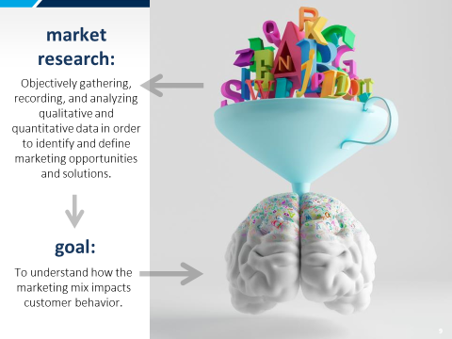
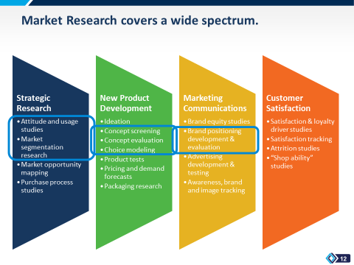
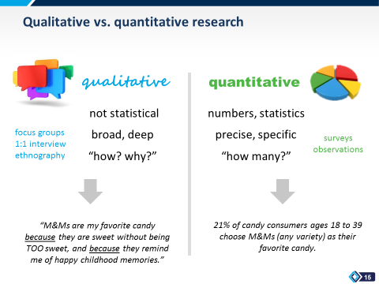
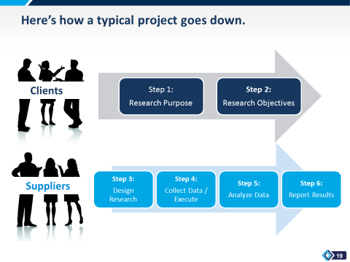
Marketing Research

Slide 5
Midterm Exam Review (Ch. 1 - 7)
Midterm Exam Information
  Mix of True/False, Multiple Choice, and Short Answer questions
  Point value will be provided for each question
  70 minutes to complete the exam
  Closed everything (textbook, laptop, cellphone, notes, online, etc.)

Slide 6
Midterm Exam Review (Ch. 1 - 7)
During the exam:
  Each person will get own exam with your name on it
  Pen/Pencil & exam - nothing else
  Abide by, read & sign Honor Code Pledge to do your own work
  One person at a time to the restroom
  No questions – all material needed in exam
  Complete test answer sheet
  Each question has a “best” and “correct” answer, but use available space to explain only if you feel you absolutely have to do so
  Return entire exam (no exceptions) – if you take exam apart, please staple it back together
  70 minutes to complete the mid term exam

Slide 7
Midterm Exam Review (Ch. 1 - 7)
How to study?
  Review the chapters
  Go through slide decks
  Study with others
    Ask each other questions
  Practice exam questions
    Make up practice multiple choice and true/false Questions
    Short Answer Questions:
      Learning Objectives at start of each chapter
      Practice Questions at the end of each chapter in textbook

Slide 8




Big Picture
External Market Environment
Customers
S.
W.
O.
T.
Segmentation and Targeting
Company
TARGET
MARKET
Differentiation and Positioning
Competitors

Slide 9
What is Marketing Strategy Planning? Finding attractive opportunities, developing sustainable marketing strategies, and being rewarded financially and otherwise for doing so well…
Marketing Strategy Planning involves:
3C’s: Company, customers, competitors SWOT analysis
Marketing Strategy: Specifying a target market and a related marketing mix
Target Market: a fairly homogenous group of customers to whom a company wishes to appeal
Marketing Mix: the controllable variables (4 P’s) the company puts together to serve this target group
  Product
  Place
  Price
  Promotion and communication
Pro forma Budget: A plan without a budget is not a plan, show me the numbers, expected revenues against expected expenses, plus other outcome metrics
Notes:
Summary Overview
Marketing strategy planning means finding opportunities and developing profitable marketing strategies that the company can use to capitalize on them.
Key Issues
Marketing strategy--specifies a target market and a related marketing mix; provides “big picture” of what the firm will do.
Target market --a fairly homogeneous (similar) group of customers to whom a company wishes to appeal.
Marketing mix--the controllable variables the company puts together to satisfy the target market.
Discussion Question: Why doe the customer (C) appear in the center of the diagram of a marketing strategy?

Slide 10
Ch. 1: What is Marketing?
Why do we care?
What is marketing?
  Definition
Consumers’ needs, wants and demands
Customer satisfaction
  Why do companies care about satisfied and dissatisfied customers?
Marketing mix/4Ps
The marketing process
  Analysis, development of strategies, plans and programs, implementation, and monitor and audit

Slide 11
Ch. 1: What is Marketing?
Production vs. Marketing
Micro-marketing vs. macro-marketing
Planned Economic vs. Market-Directed systems
Central Markets
Marketing functions & who performs them
Over time, marketing’s role in organizations

Slide 12
Ch. 2: Marketing Concept & Strategy
Customer value
Marketing concept
Marketing strategy planning
Attractive Opportunities
  Breakthrough opportunities
  Competitive advantage
Types of Opportunities to Pursue – Generic Growth Strategies
  Market penetration
  Market development
  Product development
  Diversification
GE Strategic Planning Grid, BCG Growth Share Matrix

Slide 13
Ch. 3: The Marketing Environment
What is the marketing environment?
  Direct – 3Cs
    Company -- SWOT
    Customers
    Competition
  Indirect/External
    Economic environment
    Technological environment
    Political/Legal environment
    Cultural/Social environment
Screening opportunities
  Quantitative & Qualitative

Slide 14
Ch. 4: Segmenting & Positioning
Why do we care about segmenting and positioning?
Generic markets and product-markets
Market segmentation and target market selection
Creating Target Market Strategies
  Single, Multiple, Combined
Differentiation & Positioning: How? Why?
  Perceptual Maps
    “white space”

Slide 15
Ch. 5: Final Consumers &Their Buying Behavior
Understanding Buying Behavior
  Who are our potential consumers?
Characteristics Affecting Consumer Behavior:
  Economic and Demographic Needs
  Psychological influences
  Social influences
  Culture
  Situational influences
The Buyer Behavior Model/Decision Process

Slide 16
Ch. 6: Business & Organizational Customers – B2B
Who are business/organizational customers?
  How are they different from final consumers?
  Manufacturers
  Service Provides
  Retailers & Wholesalers
  Government Market
Who influences decisions?
What are the types of buyer-seller relationships?

Slide 17
Ch. 7: Marketing Research
What is marketing research and why is it important?
  Internal and external data sources
  Primary and secondary data
  Qualitative and quantitative data
5 Steps to conduct successful marketing research
  Define the problem
  Analyze the situation
  Gather data
  Interpret data
  Solve the problem

Slide 18
Looking Ahead…
Wednesday, February 12
  Midterm Exam in class
  Midterm Exam will cover Ch. 1 – 7
  Closed book, closed notes
No class meeting Monday, February 17
  Use for team meeting to work on your major assignment of a marketing strategy plan for a local business, nonprofit, or campus organization
Read Chapter 8 Elements of Product Planning for Goods and Services for Wednesday, February 19

