Slide 1
Conceptual Understanding of Addition and Subtraction
Ralston Schools
October 18, 2018

Slide 2
Contact Information
Sarah Powell, Ph.D
The University of Texas at Austin
srpowell@austin.utexas.edu
@sarahpowellphd
119

Slide 3
Materials

Slide 4
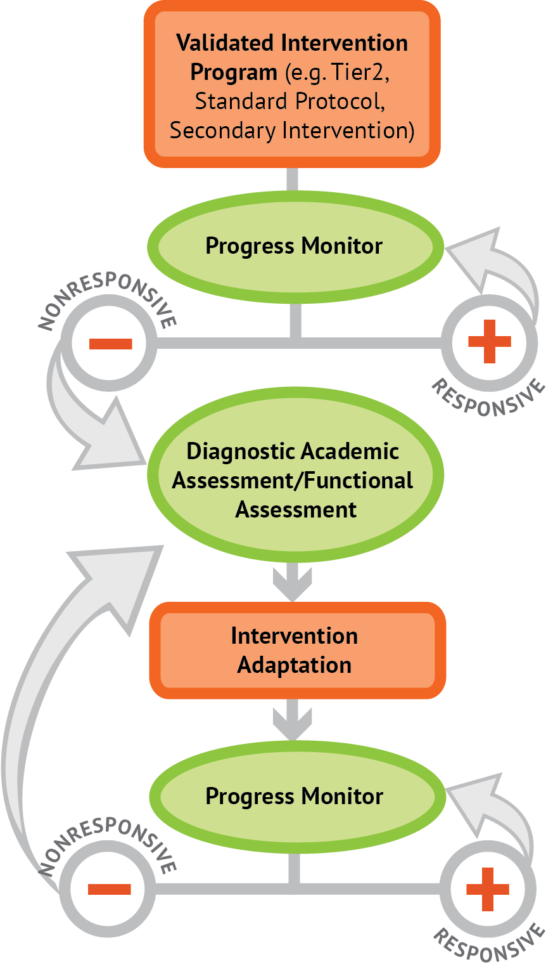
Instructional Platform
INSTRUCTIONAL DELIVERY
Explicit instruction
Concise language
Multiple representations
INSTRUCTIONAL STRATEGIES
Fluency building
Problem solving instruction
Motivation component

Slide 5
Explicit Instruction
Modeling
Practice
Clear Explanation
Guided
Practice
Planned
Examples
Independent Practice
Supporting Practices
Asking the right questions
Eliciting frequent responses
Providing immediate specific feedback
Maintaining a brisk pace

Slide 6
Multiple Representations
Abstract
Pictorial
Concrete

Slide 7
Focus on Language
precise
concise

Slide 8
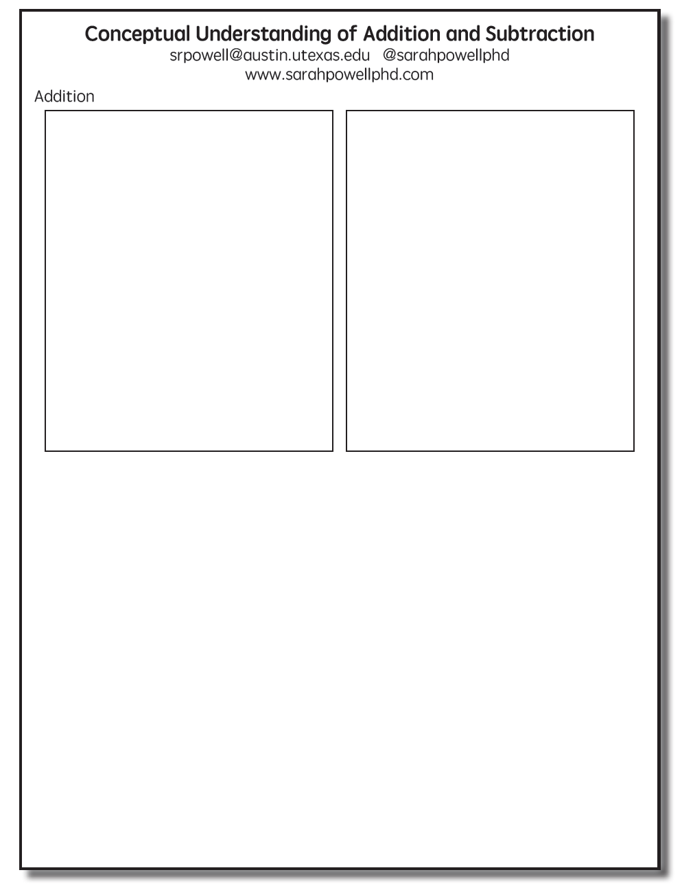

Slide 9
Addition Facts
100 addition basic facts
Single-digit addends sum to a single- or double-digit number
5 (addend)
+ 4 (addend)
9 (sum)

Slide 10
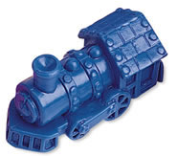
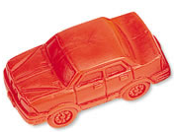
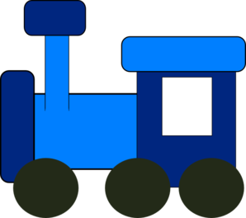
Addition: Part-Part-Whole (Total)
Count one set, count another set, put sets together, count sum
2 + 3 = 5

Slide 11
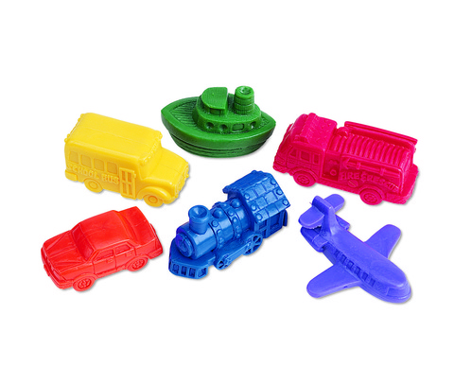
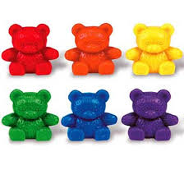
Addition: Part-Part-Whole (Total)
4 + 5 = __
3 + 7 = __
Teach this problem to a student.
Explicit instruction
Multiple representations
Concise language

Slide 12
Addition: Join (Change Increase)
Start with a set, add the other set, count sum
2 + 3 = 5

Slide 13
Addition: Join (Change Increase)
8 + 3 = __
5 + 6 = __
Teach this problem to a student.
Explicit instruction
Multiple representations
Concise language

Slide 14
Why is it important to understand addition in two separate ways?

Slide 15
Total
Parts put together into a total
Jin saw 4 cardinals and 5 blue jays. How many birds did Jin see?
4 + 5 = ?
Jin saw 9 birds. If 4 of the birds were cardinals, how many were blue jays?
4 + ? = 9
Jin saw 9 birds. 5 of the birds were blue jays, how many were cardinals?
5 + ? = 9

Slide 16
Change
An amount that increases or decreases
Mara had $4. Then she earned $3 for cleaning her room. How much money does Mara have now?
4 + 3 = ?
Mara has $4. Then she earned money for cleaning her room. Now Mara has $7. How much money did she earn?
4 + ? = 7
Mara had some money. Then she made $3 for cleaning her room. Now she has $7. How much money did Mara start with?
? + 3 = 7

Slide 17
Part-Part-Whole Versus Join
3 + 9 = __
7 + 4 = __
Determine a word problem for each schema.
Explicit instruction
Multiple representations
Concise language

Slide 19
Subtraction Facts
100 subtraction basic facts
Subtrahend and difference are single-digit numbers and minuend is single- or double-digit number
16 (minuend)
– 8 (subtrahend)
8 (difference)

Slide 20
Subtraction: Separate (Change Decrease)
Start with a set, take away from that set, count difference
5 – 3 = 2

Slide 21
Subtraction: Separate (Change Decrease)
11 – 6 = __
13 – 7 = __
Teach this problem to a student.
Explicit instruction
Multiple representations
Concise language

Slide 22
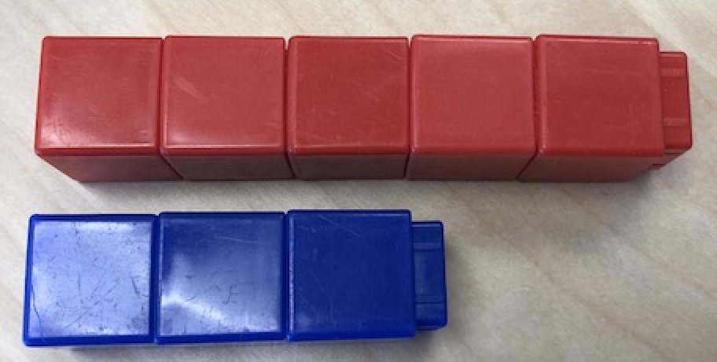
Subtraction: Compare (Difference)
Compare two sets, count difference
5 – 3 = 2

Slide 23
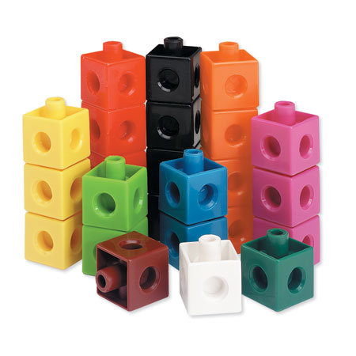
Subtraction: Compare (Difference)
10 – 7 = __
11 – 3 = __
Teach this problem to a student.
Explicit instruction
Multiple representations
Concise language

Slide 24
Why is it important to understand subtraction in two separate ways?

Slide 25
Change
An amount that increases or decreases
Aishwarya had 9 cookies. Then she ate 2 of the cookies. How many cookies does Aishwarya have now?
9 – 2 = ?
Aishwarya had 9 cookies. She ate some of the cookies. Now, she has 7 cookies. How many cookies did Aishwarya eat?
9 – ? = 7
Aishwarya had some cookies. Then, she ate 2 of the cookies. Now she has 7 cookies left. How many cookies did Aishwarya have to start with?
? – 2 = 7

Slide 26
Difference
Greater and less amounts compared for a difference
Brad has 9 apples. Caroline has 4 apples. How many more apples does Brad have? (How many fewer does Caroline have?)
9 – 4 = ?
Brad has 5 more apples than Caroline. If Caroline has 4 apples, how many does Brad have?
? – 4 = 5
Caroline has 5 fewer apples than Brad. Brad has 9 apples. How many apples does Caroline have?
9 – ? = 5

Slide 27
Separate Versus Compare
9 – 5 = __
8 – 3 = __
Determine a word problem for each schema.
Explicit instruction
Multiple representations
Concise language

Slide 28
Instructional Platform
INSTRUCTIONAL DELIVERY
Explicit instruction
Concise language
Multiple representations
INSTRUCTIONAL STRATEGIES
Fluency building
Problem solving instruction
Motivation component

Slide 29
Contact Information
Sarah Powell, Ph.D.
The University of Texas at Austin
srpowell@austin.utexas.edu
@sarahpowellphd
119

