Slide 1
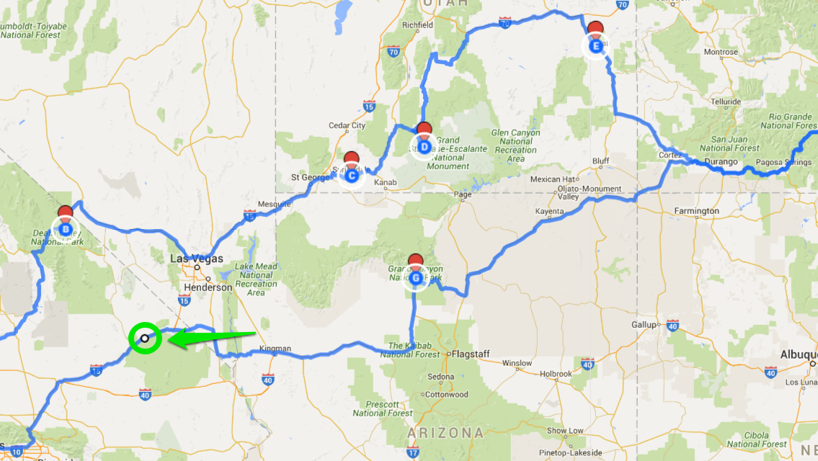
A Tour of Deal Structures
linda@pullanconsulting.com

Slide 2
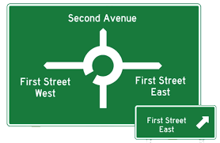
Alternative Deal Structures
Evaluation
Sale
Simple out-license
Option
Collaboration
Co-development
Territorial splits
Co-promotion
JV
1H 2022 GlobalData
65 asset sales, 122 co. sales
296 Licensing deal
93 option in deal description
312 collaboration in deal description
419 partnerships with co-dev
33 territory in deal description
46 co-marketing
13 JV

Slide 3
Deal construction – term sheets
Questions
Vocabulary
Who?
Why?
What’s included?
Structure?
Where?
Who does what?
Compensation?
Commitments?
Improvements?
How decisions get made?
Compete?
Disputes?
At the End?
The parties
The aim (whereas)
Scope (rights, asset, IP, licensed product)
Sale, license, option, etc
Territories
Roles and responsibilities
Financials
Diligence
IP ownership
Governance
Exclusivity/ non-competes
Dispute resolution
Termination and effect of termination

Slide 4
Starting deal: MTA, Pilot or Feasibility
Why? evaluate
Value? Confidence boost / use data
Who? Buy-side (MTA), Sell side (Pilot)
Money? Often for materials, costs
Can Include:
Right to negotiate (an option)
Exclusivity (generally not)
Advice?
Make experiments essential, not gray
Ideally confirmatory
Avoid blocking IP (method of use)

Slide 5
Sale
Why? Control / Simplicity
Who? No ongoing role for originator
What? Asset, IP, company
Money? Generally upfront plus some contingent payments (CVR), generally not royalties.
Advice?
Assignment of IP – more difficult to get back
Diligence requirements to ensure back-ended payments achieved

Slide 6
Simple License
What? Licensed Product under IP, IP and/or Know-How
Who? Originator still owns the IP but grants a license
Broadest: License grant to research, develop, make or have made, sell or have sold Licensed Products under the patents
Generally, includes sublicensing
Can retain rights (such as to do research)
No ongoing role for originator
Money?
Typically upfront, milestones (dev, reg, and sales), and royalties.
Can include sublicensing share.
Advice? Diligence requirements to ensure back-ended payments achieved

Slide 7
Detour 1 – BioBucks
Most deals $ not disclosed
Deal terms disclosed when material to a US public company or for bragging rights
Difficult to compare
Milestones have different triggers
Upfront may be committed
Some have options
In negotiations, all forms of contributions trade-able

Slide 8
Detour 2 – Equity
Buyer: equity derisks (diversifies investment)
But different companies see equity as a plus or a pain
Often different decision makers
Venture arms may be aligned with BD or aiming to be pre-BD or alternative to BD focus
Leads to observer board seat
Seller: rather have unrestricted cash
But validates company

Slide 9
Detour 3 – Sublicensing
Big companies want right to sublicense
To market in Greece, Turkey, China etc where nationalism favors locals
Mid sized companies often develop to clinical POC and partner again
Can have a (tiered) share of sublicensing revenue in addition or in lieu of other terms
Typically excludes equity, research funding, often excludes royalties

Slide 10
Gilead and AGenus
Dec 2018
Simple License

Slide 11
Gilead and Agenus- up to 5 Abs, IND stage Dec 2018
License for IND stage AGEN1423 (CD73 and TGFbeta).
Agenus to initiate Phase 1 (hire vendors), then transfer the IND, do manufacturing tech transfer and provide inventory
$120M upfront and $30M equity investment.
Up to $552.5M development and commercial milestones
Tiered royalties from high single digit to mid-teen
Royalty reductions, offsets, and floor all redacted
Option on AGEN1223 (regulatory T cells) and AGEN2373 (CD137) preclinical.
Right of first negotiation for two of Agenus’ undisclosed, preclinical antibody programs.

Slide 12
Terms
Field: any and all uses, human and animal
Territory: worldwide
Exclusivity: redacted, competing product definition redacted
Sublicensing: thru multiple tiers
IP: heavily redacted
Press Release: mutually agreed form
Diligence: CRE redacted

Slide 13
Dispute Resolution
No JSC. Executives to resolve disputes. If unresolved, binding arbitration International Chamber of Commerce

Slide 14
Termination
Gilead may at will terminate in its entirety or on a Licensed Product-by-Licensed Product or country-by-country basis at any time upon [******] prior written notice to Agenus.
Reversion: Product regulatory materials assigned, parties to negotiate a supply agreement or assign CMO contracts, agree to transfer or complete any started clinical trials

Slide 15
Detour 4 – Options inside deals
Why? Get more rights
What?
ROFN- Right of first negotiation
Need trigger and term
RFR- Right of first refusal
After you get offer, we can get same terms
Chilling to others
Disputes on “substantially same terms”
Option for co-dev, co-promote
Value? Underappreciated

Slide 16
Option Deal
What? An option fee to get the right to a license at a defined point
Can be an option to negotiate or defined terms or full agreement attached
Option fee may be committed to getting to decision
Why? Originator wants more ongoing role; Buyer wants less commitment
Who? Originator does work to advance the program to decision point
Likely some influence but not control by the “buy-side”
Money? Typically negotiated upfront. In theory, but not always, license value same as if license done at execution point (license upfront, milestones, royalties). Option fee is to tie up, maybe fund work.
Advice? Need a trigger and a defined term

Slide 17
Novartis Conatus Dec 2016 (summarized with access to full contract from SEC Edgar)
Product: first-in-class, orally active pan-caspase inhibitor for liver cirrhosis and fibrosis.
Option fee: $50M at signing of option
Conatus to complete phase 2b and any existing study. Novartis pays 50% of out-of-pocket costs and FTE costs for Phase 2b. Novartis pays ancillary costs. Conatus pays CMC, supplies clinical and pays for rat carcinogenicity study. If Pre-Option Costs exceed $x, Novartis pays minus Additional Costs of $y.
Option term: From Conatus providing notice of the initiation of its planned Phase IIb clinical trial in NASH liver cirrhosis (expected in the second quarter of 2017) until October 31, 2017.
License Upfront: $7M
Milestones: 2 clinical, 8 regulatory and 4 sales milestones to total up to $650M
Royalties: tiered from the high-teens to the high-twenties, from the high-single digits to the mid-teens as a percentage of net sales of Combination Products, subject to reduction in certain cases.
Convertible Note: Conatus can borrow $15M in 1 or 2 steps, 6% interest, Maturity Dec 31st 2019. Converts to common at Conatus choice, up to 19% equity.
Profit Share option: after start of Phase 3, can share 30% of profit/costs instead of royalties in the US. Net sales thresholds for sales milestones will be reduced by 30% and royalties outside the US will be reduced to mid-teens to low twenties, and for combinations to low-teems.
ROFN on any future pan-caspase inhibitors and terms to third parties must in the aggregate be no more favorable than those last offered to Novartis.

Slide 18
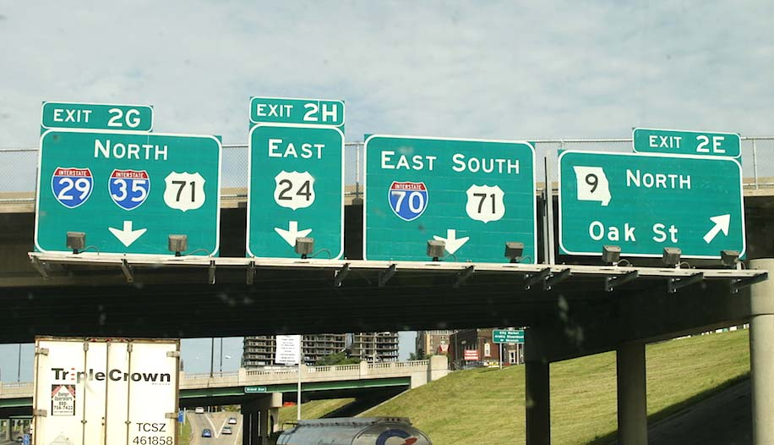
Research Collaborations = Often complex
Why? Understand their aims
What? target, lead, dev candidate?
Who does what?
Option or license?
Decision making? Research plan, success criteria, JSC
IP ownership? COM> MOU
Exclusivity?
Money? Don’t price until structure determined. Costs vs success payments.
Diligence?
Reversion on abandoned, termination?

Slide 19
Detour 5- Exclusivity
Most deals have exclusivity
One way or mutual?
Target exclusivity common
“Partners don’t compete”
But exclusivity should be proportional to advancement, vs loss of freedom for future
Can be time limited or as long as developing and selling licensed product
Can be limited to same type of molecule
Can be limited to exploited indication

Slide 20
Repare Therapeutics and BMS May 2020
From the Press Release
May 2020
Purpose: Repare will use CRISPR and synthetic lethality assays to identify multiple targets for BMS
The companies will leverage Repare’s proprietary, CRISPR-enabled genome-wide synthetic lethal target discovery platform, SNIPRx®, to jointly identify multiple synthetic lethal precision oncology targets for drug candidates. Repare will grant BMS exclusive worldwide rights to develop and commercialize therapeutics for select validated synthetic lethal precision oncology targets discovered under the collaboration.
Financials:
$65M upfront, with $15M as equity in Repare
$3B in license fees, discovery, development, regulatory and sales milestones
Royalties on each product commercialized by BMS

Slide 21
Aim: provide exclusive license option rights to those synthetic lethality targets that add lethality onto cancer gene lesions
Scope and overview
During the Collaboration Term, to the extent that Repare has not already done so, Repare shall
(a) in accordance with the Research Plan, on a Pre-Option Campaign-by-Pre-Option Campaign basis, conduct Initial Screening, Hit Confirmation [to confirm the initial targets that were hit], In Vitro Validation Activities and, as applicable, In Vivo Validation Activities with respect to such Pre-Option Campaign
with the goal of identifying Druggable/LDD Targets that have a Synthetic Lethal relationship with the Pre-Option Campaign Lesion(s) that are the subject of such Pre-Option Campaign,
(b) conduct Hit Confirmation on Prioritized Overlapping Undruggable Targets and
(c) offer BMS the opportunity to obtain rights to (i) Unblinded Targets from the Primary Campaigns and (ii) Unblinded Undruggable Targets.
“Campaign” means SNIPRx® screening efforts to identify Targets that are Synthetic Lethal with (a) a single Lesion that, by itself, identifies a patient population or (b) a combination of multiple related Lesions that, together, identify a patient population.
Up to x primary campaigns and y backup campaigns that may be substituted for a primary campaign
“Initial Screening” means the first round of Synthetic Lethal screens to be conducted in [***].
“Druggable Target” means any Target for which the activity of the protein can be modulated by an active site or allosteric small molecule chemical entity, including such proteins that can be [***]
“LDD” means [***].
“ Undruggable Target” means a Target which can be [***]
“Overlapping Undruggable Targets” Repare Potential Undruggable Targets that have been identified to the Third Party Gatekeeper that are also BMS Undruggable Targets that have been identified to the Third Party Gatekeeper

Slide 22
Each step Hit to In vivo Validation reported anonymized but JSC can decide that JSC or BMS Internal Gatekeeper needs to see unblinded data (to be firewalled from rest of BMS)
Hits (targets that create synthetic lethality with the Campaign lesion) reported anonymized to JSC or Internal Gatekeeper as BMS decides
Confirmed Hits reported anonymized
JSC or Internal Gatekeeper designates 1 or more Selected Targets for in vitro validation
Targets with In vitro validation reported
Targets that do not have in vitro validation are Excluded Targets
JSC can decide In vivo validation is feasible
4. In vivo validation reported
FINAL DATA PACKAGE
JSC or Internal Gatekeeper to decide on 1 Primary and 1 Secondary Validated Targets
BMS to give notice of desire to unblind Primary Target. Upon receipt of the full data package, the Option Term begins

Slide 23
If BMS Opts-in to a Target, BMS has a clock for progress
(a) During the Primary Target Period for such Collaboration Campaign, BMS may conduct Chemistry on the Primary Target from such Collaboration Campaign.
(b) If, on or before the end of the Primary Target Period for such Collaboration Campaign, BMS does not (i) make a Further Development Election for the Primary Target from such Collaboration Campaign and (ii) pay the [***] Milestone Payment for such Primary Target pursuant to Section 9.4, then, effective as of the expiration of such Primary Target Period, such Primary Target shall be deemed a Reverted Optioned Target and Section 2.13 shall apply to such Reverted Optioned Target.
Same concept for Optioned Undruggable Target
For each, BMS will issue reports with respect to BMS activities on such targets.

Slide 24
Excluded Campaigns and Targets
If BMS does not unblind a Primary Target for a campaign, that campaign becomes an Excluded Campaign.
If BMS does not unblind a target with the final data package, then that becomes an Excluded Target
Excluded Targets – All data shall be returned or destroyed except for a copy kept by the Internal Gatekeeper. All obligations of Repare cease.

Slide 25
License to BMS & Exclusivity
License: to BMS with rights to sublicense
an exclusive (even as to Repare)
worldwide, royalty-bearing, sublicensable (through multiple tiers license under the Repare IP
to develop, commercialize and exploit compounds and products directed to the Collaboration Targets
in the Field (all uses) in the Territory (worldwide)
Repare Exclusivity – no drugs against Collaboration Targets, or to any Target using the Campaign Lesion(s) that are the subject of such Pre-Option Campaign or Collaboration Campaign
If Repare is acquired, exclusivity does not apply as long as (a) none of the Repare Intellectual Property or Collaboration Intellectual Property is used in such Acquirer Activities, (b) none of the other Patents or Know-How licensed by either Party to the other Party pursuant to this Agreement is used in such Acquirer Activities, (c) no Confidential Information of BMS is used in any such Acquirer Activities and (d) Repare puts in place firewalls, system access restrictions or other protections that, collectively, are designed to ensure the foregoing clauses (a) through (c) are complied with

Slide 26
Payments
Upfront $50M plus $15M warrant for equity in Repare
Option exercise fee on each Campaign and on each Undruggable Target
Milestone on deciding to do further development on Target-by-Target basis
Additional Target fee (beyond primary target)
Any time achieves [***] for a Target
4 development and regulatory milestones
2 sales milestones
Royalties (3 tiers) until latest of
1) last to expire valid claim on Subject Patent on Product
“Subject Patent” means, with respect to a given Resulting Compound or Product, any Patent owned by or licensed to Repare or BMS or any of either Party’s respective Affiliates, solely or jointly with the other Party or any of the other Party’s Affiliates or any Third Party, that Covers any method of use, composition of matter, dosage or formulation of such Resulting Compound or Product.
2)10 years after First Commercial Sale in such Country
3)The expiration of Regulatory exclusivity
Reduced for Third Party IP or Generic entry
Reduced if BMS acquires an independently validated as at Target 3rd party compound
Also pay reduced royalties if BMS acquires a non-independently validated compound with royalties varying by stage, and even to reverted Targets

Slide 27
IP ownership
Platform Repare
Except for Repare Intellectual Property [pre-existing] and Repare Collaboration Intellectual Property [on platform improvements] (which shall be solely and exclusively owned by Repare),
Compounds BMS
BMS will solely and exclusively own any Patents and Know-How (including any Collaboration Intellectual Property) Covering any Collaboration Druggable/LDD Target Resulting Compounds or Collaboration Undruggable Target Resulting Compounds, or Products containing any such Resulting Compounds (such Collaboration Intellectual Property, “Resulting Compound/Product Collaboration IP”).
Joint IP
Both Parties shall jointly own all Joint Collaboration IP, such that each Party has an undivided one-half (1/2) interest in such Joint Collaboration IP, and, subject to any licenses granted by one Party to the other under this Agreement, with no duty of accounting to the other Party and no requirement to obtain consent from the other Party in connection with any licenses granted by either Party to Third Parties with respect to such Joint Collaboration IP.
BMS shall have the sole right, but not the obligation, at its sole cost and expense, to Prosecute, Defend and enforce, and apply for patent term extensions and supplementary protection certificates for, all Subject Patents. All recoveries compensating net lost profits obtained by BMS or any of its Affiliates or Sublicensees as a result of any enforcement proceeding with respect to any Subject Patent shall be treated as Net Sales and included in the calculation of Annual Net Sales for purposes of calculating milestones and royalties

Slide 28
PR
Repare may issue press release in form attached
No publications by Repare on any thing not Excluded.
Without the prior written consent of BMS, Repare shall have no right to make any Publication with respect to:
(a) any (i) Pre-Option Campaign or Collaboration Campaign, (ii) Overlapping Undruggable Target or Prioritized Overlapping Undruggable Target, or (iii) Selected Target, Validated Target, Unblinded Target or Collaboration Target;
(b) any Synthetic Lethal relationship between any Pre-Option Campaign Lesion(s) or Collaboration Campaign Lesion(s) and any Druggable/LDD Target;
(c) any Synthetic Lethal relationship between any Lesion(s) and any Overlapping Undruggable Target or Prioritized Overlapping Undruggable Target; or
(d) the data or results from any work under this Agreement pertaining to any (i) Pre-Option Campaign or Collaboration Campaign, (ii) Overlapping Undruggable Target or Prioritized Overlapping Undruggable Target, or (iii) Selected Target, Validated Target, Unblinded Target or Collaboration Target;
in each case ((a) through (d)) unless and until the applicable Campaign or Target becomes an Excluded Campaign or Excluded Target
BMS free except if it contains Repare confidential information
From and after BMS’s exercise of its Option with respect to a Primary Campaign or an Unblinded Undruggable Target (as applicable), BMS shall have the right to make Publications with respect to such Primary Campaign or an Unblinded Undruggable Target without the prior written consent of Repare; provided that, in the event that BMS desires to make a Publication that may disclose the Confidential Information of Repare, BMS shall provide a copy of the proposed Publication (including abstracts, or presentations to a journal, editor, meeting, seminar or other Third Party) to Repare for comment at le

Slide 29
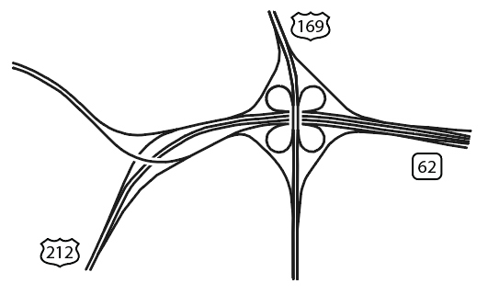
CoDevelopment and Territorial Splits
Who? Both parties
What? Development and commercialization splits. May include co-detailing or co-promotion.
Money? Often opt-in/out for cost and profit share in US, royalties in ROW

Slide 30
Structure first deal to permit a 2nd deal
Big pharma would like global rights but often a territorial deal comes first or offers more rewards
Big pharma will accept a territorial deal if
It is not the US or Europe
The contract does not preclude big pharma from largely doing as it would normally do and ensures protection for the value of the asset
Accept no obligation that the next bigger partner will find objectionable
Ensure that the biggest value is protected in decision making

Slide 31
China as first Territorial Deal
China generalizations
China is currently a low margin market, growing fast but difficult market
China deals tend to be small upfronts and milestones (maybe 1/10th global?) and near global market royalties
Global companies do place some value on China for building their future – taking it out slightly reduces the likelihood of a global deal
There are still frequent worries about IP leakage (with high turnover of Chinese employees), low quality, government controls on currency and government approval of contracts.
Government favors local manufacturing.
Ideal deal?
With a company known to global pharma for acceptable quality, funds for other activities, acceptance of structure acceptable to big pharma, providing hard to get data
To get the 2nd deal, the first deal must be palatable to a future partner

Slide 32
A Tour of Deals
Co-development
Option
Research
Collaboration
License
Territorial Split
Sale

Slide 34
The Negotiating Process
Strategy
Discuss Wants & Needs
Term Sheets
Final Agreement
Implement

Slide 35
Strategy
#1 Goal for Deal
“ability to run more than 1 clinical trial”
Needs: Met or No Deal
“partner we can work with”
Alternative to a Deal
“run only 1 clinical trial and risk all on that 1”
“cash to run other programs”
“validation”
“keep US co-promote rights”
“credible with investors”
“find partner within 6 months or run out of cash”
“take more dilution from investors”
Wants: May Trade Away
“co-promote we won’t actually use”
“higher royalties versus higher earlier payments”
“control over indications”
Deal Structure Alternatives
Review the industry variations
Review what partner has done before

Slide 36
Deals Get Done Because of
Clarity of the value proposition
Belief in the market potential
Belief that the risks can be addressed early
Competition for the asset
Internal champions
Strategic imperatives

