Slide 1
Foster Care & Juvenile Justice Program Updates
Tennessee Data & Attendance Conference
Daniel Froemel | Consolidated Planning & Monitoring | Sept. 13, 2018

Slide 2
Overview
Foster Care Important Reminders
  Overview and purpose
  Coding
Juvenile Justice Updates
  Overview and purpose
  Coding

Slide 3
Foster Care Updates

Slide 4
Foster Care in ESSA
Children and youth in foster care represent one of the most vulnerable student subgroups in this country.
Of the approximately 415,000 children in foster care in 2014, nearly 270,000 were in elementary and secondary schools.
Studies find that children in foster care are much more likely than their peers to struggle academically and fall behind in school.
Source: U.S. Dept. of Education: Non-Regulatory Guidance: Ensuring Educational Stability for Children in Foster Care

Slide 5
Children in Foster Care:
Are often a vulnerable and highly mobile student population
Experience more unscheduled school changes than their peers in a given school year
Experience (compared to their peers not in foster care):
  Lower high school graduation rates;
  Lower scores on academic assessments; and
  Higher rates of retention, absenteeism, suspensions, and expulsions

Slide 6
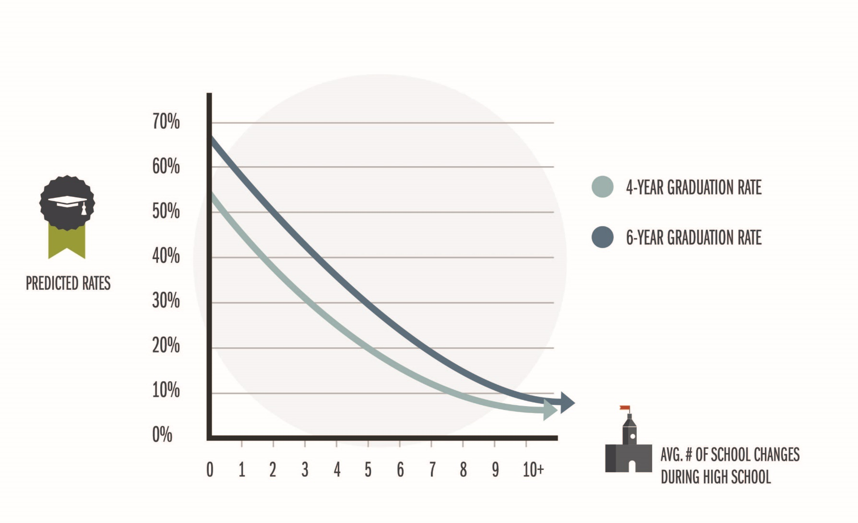

Links Between Mobility and Graduation

Slide 7
Children and Youth in Foster Care
Definition and Identification
  Children placed away from their parents or legal guardians by the Department of Children’s Services (DCS).
  Foster students are listed on the monthly report from DCS that TDOE sends to LEAs’ School Nutrition department.
  Does not include students who:
    Are staying with a family friend or relative
    Are homeless per the McKinney-Vento definition
    Are runaways
Student Classification of Foster Students
  Use code FOS01 only for students on the DCS foster care list.

Slide 8
Children and Youth in Foster Care
Included in the Economically Disadvantaged (ED) subgroup
Under ESSA, foster care students are a subgroup of graduation rate and assessment/accountability reporting
Notes:
New code; communication began last summer, reference Trish Kelly webinar

Slide 9
Economically Disadvantaged Subgroup
For accountability, assessment, and BEP funding, the economically disadvantaged subgroup consists of students eligible for free school meals due to:
  direct certification of economic disadvantage (J) as participants in federal/state income/nutrition programs (e.g., TANF, SNAP) or due to
  categorical eligibility through their status as
    foster care (FOS01),
    homeless (H),
    migrant (I), and
    runaway (U).

Slide 10
2017-18 Foster Care and Direct Cert Counts
Statewide counts for the 2017-18 school year (as of Aug. 30, 2018) were:
  Foster Care (F0S01): 7,499
  Foster Care (FOS01) AND Direct Cert (J): 6,972
  Direct Cert (J): 379,417
Notes:
Use the Student Classifications research query to check your data.
Enter revisions to SIS/EIS as needed.

Slide 11
Juvenile Justice Updates

Slide 12
T.C.A.§ 49-6-3023
Under state law, as of 2018-19, districts must provide educational services to students incarcerated in juvenile detention centers (JDCs) licensed by the Department of Children’s Services (DCS).

Slide 13
Juvenile Justice Point of Contact (POC)
All districts must appoint a juvenile justice point of contact (POC) to:
  serve as the point of contact when a student is incarcerated,
  communicate with JDCs and juvenile justice POCs in other districts, and
  expedite the transfer of school records.
  Districts list their JJ POC in ePlan
Notes:
Juvenile Justice Point of Contact (POC) (slide title)
All districts must appoint a juvenile justice point of contact (POC) to:
serve as the point of contact when a student is incarcerated,
communicate with JDCs and juvenile justice POCs in other districts, and
expedite the transfer of school records.

Slide 14
General Education Students
When a JDC notifies a LEA that a general education student has been detained:
  The student remains enrolled in the LEA regardless of the location of the JDC.
  The LEA enters the juvenile detention center student classification for the facility (see the JDC student classifications slide) in SIS and uploads to EIS.
  The juvenile justice POC makes arrangements for the student’s educational services with the JDC and the other LEA if the JDC is located in another district.
  If the student is placed in a JDC in another district, the juvenile justice POC works with the receiving LEA to ensure that all educational records are received in a timely manner and that the student is coded properly in the student information system.
Notes:
General Education Students (slide title)
When a JDC notifies a LEA that a general education student has been detained:
The student remains enrolled in the LEA regardless of the location of the JDC.
The LEA enters the juvenile detention center student classification for the facility (see the JDC student classifications slide) in SIS and uploads to EIS.
The juvenile justice POC makes arrangements for the student’s educational services with the JDC and the other LEA if the JDC is located in another district.
If the student is placed in a JDC in another district, the juvenile justice POC works with the receiving LEA to ensure that all educational records are received in a timely manner and that the student is coded properly in the student information system.

Slide 15
Special Education Students
When a JDC notifies a LEA that a special education student has been detained:
  The student remains enrolled in the LEA only if the JDC is located within the LEA.
  The student is withdrawn from the home LEA and enrolled in the receiving LEA if the JDC is located in another LEA.
    This process assures that the receiving district, which is responsible for compliance with IDEA, has access to the IEP in EdPlan (EasyIEP).
  The LEA that enrolls the student during the incarceration enters the juvenile detention center student classification for the facility in SIS and uploads it to EIS.
Notes:
Special Education Students (slide title)
It is important to note that the process is different for special education students.
When a JDC notifies a LEA that a special education student has been detained:
The student remains enrolled in the LEA only if the JDC is located within the LEA.
The student is withdrawn from the home LEA and enrolled in the receiving LEA if the JDC is located in another LEA.
This process assures that the receiving district, which is responsible for compliance with IDEA, has access to the IEP in EdPlan (EasyIEP).
The LEA that enrolls the student during the incarceration enters the juvenile detention center student classification for the facility in SIS and uploads it to EIS.

Slide 16
JDC Student Classifications
As shown on the next slide, each of the state’s 17 juvenile detention centers has a separate student classification.
  The first three digits are the letters “JDC.”
  The final two digits are a number between “01” and “17.”
The date the student enters the JDC is the student classification begin date.
The date the student leaves the JDC is the student classification end date.
Notes:
JDC Student Classifications (slide title)
As shown on the next slide, each of the state’s 17 juvenile detention centers has a separate student classification.
The first three digits are the letters “JDC.”
The final two digits are a number between “01” and “17.”
The date the student enters the JDC is the student classification begin date.
The date the student leaves the JDC is the student classification end date.

Slide 17
JDC01–JDC17 Student Classifications
Notes:
JDC01-JDC17 Student Classifications (slide title)
The table in this slide contains the 17 juvenile detention student classifications.
For example, JDC01 is for the Bedford County Juvenile Detention Center and
JDC02 is for the Blount County Juvenile Detention Center.

Slide 18
Student Classifications Research Query
To check your juvenile detention center data, use the Student Classifications research query.
Login to EIS as a district or school user.
Select “Data Reports” / “Research Queries.”
Select the “Student Classifications” research query.
Notes:
Student Classifications Research Query (slide title)
To check your juvenile detention center data, use the Student Classifications research query.
Login to EIS as a district or school user.
Select “Data Reports” / “Research Queries.”
Select the “Student Classifications” research query.

Slide 19
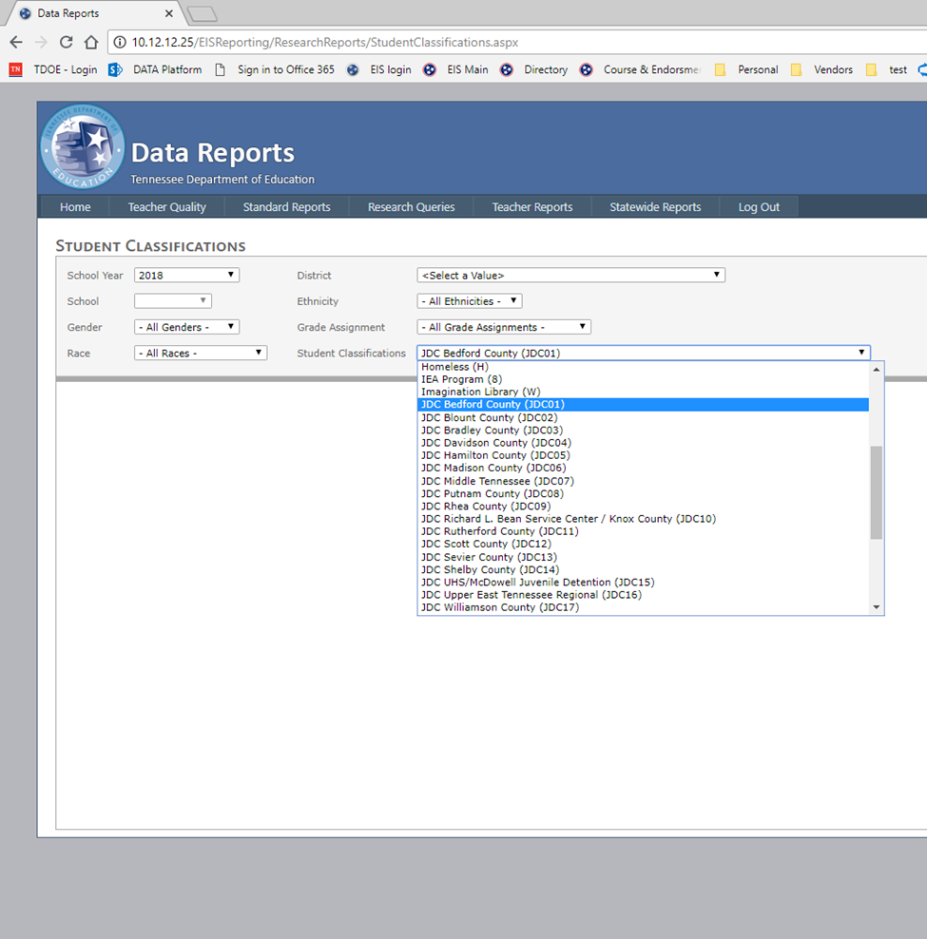
Student Classifications Research Query: Juvenile Detention Centers
Select “Student Classifications” and the code for the facility of interest.
For example, select “JDC Bedford County (JDC01)” for the Bedford County Juvenile Detention Center.
Notes:
Student Classifications Research Query: Juvenile Detention Centers (slide title)
Select “Student Classifications” and the code for the facility of interest.
For example, select “JDC Bedford County (JDC01)” for the Bedford County Juvenile Detention Center.

Slide 20
Student Classifications Research Query Results: JDC Bedford County (JDC01)
To run the query, select “View Report.”
Download in csv or Excel format using the file icon to the right of “Find” | “Next.”
As shown in the table below, the Student Classifications research query results include a record for each student flagged with the JDC Bedford County (JDC01) student classification.
Notes:
Student Classifications Research Query Results: JDC Bedford County (JDC01) (slide title)
To run the query, select “View Report.”
Download in csv or Excel format using the file icon to the right of “Find” | “Next.”
As shown in the table below, the Student Classifications research query results include a record for each student flagged with the JDC Bedford County (JDC01) student classification.

Slide 21
Timeline
By the fifth instructional day, the receiving LEA will contact the sending LEA for records
By the tenth instructional day, the sending LEA will ensure that all records are sent to the receiving LEA
By the 15th instructional day, the receiving LEA will create an ESP with the sending LEA
Instruction will start by the 20th instructional day

Slide 22
Educational Service Plan
ESP
  Must be developed by student’s 15th instructional day
  Members from both the sending school districts and the receiving school districts must be involved
  JJ POCs responsible for facilitating ESP meetings
  Purpose is for receiving district and sending district to collaborate on educational plan for student

Slide 23
Contact information
Daniel Froemel (First, East)
Daniel.Froemel@tn.gov
(615) 351-1208
Earl Lattimore (Mid-Cumberland (except MNPS),Upper Cumberland, South Central, Southeast)
Earl.Lattimore@tn.gov
(615) 390-4549
Erin Christian (Northwest, Southwest, MNPS, DCS, DOC)
Erin.Christian@tn.gov
(901) 504-9627

