Slide 1
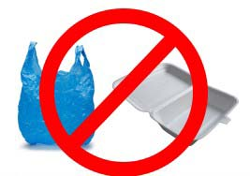
Greening Williamstown
Banning single-use plastic bags
and polystyrene products

Slide 2
Some Quick Definitions
Styrene = An organic compound derived from benzene. It is associated with a number of health risks, including cancer.
Polystyrene = Plastic made of styrene. This can take many forms, from coffee lids and sushi boxes to EPS cups.
EPS = Expanded Polystyrene, a bulky, lightweight plastic in the form of a smooth, rigid foam. Widely used for everything from coffee cups to insulation.
XPS = Extruded Polystyrene is the bumpier rougher form of EPS, the kind that breaks off in chunks. Packing materials, e.g.
Styrofoam = a brand name for the XPS manufactured by Dow Chemicals. Although it is a trademarked product, “Styrofoam” is widely used for all EPS and XPS.

Slide 3
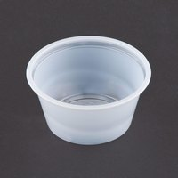
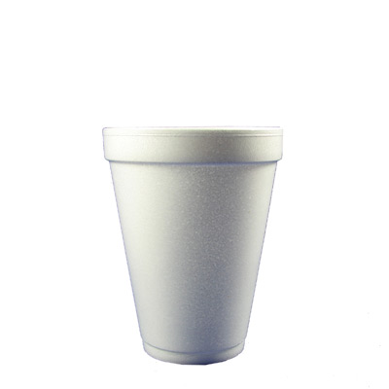
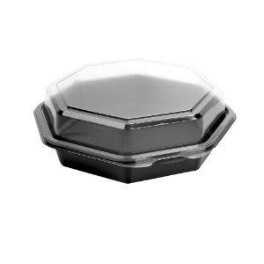
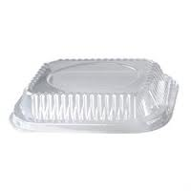
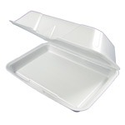
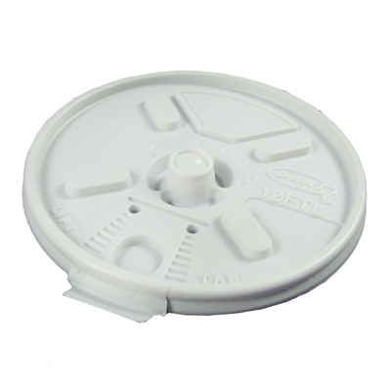
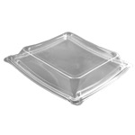
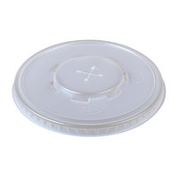
Some Common Polystyrene Products
Source: Town of Brookline, MA

Slide 4
The Case Against Polystyrene
Health Effects:
Polystyrene is based on styrene, a neurotoxin and probable carcinogen. Polystyrene is the only plastic used in food packaging that is based on a carcinogen
Polystyrene products may leach styrene when exposed to hot or greasy foods
Styrene residues are found in 100% of human fat tissue samples
Manufacturing polystyrene is highly hazardous for factory workers
Environmental Effects:
Polystyrene does not biodegrade. It is very bulky, so it takes up a lot of room in landfills.
Estimates of longevity range from hundreds to thousands of years.
Even when properly disposed, polystyrene often ends up as litter due to its light weight.
Production produces a large amount of hazardous waste and air pollution
Polystyrene items harm wildlife. At least 267 marine species worldwide have
been reported to have been affected by polystyrene litter
Polystyrene is made from non-renewable fossil fuels (oil and natural gas).

Slide 5
The Case Against Plastic Bags
Economic Effects
Every year, Americans discard 100 billion single-use plastic bags.
The average family accumulates 60 plastic bags in only four trips to the grocery store.
The plastic bag industry collects $4 billion per year in profits from U.S. retailers, who pass the costs on to consumers.
The average use time of a plastic bag is only 12 minutes.
Less than one percent of plastic carry-out bags are recycled each year. Recycling one ton of plastic bags costs $4,000. The recycled product can be sold for $32
Environmental Effects
Plastic bags are a major litter problem, thanks especially to their aerodynamic qualities.
Plastic bags are often mistaken as food by both domesticated and wild animals. Birds, turtles, whales, sea lions, seals, and fish are among the species at particular risk.
Ten percent of the plastic produced every year worldwide winds up in the ocean, 70% of which finds its way to the ocean floor, where it will likely never degrade.
Every square mile of ocean has about 46,000 pieces of plastic floating in it.

Slide 6
The Problem of Microplastics
Rather than eventually breaking down into benign substances, polystyrene and plastic bags fracture into small plastic particles (microplastics), which persist in the environment.
These tiny particles, 5 mm or smaller, present the greatest long-term danger, as these particles displace food supplies in the world’s oceans.
Animals from shellfish to whales can ingest them. This can displace space in an animal's stomach or block their digestive tracks, and then cause animals to die from starvation.
Once microplastics enter our oceans, they will stay there virtually forever, because they persist and their removal is not possible.
Sources for this and two preceding slides: Sierra Club; Save the Bay; TheWayToGo

Slide 7
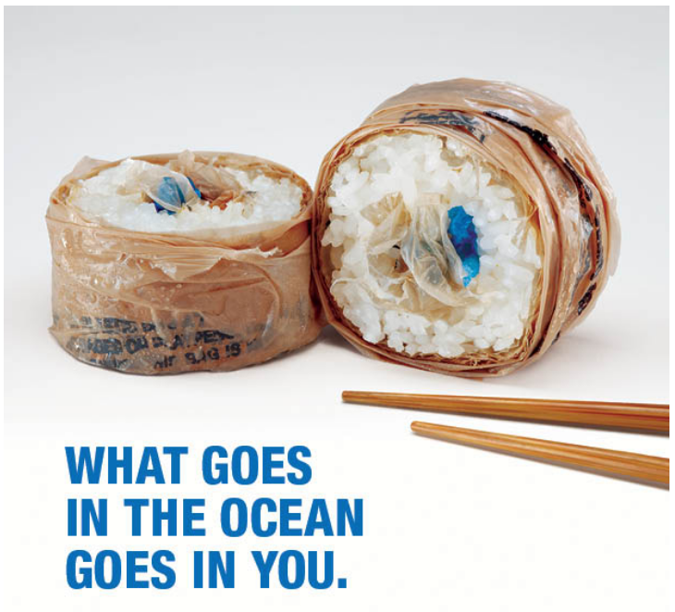
Credit: Surfrider Foundation

Slide 8
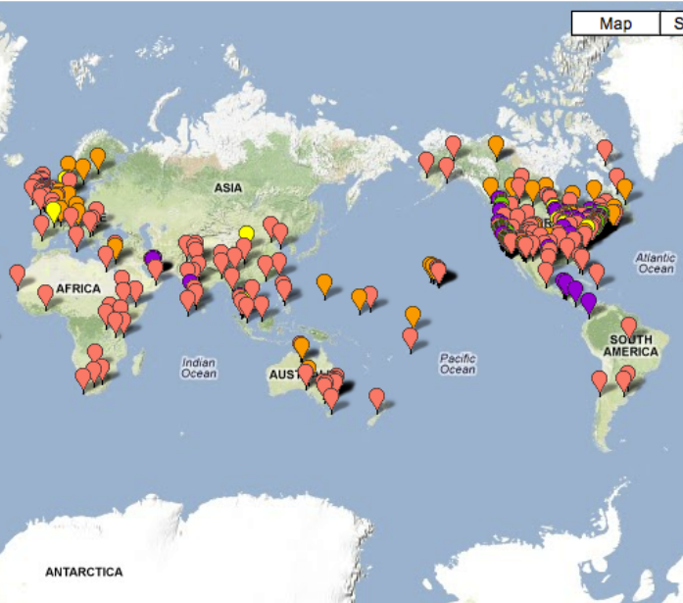
Plastic and/or Polystyrene are banned in over 100 cities all over the world
Source: Plastic Free Times

Slide 9
A Number of Municipalities in Massachusetts Have Passed or Are Currently Considering Bans
Passed
Proposed
Town | Polystyrene | Plastic Bags
Amherst | X
Brookline | X | X
Falmouth |  | X
Great Barrington | X | X
Manchester |  | X
Newburyport |  | X
Provincetown |  | X
Somerville | X
South Hadley | X
Town | Polystyrene | Plastic Bags
Brewster |  | X
Cambridge |  | X
Hamilton |  | X
Hingham |  | X
Natick |  | X
Pittsfield | X | X
Northampton |  | X
Watertown |  | X

Slide 10
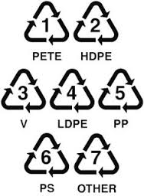
There Are Many Available Alternatives
Plastic Bags
Paper bags
Reusable tote bags
String bags
BagShare Project
Polystyrene
Recycled Paper Products
Conventional/Virgin Paper Products
Bagasse (made from sugar cane byproduct)
Recycled Plastic Products
Conventional Plastic Products
Bioplastics (generally from corn)
Biodegradable Products

Slide 11
There Are Many Vendors of Alternative Products
Selected vendors include:
US Eco Products……………………………………………….978-457-9229
Eco-Products…………………………………………………….1-866-402-1831
Tri Mark United East…………………………………………800-556-7338
Dart………………………………………………………………….800-248-5960
Vegware..…………………………………………………………845-643-0406
Biomasspackaging……………………………………………800-317-2737
Minipak Torre……………………...............................1-714-283-4200
Pactiv……………………………………………………………….847-482-2000
Hubert……………………………………………………………..1-866-482-4357
Be Green Packaging………………………………………….805-456-6088
MyTakeOutBags……………………………………………….888-321-2248
Amazon.com
… and many more. …
Note: Compiled by Town of Brookline

Slide 12
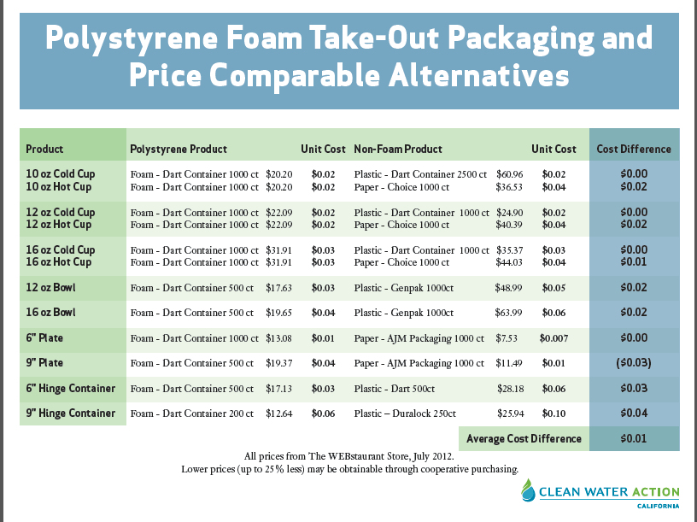
Aren’t Alternatives Much More Expensive?
No:

Slide 13
Aren’t Paper and Corn Products Just as Environmentally Harmful as Polystyrene?
No:
Styrene is toxic, paper is not.
Unlike paper, polystyrene never decomposes into soil. Rather, it just breaks down into smaller and smaller bits.
The source of the claim that paper might actually have a greater carbon impact than polystyrene is a 2011 study sponsored by the Plastic Foodservice Packaging Group (http://plasticfoodservicefacts.com/Life-Cycle-Inventory-Foodservice-Products). Merchants of doubt.
But on the other hand…

Slide 14
Disposable Packaging Does Have a Significant Carbon Footprint
Credit: City of Portland, Oregon / Eco-Products

Slide 15
Different disposable food service materials have different impacts
The Bottom Line
Recyclable/Compostable products are better than polystyrene.
Reusable is better than disposable, no matter how recyclable or compostable
Credit: City of Portland, Oregon

Slide 16
Political Notes
Bylaws passed in Town Meeting need to be approved by Massachusetts Attorney General.
There is a certain advantage to using language already approved elsewhere.
There are several legislators on Beacon Hill who are working on state bag bans.
There is a certain advantage to using unique language. A confusing local regulatory landscape will eventually have major retailers begging for statewide standards.
The future is in eliminating all disposal food service waste, not just switching to recyclables & compostables
Portland, OR, has recently passed an ordinance refusing to accept disposable ware – even if it is supposedly compostable – in the city-wide commercial and residential compost program.
Clean Water Action, a national lobby, is at the forefront of helping businesses and communities operate more sustainably, with their ReThinking Disposables campaign.

Slide 17
Banning plastic bags: Some Key Decision Points
What thickness?
Over 1.5 mil: Provincetown
2.25 mil: Brookline
Over 3.0 mil: Marblehead, Newburyport, Newton
What business impacted?
Any establishment: Marblehead, Newburyport, Provincetown
Medium size stores (2500+ sq ft): Brookline
Larger stores (3500+ sq ft): Newton
Specified guidelines for paper bags?
Yes: Brookline, Marblehead, Newton
No: Newburyport, Provincetown
Ban or mandatory levy?
Ban: Massachusetts municipalities
5 cents: DC, etc.
10 cents: California cities, etc.
Penalties: range from $50 to $200

Slide 18
Banning Polystyrene: Some Key Decision Points
Ban all polystyrene food service products or just foam (EPS)?
All polystyrene: Great Barrington, Brookline
Just EPS: Amherst, South Hadley
Ban just food packaging or other products, such as packing peanuts?
Is it possible to ban the sale of Styrofoam cups at grocery and convenience stores?
Allow grace period before ban goes into effect? How long?
Allow for hardship cases for businesses that need more time to adapt?
What penalties shall be imposed for non-compliance?
Enforcement issues: Health Department Inspectors

Slide 19
Deadlines
March 30: Due date to insert articles into warrant for Town Meeting.
By this date, the texts of our bylaws must be drafted in final form.
10 signatures required for each article.
May 19: Town Meeting.

Slide 20
Some Tasks Ahead
Legal
Draft bylaw for polystyrene
Draft bylaw for plastic bags
Outreach
Town Manager & Board of Selectmen
Select Board meets 7:00 p.m. on the second and fourth Monday of each month.
Bylaws will impose burden of enforcement on town’s Board of Health.
Business Community
Very important that they are informed and buy in. (Somerville vs. Brookline)
Chamber of Commerce -- special meeting
Businesses not in Chamber of Commerce: Chopsticks, Asian Market, Aubuchon, & chains (Dunkin Donuts, etc.)
Institutions
May need special help to transition
Schools: MGRHS, WES
Sweetwood, Sweetbrook
Hotels
Community Outreach
Spreading the word within Williamstown
Arrange for public screening of Bag It! in Williamstown and North Adams
Perhaps in partnership with Zilkha Center?

Slide 21
Expanding our efforts
Greening the Berkshires
Reach out to activists in other towns and cities in the Berkshires
Get our legislators on board: Sen. Dowling, Rep. Pignatelli.
Rep Cariddi is already with us!
Be Part of the Solution
Help identify best practices
Help local businesses & institutions identify sources of alternative products.
Ensure local vendors (Greenberg’s, Sysco, etc.) stock alternative products at comparable prices.
Encourage local vendors to accept trade-ins of polystyrene products, so businesses and institutions are not left with unusable supplies. (South Hadley did this.)
Improve information flows so other towns do not have to start from scratch
GreenMass.Org

