Slide 1
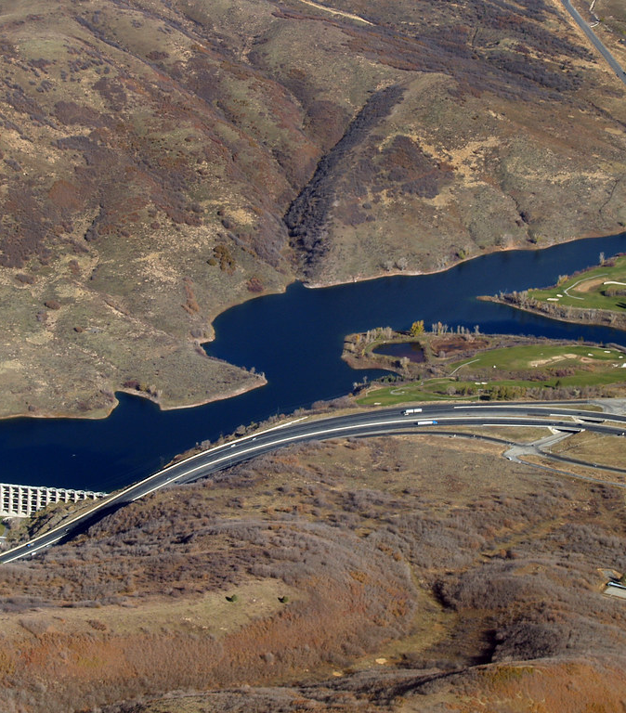
Salt Lake City Water Infrastructure Program
Salt Lake City Department of Public Utilities
January 15, 2020; East Bench Community Council Meeting
Brad Stewart, PE, Capital Improvement Program Manager
Laura Briefer, MPA, Director

Slide 2
About Salt Lake City Department of Public Utilities
Established in 1876
Department of Salt Lake City municipal government
Water provider for more than 360,000 people in Salt Lake City, Mill Creek, Holladay, Cottonwood Heights, and other communities
Sewer, stormwater, and street lighting for Salt Lake City
Regulated by the US EPA and Utah DEQ pursuant to the Clean Water Act and Safe Drinking Water Act; Utah DNR for water rights

Slide 3
Current Water-Related Infrastructure
3 water treatment plants
1 sewer treatment plant
31 pump stations
7 water storage dams and reservoirs
32 water distribution reservoirs and tanks
1,307.62 miles of water lines
654.38 miles of sewer collection lines
349.72 miles of stormwater collection lines

Slide 4
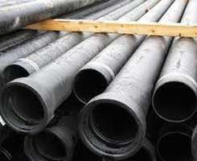
Water Lines
Age
57% 1960-2019; 43% pre 1960
15.5% pre-1920
Size
Most common sizes 6”, 8”, and 12”
1”-72”
Type
Most common are ductile iron and cast iron pipe (61.5%)
PVC (13.7%)
Steel, asbestos cement, concrete, brick still in existence

Slide 5
Asset Management Program
Inventory/Inspect Assets.
1
Assign Criticality.
2
Assign Condition.
3
Create a plan for each asset and schedule next inspection.
4

Slide 7
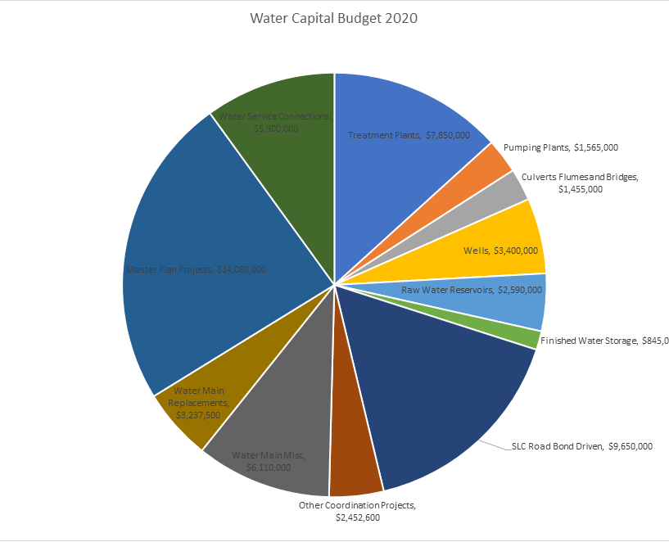
Capital Improvement Program – Water Utility
Fiscal Year 2020 CIP budget $59,255100
Total water main budget is $21,450,100

Slide 8
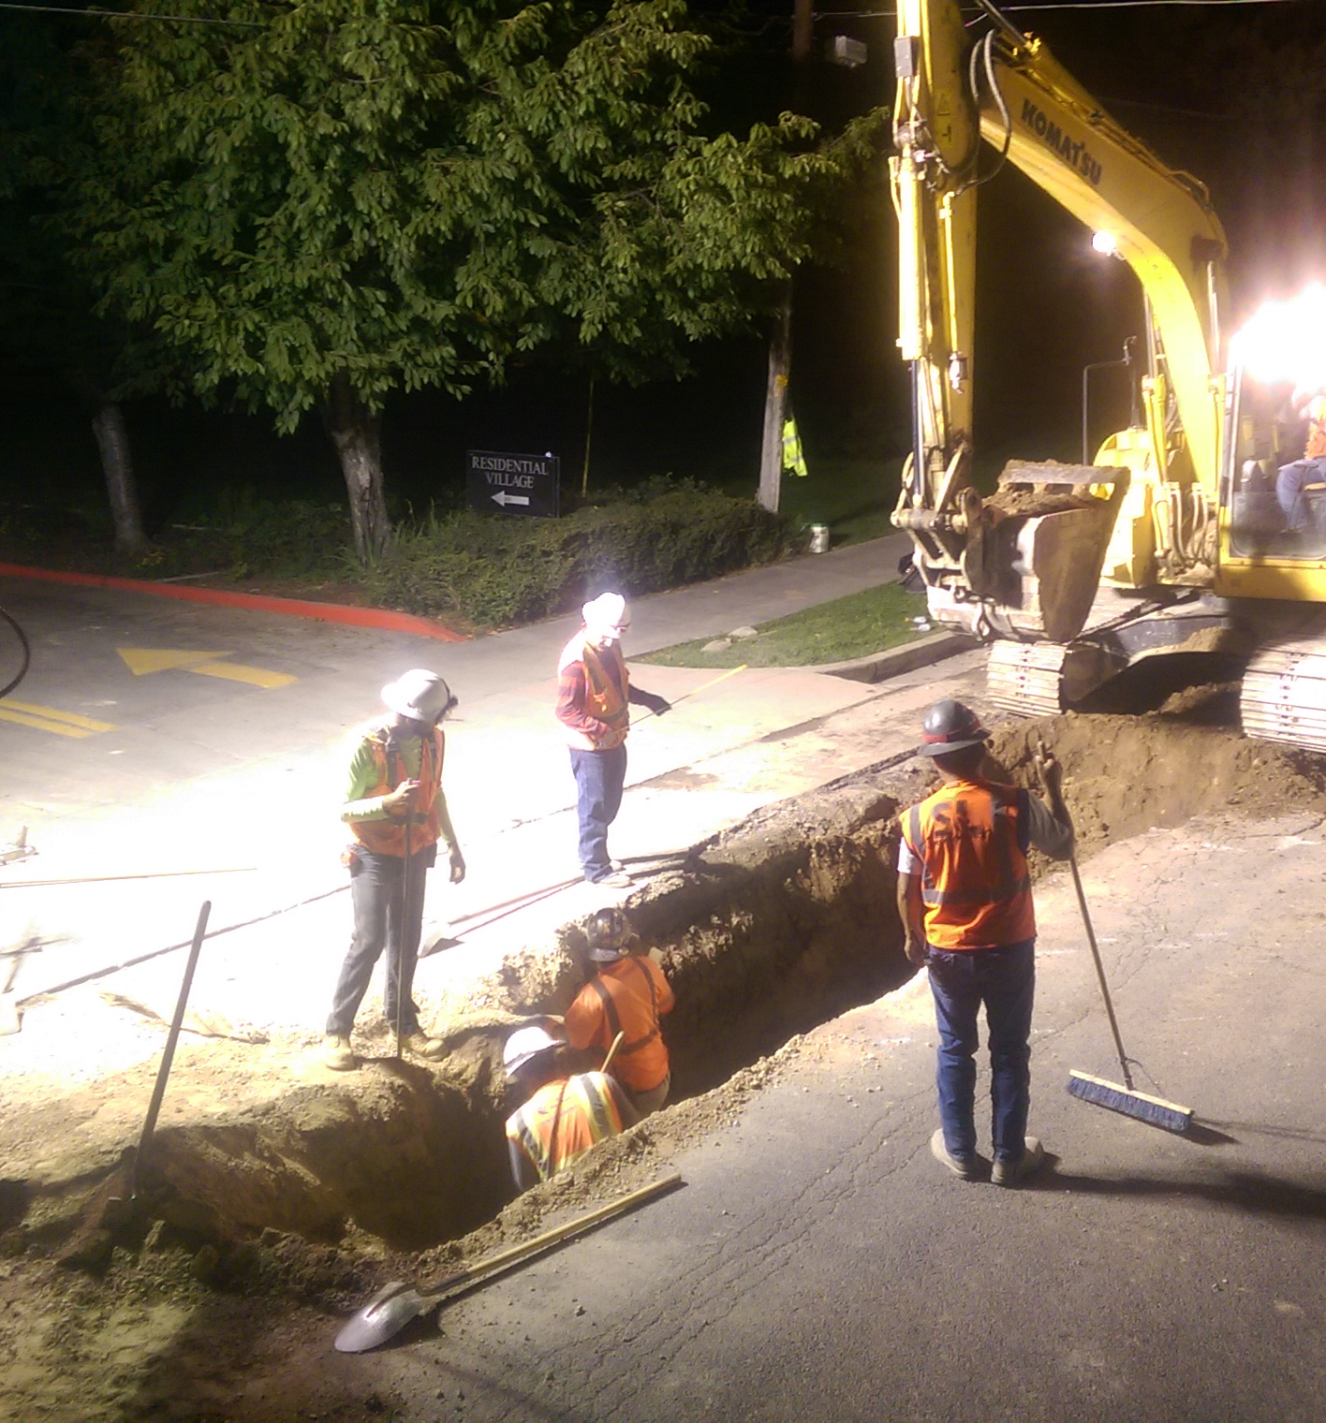
Factors in Priority and Timing of Water Infrastructure Projects
Criticality and condition of infrastructure
Growth
Regulations
Roadwork and agency coordination
Budgets, financing, and rates
Internal and external resources
Public impact

Slide 10
Replaced Water Mains - SLC

Slide 11
Replaced Water Mains- Service Area

Slide 12
Questions

