Slide 1
Top 10 unusual differences between the USA & France [exaggerated?]
Alizé Couzigou
Lauriane Fay

Slide 2
You know you’re a French exchange student in the USA when…

Slide 3
1

Slide 4
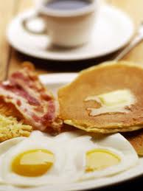
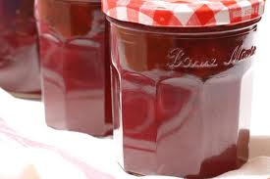
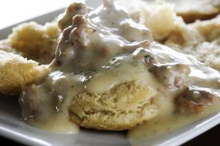
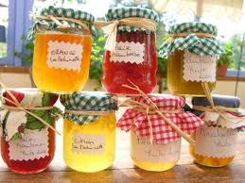
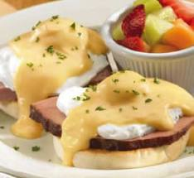
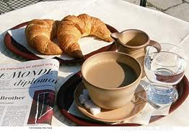
?
…You’re crazy about their XXL-size breakfast
Notes:
…You’re crazy about their XXL-size breakfast (but still miss the good french bread)
There would be a lot to say about food, but i’ll specifiy only one typical type of meal, known and appreciated in both countries: Breakfast. It will never be healthy, let’s admit that right now. But in those 2 situations, not only the ingredients but the amount are surprising.
French: Baguette, brioche, croissant, jam, Nutella (increasingly popular in Europe in general), butter (real butter), freshly squizzed orange juice, coffee, hot tea, or hot chocolate.
American: Bacon, sausage, scrambled eggs, potatoes and tomato sauce, omelet, pancakes, french toats, biscuit & gravy, oatmeal. (the number of dishes outnumber easily what we are used to!)
Story: at the dining –hall, scones vs. Biscuit
What are biscuits for us=cookies

Slide 5
2

Slide 6
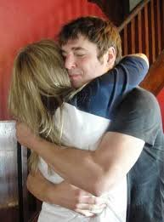
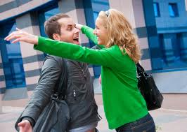
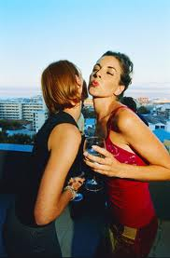
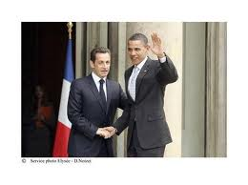
…they are surprised you say « hi » kissing them on the cheeks
?
Notes:
…they are surprised you say « hi », kissing them on the cheeks
« Friendliness at first sight » HUGS vs. Respectful manners the KISS on the cheek
Southern hospitality?
Waving at strangers in the street.
Story: Mother and her warning : « don’t be naïve. There are crazy people everywhere. Be careful »!

Slide 7
3

Slide 8
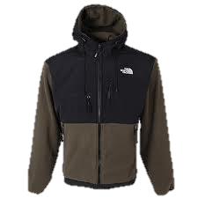
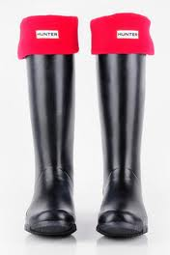
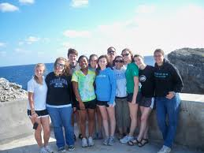
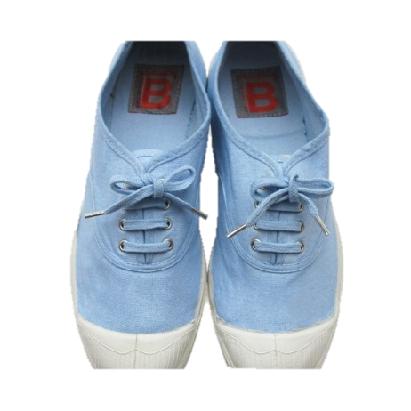
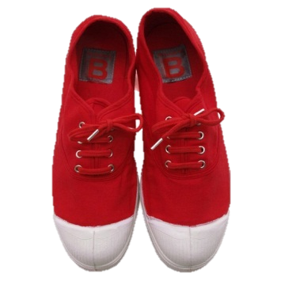
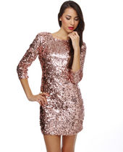
?
…you definitely want to stick with French fashion!
Notes:
…you definitely want to stick with French fashion!
USA: winter? Leggings, boots (or Hunter boots when raining), NorthFace Jacket, and the famous NorthFace Backpack, wether you are dressed up in your presentation clothes or not.
Summer: colorful, bright, sportswear, and fancy, glittery outfits at night, and heels (finally)
France:the more you wear heels, the better off!
Men: Polos, jeans
Women: natural shades colors, casual, heels

Slide 9
4

Slide 10
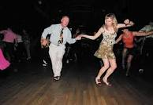
?
…you can’t help but to stare at people grinding
like you’ve never seen that before (which is true!)
Notes:
…you can’t help but to stare at people grinding like you’ve never seen that before (which is true!)
Dancing at night:
Grinding vs. Rock dance
Bars vs. Clubs
Hip-hop/rap vs. Techno/rock

Slide 11
5

Slide 12
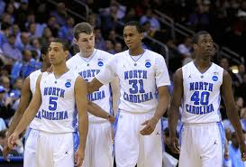
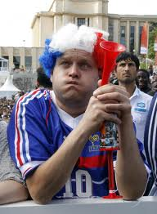
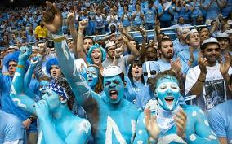
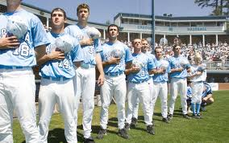
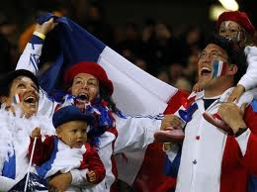
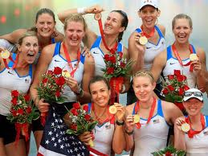
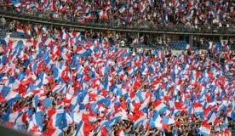
?
…you realize you actually don’t know how to cheer your team like a real american fan
Notes:
…you realize you actually don’t know how to cheer your team like a real american fan
Sport cheering/practicing
Values driven: patriotism, pride, confidence, sense of competition, support, respect of competitors, efforts, acceptance of weaknesses, working on goals, be better, share moments, reliance on team, courage.
USA: baseball, basketball, american football
France: soccer, rugby, tennis, cycling (Tour de France)

Slide 13
6

Slide 14
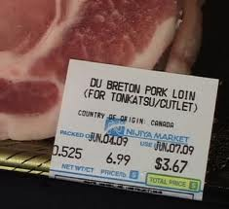
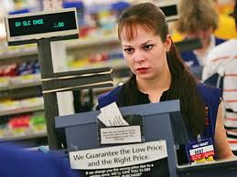
…You keep forgetting about the TIPS and taxes
True story ☹
?
The look we get…
Notes:
…you forgot to add either the taxes on the final price of a product,
Or the tips at a restaurant (reason why americans see us as cheap tourists!)
Tips are included in the service charge of the bill. No need to add it
Taxes: the price written on the tag/label/package is the actual price you’ll pay when at the cashier. No need to compute the tax.

Slide 15
7

Slide 16
…you still find it creepy to invite your profesor
to lunch or friend him on facebook!
?
Notes:
…you still find it creepy to invite your professor to lunch or friend him on facebook
Informal vs. Hierarchy
Invite your profesor to eat someday ?
Add your profesor on facebook, tweeter ?
French Hierarchie and respect of the function

Slide 17
8

Slide 18
…you go out thinking it’s really warm
whereas it’s really, REALLY cold…True story, again ☹
Kms
°C
Kgs…
?
Miles?
°F?
Pounds?
Notes:
…you go out thinking it’s really warm whereas it’s really, REALLY cold (and that’s just one example!)
Measures in general:
Keyboards, Paper size, physical measures with temperature °F vs °C, miles vs. Km, pounds vs. Kgs, keys in the door that get in upside down,

Slide 19
9

Slide 20
…You are cold 24/7 because of the A/C
?
Notes:
…you catch a cold during your stay because of the A/C and keep it until the end of your semester
The A/C works permanently, 7 days a week, 24 hours, all-year long, it doesn’t even depend on the outside temperature, or the seasons, it’s always turned on.
American don’t pay attention to it anymore.
We do!
Dry skin, which leads to excessive use of lotion
Running nose everyday
Tissue consumption
Changes in temperature from inside a building to outside air

Slide 21
10

Slide 22
…you feel like you’re an« underage » baby for bars,
again!
?
Notes:
…it’s sucks to be « underage » for bars, again!
France: legal drinking age is 18
USA: legal drinking age is 21
Do we start younger because of this agreement?
Debate…

Slide 23
Thank you for your attention!
Notes:
Other typical differences:
Size of campus, typical day, cigarette breaks, # of persons per class
Participatioon in class
Arriving late in class
Strong bonds in between classmates, and overall the whole year (230 students). Why? Parties, struggle great causes defended together, classes, WEI!!!
Parties inside the school, in between us, just us!
Water fountains
Hats or flip-flops

