Slide 1
Data-Based Individualization in Mathematics

Slide 2
srpowell@austin.utexas.edu
@sarahpowellphd
119

Slide 3
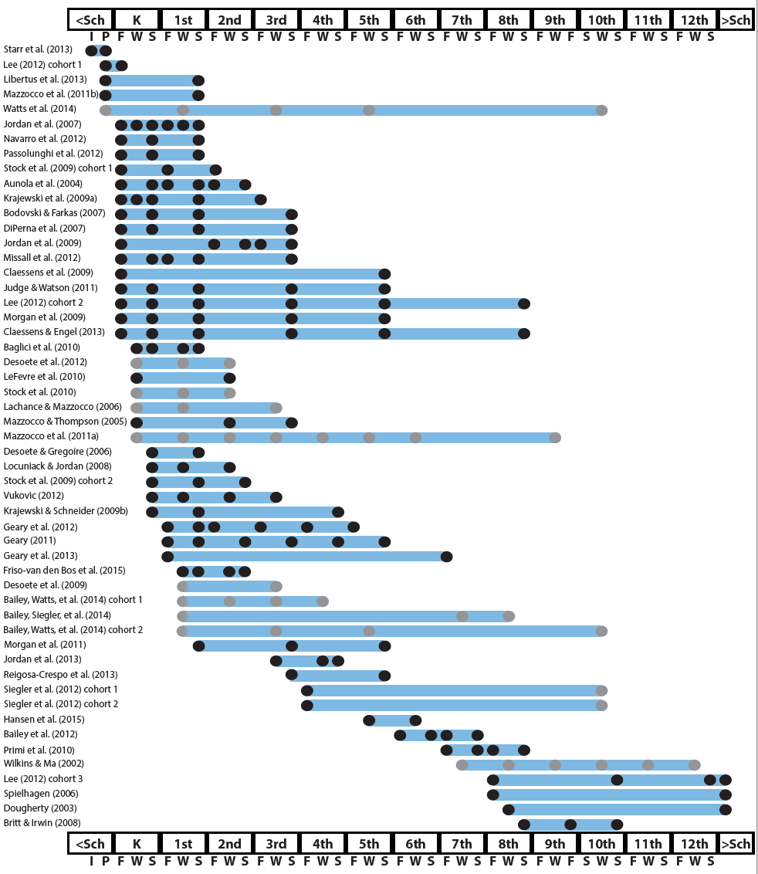
http://www.greatertexasfoundation.org/trajectories-of-mathematics-performance/

Slide 4
Broad math in preK predicted K broad math
Mathematics in preschool predicts later mathematics
http://www.greatertexasfoundation.org/trajectories-of-mathematics-performance/
Broad math in preK predicted grade 10 broad math

Slide 5
Counting in K predicted grade 1 broad math
Mathematics in kindergarten predicts later mathematics
http://www.greatertexasfoundation.org/trajectories-of-mathematics-performance/
Broad math in K predicted grade 8 broad math
K math accurately predicted math performance below 10th percentile in grades 2 and 3 with 84% correct classification

Slide 6
Mathematics in elementary school
predicts later mathematics
Addition influenced arithmetic with increasing importance from grades 1 to 5
http://www.greatertexasfoundation.org/trajectories-of-mathematics-performance/
Grade 1 arithmetic predicted arithmetic at grades 2, 3, and 4
Grade 1 broad math predicted broad math at grades 3, 5, and 10

Slide 7
Mathematics in middle school
predicts later mathematics
Counting and comparison in grades 2 or 4 predicted broad math 1 year later
http://www.greatertexasfoundation.org/trajectories-of-mathematics-performance/
Fractions at 10-12 years old predicted broad math 5 years later
Broad math in grade 7 predicted broad math in grade 8

Slide 8
Broad math in grade 8 predicted completion of 4-year college degree
Mathematics in
high school
predicts later outcomes
http://www.greatertexasfoundation.org/trajectories-of-mathematics-performance/
Students who took algebra in grades 8 took more advanced math courses and enrolled in 4-year colleges more often than students who took algebra in grade 9
Numeracy measured in adolescence impacted hourly earnings 7 to 15 years later

Slide 9
Mathematics in preschool predicts later mathematics
Mathematics in kindergarten predicts later mathematics
http://www.greatertexasfoundation.org/trajectories-of-mathematics-performance/
Mathematics in elementary school
predicts later mathematics
Mathematics in middle school
predicts later mathematics
Mathematics in
high school
predicts later outcomes

Slide 10
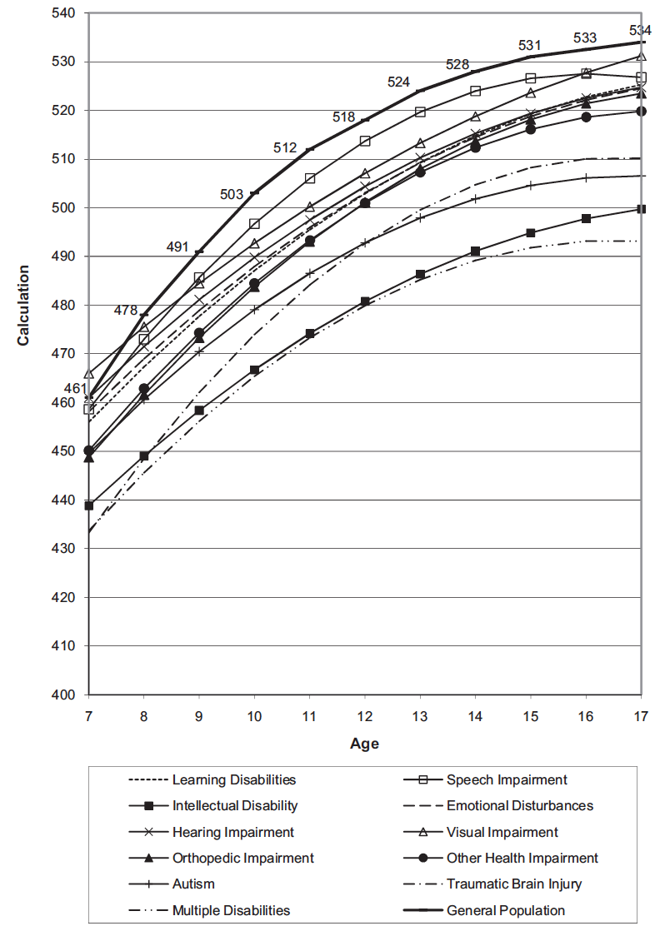
Wei, Lenz, & Blackorby (2013)

Slide 11
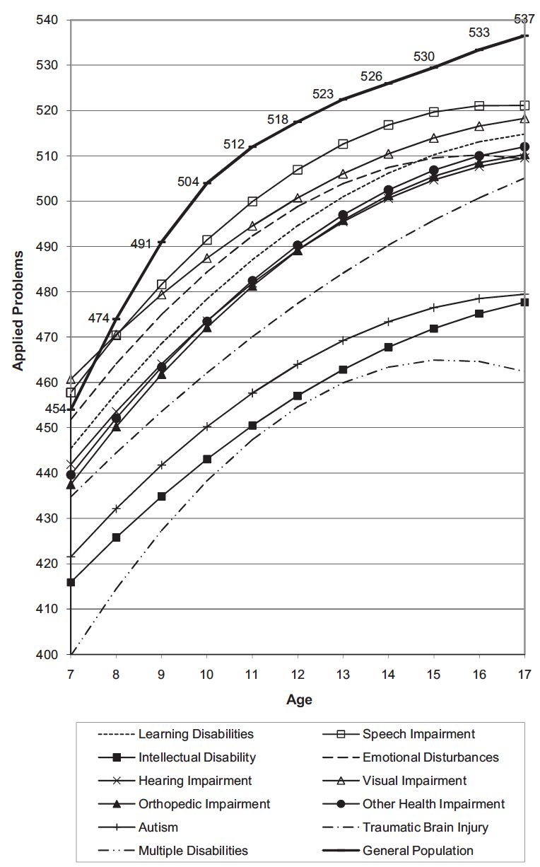
Wei, Lenz, & Blackorby (2013)

Slide 12
Descriptors of mathematics difficulty
Mathematics difficulty/disability
Mathematics learning difficulty/disability
Specific learning disability with IEP goals in mathematics
Dyscalculia

Slide 13
What support systems does your school
have in place to help these learners?

Slide 14
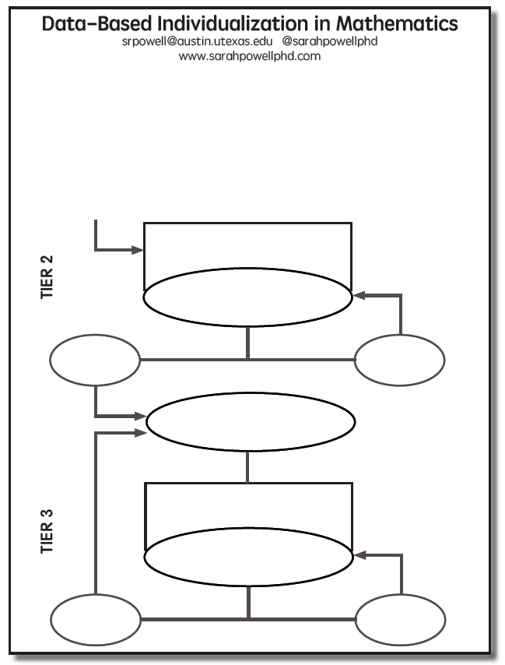

Slide 15
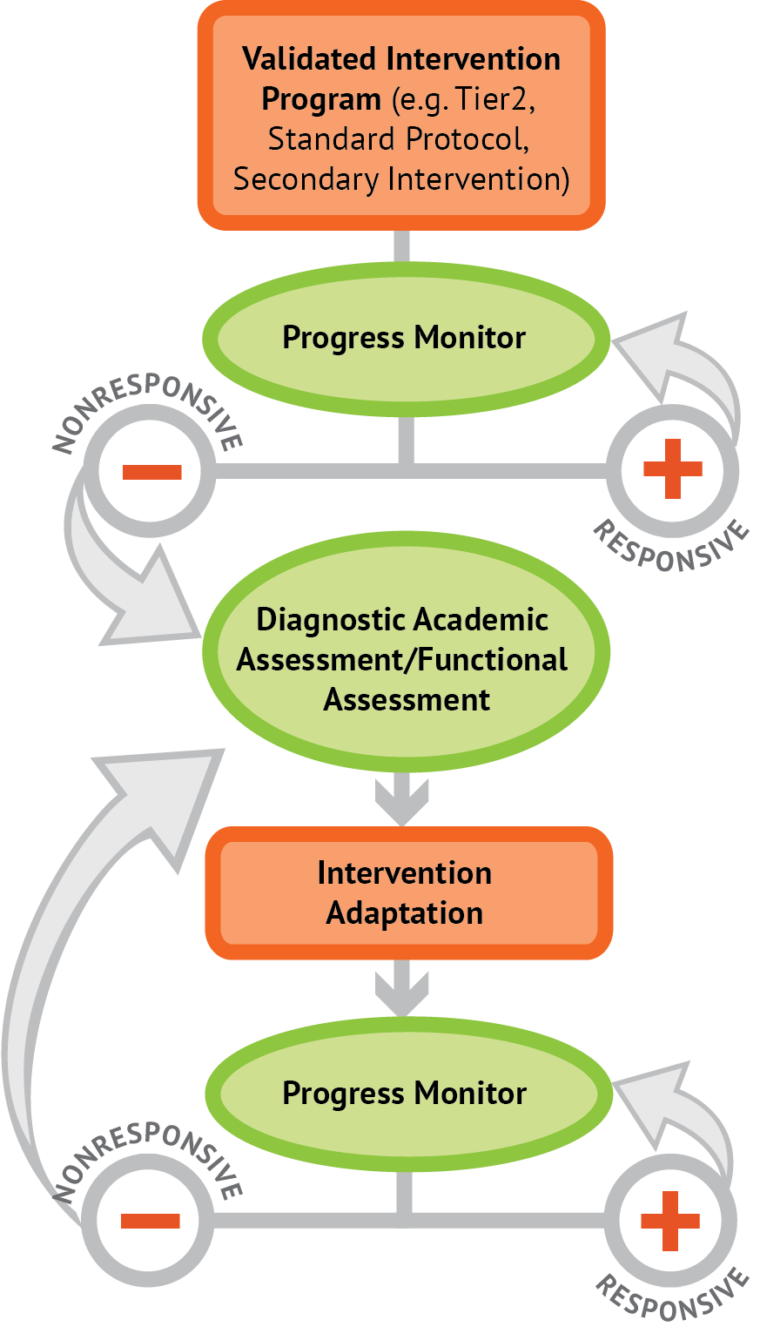
Intervention: Occurs frequently and with intensity
Assessment: Formative
Assessment: Diagnostic
Intervention adaptation: Content, dosage, explicit instruction, attention to transfer
Assessment: Formative

Slide 16
Where student IS
Where student NEEDS TO BE

Slide 17
Before we think about instruction, let’s think about content…

Slide 18
Fluency

Slide 19
Fluently add and subtract within 5.

Slide 20
Fluently add and subtract within 5.
Add and subtract within 20, demonstrating fluency for addition and subtraction within 10.

Slide 21
Fluently add and subtract within 5.
Add and subtract within 20, demonstrating fluency for addition and subtraction within 10.
Fluently add and subtract within 100 using strategies based on place value, properties of operations, and/or relationships.

Slide 22
Fluently add and subtract within 5.
Add and subtract within 20, demonstrating fluency for addition and subtraction within 10.
Fluently add and subtract within 100 using strategies based on place value, properties of operations, and/or relationships.
Fluently multiply and divide within 100, using strategies such as the relationship between multiplication and division…

Slide 23
Fluently add and subtract within 5.
Add and subtract within 20, demonstrating fluency for addition and subtraction within 10.
Fluently add and subtract within 100 using strategies based on place value, properties of operations, and/or relationships.
Fluently multiply and divide within 100, using strategies such as the relationship between multiplication and division…
Fluently add and subtract multi-digit whole numbers using the standard algorithm.

Slide 24
Fluently add and subtract within 5.
Add and subtract within 20, demonstrating fluency for addition and subtraction within 10.
Fluently add and subtract within 100 using strategies based on place value, properties of operations, and/or relationships.
Fluently multiply and divide within 100, using strategies such as the relationship between multiplication and division…
Fluently add and subtract multi-digit whole numbers using the standard algorithm.
Fluently multiply multi-digit whole numbers using the standard algorithm.

Slide 25
Fluently add and subtract within 5.
Add and subtract within 20, demonstrating fluency for addition and subtraction within 10.
Fluently add and subtract within 100 using strategies based on place value, properties of operations, and/or relationships.
Fluently multiply and divide within 100, using strategies such as the relationship between multiplication and division…
Fluently add and subtract multi-digit whole numbers using the standard algorithm.
Fluently multiply multi-digit whole numbers using the standard algorithm.
Fluently add, subtract, multiply, and divide multi-digit decimals using the standard algorithm.

Slide 26
Where student NEEDS TO BE
Fluently add and subtract within 5.
Add and subtract within 20, demonstrating fluency for addition and subtraction within 10.
Fluently add and subtract within 100 using strategies based on place value, properties of operations, and/or relationships.
Fluently multiply and divide within 100, using strategies such as the relationship between multiplication and division…
Fluently add and subtract multi-digit whole numbers using the standard algorithm.
Fluently multiply multi-digit whole numbers using the standard algorithm.
Fluently add, subtract, multiply, and divide multi-digit decimals using the standard algorithm.

Slide 27
Where student IS
Where student NEEDS TO BE
Fluently add and subtract within 5.
Add and subtract within 20, demonstrating fluency for addition and subtraction within 10.
Fluently add and subtract within 100 using strategies based on place value, properties of operations, and/or relationships.
Fluently multiply and divide within 100, using strategies such as the relationship between multiplication and division…
Fluently add and subtract multi-digit whole numbers using the standard algorithm.
Fluently multiply multi-digit whole numbers using the standard algorithm.
Fluently add, subtract, multiply, and divide multi-digit decimals using the standard algorithm.

Slide 28
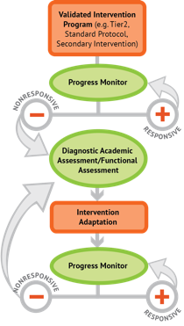
Where student IS
Where student NEEDS TO BE
Fluently add and subtract within 5.
Add and subtract within 20, demonstrating fluency for addition and subtraction within 10.
Fluently add and subtract within 100 using strategies based on place value, properties of operations, and/or relationships.
Fluently multiply and divide within 100, using strategies such as the relationship between multiplication and division…
Fluently add and subtract multi-digit whole numbers using the standard algorithm.
Fluently multiply multi-digit whole numbers using the standard algorithm.
Fluently add, subtract, multiply, and divide multi-digit decimals using the standard algorithm.

Slide 29
Place Value
continuum of mathematics learning

Slide 30
Compose and decompose numbers from 11 to 19 into ten ones and some further ones…
Recognize that in a multi-digit number, a digit in one place represents 10 times as much as it represents in the place to its right and 1/10 of what it represents in the place to its left.
Use place value understanding to round whole numbers to the nearest 10 or 100.
Recognize that in a multi-digit number, a digit in one place represents ten times what it represents in the place to its right…
Understand that the two digits of a two-digit number represent amounts of tens and ones.
Understand that the three digits of a three-digit number represent amounts of hundreds, tens, and ones.

Slide 31
Compose and decompose numbers from 11 to 19 into ten ones and some further ones…

Slide 32
Compose and decompose numbers from 11 to 19 into ten ones and some further ones…
Understand that the two digits of a two-digit number represent amounts of tens and ones.

Slide 33
Compose and decompose numbers from 11 to 19 into ten ones and some further ones…
Understand that the two digits of a two-digit number represent amounts of tens and ones.
Understand that the three digits of a three-digit number represent amounts of hundreds, tens, and ones.

Slide 34
Compose and decompose numbers from 11 to 19 into ten ones and some further ones…
Understand that the two digits of a two-digit number represent amounts of tens and ones.
Understand that the three digits of a three-digit number represent amounts of hundreds, tens, and ones.
Use place value understanding to round whole numbers to the nearest 10 or 100.

Slide 35
Compose and decompose numbers from 11 to 19 into ten ones and some further ones…
Understand that the two digits of a two-digit number represent amounts of tens and ones.
Understand that the three digits of a three-digit number represent amounts of hundreds, tens, and ones.
Use place value understanding to round whole numbers to the nearest 10 or 100.
Recognize that in a multi-digit number, a digit in one place represents ten times what it represents in the place to its right…

Slide 36
Compose and decompose numbers from 11 to 19 into ten ones and some further ones…
Understand that the two digits of a two-digit number represent amounts of tens and ones.
Understand that the three digits of a three-digit number represent amounts of hundreds, tens, and ones.
Use place value understanding to round whole numbers to the nearest 10 or 100.
Recognize that in a multi-digit number, a digit in one place represents ten times what it represents in the place to its right…
Recognize that in a multi-digit number, a digit in one place represents 10 times as much as it represents in the place to its right and 1/10 of what it represents in the place to its left.

Slide 37
Problem Solving
continuum of mathematics learning

Slide 38
Interpret and compute quotients of fractions, and solve word problems involving division of fractions by fractions…
Solve word problems that call for addition of three whole numbers whose sum is less than or equal to 20…
Solve real-world and mathematical problems involving the four operations with rational numbers.
Use addition and subtraction within 100 to solve one- and two-step word problems…
Use multiplication and division within 100 to solve word problems…
Solve real-world and mathematical problems leading to two linear equations in two variables.
Solve addition and subtraction word problems, and add and subtract within 10…
Solve multi-step word problems posed with whole numbers and having whole-number answers using the four operations…
Solve word problems involving addition and subtraction of fractions referring to the same whole, including cases of unlike denominators…

Slide 39
Solve addition and subtraction word problems, and add and subtract within 10…
Solve word problems that call for addition of three whole numbers whose sum is less than or equal to 20…
Use addition and subtraction within 100 to solve one- and two-step word problems…
Use multiplication and division within 100 to solve word problems…
Solve multi-step word problems posed with whole numbers and having whole-number answers using the four operations…
Solve word problems involving addition and subtraction of fractions referring to the same whole, including cases of unlike denominators…
Interpret and compute quotients of fractions, and solve word problems involving division of fractions by fractions…
Solve real-world and mathematical problems involving the four operations with rational numbers.
Solve real-world and mathematical problems leading to two linear equations in two variables.

Slide 40
Where student IS
Where student NEEDS TO BE
Solve addition and subtraction word problems, and add and subtract within 10…
Solve word problems that call for addition of three whole numbers whose sum is less than or equal to 20…
Use addition and subtraction within 100 to solve one- and two-step word problems…
Use multiplication and division within 100 to solve word problems…
Solve multi-step word problems posed with whole numbers and having whole-number answers using the four operations…
Solve word problems involving addition and subtraction of fractions referring to the same whole, including cases of unlike denominators…
Interpret and compute quotients of fractions, and solve word problems involving division of fractions by fractions…
Solve real-world and mathematical problems involving the four operations with rational numbers.
Solve real-world and mathematical problems leading to two linear equations in two variables.

Slide 41
Where student IS
Where student NEEDS TO BE
Use addition and subtraction within 100 to solve one- and two-step word problems…
Use multiplication and division within 100 to solve word problems…
Solve multi-step word problems posed with whole numbers and having whole-number answers using the four operations…
continuum of mathematics learning

Slide 42
Where student IS
Where student NEEDS TO BE
Explain why addition and subtraction strategies work, using place value and the properties of operations.
Understand that the two digits of a two-digit number represent amounts of tens and ones.
Use addition and subtraction within 100 to solve one- and two-step word problems…
Fluently add and subtract within 100 using strategies based on place value, properties of operations, and/or relationships.
Apply properties of operations as strategies to multiply and divide….
Fluently multiply and divide within 100, using strategies such as the relationship between multiplication and division…
Use multiplication and division within 100 to solve word problems…
Fluently add and subtract multi-digit whole numbers using the standard algorithm.
Find whole number quotients and remainders with up to four-digit dividends and one-digit divisors, using strategies based on place value, the properties of operations, and/or the relationship between multiplication and division.
Solve multi-step word problems posed with whole numbers and having whole-number answers using the four operations…
Understand that the three digits of a three-digit number represent amounts of hundreds, tens, and ones.
Fluently multiply multi-digit whole numbers using the standard algorithm.
continuum of mathematics learning

Slide 43
https://achievethecore.org/category/774/mathematics-focus-by-grade-level

Slide 44
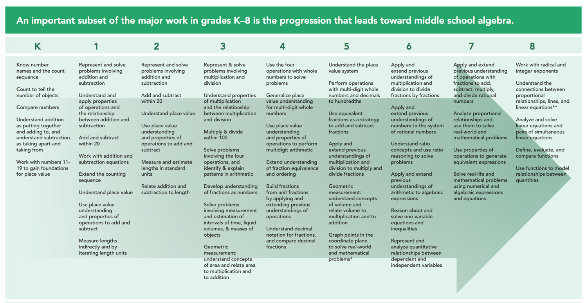
https://achievethecore.org/category/774/mathematics-focus-by-grade-level

Slide 45
Instructional Platform
INSTRUCTIONAL DELIVERY
Explicit instruction
Precise language
Multiple representations
INSTRUCTIONAL STRATEGIES
Fluency building
Problem solving instruction

Slide 47
Modeling
Practice
Clear Explanation
Guided
Practice
Planned
Examples
Independent Practice
Supporting Practices
Asking the right questions
Eliciting frequent responses
Providing immediate specific feedback
Maintaining a brisk pace

Slide 48
Goal and importance
“Today, we are learning about division. This is important because sometimes you have to share objects or things with your friends.”
Modeling
Practice
Clear Explanation
Guided
Practice
We Do
Planned
Examples
Independent Practice
“Let’s continue working with our three-dimensional shapes and volume. Understanding volume and calculating volume helps with measuring capacity.”
You Do
Supporting Practices
Asking the right questions
Eliciting frequent responses
Providing immediate specific feedback
Maintaining a brisk pace
Copyright 2018 Sarah R. Powell, Ph.D.

Slide 49
Goal and importance
Model steps
Modeling
Practice
Clear Explanation
Guided
Practice
“To solve 26 plus 79, I first decide about the operation. Do I add, subtract, multiply or divide?”
We Do
Planned
Examples
Independent Practice
“The plus sign tells me to add. So, I’ll add 26 plus 79. I’ll use the partial sums strategy. First, I add 20 plus 70. What’s 20 plus 70?”
You Do
Supporting Practices
“20 plus 70 is 90. I write 90 right here.”
Asking the right questions
Eliciting frequent responses
Providing immediate specific feedback
Maintaining a brisk pace
“Then I add 6 plus 9. What’s 6 plus 9?”
“6 plus 9 is 15. So, I write 15 here.”
“Finally, we add the partial sums: 90 and 15. 90 plus 15 is 105. So, 26 plus 79 equals 105.”
Copyright 2018 Sarah R. Powell, Ph.D.

Slide 50
Goal and importance
Model steps
Modeling
Practice
Clear Explanation
Precise language
Guided
Practice
We Do
Planned
Examples
Independent Practice
“To solve 26 plus 79, I first decide about the operation. Do I add, subtract, multiply, or divide?”
You Do
“The plus sign tells me to add. So, I’ll add 26 plus 79. I’ll use the partial sums strategy. First, I add 20 plus 70. What’s 20 plus 70?”
Supporting Practices
Asking the right questions
Eliciting frequent responses
Providing immediate specific feedback
Maintaining a brisk pace
“20 plus 70 is 90. I write 90 right here under the equal line.”
“Then I add 6 plus 9. What’s 6 plus 9?”
“6 plus 9 is 15. So, I write 15 here.”
“Finally, we add the partial sums: 90 and 15. 90 plus 15 is 105. So, 26 plus 79 equals 105.”
Copyright 2018 Sarah R. Powell, Ph.D.

Slide 51
Examples
“Today, we are learning about division. This is important because sometimes you have to share objects or things with your friends.”
Modeling
Practice
Clear Explanation
Guided
Practice
24 / 6
We Do
35 $)$ 5
28 $÷$ 7
Planned
Examples
Independent Practice
You Do
Supporting Practices
Asking the right questions
Eliciting frequent responses
Providing immediate specific feedback
Maintaining a brisk pace
Copyright 2018 Sarah R. Powell, Ph.D.

Slide 52
Examples
“Today, we are learning about division. This is important because sometimes you have to share objects or things with your friends.”
Modeling
Practice
Clear Explanation
Guided
Practice
24 / 6
We Do
35 $)$ 5
28 $÷$ 7
Planned
Examples
Independent Practice
You Do
With non-examples
Supporting Practices
Asking the right questions
Eliciting frequent responses
Providing immediate specific feedback
Maintaining a brisk pace
32 $÷$ 8
42 $÷$ 7
25 $−$ 5
Copyright 2018 Sarah R. Powell, Ph.D.

Slide 53
Modeling
Practice
Clear Explanation
Guided
Practice
Planned
Examples
Independent Practice
Supporting Practices
Asking the right questions
Eliciting frequent responses
Providing immediate specific feedback
Maintaining a brisk pace
Copyright 2018 Sarah R. Powell, Ph.D.

Slide 54
I Do
Modeling
Practice
Clear Explanation
Guided
Practice
Planned
Examples
Independent Practice
Supporting Practices
Asking the right questions
Eliciting frequent responses
Providing immediate specific feedback
Maintaining a brisk pace
Copyright 2018 Sarah R. Powell, Ph.D.

Slide 55
I Do
Modeling
Practice
Teacher and student practice together
Clear Explanation
Guided
Practice
Planned
Examples
Independent Practice
Supporting Practices
Asking the right questions
Eliciting frequent responses
Providing immediate specific feedback
Maintaining a brisk pace
Copyright 2018 Sarah R. Powell, Ph.D.

Slide 56
I Do
Modeling
Practice
Clear Explanation
Guided
Practice
Planned
Examples
Independent Practice
Student practices with teacher support
Supporting Practices
Asking the right questions
Eliciting frequent responses
Providing immediate specific feedback
Maintaining a brisk pace
Copyright 2018 Sarah R. Powell, Ph.D.

Slide 57
Modeling
Practice
Clear Explanation
Guided
Practice
Planned
Examples
Independent Practice
Supporting Practices
Asking the right questions
Eliciting frequent responses
Providing immediate specific feedback
Maintaining a brisk pace
Copyright 2018 Sarah R. Powell, Ph.D.

Slide 58
I Do
Modeling
Practice
Clear Explanation
Guided
Practice
We Do
Planned
Examples
Independent Practice
You Do
Supporting Practices
Asking the right questions
Eliciting frequent responses
Providing immediate specific feedback
Maintaining a brisk pace
Copyright 2018 Sarah R. Powell, Ph.D.

Slide 59
I Do
Modeling
Practice
Clear Explanation
Guided
Practice
Low-level and high-level
We Do
Planned
Examples
Independent Practice
You Do
“What is 7 times 9?”
“Which shape has 6 sides?”
“What do you do when you see a word problem?”
“Why do you have to regroup?”
“How would you solve this problem?”
“Why do you have to use zero pairs?”
Supporting Practices
Asking the right questions
Eliciting frequent responses
Providing immediate specific feedback
Maintaining a brisk pace
Copyright 2018 Sarah R. Powell, Ph.D.

Slide 60
I Do
Modeling
Practice
Clear Explanation
Guided
Practice
Low-level and high-level
We Do
Planned
Examples
Independent Practice
You Do
Classwide, individual, partner, write on paper, write on whiteboard, thumbs up, etc.
“Turn and discuss the formula for perimeter with your partner.”
“Write the multiplication problem on your whiteboard.”
Supporting Practices
Asking the right questions
Eliciting frequent responses
Providing immediate specific feedback
Maintaining a brisk pace
“In your math journal, draw a picture to help you remember to term parallelogram.”
Copyright 2018 Sarah R. Powell, Ph.D.

Slide 61
I Do
Modeling
Practice
Clear Explanation
Guided
Practice
Low-level and high-level
We Do
Planned
Examples
Independent Practice
You Do
Classwide, individual, partner, write on paper, write on whiteboard, thumbs up, etc.
Affirmative and corrective
Supporting Practices
“Good work using your word-problem attack strategy.”
Asking the right questions
Eliciting frequent responses
Providing immediate specific feedback
Maintaining a brisk pace
“Let’s look at that again. Tell me how you added in the hundreds column.”
Copyright 2018 Sarah R. Powell, Ph.D.

Slide 62
I Do
Modeling
Practice
Clear Explanation
Guided
Practice
Low-level and high-level
We Do
Planned
Examples
Independent Practice
You Do
Classwide, individual, partner, write on paper, write on whiteboard, thumbs up, etc.
Affirmative and corrective
Planned and organized
Supporting Practices
Asking the right questions
Eliciting frequent responses
Providing immediate specific feedback
Maintaining a brisk pace
Copyright 2018 Sarah R. Powell, Ph.D.

Slide 63
Modeling
Practice
Clear Explanation
Guided
Practice
Planned
Examples
Independent Practice
Supporting Practices
Asking the right questions
Eliciting frequent responses
Providing immediate specific feedback
Maintaining a brisk pace
Copyright 2018 Sarah R. Powell, Ph.D.

Slide 64
Modeling
Practice
Supporting Practices
Introduction of material
Review of material
Modeling
Practice
Modeling
Practice
Supporting Practices
Supporting Practices

Slide 65
How do you use explicit instruction?
Model steps using concise language
Provide guided practice opportunities
Provide independent practice opportunities
Use supporting practices during modeling and practice
Ask the right questions
Elicit frequent responses
Provide feedback
Be planned and organized

Slide 66
Describe something you taught (recently) in terms of modeling, practice, and supporting practices.

Slide 67
Instructional Platform
INSTRUCTIONAL DELIVERY
Explicit instruction
Precise language
Multiple representations
INSTRUCTIONAL STRATEGIES
Fluency building
Problem solving instruction

Slide 69
degree

Slide 70
Vocabulary Across Grades

Slide 71
Use formal math language
Use terms precisely

Slide 72
Technical terms
Subtechnical terms
Symbolic terms
General terms
trapezoid
rhombus
numerator
addend
subtract
base
degrees
cube
plane
arc
plus
zero
twelve
dollars
and
above
measure
answer
longest
outside

Slide 73
Instead of…
Say…
“And the last one is 10.”
“8, 9, 10. We’ll stop counting there but we could count more.”
“What number is in the tens place?”
“What digit is in the tens place?”
“Six hundred and forty-eight”
“Six hundred forty-eight”
“Bigger number and smaller number”
“Number that is greater and the number that is less”
Hughes et al. (2016)

Slide 74
Instead of…
Say…
“Numbers in the fraction”
“This fraction is one number.”
“Top number and bottom number”
“Numerator and denominator”
“Reduce”
“Find an equivalent fraction”
“One point two nine”
“One and twenty-nine hundredths”
Hughes et al. (2016)

Slide 75
Instead of…
Say…
“Corner”
“Angle”
“Flips, slides, and turns”
“Reflections, translations, and rotations”
“Box or ball”
“Cube or sphere”
“Long hand and short hand”
“Minute hand and hour hand”
Hughes et al. (2016)

Slide 76
How do you attend to language?
Plan for mathematical language to be precise
Connect informal language to formal language

Slide 78
Instructional Platform
INSTRUCTIONAL DELIVERY
Explicit instruction
Precise language
Multiple representations
INSTRUCTIONAL STRATEGIES
Fluency building
Problem solving instruction

Slide 79
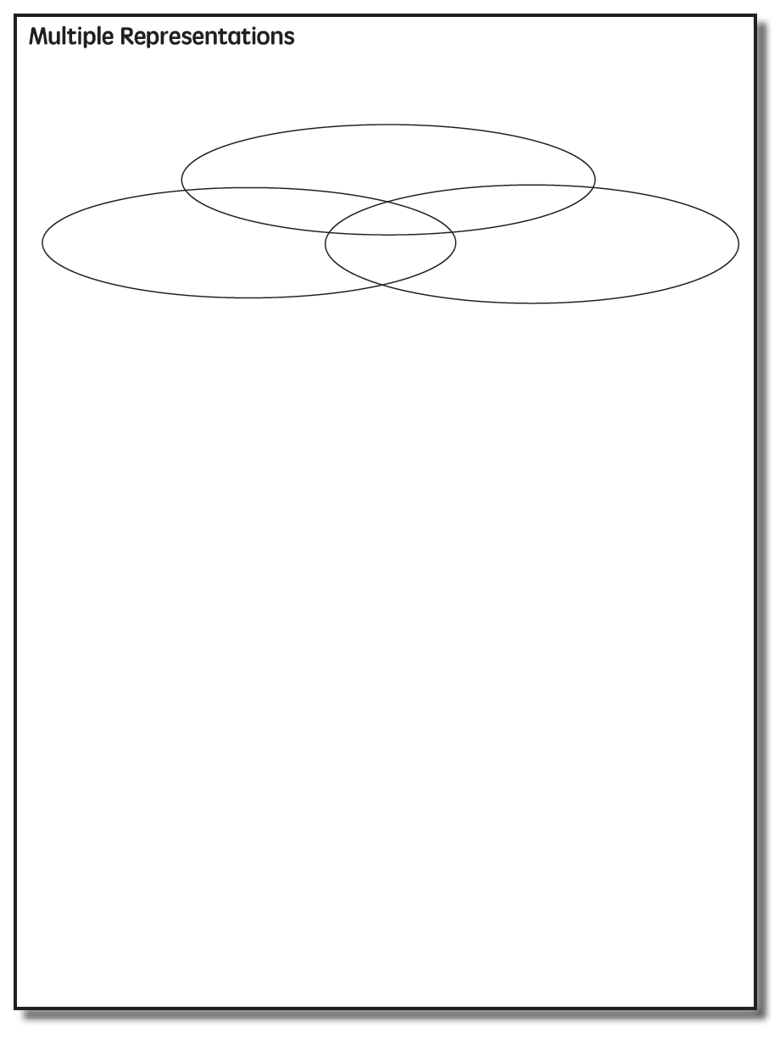

Slide 80
Multiple Representations
Abstract
Pictorial
Concrete

Slide 81
Abstract
Pictorial
Concrete
Three-dimensional objects

Slide 82
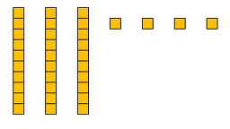
Abstract
Pictorial
Concrete
Two-dimensional images

Slide 83
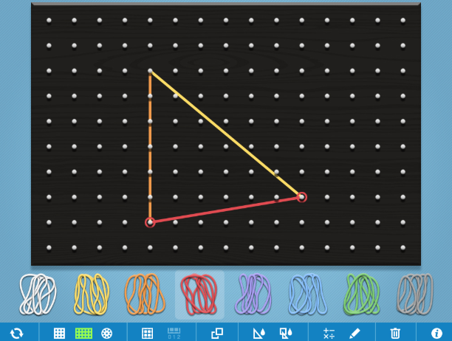
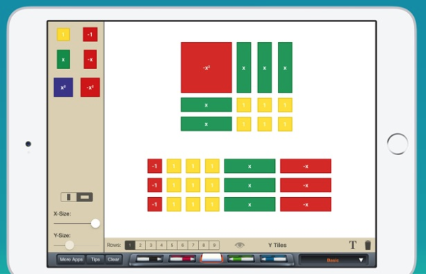
Abstract
Pictorial
Concrete
Two-dimensional images

Slide 84
Abstract
Pictorial
Concrete
Numerals and symbols
2 + 8 = 10
34 = 3 tens and 4 ones
x – 6 = 8
4,179
+ 569

Slide 85
How do you use multiple representations?
Use concrete materials to teach concepts and procedures
Use pictorial representations to teach concepts and procedures
Ensure students understand mathematics with numbers and symbols and words (i.e., the abstract)

Slide 86
An example of Multiple Representations

Slide 87
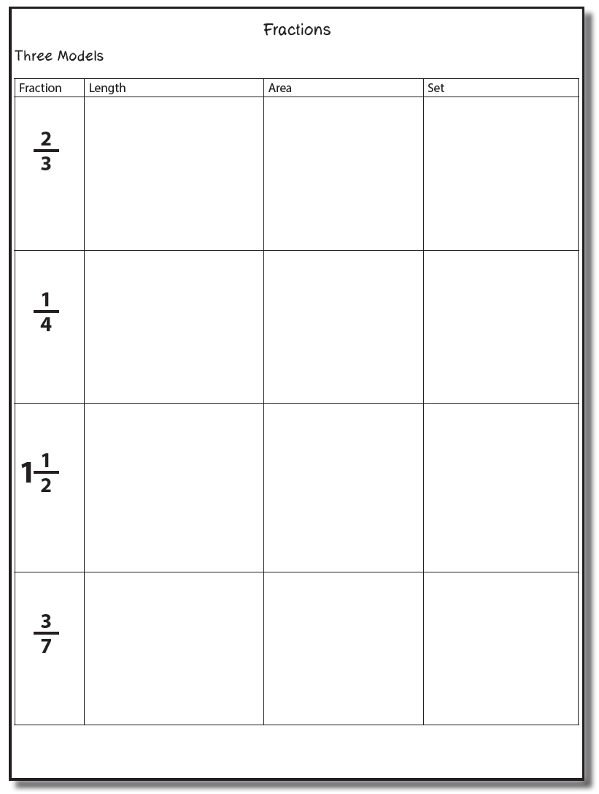

Slide 88
Fraction Models
Length
Area
Set

Slide 89
Length/Measurement
Fractions are appropriated by length
Fraction tiles/bars

Slide 90
Length/Measurement
Fractions are appropriated by length
Cuisenaire rods

Slide 91
Length/Measurement
Fractions are appropriated by length
Number line

Slide 92
Area/Region
Shapes divided into equal sections
Fraction circles

Slide 93
Area/Region
Shapes divided into equal sections
Geoboards

Slide 94
Area/Region
Shapes divided into equal sections
Pattern blocks

Slide 95
Area/Region
Shapes divided into equal sections
Legos

Slide 96
Set/Discrete
Individual shapes match the fraction
Two-color counters

Slide 97
Set/Discrete
Individual shapes match the fraction

Slide 98
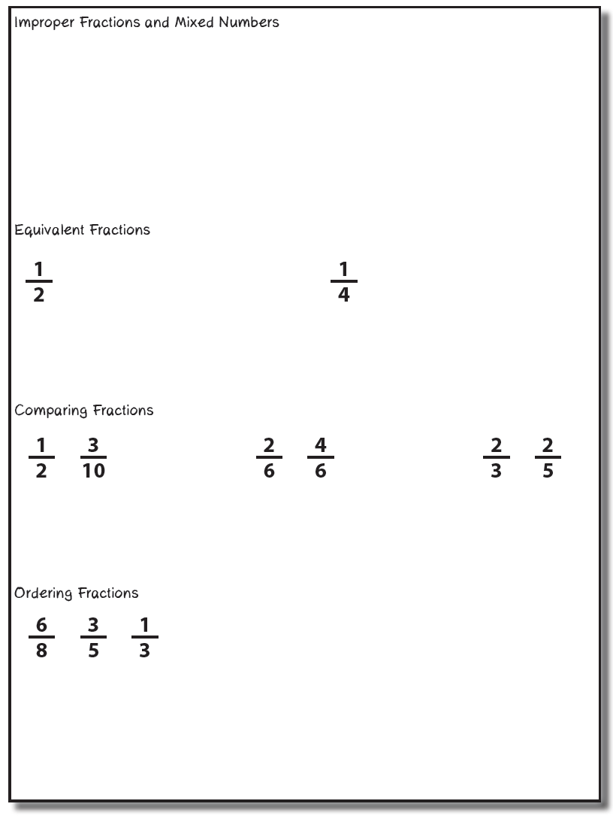
Select one of these four topics. Use explicit instruction, precise language, and multiple representations to teach to your partner.

Slide 99
Instructional Platform
INSTRUCTIONAL DELIVERY
Explicit instruction
Precise language
Multiple representations
INSTRUCTIONAL STRATEGIES
Fluency building
Problem solving instruction

Slide 100
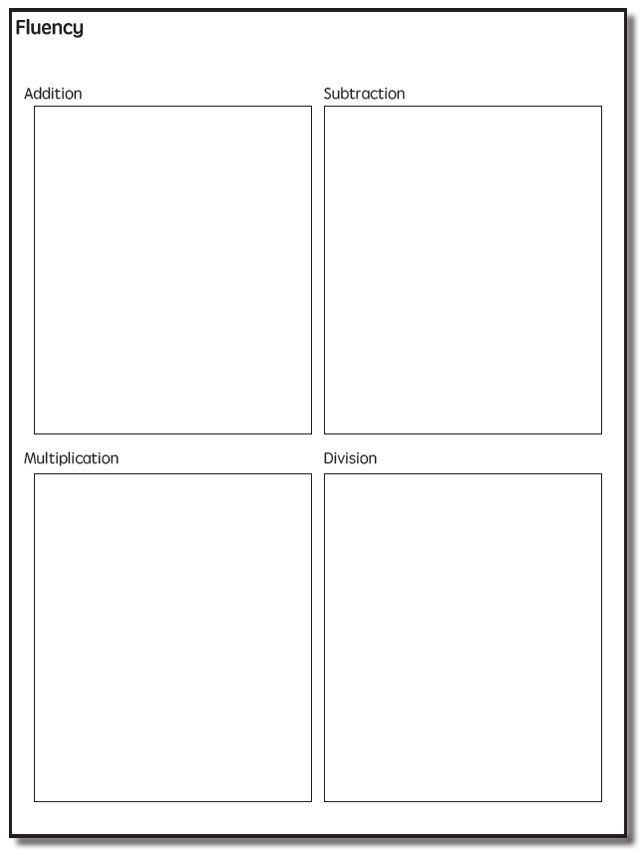

Slide 101
Addition Facts
100 addition basic facts
Single-digit addends sum to a single- or double-digit number
5 (addend)
+ 4 (addend)
9 (sum)

Slide 102
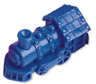
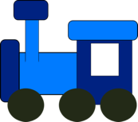
Addition: Part-Part-Whole (Total)
Count one set, count another set, put sets together, count sum
2 + 3 = 5

Slide 103
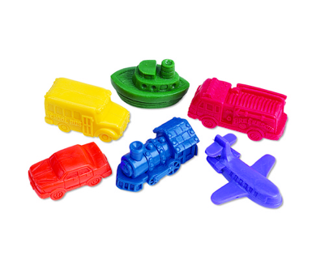
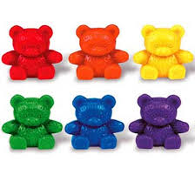
Addition: Part-Part-Whole (Total)
4 + 5 = __
3 + 7 = __
Teach this problem to a student.
Explicit instruction
Multiple representations
Concise language

Slide 104
Addition: Join (Change Increase)
Start with a set, add the other set, count sum
2 + 3 = 5

Slide 105
Addition: Join (Change Increase)
8 + 3 = __
5 + 6 = __
Teach this problem to a student.
Explicit instruction
Multiple representations
Concise language

Slide 106
Why is it important to understand addition in two separate ways?

Slide 107
Total
Parts put together into a total
Angie saw 4 cardinals and 5 blue jays. How many birds did Angie see?
4 + 5 = ?

Slide 108
Change
An amount that increases or decreases
Pam had $4. Then she earned $3 for cleaning her room. How much money does Pam have now?
4 + 3 = ?

Slide 109
Part-Part-Whole Versus Join
3 + 9 = __
7 + 4 = __
Determine a word problem for each schema.
Explicit instruction
Multiple representations
Concise language

Slide 110
Subtraction Facts
100 subtraction basic facts
Subtrahend and difference are single-digit numbers and minuend is single- or double-digit number
16 (minuend)
– 8 (subtrahend)
8 (difference)

Slide 111
Subtraction: Separate (Change Decrease)
Start with a set, take away from that set, count difference
5 – 3 = 2

Slide 112
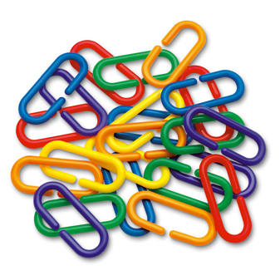
Subtraction: Separate (Change Decrease)
11 – 6 = __
13 – 7 = __
Teach this problem to a student.
Explicit instruction
Multiple representations
Concise language

Slide 113
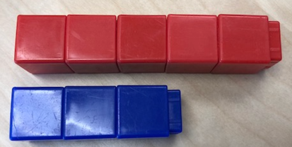
Subtraction: Compare (Difference)
Compare two sets, count difference
5 – 3 = 2

Slide 114
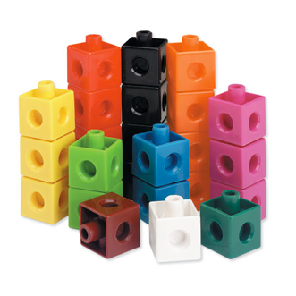
Subtraction: Compare (Difference)
10 – 7 = __
11 – 3 = __
Teach this problem to a student.
Explicit instruction
Multiple representations
Concise language

Slide 115
Why is it important to understand subtraction in two separate ways?

Slide 116
Change
An amount that increases or decreases
Amanda had 9 cookies. Then she ate 2 of the cookies. How many cookies does Amanda have now?
9 – 2 = ?

Slide 117
Difference
Greater and less amounts compared for a difference
Scott has 9 apples. Cathy has 4 apples. How many more apples does Scott have? (How many fewer does Cathy have?)
9 – 4 = ?

Slide 118
Separate Versus Compare
9 – 5 = __
8 – 3 = __
Determine a word problem for each schema.
Explicit instruction
Multiple representations
Concise language

Slide 119
Multiplication Facts
100 multiplication basic facts
Multiplication of single-digit factors results in a single- or double-digit product
2 (factor)
× 3 (factor)
6 (product)

Slide 120
Multiplication: Equal Groups
Show the groups, show the amount for each group, count product
3 × 2 = 6

Slide 121
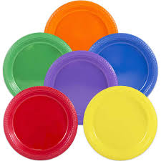
Multiplication: Equal Groups
5 × 3 = __
2 × 5 = __
Teach this problem to a student.
Explicit instruction
Multiple representations
Concise language

Slide 122
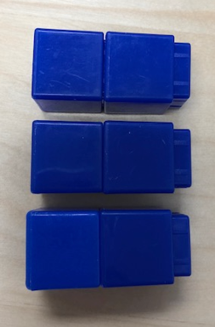
Multiplication: Array/Area
Make the array, count product
3 × 2 = 6

Slide 123
Multiplication: Array/Area
3 × 4 = __
2 × 5 = __
Teach this problem to a student.
Explicit instruction
Multiple representations
Concise language

Slide 124
Multiplication: Comparison
Show a set, then multiply the set
3 × 2 = 6

Slide 125
Multiplication: Comparison
6 × 3 = __
4 × 5 = __
Teach this problem to a student.
Explicit instruction
Multiple representations
Concise language

Slide 126
Why is it important to understand multiplication in different ways?

Slide 127
Equal Groups
Groups multiplied by number in each group for a product
Carlos has 2 bags of apples. There are 6 apples in each bag. How many apples does Carlos have altogether?
2 × 6 = ?

Slide 128
Comparison
Set multiplied by a number of times for a product
Beth picked 6 apples. Amy picked 2 times as many apples as Beth. How many apples did Amy pick?
6 × 2 = ?

Slide 129
Division Facts
90 division basic facts
Divisor and quotient are single-digit numbers and dividend is single- or double-digit number
8 ÷ 4 = 2
(dividend) (divisor) (quotient)

Slide 130
Division: Equal Groups (Partitive Division)
Show the dividend, divide equally among divisor, count quotient
6 ÷ 3 = 2

Slide 131
Division: Partitive Division
12 ÷ 4 = __
15 ÷ 3 = __
Teach this problem to a student.
Explicit instruction
Multiple representations
Concise language

Slide 132
Division: Equal Groups (Measurement Division)
Show the dividend, make groups of the divisor, count groups
6 ÷ 3 = 2

Slide 133
Division: Measurement Division
10 ÷ 5 = __
9 ÷ 3 = __
Teach this problem to a student.
Explicit instruction
Multiple representations
Concise language

Slide 134
Why is it important to understand division in different ways?

Slide 135
Equal Groups
Groups multiplied by number in each group for a product
Carlos has 12 apples. He wants to share them equally among his 2 friends. How many apples will each friend receive?
2 × ? = 12
Carlos has 12 apples. He put them into bags containing 6 apples each. How many bags did Carlos use?
? × 6 = 12

Slide 136
Addition
Subtraction
Multiplication
Division
BRIEF
(1-2 min)
DAILY
(everyday)

Slide 137
Other Types of Fluency

Slide 139
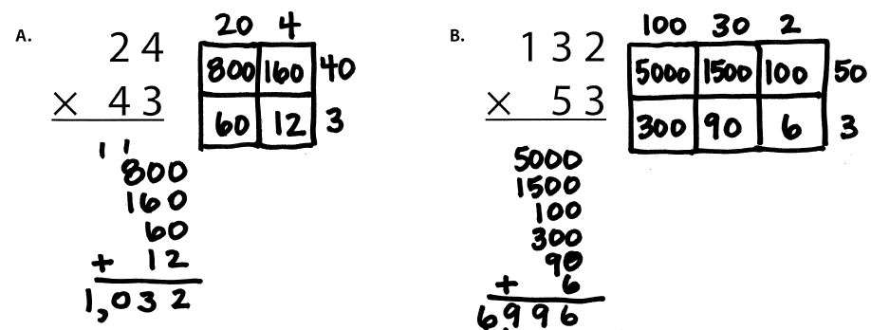
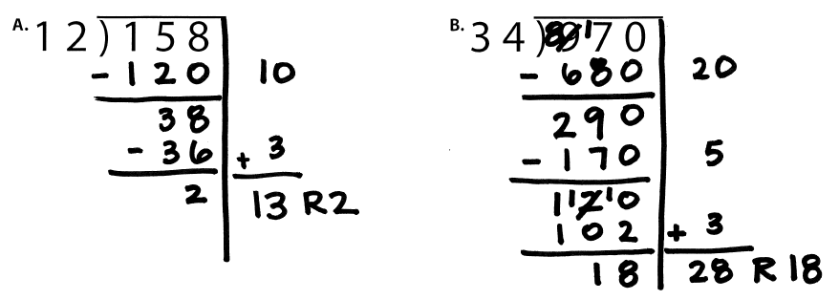

Slide 141
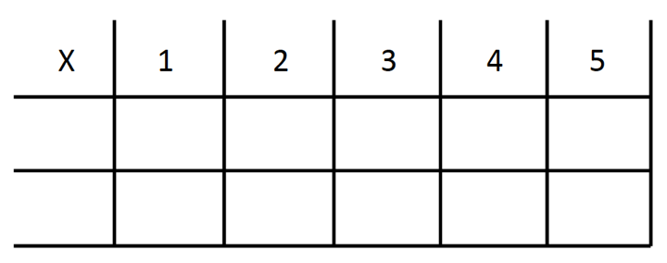
-3 + (-4) = ___ 5 – (-6) = ___

Slide 142
BRIEF
(1-2 min)
DAILY
(everyday)

Slide 143
How to build fluency?
Teach the concepts of the operations
Teach strategies to understand how facts fit together
Practice building fluency with a variety of activities and games

Slide 144
Instructional Platform
INSTRUCTIONAL DELIVERY
Explicit instruction
Precise language
Multiple representations
INSTRUCTIONAL STRATEGIES
Fluency building
Problem solving instruction

Slide 145
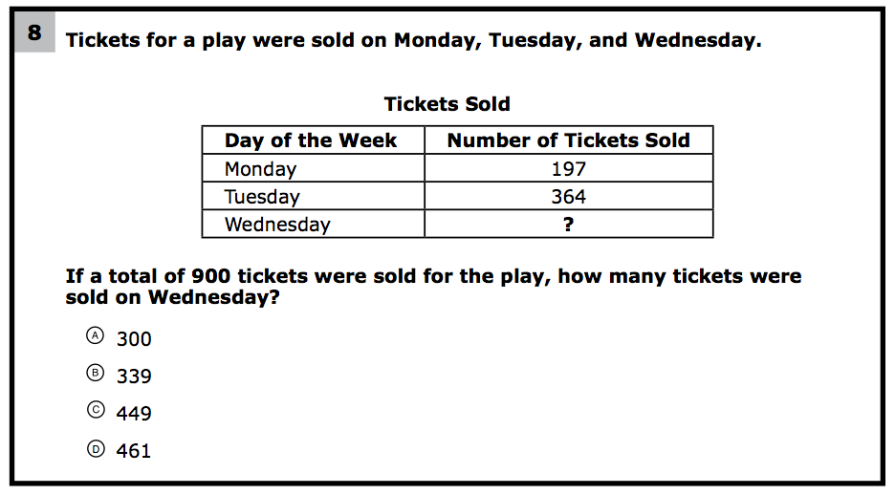
How would you teach this problem?
What do students need to know to solve this problem?
What might cause difficulty for students?

Slide 146
Problem Solving Difficulties
Reading problems
Understanding vocabulary
Identifying relevant information
Ignoring irrelevant information
Interpreting charts and graphs
Identifying appropriate operation(s)
Performing the computation(s)

Slide 148
Don’t tie key words to operations
Do have an attack strategy
Do teach word-problem schemas

Slide 149
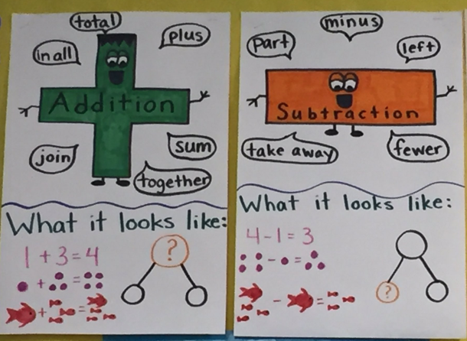
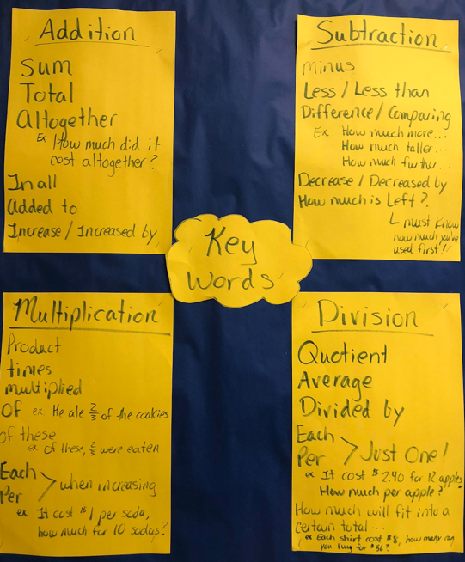

Slide 150
Kasey made $42, and Mandy made $37. How much money did they make in all?
Kasey and Mandy made $79 in all. If Kasey made $42, how much money did Mandy make?

Slide 151
Becky has $70 more than Perla. If Becky has $120, how much money does Perla have?
Becky has $70 more than Perla. If Perla has $50, how much money does Becky have?

Slide 152
Matt baked 18 cookies. His brother baked twice as many. How many cookies did his brother bake?
Matt’s brother baked twice as many cookies as Matt. If Matt’s brother baked 36 cookies, how many did Matt bake?

Slide 153
Rachel wants to share 36 brownies with 6 friends. How many cookies will each friend receive?
Rachel baked 36 brownies and shared 16 brownies with friends. How many brownies does Rachel have now?

Slide 154
Michelle made 17 paper airplanes. Dante made 24 paper airplanes. How many airplanes did they make altogether?
Michelle and Dante made 41 paper airplanes altogether. If Dante made 24 paper airplanes, how many did Michelle make?
Michelle made 4 paper airplanes using 2 pieces of paper for each airplane. How much paper did Michelle use altogether?

Slide 155
Students need to understand key words. But, key words should not be directly tied to operations.

Slide 156
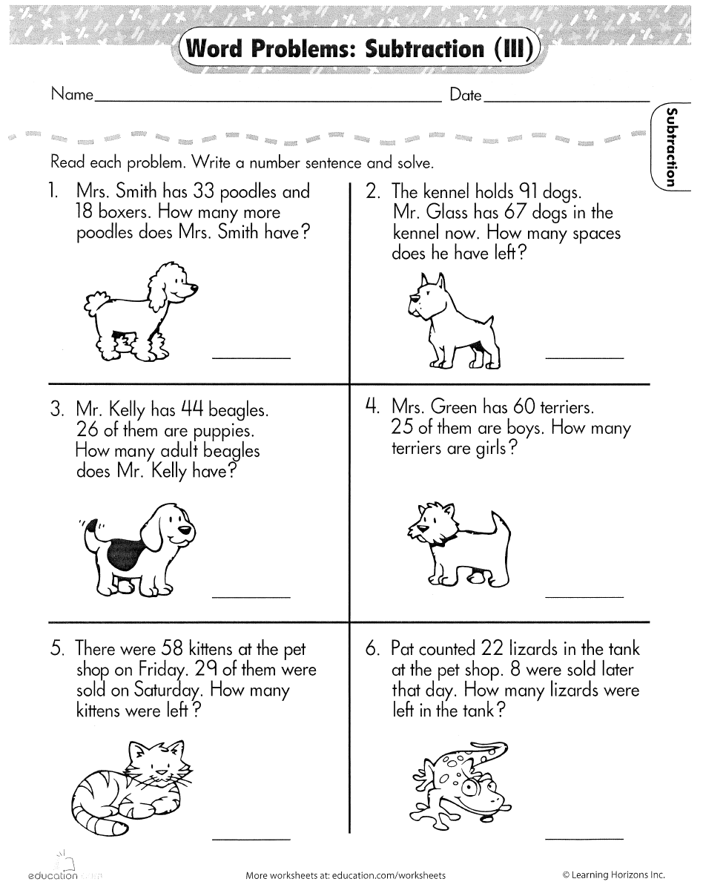

Slide 158
Don’t tie key words to operations
Do have an attack strategy
Do teach word-problem schemas

Slide 159
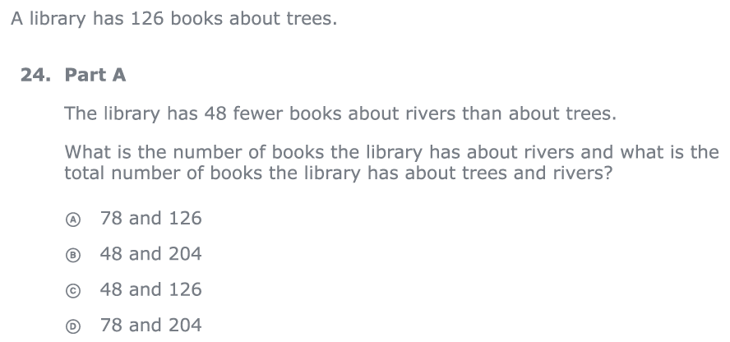
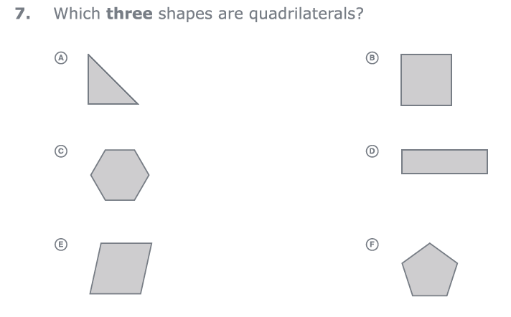
For every word problem
Regardless of problem type, students need an attack strategy for working through the problem
This strategy should work for any problem type
Routine Word Problems
Instructional Word Problems

Slide 160
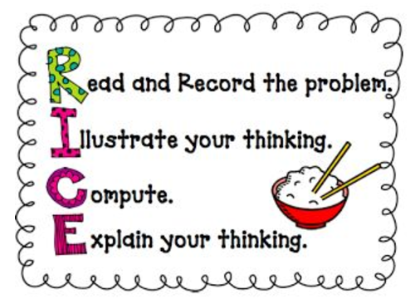
RIDGES
Read the problem.
I know statement.
Draw a picture.
Goal statement.
Equation development.
Solve the equation.
RIDE
Read the problem.
Identify the relevant information.
Determine the operation and unit for the answer.
Enter the correct numbers and calculate, then check the answer.

Slide 161
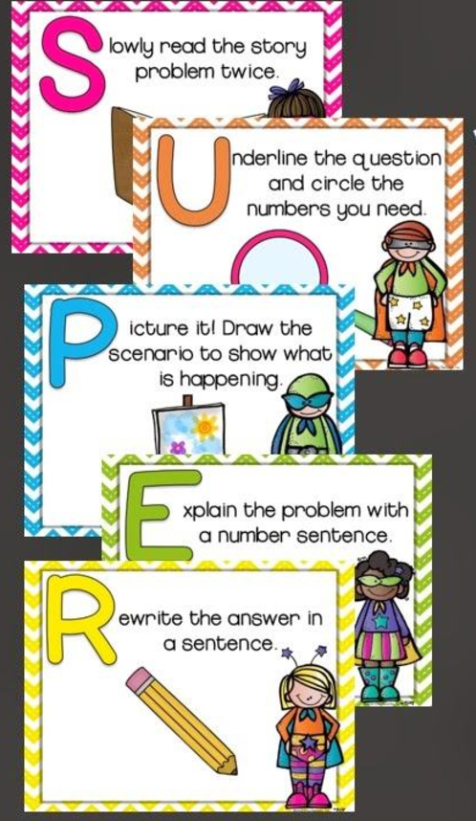

Slide 162
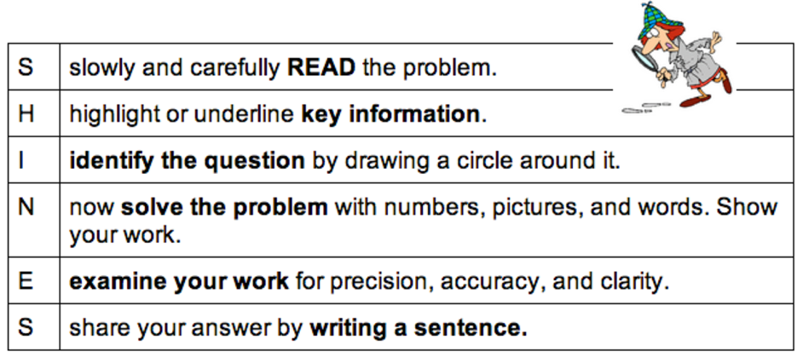
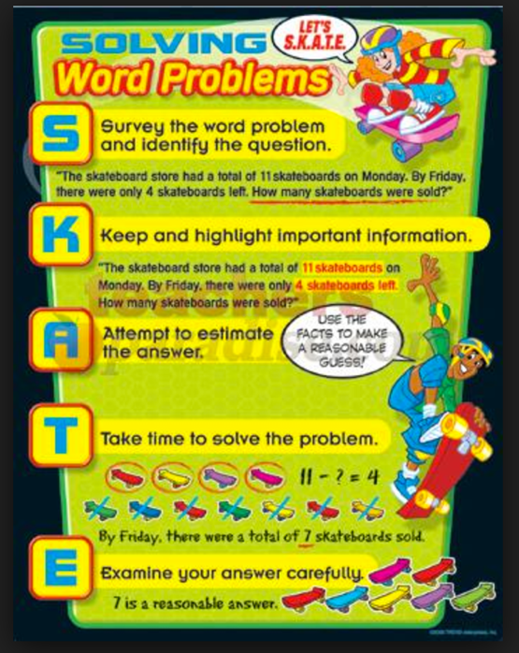
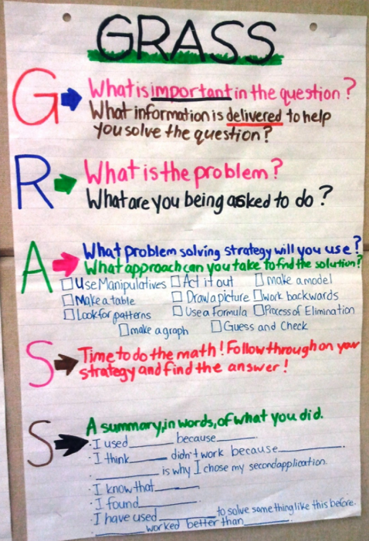

Slide 163
SIGNS
Survey questions
Identify key words
Graphically draw problem
Note operations
Solve and check
SOLVE
Study the problem.
Organize the facts.
Line up the plan.
Verify the plan with computation.
Examine the answer.

Slide 164
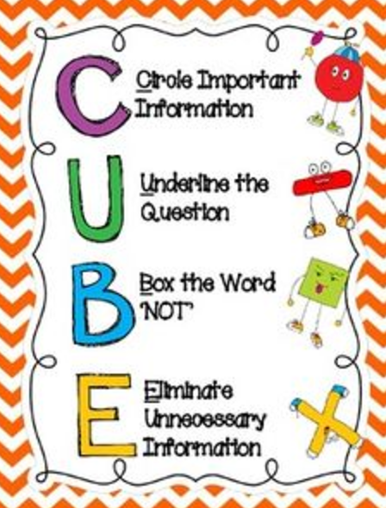
R-CUBES
Read the problem.
Circle key numbers.
Underline the question.
Box action words.
Evaluate steps.
Solve and check.

Slide 165
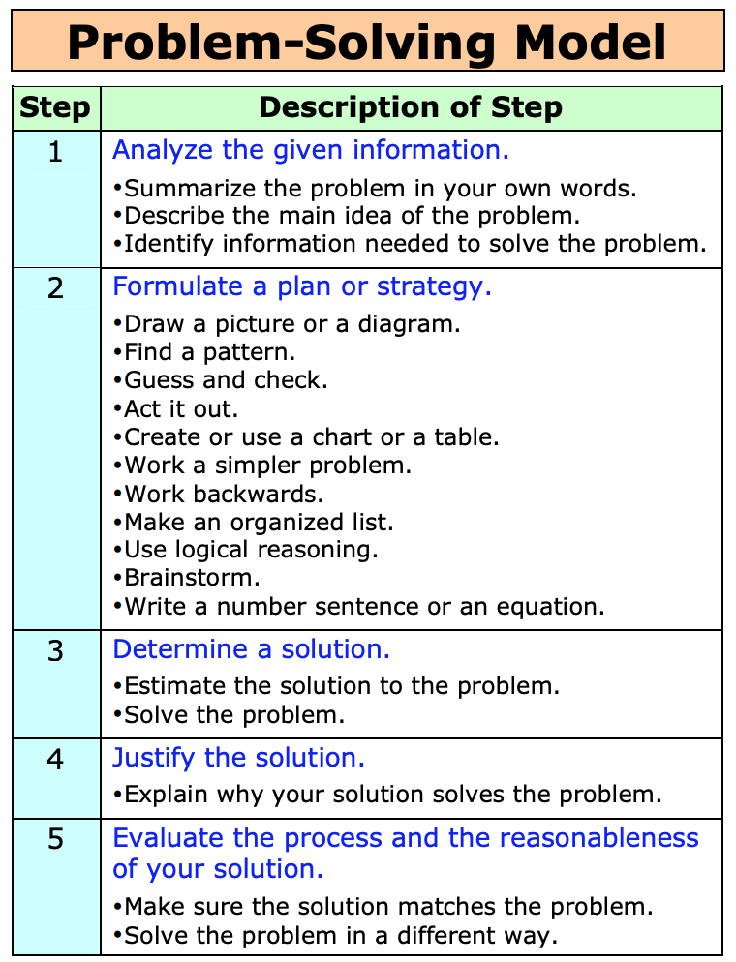

Slide 166
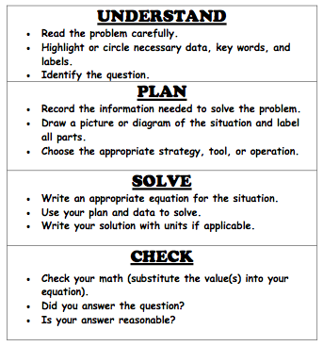

Slide 167
Don’t tie key words to operations
Do have an attack strategy
Do teach word-problem schemas

Slide 168
Additive Schemas

Slide 169
Instruction Using Schemas
A schema refers to the structure of the word problem
Total
Difference
Change

Slide 170
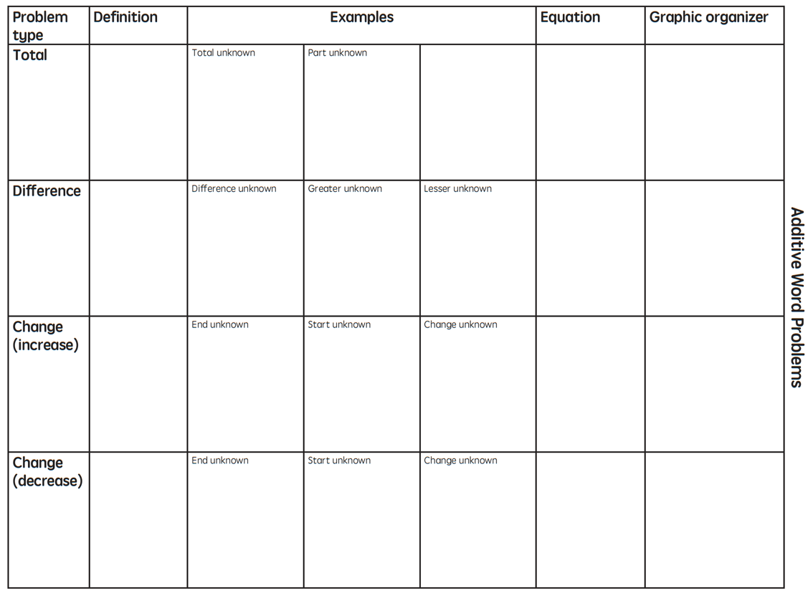

Slide 171
Total
Parts put together into a total
Autumn saw 4 cardinals and 5 blue jays. How many birds did Autumn see?
4 + 5 = ?
Autumn saw 9 birds. If 4 of the birds were cardinals, how many were blue jays?
4 + ? = 9
Autumn r saw 9 birds. 5 of the birds were blue jays, how many were cardinals?
5 + ? = 9

Slide 172
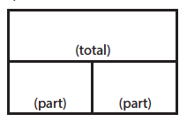
Total
P1 + P2 = T
Fuchs et al. (2008); Griffin & Jitendra (2009)

Slide 173
Total
“Are parts put together for a total?”

Slide 174
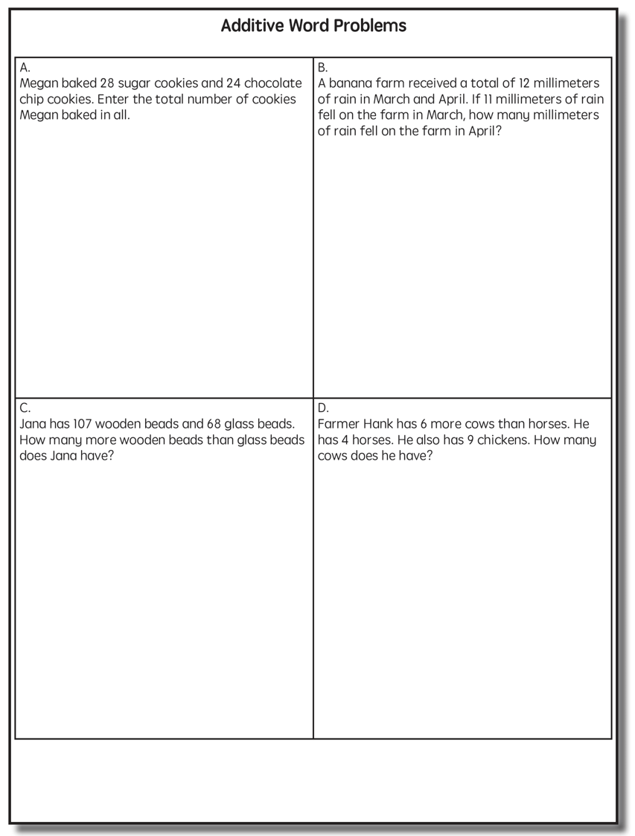
Total

Slide 175
Total
✓
✓
✓
P1 + P2 = T
U
P
S
✓
✓
28
+
24
=
?
✓
✓
28 + 24 = 52
? = 52 cookies
Grade 3 Smarter Balanced

Slide 176
Total
P1 + P2 = T
Fuchs et al. (2008); Griffin & Jitendra (2009)

Slide 178
Difference
Greater and less amounts compared for a difference
Lydia has 9 apples. Carol has 4 apples. How many more apples does Lydia have? (How many fewer?)
9 – 4 = ?
Lydia has 5 more apples than Carol. If Carol has 4 apples, how many does Lydia have?
? – 4 = 5
Carol has 5 fewer apples than Lydia. Lydia has 9 apples. How many apples does Carol have?
9 – ? = 5

Slide 179
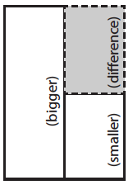
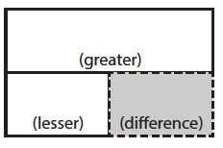
Difference
G – L = D
Fuchs et al. (2008); Griffin & Jitendra (2009)

Slide 180
Total
“Are parts put together for a total?”
Difference
“Are amounts compared for a difference?”

Slide 181
Difference

Slide 182
Difference
✓
✓
G – L = D
✓
U
P
S
✓
✓
107
-
68
=
B
107
68
68
+ ?
107
✓
107 – 68 = 39
✓
Grade 3 Smarter Balanced
B = 39 more beads

Slide 183
Difference
G – L = D
Fuchs et al. (2008); Griffin & Jitendra (2009)

Slide 185
Change
An amount that increases or decreases
Victoria had $4. Then she earned $3 for cleaning her room. How much money does Victoria have now?
4 + 3 = ?
Victoria has $4. Then she earned money for cleaning her room. Now Victoria has $7. How much money did she earn?
4 + ? = 7
Victoria had some money. Then she made $3 for cleaning her room. Now she has $7. How much money did Victoria start with?
? + 3 = 7

Slide 186
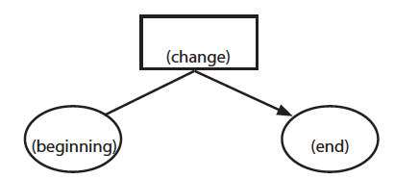
Change
ST +/– C = E
Fuchs et al. (2008); Griffin & Jitendra (2009)

Slide 187
Total
“Are parts put together for a total?”
Difference
“Are amounts compared for a difference?”
Change
“Does an amount increase or decrease?”

Slide 188
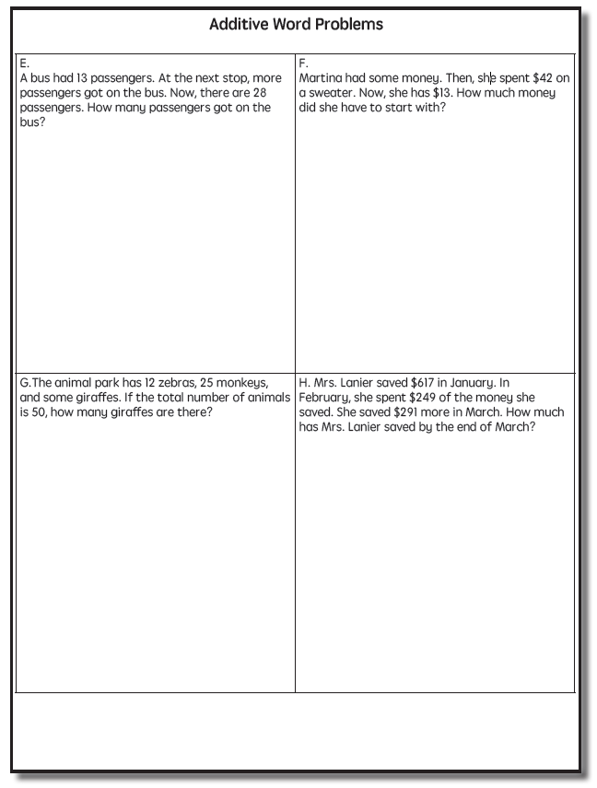
Change

Slide 189
Change
✓
A bus had 13 passengers. At the next stop, more passengers got on the bus. Now, there are 28 passengers. How many passengers got on the bus?
✓
✓
U
P
S
✓
ST + C = E
✓
13
+
?
=
28
✓
28
- 13
✓
13
+ ?
28
13 + 15 = 28
? = 15 passengers

Slide 190
Change
An amount that increases or decreases
Julie baked 9 cookies. Then, she ate 2 of the cookies. How many cookies does Julie have now?
9 – 2 = ?
Julie baked 9 cookies. Then, she ate some of the cookies. Now, she has 7 cookies. How many cookies did Julie eat?
9 – ? = 7
Julie baked some cookies. She ate 2 of the cookies and has 7 cookies left. How many cookies did Julie bake?
? – 2 = 7

Slide 191
Change
ST +/– C = E
Fuchs et al. (2008); Griffin & Jitendra (2009)

Slide 193
Total

Slide 194
Change

Slide 195
Difference

Slide 197
Total
P1 + P2 + P3 = T

Slide 198
Change
ST – C + C = E

Slide 199
Let’s Review
What’s a Total problem?
What’s a Difference problem?
What’s a Change problem?

Slide 200
Schema Quiz Time!

Slide 201
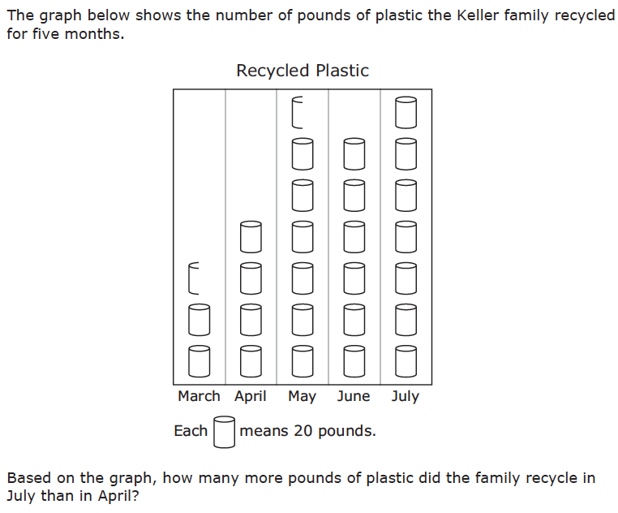
Difference
Grade 3 STAAR

Slide 202
Total
Grade 5 Smarter Balanced

Slide 203
Change
Grade 4 Smarted Balanced

Slide 204
Multiplicative Schemas

Slide 205
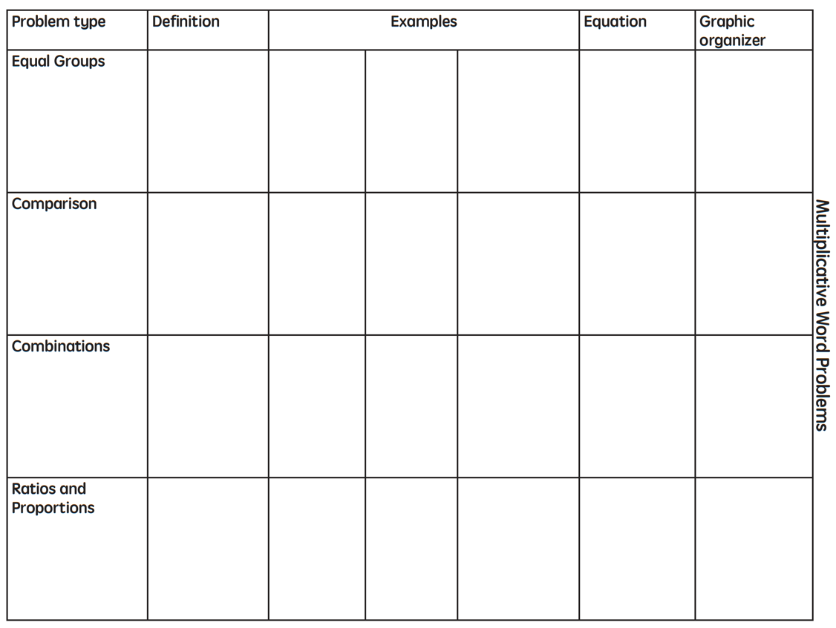

Slide 206
Equal Groups
Groups multiplied by number in each group for a product
Scott has 2 bags of apples. There are 6 apples in each bag. How many apples does Scott have altogether?
2 × 6 = ?
Scott has 12 apples. He wants to share them equally among his 2 friends. How many apples will each friend receive?
2 × ? = 12
Scott has 12 apples. He put them into bags containing 6 apples each. How many bags did Scott use?
? × 6 = 12

Slide 207
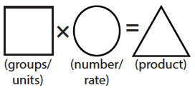
Equal Groups
G × N = P

Slide 208
Equal Groups
“Are there groups with an equal number in each group?”

Slide 210
Equal Groups
✓
✓
✓
G x N = P
U
P
S
✓
✓
x
=
6
25
?
✓
✓
6 x 25 = 150
? = 150 cherries

Slide 211
Equal Groups
G × N = P

Slide 212
Comparison
Set multiplied by a number of times for a product
Julie picked 6 apples. Amy picked 2 times as many apples as Marcie. How many apples did Lisa pick?
6 × 2 = ?
Amy picked 12 apples. She picked 2 times as many apples as Julie. How many apples did Julie pick?
? × 2 = 12
Amy picked 12 apples, and Julie picked 6 apples. How many times as many apples did Amy pick?
6 × ? = 12

Slide 213
Comparison
S × T = P

Slide 214
Equal Groups
“Are there groups with an equal number in each group?”
Comparison
“Is a set compared a number of times?”

Slide 216
Comparison
✓
U
P
S
✓
6
2
?
✓
✓
✓
Grade 4 Smarter Balanced
? = 12 DVDs

Slide 217
Comparison
S × T = P

Slide 218
Ratios/Proportions
Description of relationships among quantities
Xin et al. (2005)

Slide 219
Equal Groups
“Are there groups with an equal number in each group?”
Comparison
“Is a set compared a number of times?”
Ratios/Proportions
“Are there relationships among quantities - if this, then this?”

Slide 221
Ratios/Proportions
✓
✓
✓
✓
U
P
S
✓
✓
176
?
? = 110 slices
✓
✓
8
5

Slide 222
Ratios/Proportions
Description of relationships among quantities
Xin et al. (2005)

Slide 224
Equal Groups

Slide 225
Ratios/Proportions

Slide 226
Comparison
Grade 4 Smarter Balanced

Slide 227
Let’s Review
What’s an Equal Groups problem?
What’s a Comparison problem?
What’s a Ratios/Proportions problem?

Slide 228
Schema Quiz Time!

Slide 229
Ratios/Proportions
Grade 6 Smarter Balanced

Slide 230
Equal Groups
Grade 4 PARCC

Slide 231
Comparison
Grade 4 Smarter Balanced

Slide 232
Schemas
Total
Difference
Change
Equal Groups
Comparison
Ratios/Proportions

Slide 233
Don’t tie key words to operations
Do have an attack strategy
Do teach word-problem schemas

Slide 234
How do you teach problem solving?
Don’t use key words tied to operations
Do teach students an attack strategy
Do teach students schemas

Slide 235
Instructional Platform
INSTRUCTIONAL DELIVERY
Explicit instruction
Precise language
Multiple representations
INSTRUCTIONAL STRATEGIES
Fluency building
Problem solving instruction

Slide 236
Intervention: Occurs frequently and with intensity
Assessment: Formative
Assessment: Diagnostic
Intervention adaptation: Content, dosage, explicit instruction, attention to transfer
Assessment: Formative

Slide 238
Implement with greater fidelity
Ensure that you are implementing the intervention or strategy with fidelity

Slide 239
Implement with greater fidelity
Ensure that you are implementing the intervention or strategy with fidelity
Fuchs et al. (2008)

Slide 240
Implement with greater fidelity
Embed behavioral supports
May want to incorporate strategies to improve self-regulation and minimize nonproductive behavior
Powell, Driver, & Julian (2015)

Slide 241
Implement with greater fidelity
Embed behavioral supports
May want to incorporate strategies to improve self-regulation and minimize nonproductive behavior
UPSCheck
Understand
Plan
Solve
Check

Slide 242
Implement with greater fidelity
Embed behavioral supports
Increase dosage
Conduct longer sessions, more sessions per week, or more weeks within DBI

Slide 243
Implement with greater fidelity
Embed behavioral supports
Increase dosage
Conduct longer sessions, more sessions per week, or more weeks within DBI

Slide 244
Implement with greater fidelity
Embed behavioral supports
Increase dosage
Conduct longer sessions, more sessions per week, or more weeks within DBI
Number of weeks left in intervention

Slide 245
Implement with greater fidelity
Embed behavioral supports
Increase dosage
Adapt mathematics content

Slide 246
Implement with greater fidelity
Embed behavioral supports
Increase dosage
Adapt mathematics content
Alter the scope and sequence
Where student IS
Where student NEEDS TO BE
Explain why addition and subtraction strategies work, using place value and the properties of operations.
Use addition and subtraction within 100 to solve one- and two-step word problems…
Fluently add and subtract within 100 using strategies based on place value, properties of operations, and/or relationships.
Apply properties of operations as strategies to multiply and divide….
Fluently multiply and divide within 100, using strategies such as the relationship between multiplication and division…
Fluently add and subtract multi-digit whole numbers using the standard algorithm.
Find whole number quotients and remainders with up to four-digit dividends and one-digit divisors, using strategies based on place value, …
Solve multi-step word problems posed with whole numbers and having whole-number answers using the four operations…
Understand that the two digits of a two-digit number represent amounts of tens and ones.
Use multiplication and division within 100 to solve word problems…
Understand that the three digits of a three-digit number represent amounts of hundreds, tens, and ones.
Fluently multiply multi-digit whole numbers using the standard algorithm.

Slide 247
Implement with greater fidelity
Embed behavioral supports
Increase dosage
Solve
Adapt mathematics content
Write equation
Break down problems into smaller steps
Draw picture
Identify schema
Label graph
Underline labels
Read the problem

Slide 248
Implement with greater fidelity
Embed behavioral supports
Increase dosage
Adapt mathematics content
precise
Focus on the language of mathematics
concise

Slide 249
Implement with greater fidelity
Embed behavioral supports
Increase dosage
MATH JOURNAL
Adapt mathematics content
Focus on the language of mathematics
Define: | Characteristics:
Example: | Non-example:

Slide 250
Implement with greater fidelity
Embed behavioral supports
“Tell me how you solved this problem.”
Increase dosage
Adapt mathematics content
“What were you thinking about when you regrouped?”
Engage student in more discourse
“How would you teach this problem to another student?”
“Describe the word problem in 10 words or less.”

Slide 251
Implement with greater fidelity
Embed behavioral supports
Increase dosage
Adapt mathematics content
“Talk through this problem with me.”
Provide worked examples
405
+ 16
405
+ 16
411
421

Slide 252
Implement with greater fidelity
Abstract
Pictorial
Concrete
Embed behavioral supports
Increase dosage
Adapt mathematics content
Utilize more three-dimensional representations

Slide 253
Implement with greater fidelity
Abstract
Pictorial
Concrete
Embed behavioral supports
Increase dosage
Adapt mathematics content
Utilize more two-dimensional representations

Slide 254
Implement with greater fidelity
Abstract
Pictorial
Concrete
Embed behavioral supports
Increase dosage
Adapt mathematics content
Ensure students understand the abstract
34 = 3 tens and 4 ones
2 + 8 = 10
4,179
+ 569
x – 6 = 8

Slide 255
Implement with greater fidelity
Embed behavioral supports
Increase dosage
Adapt mathematics content
Focus on fact fluency
Addition
Subtraction
Multiplication
Division

Slide 256
Implement with greater fidelity
Embed behavioral supports
Increase dosage
Adapt mathematics content
-3 + (-4) = ___ 5 – (-6) = ___

Slide 257
Implement with greater fidelity
Embed behavioral supports
Increase dosage
Adapt mathematics content
Teach alternate algorithms

Slide 258
Implement with greater fidelity
Embed behavioral supports
Increase dosage
Adapt mathematics content
405
+ 16
405
+ 16
Encourage alternate methods and solutions
400
10
11
421
421
+

Slide 259
Implement with greater fidelity
Embed behavioral supports
Don’t tie key words to operations
Teach word-problem schemas
Have an attack strategy
Increase dosage
Adapt mathematics content
Explicitly teach problem solving

Slide 260
Implement with greater fidelity
Embed behavioral supports
Increase dosage
Adapt mathematics content
Modeling
Practice
Utilize explicit instruction
Clear Explanation
Guided
Practice
Make sure you’re doing it! And do it well!
Planned
Examples
Independent Practice
Supporting Practices
Asking the right questions
Eliciting frequent responses
Providing immediate specific feedback
Maintaining a brisk pace

Slide 261
Implement with greater fidelity
Embed behavioral supports
405
+ 16
4305
+ 216
Increase dosage
Adapt mathematics content
Utilize explicit instruction
Explicitly teach transfer
Marney baked 89 cookies and sold 40 cookies at the bake sale. How many cookies does Marney have left?
Explicitly teach how current learning relates to other learning
Marney had $89 and spent $40 on shoes. How many much does Marney have left?
Marney had $89 and spent $40 on shoes. How much money will Marney have after buying the shoes?

Slide 262
Implement with greater fidelity
Embed behavioral supports
Increase dosage
Adapt mathematics content
Utilize explicit instruction
Explicitly teach transfer

Slide 264
srpowell@austin.utexas.edu
@sarahpowellphd
119

