Slide 1
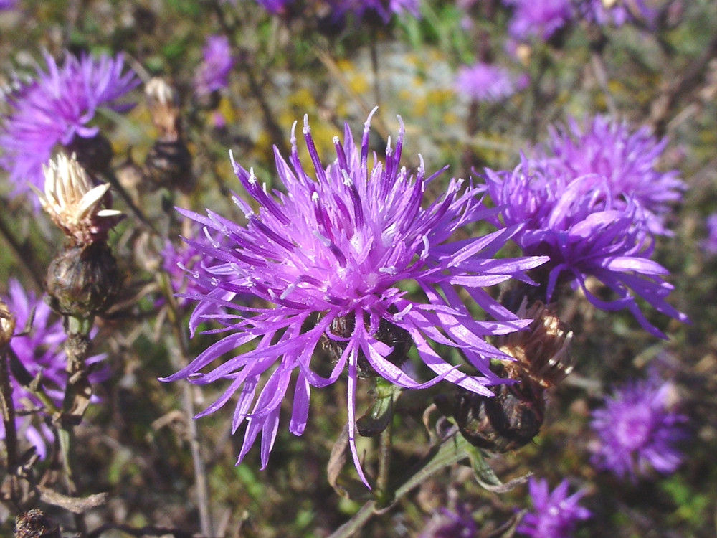
WANTED
Dead or Alive
Reward: A Better Spring Creek Ecosystem

Slide 2
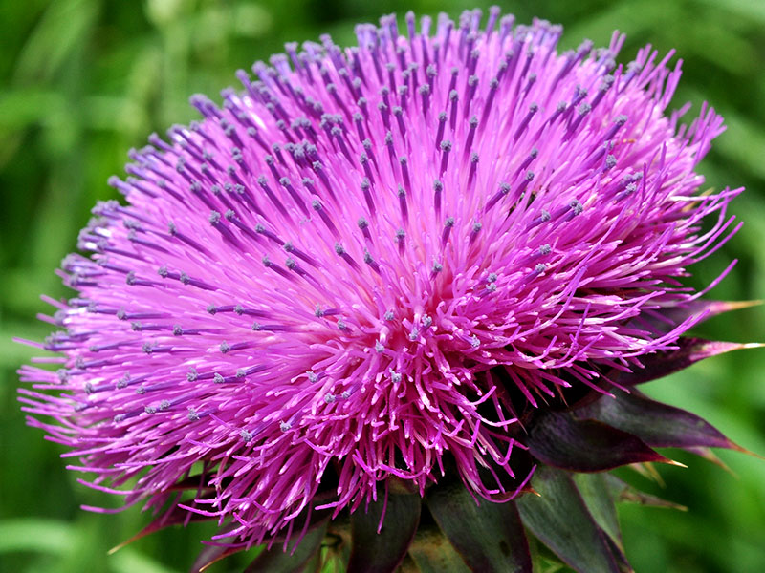
What is a Noxious Weed?!
What is a Noxious Weed?!
A noxious weed is a plant that has been designated by an agricultural authority as one that is injurious to agricultural or horticultural crops, natural habitats or ecosystems and humans or livestock.
Most noxious weeds have been introduced into an ecosystem by ignorance, mismanagement or accident.
They can also decrease the value of your property.

Slide 3
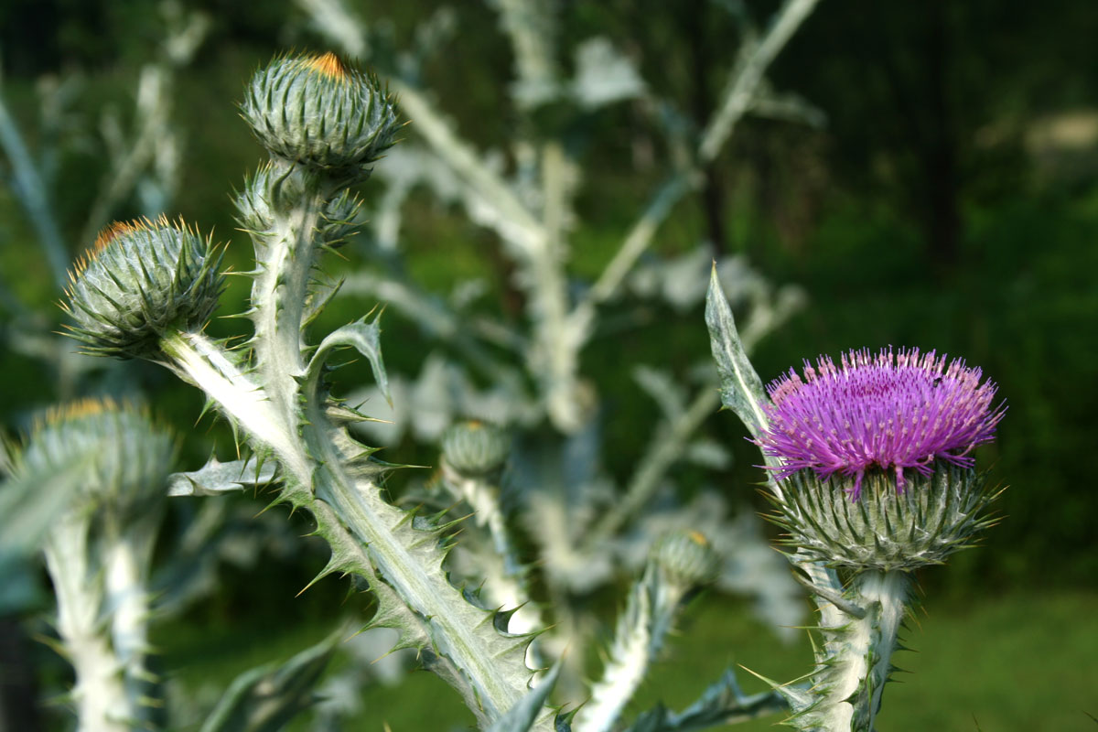
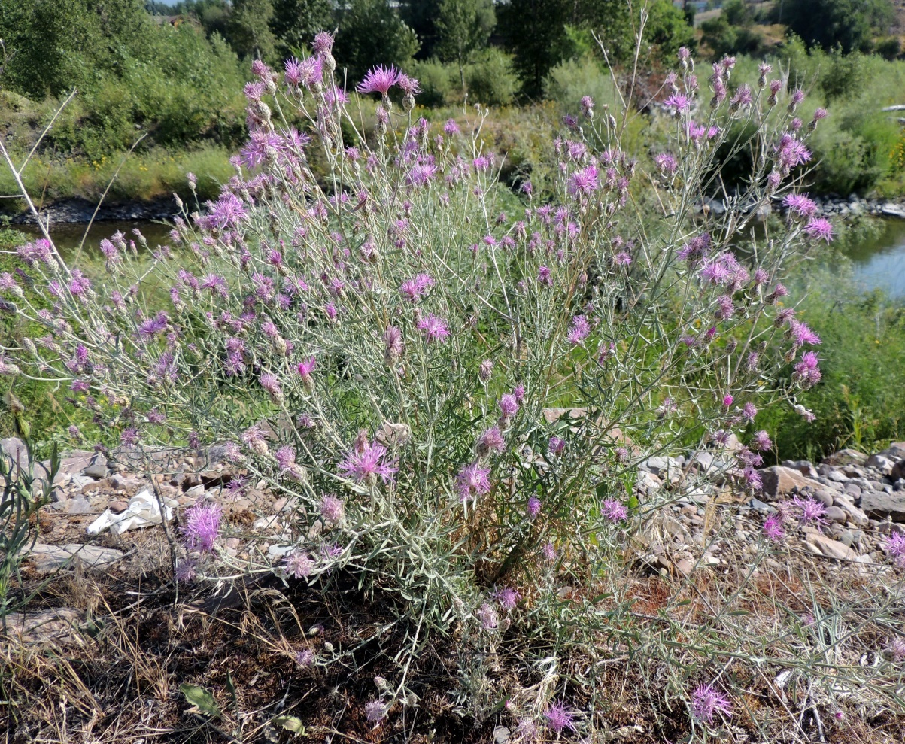
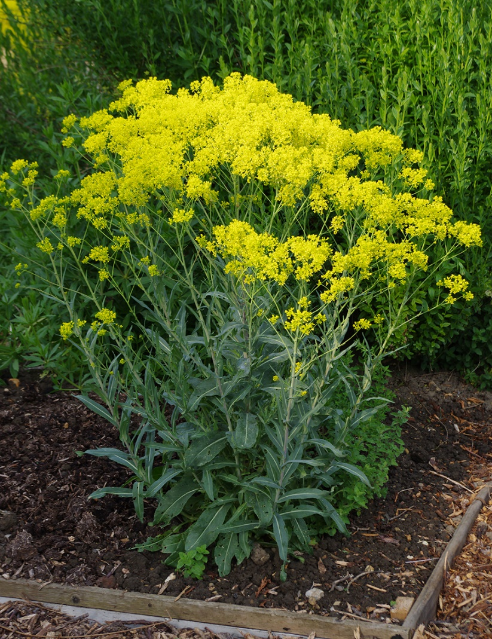
Examples of Noxious Weeds in Spring Creek
There are currently 47 listed noxious weed species for Nevada, many are growing in Spring Creek.
Scotch Thistle
Spotted Knapweed
Dyer’s Woad

Slide 4
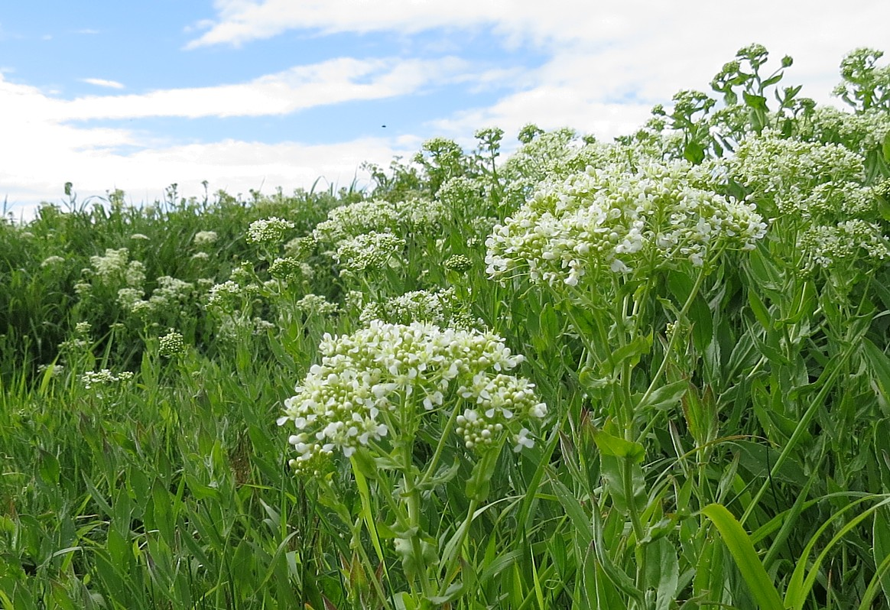
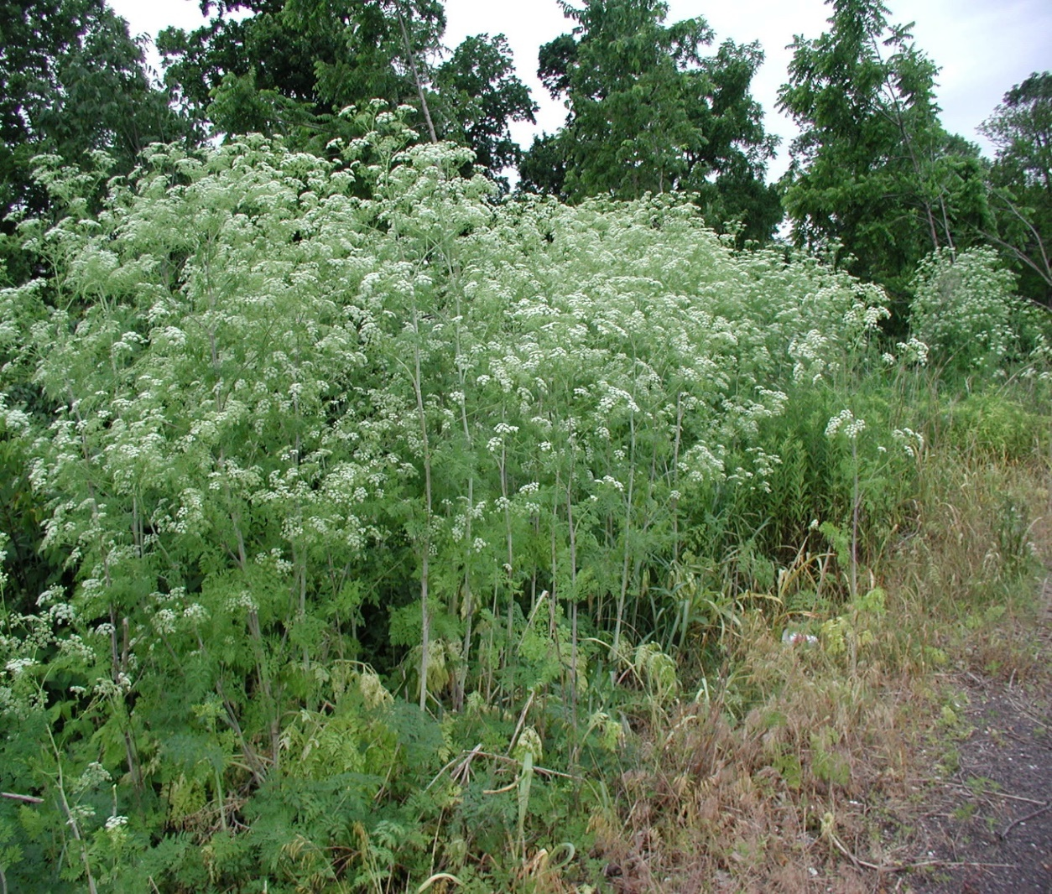
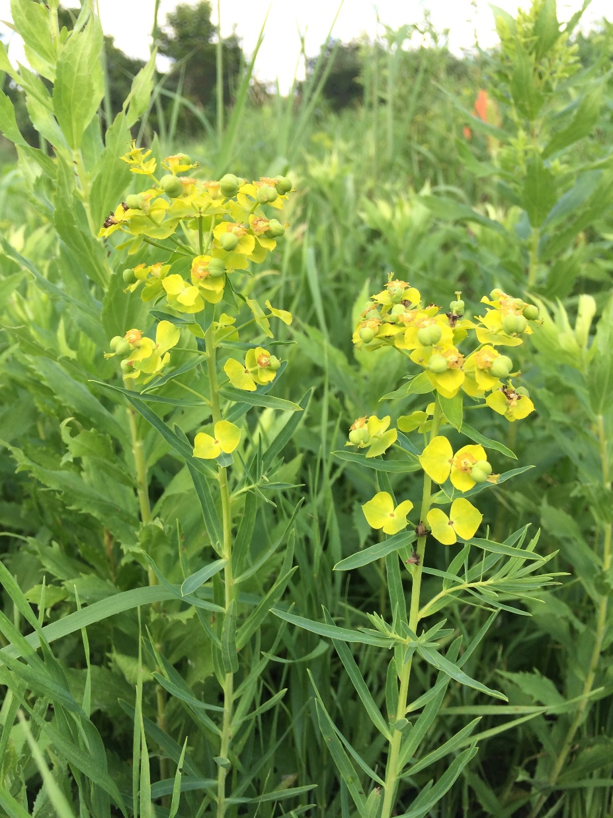
Hoary Cress
Poison Hemlock
Leafy Spurge

Slide 5
What You Can Do To Help
You, as a landowner, are required to treat/remove the noxious weeds on your property.
Noxious weed control is for prevention, eradication, rehabilitation or containment.
Check your property regularly for noxious weeds and don’t be afraid to ask for help!
Physical strategies include:
Tillage
Hand Weeding
Mowing
Grazing
Herbicide – always read the label!

Slide 6
If you have questions or concerns regarding noxious weeds on your property, please feel free to contact the SCA office at 753-6295.
For additional help, please call the NRCS, Cooperative Extension, Conservation District or Humboldt Watershed CWMA office.

