Slide 2
welcome

Slide 3
National Anthem
https://www.youtube.com/watch?v=B9oijBHCBv0

Slide 4
Pledge of Allegiance
https://youtu.be/cbFMHZprAmA?t=68

Slide 5
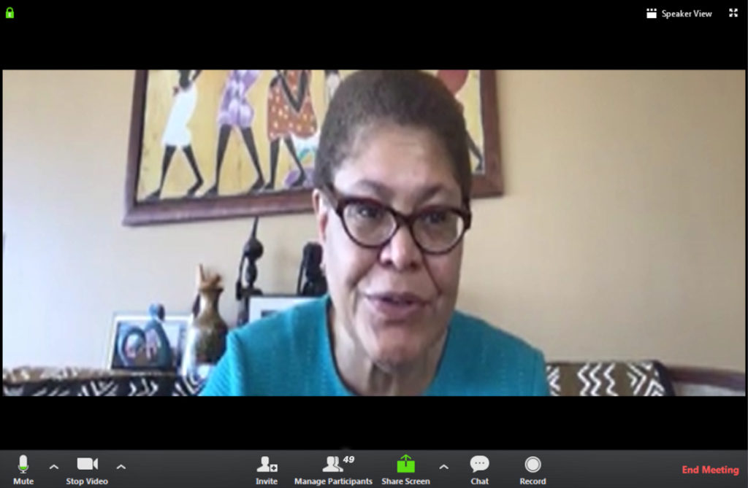
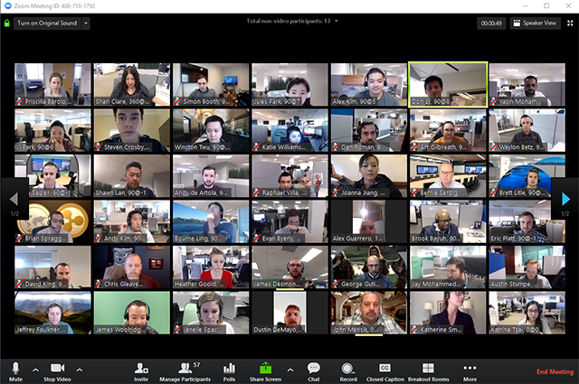
Speaker View

Slide 6
Club Business

Slide 7
Treasurer’s Report

Slide 8
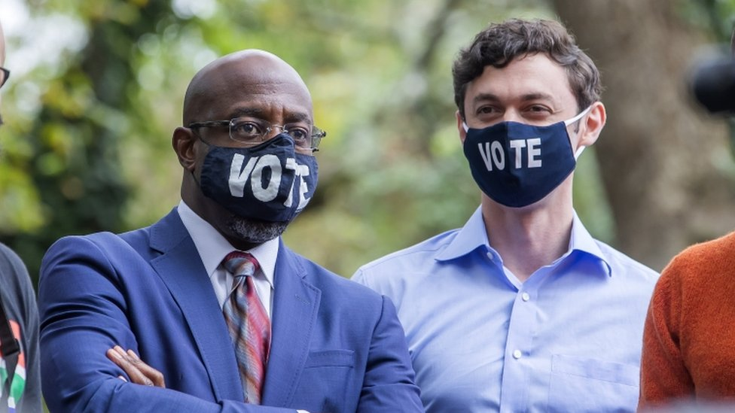
Fair Fight
$500 for the Georgia senatorial campaigns.
Dr. Raphael Warnock
Jon Ossoff

Slide 9
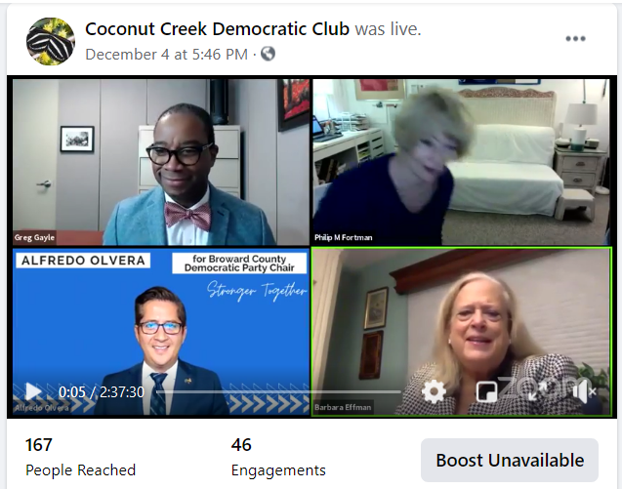
Broward Democratic Party

Slide 10
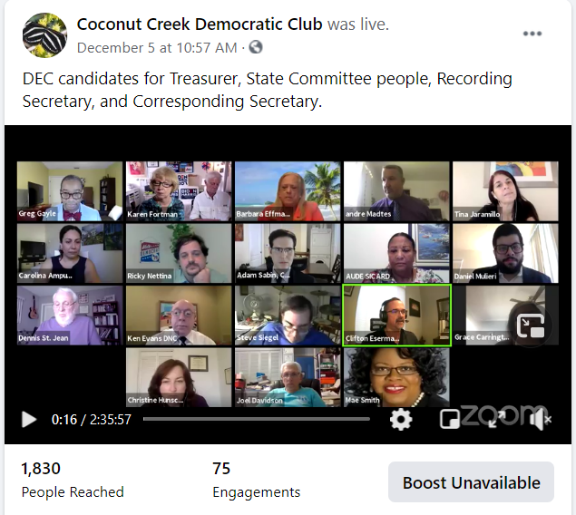
Broward Democratic Party

Slide 11
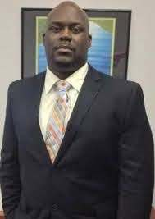
Broward Democratic Party

Slide 12
Board Discussions
Contact precinct members to assist with outreach
Email to members to renew their membership
Send emails to members on different topics
Coconut Creek Commission Candidate Forum
Tues, Feb 9, 2021
Moving our March meeting to March 2, 2021

Slide 13
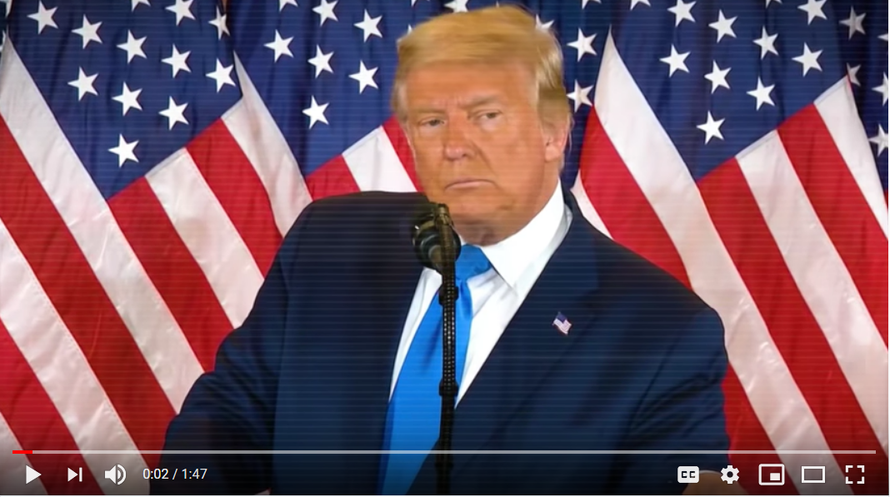
Lincoln Project
https://www.youtube.com/watch?v=N6Y4XwiLD0o

Slide 15
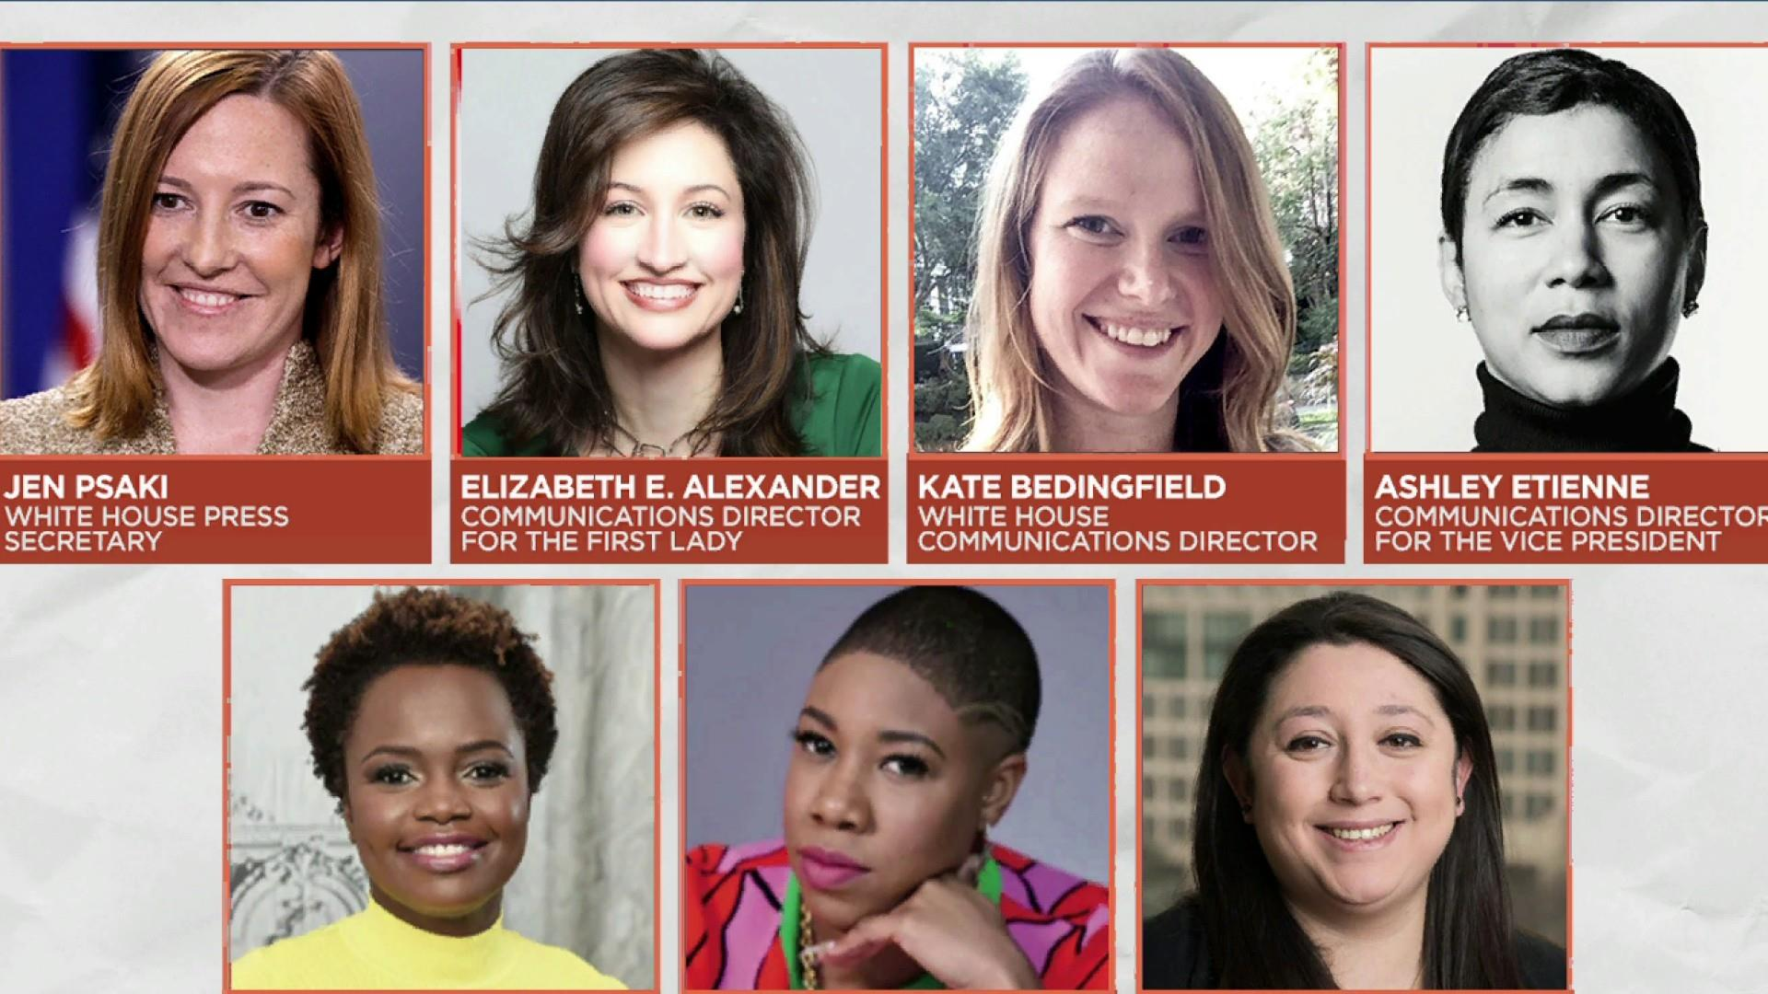
President Biden’s Cabinet

Slide 16
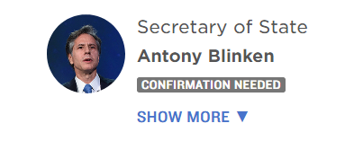
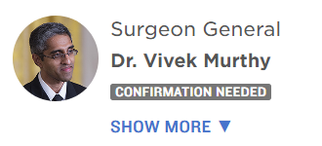
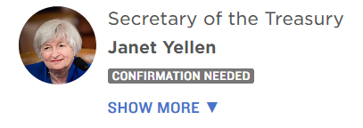
President Biden’s Cabinet

Slide 17
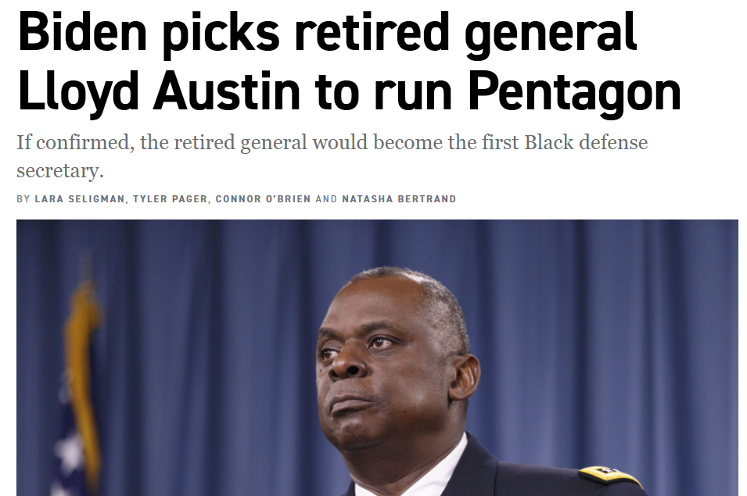
President Biden’s Cabinet

Slide 18
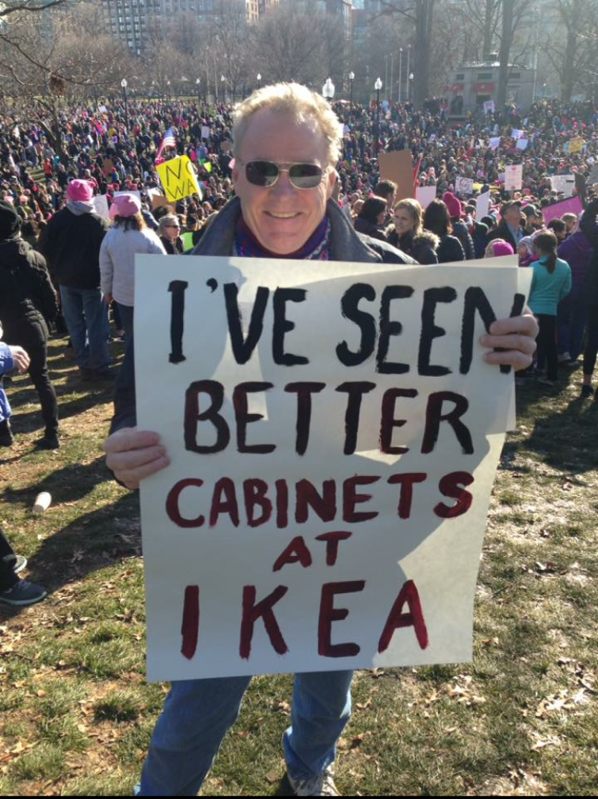
Trump’s Cabinet

Slide 19
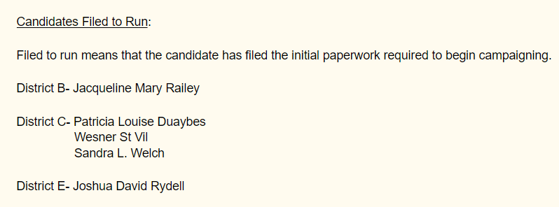
Coconut Creek Elections

Slide 20
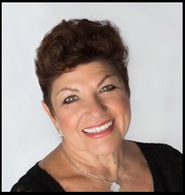
Guest Speaker
Jackie Railey,
Coconut Creek Commission Candidate

Slide 21
Questions

Slide 22
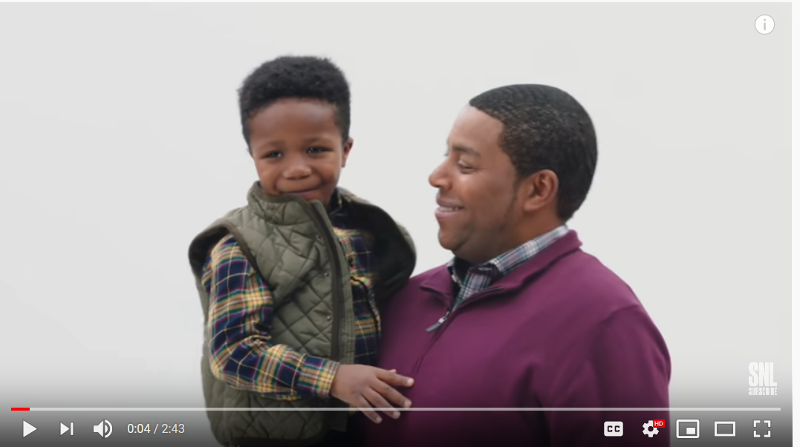
Goodnight
https://www.youtube.com/watch?v=MVXN85TJabg

