Slide 1
McKinney-Vento & Foster Care Program Updates
Tennessee Data & Attendance Conference
Justin Singleton & Alyson Lerma | Consolidated Planning & Monitoring| April19, 2018

Slide 2
Overview
McKinney-Vento Updates
  Justin C. Singleton, McKinney-Vento Coordinator
Foster Care Updates
  Dr. Alyson F. Lerma, Director of Monitoring

Slide 3
McKinney-Vento Program Updates

Slide 4
McKinney-Vento Act
Definition:
  (A) means individuals who lack a fixed, regular, and adequate nighttime residence (within the meaning of section 103(a)(1)); and
  (B) includes--
  (i) children and youths who are sharing the housing of other persons due to loss of housing, economic hardship, or a similar reason; are living in motels, hotels, trailer parks, or camping grounds due to the lack of alternative adequate accommodations; are living in emergency or transitional shelters; or are abandoned in hospitals;*
  (ii) children and youths who have a primary nighttime residence that is a public or private place not designed for or ordinarily used as a regular sleeping accommodation for human beings (within the meaning of section 103(a)(2)(C));

Slide 5
McKinney-Vento Act
  (iii) children and youths who are living in cars, parks, public spaces, abandoned buildings, substandard housing, bus or train stations, or similar settings; and
  (iv) migratory children (as such term is defined in section 1309 of the Elementary and Secondary Education Act of 1965) who qualify as homeless for the purposes of this subtitle because the children are living in circumstances described in clauses (i) through (iii).
  42, §§ 119-9101-9107 (January 6, 2015).

Slide 6
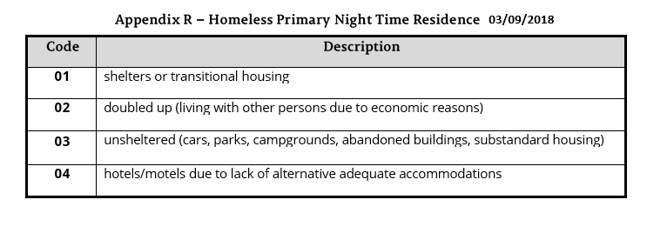
Night Time Residence Codes
(2017). Tennessee Department of Education: Data dictionary. Retrieved from
https://www.tn.gov/content/dam/tn/education/technology/EIS/eis_data_dictionary_2017-18.pdf

Slide 7
2018-19 SIS/EIS Changes
Homeless Student Classification and Homeless Primary Nighttime Residence codes | 1. Block loading of Record Id 44 Student Classification ‘H’ and generate fatal error if the associated enrollment has a Primary Nighttime Residence Code of 00 or NULL 2. Block and generate fatal error for extract 41, if there is a NULL or 00 for primary residence code and a student classification of H already exists for that enrollment. 3. SIS package should not rollover "homeless nighttime residence" as part of their year end roll over. 4. Require SIS packages to cross-validate the H student classification against homeless primary nighttime residence code to insure that both fields are entered in SIS for all homeless students.

Slide 8
Key Reminder
“00” is not a Homeless Residence code.
All students identified as homeless should have a Homeless Residence (1-4) and Homeless Classification (Y).
SIS packages and EIS do not transfer data in real time. Updates may take more than 24 hours.

Slide 9
Foster Care Updates

Slide 10
Children and Youth in Foster Care
Definition and Identification
  Children placed away from their parents or legal guardians by the Department of Children’s Services (DCS).
  Foster students are listed on the monthly report from DCS that TDOE sends to LEAs’ School Nutrition.
  DOES NOT INCLUDE STUDENTS WHO:
    Are staying with a family friend or relative
    Are homeless per McKinney-Vento definition
    Are runaways
Student Classification of Foster Students
  Use code: FOS01

Slide 11
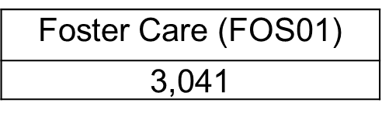
Children and Youth in Foster Care
Included in the Economically Disadvantaged (ED) subgroup.
New required reporting per ESSA
Economically Disadvantaged (ED) Subgroup
  Enter the J-Direct Certification of Economic Disadvantage student classification IN ADDITION to the FOS01-Foster Care student classification.
Notes:
New code; communication began last summer

Slide 12
Economically Disadvantaged Subgroup
For accountability, assessment, and BEP funding consists of students eligible for free school meals due to:
  direct certification of economic disadvantage (J) as participants in federal/state income/nutrition programs (e.g., TANF, SNAP) or due to
  categorical eligibility through their status as
    foster care (FOS01),
    homeless (H),
    migrant (I), and
    runaway (U).

Slide 13
J-Direct Cert Student Classification
328,288 students were flagged with the J-Direct Cert student classification in March 2018.
Over 398,000 students were flagged in June 2017.
Notes:
Use the Student Classifications research query to check your data.
Enter revisions to SIS/EIS as needed.

