Slide 1
DEVELOPING A PROPHETIC CONSCIOUSNESS
Presented to
The Middle District MBA Elizabeth Williams Young Institute
February 23, 2022
By
Rev. James E. Victor, Jr.

Slide 2
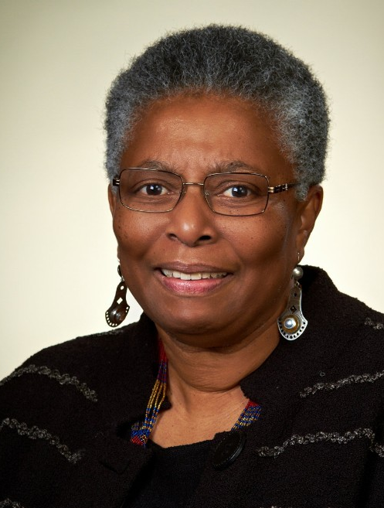
WHAT IS PROPHETIC CONSCIOUSNESS?
Prophetic consciousness is a deeply spiritual faith predicated upon a love ethic that operates from a worldview sensitive to God’s demand for justice which seeks to rectify the sinful imbalances of injustice at personal, communal, and systemic levels.
Dr. Katie Cannon
Nat Turner
Dr. King, Jr.
This Photo by Unknown Author is licensed under CC BY

Slide 3
What do we want the church to do? We ask for its presence with us, beside us, as Christ among us. We ask the church to sacrifice with the people for social change, for justice and for love of brother and sister. We don’t ask for words. We ask for deeds. We don’t ask for paternalism. We ask for servanthood. Cesar Chavez
Taken from the article, Food, Faith, and Cesar Chavez in Real Clear Politics by Carl M. Cannon (3/31/16)
Does your faith recognize the injustices of the world or is it only consumed with your needs?

Slide 4
WHY DO WE NEED A PROPHETIC CONSCIOUSNESS?
It’s Biblical (Micah 6:8)
It’s Counter-cultural (Mark 10)
It’s Missional (Matthew 28:16-20)

Slide 5
HOW TO DEVELOP A PROPHETIC CONSCIOUSNESS!
Matthew 3:1-10
In those days John the Baptist appeared in the wilderness of Judea, proclaiming, “Repent for the Kingdom of heaven has come near.” This is the one whom the prophet Isaiah spoke when he said, “The voice of one crying in the wilderness: Prepare the way of the Lord, make his paths straight.” Now John wore clothing of camel’s hair with a leather belt around his waist, and his food was locust and wild honey. Then the people of Jerusalem and all Judea were going out to him, and all the region along the Jordan, and they were baptized by him in the river Jordan, confessing their sins. But when he saw Pharisees and Sadducees coming for baptism, he said to them, “You brood of vipers! Who warned you to flee from the wrath to come? Bear fruit worthy of repentance. Do not presume to say to yourselves, “ We have Abraham as our ancestor”: for I tell you, God is able from these stones to raise up children to Abraham. Even now the ax is lying at the root of the trees; every tree therefore that does not bear good fruit is cut down and thrown into the fire.

Slide 6
STEPS TOWARD A PROPHETIC CONSCIOUSNESS
Know the Times (In those Days)
Step Up ( He Appeared)
Renounce the Centers (In the Wilderness)
Find your Voice (He proclaimed)
Embrace your Vocation( He wore camel’s hair)
Watch what you Eat ( Wild Honey)
Follow Moral Compass (Confess Sins)
Act Courageously (You Brood of Vipers)
Imagine a New Reality (Kingdom of Heaven & New Children of Abraham)

Slide 7
Prophet vs. Prophets
A
Community
Of
Prophets
Charles Spurgeon
Margaret Walker
Jesus
We are all at times unconscious prophets
The Word of fire burns today on the lips of our prophets in an evil age
Woe to you when all speak well of you, for that is what their ancestors did to the false prophets
Luke 6:26
NEW MORAL CENTERS
NEW COMMUNITY CENTERED ON MORALS
Then the people of Jerusalem and all Judea were going out to him, and all the region along the Jordan Matthew 3: 6

