Slide 1
Resuscitation Teaching Stations
Notes:
Your ENPC testing scenario will NOT require chest compressions or defibrillation, but it is important to know how to manage pediatric cardiopulmonary arrest. The next 2 PNP scenarios will review cardiopulmonary resuscitation. This discussion includes content from Chapter 5, Initial Assessment, and Chapter 7, the Child in Need of Stabilization and is based on the 2020 American Heart Association Guidelines for Cardiopulmonary Resuscitation and Emergency Cardiovascular Care.
Objectives
Describe the principles and sequence of high-quality pediatric cardiopulmonary resuscitation.
Apply the pediatric nursing process to an unresponsive child without normal breathing or a palpable pulse.

Slide 2
Resuscitation Principles
High-quality
Minimize pauses in compressions
Estimated weight if necessary
Early defibrillation
Early epinephrine
Identification of reversible causes
Team communication
Assign roles
Ensure orders and actions are clearly understood
Caregiver presence
References:
American Heart Association. (2020). Pediatric advanced life support provider manual.
American Heart Association. (2020). 2020 AHA guidelines for CPR and ECC.
Notes:
When are chest compressions indicated?
Unresponsive child with abnormal breathing and no palpable pulse OR a pulse of less than 60 with signs of poor perfusion
How do you minimize pauses in compressions?
Apply pads and charge defibrillator during compressions
Assess pulse while compressions are in progress and keep fingers on pulse during pauses to evaluate for quality of compressions and quickly assesses for a pulse during rhythm checks
Be ready to change compressors every 2 minutes
Immediately resume compressions after defibrillation
What do you use to estimate the patient’s weight?
How are you able to support caregiver presence at your facility?

Slide 3
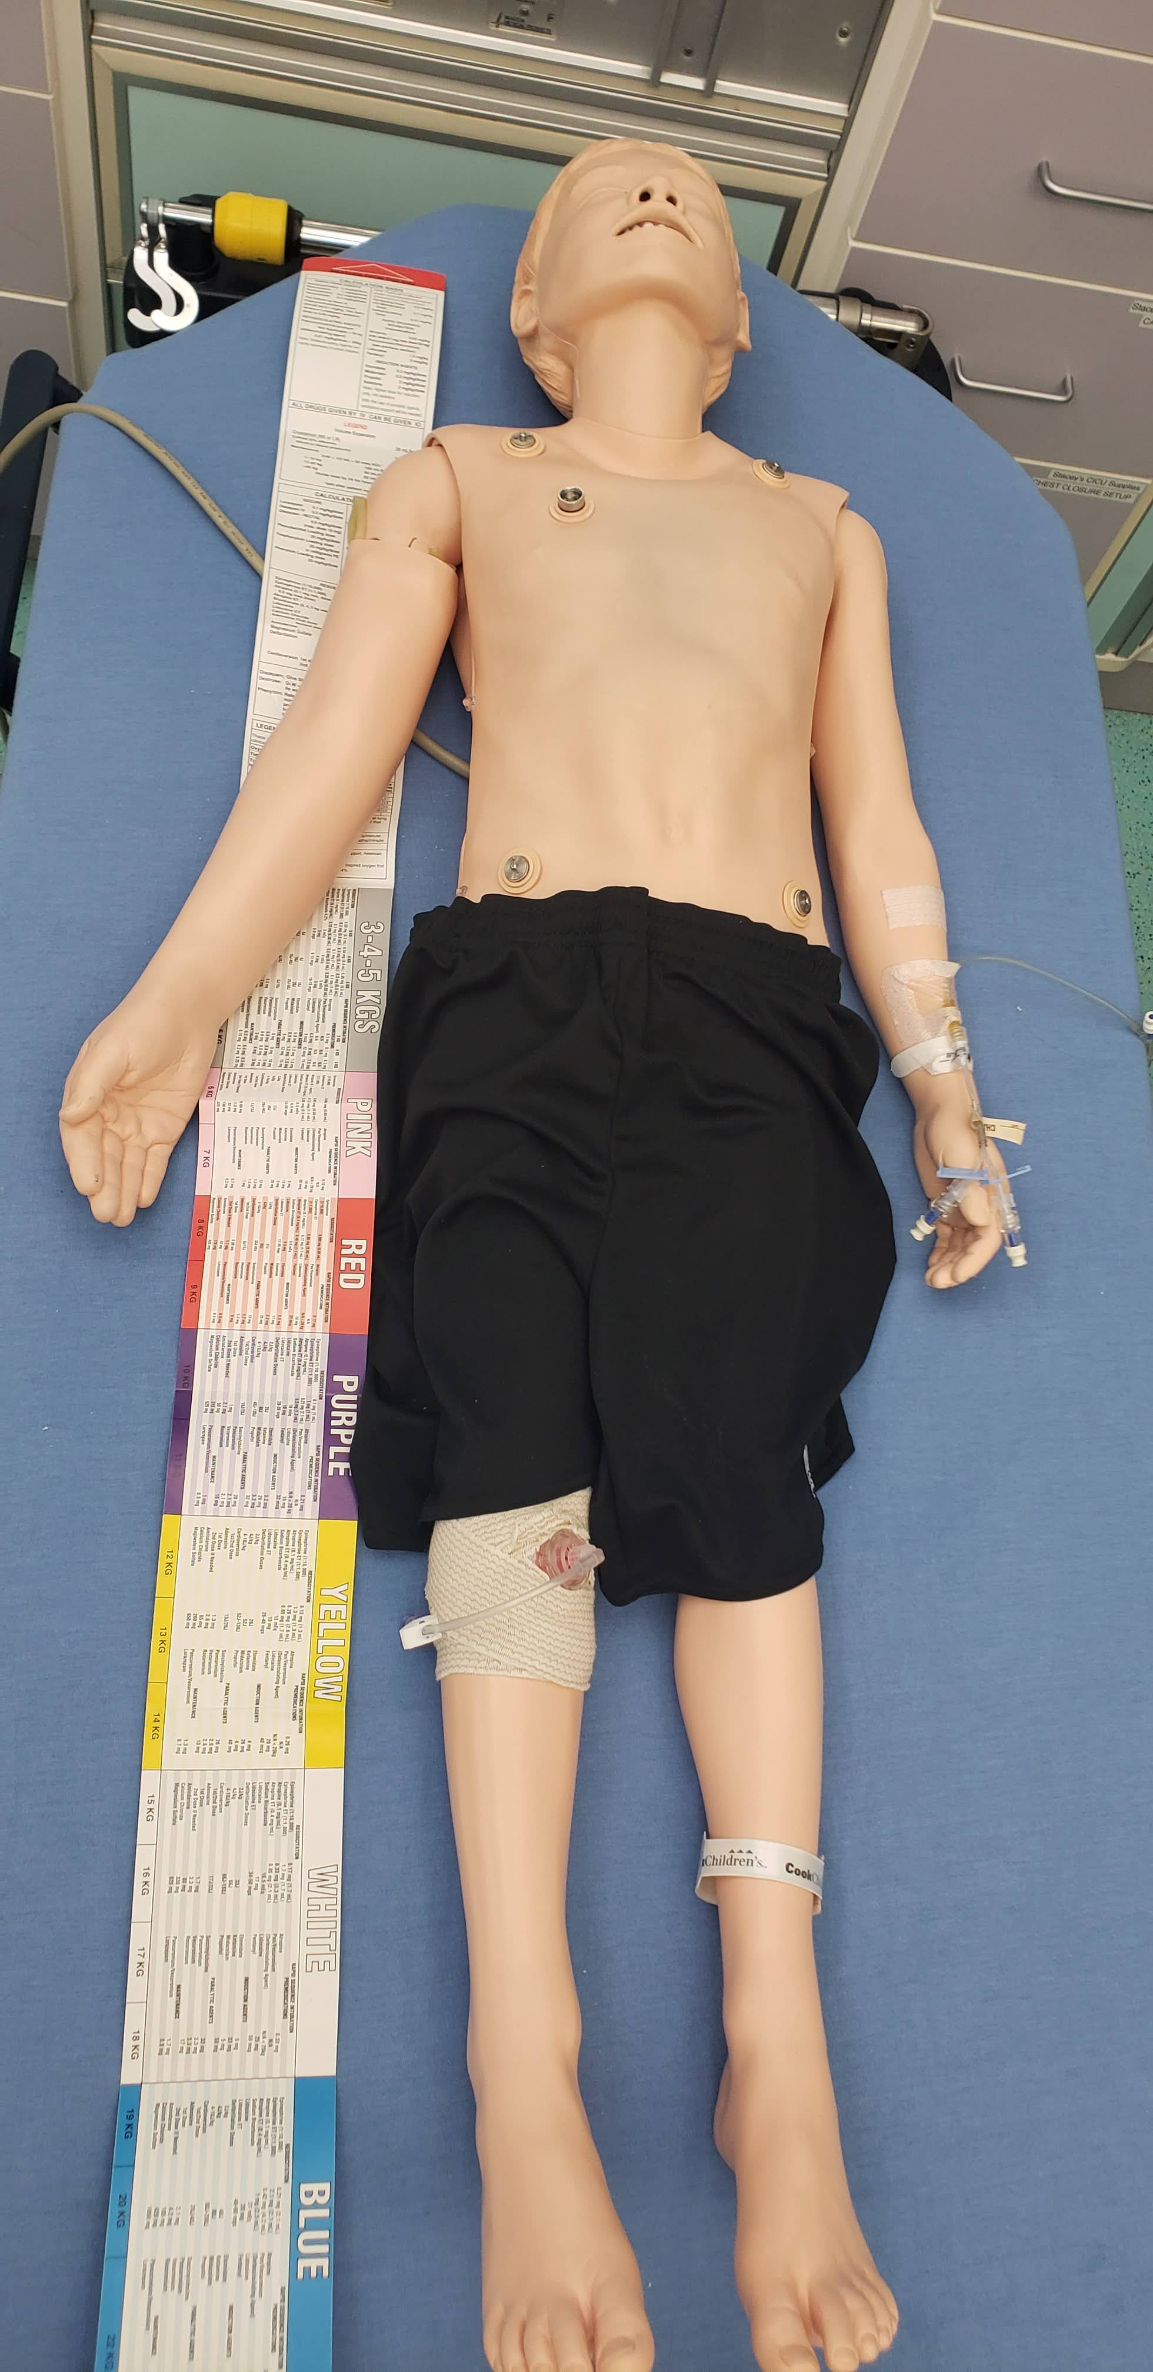
Image courtesy Cam Brandt
Length-Based Resuscitation Tape
Notes:
Who has used a length-based resuscitation tape? Are there any tricks to using it?
Red to the head, estimate the length to the child’s heels, not the toes.
Review facility-specific methods to estimate weight if applicable.

Slide 4
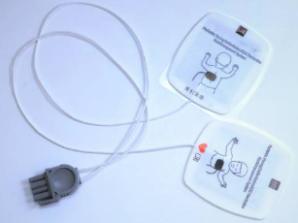
Defibrillation and Cardioversion
Notes:
We will want to apply the defibrillation pads as soon as possible to determine if it is a shockable rhythm. Do you know when you would use the pediatric pads?
Weight-based depending on manufacturer, if the pads do not overlap you can generally use the adult pads but defer to manufacturer instructions.
What is the initial defibrillation dose? What are subsequent defibrillation doses?
Start at 2 joules/kg, second shock at 4 joules/kg, may increase subsequent doses up to a maximum of 10 joules/kg
We will use the “sync” mode to cardiovert. What is the cardioversion dose?
0.5-1 joule/kg

Slide 5
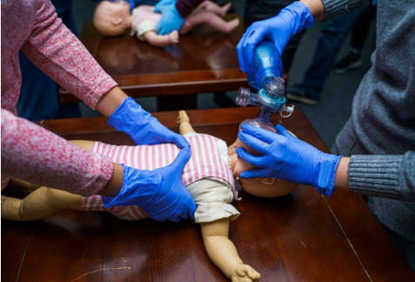
Compressions and Ventilations
Notes:
What is the compression to ventilation ratio for one rescuer?
30:2
What is the compression to ventilation ratio for two rescuers?
15:2
Once you have an advanced airway, how do you coordinate compressions and ventilations?
Continuous compressions at a rate of 100-120/minute with no pauses for ventilations.
Ventilation rate depending on signs of puberty
No signs of puberty: 1 breath every 2-3 seconds
Signs of puberty: 1 breath every 6 seconds

Slide 6
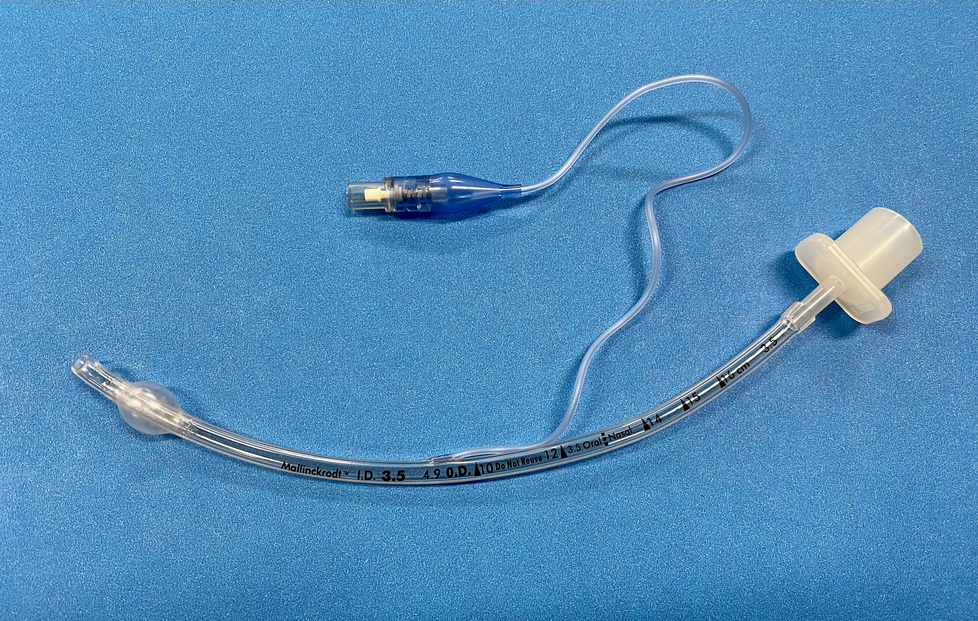
CO₂ detector device (assess after 5 to 6 breaths) Look for chest rise Auscultate epigastrium & lungs Secure, continue ventilations
ENA
Notes:
After intubation, you will need to confirm correct endotracheal tube placement.

Slide 7
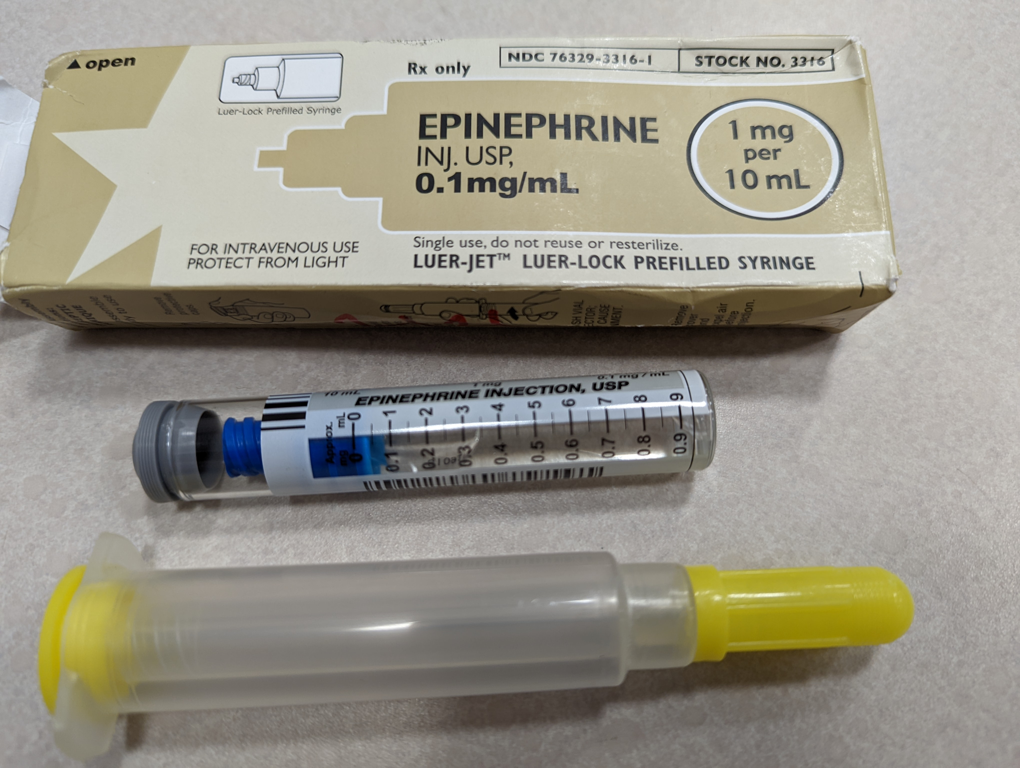
ENA
Notes:
What resources do you have to calculate pediatric drug dosages?
Refer to facility resources
0.01 mg/kg of epinephrine is given every 3-5 minutes. That is 1.2 mL for a 12 kg child. How do you draw up multiple doses of epinephrine?
Refer to 3-way stopcock or other syringe transfer devices
We will reinforce all of this in 2 resuscitation teaching scenarios. Your testing scenario will NOT require chest compressions or defibrillation.
Are you ready to see how this plays out in a patient scenario?

