Slide 1
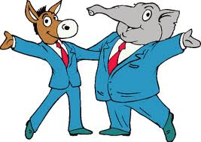
Political Parties
By Loren Miller

Slide 2
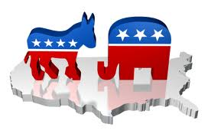
Political Parties
A political party is a group organized to nominate candidates, to try to win political power through elections, and to promote ideas about public policy.
To win elections in the United States, political parties must be “broad based.”
The party platform, a statement about their positions on the issues, must appeal to a wide segment of the voting population.
Role of Political Parties -Tulis

Slide 3
Political Parties
America is a two-party system and always has been . . . .
-- Single-member constituency (Duverger’s Law)
While there are many minor parties around, they rarely have a chance to win a major office.
Throughout American history one party has been the dominant majority party for long periods of time.
A majority of voters identify with the party in power. Thus, this party tends to win a majority of elections.
These periods are called “party eras.”

Slide 4
Why We Have a Two-Party System
(Remember we have one winner per election)
Election Results:
Party A 40%
Party B 30% Party A wins as they have the most votes
Party C 20%
Party D 10%
Party D, which received only 10% of the votes tries to make a deal
with one of the other three parties. You incorporate some of my ideas
and I’ll throw my support to you. Also, how difficult would it be for Party D
to raise funds knowing that it is unlikely to win.
So Party D merges and most support Party B, but some support Party C

Slide 5
Why We Have a Two-Party System
(Remember we have one winner per election)
Election Results:
Party A 40%
Party B 38% Party A wins as they have the most votes
Party C 22%
Party C, which received only 22% of the votes tries to make a deal
with one of the other two parties. You incorporate some of my ideas
and I’ll throw my support to you. Also, how difficult would it be for Party C
to raise funds knowing that it is unlikely to win.
So Party C merges and most support Party B, but some support Party A
And we end up with two major broad based parties

Slide 6
Critical Elections
A critical election is sometimes called an electoral earthquake.
-- splits appear in each party’s coalition
-- new issues appear which divide the electorate
-- each party forms a new coalition
A critical election transforms the party system and the process is called “party realignment.”
Typically, what would trigger a realignment??

Slide 7
The First Party System: 1796-1828
Ironically, many of our early political leaders were initially opposed to political parties, but later realized that there was a need to organize those who shared their views.
-- James Madison in Federalist #10 warned of factions, but later pressured Thomas Jefferson to form an opposition party to the Federalists
-- George Washington, in his Farewell Address, which is sometimes credited to Alexander Hamilton, warned about the “baneful effects of the spirit of party.”

Slide 8
The First Party System: 1796-1828
While the Federalists and Anti-Federalists battled over the ratification of the Constitution, once it was ratified, the two groups “buried the hatchet” for a short time.
When Hamilton, the Secretary of the Treasury, presented his economic policy featuring economic stability, this split the North and the South.
-- full funding of the national and state debts
-- should speculators reap the benefits
-- northern states owed more
-- creation of a national bank
-- rural (South) v. urban (North)
The economic policy passed when a deal was struck to bring the nation’s capital to the South.

Slide 9
The Second Party System: 1832-1860
The Federalist Party had dissolved and an “era of good feelings” (there was no opposition to the Democratic-Republican Party) was ushered in by President Monroe (1816 and reelected in 1820).
However, the absence of another party did not mean a lack of conflict within the Democratic-Republican Party.
The election of 1824 reflected this split as five Democratic-Republicans sought the presidential nomination.
-- John Calhoun, Secretary of War
-- John Quincy Adams, Secretary of State
-- William Crawford, Secretary of the Treasury
-- Henry Clay, Speaker of the House
-- Andrew Jackson, military hero (Battle of New Orleans)

Slide 10
The Second Party System: 1832-1860
The election of 1824 created a violent split in the Democratic-Republican Party.
-- the supporters of Adams (National Republicans)
-- the supporters of Jackson (Democratic Republicans)
Between 1824 and the election of 1828, Jackson campaigned and mobilized voters. He defeated “King Caucus” (elite rule) with a populist “revolution.”
-- grass-roots politics organized by Martin Van Buren
Van Buren is known as the “father of parties” as he ushered in the national party convention as a means of nominating presidential candidates (thus stripping the power from Congress and the Caucus).

Slide 11
The Second Party System: 1832-1860
As the Jacksonian-Democrats continued to build support, a new opposition party led by Henry Clay and Daniel Webster, the Whigs.
-- they were primarily united in opposition to Andrew Jackson
The election of 1836 competition between the Whigs and the Democratic-Republicans was intense and the competition between these two parties lasted into the 1850s.
-- 1836 election:
Martin Van Buren (D-R) 170 electoral votes
William Henry Harrison (W) 73 electoral votes
Hugh White (W) 26 electoral votes
Daniel Webster (W) 14 electoral votes
W.P. Mangum (Anti-Jackson) 11 electoral votes

Slide 12
The Second Party System: 1832-1860
Strong party organizations were used to bring out the vote -- voter turnout in 1840 was 78 percent of adult white voters
Political rhetoric incited the people; parades stoked their emotions; and catchy slogans simplified their views.
-- “Tippecanoe and Tyler Too”
-- “Van, Van is a Used Up Man”
William Henry Harrison, a Whig, is elected president in 1840 and Zachary Taylor, another Whig was elected in 1848.
-- what do these two have in common?
In 1844, James K. Polk, a Democrat was elected president.

Slide 13
The Second Party System: 1832-1860
The Whigs had two distinct wings:
-- Northern industrialists and Southern planters
In the 1850s, the issue of slavery dominated American politics and split both the Whigs and the Democrats and created two “third parties”.
-- the Free Soil Party and the Liberty Party (both abolitionist)
The Republican Party rose in the late 1850s as an antislavery party.
-- they were able to unite the Northern Whigs, the antislavery Democrats, the Free Soilers and the Liberty Party
-- John C. Fremont was the Republican nominee in 1856 and got nearly 40 percent of the vote. He carried the North but was not on the ballot in the Southern states, so Buchanan (D) was victorious.

Slide 14
Political Parties Timeline
1796-1860
1796 Federalists Jeffersonian-Republicans
1816
Democratic
1828
National Republican Anti-Masonic
1840
Liberty
Whigs
Free Soil
Know-Nothings
Northern Whigs Southern Whigs
1860
Republican
Northern Democratic Southern Democratic

Slide 15
The Third Party System: 1860-1896
Political parties achieved unprecedented levels of power and organization.
-- the most competitive period in American history
-- intense electoral competition both locally and nationally
Republicans would have dominated this period had it not been for unrelated events that hurt their fortunes.
-- economic depressions in 1873 and 1890
-- the scandals of the Grant administration
To win required discipline, coordination, and energy.
-- parties lined up like armies for combat
-- highest voter turnout in American history (almost 80% turnout)
This ushered in the urban political machine.
-- Tammany Hall
-- patronage jobs were the reward for electoral success

Slide 16
The Third Party System: 1860-1896
With rapid industrialization and the domination of government and politics by the business community, the farmers of the Midwest discovered that they were the consistent losers.
-- neither party took up their cause
-- the Granger movement (1870s +) and the Farmers Alliance were formed as a voice of agrarian discontent
The Populists took the frustrations of the farmers into the political realm.
Prior to 1896 both parties favored industrialization and sought to appeal to urban populations.

Slide 17
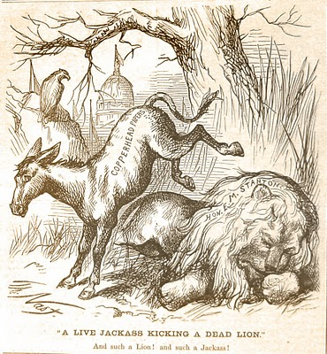
Democrats are
jackasses
Stanton is “lionized”
On January 15, 1870, in Harper’s Weekly, Thomas Nast introduced the donkey as the symbol of the Democratic party. Nast was lambasting a northern faction of the party that had opposed the Civil War and those Democratic papers that continued to criticize Lincoln’s recently deceased Secretary of War.

Slide 18
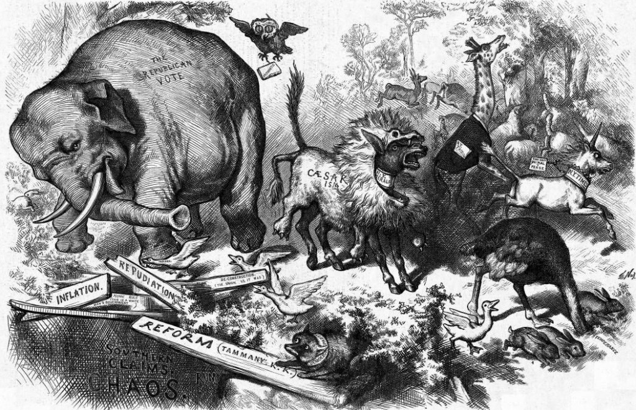
An ass in
sheep’s
Clothing
(from Aesop’s
Fables)
Ulysses Grant (a Republican) was serving his second term. During the
midterm elections in 1874, Grant was accused of “Caesarism” due to a
rumor that he was planning on running for a third term. Harper’s Weekly
published this cartoon by Thomas Nast. The elephant became the symbol
for the Republican party.

Slide 19
The Fourth Party System: 1896-1932
The election of 1896 was a realigning election.
-- a shifting of party coalitions
Republicans
-- Eastern manufacturers
-- industrial Northeast and Midwest
Democrats (a losing coalition)
-- white Southerners
-- rural debtors
William Jennings Bryan was the Democratic nominee while William McKinley won the Republican nod.
-- Bryan was portrayed as a radical enemy of urban workers
-- McKinley’s campaign was almost entirely financed by Northern industrialists

Slide 20
The Fourth Party System: 1896-1932
Republicans would hold the White House for sixteen consecutive years and for twenty-eight of the next thirty-six years.
-- Wilson won in 1912 because Teddy Roosevelt split the Republican vote and he barely won in 1916.
-- by 1920 the Republican coalition has regained prominence
Republicans dominated the North and Midwest (industry and business interests).
Democrats maintained a stronghold in the Southern states and border states (rural interests).

Slide 21
The Fourth Party System: 1896-1932
Graft and corruption which was rampant in the Third Party System became a target in the Fourth Party System.
-- Civil Service System
-- Australian Ballot (secret ballot)
-- a ballot which listed all candidates for a particular position, not one party’s candidates for all positions
-- this facilitated split-ticket voting
-- Direct primary elections
-- some cities introduced non-partisan elections
-- Initiative (citizens can bring a proposed law to the electorate without legislative approval)
-- Referendum (an election in which the citizens are asked to vote directly on passage of a piece of legislation)
-- Recall (citizens by petition can call for a vote on removing an elected official before the end of the term)
-- Seventeenth Amendment (direct election of senators; no longer to be selected by state legislators [business interests])

Slide 22
Political Parties Timeline
1860-1920
1860 Republican Democrat
Greenback
1880
Populist
Prohibition
1900
Socialist
1910
Bull Moose
1920

Slide 23
The Fifth Party System: 1932-1968
The stock market crash and the Great Depression were blamed on the Republicans and their President Herbert Hoover.
A new Democratic coalition formed:
-- Southerners
-- urban workers
-- minorities (African Americans, ethnic Americans, Jews, Roman Catholics)
-- farmers
Groups that favored an increased role for the federal government through the New Deal public works, pro-union legislation, social welfare programs, and farm supports favored the Democrats.

Slide 24
The Fifth Party System: 1932-1964
Throughout the New Deal era, the two major parties were roughly divided along class lines.
-- the Democratic party supported the working class and the poor
-- the Republicans represented business interests and the more affluent

Slide 25
Political Parties Timeline
1920-2010
1920 Republican Democrat
1940
Dixiecrat
1960
American Independent
Libertarian
1980
Green
2000
2010

Slide 26
The Sixth Party System: 1972-Present
The Democratic party showed signs of disagreement in the late 1940s over the question of civil rights.
-- the Dixiecrat party
This fissure increased in the 1960s when both civil rights and the Vietnam War divided the Northern from the Southern Democrats.
-- Civil Rights Act of 1964
-- Voting Rights Act of 1965
Cultural issues also divided the Democratic party.
-- Social Conservatism of the South v. Northern Liberalism
-- abortion (Roe v. Wade, 1973)
-- gay rights

Slide 27
Critical Elections:
1800: Thomas Jefferson’s Democratic-Republicans dominated for 28 years (Federalists faded from the scene).
1828: Andrew Jackson redefines the Democrats as the party for reforming democracy; Democrats win every presidential election from 1828 to 1856.
1860: Abraham Lincoln’s Republican Party gains control of national politics and stays in power for 20 years.
1896: After 10 years of stalemate, William McKinley restores the Republicans to power; they will dominate for 30 years.
1932: Franklin D. Roosevelt’s landslide victory ushers in almost 30 years of Democratic supremacy; a new coalition of urban poor and middle class, farmers, southerners, immigrants and labor union members.
1972: No political party has dominated. In ten elections we have had an even split between the Democrats and the Republicans. Elections have become very competitive.

Slide 28
Party Platforms
The Democratic National Committee (DNC) and the Republican National Committee (RNC) are responsible for producing party platforms, statements of party principles and issue positions.
These platforms help guide voters and candidates in knowing where the party stands on important issues.
-- there are many philosophical differences between the parties on many issues: tax policy, labor laws, abortion, gay and lesbian rights, and affirmative action
-- the two party platforms do not show much difference on some issues: gun control, and support for Israel
Republican Platform Democratic Platform

Slide 29
Third Parties
A third party is one that enters the electoral contests without having a realistic chance of winning an election.
-- at times these parties do affect the outcome of the contest between the two major parties (Ralph Nader in 2000)
Third parties are created for different reasons:
-- they promote certain causes (prohibition) or extreme ideological positions (socialism or libertarianism)
-- they are an offshoot, a splinter group, of a major party (Teddy Roosevelt’s Progressives or Strom Thurmond’s States’ Righters [Dixiecrat])
-- a popular person wants to run who is dissatisfied with the two major parties and is unable to win a major party’s nomination (Ross Perot in 1992 and 1996)

Slide 30
Third Parties
Third parties often bring new groups into the electorate and serve as “safety valves” for discontent.
-- Free Soilers were the first anti-slavery party
-- the Progressives and Populists put forth many social reforms
-- American Independent party (George Wallace) focused support for “law and order”
-- Ross Perot focused on the federal deficit
-- Ralph Nader’s Green party focused on the environment
If we had a multi-party system where we have more than one winner in an election (European model [coalition governments]), we would end up with very narrow-based parties (an environmental party, a Roman Catholic party, a union-based party, farmers’ parties, or an African American party).

Slide 31
Proportional Representation
(Israel)
N = 120
2013

Slide 32
Proportional Representation
(Netherlands)
Votes
Seats
Christian Democrats
Christian Democrats
Socialist
Socialist
People’s
Party
People’s
Party
Labor
Freedom
Party
Freedom
Party
2012

Slide 33
Proportional Representation
(United Kingdom)
Votes
Seats
Conservatives
Conservatives
Liberal Democrats
Liberal
Democrats
Labor
Labor
2010

Slide 34
What’s it Mean to be a Democrat? A Republican?
Political parties in the United States are too decentralized for either party to take a national position and then enforce it at the state and local level. We do not have a “responsible party system”.
There is no mechanism for a party to discipline officeholders and ensure cohesion in policymaking.
In a primary election, do party leaders have control as to who will run?
So are all Republicans/Democrats committed to its program?

Slide 35
American Political Parties are
Broad Based Coalitions

Slide 36
Party Coalitions Today
2014

Slide 37
Votes for Republican President by Demographic Group: Gender
Bush (Kerry)
McCain (Obama)
Romney (Obama)

Slide 38
Votes for Republican President by Demographic Group: Race/Ethnicity
Bush (Kerry)
McCain (Obama)
Romney (Obama)

Slide 39
Votes for Republican President by Demographic Group: Religion
Bush (Kerry)
McCain (Obama)
Romney (Obama)

Slide 40
Votes for Republican President by Demographic Group: Age
Bush (Kerry)
McCain (Obama)
Romney (Obama)

Slide 41
Party Loyalty
Democratic Candidate
Republican Candidate
Romney
Obama
McCain
Kerry
Bush
Gore
Bush

Slide 42
% saying that there is a difference in what the Republicans and Democratic Parties stand for
2014

Slide 43
Young/Old Voting Gap, 1972-2012
2014

Slide 44
How the Generations See Themselves
2014

