Slide 1
Injury
Teaching Stations
Notes:
Our last 2 PNP scenarios involve traumatically injured children. The PNP does not change but there are some trauma-specific interventions.
This discussion includes content from Chapter 5, Initial Assessment, Chapter 7, The Child in Need of Stabilization, and Chapter 9, The Child with an Injury.
Objectives
Identify trauma-specific assessments and interventions.
Apply the pediatric nursing process to an injured child.

Slide 2
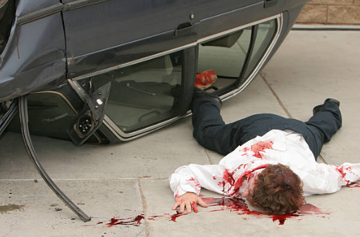
Notes:
Traumatic injuries occur as a result of the body being subjected to forces it cannot withstand.
What forces was this child subjected to?
Acceleration,
deceleration (car collision motions, ejection from vehicle),
seat belt compression,
blunt from striking surfaces in the car and landing on the ground,
penetrating from broken glass or other sharp objects
What important information can prehospital personnel tell you for motor vehicle collisions or other traumatic mechanisms of injury?
Level of consciousness on scene
Height of fall
Speed of vehicle
Amount of damage to vehicle
Distance patient was thrown
Use of restraints or other protective equipment
Volume of fluid administered en route
Time of injury (burns)
Any patient movement noted (spinal cord injury)

Slide 3
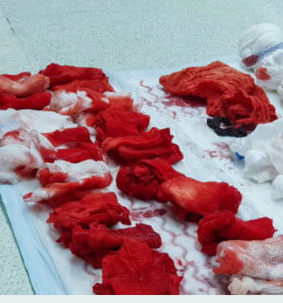
Notes:
Uncontrolled hemorrhage is the leading cause of traumatic death. What does uncontrolled bleeding look like?
Uncontrolled bleeding might not be a spurting arterial wound.
It can be an ongoing venous bleed that doesn’t stop with direct pressure.
Have you ever put a pressure dressing on a wound and returned to find the dressing soaked through? That is uncontrolled bleeding.
What can we do to stop uncontrolled bleeding?
Direct pressure
Wound packing
Gauze impregnated with clotting agent
Children’s limbs are smaller, it may be possible to apply circumferential pressure with your hand
Tourniquets
Surgical intervention (sutures, clips, clamps, cautery)

Slide 4
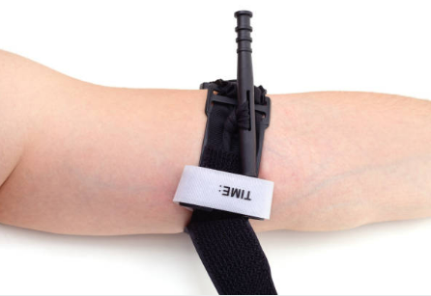
Notes:
What areas with bleeding are tricky to stop with direct pressure or a tourniquet?
Neck – airway issues
Wound over a displaced skull fracture – can cause brain tissue trauma
Areas a tourniquet will not fit around
Other examples
If you did need to control hemorrhage, what quick assessment can you do once bleeding is controlled to determine if you need to obtain IV access and initiate volume replacement?
Capillary refill, pulses, and skin color/temperature/moisture
If you notice significant alterations (very delayed capillary refill, thready and rapid pulses, or skin that is pale, cool, and diaphoretic) it might be necessary to replace volume. Otherwise, you can go on to assess Alertness and Airway.

Slide 5
Primary Survey
AVPU
Cervical stabilization as indicted
Bony deformity
Edema
Fluids
Foreign objects
Loose or missing teeth
Sounds
Tongue obstruction
Vocalization
Breath sounds
Depth, pattern, rate
Work of breathing
Open wounds/deformities
Skin color
Spontaneous breathing
Subcutaneous emphysema
Symmetrical chest rise
Capillary refill
Skin color, temperature, and moisture
Pulse
GCS
Pupils
Blood glucose if altered
Exposure
Environment
Image: Pixabay/Prawny
Notes:
Look at your Pediatric Nursing Process for Students.
What trauma-specific assessments, abnormalities, and interventions can you think of?
Airway edema from burns
When would you avoid a nasopharyngeal airway or nasogastric tube?
Any head or facial trauma, potential for basilar skull fracture and route of entry to the brain
Vented dressing for open chest wound
Tension pneumothorax (decompress)/pericardial tamponade (pericardiocentesis) – obstructive shock
Escharotomies for circumferential burns of the chest impairing chest expansion
Blood administration – 10 mL/kg
FAST exam for sources of internal hemorrhage
Pelvic binder, tranexamic acid for hemorrhage
Unequal pupils or decreased reactivity to light associated with increased intracranial pressure
Mannitol or hypertonic saline for increased intracranial pressure
Keep head midline for increased intracranial pressure
Considering the need for evidence collection when cutting off clothing
Does your facility have pediatric cervical collars or pelvic binders? What other options can you use?
How can you administer warmed blood to pediatric patients? Most rapid volume infusers that warm cannot be used on small children.

Slide 6
Volume Resuscitation in Trauma
Estimate volume of crystalloids administered prior to arrival
May be more appropriate to administer blood if immediately available
10 mL/kg
Burn resuscitation formulas
Start with 125, 250, or 500 mL/hr based on age
Then calculate based on TBSA burned
Half in the first 8 hours after the burn
Half in the remaining 16 hours
Titrate to urine output (0.5-1 mL/kg/hr based on ideal body weight)
Increase for dark, red-tinged urine
Consult with trauma center early

Slide 7
Adjuncts and Secondary Survey
Full set of vital signs
Family presence
Labs
Monitor
Naso- or orogastric tube
Oxygenation
Pain assessed and managed
History
Head-to-toe exam
Inspect the posterior
Image: Pixabay/Prawny
Notes:
What trauma-specific considerations can you think of?
Family presence – who is the assailant? Consider staff and patient safety while giving parents the benefit of the doubt.
Type and crossmatch for blood administration
Thromboelastography/thromboelastometry (TEG/ROTEM)
Escharotomies for circumferential burns of extremities with edema impairing circulation
Pain management vital to prevent the injury and/or medical treatment from becoming an adverse childhood experience (ACE)
When is ice appropriate? When is ice inappropriate?
Encouraged for minor trauma, danger of hypothermia with major trauma (trauma triad of death)
What if you discover an impaled object at any point – what do you do with it?
Risk of hemorrhage - stabilize, do not remove, wait until the patient is in a controlled surgical environment.
What would make you hesitant to turn a patient to inspect the posterior?
Any movement can cause hemorrhage from an unstable pelvis or worsen spinal cord injury.
What are the options where you work for moving the patient as safely as possible?

Slide 8
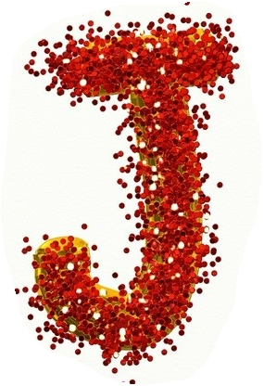
Just Keep Reevaluating
What interventions or diagnostics do you anticipate for this patient?
What findings will you continue to reevaluate while the patient is in your care?
What is the definitive care for this patient?
Image: Pixabay/Prawny
Notes:
Significantly injured children will require admission or transfer to a pediatric trauma center. What are the resources in your area?
How do your physicians or advanced practice providers determine what imaging will be performed?
Consult with pediatric radiologists
Consult with tertiary pediatric facility
What kind of injuries would make you suspicious for child maltreatment? How do you report your suspicions?
Frenulum tear in young infants (tissue connecting upper lip to upper gum can be caused by forceful bottle feeding or pacifier placement, rubbing/striking upper lip)
TEN-4 (Torso, ears, neck in children younger than 4 years or 4 months)
FACES-P (frenulum, angle of the jaw/auricular area [ear], cheek, eyelid, subconjunctivae, and patterned injuries)
Bruises, marks, scars in patterns
Bruises in nonambulating child
Subconjunctival hemorrhage

Slide 9
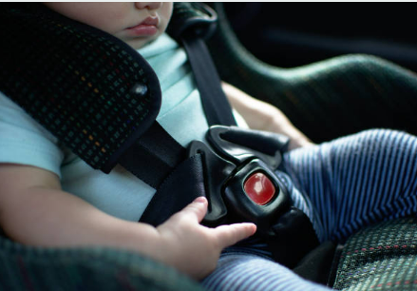
Notes:
Many of these children will be discharged. If a child’s car seat was damaged in a motor vehicle collision, what do you do?
Some facilities will cut the straps so the car seat cannot be used. This is not always necessary and the nurse must ensure there is a replacement car seat available for the child’s trip home.
Be familiar with regional resources and car seat laws.

Slide 10
Notes:
Health promotion and injury prevention can be interwoven into many patient interactions and can be re-emphasized with the discharge instructions.
What injury prevention resources or initiatives are you familiar with?
Tertiary pediatric facilities
ENA Councils/Chapters
Local health departments
Safe sleep
Graduated return to play protocol after head trauma
Preventing Window Falls
Firearm injury prevention

