Slide 1
How Your Brain Drives Addiction (Biology of Craving and Withdrawal)
The Recovery Research Network
110 John F Kennedy Drive Suite 118 Lake Worth Florida 33462
Office: (561) 812 – 2000 info@TRRN.org www.TRRN.org
© 2017 The Recovery Research Network

Slide 2
Addiction is a Chronic Brain Disease
Often times you will hear addiction referred to as a chronic brain disease, but do you really understand what that means?
Do you really understand why you or your loved one continues to struggle with drug use in the face of all the negative consequences?
The Recovery Research Network wants to help you begin to understand how your brain can continue to drive drug use, even when you are battling to stop the use and find your recovery.
© 2017 The Recovery Research Network

Slide 3
Although many drugs cause craving and withdrawal after repetitive use, we will be focusing on the example of opioids (Heroin, Vicodin, Oxycontin, etc.) for this discussion.
It is worth noting that many drugs of abuse effect the same brain regions and produce similar effects on the brain.
This is why removing the drug of abuse is an important first step in recovery, but does not “cure” the disease.
© 2017 The Recovery Research Network

Slide 4
Opioids and the Brain
Opioids (Heroin, Vicodin, Oxycontin, etc.) attach to specific sites (AKA receptors) in the brain called mu-opioid receptors
When opioids attach and activate these mu-opioid receptors, it causes a pleasure response (euphoria)
Repeated opioid attachment and activation of these mu-opioid receptors creates tolerance (more drug needed to get the same effect)
Absence of opioids attaching and activating the mu-opioid receptors after prolonged use will lead to craving & withdrawal
© 2017 The Recovery Research Network
Notes:
Here are a few basic facts about opioids and how they affect the brain.
Opioids bind to receptors in the brain that are specifically designed for them.
Once opioids bind to these receptors, they cause an intense euphoric rush, which is experienced as extremely pleasurable.
With repeated administration of the drug, the body begins to adapt, and tolerance develops. This means that it requires more of the drug to get the same affect and withdrawal occurs if the amount of use is decreased or stopped.
It is important to emphasize that the presence of tolerance or withdrawal is not enough to say that someone is addicted to the drug. Addiction requires continued use in spite of negative consequences resulting from use. Physical dependence may or may not be present.

Slide 5
How is Substance Use Disorder Diagnosed?
To diagnose any Substance Use Disorder, there is a diagnostic tool called the Diagnostic and Statistical Manual of Mental Disorders – 5 (DSM-5).
This manual reviews a patient’s substance use across 11 different criteria, and is able to rate a patient as having a Mild, Moderate, or Severe form of Substance Use Disorder.
Meeting the criteria for Substance Use Disorder:
2-3 criteria = Mild
4-5 criteria = Moderate
6-7 criteria = Severe
© 2017 The Recovery Research Network

Slide 6
DSM-5: Opioid Use Disorder Criteria
A problematic pattern of opioid use leading to clinically significant impairment or distress, as manifested by at least two of the following, occurring within a 12-month period:
1. Opioids are often taken in larger amounts or over a longer period than was intended.
2. There is a persistent desire or unsuccessful efforts to cut down or control opioid use.
3. A great deal of time is spent in activities necessary to obtain the opioid, use the opioid, or recover from its effects.
4. Craving, or a strong desire or urge to use opioids.
5. Recurrent opioid use resulting in a failure to fulfill major role obligations at work, school, or home.
6. Continued opioid use despite having persistent or recurrent social or interpersonal problems caused or exacerbated by the effects of opioids.
7. Important social, occupational, or recreational activities are given up or reduced because of opioid use.
8. Recurrent opioid use in situations in which it is physically hazardous.
9. Continued opioid use despite knowledge of having a persistent or recurrent physical or psychological problem that is likely to have been caused or exacerbated by the substance.
10. *Tolerance, as defined by either of the following:
a. A need for markedly increased amounts of opioids to achieve intoxication or desired effect.
b. A markedly diminished effect with continued use of the same amount of an opioid.
11. *Withdrawal, as manifested by either of the following:
a. The characteristic opioid withdrawal syndrome (refer to Criteria A and B of the criteria set for opioid withdrawal).
b. Opioids (or a closely related substance) are taken to relieve or avoid withdrawal symptoms.
* Note: This criterion is not considered to be met for those taking opioids solely under appropriate medical supervision.
© 2017 The Recovery Research Network

Slide 7
Understanding How the Brain Works
We will be zooming in on the brain to look at how the different brain regions communicate with each other under normal and addictive states.
The names of brain regions and chemicals can be confusing and distracting, so don’t focus on the specific names, think about the overall process involved and how it may impact you emotionally or drive your behavior.
In the first part of our discussion we will be discussing how opioids can affect two chemicals
GABA – Acts as a “brake” to slow down brain activity
Dopamine – A chemical that gives you a feeling of pleasure or euphoria
© 2017 The Recovery Research Network

Slide 8
Craving & Withdrawal
In this discussion we will focus on two relevant symptoms that occur with addiction, craving and withdrawal. We want to begin to describe how and why the brain drives these symptoms and continued drug use.
Craving
Brain changes (Neurochemical adaptation)
Triggers & Cues (Conditioned drug associations/memories)
Stress coping is affected
Brain regions: Ventral Tegmental Area (VTA) & Nucleus Accumbens (NA)
Withdrawal
Brain changes (Neurochemical adaptation)
Specific withdrawal symptoms commonly seen when drug of abuse is no longer in the body
Brain region: Locus Coeruleus (LC)
© 2017 The Recovery Research Network
Notes:
j

Slide 9
Brain Regions & Craving
Ventral tegmental area (VTA) & Nucleus accumbens (NA):
Brain cells (neurons) that are in the VTA (red circle in image) use dopamine (a brain chemical) to “talk” to the NA (green circle in image). These brain regions are part of a system call the “Reward System.”
The Brain’s Reward System:
The brain normally uses this system to “reward” life sustaining behavior (when thirsty you drink, when hungry you eat). The reward that is used is dopamine (DA). DA is used to “reward” the brain to drive life sustaining behaviors.
© 2017 The Recovery Research Network

Slide 10
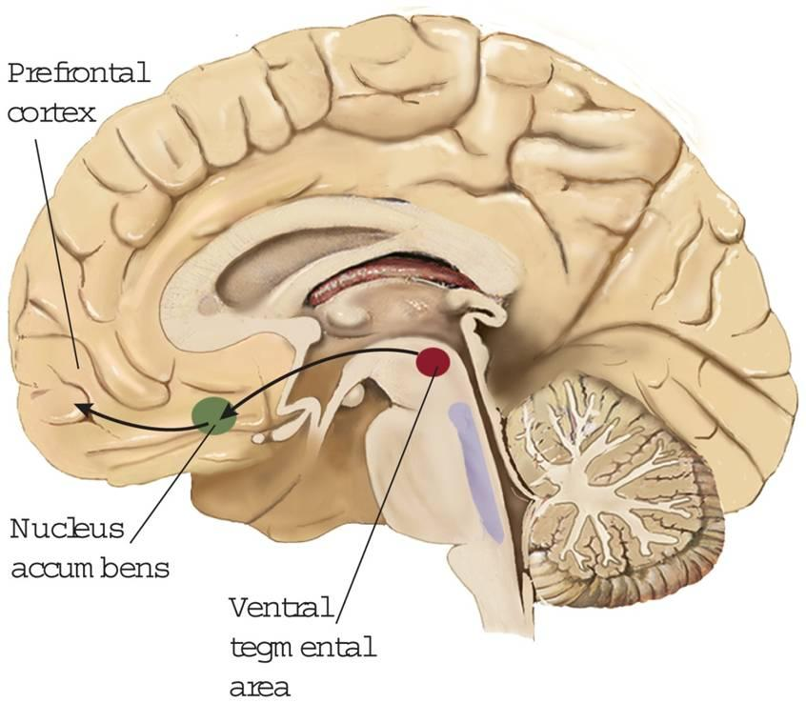
Zooming in on The Reward System….
We will be looking at how the
Ventral tegmental area (VTA)
talks to the
Nucleus accumbens (NA).
Lets zoom in on the area contained in the yellow box….
© 2017 The Recovery Research Network

Slide 11
The Brain’s Natural Reward System
GABA
(“brake”)
The major pathway associated with the brain’s reward system is the dopamine neurons. Dopamine (DA) is used by the brain to “reward” behavior that the brain sees as life sustaining.
In this image, GABA acts as a “brake” to block or slow the release of dopamine (DA). At rest, you have little dopamine being released.
G
mu-opioid receptor
G
GABA receptor
DA
DA
“Brake” to slow
DA release
DA
DA
Dopamine
receptor
DA
Ventral Tagmental Area
(VTA)
Nucleus Accumbens
(NA)
© 2017 The Recovery Research Network

Slide 12
Natural Rewarding Behavior
GABA
(“brake”)
Under natural rewarding behavior (ex. “Runner’s High”), activation of the mu-opioid receptor, by the body’s natural chemicals (endorphins), blocks the release of GABA. This removes the “brake,” allowing for release of dopamine (DA). You experience this as pleasure or euphoria.
This is the body’s natural reward process to encourage repeating this behavior in the future.
Endorphin
G
mu-opioid receptor
G
“Brake” is gone!
DA
DA
DA
DA
Reward!
DA
DA
DA
DA
Ventral Tagmental Area
(VTA)
Nucleus Accumbens
(NA)
© 2017 The Recovery Research Network

Slide 13
Addictive Opioid Use
GABA
(“brake”)
Using the brain’s natural reward system, opioid use generates a pleasure or euphoric response 2-10 fold higher than what is typically achieved under naturally rewarding conditions (like in the example of “runner’s high”.
Opioid (Heroin)
G
mu-opioid receptor
G
“Brake” is gone!
DA
DA
DA
DA
DA
DA
EUPHORIA!
DA
DA
DA
DA
DA
DA
Ventral Tagmental Area
(VTA)
Nucleus Accumbens
(NA)
© 2017 The Recovery Research Network

Slide 14
Repetitive Opioid Use and Craving
GABA
(“brake”)
Endorphin
With repeated use of opioids, changes in the brain’s reward system leads to increased GABA release (increased brake) to off-set the enhanced DA release that the body has gotten from the opioid use.
The brain is unable to respond “normally” to the body’s natural chemicals (endorphins). This leads to craving, which is the brain’s way of saying, “I don’t feel normal, I need opioids to survive!”
G
G
G
mu-opioid receptor
G
G
G
G
G
G
The “Brake” is
slammed on!
DA
CRAVING!
DA
DA
No normal
dopamine release
DA
Ventral Tagmental Area
(VTA)
Nucleus Accumbens
(NA)
© 2017 The Recovery Research Network

Slide 15
Repetitive & Addictive Opioid Use
GABA
(“brake”)
Opioid (Heroin)
With repeated opioid use, changes in the brain’s reward system leads to increased GABA release (increased brake) to off-set the enhanced DA release that the body has gotten from the opioid use.
Increased amounts of opioids are needed to drive a release of dopamine (DA), so that you can feel normal and satisfy the drug craving.
G
G
G
mu-opioid receptor
NO BRAKES!
DA
DA
DA
DA
DA
FEEL
NORMAL!
DA
DA
DA
DA
DA
DA
Large DA release
DA
Ventral Tagmental Area
(VTA)
Nucleus Accumbens
(NA)
© 2017 The Recovery Research Network

Slide 16
Buprenorphine Reduces Craving?
GABA
(“brake”)
G
B
Buprenorphine
As we saw, repeated opioid use leads to changes in the brain’s reward system, which in turn leads to increased GABA release (increased brake) to off-set the enhanced DA release:
The brain has an unconscious drive to seek and use opioids to drive the dopamine (DA) response. This is part of the brain’s survival mechanism.
Buprenorphine is able to support dopamine (DA) release and quiet the reward systems drive. This helps to reestablish proper brain activity and prevents craving.
G
G
mu-opioid receptor
G
G
G
G
G
G
DA
DA
DA
Anti-
craving
DA
DA
DA
DA
DA
© 2017 The Recovery Research Network

Slide 17
Summary of Opioid Craving
Craving from addiction is in part a response to the brain and body’s drive to feel normal.
Substances of abuse take advantage of the brain’s natural “reward system” and highjack the dopamine, which causes changes in brain chemistry and imbalance.
Buprenorphine is a medication that is able to regulate the opioid system and re-establish some stability within the dopamine system to reduce and/or eliminate craving.
© 2017 The Recovery Research Network

Slide 18
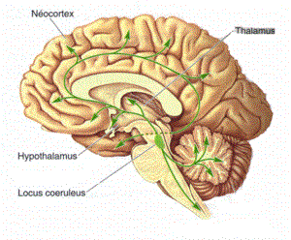
Brain Regions & Withdrawal
Locus Coeruleus (LC):
Changes to the norepinephrine (NE) (brain chemical) system in the locus coeruleus (LC) (red box) can lead to withdrawal symptoms
Typical Functions of norepinephrine (NE) in the locus coeruleus (LC):
Wakefulness
Breathing
Blood pressure
Alertness
LOCUS COERULEUS (LC)
© 2017 The Recovery Research Network

Slide 19
Normal Brain Activity
Endorphin
The brain uses the chemical, norepinephrine (NE) to drive normal regulatory processes:
Wakefulness
Breathing
Blood pressure
Alertness
Activation of the mu-opioid receptor by the body’s natural chemicals (endorphins) can control norepinephrine (NE) release by acting as a “brake,” blocking, slowing, or regulating norepinephrine release.
“Brake” to
regulate NE release
mu-opioid receptor
NE
NE
NE
NE
NE
NE
NE
Normal
Activity
NE
Locus Coeruleus
© 2017 The Recovery Research Network

Slide 20
Addictive Opioid Use
Opioid (Heroin)
Under conditions of opioid use (Vicodin, Oxycontin, Heroin, etc.), there is an increase in mu-opioid receptor activation. This activation acts as a hard “brake” to reduce the release of norepinephrine (NE).
This leads to the typical biological effects of opioids:
Drowsiness
Slowed breathing
Low blood pressure
Reduced alertness
Hard “Brake” that
reduces NE release
mu-opioid receptor
NE
NE
NE
NE
NE
NE
Reduced Activation
Locus Coeruleus
© 2017 The Recovery Research Network

Slide 21
Brain Driving Withdrawal
mu-opioid receptor
When the addictive opioid is no longer available in the brain, the “brake” on norepinephrine (NE) release is no longer present. This leads to bulk release of norepinephrine (NE) and thus withdrawal symptoms emerge:
Anxiety
Muscle cramps
Nausea/Vomiting
Diarrhea
Etc.
NE
NE
NE
NE
NE
NE
NE
NE
NE
Withdrawal
Symptoms
NE
NE
NE
Locus Coeruleus
© 2017 The Recovery Research Network

Slide 22
Repeated Opioid Use
Opioid (Heroin)
With repeated use of opioids the brain’s norepinephrine (NE) system changes to help restore proper biological function. This occurs as the brain compensates for the “opioid break” on the release of norepinephrine (NE). The brain increases its production of norepinephrine, so the body can feel normal; however, this only happens when the opioid is present.
A new baseline is established, so that the individual only feels “normal” when the opioid of abuse is present. Otherwise, the individual feels the withdrawal symptoms due to the increased norepinephrine (NE).
Opioid is needed
to “brake” NE release
mu-opioid receptor
NE
NE
NE
NE
NE
NE
NE
Feel
Normal
NE
Locus Coeruleus
© 2017 The Recovery Research Network

Slide 23
Buprenorphine Reduces Withdrawal
B
Buprenorphine
“Taps the brake” to reduce
the excess NE release
Buprenorphine is able to activate mu-opioid receptors in the Locus Coeruleus to reduce the norepinephrine (NE) release, thus eliminating the withdrawal symptoms. This allows the norepinephrine (NE) system to re-equilibrate overtime.
mu-opioid receptor
NE
NE
NE
NE
NE
NE
NE
Enhanced NE release:
NE
Withdrawal
Symptoms
Basal NE activity:
NE
Feel
Normal
Wakefulness
Breathing
Blood pressure
Alertness
NE
Anxiety
Muscle cramps
Nausea/Vomiting
Diarrhea
Etc.
NE
NE
Locus Coeruleus
© 2017 The Recovery Research Network

Slide 24
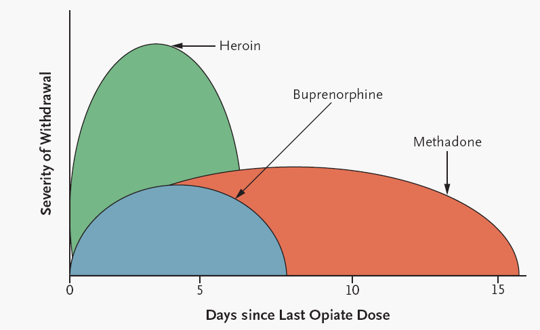
Acute Withdrawal Severity & Duration
Not all opioids are equal (Short vs. Long-Acting Opioids)
Kosten & O’Connor N. Eng J. Med. 2003;348(18):1786-1795.
© 2017 The Recovery Research Network

Slide 25
Summary of Opioid Withdrawal
Withdrawal is a response to your body being dependent on a substance of abuse
Your brain chemistry is altered in order for you to “feel normal” when substances of abuse are present in your system.
When the substance of abuse is no longer in your system, you can experience “dope sickness” or withdrawal. This is due to the excess norepinephrine that your brain produces to compensate for the exposure to the substance of abuse.
Buprenorphine is a medication that can stabilize the norepinephrine overdrive, and reduce and/or eliminate withdrawal symptoms.
© 2017 The Recovery Research Network

Slide 26
The Recovery Research Network
110 John F Kennedy Drive, Suite 118
Lake Work, Florida 33462
Office: (561) 812 – 2000
info@TRRN.org
www.TRRN.org
© 2017 The Recovery Research Network

