Slide 1
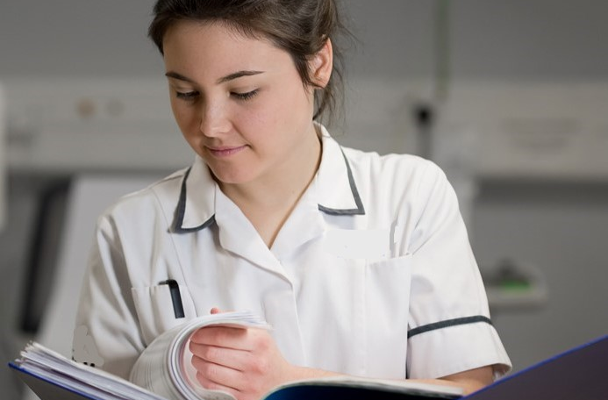
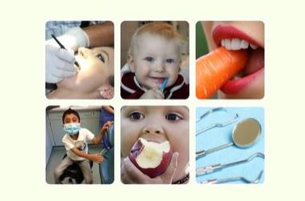
Healthy Living Dentistry
Training for the Primary Care Dental Team
Notes:
Welcome everyone, thank you for attending the briefing on implementing healthy living dentistry in our practice.

Slide 2
Sign the register
Participants must register by adding their full name and GDC number to the registration sheet for the following reasons:
To evidence team participation in Healthy Living Dentistry (HLD)
To evidence attendance for eCPD
Notes:
Please ensure you have all put your details on this form so I can update this on-line to evidence everybody's attendance and participation in the HLD programme.

Slide 3
Learning Outcome
Aim: Ensure the whole team contributes to the achievement of HLD
Objectives:
At the end of the session the participants will be able to:
State the benefits of HLD for the practice, team and patients
Recognise the requirements to fulfil Level 1 & Level 2
Contribute to the development of the practice action plan
Participate in HLD through participating, implementing the toolkits and delivery of campaigns
Learning Outcome:
Team members will actively contribute towards achievement of Healthy Living Dentistry status
GDC Development: B & D
Notes:
Read through and discuss

Slide 4
What is Healthy Living Dentistry?
Quality framework that brings together all the toolkits
Improves the health and wellbeing of patients
Acknowledges work you have already done
Develops the dental team
Builds on success in Wigan and of Healthy Living Pharmacy & first waves of HLD in GM
Notes:
HLD is about teamwork, yes, the lead and champion have specific roles to undertake but it is for the whole dental team to be involved, contribute to and have that investment in so everyone can benefit.
This programme of work is the future of dentistry not just something that is undertaken once and then its done, it should become embedded within the ethos of our dental practice and team.

Slide 5
Benefits for patients and public
Improved quality of care
Identifies health risk factors and opportunities to improve health
Advice and support provided to address wider health needs
Healthcare more joined up and seamless
Greater partnership working across local authorities, NHS, dental practices and primary care locally
Notes:
As the team the question ‘what do they think the benefits are or Read through and add any others you and the team can think of.

Slide 6
Benefits for practice
Quality marker for practice
Recognises what you are already doing
Training and team development
Access to useful resources
Evidence for CQC
Evidence for commissioners of health improvement and engagement
Builds links with other health providers and local care organisations
Notes:
You can either read through or ask your team what they think the benefits to the practice or if there are any others you and the team can think of and would like to add

Slide 7
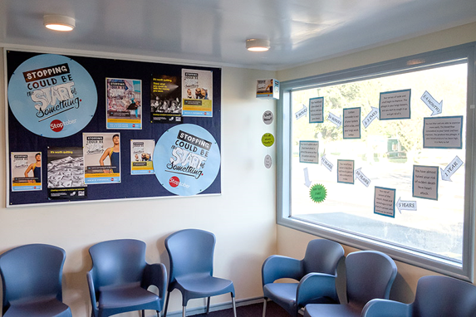
Achieving Healthy Living Dentistry – Level 1
Meet GDC and CQC requirements
HLD lead and champion - introduction training
HLD Champion – DBOH & RSPH level 2 course
Run six campaigns per year (Very brief advice and signposting)
Monitor interactions and evaluate uptake
Submit action plan
Notes:
It is necessary to plan, implement and have evidence of at least one campaign to achieve level 1 all of the 6 campaigns must at least be planned with set dates as well.
A new action plan should be planned every year and submitted to dental@cpgmhealthcare.co.uk

Slide 8
Achieving Healthy Living Dentistry
Healthy Living Dentistry - who does what?
HLD Lead
HLD Champion
Leadership of HLD in practice (Dentist or PM)
Leads HLD by:
Delivering in house training to the practice team
Works with the team to develop the action plan
Supporting the HLD Champion
Ensuring toolkits and campaigns are implemented
Networks with other leads
Dental nurse, Receptionist or PM
Supports the HLD lead to deliver the in house training
Undertakes the e-learning and RSPH qualification
Completes champion training
Supports the HLD lead in the development of the action plan
Networks with other HLD champions
Notes:
To clarify the roles but to also inform the rest of the dental team of the roles , also stress the importance of everybody’s role in embedding HLD into the practice.

Slide 9
Achieving Healthy Living Dentistry
The team are expected to:
Support the HLD Lead and Champion
Participate in all practice training
Read and adopt all the toolkits
Implement best practice and evidenced based prevention and treatment pathways
Actively engage in Making Every Contact Count
Support the delivery of campaigns
Notes:
This is what we are all expected to do in terms of achieving Healthy Living Dentistry, we will cover these in the training that we undertake throughout this process.

Slide 10
Activity 1 – Let’s discuss
Subtitle – Arial 32
Body text – Arial 24
How will our practice benefit from Healthy Living Dentistry?
How will we measure impact in the practice?
Time allocation: 5 mins
Notes:
It is advisable notes are taken by a member of the team in terms of measuring impact

Slide 11
Developing our action plan
Level 1 Requirements | What needs to be done | Evidence needed | Evidence check
All staff are aware of health needs of local community and have a plan to address this | Oral health lead & champion attend HLD training session | Record of HEE training – both certificates emailed to dental@cpgmhealthcare.co.uk
 | Briefing of staff at team meeting. Share resources. | Notes of meeting, yearly action plan for practices to be submitted, copies emailed to dental@cpgmhealthcare.co.uk
A HLD champion is in place and trained | Online training & face to face training sessions | Record of RSPH certificate, emailed to dental@cpgmhealthcare.co.uk
Fluoride varnish | Rate for last 12 months Target for next 12 months | Figure for last year’s rate and agreement on target for next year __ % (please insert figure). Letter from Compass emailed to dental@cpgmhealthcare.co.uk
Evidence of campaigns | One campaign planned completed and evidence sent along with and all 6 planning sheets for the year to be emailed with action plan | Photo, a line or two about what was done, tally chart, case study. Please email over to dental@cpgmhealthcare.co.uk
Baby Teeth Do Matter | E-Learning | Email certificate to cpgm@healthcare.co.uk
Pledge to encourage dental checks by 1 and welcome children into the practice. | Verbal agreement
Notes:
We all need to be aware of this document, its my responsibility as lead to write this but would appreciate contributions from the champion and the rest of the team to achieve the outcomes.
We will need to come together in-terms of campaign planning and we will have a look at some examples of completed action plans and campaign planning in the next few slides.

Slide 12
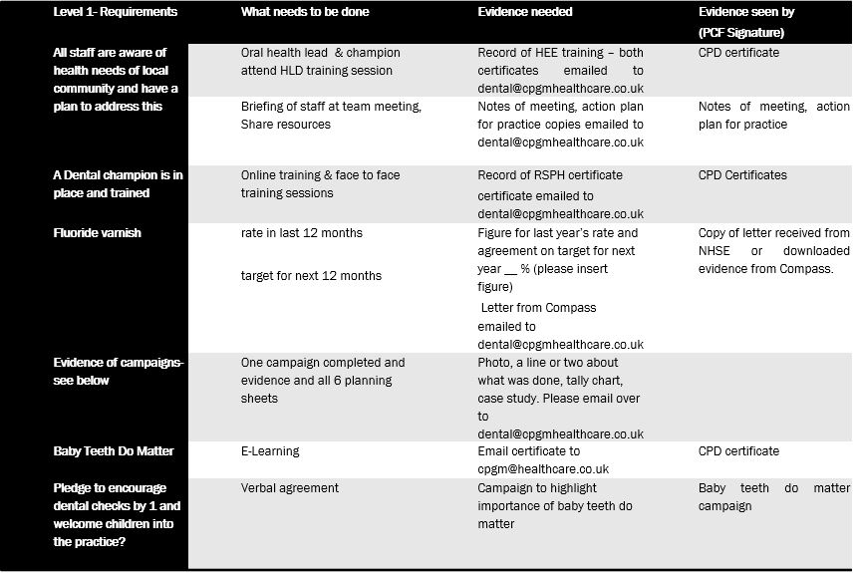
Level 1
Notes:
Read through slide and ask –are there any other suggestions /ideas of examples of evidence

Slide 13
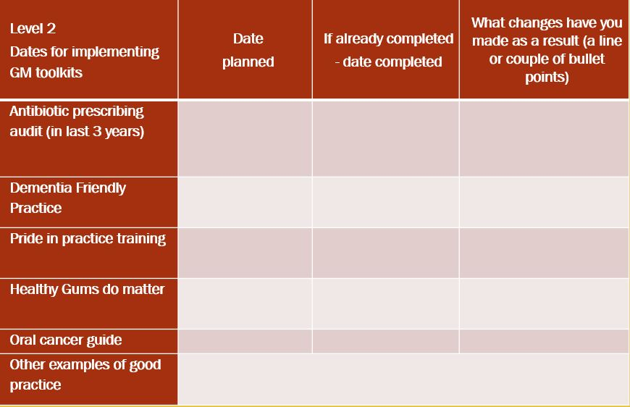
Level 2
Notes:
To achieve level 2 outline what your plans are to complete the LDN toolkits- put in some dates over the next year. If you have already done the training recently put in the date and what you have done as a result.
Once you have completed these aspects you can send in all the information and accompanying evidence to dental@cpgmhealthcare.co.uk

Slide 14
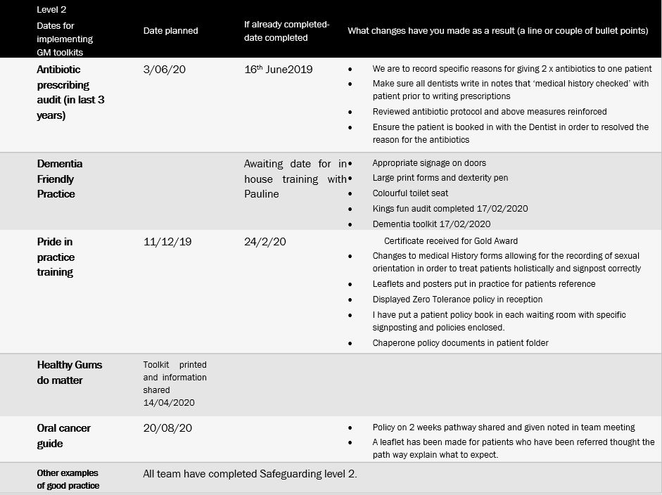
Notes:
Further examples of changes made to practice for the listed toolkits.

Slide 15
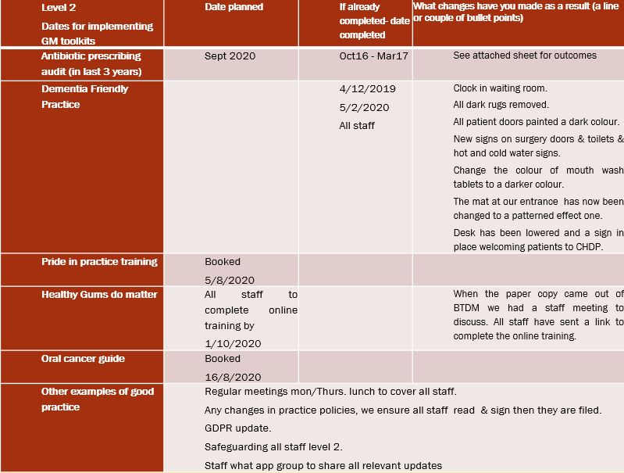
Level 2- outline what your plans are to complete the LDN toolkits- put in some dates over the next year. If you have already done the training recently put in the date and what you have done as a result.
Notes:
Consider and discuss

Slide 16
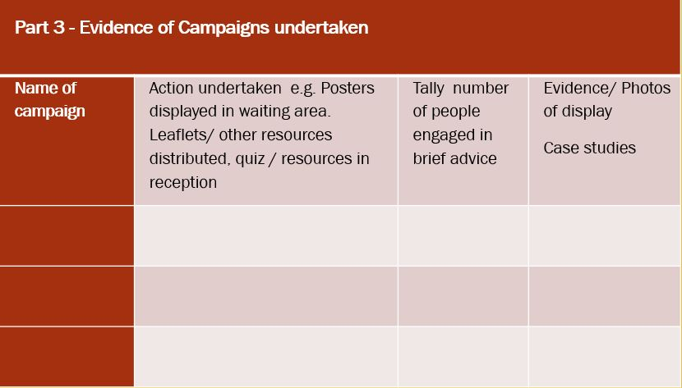
HLD Plan – part 3
Notes:
To achieve level 1 all 6 campaigns must be planned and recorded on this document with dates they are to be implemented, only 1 campaign must be implemented and evidenced to achieve level 1.
To achieve level 2 along with all the toolkit implementation all 6 campaigns must be completed and evidenced before level 2 award can be achieved.

Slide 17
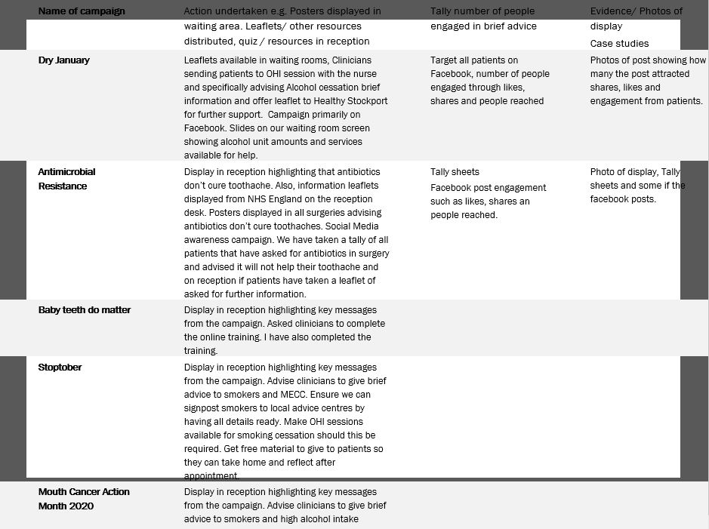
Part 3- Evidence of Campaigns undertaken
Notes:
Discuss

Slide 18
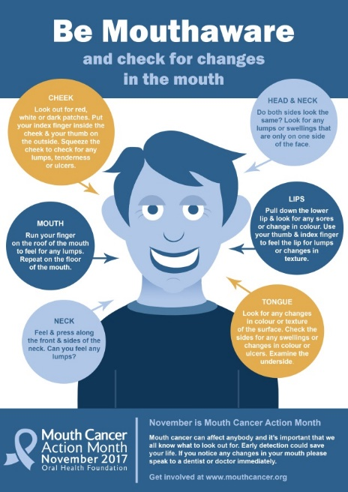
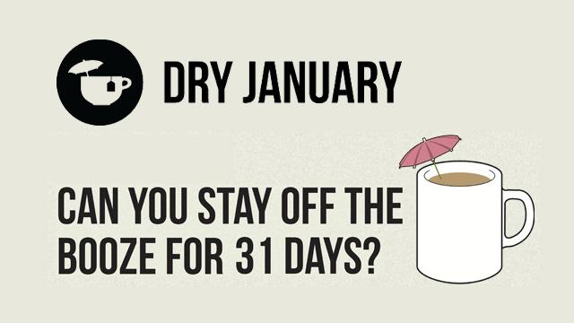
Campaigns to run over the year
Notes:
Often campaigns and displays are used interchangably thinking that a display is a campaign. A display can be one aspect of a campaign but that’s not everything.
A health campaign attempts to promote public health by making new health interventions available.
Campaigns are used to raise awareness of important health issues and stimulate groups or individuals to seek information and services through any increase in knowledge, people can over time change attitudes and longer term particularly when other interventions are used change their behaviours.
Campaigns can be placed on social media platforms and promoted away from the clinical enviroment and can be used as a conversation opener to ask if the patient saw the campaign and asking them what they thought about it , opening up that opportunistic health conversation ( Making Every Contact Count).

Slide 19
Campaigns - Preparation and delivery dates
Dry January /Alcohol Prep December order resources from https://alcoholchange.org.uk/getinvolved/campaigns/ dry-january/get-involved/your-dry-january-resources | National Smile Month – Top Tips for Teeth or Sugar Swap Prep April and order your resources from https://campaignresources.phe.gov.uk/resources/ campaigns/69-top-tips-for-teeth
Fizz Free February Prep January and order resources from https://www.sugarsmartuk.org/resources/files/ FFF_Guidance_for_Comms_Campaign.pdf | Stoptober Prep August/September and order resources from https://www.nhs.uk/better-health/quit-smoking/ https://ukpublichealthnetwork.org.uk/events/ stoptober-2021-10-01/
ONE YOU Prep January and order resources from https://campaignresources.phe.gov.uk/resources /campaigns/44-one-you | Mouth Cancer Awareness Month Prep September https://www.mouthcancerfoundation.org/sites/ mcfdev/files/body/PDFs/mcf-action-month-poster.pdf
Drymester Prep March and order resources from https://www.drymester.org.uk/categories/drymester-resources/ | Keep Antibiotics Working Ongoing https://campaignresources.phe.gov.uk/resources/ campaigns/58-keep-antibiotics-working/resources
Notes:
Preparation is so important and the more organised we are the more likely we are to get free resources to promote the campaigns.
This calendar should be up in the staff room so we can start the planning for each campaign early

Slide 20
HLD Campaign Display - Example from a GM dental practice
Notes:
Example

Slide 21
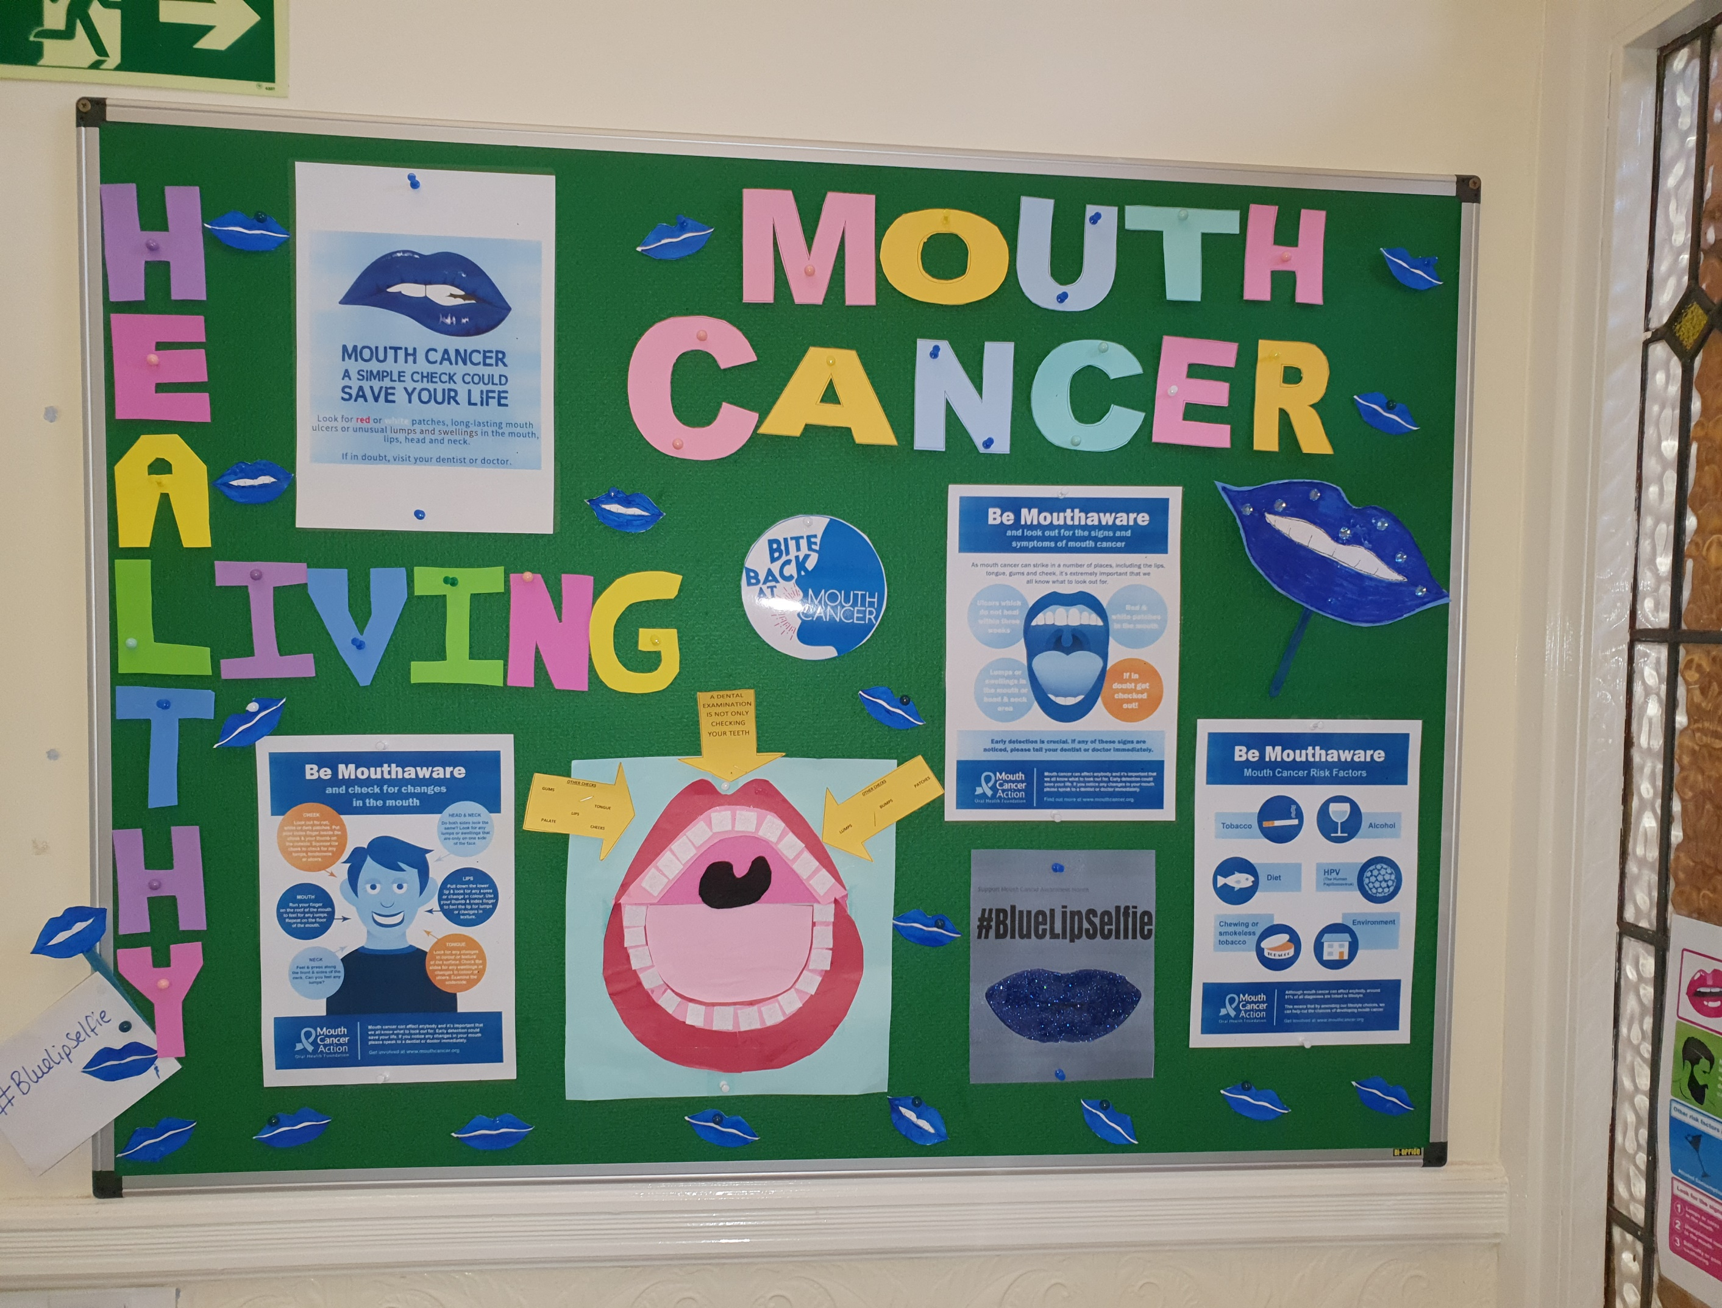
HLD Campaign Display - example from a GM dental practice
Notes:
Example

Slide 22
Activity – write your practice action plan
Having looked at the examples as guidance, let's have a look at planning this together
What if anything have we achieved already?
Let's consider how we might implement some of the campaigns, social media possibly or display and MECC?
Notes:
Lets draft this plan together and lets discuss aspects of it that people may be willing to take on or lead on.
When we have drafted the action plan we can then consider actually planning a campaign

Slide 23
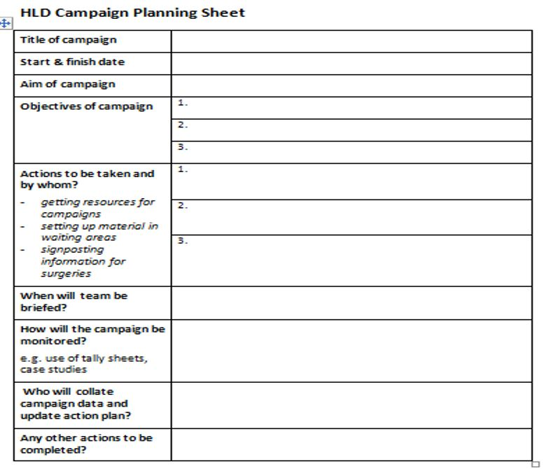
Notes:
The Aim is a general statement of intent, overall goal of what you would like to achieve
The objectives for a campaign are what you want the practice/ staff to achieve/do so the campaign becomes active/implemented. We can then measure success and observe if its been completed.
Use your HLD calendar when planning campaigns.
A planning sheet must be completed for every campaign undertaken.

Slide 24
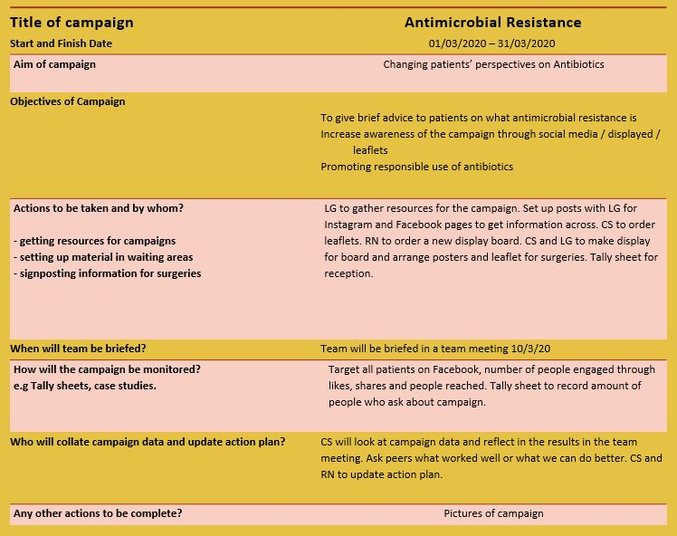
HLD Planning Sheet
Notes:
This is an example of one from a practice who has already achieved level 1.
Read and discuss

Slide 25
Delivering your campaign
INVOLVMENT OF THE HLD TEAM
Has the team been briefed?
Have referral pathways been implemented ?
EARLY CHECK
Is it all going to plan?
Get early feedback and change actions if necessary
Check monitoring sheets are being used by all the team
PLAN YOUR EVALUATION NOW
How will you collect data on numbers engaged? (tally sheet)
How will you get team feedback? (feedback sheet)
Notes:
Read and discuss

Slide 26
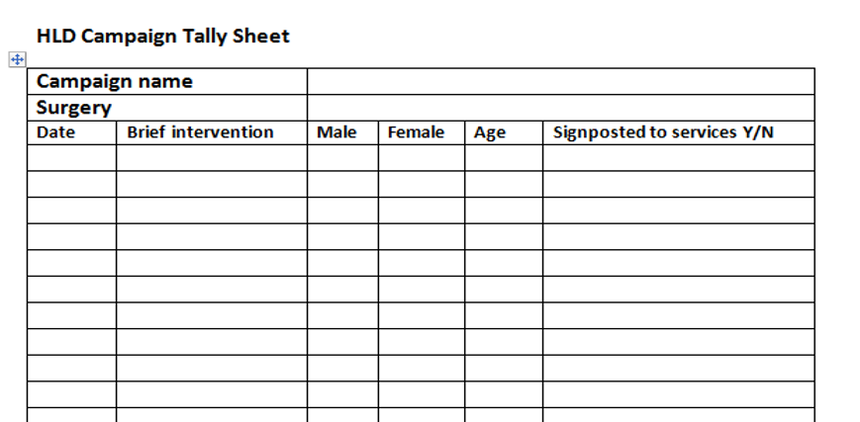
Tally Sheet
Notes:
This is the form to complete showing monitoring of the campaigns and will be part of the evidence provided.

Slide 27
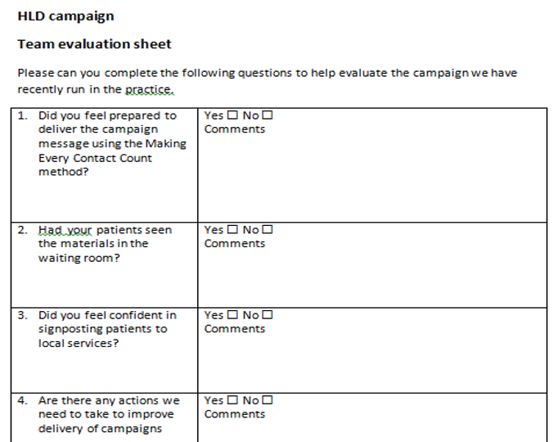
Team feedback
Notes:
Reflection and team feedback is very important, part of the process of getting ready for a campaign is that all members of the team are informed on every aspect of the planning. How all this is communicated should be considered at the planning stage.

Slide 28
Evaluate your campaign
PURPOSE OF EVALUATION
Involvement of the whole team
To celebrate achievements
To ensure future learning, use team feedback to learn and improve
To complete HLD programme evidence returns to
MONITORING
Use simple tally sheets to collect data on numbers engaged
Review team evaluation feedback
Notes:
Self reflection is also a useful tool, we evaluate everything we do so improvements/adjustments can be made. Nothing is ever perfect but we need to know was it effective the way it was done, must evaluate to answer this, did we have the desired impact we set out to achieve?

Slide 29
Support for our practice
Training programme for health champions
Advice on training and education for the team from HEE dwt@hee.nhs.uk
Network of champions - sharing ideas
Regular updates - access to training, campaign resources
Support on queries with action planning vicky.brand@mft.nhs.uk
Healthy Living Dentistry website http://www.cpgmhealthcare.co.uk/dental.html
Notes:
Our dental champion will complete further training including a qualification in health promotion.
Please familiarise yourselfs with the HLD website.
Can you all ensure you have registered with MAXCOURSE which allows us all to access further training whch is available with Health Education England and will be accredited so provides eCPD
We can get further support and queries with this as well.
The champion will be able to attend the bi-monthly support network for champions which will provide updates and speakers on a variety of topics and this can then be disseminated to the rest of the team.

Slide 30
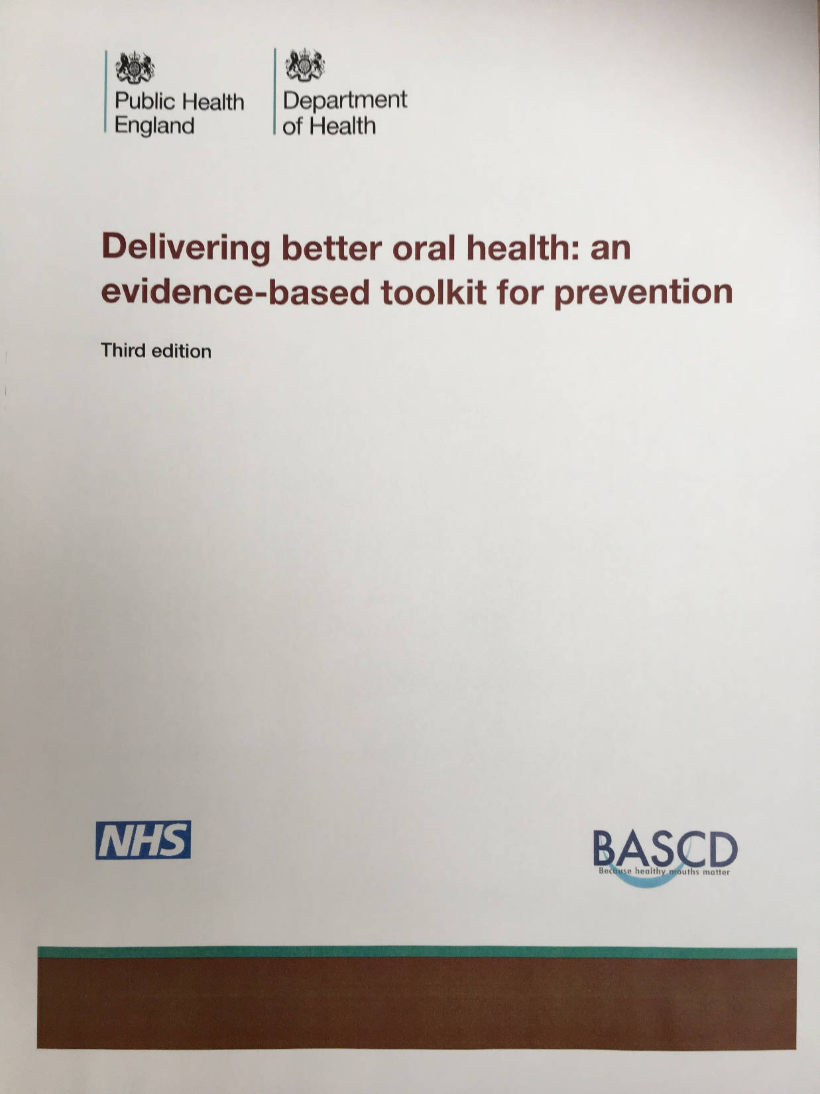
Toolkits - Delivering Better Oral Health:
Why did the toolkit come about?
Who is it for?
What are the contents?
https://www.gov.uk/government/publications/delivering-better-oral-health-an-evidence-based-toolkit-for-prevention
Notes:
This document was orginally put togther in 2007 and has been updated three times since then, The latest edition (4th ) was launched 21st September 2021. It serves to provide all those working in any aspect of oral health care with evidenced based clinical and prevention guidance to support all patients regardless of risk. It came about because many dental teams and non-clinical professionals wanted clear guidance on the advice they should give and the actions they should take to ensure prevention of poor oral health and poor general health.
There is emphasis on prevention to ensure health inequalities are reduced by giving advice and provision of support to change behaviuor and provision for the opportunity to provide informed choice and informed actions.
The document provides us with
Simple messages
Concise advice
Evidence based with strength of evidence
Practical and easy to use
Good reference tool
Links oral health with general health and well-being
Standards
The most important thing is its no good that we have this document on a shelf in the staff room and have a little knowledge of it, we all must know the contents, the key messages must be delivered in practice to ensure consistent evidence-based messages and preventative care is standard across the dental practice.

Slide 31
Toolkit - OCC:
Notes:
We are all aware that the prevention, early detection , referral and on-going care of patients with cancer and oral cancer is extremly important. As a dental team we should ensure this toolkit is embedded within the practice of the whole dental team.
We have a role to ensure screening for all adult patients and refer any patients with a suspecious lesion through a 2 week referral pathway. Our patients must be reassured and supported during the investigative process.
I would like you all to look through this document and familarise yourself with it and identify your roles within this. We will then deliver some in-house training following an update on Oral Cancer from Health Education England. This is to ensure this toolkit becomes standard practice for us all.
The toolkit is downloadable from the HLD website www.cpgmhealthcare.co.uk

Slide 32
Toolkit - DFD:
Notes:
As we know the UK population is changing with people living longer , not only living longer but living with more complex oral health needs and treatment requirements.
The number of people with dementia is also increasing and is set to increase by 40% to over 1 million people living with dementia by 2025.
As a dental profession we need to be prepared for this so we are competent to care for the needs of patients with dementia, this toolkit of best practice will provide us with guidance on accurate prevention advice and help with appropriate treatment choices.
The work we do by embedding this toolkit and making the necessary changes will benefit patients in-terms of self esteem, dignity, social intergration and nutrition for all patients living with dementia.
It would be great if we can identify a dementia champion to ensure this work is undertaken so to look at the Kingsfund audit so we can identify any changes to the enviroment required to ensure visits to the dental practice are pleasant ones.
We can then take this forward by attending the DFD training from Health Education England and then we can complete some in-depth inhouse training on this to become a Dementia Friendly Practice and receive an award.
We need to let HEE know we are interested in attending the training for this, identify 2 people to attend.
Can you all familiarise yourselves with the toolkit in the meantime?

Slide 33
THANK YOU
Notes:
Any questions.
Dates to be planned for further HLD briefings/meetings,
HLD should be a standard item on practice team agendas.

