Slide 1
Marketing and Recruiting for Lifesharing Families

Slide 2
Marketing/Recruiting Strategy
Your Digital Identity
To start a digital based recruiting/marketing strategy review (every 90 days):
Evaluate where you are today
Ask (your peers or mentors)
Compare and contrast
Report, make changes
train and revisit (or set new goals)
Culture
The Web
Referrals, Partners, and Connectors
Campaigns
Events
Recruiters
Conversions

Slide 3
Digital Identity
Digital Identity
What
Where
Who is it
How to use it
Culture
The Web
Referrals, Partners, and Connectors
Campaigns
Events
Recruiters
Conversions

Slide 4
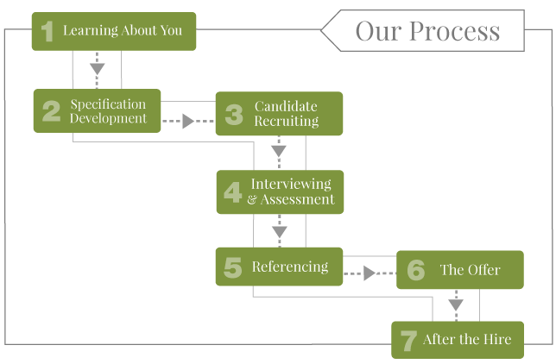
Your Culture
Why are they leaving the process?
How are they getting there?

Slide 5
Recruiting Families - Culture
Digital Identity
What is the vibe?
Why is that important?
How do you show it?
Is that what you show?
Ideal Family/Ideal Recruit
Messaging or ideal
Culture
The Web
Referrals, Partners, and Connectors
Campaigns
Events
Recruiters
Conversions

Slide 6
Your Web Presence & using the data
Data
Messaging
Visits Coming from where?
Clicks
Analytics
Metrics
Big Data versus Little Data
How do your systems work together?
Example: More Clicks
Abandon rate?
Culture
The Web
Referrals, Partners, and Connectors
Campaigns
Events
Recruiters
Conversions

Slide 7
Referrals, Partners, and Connectors
Data
Who will like and share your messages and invites?
Culture
The Web
Referrals, Partners, and Connectors
Campaigns
Events
Recruiters
Conversions

Slide 8
Campaigns
Data
Culture
Social Media
It’s not going away
The Web
Referrals, Partners, and Connectors
Email, Supportive ads, Newsletters
Campaigns
Events
Recruiters
Phone
Conversions

Slide 9
Continual Touches – Selecting the best channels to use
Data
Culture
How often
Share articles (get creative)
Why giving back is good for you
The Web
Referrals, Partners, and Connectors
Are you adding new recipients?
Email, Supportive ads, Newsletters
Campaigns
Events
Recruiters
Phone
Conversions

Slide 10
Events
Data
Live
Web Based
Virtual Meetings
It’s a long term commitment!!
Culture
The Web
Referrals, Partners, and Connectors
Campaigns
Events
Recruiters
Conversions

Slide 11
Reporting – Honest Discussions
Data
Training
Reporting
Culture
The Web
Referrals, Partners, and Connectors
Campaigns
Events
Recruiters
Conversions

Slide 12
Conversions
Data
How are you using your data?
What’s working
What’s not
Culture
The Web
Referrals, Partners, and Connectors
Campaigns
Events
Recruiters
Conversions

Slide 13
Recap: Now where do I start?
Is your message up to date and visible?
Does it include – WIIFM – why would a family want to be involved with Lifesharing?
Do People know your mission and vision
How do you know that they know? (data)
What do you want to try in 2016?
How continual are your efforts and can you make a long term commitment to those activities?
What influencers can you share with? Is it a formal process?
Notes:
Use image of Marketing Wheel….

Slide 14
Contact
Angie Yasulitis
CEO, Managing Partner, YaZo
Chief Brand Officer, The Gamechanger
(814) 312-8876
angiey@yazogroup.com

