Slide 1
Integrating Technology in the Classroom
FAPSC Orlando Region Faculty conference 2016

Slide 2
Kids Speak Out on Student Engagement
Edutopia
"Students are most interested when the curriculum applies to more than just the textbook. The book is there -- we can read a book. If we're given projects that expand into other subjects and make us think, it'll help us understand the information.”
"I like to explore beyond the range of what normal textbooks allow us to do through hands-on techniques such as project-based learning. Whenever I do a project, I always seem to remember the material better than if I just read the information straight out of a textbook."

Slide 3


Slide 4


Slide 5
Technology – Merriam Webster
the use of science in industry, engineering, etc., to invent useful things or to solve problems
a machine, piece of equipment, method, etc., that is created by technology
the practical application of knowledge especially in a particular area
a capability given by the practical application of knowledge

Slide 6
Low Tech
Post It
Dry Erase
Different colors fonts / markers

Slide 7
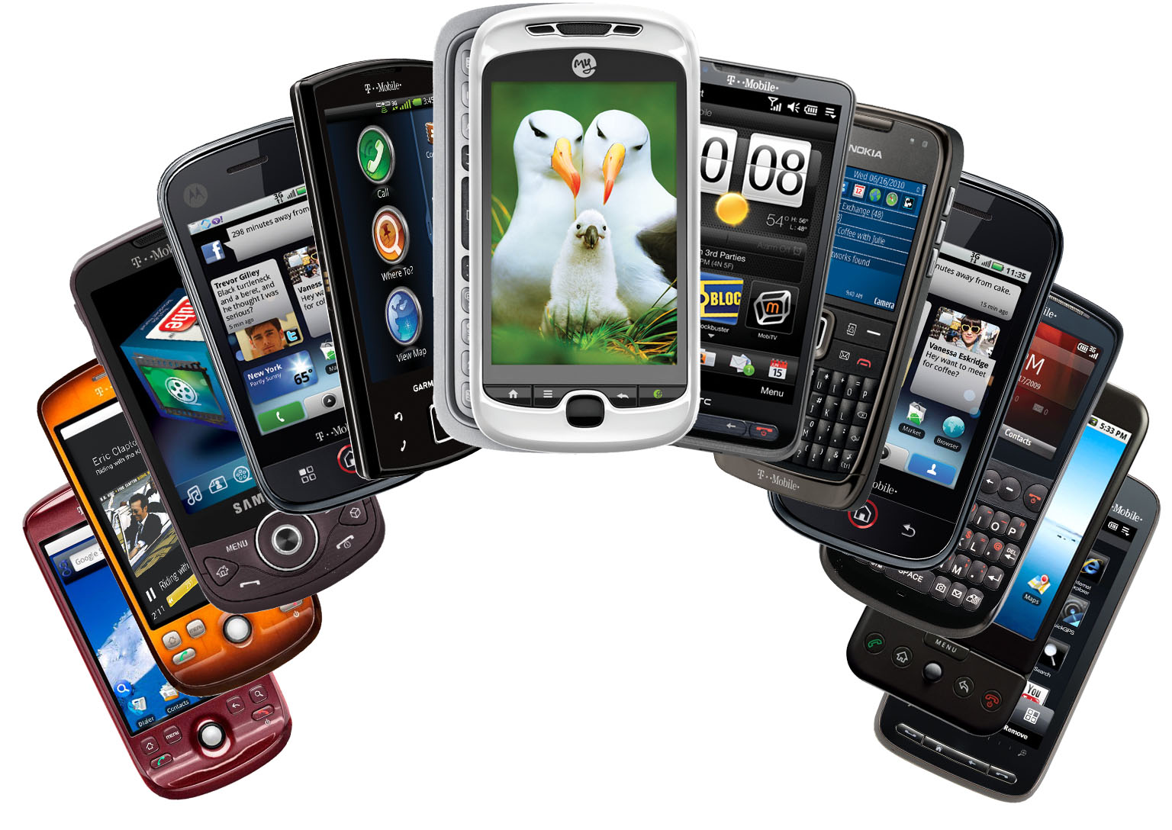
Smart Phones & Tablets
Interview
Oral Speaking
Picture Prompt
Apps

Slide 8
TodaysMeet --- https://todaysmeet.com/FAPSC-Orlando2016

Slide 9
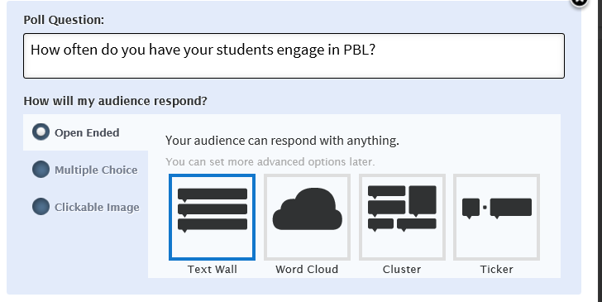
Poll Everywhere http://www.polleverywhere.com/

Slide 10
Poll Everywhere http://www.polleverywhere.com/

Slide 11
Twitter
Create a class or lesson hashtag (#)
#ABTUMKTG
#SmithScience
#iwishmyteacherknew

Slide 12
https://kahoot.it/#/ game pin 607686

Slide 13
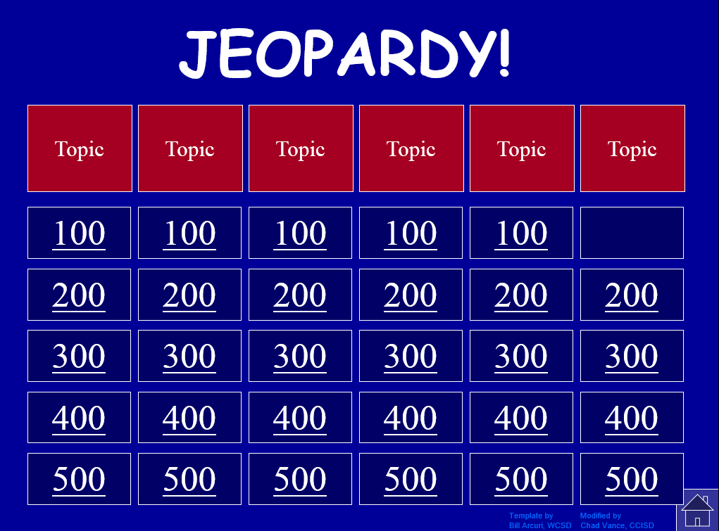
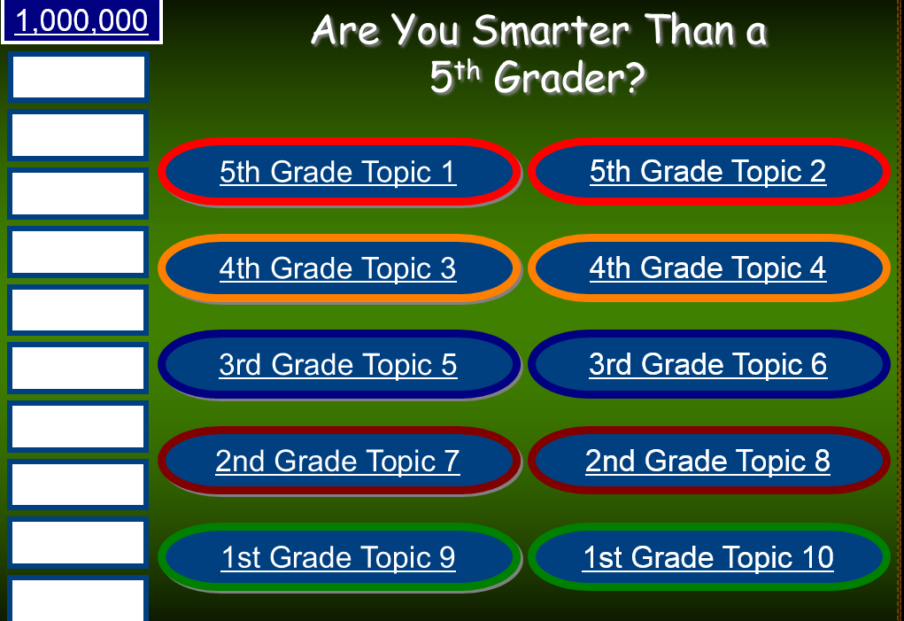
Games
http://powerpointgames.wikispaces.com/PowerPoint+Game+Templates
http://www.ircsd.org/webpages/dyoung/game_templates.cfm

Slide 14
Trello https://trello.com/

Slide 15
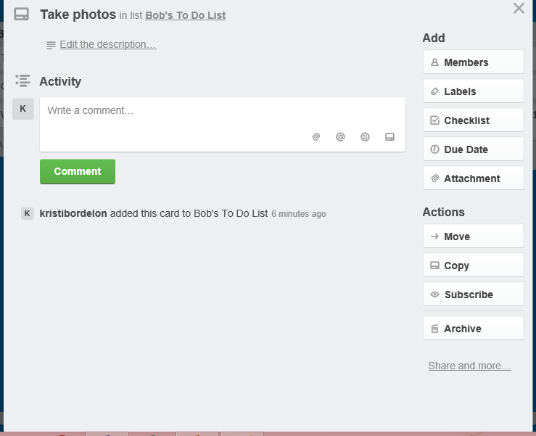

Slide 16

  Smore https://www.smore.com/
Notes:
Already created libraries
templates

Slide 17
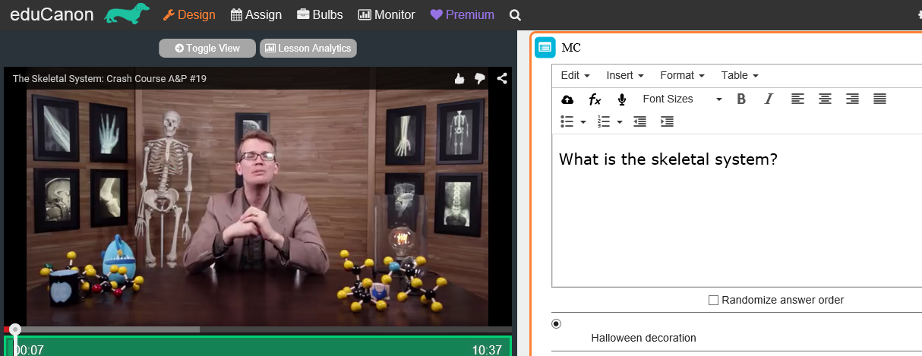
  eduCanon http://www.educanon.com/
Notes:
Educanon - Create a video, add questions, flipped classroom or have students create lectures / quizzes

Slide 18
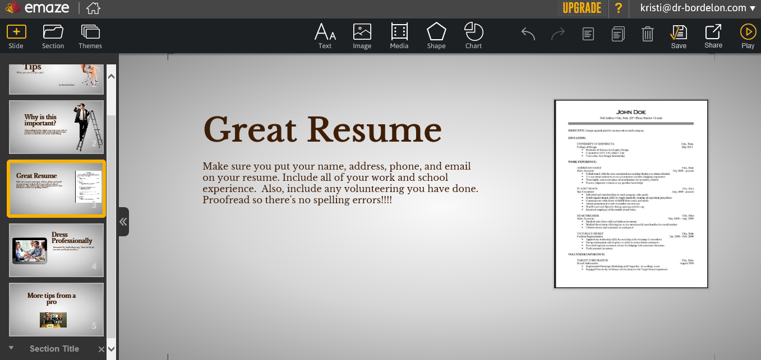
  EMaze https://www.emaze.com
Notes:
Online presentation maker and can include video and audio files.

Slide 19
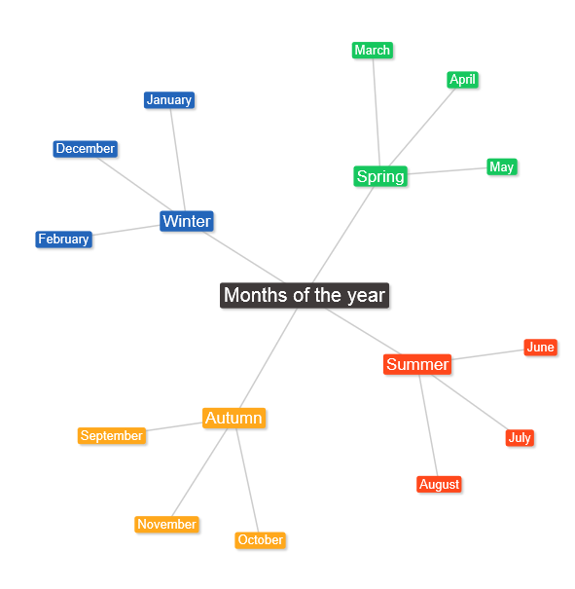
  Text 2 Mind Map https://www.text2mindmap.com/
Notes:
Graphic organizer creator

Slide 20
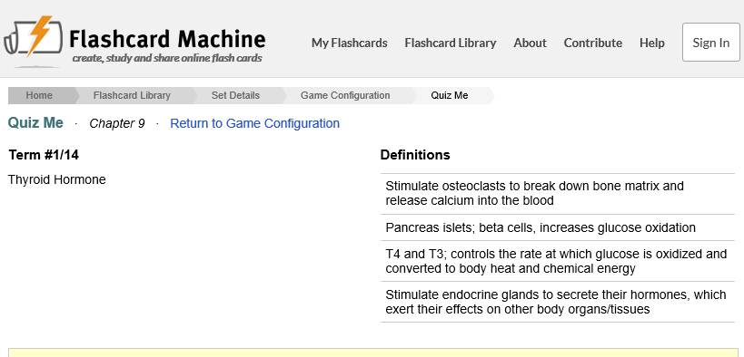
  Flashcard Machine http://www.flashcardmachine.com/

Slide 21
  Flashcard Machine http://www.flashcardmachine.com/

Slide 22
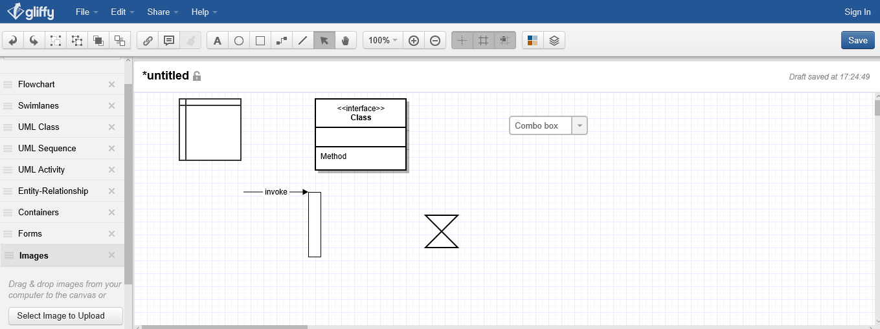
Gliffy https://www.gliffy.com/

Slide 23
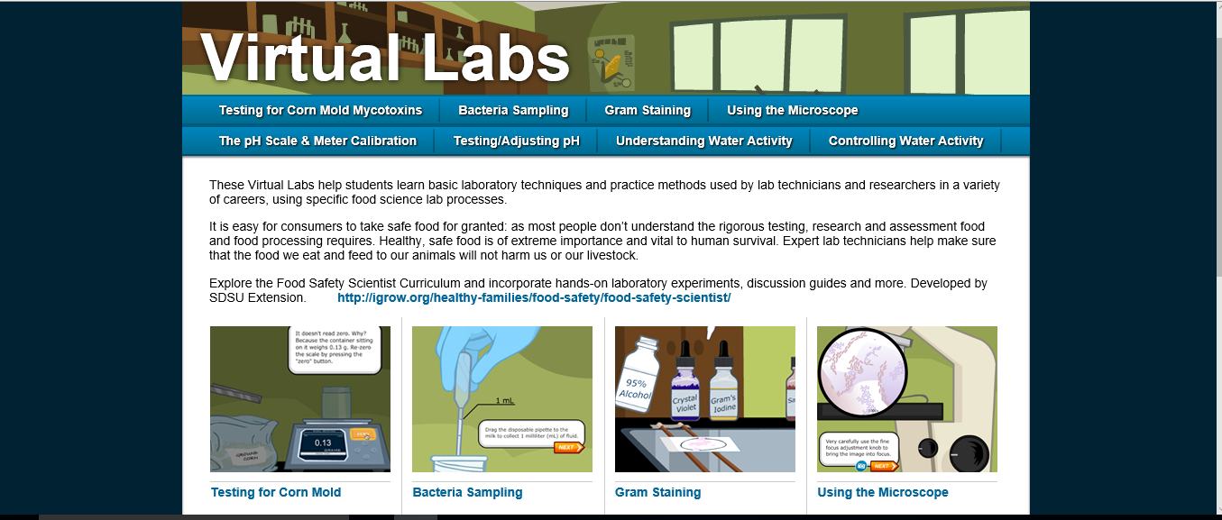
Virtual Food Science Lab http://www.virtuallabs.nmsu.edu/
https://bubbl.us/

Slide 24
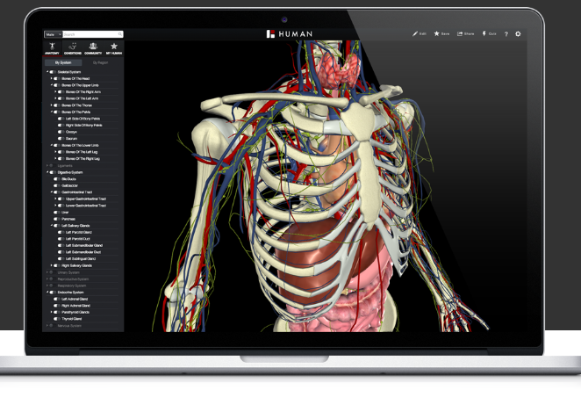
Biodigital Human https://www.biodigital.com/

Slide 25
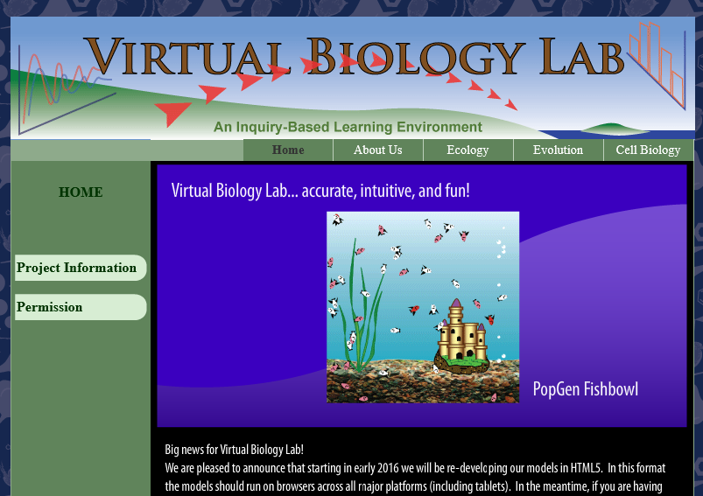
Virtual Biology Lab http://virtualbiologylab.org/index.htm

Slide 26
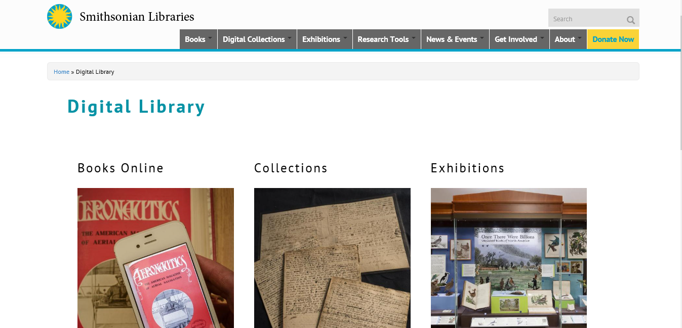
Smithsonian Digital Collection http://library.si.edu/digital-library
Notes:
There are pictures, videos, and audio files available for free.

Slide 27
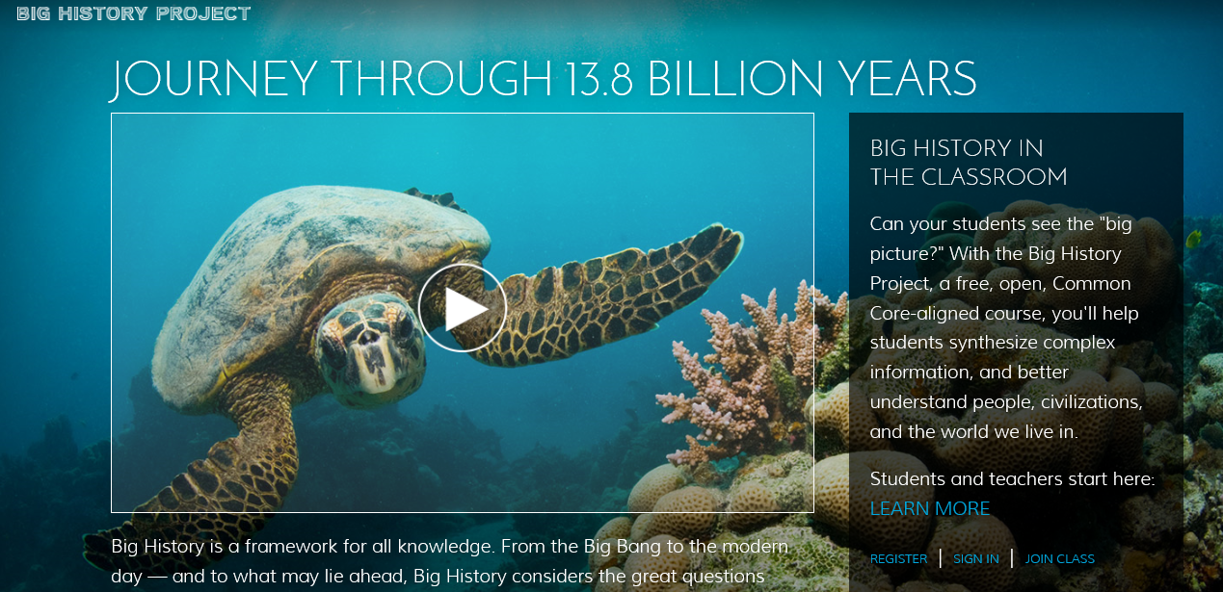
The Big History Project https://www.bighistoryproject.com/home

Slide 28
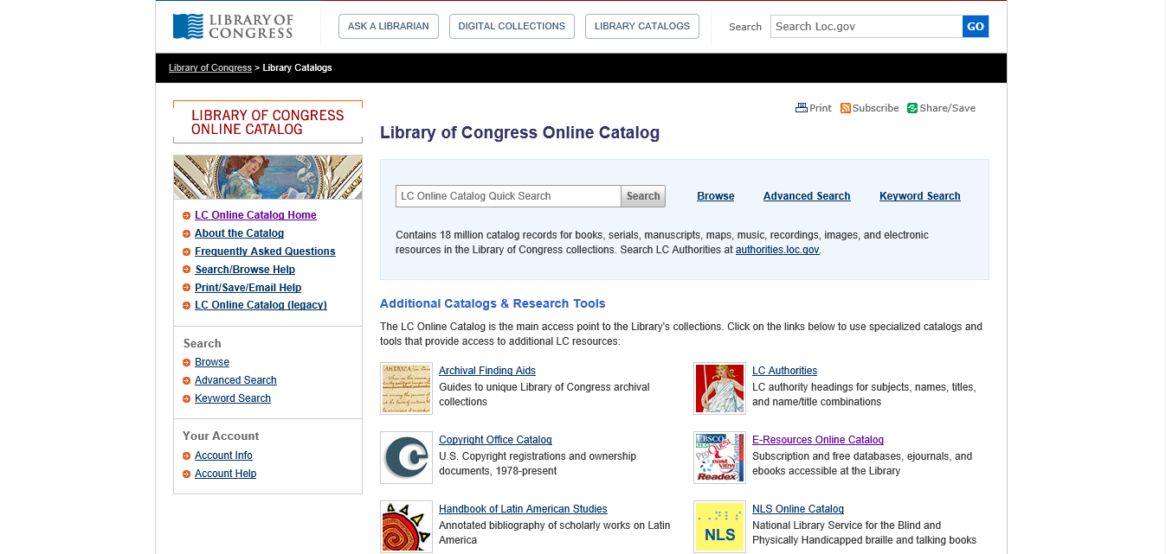
Library of Congress Digital Collection http://loc.gov/library/libarch-digital.html
Notes:
There are pictures, videos, and audio files available for free.

Slide 29
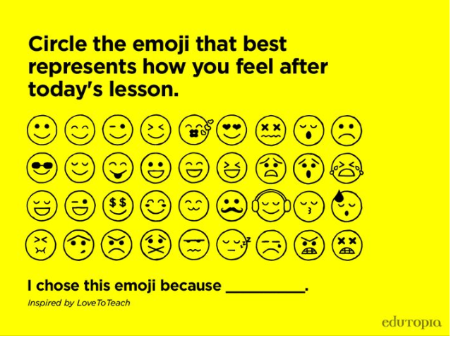

Slide 30
Now it’s your turn……
Kristi@dr-Bordelon.com

