Slide 1
Graduation Cohort Process: Timeline and Overview
April 21, 2016
Mary Batiwalla, Executive Director – Office of Accountability
Evan Kramer, Project Manager – Office of Accountability

Slide 2
Agenda
Timeline, Process, and Resources
Federal Requirements and Definitions
Guidance and Common Questions
Feedback/Questions

Slide 3
Timeline, Process, and Resources

Slide 4
Process Improvement
Process improvement
We have made a couple process adjustments
Currently approving/denying documentation
Documentation and EIS data to change cohort year
Altered timeline
Looking into changing how dropout rate is calculated
Where we hope to go:
Ongoing document upload/review process for students in all four active cohort years
Appeals
Detailed guidance and webinar in May

Slide 5
Graduation Cohort Process Timeline
Phase I: Feb. 16 – June 15
Correct student data in EIS
Upload required documentation
Phase II: July 25 – Aug. 12
Appeals window opens
Phase III: Aug. 29 – Sept. 9
Preliminary graduation rates published to review and, in infrequent cases, to appeal withdrawals since the last week of Phase I only
Phase IV: Oct. 10
Final graduation rates published
Report completion types in EIS
Update summer graduation completion data
Only students withdrawn since the last week of Phase I will be eligible for document uploads

Slide 6
Phase I: Common Issues to Resolve
One student, multiple IDs
Multiple students, one ID
Missing subsequent enrollments (3, 4, or 14)
Completion types and dates for early graduates (12)
Adjusting incorrect withdrawal codes
Accurate subgroup reporting, as required by federal law
Students in EIS missing from cohort

Slide 7
Upcoming Deadlines
June 15, 2016:
All data, including withdrawal codes and supporting documentation in EIS and the Cohort Application must be correct and verified by districts.
August 12, 2016:
Deadline to submit summer graduate data
Deadline to submit appeals for fall/spring cohort decisions

Slide 8
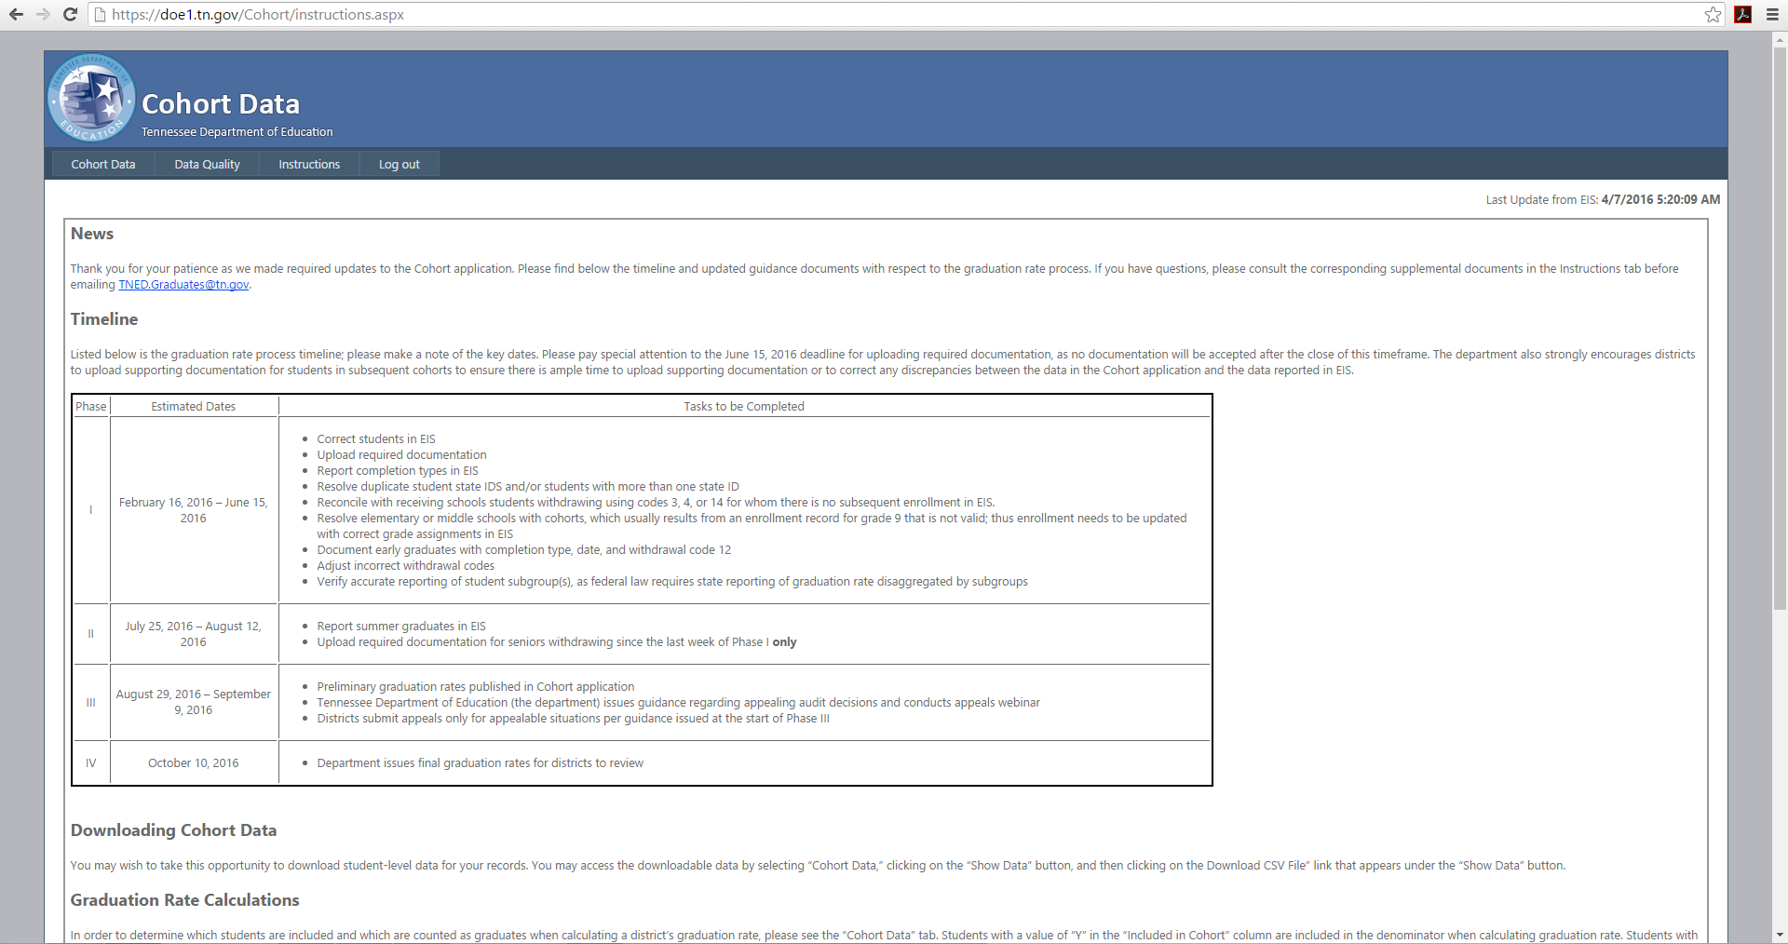
Available Resources

Slide 9
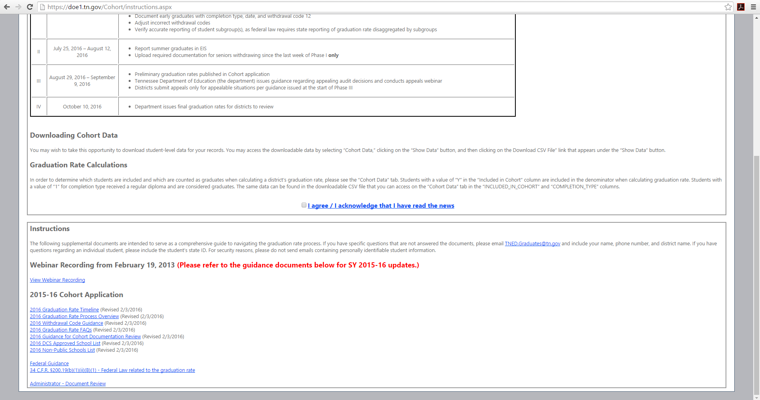
Available Resources

Slide 10
Available Resources
Notes:
And, of course, if you have questions, you can always email TNED.Graduates@tn.gov

Slide 11
In Summary: Timeline, Processes, Resources
What is different about the graduation rate process this year?
Document review has begun; earlier approvals/denials
When should I enter/correct and, upload documents?
By June 15, 2016 for fall/spring graduates
By August 12, 2016 for summer graduates
What resources can I consult to help answer my questions?
Instructions page of Cohort application
If still unanswered, TNED.Graduates@tn.gov

Slide 12
Federal Requirements and Definitions

Slide 13
Current Federal Requirements
No Child Left Behind (NCLB):
Required to calculate 4-year adjusted cohort graduation rate
Standardized reporting and accountability across states
Prescriptive guidance
Every Student Succeeds Act (ESSA):
Still awaiting guidance from USED regarding possible changes to graduation rate calculations

Slide 14
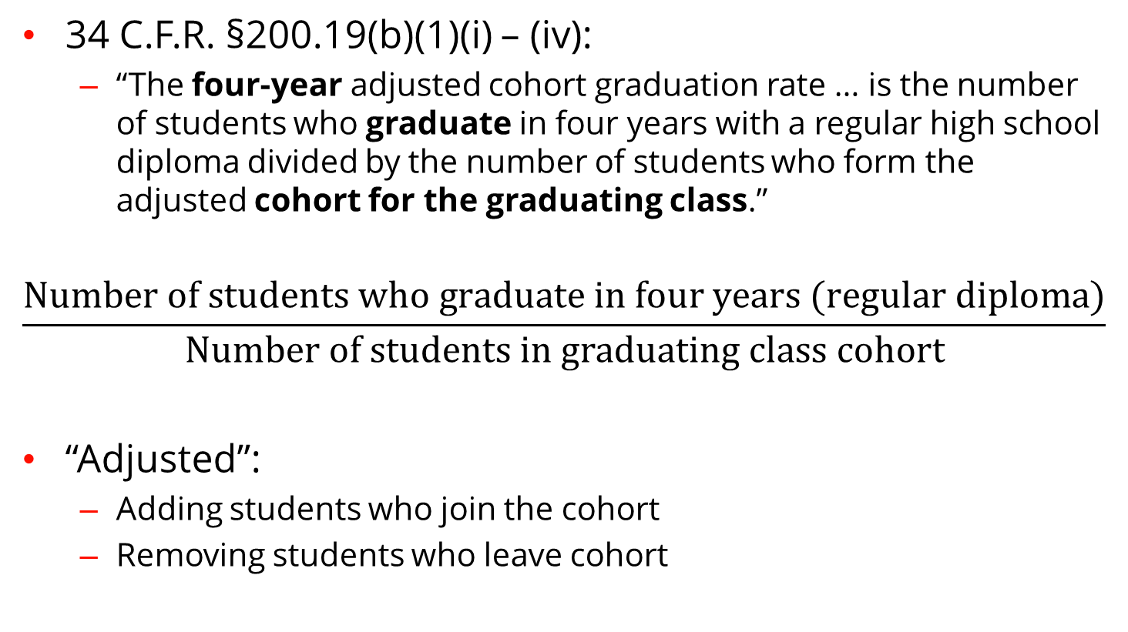
Current Federal Definition
34 C.F.R. §200.19(b)(1)(i) – (iv):
“The four-year adjusted cohort graduation rate … is the number of students who graduate in four years with a regular high school diploma divided by the number of students who form the adjusted cohort for the graduating class.”
$$\frac{Number of students who graduate in four years (regular diploma)}{Number of students in graduating class cohort}$$
“Adjusted”:
Adding students who join the cohort
Removing students who leave cohort

Slide 15
Defining Graduates
Which students count as graduates?
Students who receive a regular education diploma
AND
Students who graduate on time
Students who graduate in less than 4 years
Students who graduate in 4 years
Students who graduate in 4 years plus a summer (state option)
Which students do not count as graduates?
GEDs or modified/alternative diplomas do not count
Special education/occupational diplomas do not count
Certificates of attendance do not count

Slide 16
Cohort Adjustments
Which students can be removed from the cohort?
Students who transfer out and enroll in another school/program that culminates in an on-time, regular education diploma
Students who move out of state/country
Deceased students
What documentation is required to remove students from the cohort?
Please see 2016 Withdrawal Code Guidance
(Cohort application > Instructions page)
Prescriptive federal guidance

Slide 17
Guidance and Common Questions

Slide 18
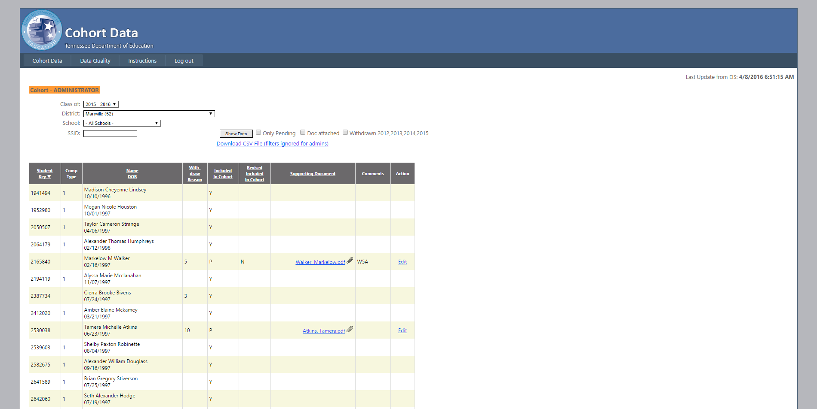
Decoding the Cohort Application
Documentation was approved; student will not be included in cohort
Must work with receiving district to get subsequent enrollment entered in EIS
Yet to be reviewed, status still pending (P)
Notes:
5 – out of state
3 – need subsequent enrollment
10 – homeschool

Slide 19
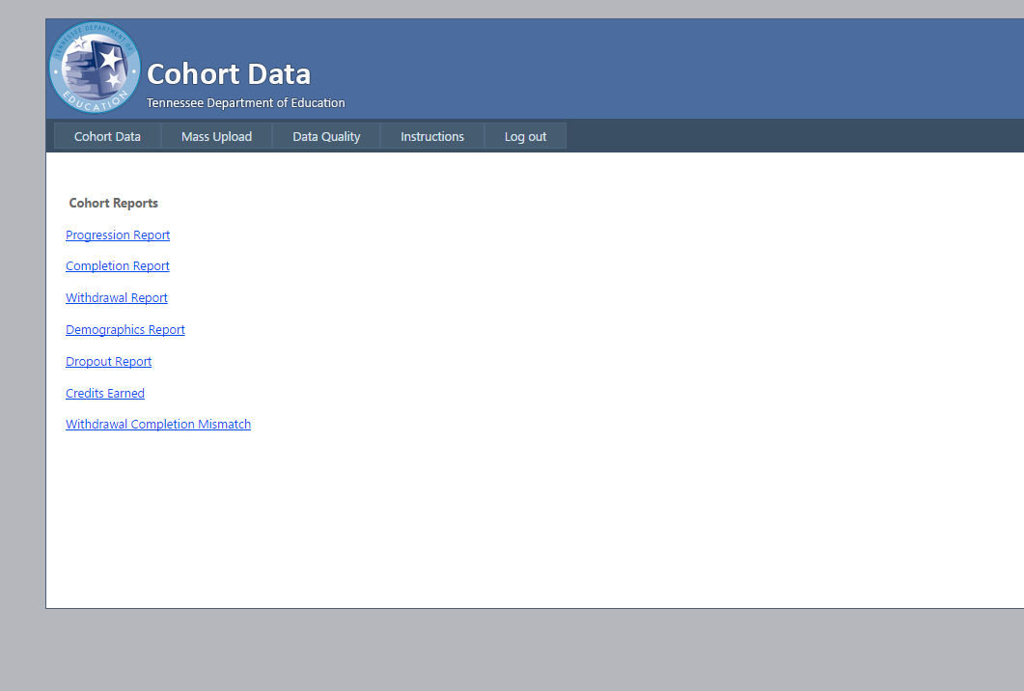
Cohort Application Reports
Progression: List of students enrolled but not on track to graduate based on cohort year and last enrolled grade
Completion: Counts of completion types
Withdrawal: Counts of withdrawal codes
Demographics Report: Counts of demographic groups
Dropout Report: List of students considered dropouts
Credits Earned: Counts of credits by student
Withdrawal Completion Mismatch: List of students with withdrawal codes 0, 1, 2, 5, 6, 8, 10, and 17 who have a completion document (receipt of a regular education diploma)

Slide 20
Common Code Concerns
Codes 05/06/10/17:
Any indication that students enrolled in out-of-state online programs should be withdrawn via code 17, even if they were initially withdrawn with codes 05, 06, or 10.
Job Corps:
Official documentation of regular on-time diploma (official diploma, transcript with completion date, letter on letterhead confirming completion date)
Code 03:
Sending districts must work with receiving districts to ensure entry of subsequent enrollment in EIS
Documentation upload:
2, 5, 6, 8, 10, and 17 are the only codes for which documentation can be uploaded

Slide 21
Common Code Concerns, Continued
Codes 02/06:
Please check DCS-approved and non-public school lists
Code 12:
Early graduates require code 12 and corresponding completion data in EIS ahead of the June 15 or August 12, 2016 deadlines, depending on whether the student was a fall/spring or summer graduate
Code 17:
Screenshots of student homepage, payment receipts, and/or enrollment applications are all insufficient

Slide 22
Common Reasons for Denial by Code
Code 02:
Written acknowledgment must confirm that the student receives services resulting in regular diploma
Code 05:
Notes/hearsay from friends/neighbors/pastors, etc. are not sufficient documentation for out-of-country withdrawals
For exchange students: Documents must come from exchange agency and indicate year of participation
Codes 06/10:
Code corresponds to homeschool but document indicates non-public enrollment (or vice versa)
Documentation supports withdrawal to out-of-state online schools should use code 17

Slide 23
Other Common Issues to Resolve
If documentation is denied because a withdrawal code change is required, please email TNED.Graduates@tn.gov
If new documentation is needed, there is no need to email
Also email TNED.Graduates for:
Students to be removed because of cohort year
Required: Transcript for evidence of change, SSID
Other requests for removal directly via email will not be considered
Students in EIS but not Cohort Application
Required: SSID
Students whose uploaded documentation should be removed
Required: SSID

Slide 24
Status Update
As of April 18, 2016…
4,724 documents were uploaded
710 documents were already reviewed
Benefits of early documentation upload:
Faster feedback
Opportunity to resubmit documents before appeals window

Slide 25
We are partners in the graduation cohort work.
We are excited to find ways to improve the process in alignment with new federal policy.
We aim to ensure that cohort policies comply with state and federal law while incentivizing what is best for students.
More information regarding appeals will be coming in May with a webinar for additional clarification.
For questions that were not addressed today, please consult the documentation on the Cohort Application or email TNED.Graduates@tn.gov.

Slide 26
Feedback/Questions TNED.Graduates@tn.gov

