Slide 1
Public Records Management
North Carolina Permitting Personnel Association
February 24, 2022
Mark Holland
Supervisor, Records Analysis Unit
Notes:
Welcome to Managing Public Records for Local Government
There will be information at the end of the course on how to obtain a certificate.

Slide 2
Records Management Analysts
Update existing retention schedules and create new retention schedules
Transfer materials to State Archives
Guide records destructions
Clarify public records law
Train records custodians
Notes:
Retention schedule: document that identifies and describes an organization’s records, often at the series level, and provides instructions for the disposition of records throughout their life cycle

Slide 3
Values of Records
Administrative
Fiscal
Historical
Legal
Notes:
The value of a record can help determine retention
Administrative Records support the routine management of your organization. Occasionally administrative records will have lasting importance. It could be that a procedure manual may be needed to verify how something was done at a certain point. Other administrative records, however, such as meeting agendas, notices that go around the office, or reference records like that catalog for office supplies you might get in the mail don’t need to be kept indefinitely.
Fiscal records fulfill and document financial authorizations, obligations, and transactions and are often subject to audits. We insert audit hold language into record retention schedules as a reminder not to destroy those files if an audit is pending against the records. Once audits have been resolved, fiscal records often lose their value rapidly.
Legal records provide for defense in litigation, demonstrates compliance with laws and regulations, or meets other legal needs records with legal value are often subject to official actions -subpoenas, investigations, lawsuits, that sort of thing. We’ll use litigation hold language to ensure legal records are preserved. And just as you shouldn’t destroy records if you believe there might be an audit, you should not destroy records if you hear about a lawsuit, or potential lawsuit being filed against your office, even if the records have met their scheduled retention period. That’s the worst time to clean out your files. Judges tend to take a dim view of that sort of thing.
Historical records document historical or significant actions or events and have enduring value these records may also reflect decisions about significant actions or events.

Slide 4
Authentic Records
Created during the course of normal business
As part of established office procedures
Using policies and procedures for system development, maintenance, and use
Notes:
Authenticity: An authentic record is one that has the properties and attributes of being genuine, a record that is precisely what it claims to be. That means the record was created and used in the normal course of business, and that the information on the record has not been altered since it reached its final form.
Admissibility

Slide 5
Transitory Materials
Information copies of documents
Routing slips and transmittal sheets
Duplicate copies of documents maintained in the same file
Catalogs, trade journals
Publications received from other Government agencies, commercial firms, or private institutions and that require no action and are not part of a case on which action is taken
Notes:
Transitory Record: A record that has little or no documentary or evidential value and that need not be set aside for future use.
Examples include:
Information copies of correspondence, directives, forms, and other documents on which no administrative action is recorded or taken.
Routing slips and transmittal sheets adding no information to that contained in the transmitted material.
Duplicate copies of documents maintained in the same file
Catalogs, trade journals
Publications that are received from other Government agencies, commercial firms, or private institutions and that require no action and are not part of a case on which action is taken

Slide 6
NC General Statute 121
§ 121-4. Powers and duties of the Department of Natural and Cultural Resources.
(2) To conduct a records management program, including the operation of a records center or centers and a centralized microfilming program, for the benefit of all State agencies, and to give advice and assistance to the public officials and agencies in matters pertaining to the economical and efficient maintenance and preservation of public records.
(3) To preserve and administer, in the North Carolina State Archives, such public records as may be accepted into its custody, and to collect, preserve, and administer private and unofficial historical records and other documentary materials relating to the history of North Carolina and the territory included therein from the earliest times. The Department shall carefully protect and preserve such materials, file them according to approved archival practices, and permit them, at reasonable times and under the supervision of the Department, to be inspected, examined, or copied: Provided, that any materials placed in the keeping of the Department under special terms or conditions restricting their use shall be made accessible only in accordance with such terms or conditions.
records management program
economical and efficient maintenance and preservation of public records
State Archives
Notes:
statute

Slide 7
NC General Statute 132
§ 132-1. "Public records" defined.
Public records =
all documents, papers, letters, maps, books, photographs, films, sound recordings, magnetic or other tapes, electronic data-processing records, artifacts, or other documentary material,
regardless of physical form or characteristics,
made or received pursuant to law or ordinance in connection with the transaction of public business by any agency of North Carolina government or its subdivisions.
regardless of physical form or characteristics
made or received in connection with the transaction of public business
Notes:
Public record
Records custodian: The public official in charge of an office is designated to be the custodian of records for that office (N.C.G..S. § 132-2) is responsible for making records available for inspection.

Slide 8
Public Records Requests
§ 132-6. Inspection and examination of records.
(a) Every custodian of public records shall permit any record in the custodian's custody to be inspected and examined at reasonable times and under reasonable supervision by any person, and shall, as promptly as possible, furnish copies thereof upon payment of any fees as may be prescribed by law. As used herein, "custodian" does not mean an agency that holds the public records of other agencies solely for purposes of storage or safekeeping or solely to provide data processing.
(b) No person requesting to inspect and examine public records, or to obtain copies thereof, shall be required to disclose the purpose or motive for the request.
(c) No request to inspect, examine, or obtain copies of public records shall be denied on the grounds that confidential information is commingled with the requested nonconfidential information. If it is necessary to separate confidential from nonconfidential information in order to permit the inspection, examination, or copying of the public records, the public agency shall bear the cost of such separation.
(f) Notwithstanding the provisions of subsection (a) of this section, the inspection or copying of any public record which, because of its age or condition could be damaged during inspection or copying, may be made subject to reasonable restrictions intended to preserve the particular record.
at reasonable times
as promptly as possible
purpose or motive for the request
agency bears cost of separating confidential from nonconfidential
Notes:
G.S. 132-6 has been amended regarding access to records posted online including records in databases.
A public agency or custodian may satisfy the requirements of public inspection and public record requests by making public records available online and by providing access to public records in computer databases in a format that allows a person to view the public record and print or save the public record to obtain a copy. If the public agency or custodian provides access in this way they are not required to provide copies to these public records in any other way.
This change to the law says that online access is sufficient under the law. Hopefully this will help public agencies provide public access to records more efficiently.

Slide 9
Confidential Records
Medical and mental health records
Personnel records
Prison records
Students’ records
Blueprints for public buildings
Personally Identifying Information (PII)
G.S. 132-11: Confidentiality expires for most records after 100 years
Notes:
Confidentiality: In order for records to be considered confidential in North Carolina, they must be made confidential, by state or federal statute. Unless there is a specific statute that exempts a public record from public access, that record is considered open and must be allowed inspection by the public. This means, if you, as a custodian of public records deny access to any of your records, you should be able to point to a specific statute that allows you to withhold access. Sometimes “confidential” will only apply to a certain portion of the record or it might mean that only certain people can see the records in particular situations.
G.S. 132-11: Confidentiality expires for most records after 100 years

Slide 10
http://archives.
ncdcr.gov/
government/
retention-schedules/
local-government-schedules
http://archives.ncdcr.gov

Slide 11
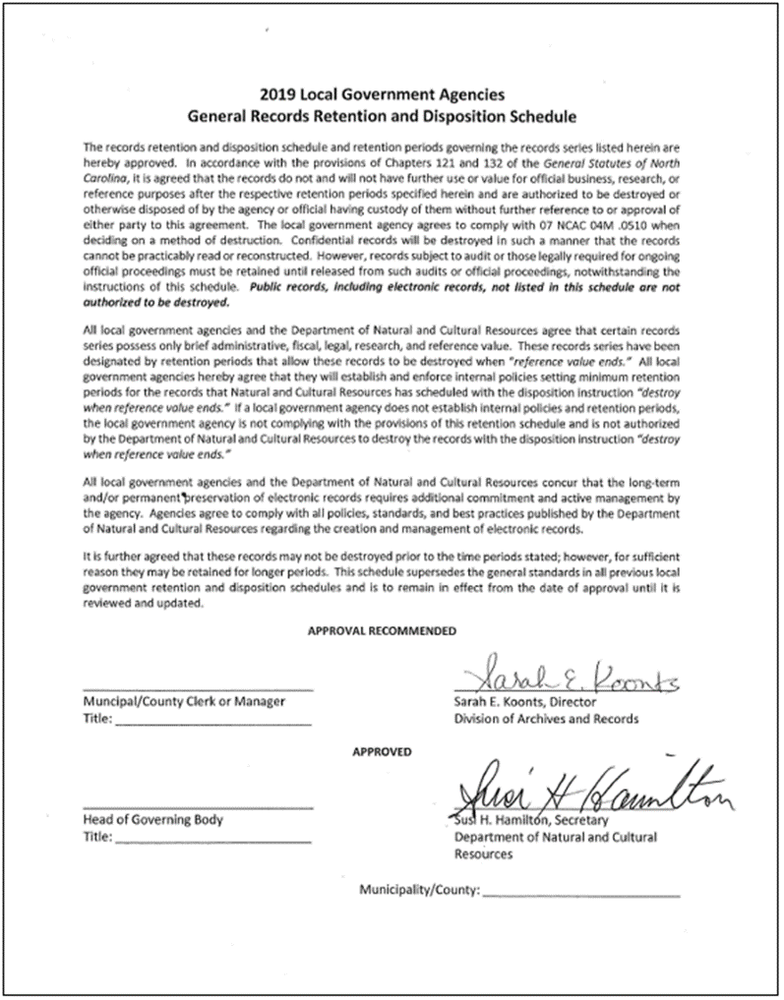
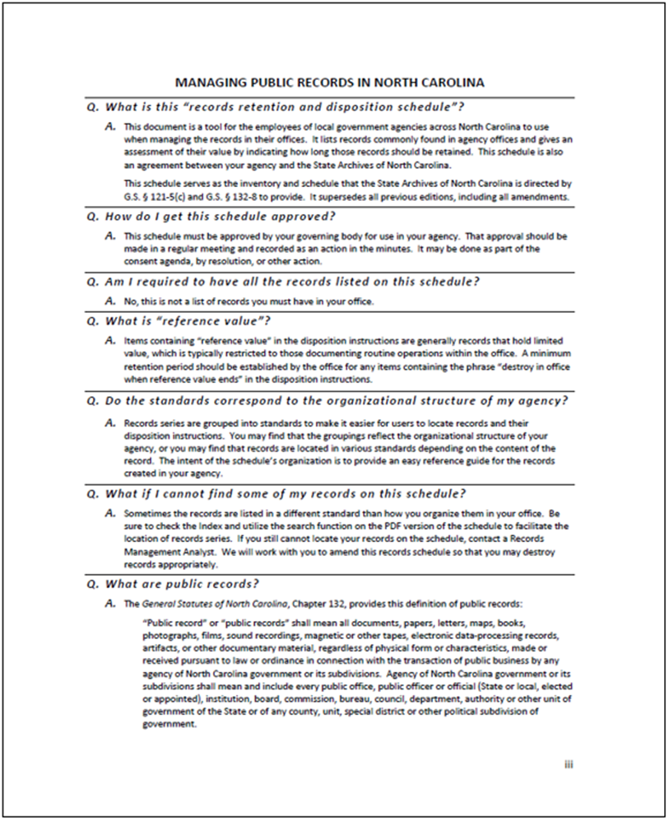
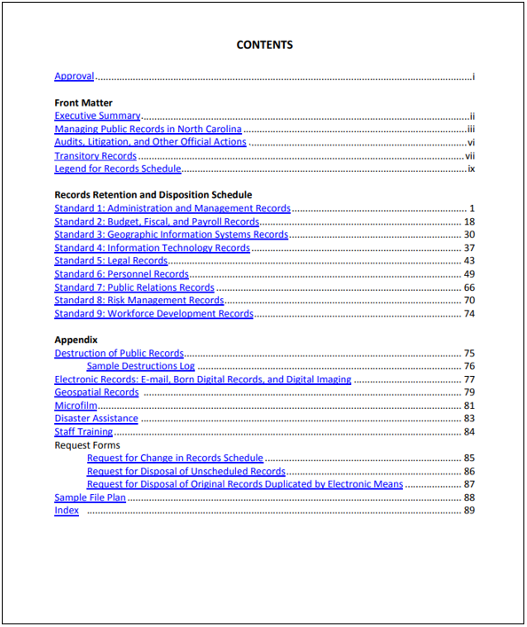
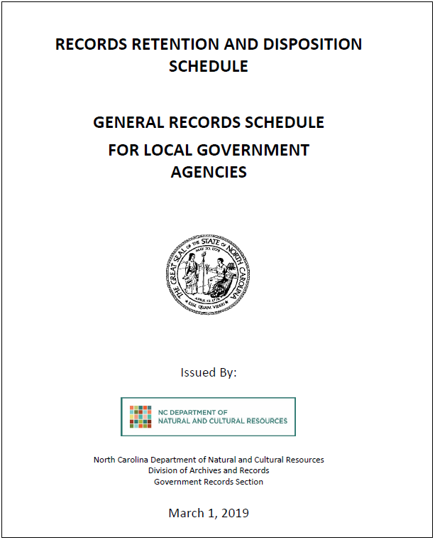
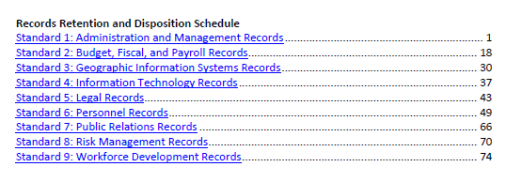
Notes:
****Flagged for Review****
This is the 2019 General Records Schedule.

Slide 12
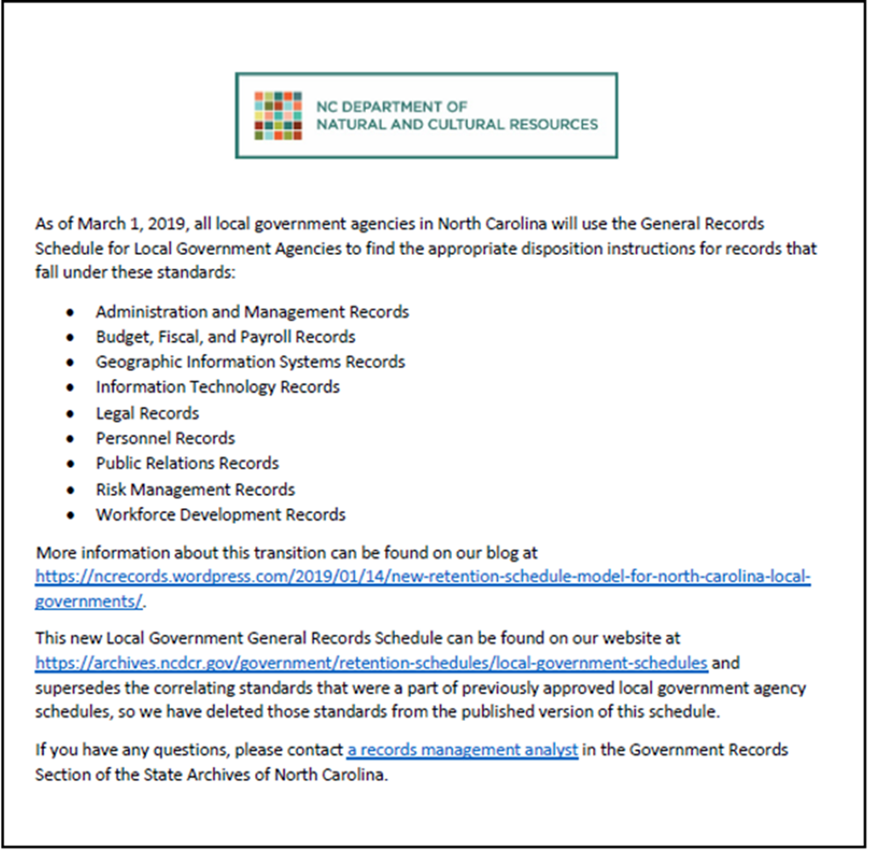
General Records Schedule
Notes:
Supersedes standards on program schedules, so they were excised from PDFs on website

Slide 13
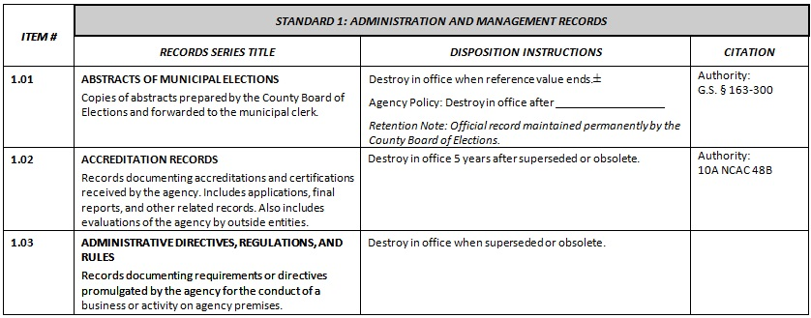
Local Records Schedules
Notes:
Series: A group of similar records that are arranged according to a filing system and that are related as the result of being created, received, or used in the same activity
Disposition: Materials’ final destruction or transfer to an archives as determined by their appraisal.

Slide 14
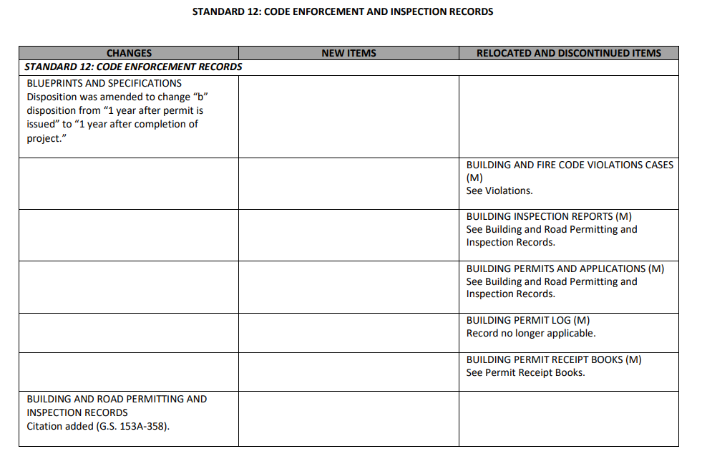
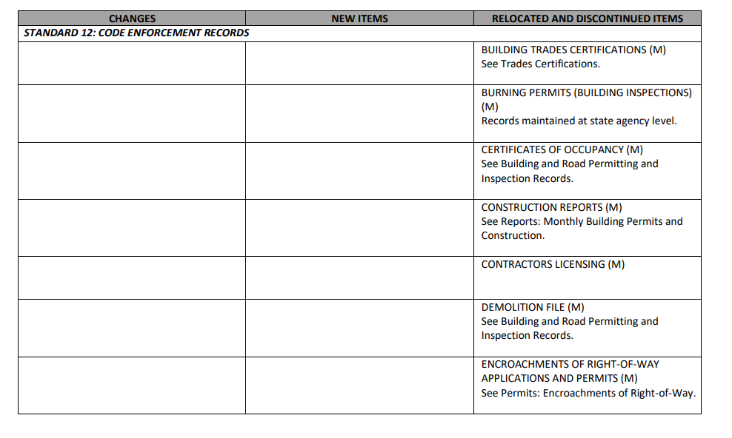
Code Enforcement and Inspection Records

Slide 15
Reference Value
Establish and enforce internal policies setting minimum retention periods for records with the disposition instruction “destroy in office when reference value ends.” Without the establishment of these policies, the office is not authorized by the Department of Natural and Cultural Resources to destroy these records.
Notes:
POLL: Open-ended?
Citizen Surveys have a required retention of keep until reference value ends. How long do you think these records should be kept for your agency’s needs?
Reference value: The usefulness of records based on their content, regardless of evidential value
Local government agencies must establish and enforce internal policies setting minimum retention periods for records with the disposition instruction “destroy when reference value ends.” Without the establishment of these policies, the office is not authorized by the Department of Natural and Cultural Resources to destroy these records.

Slide 16
Search
Notes:
PDF

Slide 17
Using the Index
Notes:
Example: Utilities Usage Log, former records series, can be found in index pointing to current records series

Slide 18
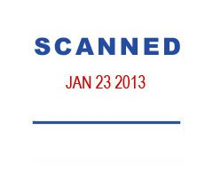
Triggers
RECEIVED
APR 28 2015
What starts the clock on the retention period?
COMPLETED
DEC 24 2014
Notes:
Some records have retention periods predicated on event-based triggers.
Examples: Employee service ends; upon resolution of an event.
Courtney will talk more about filing based on triggers.

Slide 19
Records Destruction
07 NCAC 04M .0510
METHODS OF DESTRUCTION
Notes:
North Carolina Administrative Code 7.4.M.0510 has defined “destruction” for records management as one of the following:
Burned, unless prohibited by local ordinance. FIX THIS LANGUAGE BASED ON MH’S FINDINGS
Shredded or torn up so as to destroy the record content of the documents or materials concerned so they cannot be reconstructed.
sold as waste paper, That’s what we do. We have ours pulverized, pulped and turned into paper towels
Acid vats so as to reduce the paper to pulp and to terminate the existence of the document or materials concerned.
Burying your records is no longer an option due to recent changes to the North Carolina Administrative Code.
Destruction of records also includes digital files.
In July 2014 the State Archives of North Carolina updated our section of the North Carolina Administrative Code to explicitly incorporate electronic records. As you may know, deleting a file isn’t enough to erase it from your computer—all that does is give the computer permission to overwrite the information when it feels like it. To destroy an electronic record, the actual data associated with the record (metadata) needs to be overwritten. Keep in mind as well that multiple copies of the same record may exist on different computers.

Slide 20
Records Destruction
07 NCAC 04M .0510
Electronic Records
data and metadata are overwritten, deleted, and unlinked so the data and metadata may not be practicably reconstructed

Slide 21
Audits, Litigation Holds, and Public Records Requests
Remember:
If there’s an ongoing audit, a public records request, a lawsuit, or even a "reasonably anticipated" lawsuit, you may be required to retain records, including the metadata associated with electronic records, EVEN IF THEY COULD BE DESTROYED LEGALLY UNDER THE RETENTION RULES
Notes:
Also important to note that public records requests can also halt the destruction process
"reasonable" test
21

Slide 22
Plan for Sustainability
Never trust claims that you won’t have to actively manage electronic records over time
Anticipate changes to the underlying hardware and software (these are inevitable)
Periodically sample records to ensure that they’re still readable and not corrupted
Notes:
Media
Never trust claims from vendors that you won’t have to actively manage records over time. Recognize that hardware and software are going to change, and make sure that you have a way to get your records out of proprietary or vendor-based systems.
Who has a PC or laptop without a CD Drive?
Who remembers Lotus 1-2-3 and WordStar? ***Software companies have a built-in incentive to get you to buy their latest version or keep you locked into a proprietary format/tool for opening files, and that means not having a great degree of backward/lateral compatibility.***
Finally, active management also means checking on these files periodically to make sure that they are still accessible – that all of the technology required to read that file is still working properly, and the media on which the files are stored is still readable.

Slide 23
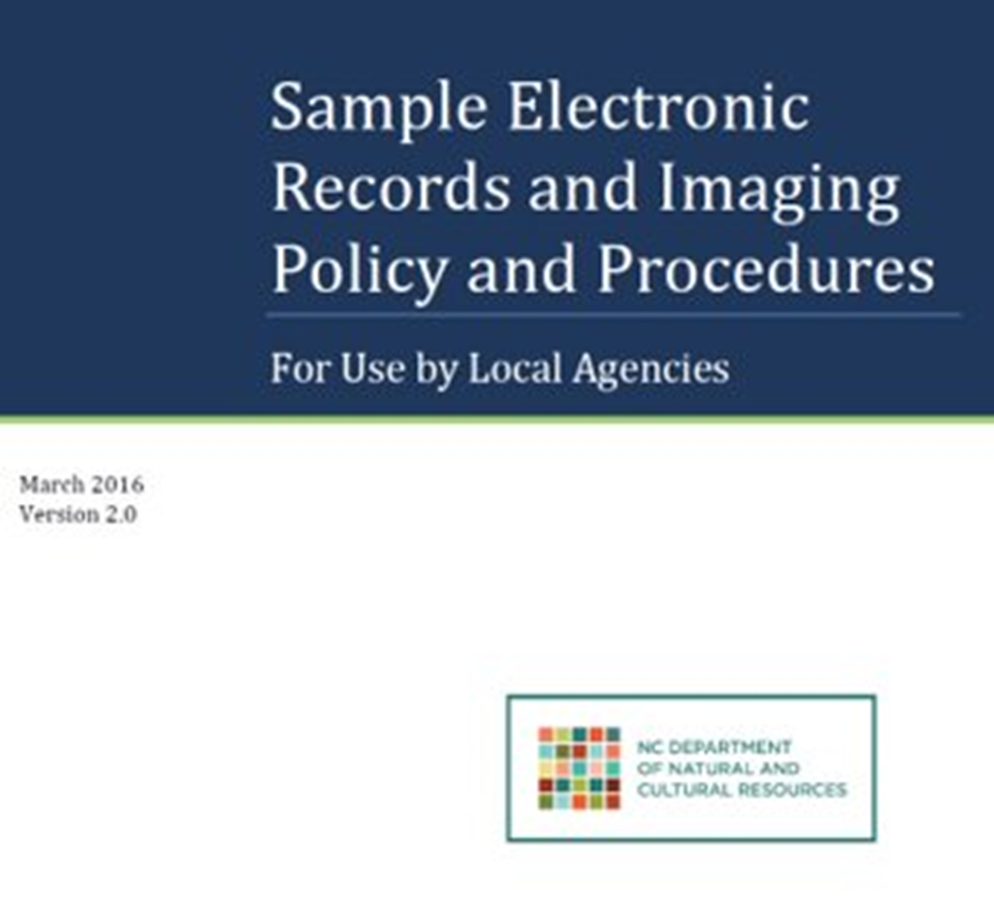
Sample Electronic Records and Imaging Policy
Notes:
Addresses records that are born-digital—natively created in a digital format—and records that have been digitized.

Slide 24
Scanning
Notes:
Electronic records section:
Imaging and microfilming
Trustworthy electronic records
Nitty-gritty: Email, social media, file formats

Slide 25
Is Imaging the Solution?
Never/infrequently use
Will destroy soon
Use every day
Need to share
Need quickly
Need often
Difficult to search
Notes:
25
Mention scanning vendor checklist

Slide 26
Electronic Means Form
Record Series Title
Dates
Retention Period
Description of Records
Volume

Slide 27
Scan-and-Destroy Authorization

Slide 28
E-mail
Contains Public Records
Avoid using public account for personal business
Avoid using personal account for public business
2. Must be retained in keeping
with the records schedule
Notes:
Digital Communications workshop in Manteo on October 31; another on December 5 in Warrenton, Warren County
Proliferation of email: applying what Josh said about records custodians? Am I the records custodian for this email, or is it a reference copy?

Slide 29
Social Media
Notes:
Every government should have a clear communications strategy and should take the time to determine how social media fits into this strategy.
All use of social networking sites by local governments should be consistent with applicable state, federal, and local laws, regulations, and policies including all information technology security policies.
Communication through local government-related social media is considered a public record under G.S. 132 and will be managed as such.
All comments or posts made to local government account walls or pages are public, not private.
Account administrators who receive messages through the private message service offered by some social media sites should encourage users to contact them at a public e-mail address maintained by their organization. For private messages that account administrators do receive, they should be treated as constituent e-mails and therefore, as public records. Account administrators or other authorized staff members should reply using their government e-mail account.
Local governments should set all privacy settings to public.
Local governments must assume responsibility for public records and comply with the retention period set forth in their approved retention and disposition schedule. Local governments must assign their own schedule of collection and disposal for social networking Web sites according to the administrative value of the record and permanently retain records with historical value. Refer to Web Site Guidelines policies on North Carolina Government Records Web site

Slide 30
Records Management Analysts
Raleigh Office
Asheville Office
Mark Holland, Supervisor mark.holland@ncdcr.gov (919) 814-6908 | Rashida Felder rashida.felder@ncdcr.gov (919) 814-6907
Josh Hager joshua.hager@ncdcr.gov (919) 814-6914 | Sarah Morrell sarah.morrell@ncdcr.gov (919) 814-6910
 | Colin Reeve colin.reeve@ncdcr.gov (919) 814-6915
Asheville Office
Jason Woolf (jason.woolf@ncdcr.gov) (828) 250-3103
archives.ncdcr.gov
Notes:
Ending activity:
Last person standing questions as polls

