Slide 1
Single Family Housing Programs

Slide 2
United States Department of Agriculture
Rural Development
Homeownership Programs
Low interest, fixed-rate Homeownership loans are provided to qualified persons directly by USDA Rural Development. Financing is also offered at fixed-rates and terms through a loan from a private financial institution and guaranteed by USDA Rural Development for qualified persons. Neither one of these home loan programs require a down payment.
USDA Rural Development also offers competitive grants to public and private non-profit Self-Help Housing organizations and Federally Recognized Tribes to enable hardworking families to build their own homes.

Slide 3
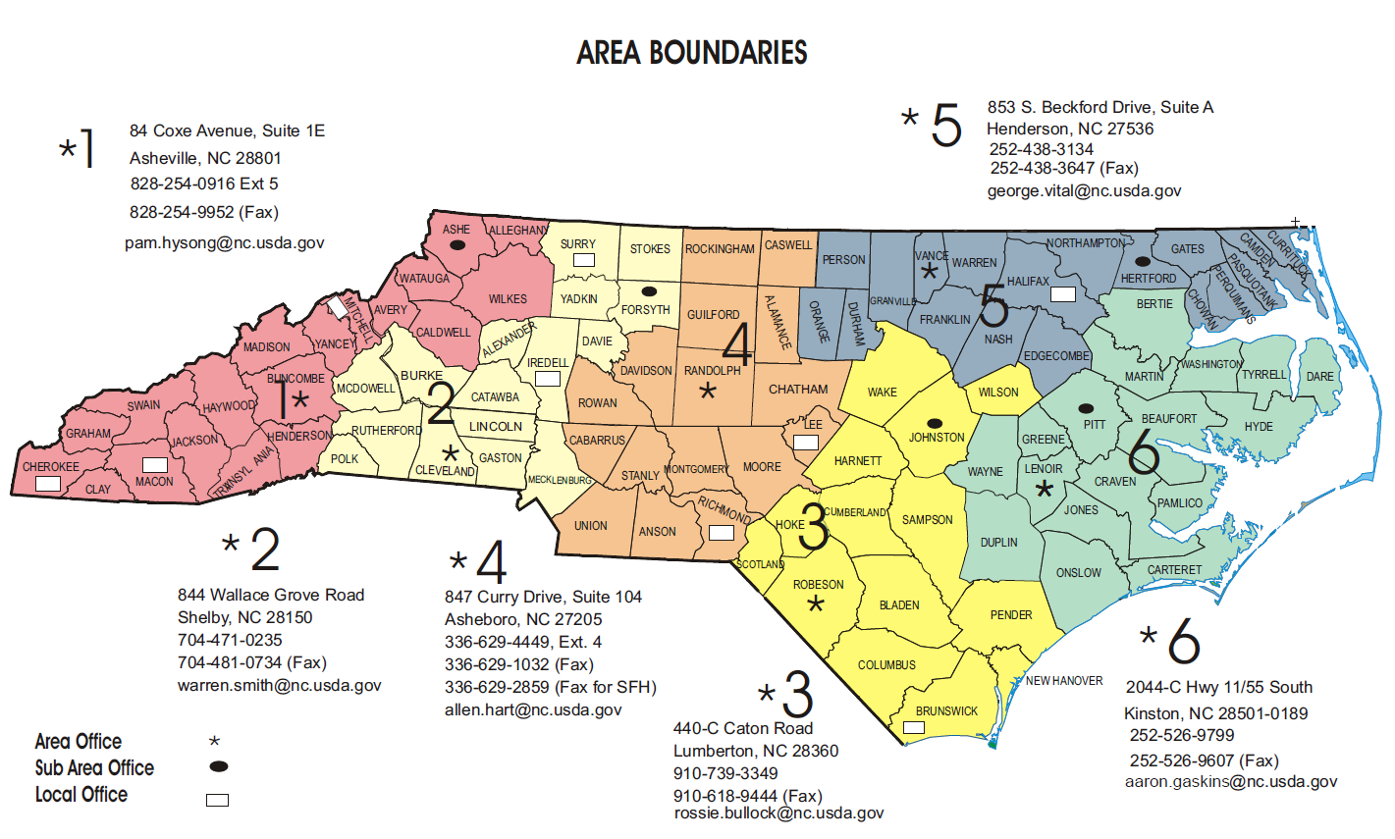

Slide 4
Single Family Housing Programs
Type | Description
Single Family Housing Direct Home Loans | This program assists low- and very-low-income applicants obtain decent, safe and sanitary housing in eligible rural areas by providing payment assistance to increase an applicant’s repayment ability
Single Family Housing Home Loan Guarantees | This program assists approved lenders in providing low- and moderate-income households the opportunity to own adequate, modest, decent, safe and sanitary dwellings as their primary residence in eligible rural areas.
Single Family Housing Repair Loans and Grants | This program provides loans to very-low-income homeowners to repair, improve or modernize their homes or grants to elderly very-low-income homeowners to remove health and safety hazards.
Mutual Self-Help Housing Technical Assistance Grants | Provides grants to qualified organizations to help them carry out local self-help housing construction projects. Grant recipients supervise groups of very-low- and low-income individuals and families as they construct their own homes in rural areas.
Rural Housing Site Loans | Loans are made to acquire and develop sites for low- or moderate-income families, with no restriction as to the method of construction.
Notes:
The certified packaging pilot was created as a means to outreach to and increase the number of very low and low-income applicants. In addition, certified packagers assist RD staff with marketing efforts and the assembly of complete applications, which in turn allows staff to focus their time on loan origination and underwriting. The partnership created by the certified packaging process includes a quality assurance review by the intermediary (when present), thus helping to ensure what is received by the Agency is a quality product.

Slide 5
Single Family Housing Direct Home Loans
Also known as the Section 502 Direct Loan Program, this program assists low- and very-low-income applicants obtain decent, safe and sanitary housing in eligible rural areas by providing payment assistance to increase an applicant’s repayment ability. Payment assistance is a type of subsidy that reduces the mortgage payment for a short time. The amount of assistance is determined by the adjusted family income.
Who may apply for this program?
A number of factors are considered when determining an applicant’s eligibility for Single Family Direct Home Loans. At a minimum, applicants interested in obtaining a direct loan must have an adjusted income that is at or below the applicable low-income limit for the area where they wish to buy a house and they must demonstrate a willingness and ability to repay debt.
How may funds be used?
Loan funds may be used to help low-income individuals or households purchase homes in rural areas. Funds can be used to build, repair, renovate or relocate a home, or to purchase and prepare sites, including providing water and sewage facilities.
Fixed Interest Rate / Interest Rate with Payment Assistance as low as 1% / Term 33 Years
No Down payment

Slide 6
Single Family Housing Guaranteed Loan Program
This program assists approved lenders in providing low- and moderate-income households the opportunity to own adequate, modest, decent, safe and sanitary dwellings as their primary residence in eligible rural areas. Eligible applicants may build, rehabilitate, improve or relocate a dwelling in an eligible rural area. The program provides a 90% loan note guarantee to approved lenders in order to reduce the risk of extending 100% loans to eligible rural homebuyers.
How may funds be used?
New or existing residential property to be used as a permanent residence. Closing cost and reasonable/customary expenses associated with the purchase may be included in the transaction
A site with a new or existing dwelling
Repairs and rehabilitation when associated with the purchase of an existing dwelling
Refinancing of eligible loans
Special design features or permanently installed equipment to accommodate a household member who has a physical disability

Slide 7
Single Family Housing Repair Loans & Grants
Program provide funds to elderly and very-low-income homeowners to remove health and safety hazards, perform necessary repairs, improve or modernize a home, make homes accessible for people with disabilities, or make homes more energy efficient so these very-low-income families use less of their income on utility bills
What are the terms of the loan or grant?
Loans can be repaid over 20 years
Loans have a lifetime limit of $40,000
Loan interest rate is fixed at 1%
Full title service is required for loans of $7,500 or more
Grants have a lifetime limit of $10,000
Grants must be repaid if the property is sold in less than 3 years
If applicants can repay part, but not all of the costs, applicants may be offered a loan and grant combination
Is there a deadline to apply?
Home loans are available year-round as long as funding is available
Home loan applications are processed in the order they are received

Slide 8
Persistent Poverty Counties
These areas are often isolated geographically, lack resources and economic opportunities, and suffer from decades of disinvestment and double- digit poverty rates.
North Carolina has 10 persistent poverty counties:
Bertie
Bladen
Columbus
Halifax
Martin
Northampton
Pitt
Roberson
Tyrrell
Washington
Notes:
The certified packaging process involves three parties with distinct roles: the certified packager, the qualified employer, and the intermediary. Each party’s roles will be discussed in the following slides.

Slide 9
Program Eligible Rural Areas
**Designation of eligible and ineligible areas are available at:
http://eligibility.sc.egov.usda.gov/eligibility/welcomeAction.do
What is an Eligible Area?
Notes:
Add contact information for questions with map eligibility

Slide 10
Questions?
Rural Development
United States Department of Agriculture
4405 Bland Road, Suite 260
Raleigh, NC 27609
919-873-2051
www.rd.usda.gov/nc

Slide 11
My Contact Information
Reginald Speight, Rural Development State Director
Reginald.Speight@usda.gov
919-939-0314 cell

Slide 12
USDA is an equal opportunity provider, employer, and lender. To file a program discrimination complaint, complete the USDA Program Discrimination Complaint Form, AD 3027, found online at http://www.ascr.usda.gov/complaint_filing_cust.html and at any USDA office or write a letter addressed to USDA and provide in the letter all of the information requested in the form. To request a copy of the complaint form, call (866) 632-9992. Submit your completed form or letter to USDA by mail at: U.S. Department of Agriculture, Office of the Assistant Secretary for Civil Rights, 1400 Independence Avenue, S.W., Washington, D.C. 20250-9410; by fax (202) 690-7442; or email at program.intake@usda.gov.

