Slide 1
Chapter 16
The Civil War

Slide 2
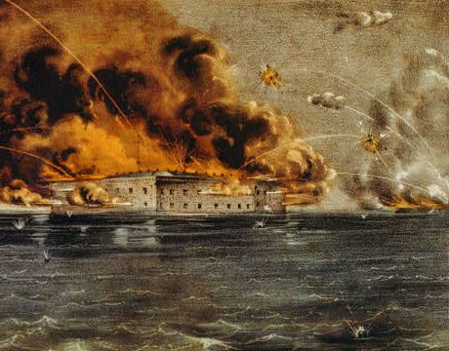
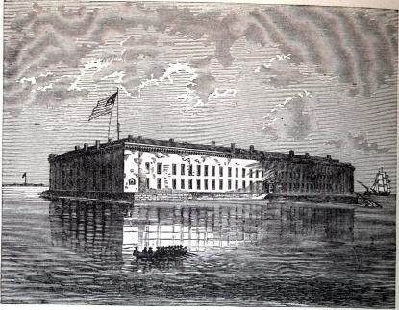
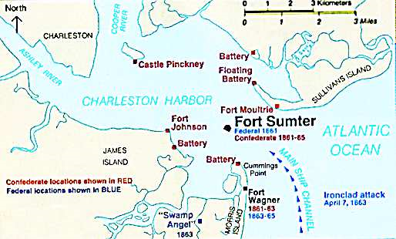
Fort Sumter
South Carolina
Under Federal (U.S.) control
Running out of supplies
Lincoln sent supply ships
April 12, 1861
Confederates attacked
Union surrendered fort
The Civil War had begun
Shortly after, other states join the Confederacy

Slide 3
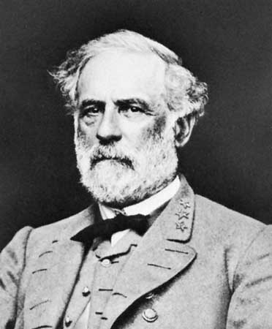
Virginia
Why was Virginia important to the Confederacy?
Rich
Populous
C.S. moved capital to Richmond, VA
Robert E. Lee
Brilliant General
Joined C.S. army after VA seceded

Slide 4
Border States
Slave States that bordered Free States
Delaware
Maryland
Kentucky
Missouri
(West Virginia)
Stayed in the Union

Slide 5
Confederate Strategy
Defense
Why?
Wanted to drag out the war
Hoped to export cotton in return for European military aid

Slide 6
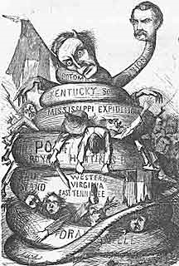
Union Strategy
Invade and Conquer
The Anaconda Plan
Strangle and Squeeze the South’s Economy
Blockade the South’s coastline
Prevent trade and travel
Take control of Mississippi River
Divide and Conquer
Capture Richmond (capital)

Slide 8
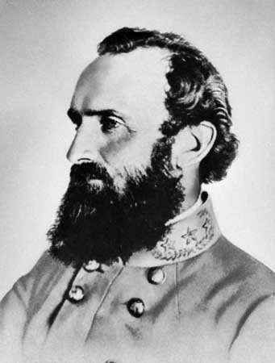
First Battle of Bull Run (Manassas)
North thought one battle would end the war
July 1861- Union troops march from D.C. to Manassas, VA
Spectators came to watch the battle
Confederates driven back at first
C.S. General Thomas “Stonewall” Jackson inspires troops
“Rebel Yell”
Union Troops (and spectators) flee back to D.C.

Slide 9
Effects of Bull Run
Casualties
Union: 2,700
Confederate: 2,000
Lessons
The fighting would be bloody
The war would be long
Southerners would fight fiercely

