Slide 1
2020 CASHA Workshop Cleft Palate and VPI: Overview, Assessment and Treatment
October 26, 2020
Jackie Klein, MA, CCC-SLP, MBA

Slide 2
Assessment of VPI and Related Disorders
Part 2

Slide 3
Case History
Typical case history with emphasis on:
Previous services
Medical history
Surgical procedures and any complications
Medications
Family and child’s priorities

Slide 4
Other Professionals
Office notes with permission
Is family account accurate
Any information that was not relayed to family

Slide 5
Assessment
What is our main goal of assessment?
Need to answer the questions of structure or function?

Slide 6
Oral Mech Eval? (Screening)
Structures
Face
Nose
Lips
Teeth (presence and malocclusion)
Tongue
Uvula
Hard Palate
Soft Palate
Uvula
Tonsils
What about strength and ROM?

Slide 7
Speech Assessment
Formal articulation assessment
GFTA - 3
Arizona – 4
Bzoch Error Pattern Diagnostic Articulation Test (also a screener)
Iowa Pressure Test
Templin Darley Tests of Articulation
Phonological analysis (if applicable)
Intelligibility Rating
Syllable, sentence and word repetitions
Speech Samples
Pressure Consonants
Compensatory Strategies

Slide 8
Speech Assessment
Obligatory errors - physically based
Compensatory errors – learned behaviors
Developmental errors – may not be impacted by diagnosis

Slide 9
Compensatory Strategies
Glottal Stop
Sudden and quick adduction and release of folds - Usually for stopped consonants but may be seen in others
Nasalized Plosives
Pharyngeal Plosives
Pharyngeal Fricatives
Nasal Fricatives

Slide 10
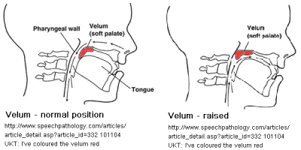
Velopharyngeal Dysfunction

Slide 11
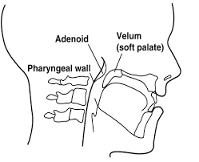
Cincinnati Children’s Hospital, 2015

Slide 12
VPI
Insufficiency – can not change change
Incompetence – can change

Slide 13
Resonance
Hypernasal
Hyponasal
Mixed
Cul de sac
Nasal Airflow
Audible
Grimacing
Weak pressure
ASHA.Org, 2013

Slide 14
VPI-Assessment Instrumentation
Always nice to have instrumentation, not always necessary
Instrumentation:
Nasometery
Nasopharyngoscope
Radiographic studies/Videofluoroscopy
***Pros and cons to medical/instrumental assessments***

Slide 15
Nasometry
Non invasive (ish)
Measure nasalance
Visual representation of resonance

Slide 16
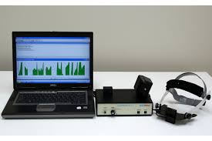
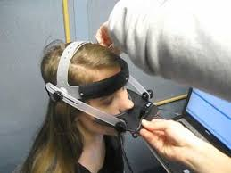
Nasometer

Slide 17
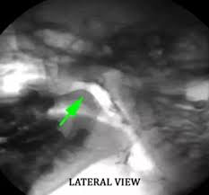
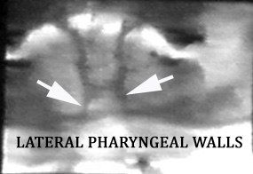
Videofluoroscopy VPI
10 CC barium in each nostril
Speech Sample
VCFScenter.com, 2018

Slide 18
Low Tech
Fingers
Tubes
Mirrors
See Scape

Slide 19
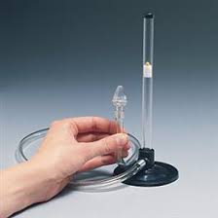
See Scape

Slide 20
Hearing
A large component of information for the evaluation and potential therapeutic process.
Dhillon, 1988 presents findings in children under 2 years of age a 97% incidence of otitis media with effusion in children with cleft palate.
What does this mean?
Increased risk of conductive lost in children without a syndrome
Can not rule out sensory or sensory neural loss with associated syndrome.

Slide 21
WHO Framework, 2001
Impairment in body structure an function in speech production and communication
Strengths
Weaknesses
Co-morbid deficits or conditions
Developmental disabilities
Syndromes
Limitations in activity and participation
Functional communication
Family and peer interactions
Education
Environmental and Personal
Contextual factors that are a barrier to success to both communication and participation.
Impact on quality life of both the child and the family

