Slide 1
European Exploration

Slide 2
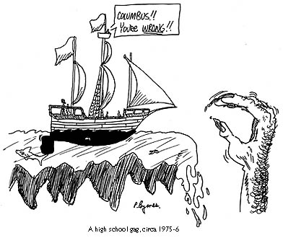

Slide 3
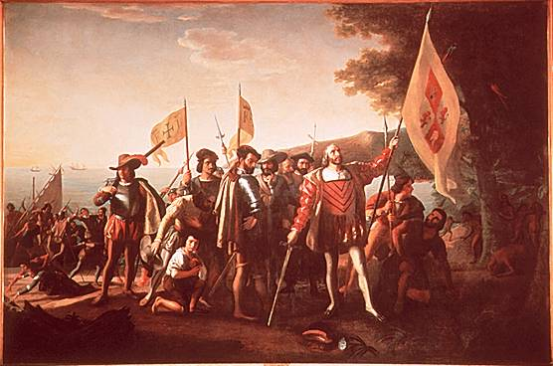
Europeans Arrive
In 1492, Columbus sets sail to find a western passage to Asia.
He lands on an island that he thinks is the West Indies, but in fact, it was a “New World”.
Europeans had probably been here before, but this time, they will continue to come back.
From 1492 to 1700, millions of Europeans flood the Americas, and dominate the hemisphere.
Notes:
Insert a map of your country.

Slide 4
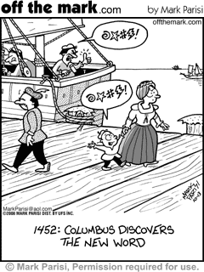

Slide 5
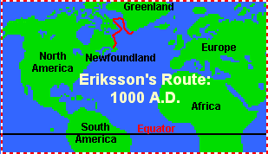
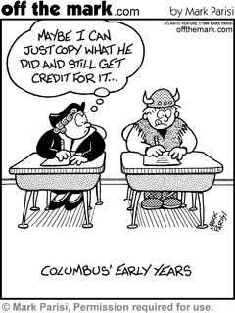
Leif Ericsson (also spelled Eriksson) the Lucky (980?-1020?) was a Viking (Norse) explorer who was possibly the first European to sail to North America. Leif sailed north from the southern tip of Greenland, then went south along the coast of Baffin Island down to Labrador, and then landed in what is now called Newfoundland (which he called Vinland). Ericsson sailed around the year 1000.

Slide 6
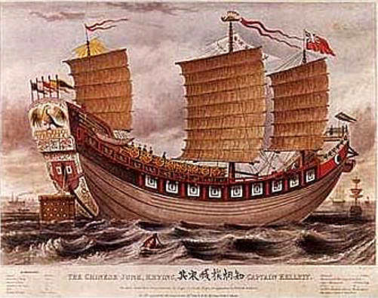
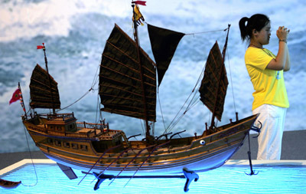
1421 Theory
In his bestselling book, "1421: The Year China Discovered America," British amateur historian Gavin Menzies turns the story of the Europeans' discovery of America on its ear with a startling idea: Chinese sailors beat Christopher Columbus to the Americas by more than 70 years
Ancient Chinese maps of North America and shipwrecks found of Chinese Junks (ships) of that era have been found off the coast of California. Native American legends tell of Chinese visitors.
In the Pacific Northwest of the present-day United States, investigations at eight different sites have uncovered Chinese coins.
A garment from the Nez Perce tribe of present-day Idaho that's dated at over 300 years old has woven ornaments into it that are believed to be Chinese beads.

Slide 7
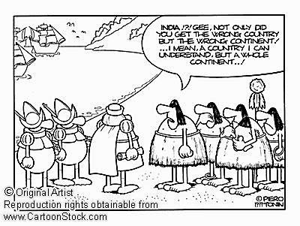

Slide 8
The New World
Europeans crossed the Atlantic Ocean to reach the Americas. The reason it was called the New World is because there had been no record of contact between the rest of the world and this place.

Slide 9
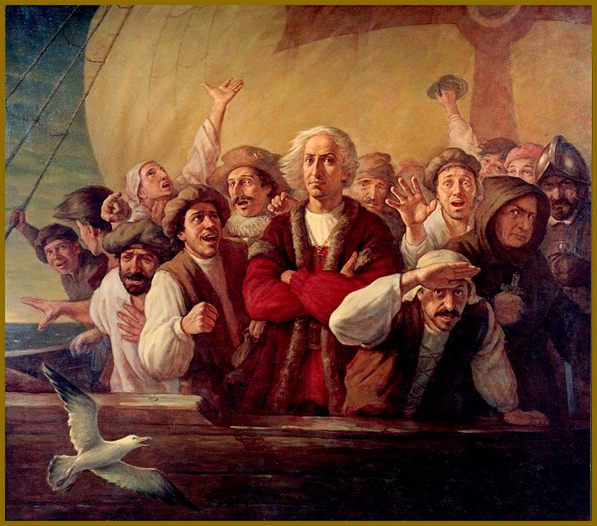

Slide 10
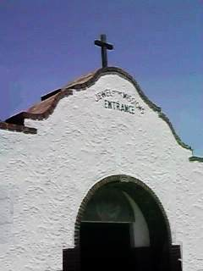
European Reasons for Exploration
God – Many Europeans want to spread Christianity or be able to practice their religion freely.
Gold – Besides the gold, the Americas offered many riches like silver, animal skins, food, and land.
Glory – The fame associated with being an explorer as well as the pride of claiming land for your country drew many as well.
Notes:
Insert a picture of one of the geographic features of your country.

Slide 12
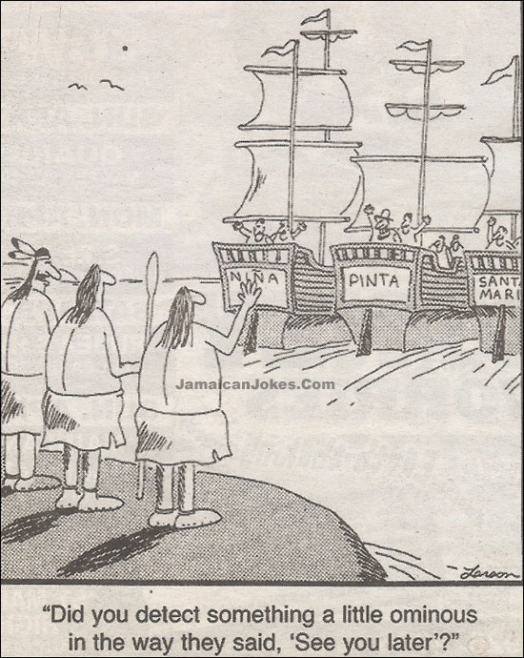

Slide 13
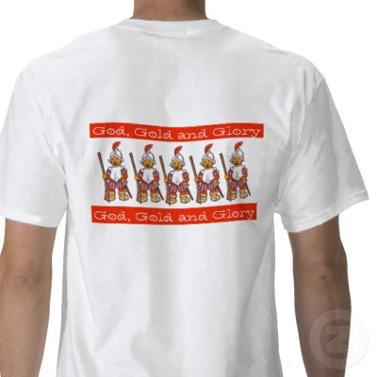

Slide 14
European Countries that Explore
Spain leads the way and dominates Central America by brutally claiming the Natives land and taking their riches.
Portugal takes South America but with less brutality.
France and the Netherlands go to North America, but trade with Natives and do not set up many settlements.
England is the last to go, and struggles to find success
Notes:
Insert a picture illustrating a season in your country.

Slide 15
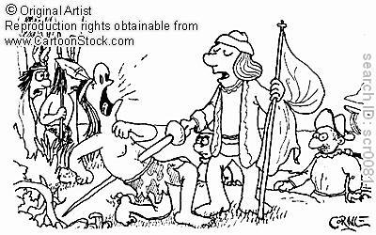
Long Lasting Impacts
European countries take over the region completely, which leads to the following:
European countries become richer and more powerful, leading to them dominating world events for over 400 years
Native American populations are devastated by war and disease until near elimination.
Slaves are brought in from Africa to do manual labor with no hope for freedom. African slaves will be used for 250 years.
Wars for land, wealth and freedom between these countries, their colonies, and their people will last for 400 years.

Slide 16
Your Interpretation
Now in your notebook give your interpretation or personal response. Choose ONE of the following
You can write a paragraph summary in your own words
Write a poem or personal response (your thoughts and opinion)
Draw a picture of an event, person, or place

